Slide 1
PHYS 1444 – Section 002
Lecture #9
Monday, Oct. 2, 2017
Dr. Jaehoon Yu
Chapter 23 Electric Potential
  V due to Charge Distributions
  Equi-potential Lines and Surfaces
  Electric Potential Due to Electric Dipole
  Electrostatic Potential Energy
Chapter 24 Capacitance etc..
  Capacitors
Today’s homework is homework #6, due 11pm, Monday, Oct. 9!!

Slide 2
Announcements
Bring out your special project #3 now
Special colloquium 4pm tomorrow, Tuesday, Oct. 3 in SH103
  Dr. Joseph Ngai of UTA Physics dept.

Slide 3
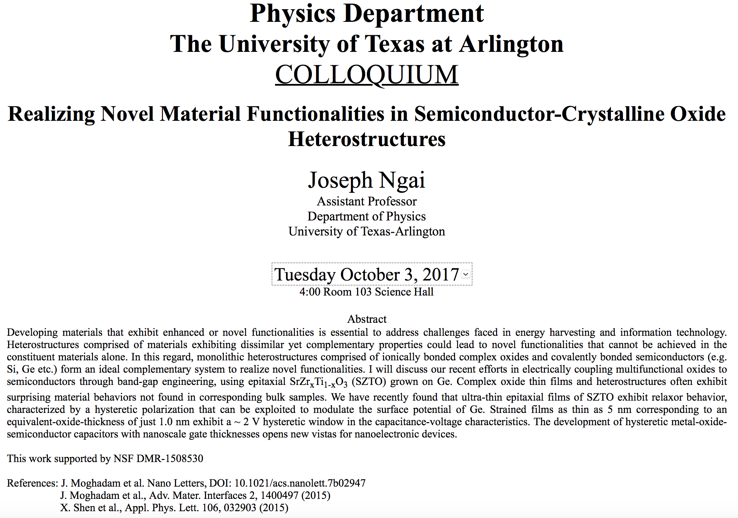

Slide 4
Electric Potential by Charge Distributions
Let’s consider a case of n individual point charges in a given space and V=0 at r=∞.
Then the potential V_{ia} due to the charge Q_{i} at point a, distance r_{ia} from Q_{i} is
Thus the total potential V_{a} by all n point charges is
For a continuous charge distribution, we obtain

Slide 5
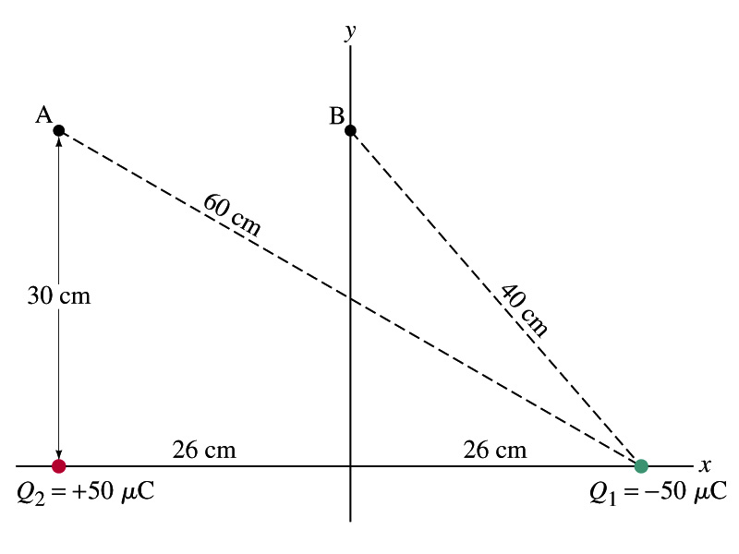
Example
Potential due to two charges: Calculate the electric potential (a) at point A in the figure due to the two charges shown, and (b) at point B.
Electric potential is a scalar quantity, so one adds the potential by each of the source charge, as if they are numbers.
(a) potential at A is
(b) How about potential at B?

Slide 6
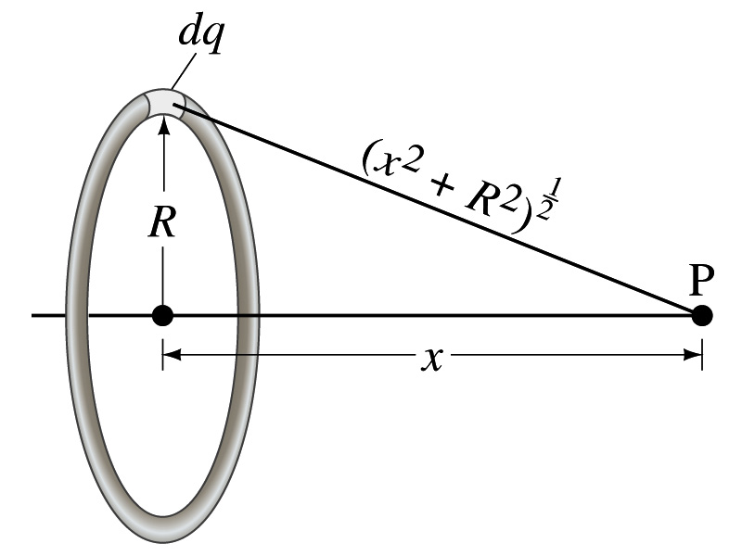
Example 23 – 8
Potential due to a ring of charge: A thin circular ring of radius R carries a uniformly distributed charge Q. Determine the electric potential at a point P on the axis of the ring a distance x from its center.
Each point on the ring is at the same distance from the point P. What is the distance?
So the potential at P is
What’s this?

Slide 7
Equi-potential Surfaces
Electric potential can be graphically shown using the equipotential lines in 2-D or the equipotential surfaces in 3-D
Any two points on the equipotential surfaces (lines) are at the same potential
What does this mean in terms of the potential difference?
  The potential difference between the two points on an equipotential surface is 0.
How about the potential energy difference?
  Also 0.
What does this mean in terms of the work to move a charge along the surface between these two points?
  No work is necessary to move a charge between these two points.

Slide 8
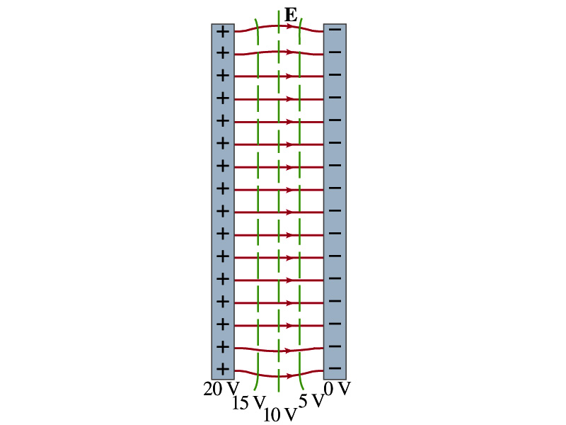
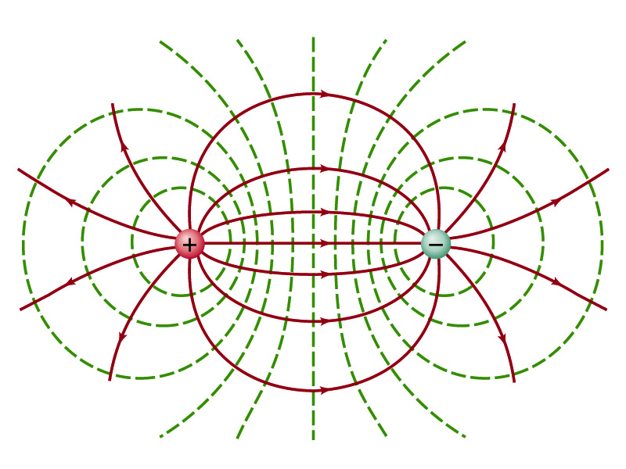
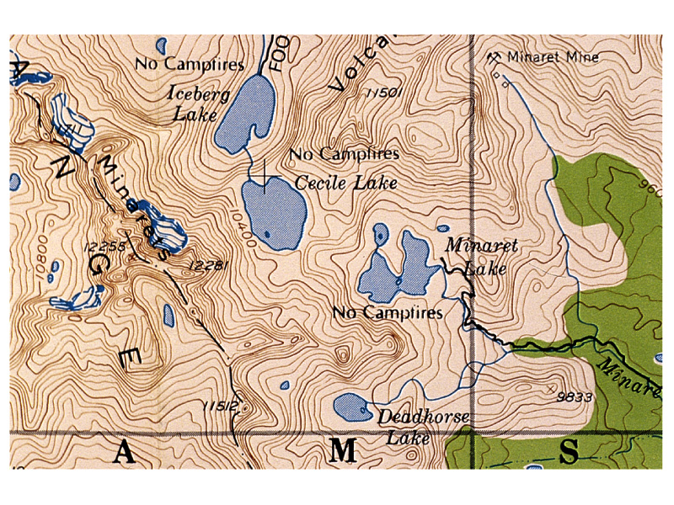
Equi-potential Surfaces
An equipotential surface (line) must be perpendicular to the electric field. Why?
  If there are any parallel components to the electric field, it would require work to move a charge along the surface.
Since the equipotential surface (line) is perpendicular to the electric field, we can draw these surfaces or lines easily.
Since there can be no electric field within a conductor in a static case, the entire volume of a conductor must be at the same potential.
So the electric field must be perpendicular to the conductor surface.
Parallel Plate
Point charges
Just like the topological map

Slide 9
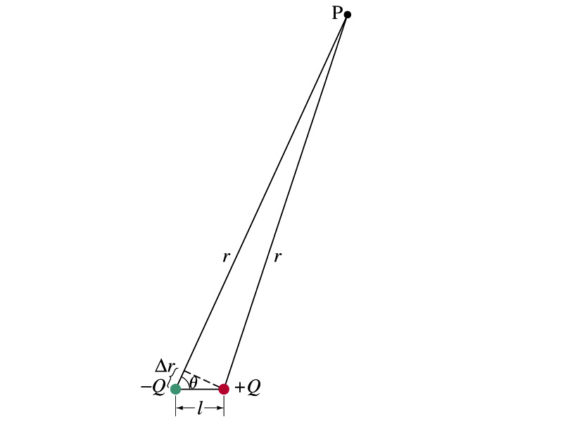
Electric Potential due to Electric Dipoles
What is an electric dipole?
  Two equal point charge Q of opposite signs separated by a distance l and behaves like one entity: P=Ql
For the electric potential due to a dipole at a point p
  We take V=0 at r=∞
The simple sum of the potential at p by the two charges is
Since Δr=lcosθ and if r>>l, r>>Δr, then r~r+Δr and
V by a dipole at a
distance r from
the dipole

