Slide 1
PHYS 1444 – Section 002
Lecture #11
Monday, Oct. 9, 2017
Dr. Jaehoon Yu
Chapter 24 Capacitance etc..
  Capacitors in Series or Parallel
  Electric Energy Storage
  Effect of Dielectric
  Molecular description of Dielectric Material
Chapter 25
  Electric Current and Resistance
  The Battery
Today’s homework is #7, due 11pm, Monday, Oct. 16!!

Slide 2
Announcements
Quiz 2 results
  Class average: 27.7/60
    Equivalent to 46.2/100
    Previous quizzes: 48/100
  Top score: 48/60
Mid Term Exam
  In class next Wednesday, Oct. 18
  Covers CH21.1 through what we cover in class Monday, Oct. 16 + appendix
  Bring your calculator but DO NOT input formula into it!
    Cell phones or any types of computers cannot replace a calculator!
  BYOF: You may bring a one 8.5x11.5 sheet (front and back) of handwritten formulae and values of constants
  No derivations, word definitions or solutions of any kind!
  No additional formulae or values of constants will be provided!
Triple credit colloquium 3:30pm this Wednesday in NH100
  Dr. Michael Turner of U. of Chicago, National Academy of Science member

Slide 4
Example 24 – 1
Capacitor calculations: (a) Calculate the capacitance of a capacitor whose plates are 20cmx3.0cm and are separated by a 1.0mm air gap. (b) What is the charge on each plate if the capacitor is connected to a 12-V battery? (c) What is the electric field between the plates? (d) Estimate the area of the plates needed to achieve a capacitance of 1F, given the same air gap.
(a) Using the formula for a parallel plate capacitor, we obtain
(b) From Q=CV, the charge on each plate is

Slide 5
Example 24 – 1
(C) Using the formula for the electric field in two parallel plates
Or, since
we can obtain
(d) Solving the capacitance formula for A, we obtain
Solve for A
About 40% the area of Arlington (256km²).

Slide 6
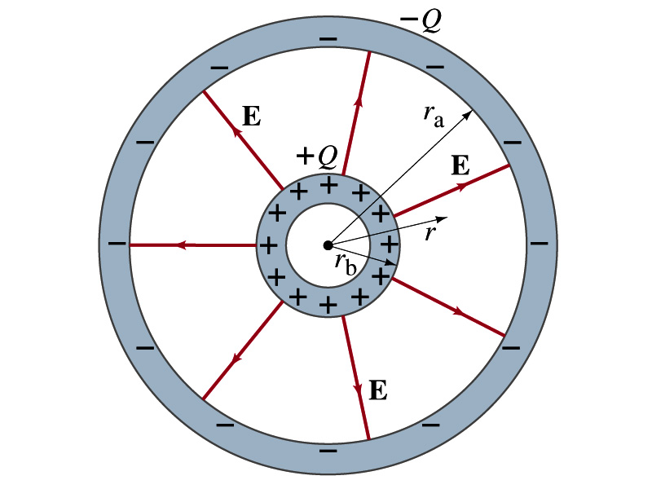
Example 24 – 3
Spherical capacitor: A spherical capacitor consists of two thin concentric spherical conducting shells, of radius r_{a} and r_{b}, as in the figure. The inner shell carries a uniformly distributed charge Q on its surface and the outer shell an equal but opposite charge –Q. Determine the capacitance of the two shells.
Using Gauss’ law, the electric field outside a uniformly charged conducting sphere is
So the potential difference between a and b is
Thus capacitance is

Slide 7
Capacitor Cont’d
A single isolated conductor can be said to have a capacitance, C.
C can still be defined as the ratio of the charge to the absolute potential V on the conductor.
  So Q=CV.
The potential of a single conducting sphere of radius r_{b} can be obtained as
where
So its capacitance is

Slide 8
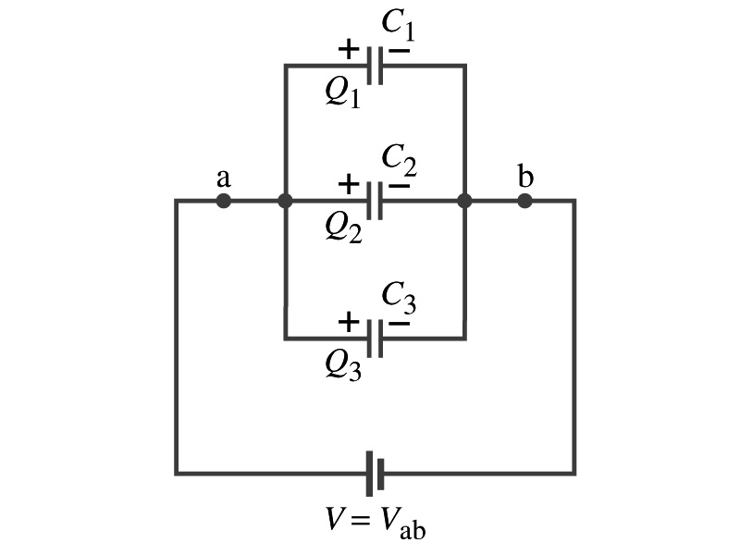
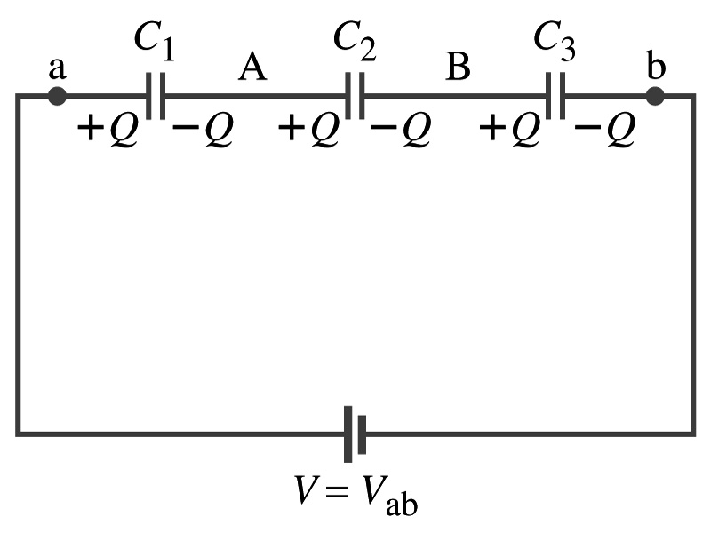
Capacitors in Series or Parallel
Capacitors may be used in electric circuits
What is an electric circuit?
  A closed path of conductors, usually wires connecting capacitors and other electrical devices, in which
    charges can flow
    And includes a voltage source such as a battery
Capacitors can be connected in various ways.
  In parallel, in series or in combination

Slide 9
Capacitors in Parallel
Parallel arrangement provides the same voltage across all the capacitors.
  Left hand plates are at V_{a} and right hand plates are at V_{b}
  So each capacitor plate acquires charges given by the formula
    Q₁=C₁V, Q₂=C₂V, and Q₃=C₃V
The total charge Q that must leave the battery is then
  Q=Q₁+Q₂+Q₃=V(C₁+C₂+C₃)
Consider that the three capacitors behave like an equivalent one
  Q=C_{eq}V= V(C₁+C₂+C₃)
Thus the equivalent capacitance in parallel is
What is the net effect?
The capacitance increases!!!

Slide 10
Capacitors in Series
Series arrangement is more interesting
  When battery is connected, +Q flows to the left plate of C₁ and –Q flows to the right plate of C₃.
  Since capatotors in between were originally neutral, charges get induced to neutralize the ones in the middle.
  So the charge on each capacitor plate is the same value, Q. (Same charge)
Consider that the three capacitors behave like an equivalent one
  Q=C_{eq}V
The total voltage V across the three capacitors in series must be equal to the sum of the voltages across each capacitor.
  V=V₁+V₂+V₃=Q/C₁+Q/C₂+Q/C₃
Putting all these together, we obtain:
V=Q/C_{eq}=Q(1/C₁+1/C₂+1/C₃)
Thus the equivalent capacitance is
What is the net effect?
The capacitance smaller than the smallest C!!!

Slide 11
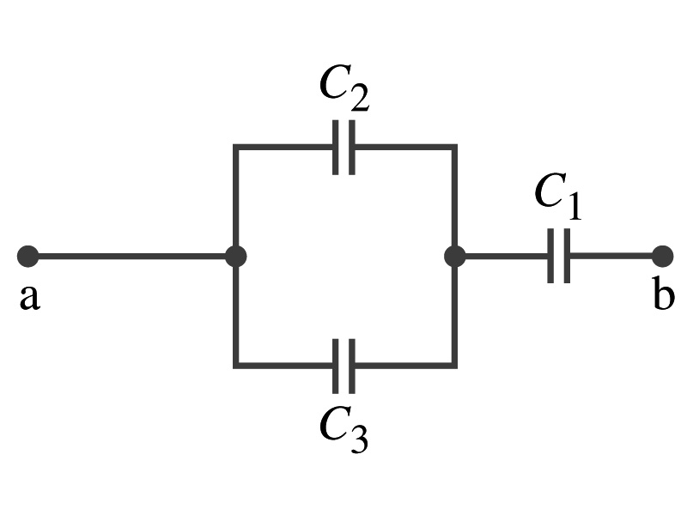
Example 24 – 5
Equivalent Capacitor: Determine the capacitance of a single capacitor that will have the same effect as the combination shown in the figure. Take C₁=C₂=C₃=C.
We should do these first!!
How?
These are in parallel so the equivalent capacitance is:
Now the equivalent capacitor is in series with C1.
Solve for C_{eq}

Slide 12
Electric Energy Storage
A charged capacitor stores energy.
  The stored energy is the amount of the work done to charge it.
The net effect of charging a capacitor is removing one type of charge from one plate and put them on to the other.
  Battery does this when it is connected to a capacitor.
Capacitors do not get charged immediately.
  Initially when the capacitor is uncharged, no work is necessary to move the first bit of charge. Why?
    Since there is no charge, there is no field that the external work needs to overcome.
  When some charge is on each plate, it requires work to add more charge due to the electric repulsion.

Slide 13
Electric Energy Storage
The work needed to add a small amount of charge, dq, when a potential difference across the plate is V: dW=Vdq.
Since V=q/C, the work needed to store total charge Q is
Thus, the energy stored in a capacitor when the capacitor carries the charges +Q and –Q is
Since Q=CV, we can rewrite

Slide 14
Example 24 – 8
Energy store in a capacitor: A camera flash unit stores energy in a 150μF capacitor at 200V. How much electric energy can be stored?
Using the formula for stored energy.
Umm.. Which one?
What do we know from the problem?
C and V
So we use the one with C and V:
How do we get J from FV²?

