Slide 1
PHYS 1444 – Section 002
Lecture #12
Wednesday, Oct. 11, 2017
Dr. Jaehoon Yu
Chapter 24 Capacitance etc..
  Electric Energy Storage
  Effect of Dielectric
  Molecular description of Dielectric Material
Chapter 25
  Electric Current and Resistance
  The Battery
  Ohm’s Law: Resisters, Resistivity
  Electric Power

Slide 2
Announcements
Mid Term Exam
  In class next Wednesday, Oct. 18
  Covers CH21.1 through what we cover in class Monday, Oct. 16 + appendix
  Bring your calculator but DO NOT input formula into it!
    Cell phones or any types of computers cannot replace a calculator!
  BYOF: You may bring a one 8.5x11.5 sheet (front and back) of handwritten formulae and values of constants
  No derivations, word definitions or solutions of any kind!
  No additional formulae or values of constants will be provided!
Triple credit colloquium 3:30pm today in NH100
  Dr. Michael Turner of U. of Chicago, National Academy of Science member

Slide 4
Electric Energy Density
The energy stored in a capacitor can be considered as being stored in the electric field between the two plates
For a uniform field E between two plates, V=Ed and C=ε₀A/d
Thus the stored energy is
Since Ad is the gap volume V, we can obtain the energy density, stored energy per unit volume, as
Valid for any space that is vacuum
Electric energy stored per unit volume in any region of space is proportional to the square of E in that region.

Slide 5
Dielectrics
Capacitors have an insulating sheet of material, called dielectric, between the plates to
  Increase breakdown voltage greater than that in air (3MV/m)
  Apply higher voltage to the gap without the charge passing across
  Allow the plates get closer together without touching
    Increases capacitance ( recall C=ε₀A/d)
  Increase the capacitance by the dielectric constant
  Where C₀ is the intrinsic capacitance when the gap is vacuum

Slide 6
Dielectrics
The value of dielectric constant K varies depending on the material (Table 24 – 1)
  K for vacuum is 1.0000
  K for air is 1.0006 (this is why permittivity of air and vacuum are used interchangeably.)
  K for paper is 3.7
Maximum electric field before breakdown occurs is called the dielectric strength. What is its unit?
  V/m
The capacitance of a parallel plate capacitor with a dielectric (K) filling the gap is

Slide 7
Dielectrics
A new quantity of the permittivity of a dielectric material is defined as ε=Kε₀
The capacitance of a parallel plate capacitor with a dielectric medium filling the gap is
The energy density stored in an electric field E in a dielectric is
Valid for any space w/ dielectric w/ permittivity ε.
What is the stored energy in between ProtoDUNE cathode (-600kV) plate (6mx6m) and the cryostat wall (0V), d=1.5m, LAr K=1.6?

Slide 8
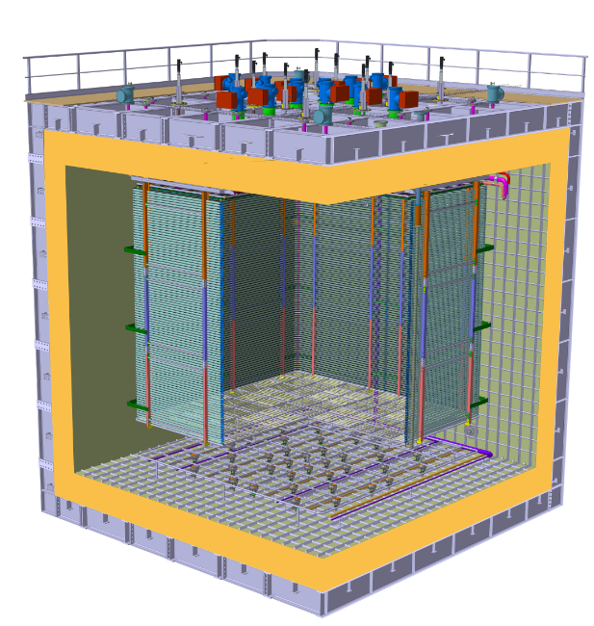
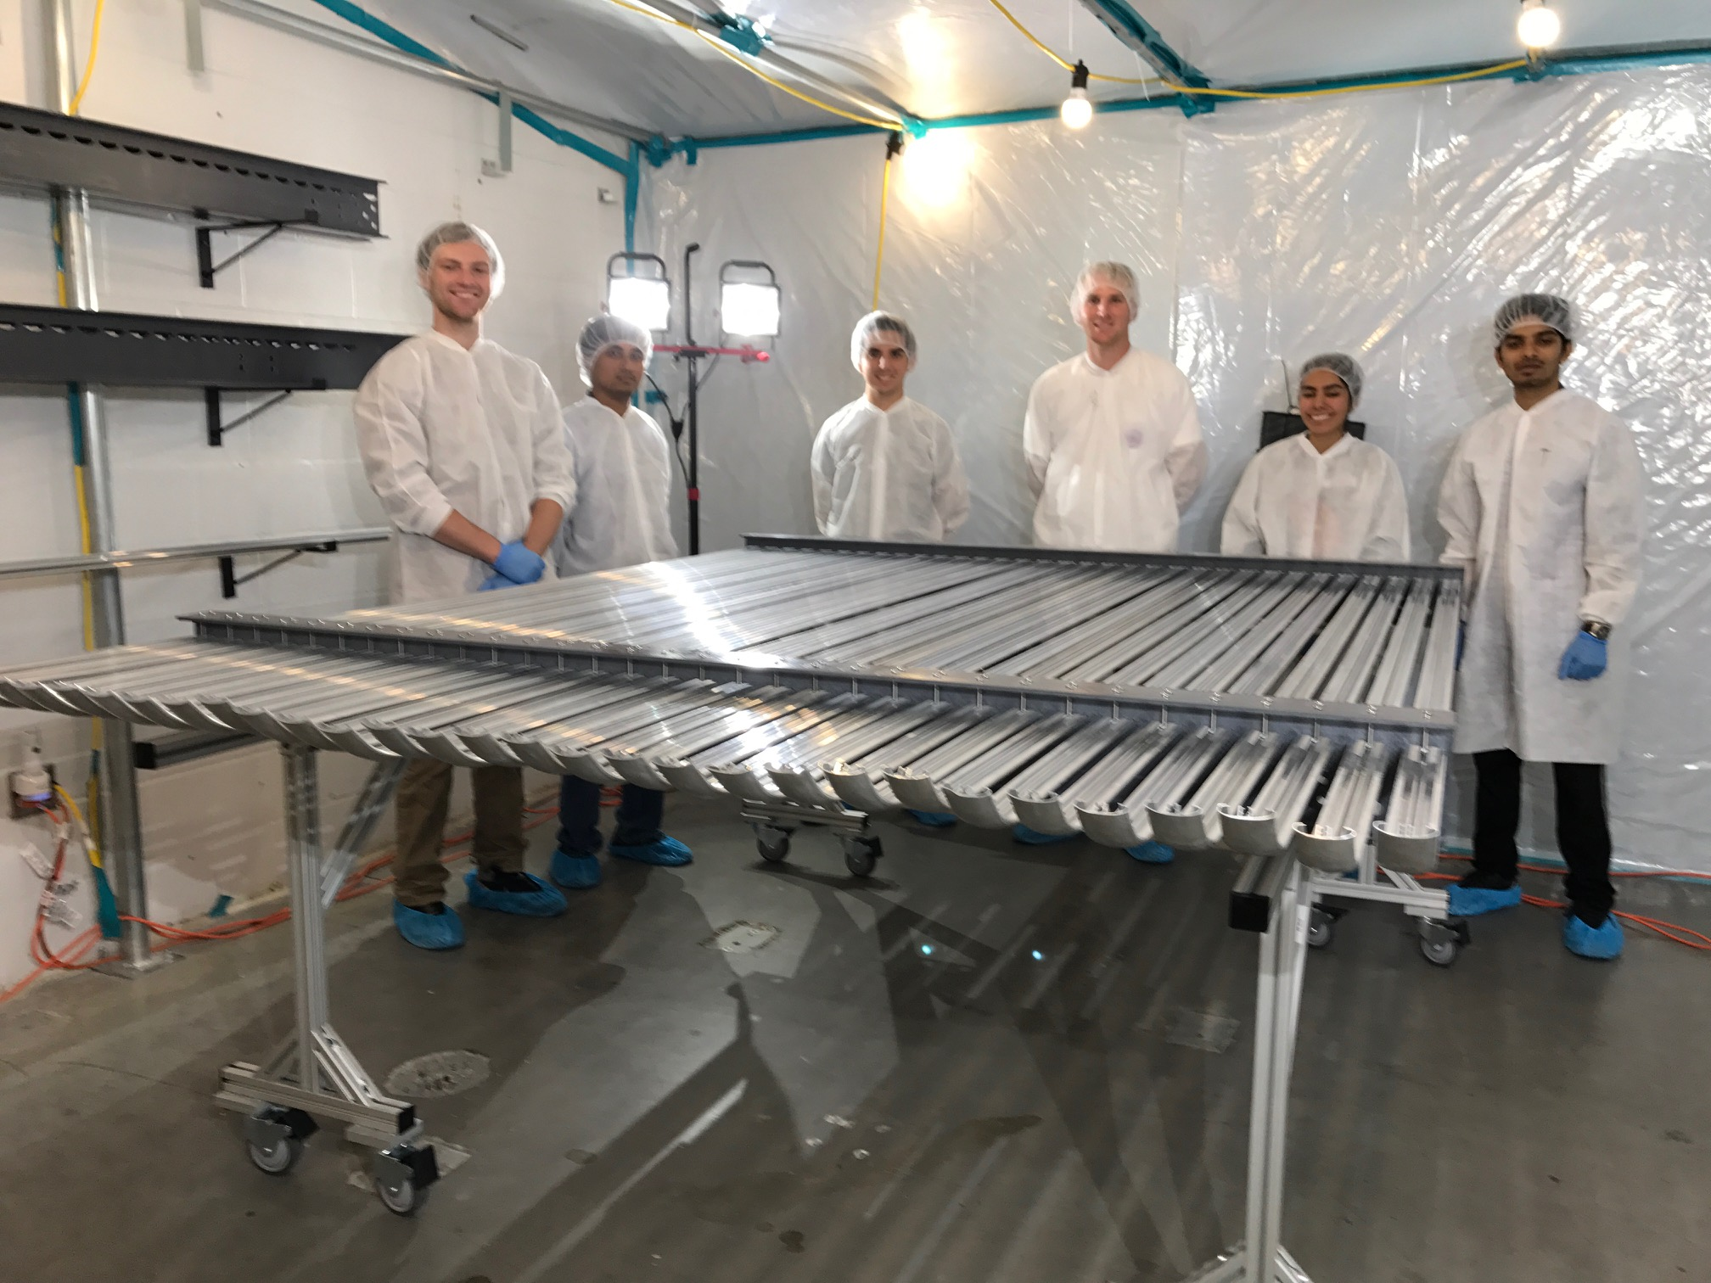
ProtoDUNE Dual Phase
Field Cage and cathode hangs off of the ceiling
Essential to have light yet sturdy structure
Based on modular concept as SP
Charge Readout Planes
6 m
Field Cage (common structural elements with SP)
1.5 m
Cathode
6 m

Slide 9
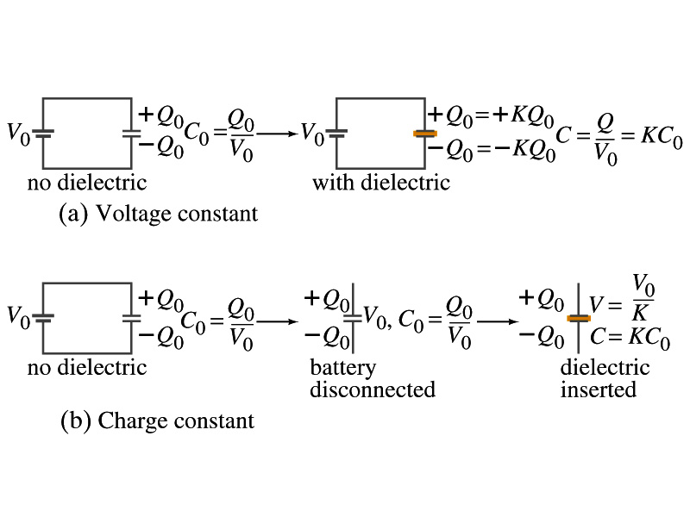
Effect of a Dielectric Material on Capacitance
Let’s consider the two cases below:
Case #1 : constant V
Case #2 : constant Q
Constant voltage: Experimentally observed that the total charge on the each plate of the capacitor increases by K as a dielectric material is inserted between the gap ➔ Q=KQ₀
  The capacitance increased to C=Q/V₀=KQ₀/V₀=KC₀
Constant charge: Voltage found to drop by a factor K ➔ V=V₀/K
  The capacitance increased to C=Q₀/V=KQ₀/V₀=KC₀

Slide 10
Effect of a Dielectric Material on Field
What happens to the electric field within a dielectric?
Without a dielectric, the field is
  What are V₀ and d?
    V₀: Potential difference between the two plates
    d: separation between the two plates
For the constant voltage, the electric field remains the same
For the constant charge: the voltage drops to V=V₀/K, thus the field in the dielectric is
  The field in the dielectric is reduced.

Slide 11
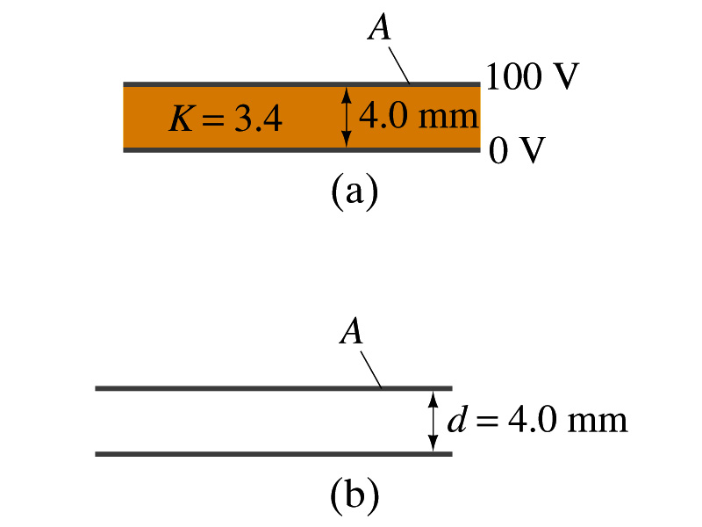
Example 24 – 11
Dielectric Removal: A parallel-plate capacitor, filled with the dielectric of K=3.4, is connected to a 100-V battery. After the capacitor is fully charged, the battery is disconnected. The plates have area A=4.0m², and are separated by d=4.0mm. (a) Find the capacitance, the charge on the capacitor, the electric field strength, and the energy stored in the capacitor. (b) The dielectric is carefully removed, without changing the plate separation nor does any charge leave the capacitor. Find the new value of capacitance, electric field strength, voltage between the plates and the energy stored in the capacitor.
(a)

Slide 12
Example 24 – 11 cont’d
(b)
Since the dielectric has been removed, the effect of dielectric constant must be removed as well.
Since charge is the same ( ) before and after the removal of the dielectric, we obtain
Wrong!
Where did the extra energy come from?
The energy conservation law is violated in electricity???
Wrong!
Wrong!
An external force has done the work of 3.6x10⁻⁴J on the system to remove dielectric!!

Slide 13
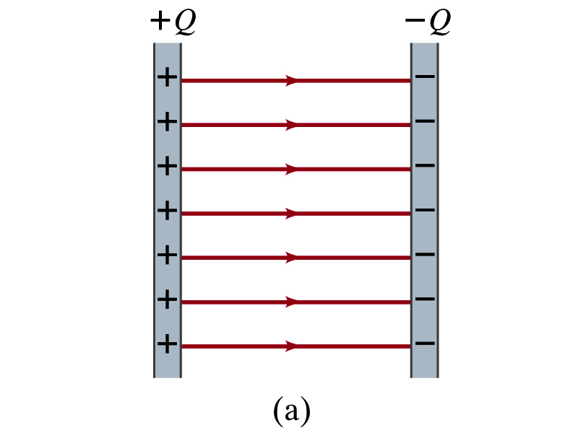
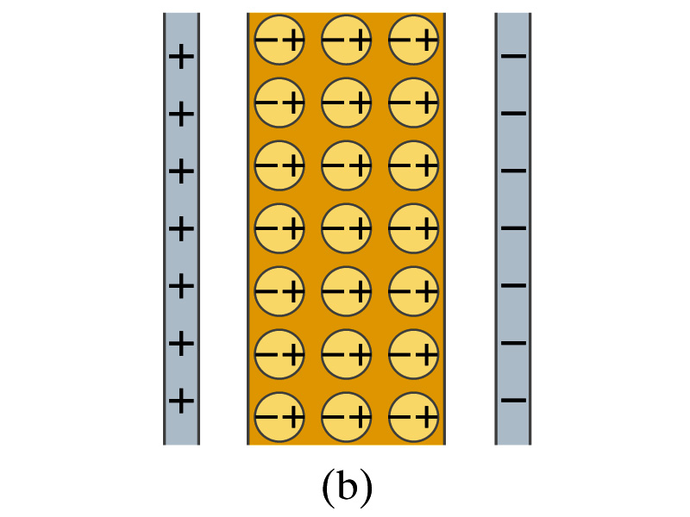
Molecular Description of Dielectric
So what in the world makes dielectrics behave the way they do?
We need to examine this in a microscopic scale.
Let’s consider a parallel plate capacitor that is charged up +Q(=C₀V₀) and –Q with air in between.
  Assume there is no way any charge can flow in or out
Now insert a dielectric
  Dielectric can be polar ➔ could have permanent dipole moment. What will happen?
Due to the electric field molecules will be aligned.

Slide 14
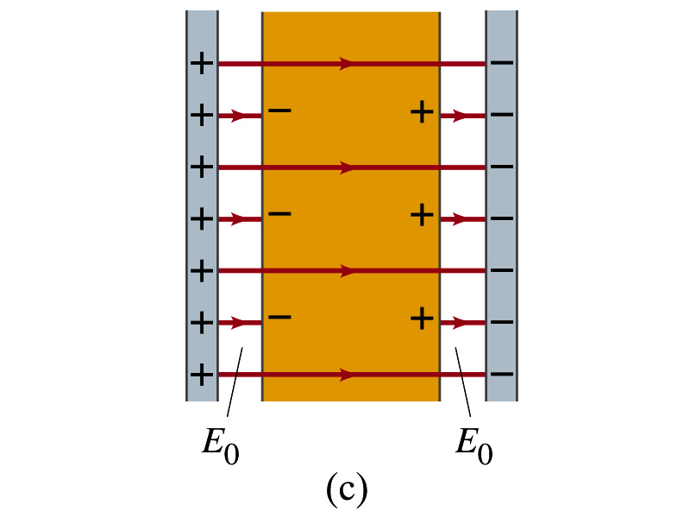
Molecular Description of Dielectric
OK. Then what happens?
Then effectively, there will be some negative charges close to the surface of the positive plate and positive charge on the negative plate
  Some electric field do not pass through the whole dielectric but stops at the negative charge
  So the field inside dielectric is smaller than the air
Since electric field is smaller, the force is smaller
  The work need to move a test charge inside the dielectric is smaller
  Thus the potential difference across the dielectric is smaller than across the air

Slide 15
Electric Current and Resistance
So far we have been studying static electricity
  What is the static electricity?
    The charges so far has not been moving but staying put at the location they are placed.
Now we will learn dynamics of electricity
What is the electric current?
  A flow of electric charge
  A few examples of the things that use electric current in everyday lives?
In an electrostatic situation, there is no electric field inside a conductor but when there is current, there is field inside a conductor. Why?
  Electric field is needed to keep charges moving

Slide 16
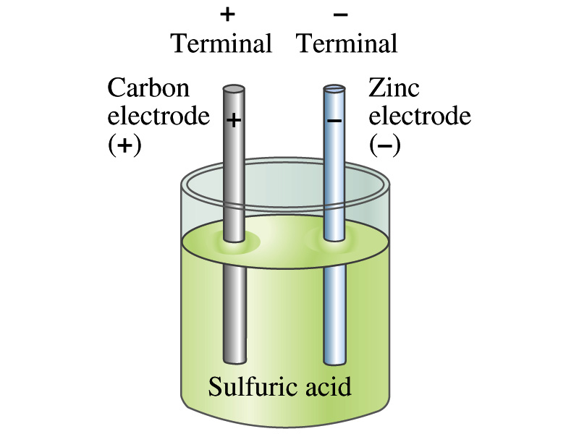
The Electric Battery
What is a battery?
  A device that produces electrical energy from the stored chemical energy and produces electricity ➔ Maintains potential difference!
Electric battery was invented by Volta in 1790s in Italy
  It was made of disks of zinc and silver based on his research that certain combinations of materials produce a greater electromotive force (emf), or potential, than others
Simplest batteries contain two plates made of dissimilar metals called electrodes
  Electrodes are immersed in a solution, the electrolyte
  This unit is called a cell and many of these form a battery
Zinc and Iron in the figure are called terminals

Slide 17
How does a battery work?
One of the electrodes in the figure is zinc and the other carbon
The acid electrolyte reacts with the zinc electrode and dissolves it.
Each zinc atom leaves two electrons in the electrode and enters into the solution as a positive ion ➔ zinc electrode acquires negative charge and the electrolyte (the solution) becomes positively charged
The carbon electrode picks up the positive charge
Since the two terminals are oppositely charged, there is a potential difference between them

Slide 18
How does a battery work?
When the terminals are not connected, only the necessary amount of zinc is dissolved into the solution.
How is a particular potential maintained?
  If the terminals are not connected, as too many of zinc ion gets produced,
    zinc electrode gets increasingly charged up negative
    zinc ions get recombined with the electrons in zinc electrode
Why does battery go dead?
  When the terminals are connected, the negative charges will flow away from the zinc electrode
  More zinc atoms dissolve into the electrolyte to produce more charge
  One or more electrode get used up not producing any more charge.

Slide 19
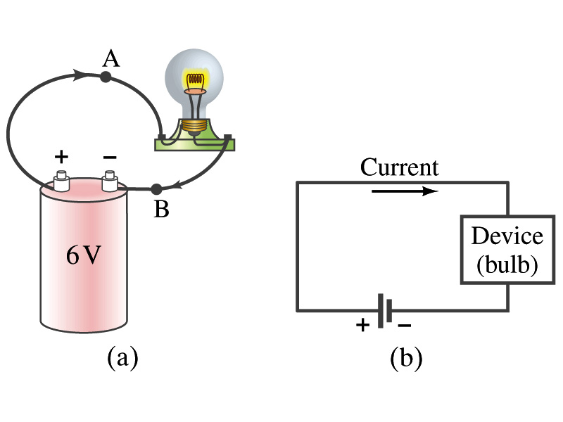
Electric Current
When a circuit is powered by a battery (or a source of emf) the charge can flow through the circuit.
Electric Current: Any flow of charge
  Current can flow whenever there is a potential difference between the ends of a conductor (or when the two ends have opposite charges)
    The current can flow even through the empty space under certain conditions
  Electric current in a wire can be defined as the net amount of charge that passes through the wire’s full cross section at any point per unit time (just like the flow of water through a conduit.)
  Average current is defined as:
  The instantaneous current is:
  What kind of a quantity is the current?
Unit of the current?
C/s
1A=1C/s
Scalar
In a single circuit, conservation of electric charge guarantees that the current at one point of the circuit is the same as any other points on the circuit.

Slide 20
Example 25 – 1
Current is a flow of charge: A steady current of 2.5A flows in a wire for 4.0min. (a) How much charge passed by any point in the circuit? (b) How many electrons would this be?
Current is total amount charge flown through a circuit in a given time. So from we obtain
The total number of electrons passed through the circuit is

