Slide 1
PHYS 1444 – Section 002 Lecture #14
Monday, Oct. 23, 2017
Dr. Jaehoon Yu
Chapter 25
Microscopic View of Electric Current
EMF and Terminal Voltage
Chapter 26
Kirchhoff’s Rules
EMFs in Series and Parallel
RC Circuits
Chapter 27: Magnetism and Magnetic Field
Today’s homework is homework #8, due 11pm, Monday, Oct. 30!!

Slide 2
Announcements
Mid-term grade discussions
From 12:00 – 2:30pm, this Wednesday, Oct. 25 in my office (CPB342)
Last name starts with A – D (12 – 12:30), E– K (12:30 – 1), L – O (1 – 1:30), P – S (1:30 – 2:00), T – Z (2-2:30)
Grade scheme reminder
Homework: 25%
Final exam: 23%
Midterm exam: 20%
Better of the two term exams: 12%
Lab: 10%
Quizzes: 10%
Extra Credit: 10%

Slide 3
Special Project #5
Make a list of the power consumption and the resistance of all electric and electronic devices at your home and compiled them in a table. (5 points total for the first 10 items and 0.25 points each additional item.)
Estimate the cost of electricity for each of the items on the table using your own electric cost per kWh (if you don’t find your own, use $0.12/kWh) and put them in the relevant column. (2 points total for the first 10 items and 0.1 points each additional items)
Estimate the the total amount of energy in Joules and the total electricity cost per day, per month and per year for your home. (6 points)
Due: Beginning of the class Wednesday, Nov. 1

Slide 4
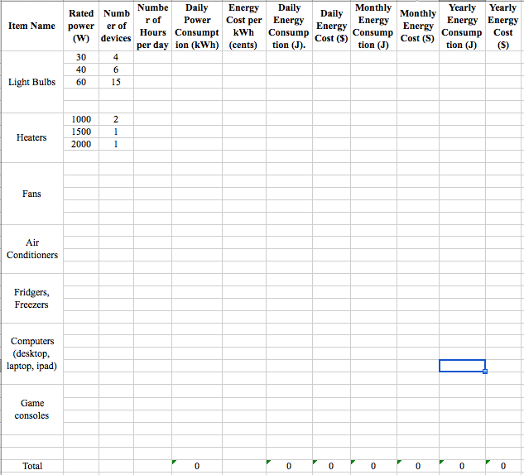

Slide 5
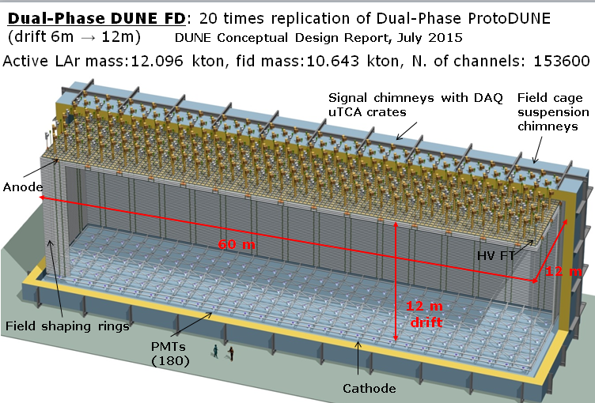
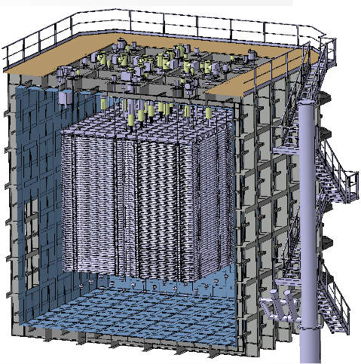
DUNE Dual Phase Strategic Approach
3x1x1m³ 42t active volume Pilot detector
6x6x6m³ 600t protoDUNE Dual Phase
10kt DUNE Dual Phase LArTPC
3x1x1m³ Pilot
protoDUNE DP 6x6x6m³
10kt DUNE Dual Phase
3mx1m CRP units
50 field shaping rings
4 signal FT chimneys
4 suspension chimneys
12 PMTs
1280 readout channels
4 3mx3m CRP units
98 field shaping rings
12 signal FT chimneys
12 suspension chimneys
36 PMTs
7680 readout channels
80 3mx3m CRP units
200 field shaping rings
240 signal FT chimneys
240 suspension chimneys
180 PMTs
153600 readout channels

Slide 6
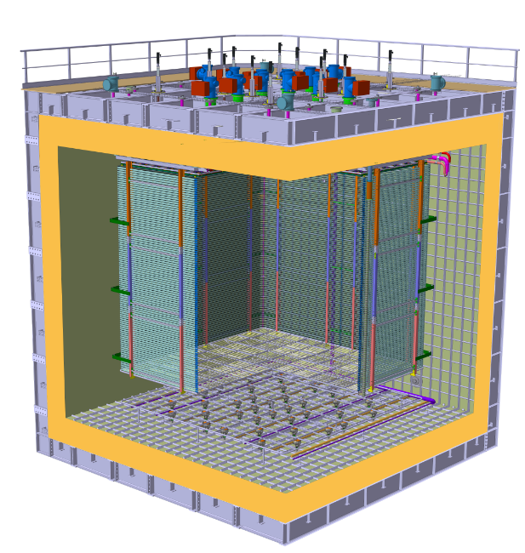
protoDUNE DP Detector–Cryostat Integration
Charge Readout Planes
6 m
Field Cage (common structural elements with SP)
Cathode
6 m

Slide 7
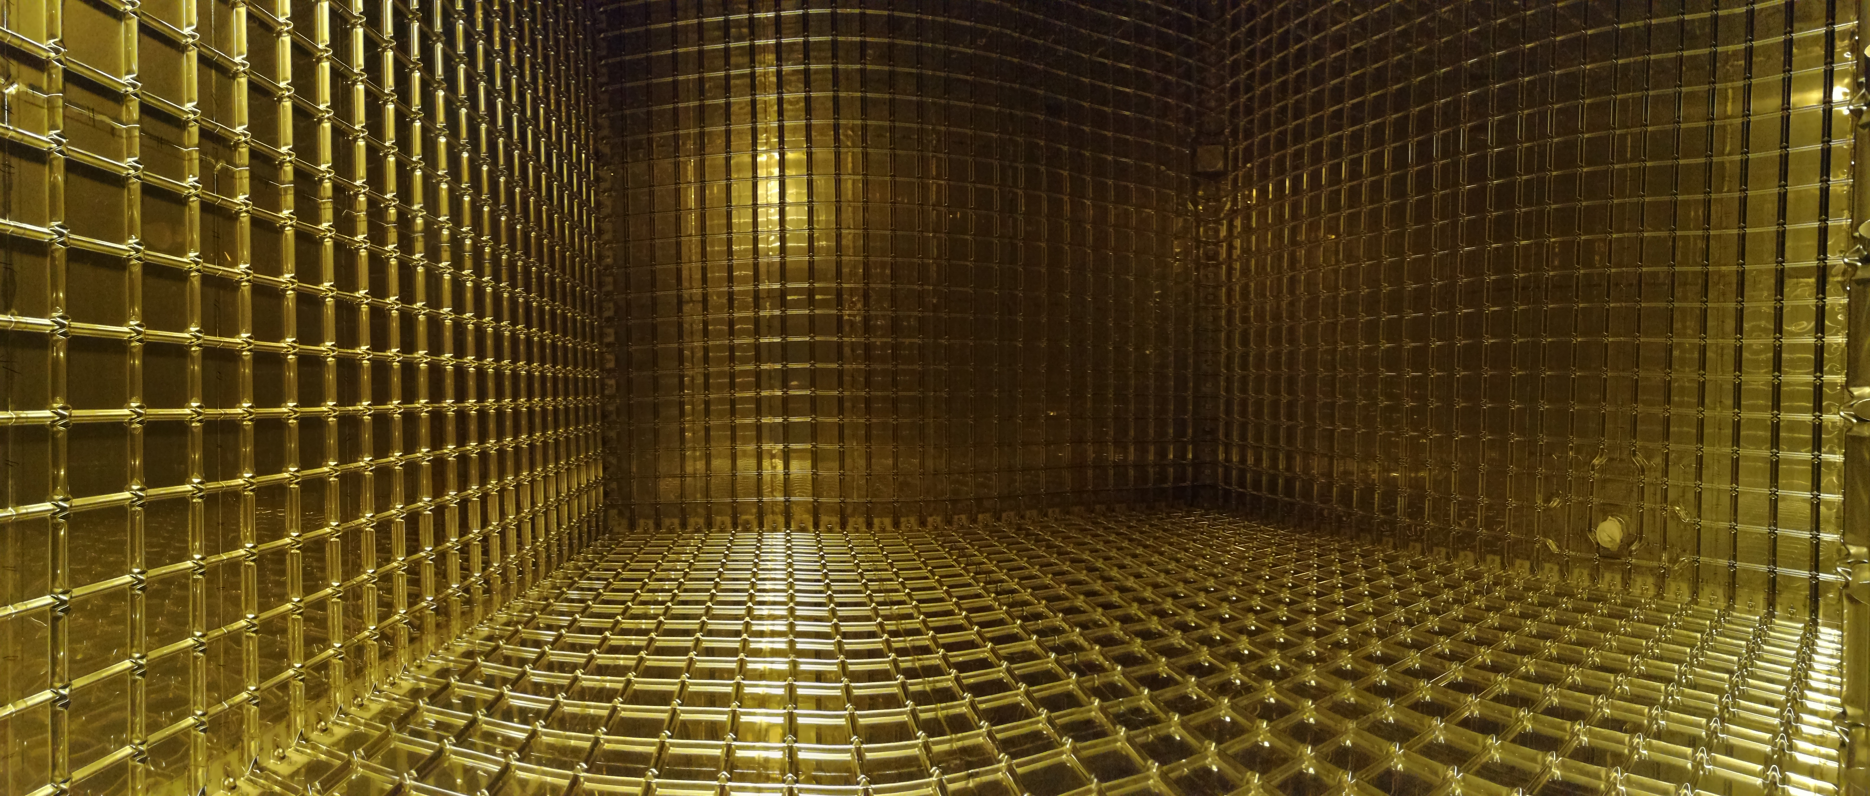
ProtoDUNE DP Cryostat

Slide 8
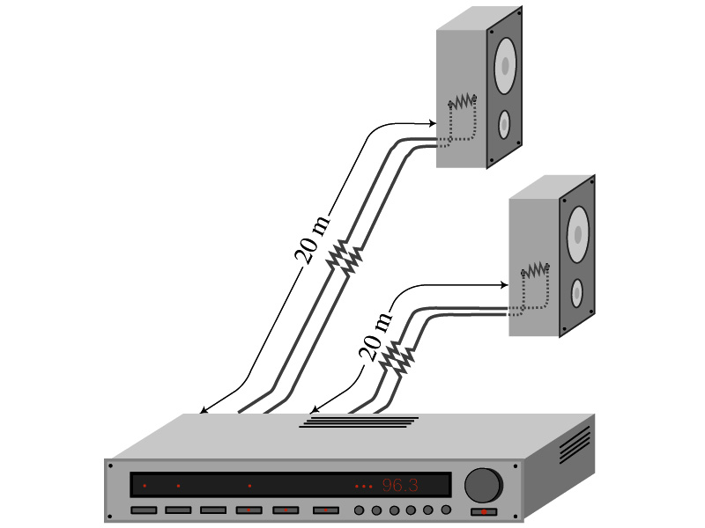
Example 25 – 5
Speaker wires: Suppose you want to connect your stereo to remote speakers. (a) If each wire must be 20m long, what diameter copper wire should you use to keep the resistance less than 0.1-Ω per wire? (b) If the current on each speaker is 4.0A, what is the voltage drop across each wire?
The resistivity of a copper is
Table 25.1
From the formula for resistance, we can obtain the formula for area
Solve for A
Solve for d
From Ohm’s law, V=IR, we obtain

Slide 9
Electric Power
How do we find out the power transformed by an electric device?
What is the definition of the power?
The rate at which work is done or the energy is transformed
What is the energy transformed when an infinitesimal charge dq moves through a potential difference V?
dU=Vdq
If dt is the time required for an amount of charge dq to move through the potential difference V, the power P is
Thus, we obtain .
What is the unit?
What kind of quantity is the electrical power?
Scalar
P=IV can apply to any devices, while the formula with the resistance can only apply to devices that has resistance.
What is this?
In terms of resistance
Watts = J/s

Slide 10
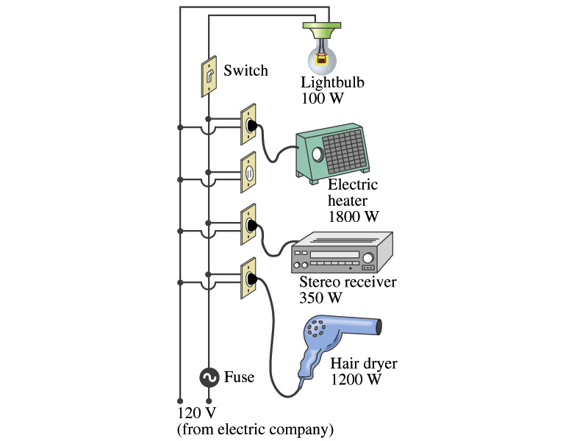
Example 25 – 11
Will the fuse blow?: Determine the total current drawn by all the devices in the circuit in the figure.
The total current is the sum of current drawn by an individual device.
Solve for I
Bulb
Heater
Stereo
Dryer
Total current
What is the total power?

Slide 11
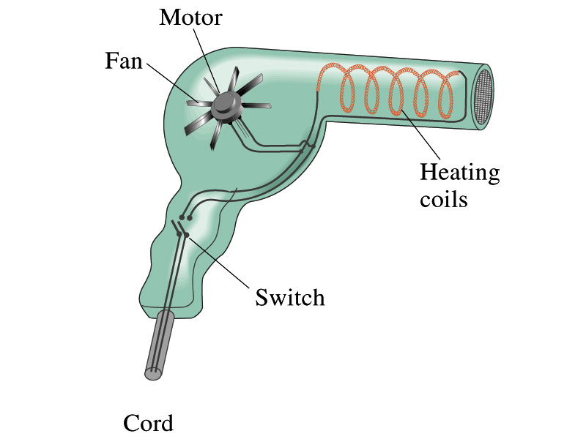
Example 25 – 13
Hair Dryer. (a) Calculate the resistance and the peak current in a 1000-W hair dryer connected to a 120-V AC line. (b) What happens if it is connected to a 240-V line in Britain?
The rms current is:
The peak current is:
Thus the resistance is:
(b) If connected to 240V in Britain …
The average power provide by the AC in UK is
So?
The heating coils in the dryer will melt!

Slide 12
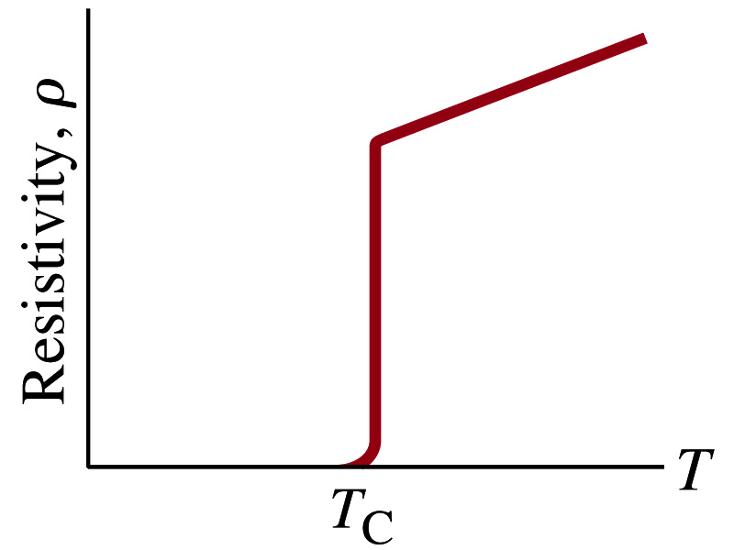
Superconductivity
At the temperature near absolute 0K, resistivity of certain material becomes 0.
This state is called the “superconducting” state.
Observed in 1911 by H. K. Onnes when he cooled mercury to 4.2K (-269ºC).
Resistance of mercury suddenly dropped to 0.
In general superconducting materials become superconducting below a transition temperature (T_{c}).
The highest temperature superconductivity seen is 160K
First observation above the boiling temperature of liquid nitrogen is in 1987 at 90k observed from a compound of yttrium, barium, copper and oxygen.
Since much smaller amount of material can carry just as much current more efficiently, superconductivity can make electric cars more practical, computers faster, and capacitors store higher energy

Slide 13
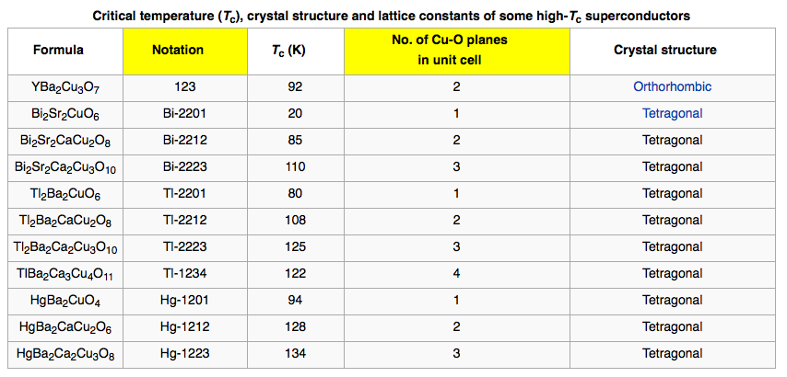
Critical Temperature of Superconductors

Slide 14
Electric Hazards: Leakage Currents
How does one feel shock by electricity?
Electric current stimulates nerves and muscles, and we feel a shock
The severity of the shock depends on the amount of current, how long it acts and through what part of the body it passes
Electric current heats the tissue and can cause burns
Currents above 70mA on a torso for a second or more is fatal, causing heart to function irregularly, “ventricular fibrillation”.
A dry human body between two points on opposite side of the body is about 10⁴ to 10⁶ Ω.
When wet, it could be 10³Ω.
A person in good contact with the ground who touches 120V DC line with wet hands can get the current:
Could be lethal

Slide 15
EMF and Terminal Voltage
What do we need to have current in an electric circuit?
A device that provides a potential difference, such as a battery or a generator
They normally convert some types of energy into the electric energy
These devices are called source of electromotive force (emf)
This is does NOT refer to a real “force”.
Potential difference between terminals of an emf source, when no current flows to an external circuit, is called the emf (E) of the source.
The battery itself has some internal resistance (r) due to the flow of charges in the electrolyte
Why does the headlight dim when you start the car?
The starter needs a large amount of current but the battery cannot provide charge fast enough to supply current to both the starter and the headlight

Slide 16
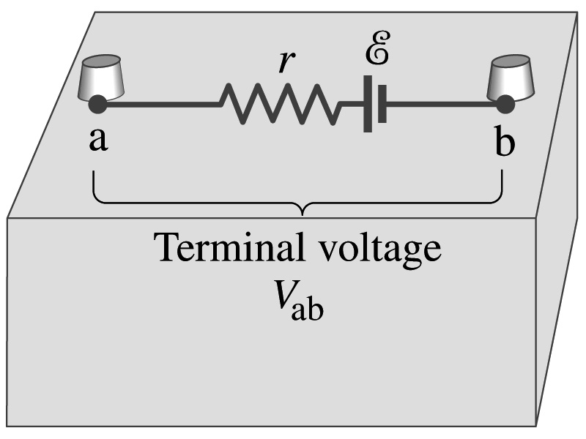
EMF and Terminal Voltage
Since the internal resistance is inside the battery, we can never separate them out.
So the terminal voltage difference is V_{ab}=V_{a}-V_{b}.
When no current is drawn from the battery, the terminal voltage equals the emf which is determined by the chemical reaction; V_{ab}= E.
However when the current I flows naturally from the battery, there is an internal drop in voltage which is equal to Ir. Thus the actual delivered terminal voltage is

