Slide 1
PHYS 1444 – Section 002 Lecture #15
Monday, Oct. 30, 2017
Dr. Jaehoon Yu
Chapter 26
Resistance in series and parallel
Kirchhoff’s Rules
EMFs in Series and Parallel
Today’s homework is homework #9, due 11pm, Monday, Nov. 6!!

Slide 2
Announcements
Reading assignments
CH26.5, 6 and 7
Mid-term exam results
Class average: 70.5/96
Equivalent to 73.4/100
Previous exam: 50.1/100
Top score: 96/96
Quiz #3
At the beginning of the class Monday, Nov. 6
Covers CH25.5 to what we learn this Wednesday, Nov. 1
BYOF

Slide 3
Valid Planetarium Shows
Regular running shows
Stars of Pharaoes – Saturdays at 6:00pm
Astronaut – Sundays at 1:30pm
Shows that need special arrangements
Black Holes (up to 2 times)
Bad Astronomy, Cosmic Origin, Experience the Aurora
From Earth to the Universe, IBEX, Ice Worlds, Magnificent Sun
Mayan Prophecies, Nanocam, Phantom of the Universe
Two Small Pieces of Glass, Unseen Universe: The Vision of SOFIA
Violent Universe, We are Astronomers
How to submit for extra credit?
Obtain the ticket stub that is signed and dated by the planetarium star lecturer at the show
Collect the ticket stubs
Tape all of them on a sheet of paper with your name and ID written on it
Submit the sheet at the beginning of the class Nov. 29

Slide 4
Reminder: Special Project #5
Make a list of the power consumption and the resistance of all electric and electronic devices at your home and compiled them in a table. (5 points total for the first 10 items and 0.25 points each additional item.)
Estimate the cost of electricity for each of the items on the table using your own electric cost per kWh (if you don’t find your own, use $0.12/kWh) and put them in the relevant column. (2 points total for the first 10 items and 0.1 points each additional items)
Estimate the the total amount of energy in Joules and the total electricity cost per day, per month and per year for your home. (6 points)
Due: Beginning of the class this Wednesday, Nov. 1

Slide 5
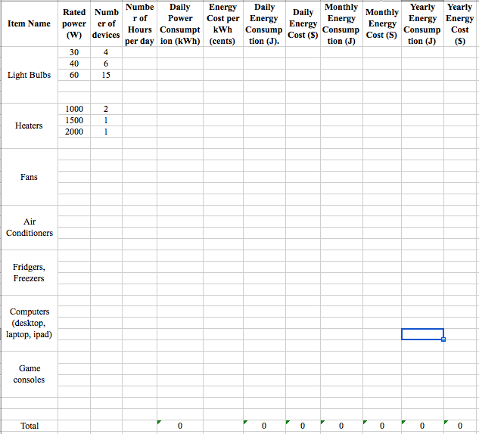

Slide 6
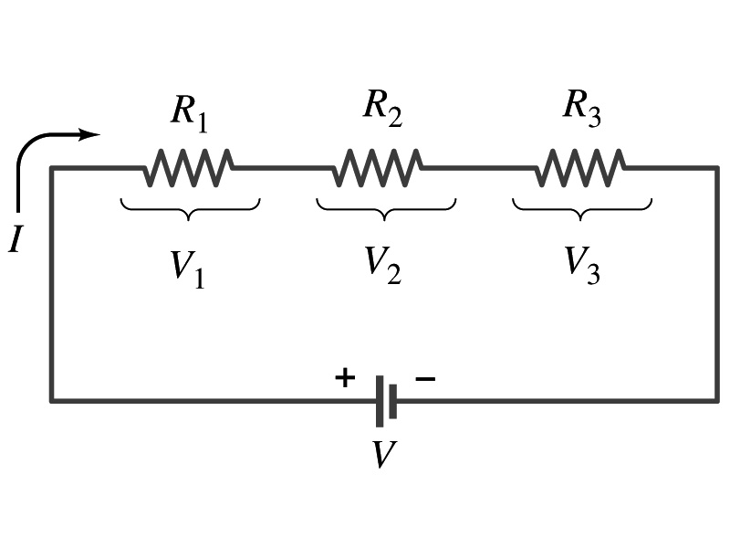
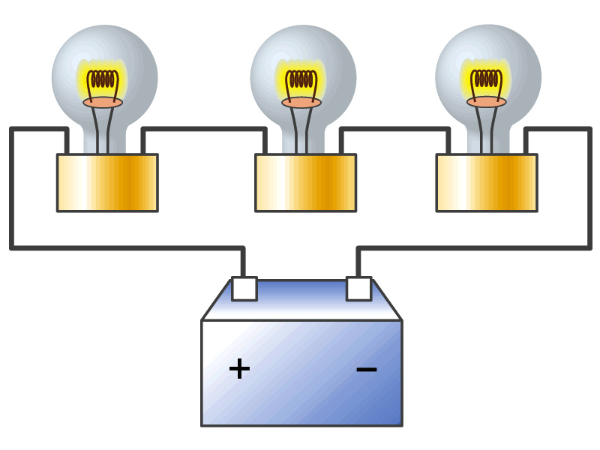
Resisters in Series
Resisters are in series when two or more resisters are connected end to end
These resisters represent simple resisters in circuit or electrical devices, such as light bulbs, heaters, dryers, etc
What is common for devices in a series circuit?
Current is the same through all the elements in series
Potential difference across every element in the circuit is
V₁=IR₁, V₂=IR₂ and V₃=IR₃
Since the total potential difference is V, we obtain
V=IR_{eq}=V₁+V₂+V₃=I(R₁+R₂+R₃)
Thus, R_{eq}=R₁+R₂+R₃
Resisters in series
When resisters are connected in series, the total resistance increases and the current decreases.

Slide 7
Energy Losses in Resisters
Why is it true that V=V₁+V₂+V₃?
What is the potential energy loss when charge q passes through resisters R₁, R₂ and R₃
ΔU₁=qV₁, ΔU₂=qV₂, ΔU₃=qV₃
Since the total energy loss should be the same as the total energy provided to the system, we obtain
ΔU=qV=ΔU₁+ΔU₂+ΔU₃=q(V₁+V₂+V₃)
Thus, V=V₁+V₂+V₃

Slide 8
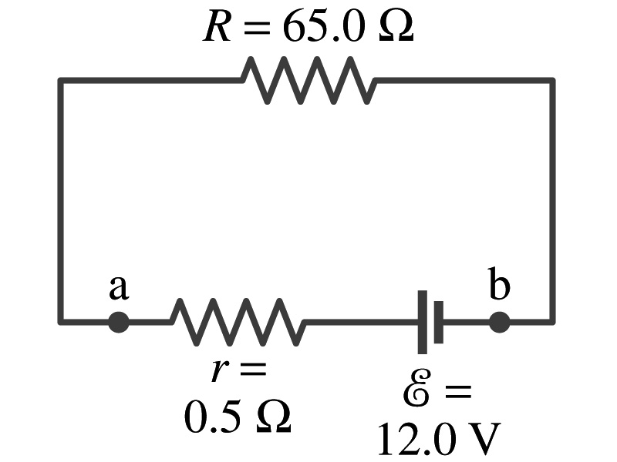
Example 26 – 1
Battery with internal resistance. A 65.0-Ω resistor is connected to the terminals of a battery whose emf is 12.0V and whose internal resistance is 0.5-Ω. Calculate (a) the current in the circuit, (b) the terminal voltage of the battery, V_{ab}, and (c) the power dissipated in the resistor R and in the battery’s internal resistor.
(a) Since
We obtain
What is this?
Solve for I
A battery or a source of emf.
(b) The terminal voltage V_{ab} is
(c) The power dissipated in R and r are

Slide 9
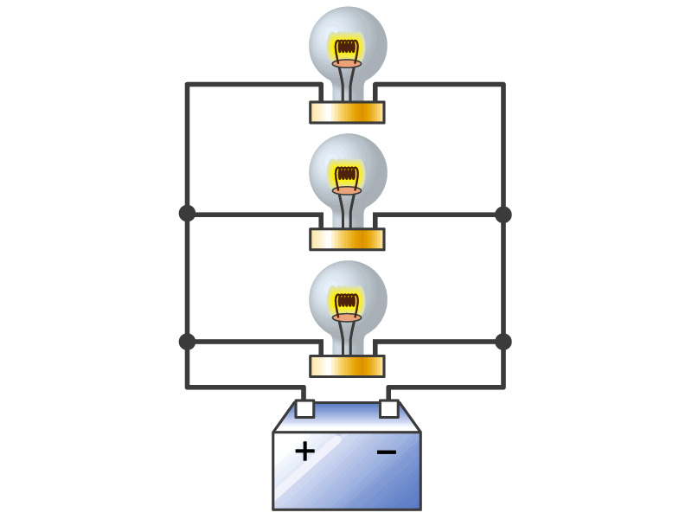
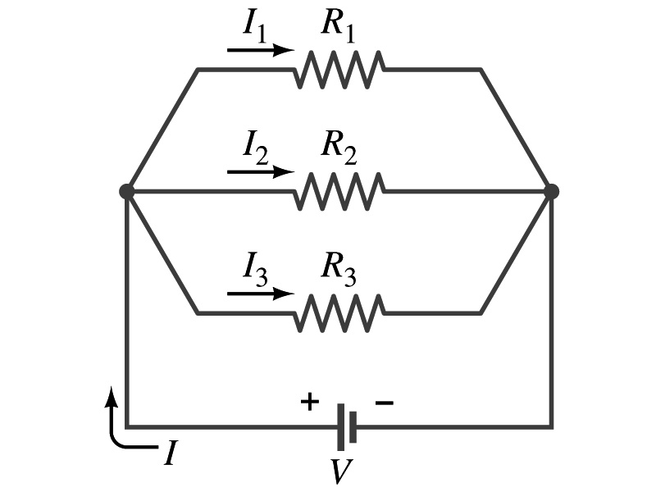
Resisters in Parallel
Resisters are in parallel when two or more resisters are connected in separate branches
Most the house and building wirings are arranged this way.
What is common for the devices in a parallel circuit?
The voltage is the same across all the resisters.
The total current that leaves the battery is, however, split.
The current that passes through every element is
I₁=V/R₁, I₂=V/R₂, I₃=V/R₃
Since the total current is I, we obtain
I=V/R_{eq}=I₁+I₂+I₃=V(1/R₁+1/R₂+1/R₃)
Thus, 1/R_{eq}=1/R₁+1/R₂+1/R₃
Resisters in parallel
When resisters are connected in parallel, the total resistance decreases and the current increases.

Slide 10
Resister and Capacitor Arrangements
Parallel Capacitor arrangements
Parallel Resister arrangements
Series Capacitor arrangements
Series Resister arrangements

Slide 11
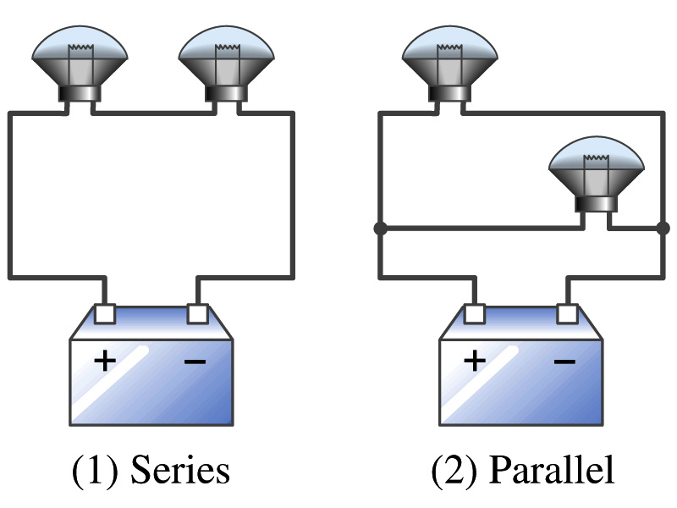
Example 26 – 2
Series or parallel? (a) The light bulbs in the figure are identical and have identical resistance R. Which configuration produces more light? (b) Which way do you think the headlights of a car are wired?
(a) What are the equivalent resistances for the two cases?
Series
Parallel
So
The bulbs get brighter when the total power transformed is larger.
series
parallel
So parallel circuit provides brighter lighting.
(b) Car’s headlights are in parallel to provide brighter lighting and also to prevent both lights going out at the same time when one burns out.
So what is bad about parallel circuits?
Uses more energy in a given time.

Slide 12
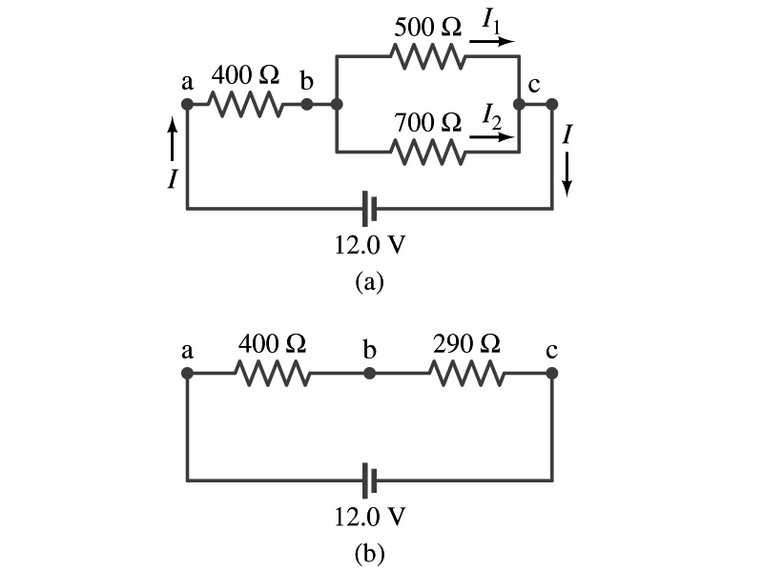
Example 26 – 5
Current in one branch. What is the current flowing through the 500-Ω resister in the figure?
We need to find the total current.
What do we need to find first?
To do that we need to compute the equivalent resistance.
R_{eq} of the small parallel branch is:
R_{eq} of the circuit is:
Thus the total current in the circuit is
The voltage drop across the parallel branch is
The current flowing across 500-Ω resister is therefore
What is the current flowing 700-Ω resister?

Slide 13
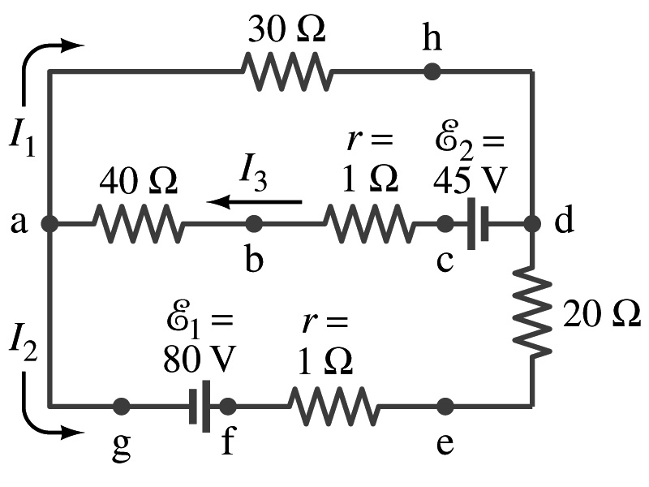
Kirchhoff’s Rules – 1st Rule
Some circuits are very complicated to do the analysis using the simple combinations of resisters
G. R. Kirchhoff devised two rules to deal with complicated circuits.
Kirchhoff’s rules are based on conservation of charge and energy
Kirchhoff’s 1st rule: The junction rule, charge conservation.
At any junction point, the sum of all currents entering the junction must be equal to the sum of all currents leaving the junction.
In other words, what goes in must come out.
At junction a in the figure, I₃ comes into the junction while I₁ and I₂ leaves: I₃ = I₁+ I₂

Slide 14
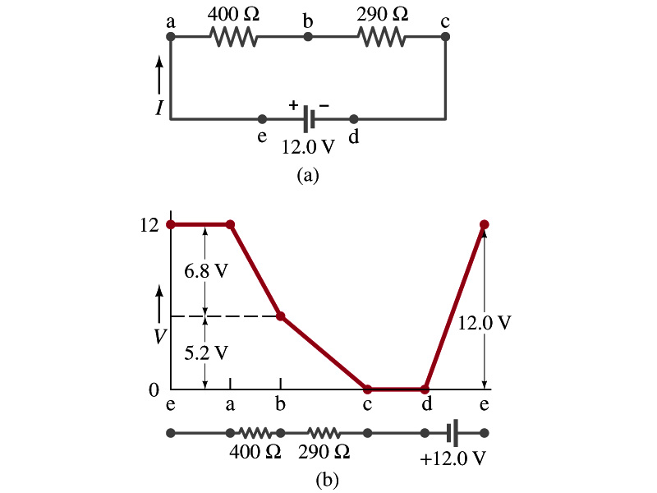
Kirchhoff’s Rules – 2nd Rule
Kirchoff’s 2nd rule: The loop rule, uses conservation of energy.
The sum of the changes in potential in any closed path of a circuit must be zero.
I=12/690=0.017A.
The current in the circuit in the figure is
Point e is the high potential point while point d is the lowest potential.
When the test charge starts at e and returns to e, the total potential change is 0.
Between point e and a, no potential change since there is no source of potential nor any resistance.
Between a and b, there is a 400Ω resistance, causing IR=0.017*400 =6.8V drop.
Between b and c, there is a 290Ω resistance, causing IR=0.017*290 =5.2V drop.
Since these are voltage drops, we use negative sign for these, -6.8V and -5.2V.
No change between c and d while from d to e there is +12V change.
Thus the total change of the voltage through the loop is: -6.8V-5.2V+12V=0V.

Slide 15
How to use Kirchhoff’s Rules??
Determine the flow of currents at the junctions and label each and everyone of the currents.
It does not matter which direction, you decide but keep it!
You cannot have all current coming in or going out of a junction, though!
If the value of the current after completing the calculations are negative, you just need to flip the direction of the current flow.
Write down the current equation based on Kirchhoff’s 1st rule at various junctions.
Be sure to see if any of them are the same.
Choose closed loops in the circuit
Write down the potential in each interval of the junctions, keeping the proper signs as you decided in step 1 above.
Write down the potential equations for each loop.
Solve the equations for unknowns.

