Slide 1
PHYS 1444 – Section 002
Lecture #18
Wednesday, Nov. 8, 2017
Dr. Jaehoon Yu
Chapter 27: Magnetism & Magnetic Field
  Magnetic Forces on a Moving Charge
  Charged Particle Path in a Magnetic Field
  Cyclotron Frequency
  Torque on a Current Loop
  Magnetic Dipole Moment

Slide 2
Announcements
Term 2
  In class, Wednesday, Nov. 15
  Non-comprehensive exam which covers: CH25.5 – what we finish Monday, Nov. 13
  Bring your calculator but DO NOT input formula into it!
    Cell phones or any types of computers cannot replace a calculator!
  BYOF: You may bring a one 8.5x11.5 sheet (front and back) of handwritten formulae and values of constants
  No derivations, word definitions or solutions of any kind!
  No additional formulae or values of constants will be provided!
Colloquium today
  4pm in SH100
Reading assignments
  CH27.6, 8, 9 and CH28.6 – 10

Slide 3
Special Project #5
B due to current I in a straight wire. For the field near a long straight wire carrying a current I, show that
the Ampere’s law gives the same result as the simple long straight wire, B=μ₀I/2πR. (10 points)
That Biot-Savarat law gives the same result as the simple long straight wire, B=μ₀I/2πR. (10 points)
Must be your OWN work. No credit will be given for for copying straight out of the book, lecture notes or from your friends’ work.
Due is Monday, Nov. 20

Slide 4
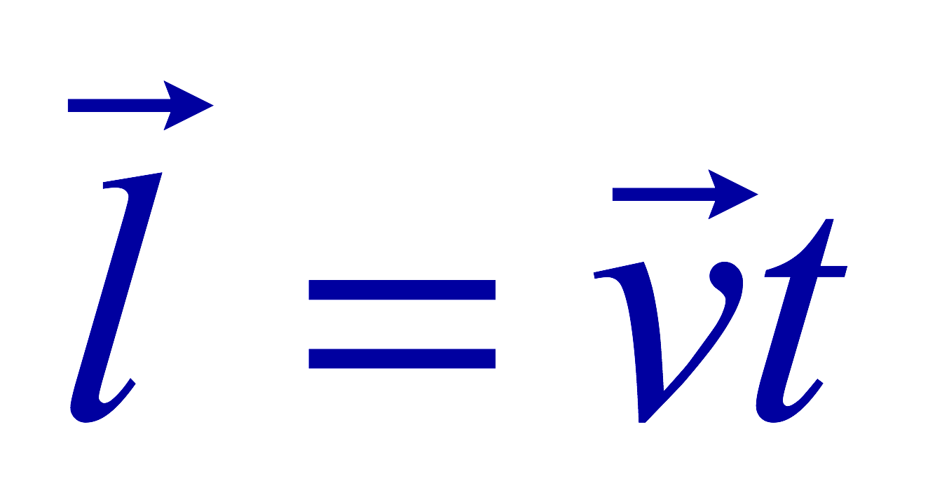
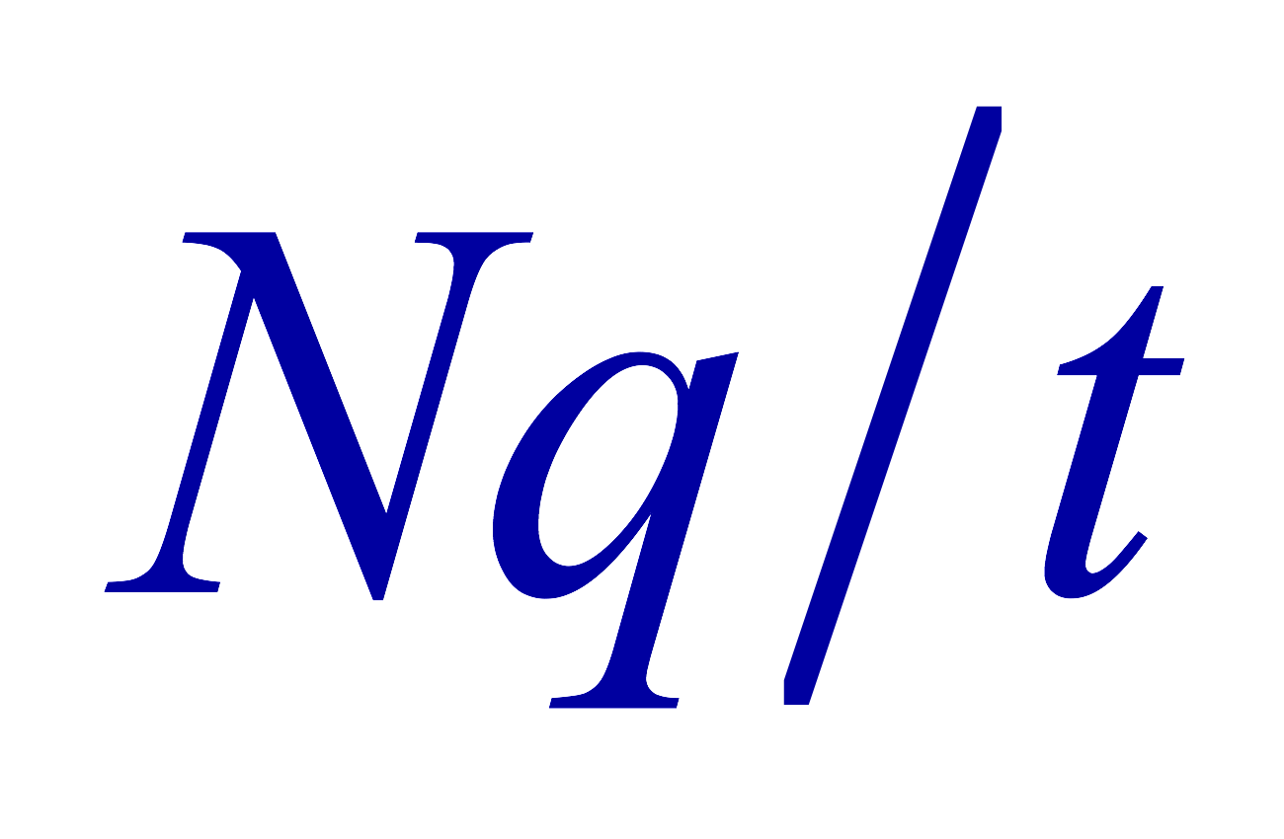
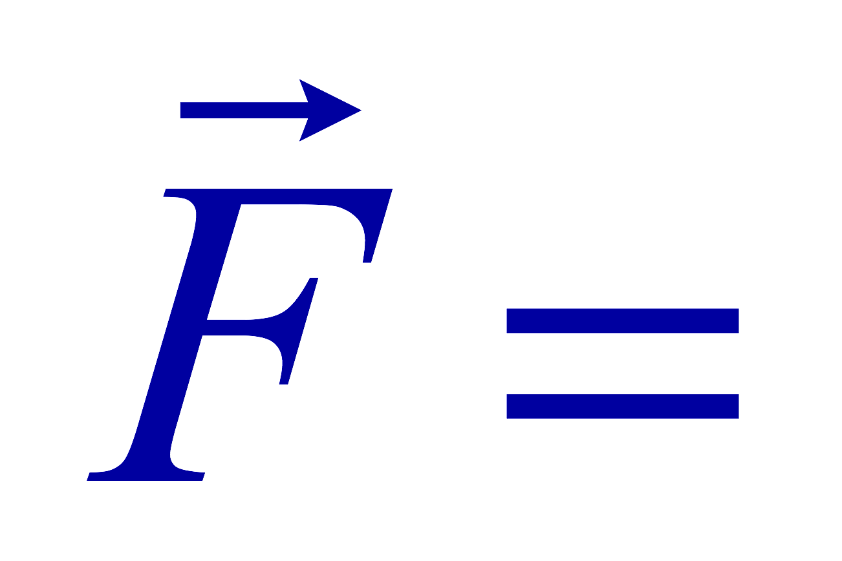
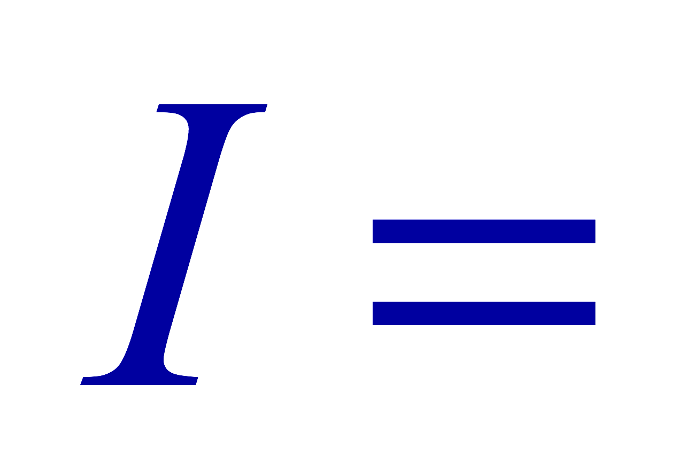
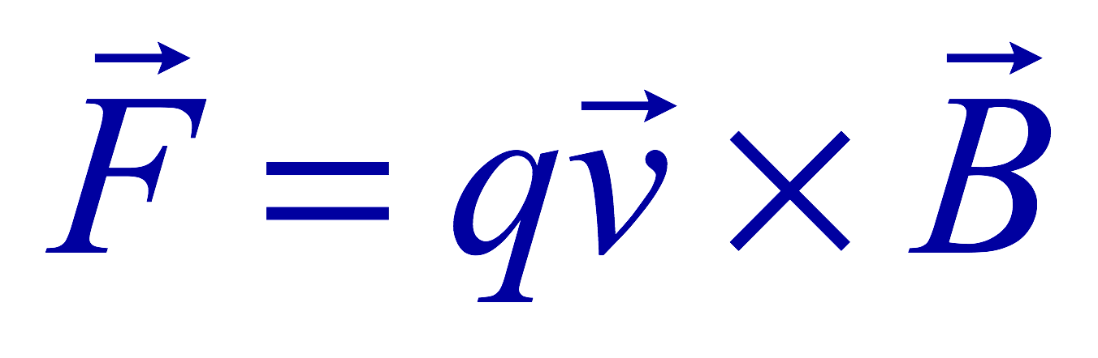
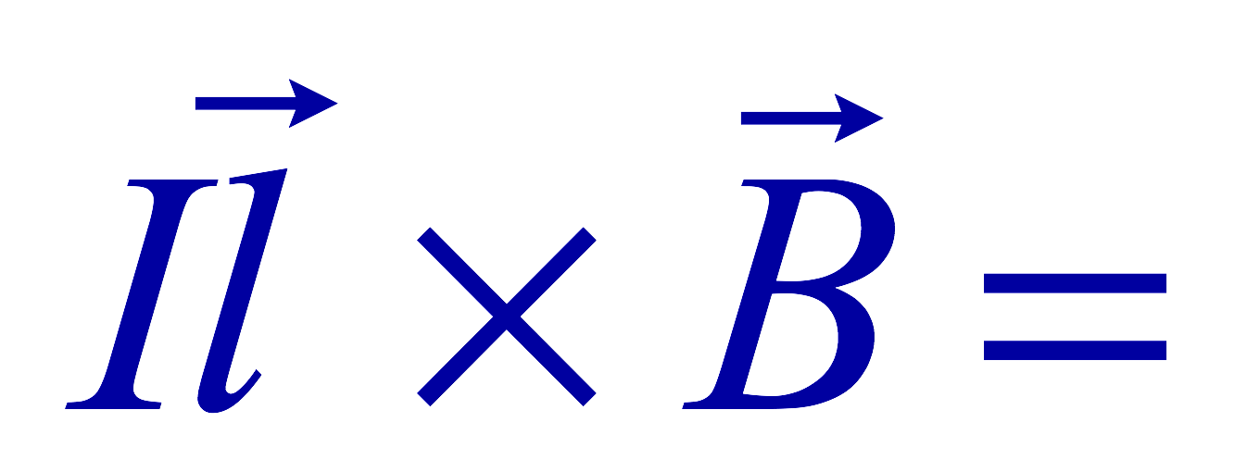
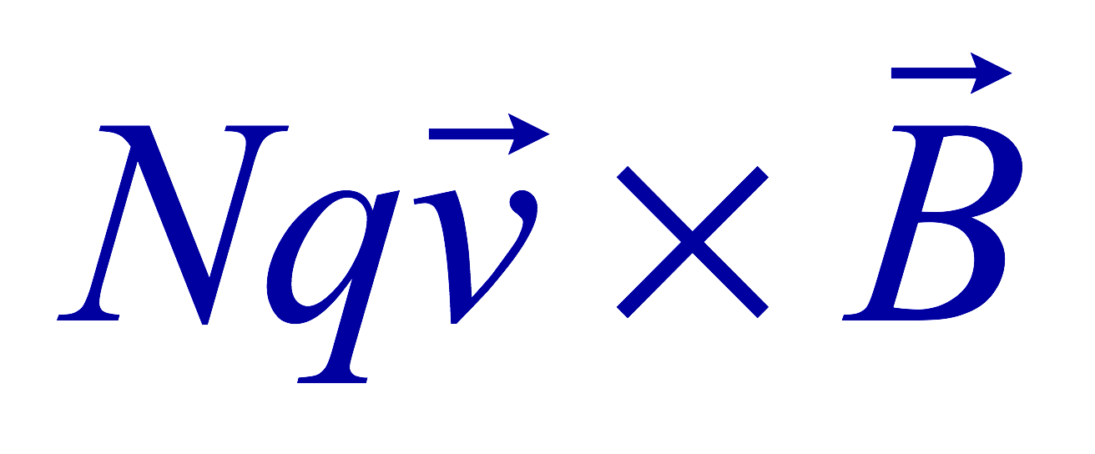
Magnetic Forces on a Moving Charge
Will moving charge in a magnetic field experience force?
  Yes
  Why?
  Since the wire carrying current (moving charge) experience force in a magnetic field, a free moving charge must feel the same kind of force…☺
OK, then how much force would it experience?
  Let’s consider N moving particles with charge q each, and they pass by a given point in a time interval t.
    What is the current?
  Let t be the time for a charge q to travel a distance L in a magnetic field B
    Then, the length vector l becomes
    Where v is the velocity of the particle
Thus the force on N particles by the field is
The force on one particle with charge q,

Slide 5
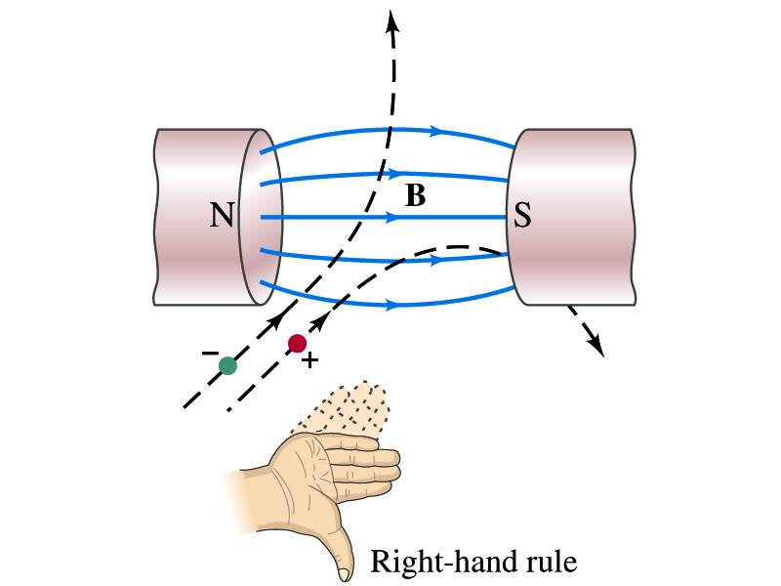

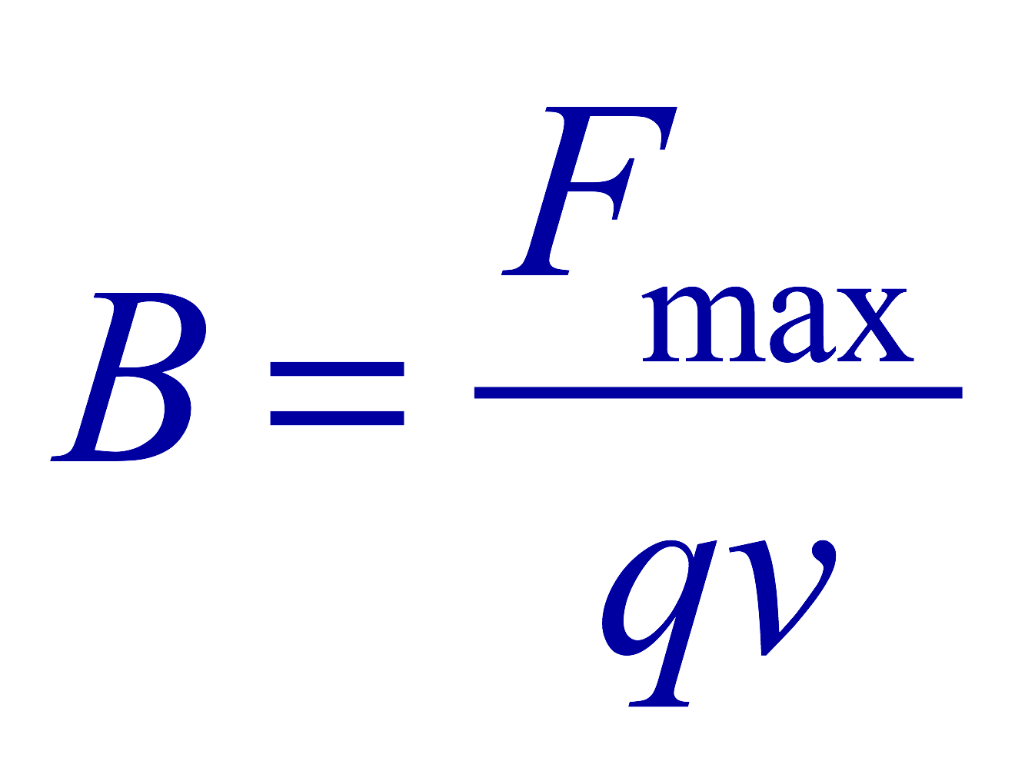
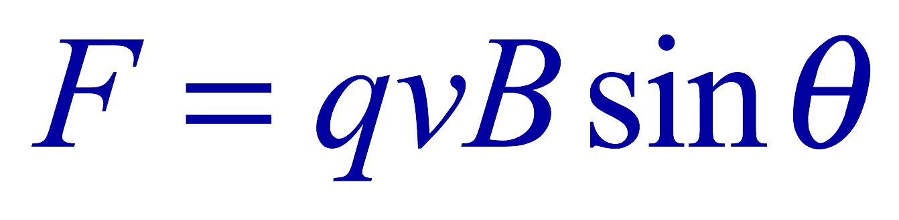
Magnetic Forces on a Moving Charge
This can be an alternative way of defining the magnetic field.
  How?
  The magnitude of the force on a particle with charge q moving with a velocity v in a field B is
    What is θ?
      The angle between the magnetic field and the direction of particle’s motion
    When is the force maximum?
      When the angle between the field and the velocity vector is perpendicular.
    ➔
  The direction of the force follows the right-hand-rule and is perpendicular to the direction of the magnetic field

Slide 6
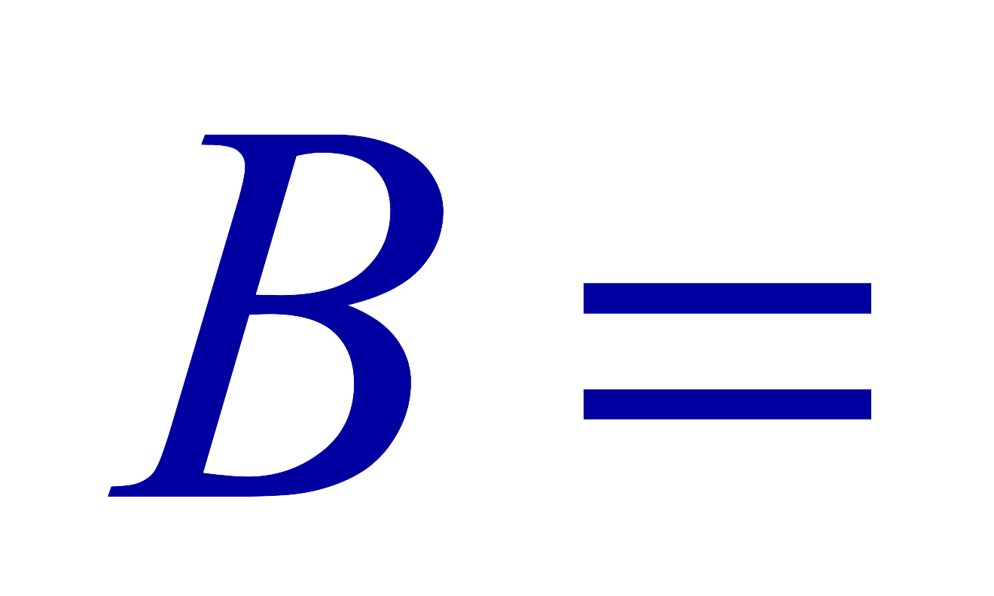
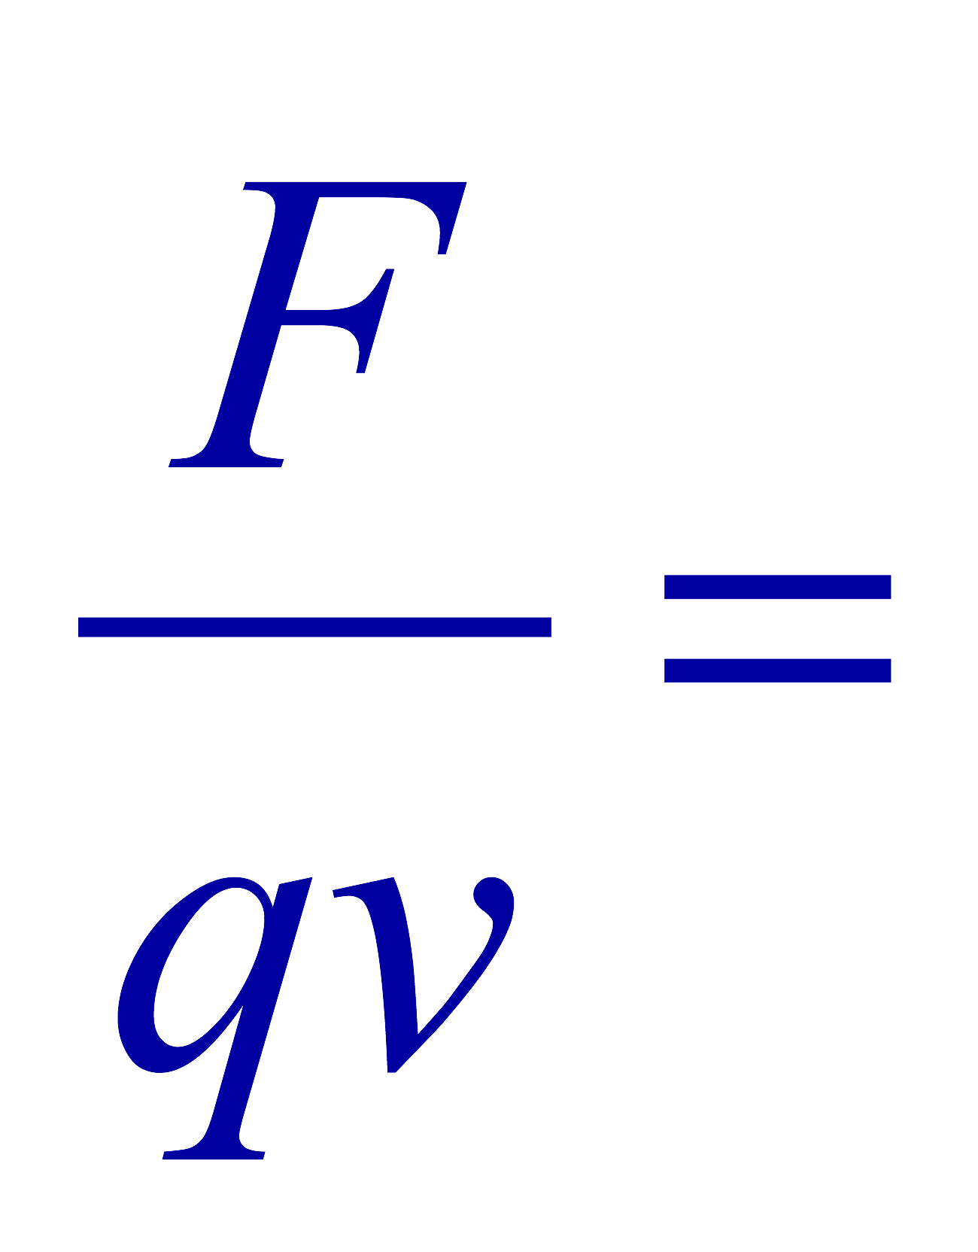
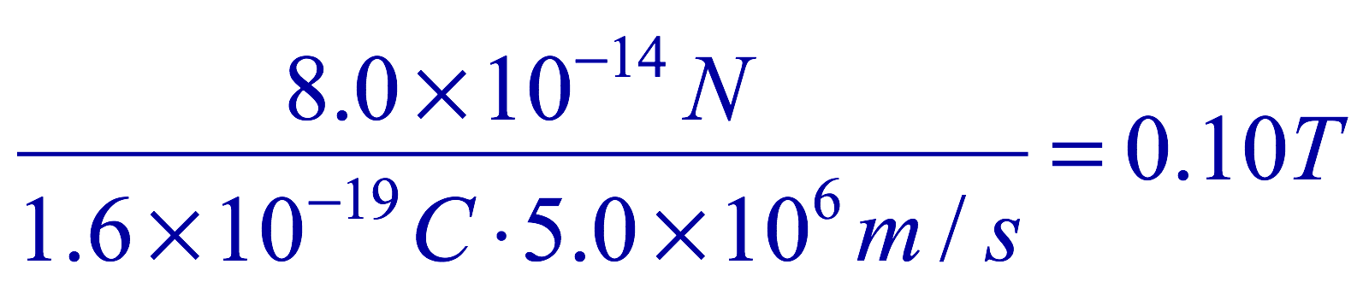
Example 27 – 5
Magnetic force on a proton. A proton with the speed of 5x10⁶m/s in a magnetic field feels the force of F=8.0x10⁻¹⁴N toward West when it moves vertically upward. When moving in a northerly direction, it feels zero force. What is the magnitude and the direction of the magnetic field in this region?
What is the charge of a proton?
What does the fact that the proton does not feel any force in a northerly direction tell you about the magnetic field?
The field is along the north-south direction.
Why?
Because the particle does not feel any magnetic force when it is moving along the direction of the field.
Since the particle feels force toward West, the field should be pointing to ….
North
Using the formula for the magnitude of the field B, we obtain
We can use magnetic field to measure the momentum of a particle. How?

Slide 7
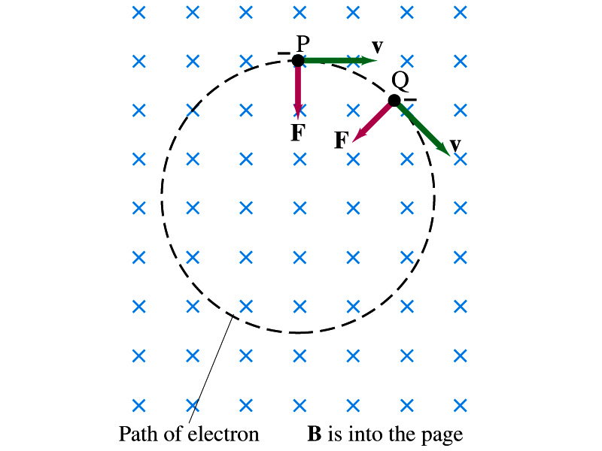
Charged Particle’s Path in Magnetic Field
What shape do you think is the path of an electron on a plane perpendicular to a uniform magnetic field?
  Circle!! Why?
  An electron moving to right at the point P in the figure will be pulled downward
  At a later time, the force is still perpendicular to the velocity
  Since the force is always perpendicular to the velocity, the magnitude of the velocity is constant
  The direction of the force follows the right-hand-rule and is perpendicular to the direction of the magnetic field
  Thus, the electron moves on a circular path with the centripetal force F provided by the magnetic field

Slide 8
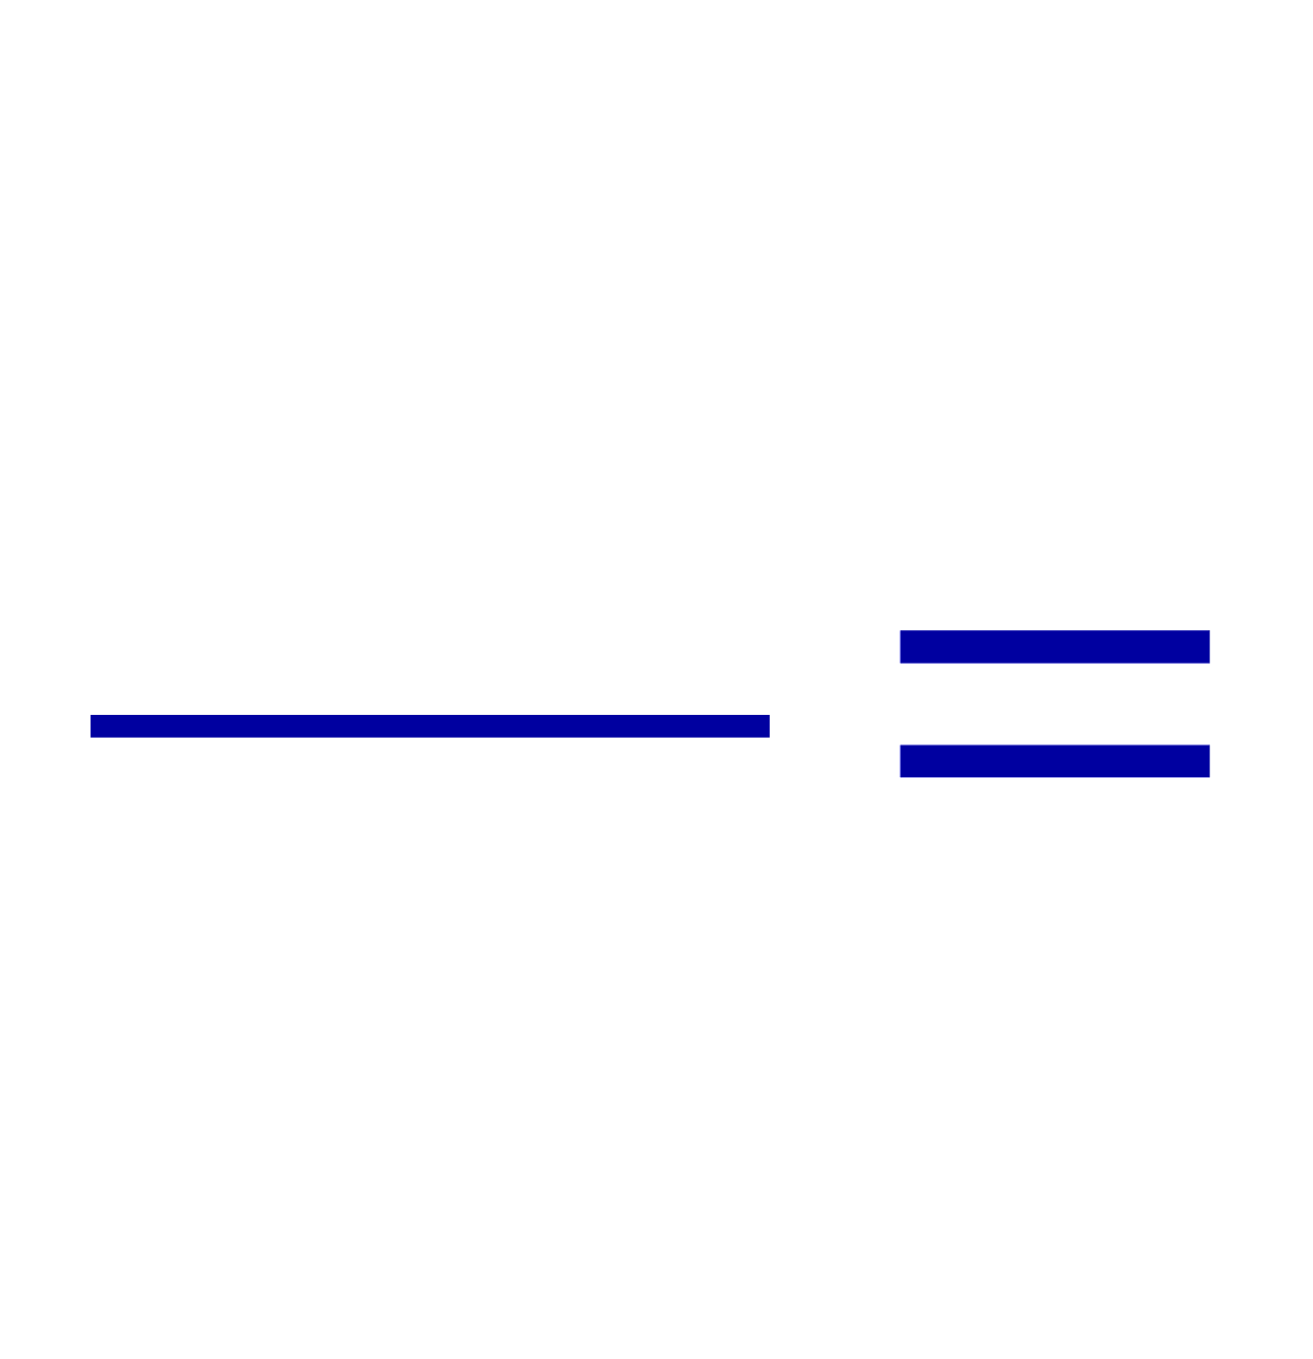
Example 27 – 7
Electron’s path in a uniform magnetic field. An electron travels at the speed of 2.0x10⁷m/s on a plane perpendicular to a 0.010-T magnetic field. What is the radius of the electron’s path?
What is formula for the centripetal force?
Since the magnetic field is perpendicular to the motion of the electron, the magnitude of the magnetic force is
Since the magnetic force provides the centripetal force, we can establish an equation with the two forces
Solving for r

Slide 9
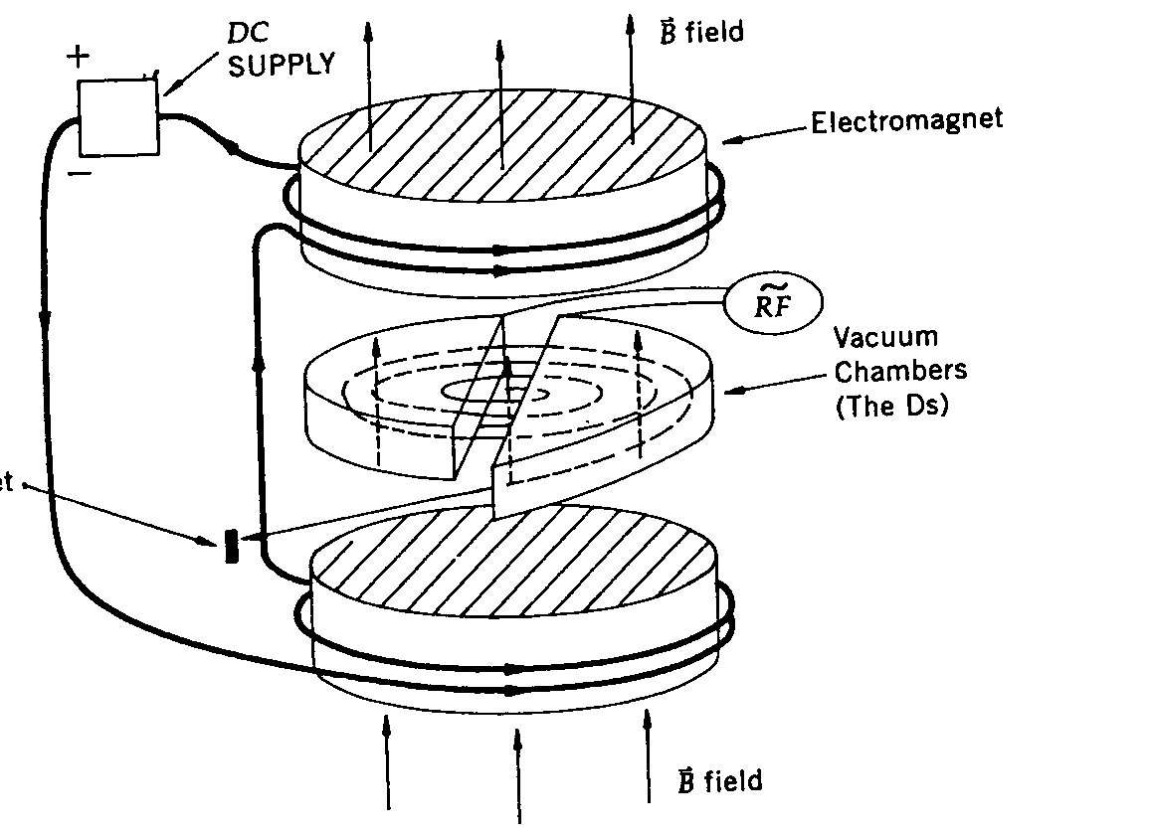
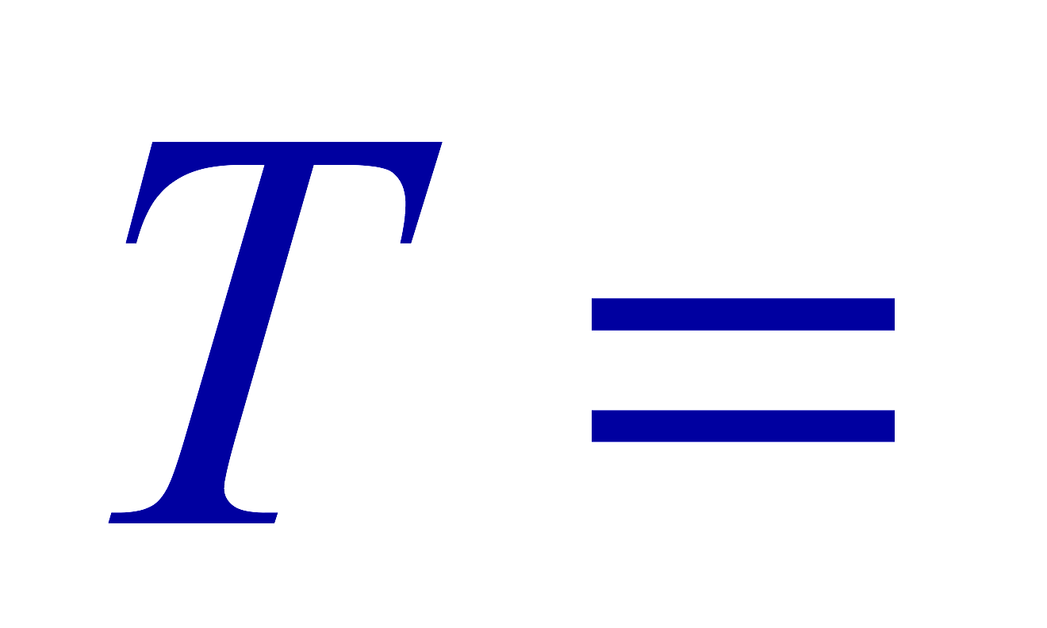
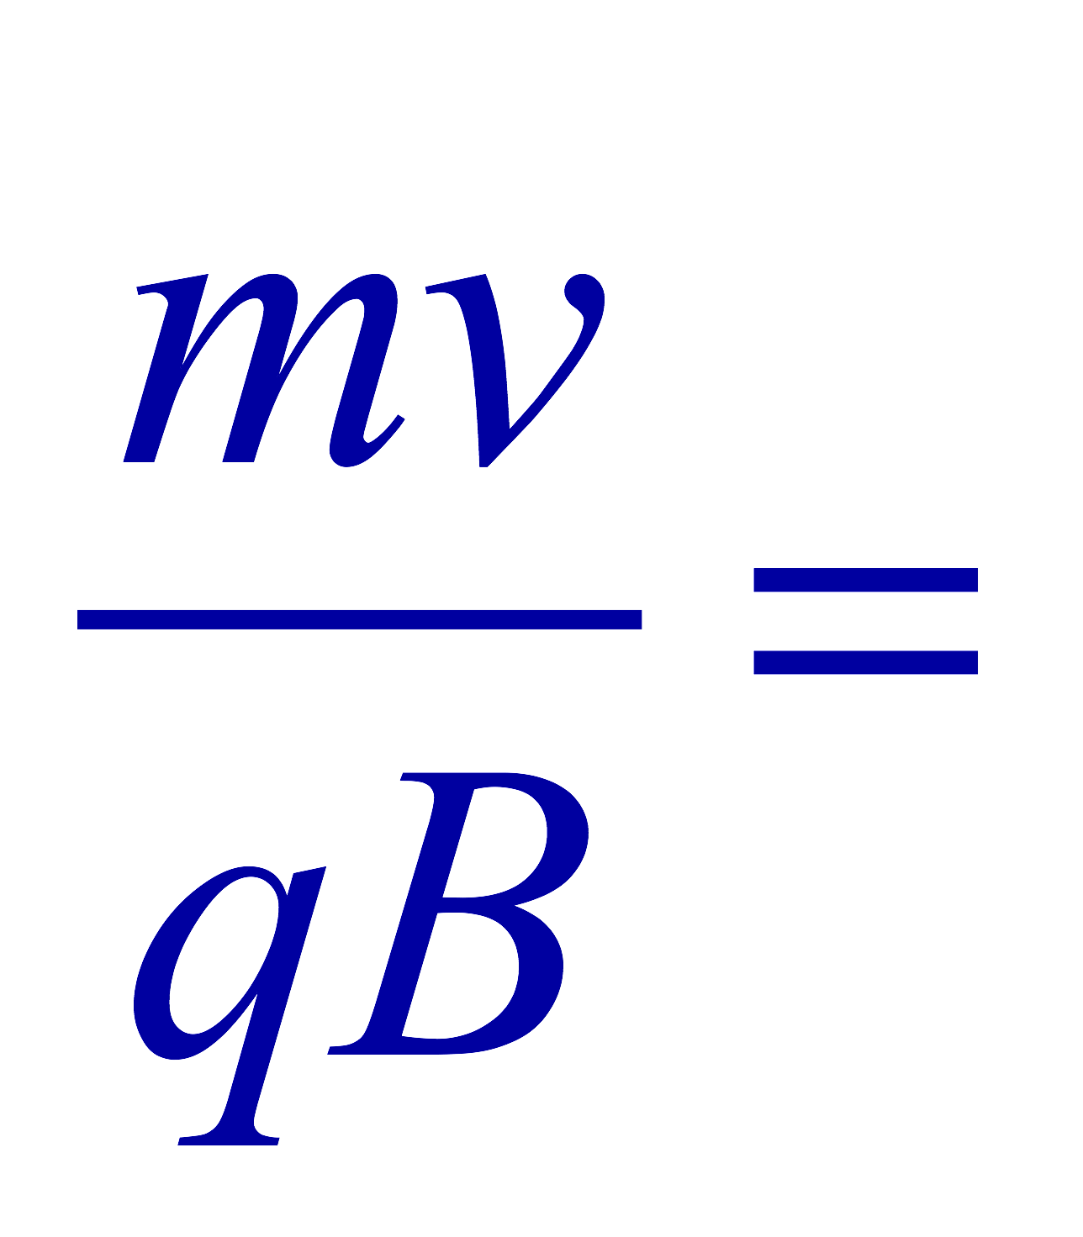
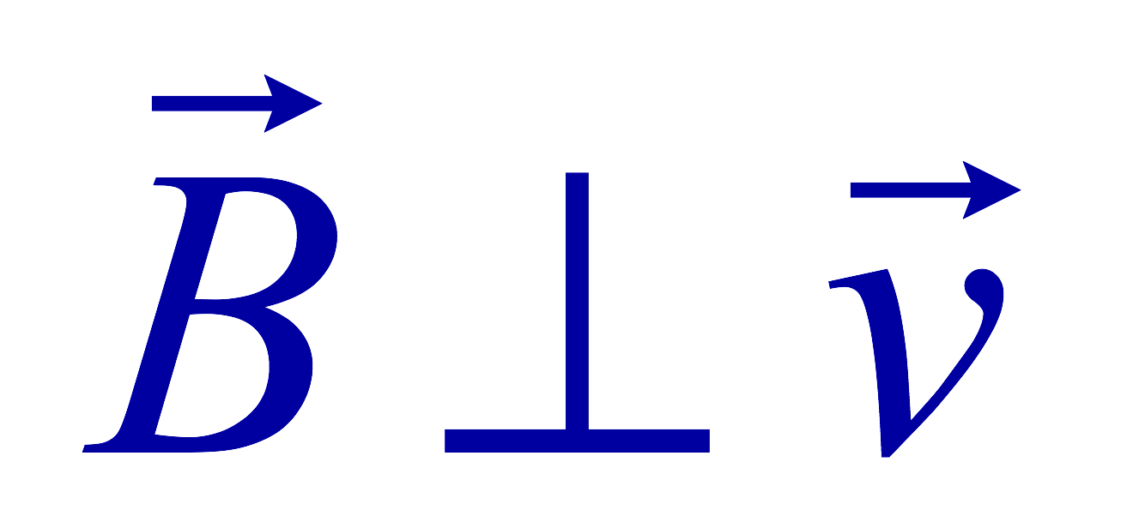
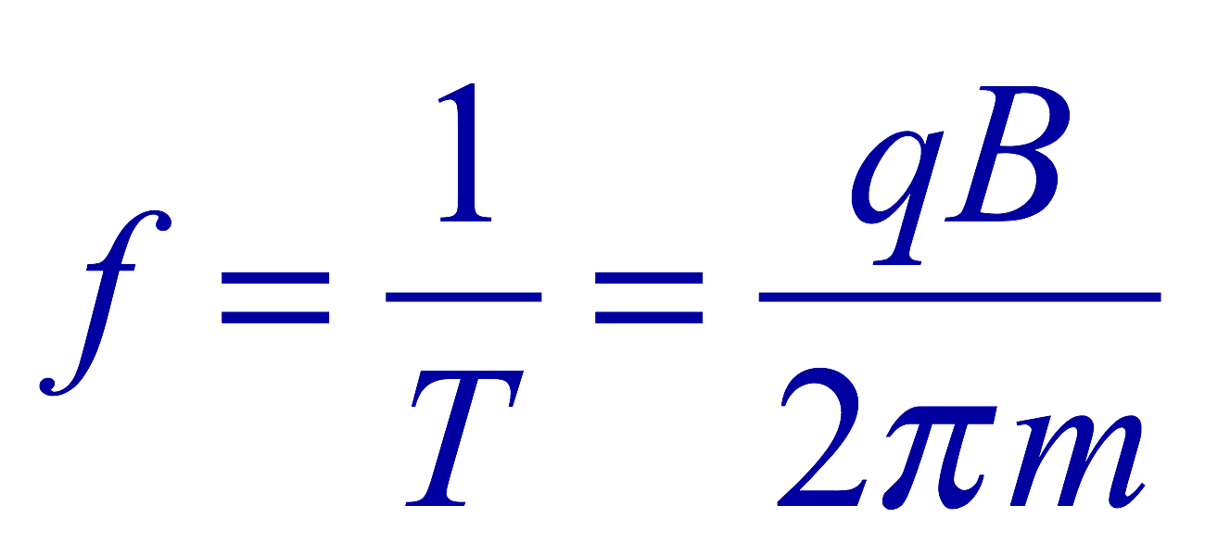
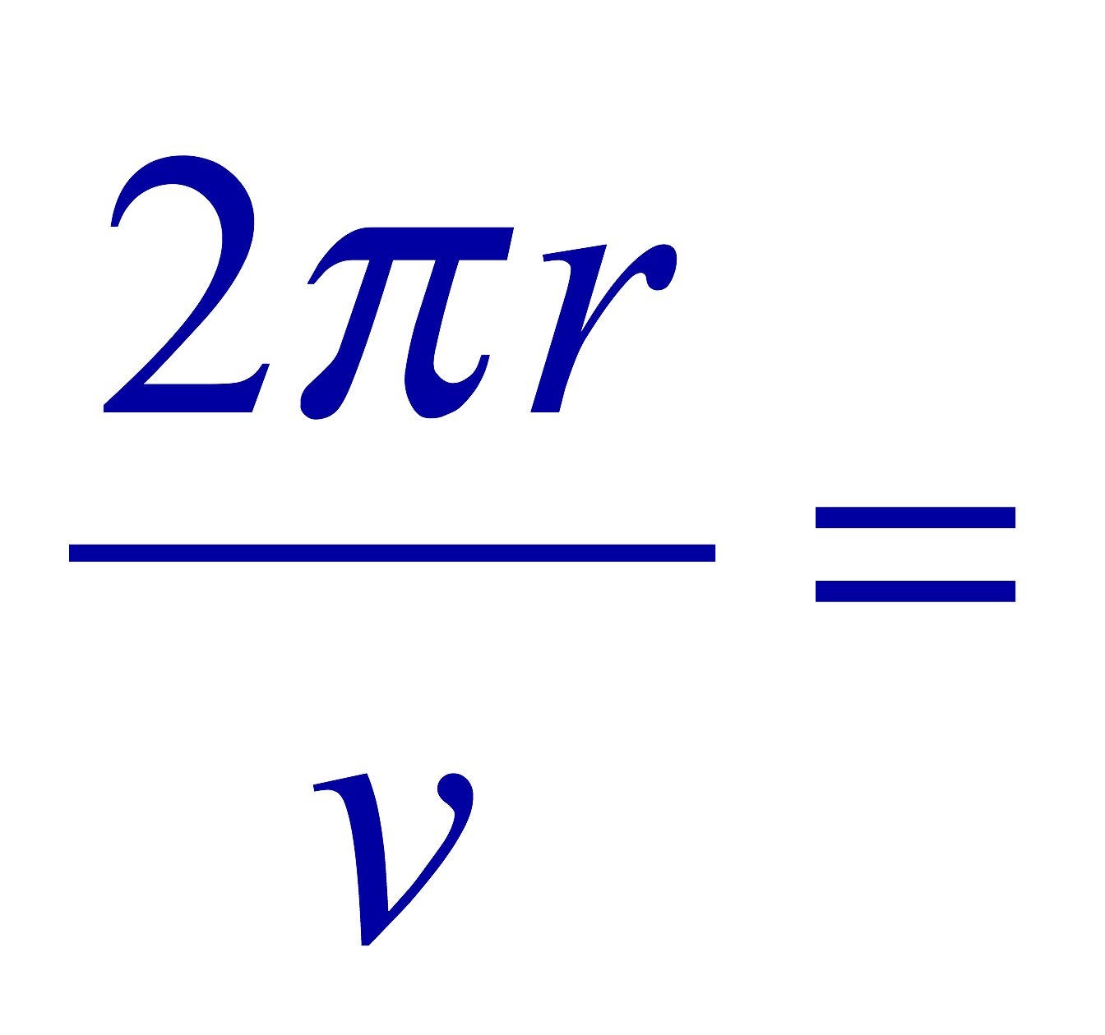
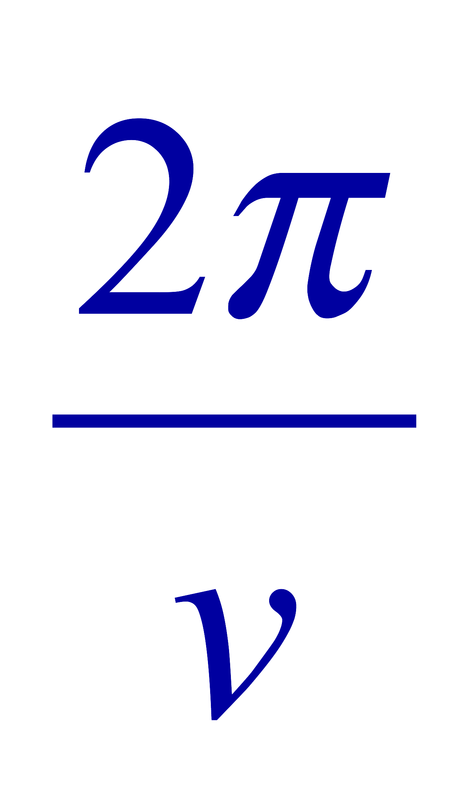
Cyclotron Frequency
The time required for a particle of charge q moving w/ a constant speed v to make one circular revolution in a uniform magnetic field, , is
Since T is the period of rotation, the frequency of the rotation is
This is the cyclotron frequency, the frequency of a particle with charge q in a cyclotron accelerator
  While r depends on v, the frequency is independent of v and r.

Slide 10
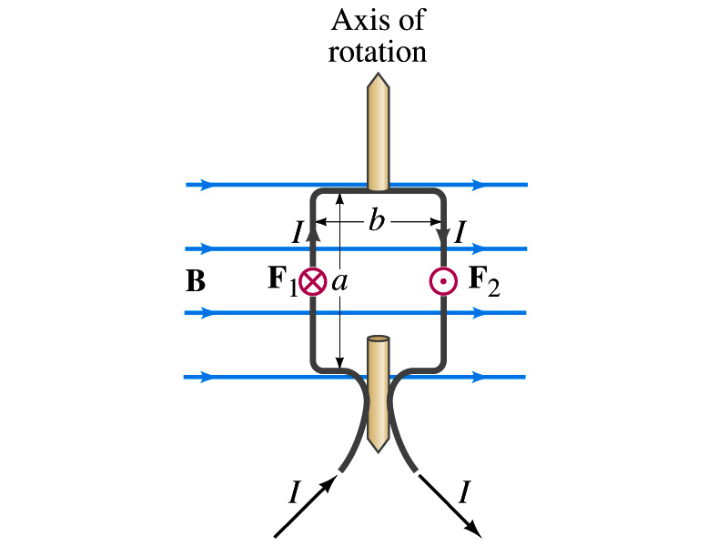
Torque on a Current Loop
What do you think will happen to a closed rectangular loop of wire with electric current as shown in the figure?
  It will rotate! Why?
  The magnetic field exerts a force on both vertical sections of wire.
  Where is this principle used in?
    Ammeters, motors, volt-meters, speedometers, etc
The two forces on the different sections of the wire exerts net torque to the same direction about the rotational axis along the symmetry axis of the wire.
What happens when the wire turns 90 degrees?
  It will not turn any more unless the direction of the current changes

Slide 11
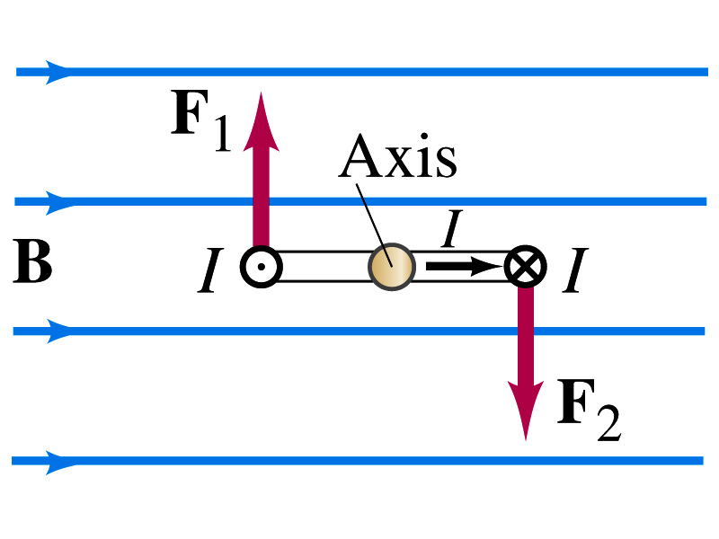
Torque on a Current Loop
So what would be the magnitude of this torque?
  What is the magnitude of the force on the section of the wire with length a?
    F_{a}=IaB
    The moment arm of the coil is b/2
  So the total torque is the sum of the torques by each of the forces
    Where A=ab is the area of the coil loop
  What is the total net torque if the coil consists of N loops of wire?
  If the coil makes an angle θ w/ the field

Slide 12
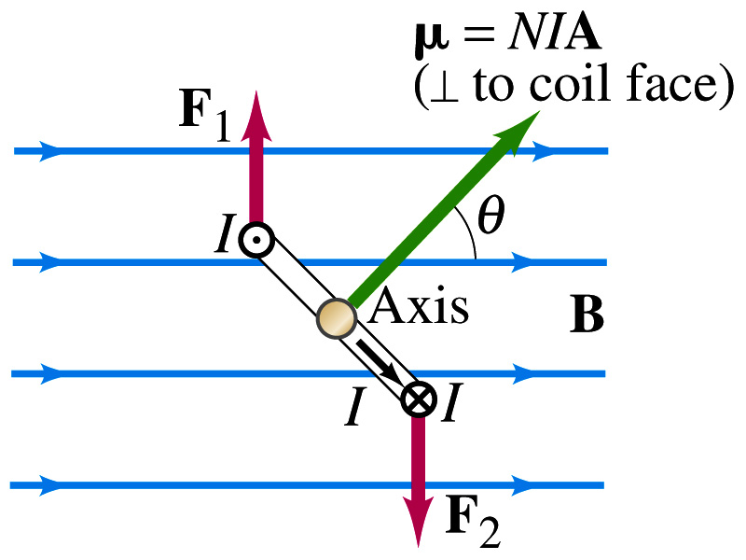
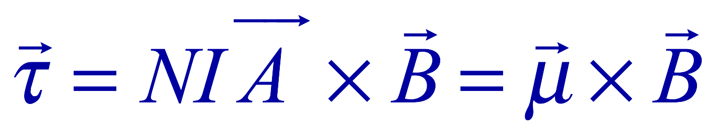
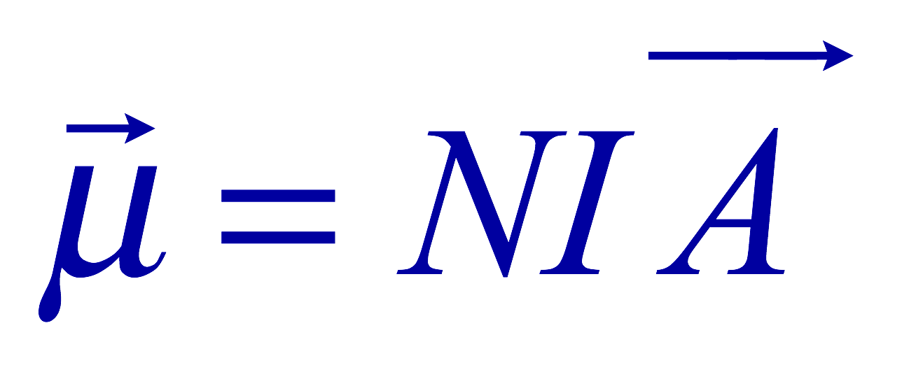
Magnetic Dipole Moment
The formula derived in the previous page for a rectangular coil is valid for any shapes of the coil
The quantity NIA is called the magnetic dipole moment of the coil
  It is considered a vector
    Its direction is the same as that of the area vector A and is perpendicular to the plane of the coil consistent with the right-hand rule
      Your thumb points to the direction of the magnetic moment when your finer cups around the loop in the direction of the current
  Using the definition of magnetic moment, the torque can be rewritten in vector form as

Slide 13
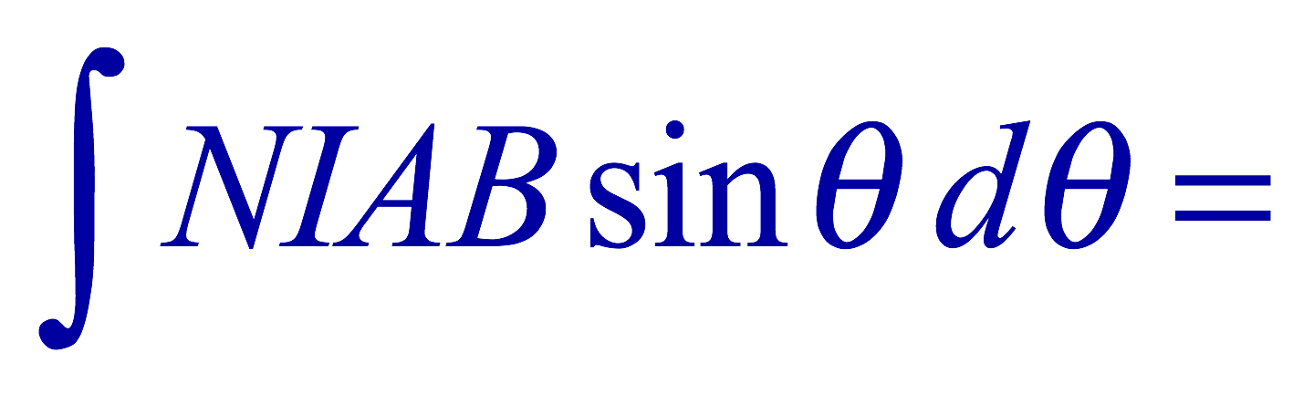
Magnetic Dipole Potential Energy
Where else did you see the same form of the torque?
  Remember the torque due to electric field on an electric dipole?
  The potential energy of the electric dipole is
How about the potential energy of a magnetic dipole?
  The work done by the torque is
  If we chose U=0 at θ=π/2, then C=0
  Thus the potential energy is
    Very similar to the electric dipole

Slide 14


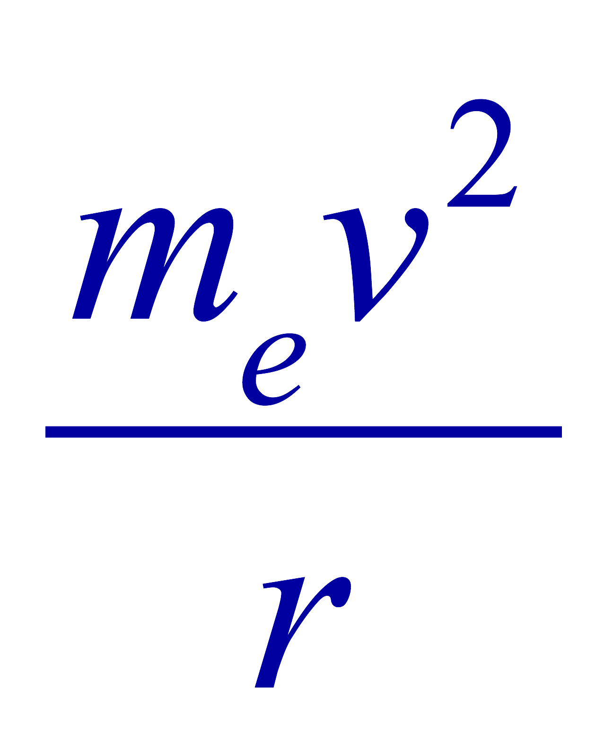

Example 27 – 12
Magnetic moment of a hydrogen atom. Determine the magnetic dipole moment of the electron orbiting the proton in a hydrogen atom, assuming (in the Bohr model) it is in its ground state with a circular orbit of radius 0.529x10⁻¹⁰m.
What provides the centripetal force?
The Coulomb force
So we can obtain the speed of the electron from
Solving for v
Since the electric current is the charge that passes through the given point per unit time, we can obtain the current
Since the area of the orbit is A=πr², we obtain the hydrogen magnetic moment

Slide 15
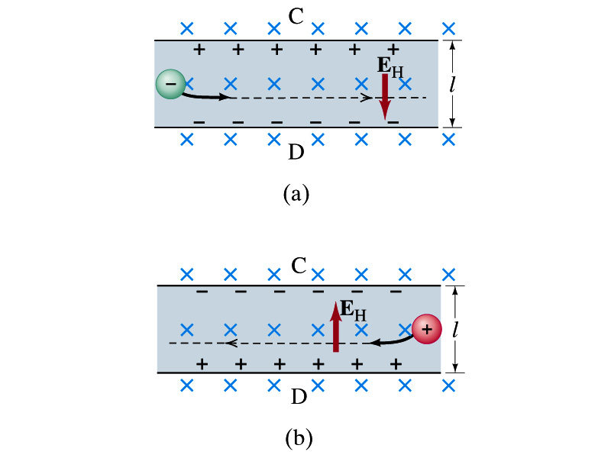
The Hall Effect
What do you think will happen to the electrons flowing through a conductor immersed in a magnetic field?
  Magnetic force will push the electrons toward one side of the conductor. Then what happens?
  A potential difference will be created due to continued accumulation of electrons on one side. Till when? Forever?
  Nope. Till the electric force inside the conductor is equal and opposite to the magnetic force
This is called the Hall Effect
  The potential difference produced is called
    The Hall emf
  The electric field due to the separation of charge is called the Hall field, E_{H}, and it points to the direction opposite to the magnetic force

Slide 16
The Hall Effect
In an equilibrium, the force due to Hall field is balanced by the magnetic force ev_{d}B, so we obtain
and
The Hall emf is then
  Where l is the width of the conductor
What do we use the Hall effect for?
  The current of negative charge moving to right is equivalent to the positive charge moving to the left
  The Hall effect can distinguish these since the direction of the Hall field or the direction of the Hall emf is opposite
  Since the magnitude of the Hall emf is proportional to the magnetic field strength ➔ can measure the B-field strength
    Hall probe

