Slide 1
PHYS 1441 – Section 001
Lecture #20
Monday, Nov. 20, 2017
Dr. Jaehoon Yu
Chapter 28:Sources of Magnetic Field
  Solenoid and Toroidal Magnetic Field
  Biot-Savart Law
  Magnetic Materials
  Hysteresis
Chapter 29:EM Induction & Faraday’s Law
  Induced EMF and EM Induction
  Faraday’s Law of Induction
  Lenz’s Law

Slide 2
Announcements
Bring your planetarium extra credit sheet by the beginning of the class Wednesday, Nov. 29!
  Be sure to tape one end of the ticket stub on a sheet of paper with your name on it
Bring your special project #5
Quiz #4
  Wednesday, Nov. 29 at the beginning of the class
  Covers CH28.4 through what we finish Monday, Nov. 27
  BYOF
No class this Wednesday, Nov. 22
  Happy Thanksgiving!

Slide 3
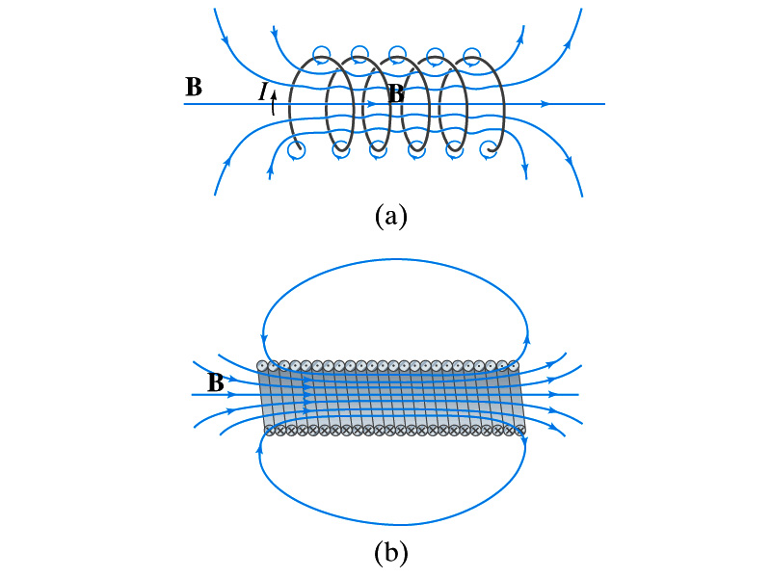
Solenoid and Its Magnetic Field
What is a solenoid?
  A long coil of wire consisting of many loops
  If the space between loops are wide
    The field near the wires are nearly circular
    Between any two wires, the fields due to each loop cancel
    Toward the center of the solenoid, the fields add up to give a field that can be fairly large and uniform
  For a long, densely packed loops
    The field is nearly uniform and parallel to the solenoid axes within the entire cross section
    The field outside the solenoid is very small compared to the field inside, except the ends
      The same number of field lines spread out to an open space
Solenoid Axis

Slide 4
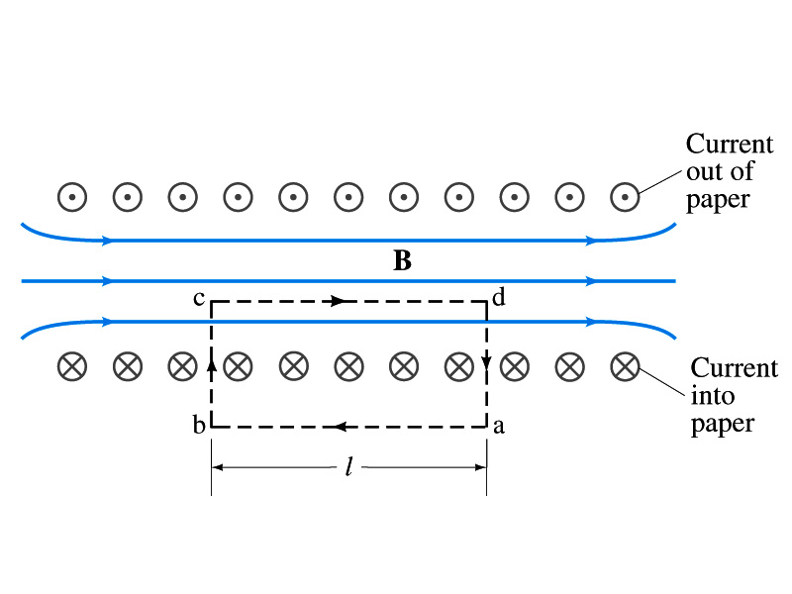
Solenoid Magnetic Field
Now let’s use Ampere’s law to determine the magnetic field inside a very long, densely packed solenoid
Let’s choose the path abcd, far away from the ends
  We can consider four segments of the loop for integral
  The field outside the solenoid is negligible. So the integral on a→b is 0.
  Now the field B is perpendicular to the bc and da segments. So these integrals become 0, also.

Slide 5
Solenoid Magnetic Field
  So the sum becomes:
  If the current I flows in the wire of the solenoid, the total current enclosed by the closed path is NI
    Where N is the number of loops (or turns of the coil) enclosed
  Thus Ampere’s law gives us
  If we let n=N/l be the number of loops per unit length, the magnitude of the magnetic field within the solenoid becomes
    B depends on the number of loops per unit length, n, and the current I
      Does not depend on the position within the solenoid but uniform inside it, like a bar magnet

Slide 6
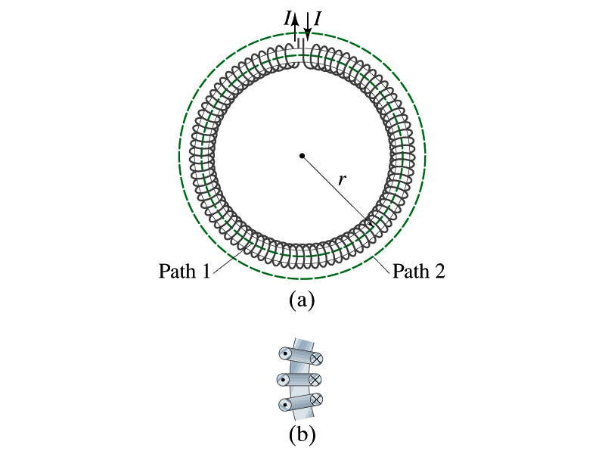
Example 28 – 10
Toroid. Use Ampere’s law to determine the magnetic field (a) inside and (b) outside a toroid, which is like a solenoid bent into the shape of a circle.
(a) How do you think the magnetic field lines inside the toroid look?
Since it is a bent solenoid, it should be a circle concentric with the toroid.
If we choose path of integration one of these field lines of radius r inside the toroid, path 1, to use the symmetry of the situation, making B the same at all points on the path, we obtain from Ampere’s law
Solving for B
So the magnetic field inside a toroid is not uniform. It is larger on the inner edge. However, the field will be uniform if the radius is large and the toroid is thin. The filed in this case is B = μ₀nI.
(b) Outside the solenoid, the field is 0 since the net enclosed current is 0.

Slide 7
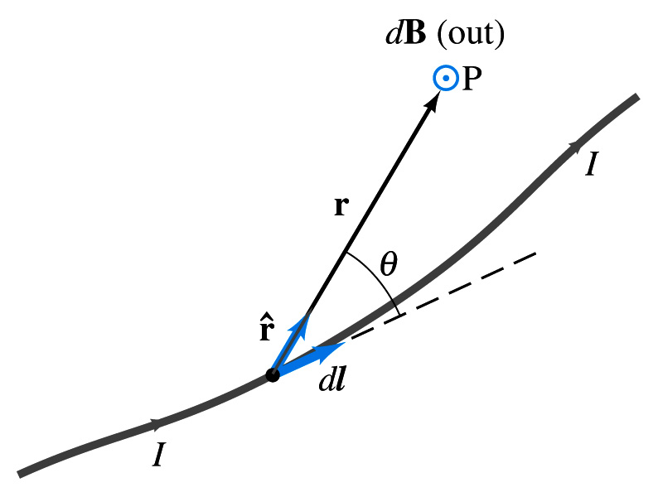
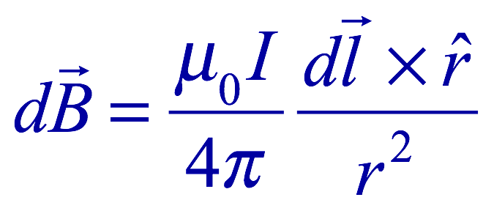
Biot-Savart Law
Ampere’s law is useful in determining magnetic field utilizing symmetry
But sometimes it is useful to have another method of using infinitesimal current segments for B field
  Jean Baptiste Biot and Feilx Savart developed a law that a current I flowing in any path can be considered as many infinitesimal current elements
  The infinitesimal magnetic field dB caused by the infinitesimal length dl that carries current I is
    r is the displacement vector from the element dl to the point P
    Biot-Savart law is the magnetic equivalent to Coulomb’s law
Biot-Savart Law
B field in Biot-Savart law is only that by the current, nothing else.

Slide 8
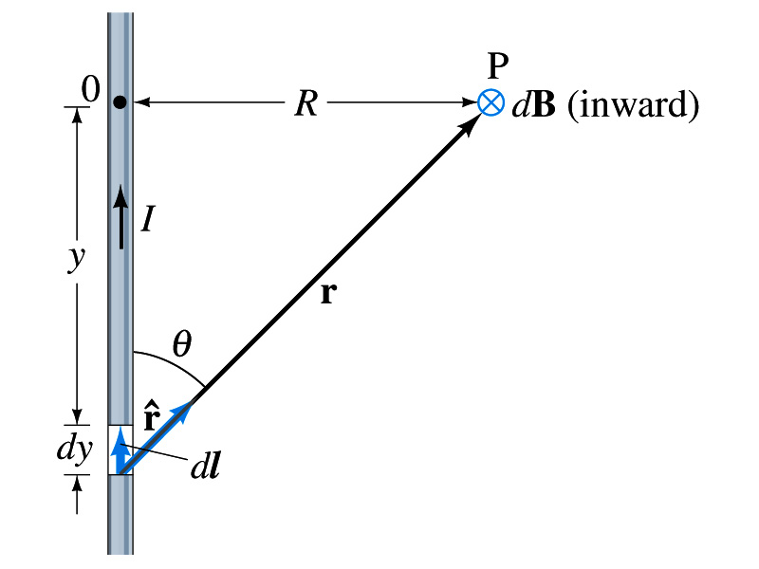
Example 28 – 11
B due to current I in a straight wire. For the field near a long straight wire carrying a current I, show that the Biot-Savarat law gives the same result as the simple long straight wire, B=μ₀I/2πR.
What is the direction of the field B at point P?
Going into the page.
All dB at point P has the same direction based on right-hand rule.
The magnitude of B using Biot-Savart law is
Where dy=dl and r²=R²+y² and since we obtain
Integral becomes
The same as the simple, long straight wire!! It works!!

Slide 9
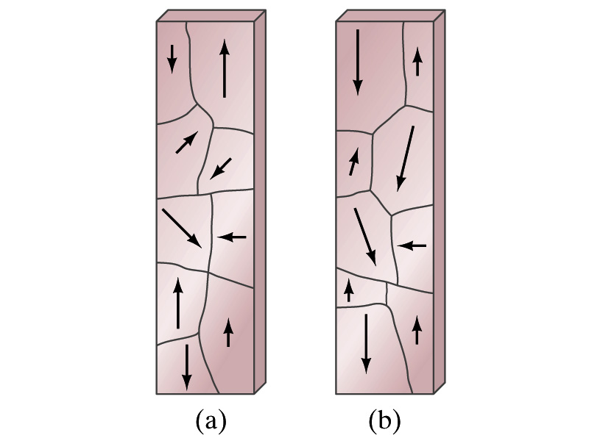
Magnetic Materials - Ferromagnetism
Iron is a material that can turn into a strong magnet
  This kind of material is called ferromagnetic material
In microscopic sense, ferromagnetic materials consist of many tiny regions called domains
  Domains are like little magnets usually smaller than 1mm in length or width
What do you think the alignment of domains are like when they are not magnetized?
  Randomly arranged
What if they are magnetized?
  The size of the domains aligned with the external magnetic field direction grows while those of the domains not aligned reduce
  This gives magnetization to the material
How do we demagnetize a bar magnet?
  Hit the magnet hard or heat it over the Curie temperature

Slide 10
B in Magnetic Materials
What is the magnetic field inside a solenoid?
  Magnetic field in a long solenoid is directly proportional to the current.
  This is valid only if air is inside the coil
What do you think will happen to B if we have something other than the air inside the solenoid?
  It will be increased dramatically, when the current flows
    Especially if a ferromagnetic material such as an iron is put inside, the field could increase by several orders of magnitude
Why?
  Since the domains in the iron aligns permanently by the external field.
  The resulting magnetic field is the sum of that due to current and due to the iron

Slide 11
B in Magnetic Materials
It is sometimes convenient to write the total field as the sum of two terms
  B₀ is the field due only to the current in the wire, namely the external field
    The field that would be present without a ferromagnetic material
  B_{M} is the additional field due to the ferromagnetic material itself; often B_{M}>>B₀
The total field in this case can be written by replacing μ₀ with another proportionality constant μ, the magnetic permeability of the material
  μ is a property of a magnetic material
  μ is not a constant but varies with the external field

Slide 12
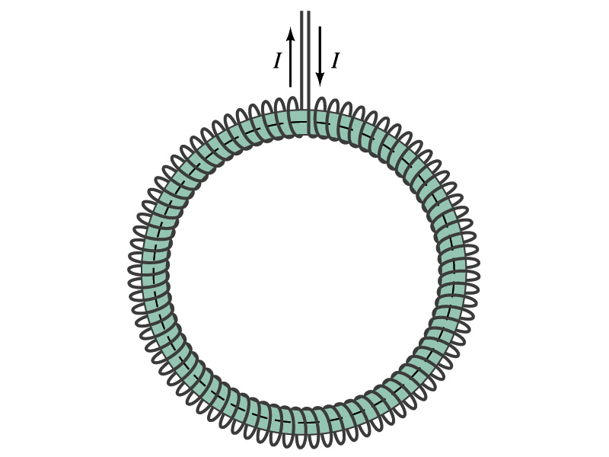
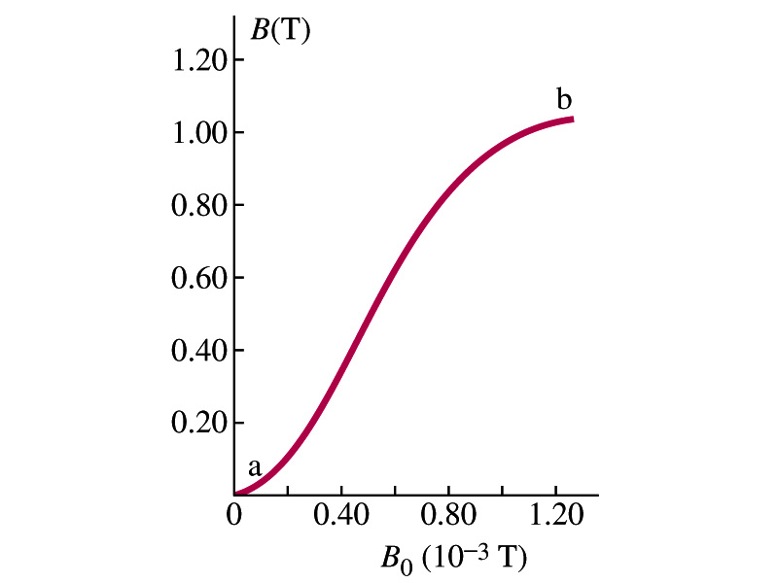
Hysteresis
Iron Core Toroid
What is a toroid?
  A solenoid bent into a shape
Toroid can be used for magnetic field measurement
  Why?
  Since it does not leak magnetic field outside of itself, it fully contains all the magnetic field created within it.
Consider an un-magnetized iron core toroid, without any current flowing in the wire
  What do you think will happen if the current slowly increases?
  B₀ increases linearly with the current.
  And B increases also but follows the curved line shown in the graph
  As B₀ increases, the domains become more aligned until nearly all are aligned (point b on the graph)
    The iron is said to be approaching saturation
    Point b is typically at 70% of the max

Slide 13
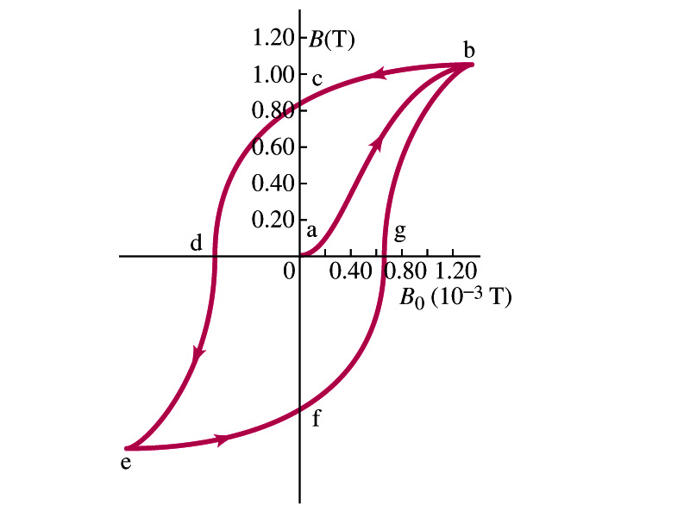
Hysteresis
What do you think will happen to B if the external field B₀ is reduced to 0 by decreasing the current in the coil?
  Of course it goes to 0!!
  Wrong! Wrong! Wrong! They do not go to 0. Why not?
  The domains do not completely return to random alignment state
Now if the current direction is reversed, the external magnetic field direction is reversed, causing the total field B pass 0, and the direction reverses to the opposite side
  If the current is reversed again, the total field B will increase but never goes through the origin
This kind of curve whose path does not retrace themselves and does not go through the origin is called the Hysteresis.

Slide 14
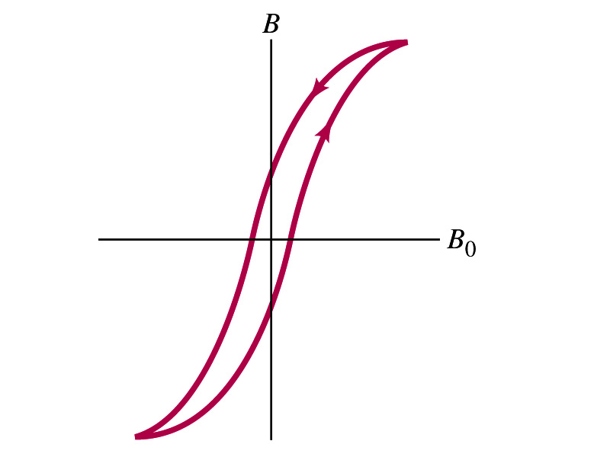
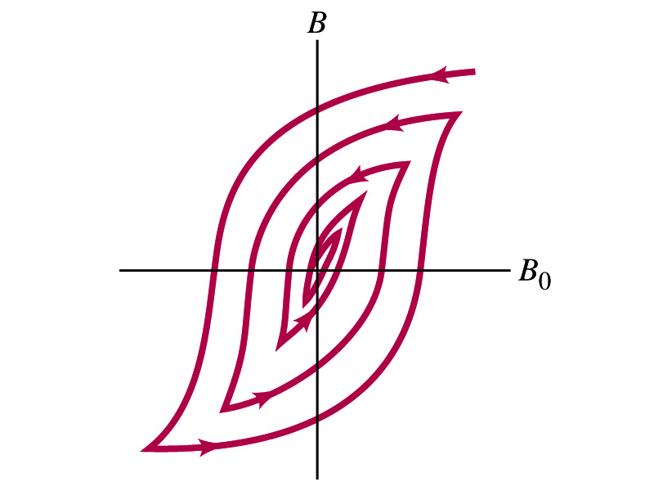
Magnetically Soft Material
In a hysteresis cycle, much energy is transformed to thermal energy. Why?
  Due to the microscopic friction between domains as they change directions to align with the external field
The energy dissipated in the hysteresis cycle is proportional to the area of the hysteresis loop
Ferromagnetic material with s large hysteresis area is called magnetically hard while the small ones are called soft
  Which one do you think are preferred in electromagnets or transformers?
    Soft. Why?
    Since the energy loss is small and much easier to switch off the field
Then how do we demagnetize a ferromagnetic material?
  Keep repeating the Hysteresis loop, reducing the range of B₀.

Slide 15
Induced EMF
It has been discovered by Oersted and company in early 19th century that
  Magnetic field can be produced by the electric current
  Magnetic field can exert force on the electric charge
So if you were scientists at that time, what would you wonder?
  Yes, you are absolutely right! You would wonder if the magnetic field can create the electric current.
  An American scientist Joseph Henry and an English scientist Michael Faraday independently found that it was possible
    Though, Faraday was given the credit since he published his work before Henry did
      He also did a lot of detailed studies on magnetic induction

Slide 16
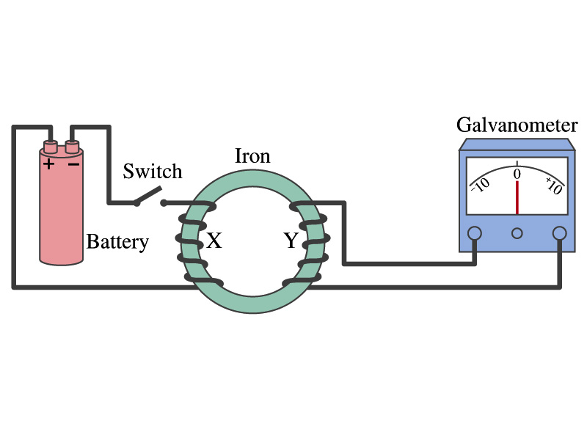
Electromagnetic Induction
Faraday used an apparatus below to show that magnetic field can induce current
Despite his hope he did not see steady current induced on the other side when the switch is thrown
But he did see that the needle on the Galvanometer turns strongly when the switch is initially thrown and is opened
  When the magnetic field through coil Y changes, a current flows as if there were a source of emf
Thus he concluded that an induced emf is produced by a changing magnetic field ➔ Electromagnetic Induction

