Slide 1
PHYS 1441 – Section 001
Lecture #21
Monday, Nov. 27, 2017
Dr. Jaehoon Yu
Chapter 29:EM Induction & Faraday’s Law
  Induced EMF and EM Induction
  Faraday’s Law of Induction
  Lenz’s Law
  Generation of Electricity
  Transformer
Today’s homework is homework #12, due 11pm, Monday, Dec. 4!!

Slide 2
Announcements
Bring your planetarium extra credit sheet by the beginning of the class this Wednesday, Nov. 29!
  Be sure to tape one end of the ticket stub on a sheet of paper with your name on it
Term 2 results
  Class average: 68.3/96
  Equivalent to 74.2/100
    Previous exams: 51/100 and 71/100
  Top score:94/96
Quiz #4
  This Wednesday, Nov. 29 at the beginning of the class
  Covers CH28.4 through what we finish Monday, Nov. 27
  BYOF
Final exam
  Date and time: 11am, Monday, Dec. 11 in class
  Comprehensive exam: covers CH21.1 through what we fisish next Wednesday, Dec. 6
  BYOF

Slide 3
Induced EMF
It has been discovered by Oersted and company in early 19th century that
  Magnetic field can be produced by the electric current
  Magnetic field can exert force on the electric charge
So if you were scientists at that time, what would you wonder?
  Yes, you are absolutely right! You would wonder if the magnetic field can create the electric current.
  An American scientist Joseph Henry and an English scientist Michael Faraday independently found that it was possible
    Though, Faraday was given the credit since he published his work before Henry did
      He also did a lot of detailed studies on magnetic induction

Slide 4
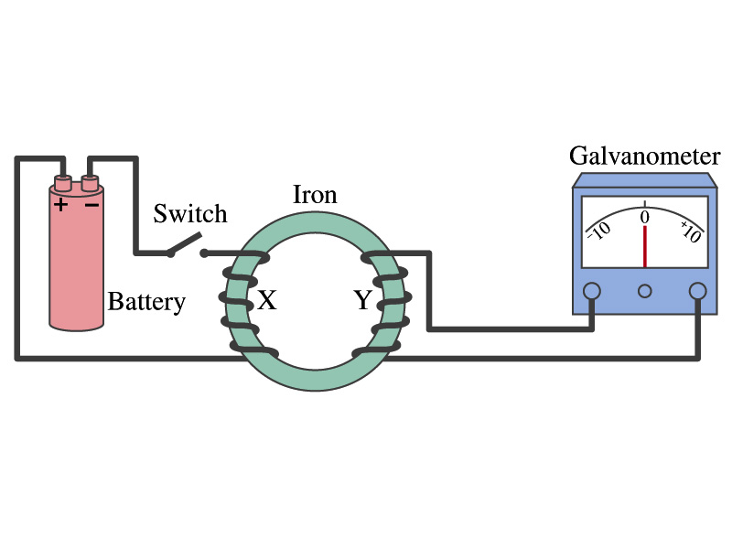
Electromagnetic Induction
Faraday used an apparatus below to show that magnetic field can induce current
Despite his hope he did not see steady current induced on the other side when the switch is thrown
But he did see that the needle on the Galvanometer turns strongly when the switch is initially thrown and is opened
  When the magnetic field through coil Y changes, a current flows as if there were a source of emf
Thus he concluded that an induced emf is produced by a changing magnetic field ➔ Electromagnetic Induction

Slide 5
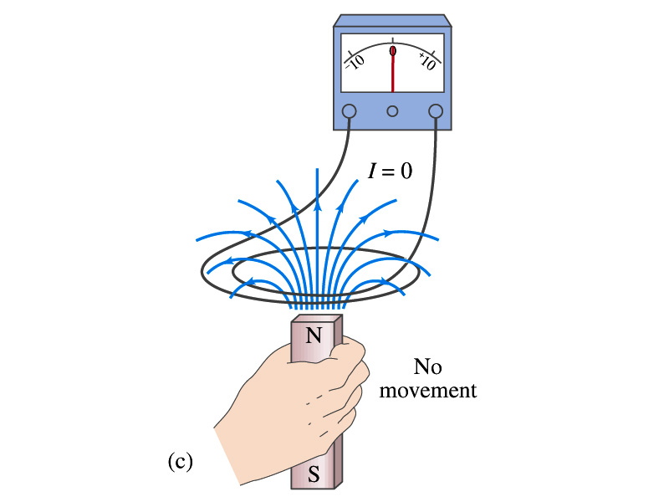
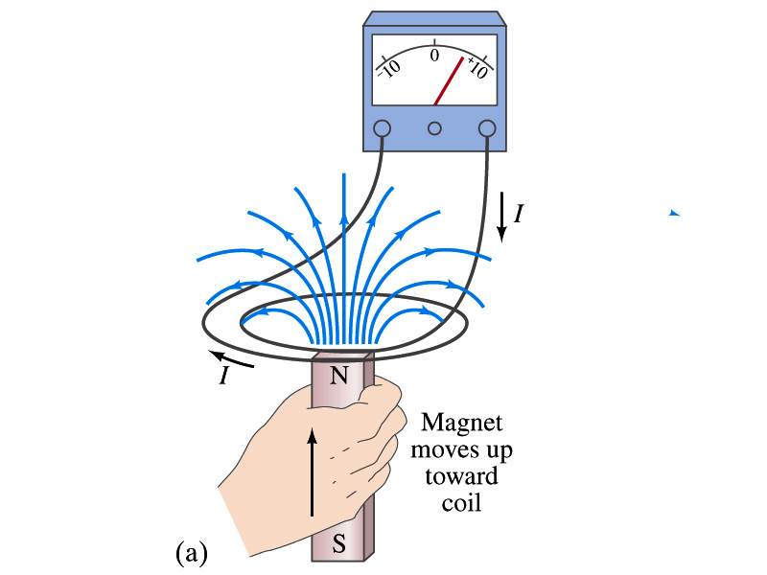
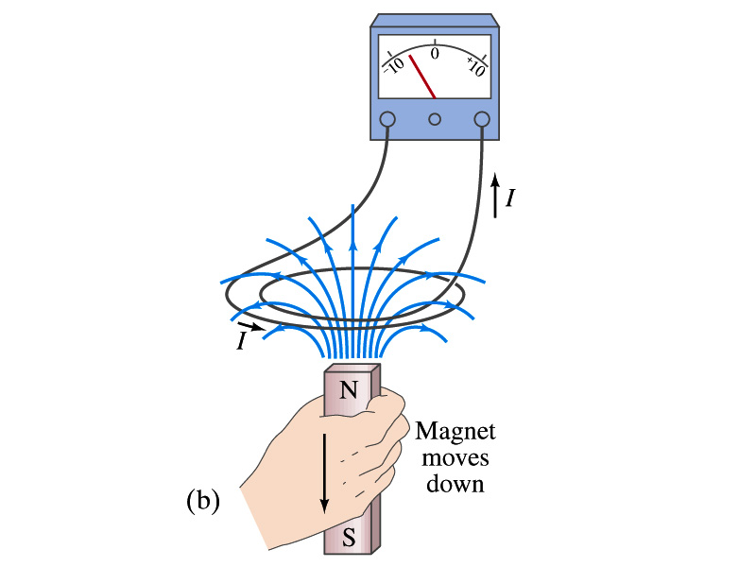
Electromagnetic Induction
Further studies on electromagnetic induction taught
  If a magnet is moved quickly into a coil of wire, a current is induced in the wire.
  If a magnet is removed from the coil, a current is induced in the wire in the opposite direction
  By the same token, the current can also be induced if the magnet stays put but the coil moves toward or away from the magnet
  Current is also induced if the coil rotates.
In other words, it does not matter whether the magnet or the coil moves. It is the relative motion that counts.

Slide 6
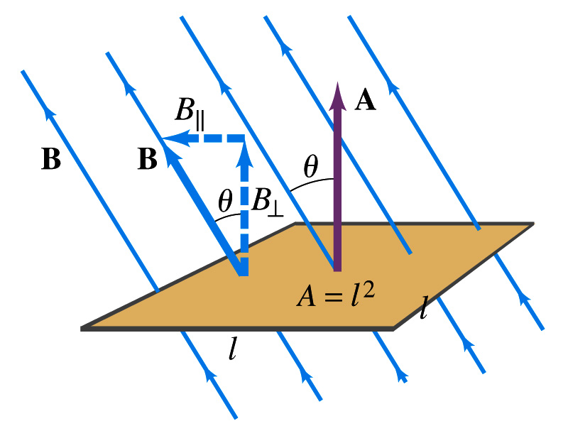
Magnetic Flux
So what do you think is the induced emf proportional to?
  The rate of changes of the magnetic field?
    the higher the changes the higher the induction
  Not really, it rather depends on the rate of change of the magnetic flux, Φ_{B}.
  Magnetic flux is defined as (just like the electric flux)
    θ is the angle between B and the area vector A whose direction is perpendicular to the face of the loop based on the right-hand rule
  What kind of quantity is the magnetic flux?
    Scalar. Unit?
    or weber
If the area of the loop is not simple or B is not uniform, the magnetic flux can be written as

Slide 7
Faraday’s Law of Induction
In terms of magnetic flux, we can formulate Faraday’s findings
  The emf induced in a circuit is equal to the rate of change of magnetic flux through the circuit
If the circuit contains N closely wrapped loops, the total induced emf is the sum of emf induced in each loop
  Why negative?
    Has got a lot to do with the direction of induced emf…
Faraday’s Law of Induction

Slide 8
Lenz’s Law
It is experimentally found that
  An induced emf gives rise to the current whose magnetic field opposes the original change in flux ➔ This is known as Lenz’s Law
  In other words, an induced emf is always in the direction that opposes the original change in flux that caused it.
  We can use Lenz’s law to explain the following cases in the figures
    When the magnet is moving into the coil
      Since the external flux increases, the field inside the coil takes the opposite direction to minimize the change and causes the current to flow clockwise
    When the magnet is moving out
      Since the external flux decreases, the field inside the coil takes the opposite direction to compensate the loss, causing the current to flow counter-clockwise
Which law is Lenz’s law result of?
  Energy conservation. Why?

Slide 9
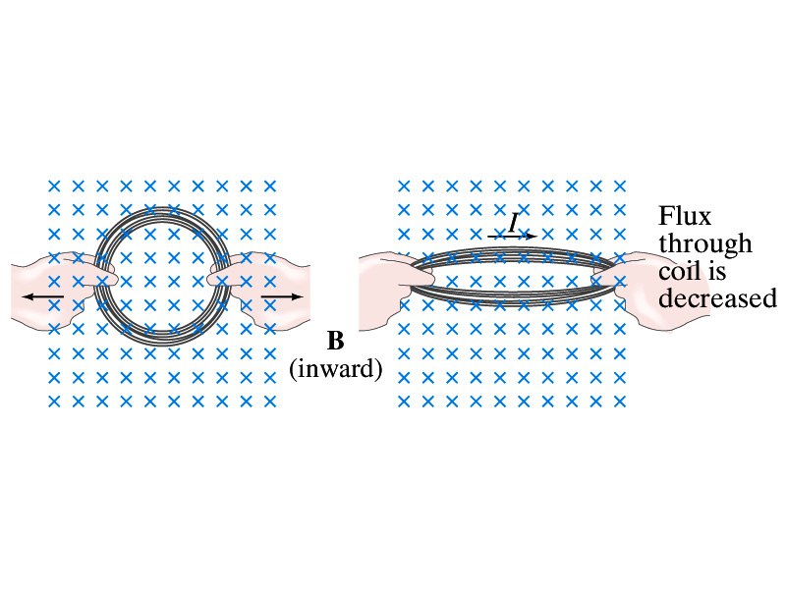
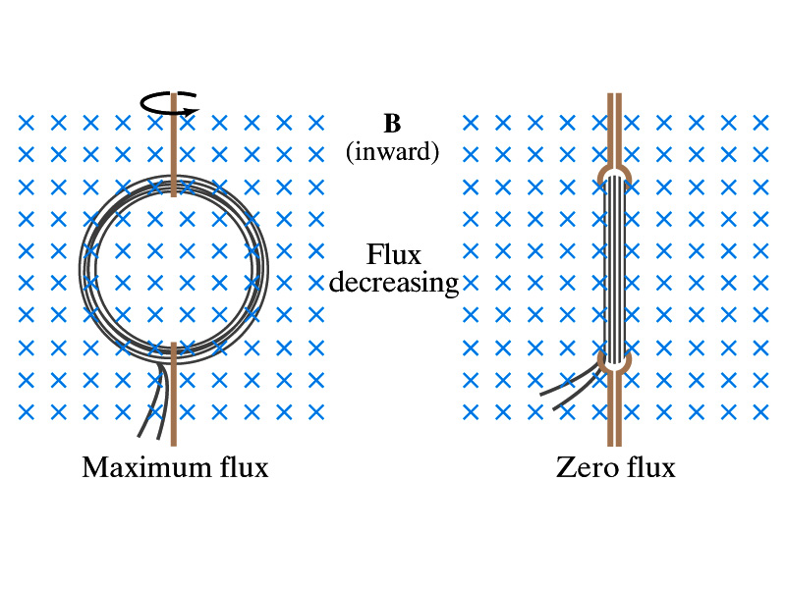
Induction of EMF
How can we induce emf?
Let’s look at the formula for the magnetic flux
What do you see? What are the things that can change with time to result in change of magnetic flux?
  Magnetic field
  The area of the loop
  The angle θ between the field and the area vector

Slide 10
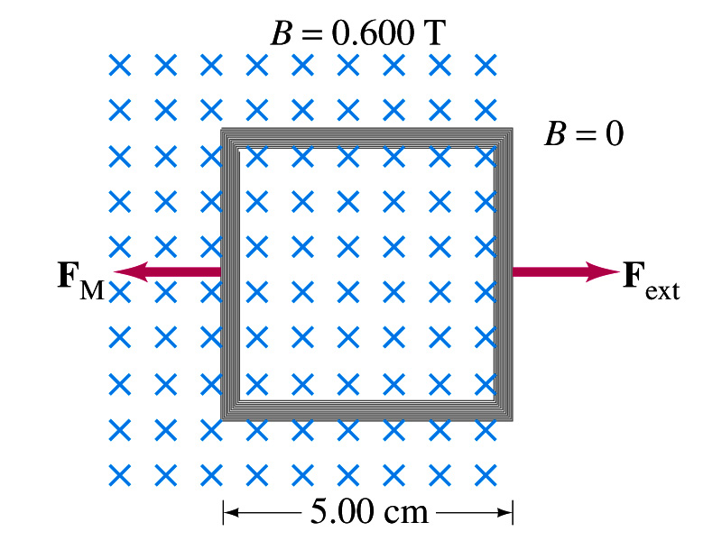
Example 29 – 5
Pulling a coil from a magnetic field. A square coil of wire with side 5.00cm contains 100 loops and is positioned perpendicular to a uniform 0.600-T magnetic field. It is quickly and uniformly pulled from the field (moving perpendicular to B) to a region where B drops abruptly to zero. At t=0, the right edge of the coil is at the edge of the field. It takes 0.100s for the whole coil to reach the field-free
region. Find (a) the rate of change in flux through the coil, (b) the emf and the current induced, and (c) how much energy is dissipated in the coil if its resistance is 100Ω. (d) what was the average force required?
What should be computed first?
The initial flux at t=0.
The flux at t=0 is
The change of flux is
Thus the rate of change of the flux is

Slide 11
Example 29 – 5, cnt’d
Thus the total emf induced in this period is
The induced current in this period is
Which direction would the induced current flow?
Clockwise
The total energy dissipated is
Force for each coil is
Force for N coil is

Slide 12
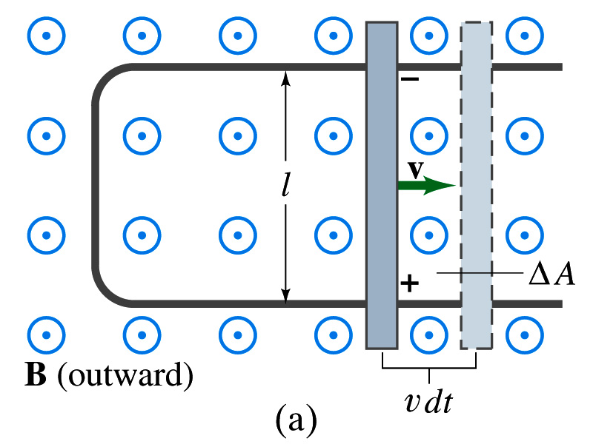
EMF Induced on a Moving Conductor
Another way of inducing emf is using a U shaped conductor with a movable rod resting on it.
As the rod moves at a speed v, it travels vdt in time dt, changing the area of the loop by dA=lvdt.
Using Faraday’s law, the induced emf for this loop is
  This equation is valid as long as B, l and v are perpendicular to each other. What do we do if not?
    Use the scalar product of vector quantities
An emf induced on a conductor moving in a magnetic field is called a motional emf

Slide 13
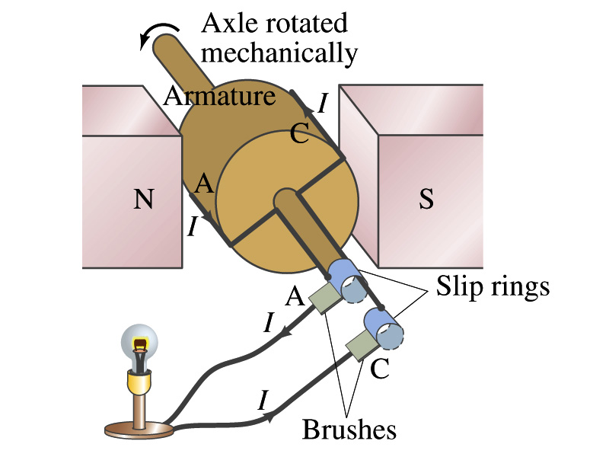
Electric Generators
What does a generator do?
  Transforms mechanical energy into the electrical energy
  What does this look like?
    An inverse of an electric motor which transforms electrical energy to mechanical energy
  An electric generator is also called a dynamo
Whose law does the generator based on?
  Faraday’s law of induction

Slide 14
How does an Electric Generator work?
An electric generator consists of
  Many coils of wires wound on an armature that can rotate by mechanical means in a magnetic field
An emf is induced in the rotating coil
Electric current is the output of a generator
Which direction does the output current flow when the armature rotates counterclockwise?
  The conventional current flows outward on wire A toward the brush
  After half the revolution the wire A will be where the wire C is and the current flow on A is reversed
Thus the current produced is alternating its direction

Slide 15
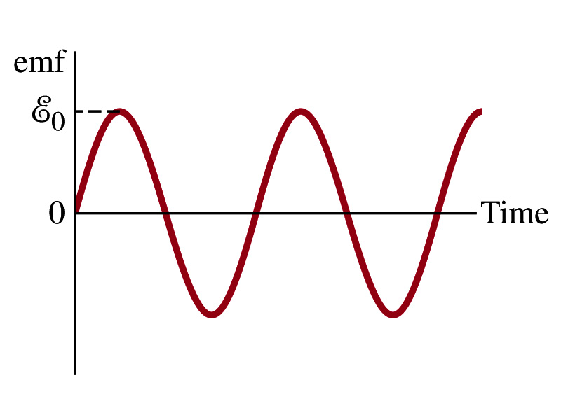

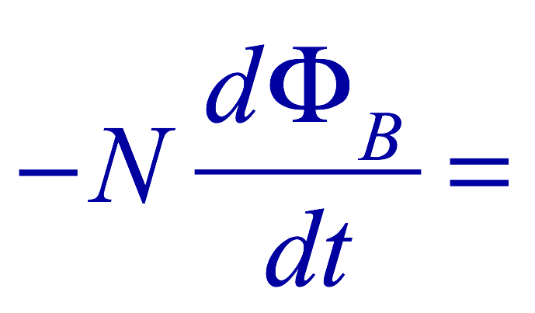

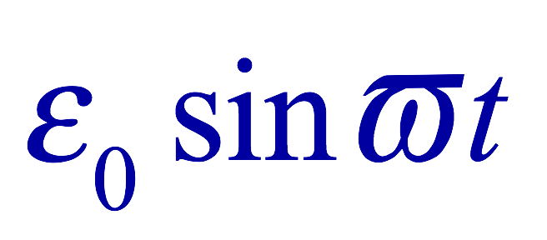
How does an Electric Generator work?
Let’s assume the loop is rotating in a uniform B field w/ a constant angular velocity ω. The induced emf is
What is the variable that changes above?
  The angle θ. What is dθ/dt?
    The angular speed ω.
  So θ=θ₀+ωt
  If we choose θ₀=0, we obtain
  If the coil contains N loops:
  What is the shape of the output?
    Sinusoidal w/ the amplitude ε₀=NBAω
USA frequency is 60Hz. Europe is at 50Hz
  Most the U.S. power is generated at steam plants

Slide 16
Example 29 – 9
An AC generator. The armature of a 60-Hz AC generator rotates in a 0.15-T magnetic field. If the area of the coil is 2.0x10⁻²m², how many loops must the coil contain if the peak output is to be ε₀=170V?
The maximum emf of a generator is
Solving for N
Since
We obtain

Slide 17
US Electricity Sources

Slide 18
US Electric E Consumption by Users
US Energy Information Administration http://www.eia.gov/electricity/

Slide 19
The World Energy Consumption
In 2013, total worldwide energy consumption was 567 EJ (567×10¹⁸ J=157 PWh)➔ expected >1000EJ by 2050
  Equivalent to an average energy consumption rate of 18 terawatts (1.8×10¹³ W)
  US uses 39.1 PWh (1.38kWh/person, as of 2014)
The potential for renewable energy
  solar energy 1600 EJ (444,000 TWh)
  wind power 600 EJ (167,000 TWh)
  geothermal energy 500 EJ (139,000 TWh),
  biomass 250 EJ (70,000 TWh)
  hydropower 50 EJ (14,000 TWh) an
  ocean energy 1 EJ (280 TWh)
  Read this paper if you want to learn more

