Slide 1
PHYS 1441 – Section 002
Lecture #1
Monday, Aug. 27, 2018
Dr. Jaehoon Yu
Who am I?
How is this class organized?
What is Physics?
What do we want from this class?
Brief history of physics
Standards and units
Today’s homework is homework #2, due 11pm, Tuesday, Sept. 4!!

Slide 2
Announcements
Plea to you: Please turn off all your electronic gadgets, including cell-phones, computers, etc
Reading assignment #1: Read and follow through all sections in appendix A by Wednesday, Aug. 29
  A-1 through A-8
There will be a quiz on this and Ch. 21 on Wednesday, Sept. 5.
34/99 registered to homework
  23/34 submitted the homework
  You need my enrollment approval… So move quickly…
  Remember, the deadline for the first homework is 11pm Wednesday, Aug. 29
  You MUST submit the homework to obtain 100% credit!
  Also please be sure to make the payment in time otherwise your access as well as my access to the site for grading is cut.

Slide 3
Who am I?
Name: Dr. Jaehoon Yu (You can call me Dr. Yu)
Office: Rm 342, Chemistry and Physics Building
Extension: x22814, E-mail: jaehoonyu@uta.edu
My profession: High Energy Particle Physics (HEP)
  Collide particles (protons on anti-protons or electrons on anti-electrons, positrons) at the energies equivalent to 10,000 Trillion degrees
  To understand
    Fundamental constituents of matter
    Forces between the constituents (gravitational, electro-magnetic, weak and strong forces)
    Origin of Mass
    Search for Dark Matter and Making of Dark Matter Beams
    Creation of Universe (Big Bang Theory)
  A pure scientific research activity
    Direct use of the fundamental laws we find may take longer than we want but
    Indirect product of research contribute to every day lives; eg. WWW
  Why do we do with this?
    Make our everyday lives better to help us live well as an integral part of the universe

Slide 4
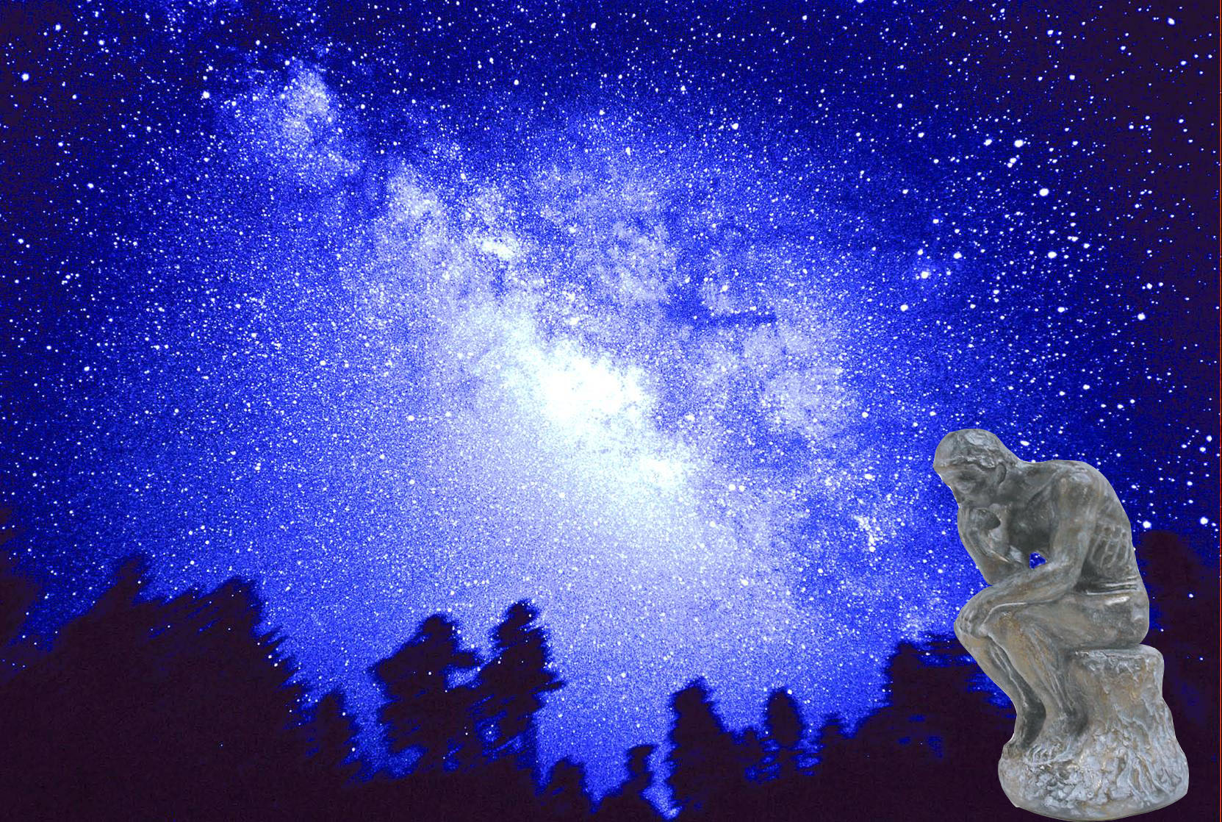

We always wonder…
What makes up the universe?
How does the universe work?
What holds the universe together?
How can we live in the universe well?
Where do we all come from?

Slide 5
High Energy Physics
Definition: A field of physics that pursues understanding the fundamental constituents of matter and basic principles of interactions between them.
Known interactions (forces):
  Gravitational Force
  Electromagnetic Force
  Weak Nuclear Force
  Strong Nuclear Force
Current theory: The Standard Model of Particle Physics

Slide 6
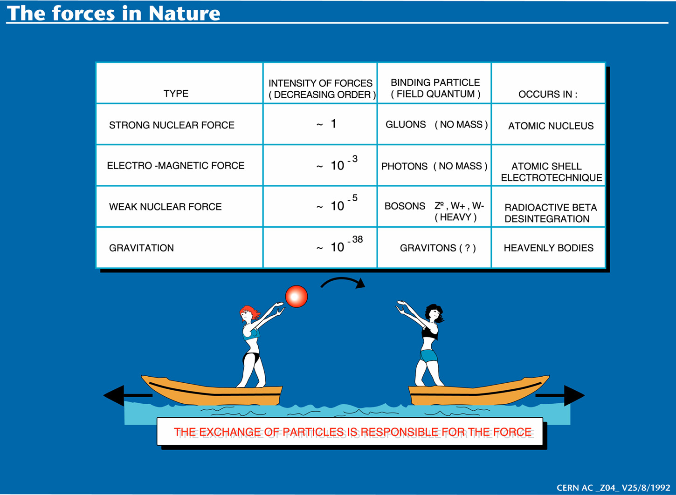

Slide 7
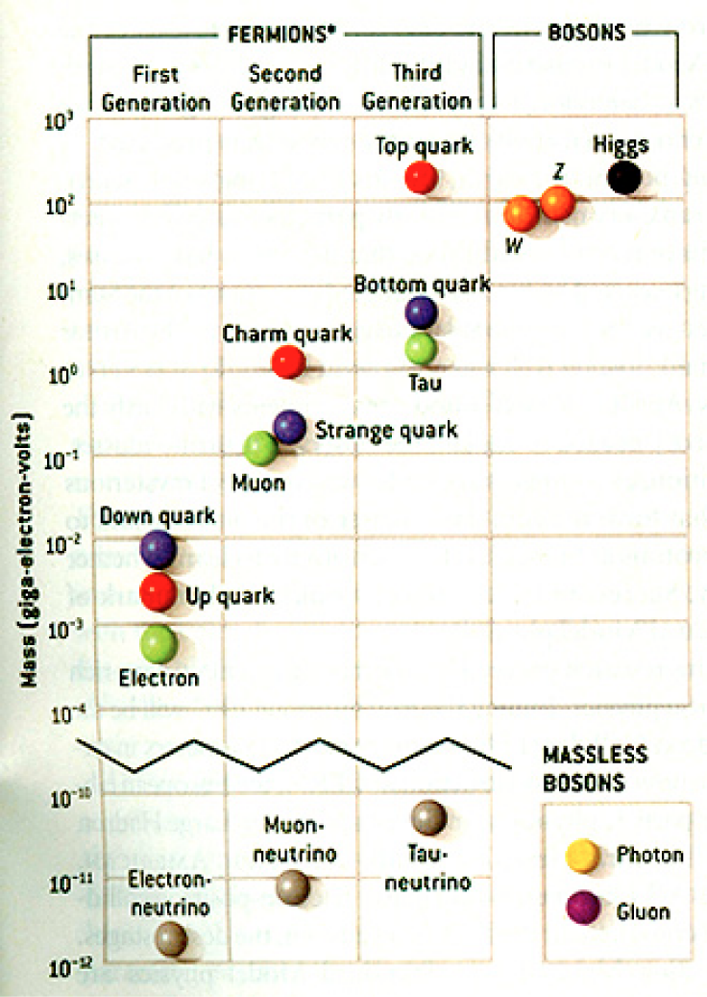
HEP and the Standard Model
Discovered in 1995, ~175m_{p}
Make up most ordinary matters ~0.1m_{p}
Total of 16 particles (12+4 force mediators) make up all the visible matter in the universe! ➔ Simple and elegant!!!
Tested to a precision of 1 part per million!

Slide 8

So what’s the problem?
Why is the mass range so large (0.1m_{p} – 175 m_{p})?
Is the new particle we’ve discovered really the Higgs particle?
Why is the matter in the universe made only of particles?
Neutrinos have mass!! What are the mixing parameters, particle-anti particle asymmetry and mass ordering?
Why are there only four apparent forces?
  Were they all unified at the Big Bang?
Notes:
----- Meeting Notes (2/12/14 10:16) -----

Slide 9
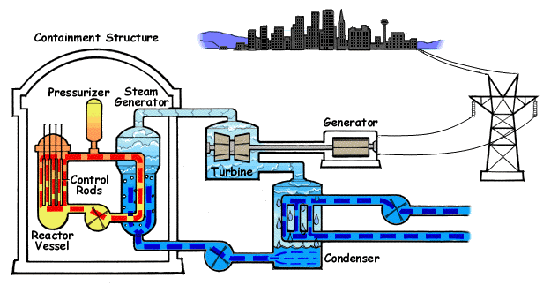
How does a nuclear power plant work?
Duke Energy
My 1000 year dream: Skip the whole thing!
Make electricity directly from nuclear force!

Slide 10
So what’s the problem?
Why is the mass range so large (0.1m_{p} – 175 m_{p})?
Is the particle we discovered really the Higgs particle?
Why is the matter in the universe made only of particles?
Neutrinos have mass!! What are the mixing parameters, particle-anti particle asymmetry and mass ordering?
Why are there only four apparent forces?
  Were they all unified at the Big Bang?
Is the picture we present the real thing?
Notes:
----- Meeting Notes (2/12/14 10:16) -----

Slide 11
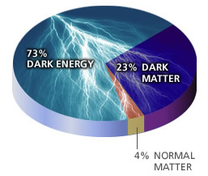
What makes up the universe?
~95% unknown!!
Notes:
----- Meeting Notes (2/12/14 10:16) -----

Slide 12
So what’s the problem?
Why is the mass range so large (0.1m_{p} – 175 m_{p})?
Is the particle we discovered really the Higgs particle?
Why is the matter in the universe made only of particles?
Neutrinos have mass!! What are the mixing parameters, particle-anti particle asymmetry and mass ordering?
Why are there only four apparent forces?
  Were they all unified at the Big Bang?
Is the picture we present the real thing?
  What makes up the remaining ~95% of the universe?
Are there any other particles we don’t know of?
  Big deal for the new LHC Run!
Where do we all come from?
How can we live well in the universe as an integral partner?
Notes:
----- Meeting Notes (2/12/14 10:16) -----

Slide 13
Accelerators are Powerful Microscopes.
They make high energy particle beams
that allow us to see small things.
seen by
low energy beam
(poorer resolution)
seen by
high energy beam
(better resolution)

Slide 14
Accelerators are also Time Machines.
They make particles last seen
in the earliest moments of the universe.
Energy
particle beam
energy
anti-particle beam
energy
Particle and anti-particle annihilate.
E = mc²

Slide 15
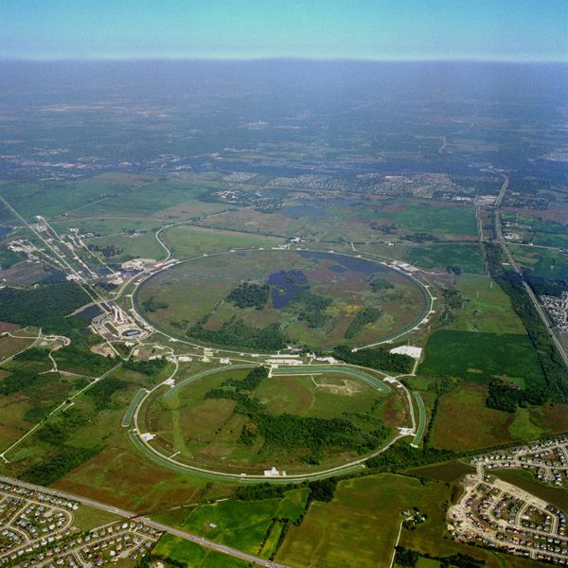
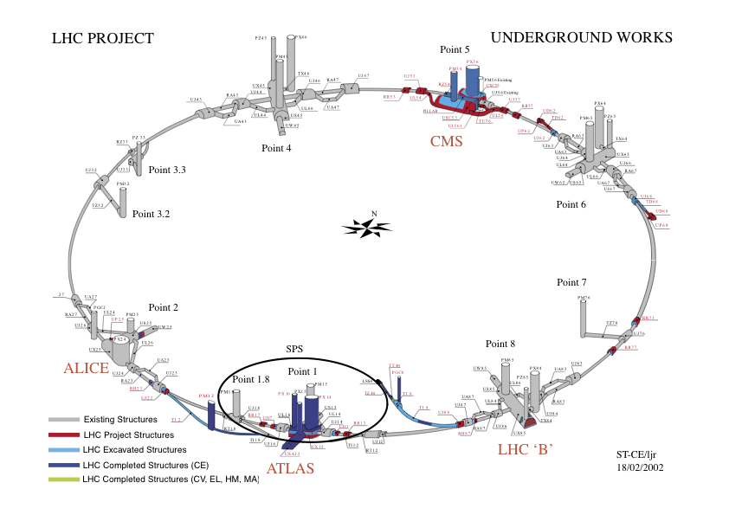
Fermilab Tevatron and LHC at CERN
World’s Highest Energy proton-anti-proton collider
  4km (2.5mi) circumference
  E_{cm}=1.96 TeV (=6.3x10⁻⁷J/p➔ 13M Joules on the area smaller than 10⁻⁴m²)
  Equivalent to the kinetic energy of a 20t truck at the speed 130km/hr
    ~100,000 times the energy density at the ground 0 of the Hiroshima atom bomb
  Tevatron was shut down in 2011
  New frontiers with high intensity proton beams including the search for dark matter with beams!!
World’s Highest Energy p-p collider
  27km (17mi) circumference, 100m (300ft) underground
  Design E_{cm}=14 TeV (=44x10⁻⁷J/p➔ 362M Joules on the area smaller than 10⁻⁴m²)
  Equivalent to the kinetic energy of a B727 (80tons) at the speed 310km/hr
    ~3M times the energy density at the ground 0 of the Hiroshima atom bomb
Discovered a new heavy particle that looks like the Higgs particle (The God Particle) in 2012
Search for new particles ongoing!!
Chicago
CDF
p
DØ
Tevatron
p

Slide 16
What is the Higgs and What does it do?
When there is perfect symmetry, one cannot tell directions!

Slide 17

What? What’s the symmetry?
Where is the head of the table?
Without a broken symmetry, one cannot tell directional information!!

Slide 18
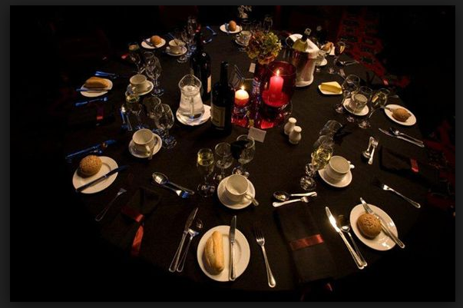
A broken symmetry

Slide 19
What is the Higgs and What does it do?
When there is perfect symmetry, one cannot tell directions!
Only when symmetry is broken, can one tell directions
Higgs field works to break the perfect symmetry and gives mass to all fundamental particles
Sometimes, this field spontaneously generates a particle, the Higgs particle
So the Higgs particle is the evidence of the existence of the Higgs field!

Slide 20



So how does Higgs Field work again?
Person in space ➔ no symmetry breaking
Person in air ➔ symmetry can be broken
Sometimes, you get
Just like the tornado is a piece of evidence of the existence of air, Higgs particle is a piece of evidence of Higgs mechanism

Slide 21
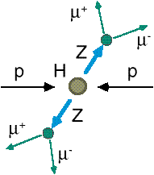
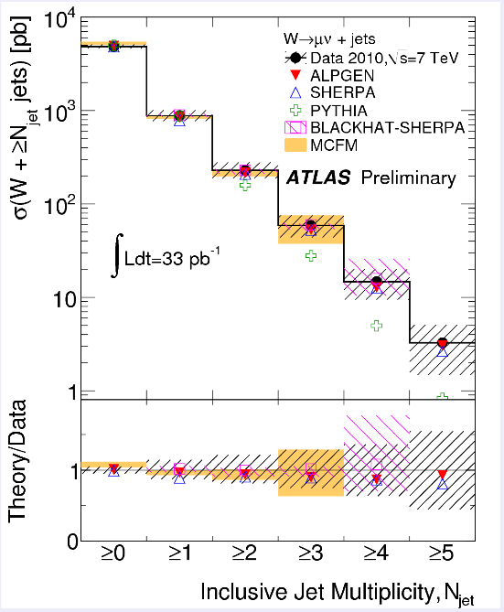
How do we look for the Higgs?
Identify Higgs candidate events
Understand fakes (backgrounds)
Look for a bump!!
  Large amount of data absolutely critical
e⁺ (μ⁺)
e⁻ (μ⁻)
e⁺
e⁻

Slide 22
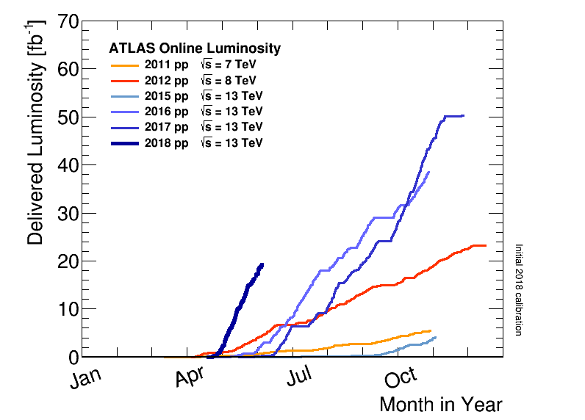
Amount of the LHC Data
Superb performance!!
Total over 150fb⁻¹
2012:21.2fb⁻¹
Total at 7 and 8 TeV ~1fb⁻¹/week
The discovery announcement
2011 5.6 fb⁻¹
at 7 TeV
2010 0.05 fb⁻¹
at 7 TeV

Slide 23

What did statistics do for Higgs?

Slide 24

How about this?

Slide 25
So have we seen the Higgs particle?
The statistical significance of the finding is way over 7 standard deviations

Slide 26
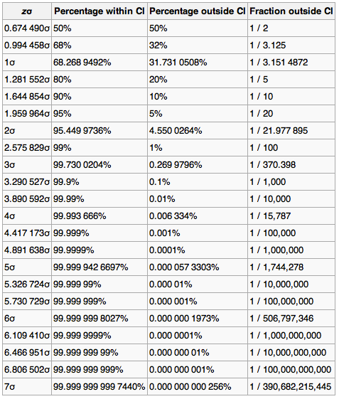
Statistical Significance Table

Slide 27
So have we seen the Higgs particle?
The statistical significance of the finding is much bigger than seven standard deviations
  Level of significance: much better than 99.999 999 999 7% (eleven 9s!!)
  We could be wrong once if we do the same experiment 391,000,000,000 times (will take ~13,000 years even if each experiment takes 1s!!)
So did we find the Higgs particle?
  We have discovered the heaviest new boson we’ve seen thus far
  It has many properties consistent with the Standard Model Higgs particle
    It quacks like a duck and walks like a duck but…
  We sill do not have enough data to precisely measure all the properties – mass, lifetime, the rate at which this particle decays to certain other particles, etc – to definitively determine its nature
Precision measurements and searches in new channels ongoing

Slide 28

Discovery of the God Particle in 2012
2012 God particle discovery

Slide 29
Fermilab Neutrino Program
Fermilab is building high intensity proton beam based neutrino physics facility (LBNF – Long Baseline Neutrino Facility)
  Precision neutrino oscillation properties
    Mass Hierarchy, CP phase, etc
    Supernova detection
  Physics beyond Standard Model
  Search for sterile neutrinos, dark matter, etc
Require capable ND and large mass underground FD w/ a capability for low energy detection, good position resolution, timing resolution and good particle ID
Also a short-baseline neutrino program

Slide 30
Light DM Production at High Intensity Accelerator
The Higgs particle, a part of only 5% of the universe, may’ve been seen
The remaining 95% of the universe must explored further!!

Slide 31
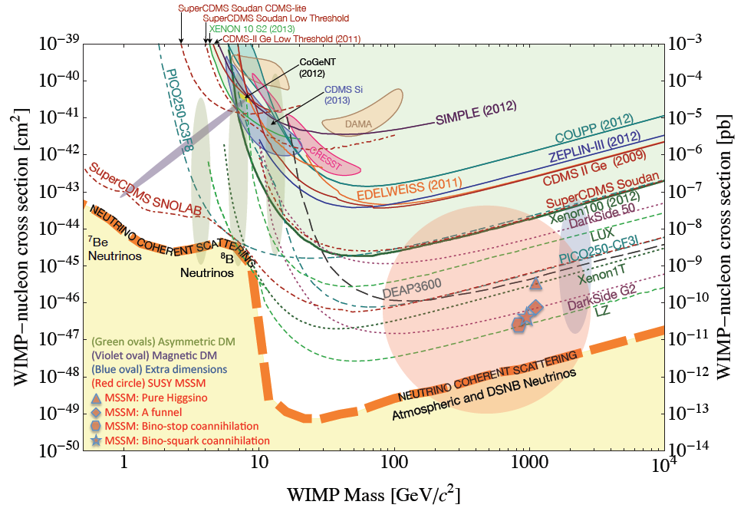
Dark Matter Search Motivation
LHC@CERN
No DM

Slide 32
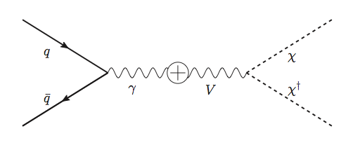
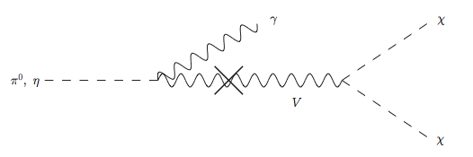
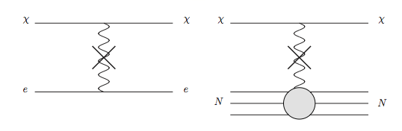
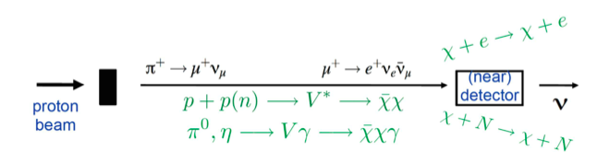
Light DM Production at High Intensity Accelerator
The Higgs particle, a part of only 5% of the universe, may’ve been seen
The remaining 95% of the universe must be explored further!
Detection of DM (elastic):
How does a DM event look in an experiment?:
Minimal model w/ kinetic mixing
Battell et al., PRD80, 095024
Higher E_{P} @ DUNE
Lower E_{P} @ MiniBooNE
High Intensity Proton Beam

Slide 33

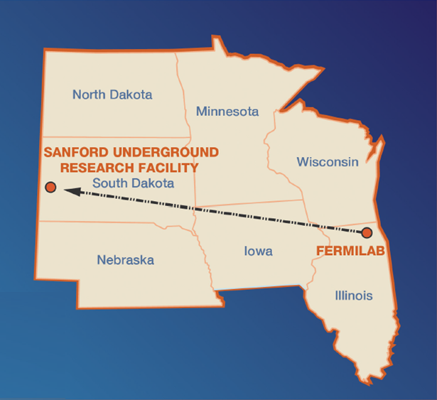
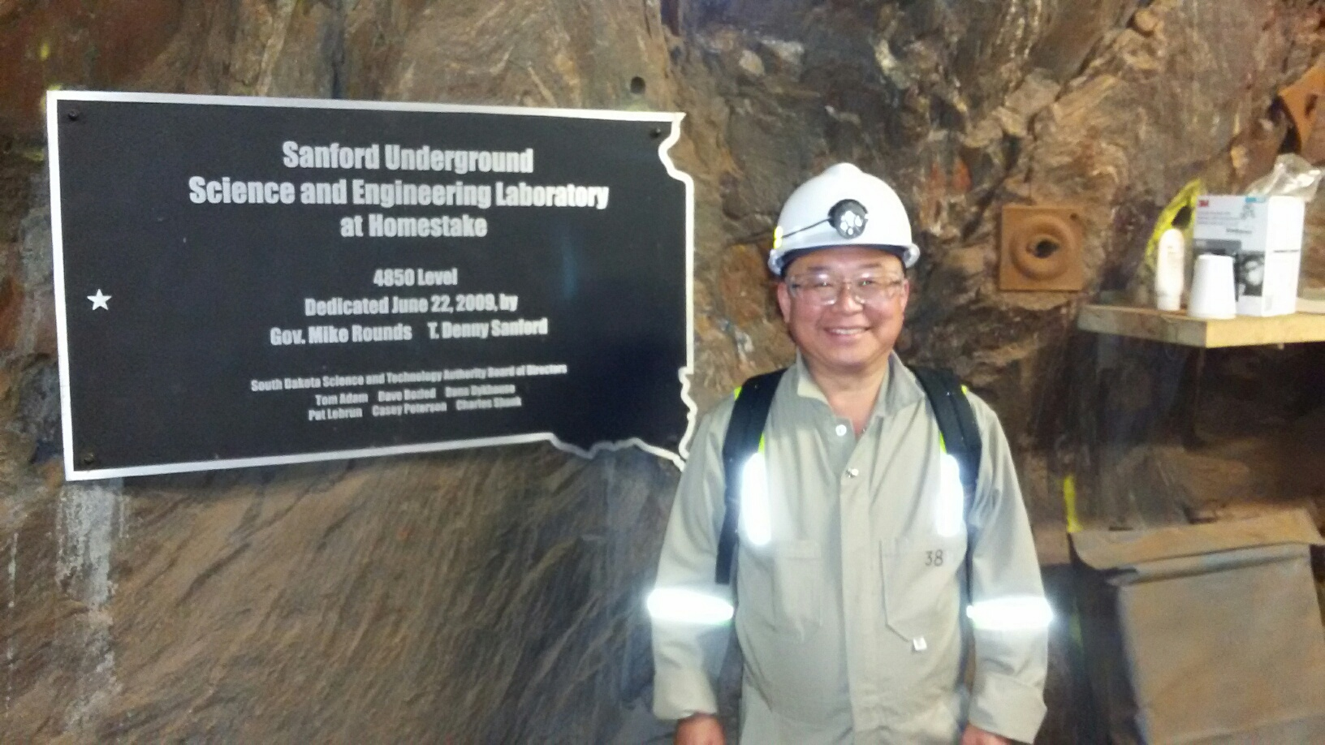
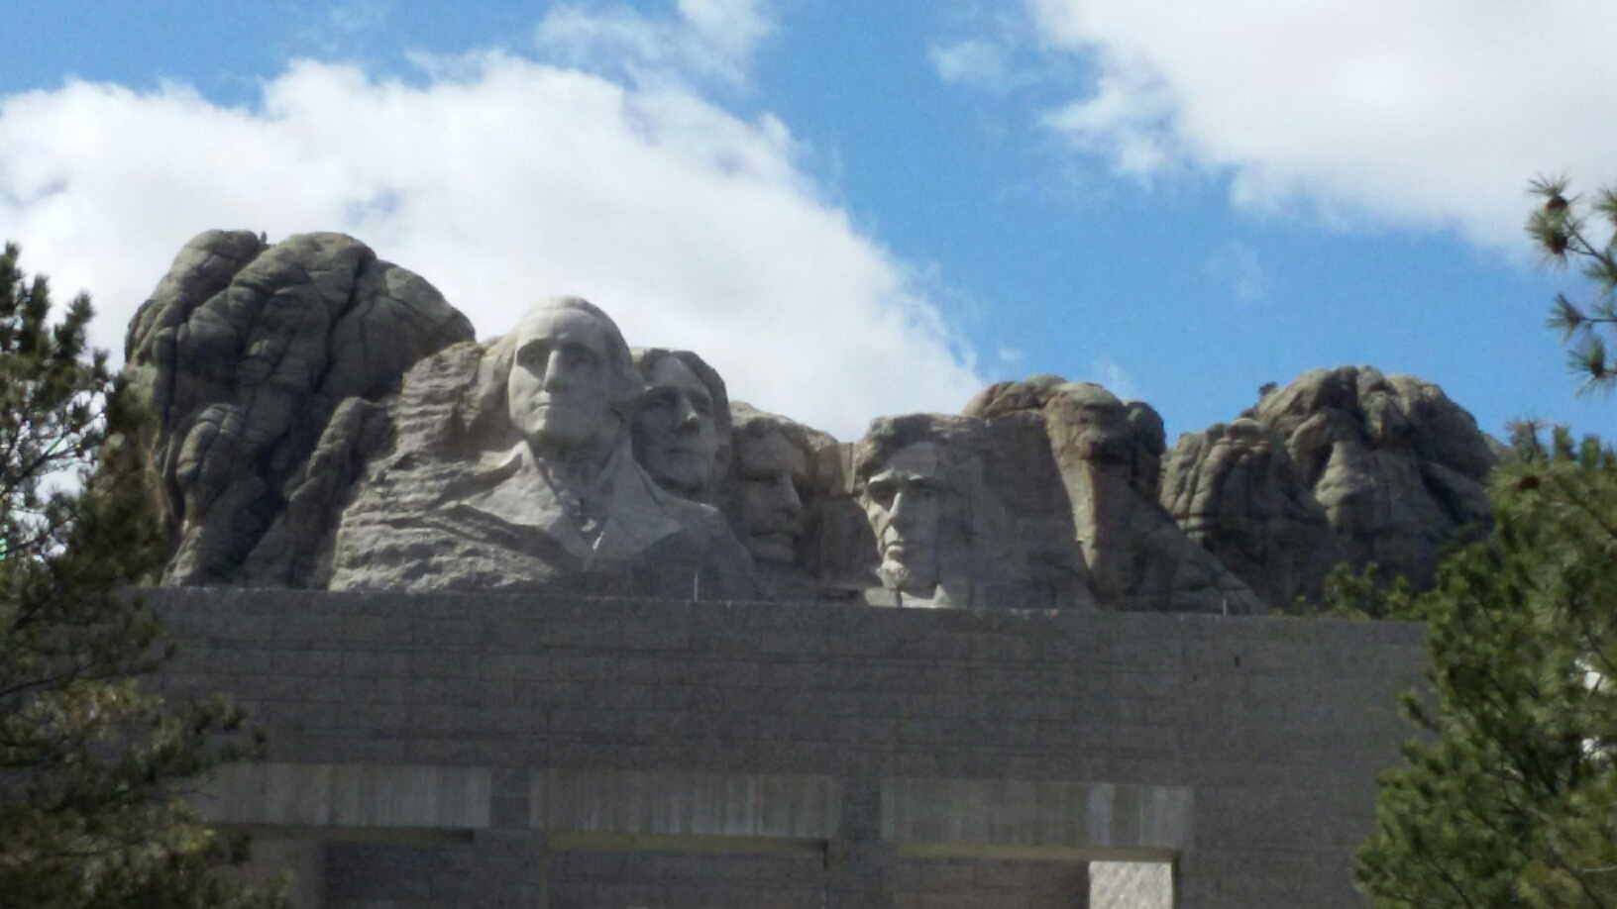
The Next Big Thing - DUNE Experiment
Stands for Deep Under Ground Neutrino Experiment
The flagship long baseline (1300km) ν experiment
  1500m underground in South Dakota
Yes, you are right! Mount Rushmore!!
Nobel Winning Neutrino Discovery by Ray Davis in 1960’s
Many Dark Matter experiments in progress
New DUNE area to be excavated shortly

Slide 34
The Next Big Thing - DUNE Experiment
Stands for Deep Under Ground Neutrino Experiment
The flagship long baseline (1300km -800mi) ν experiment
  1500m underground in an old South Dakota gold mine
With very high intensity proton beams (1.2MW → 2.4MW!)
  Result in large number of neutrinos
  A great potential for DM & other physics beyond the Standard Model
  Food for thoughts! How many 100GeV protons per second do these beam powers correspond to?
Large mass (~80kt! total) LAr Detector at SURF
Powerful near detector
Was born March 2015! A two year old baby!
  Combination of two large proposals – LBNE (US) and LBNO (EU)
1020 collaborators from ~174 institutes in 30 countries

Slide 35
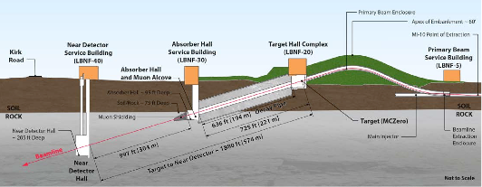
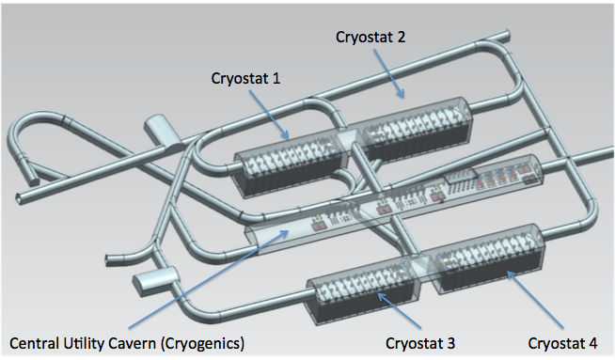
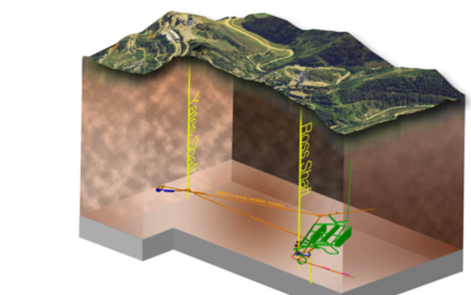
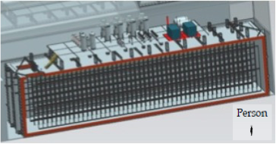
The Components of the DUNE Experiment
1300km (800 miles)
4 caverns with ~20kt total each
1500m underground
15m
66m
15m

Slide 36
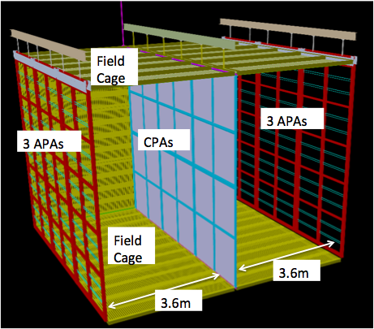
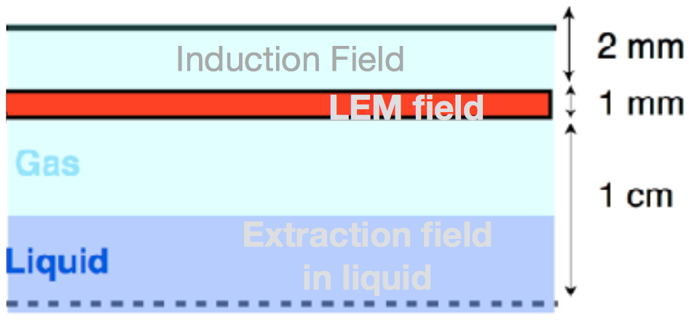

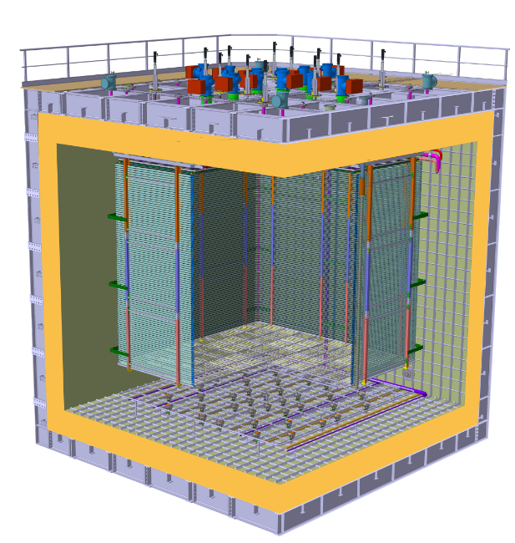

Prototyping the DUNE Experiment
Building four 10kt active volume LAr Detectors very challenging!
Need to understand many aspects of the detector technology
Two full scale prototype detectors under construction at CERN – SP and DP
35T @ FNAL
single phase technology: Interaction & detection in LAr
protoDUNE SP@CERN
6mx6mx6m Active
WA105 3x1x1@CERN
600t
Dual Phase: Interaction in LAr & detection in GAr
6 m
protoDUNE DP@CERN
6mx6mx6m Active
6 m
6 m

Slide 37
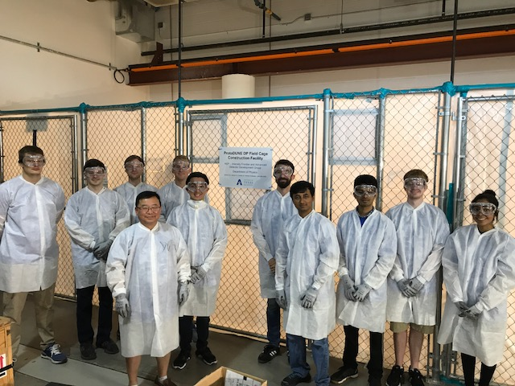
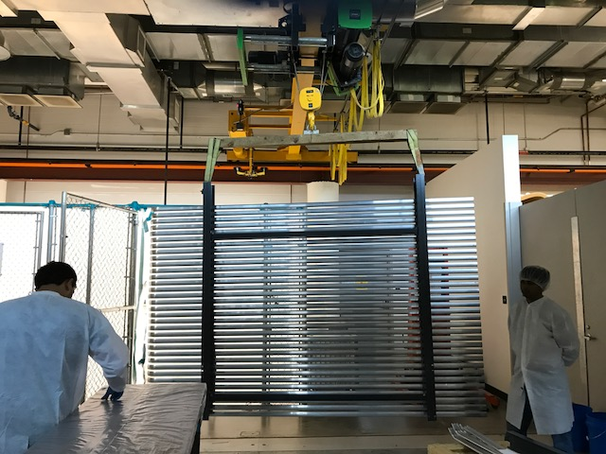
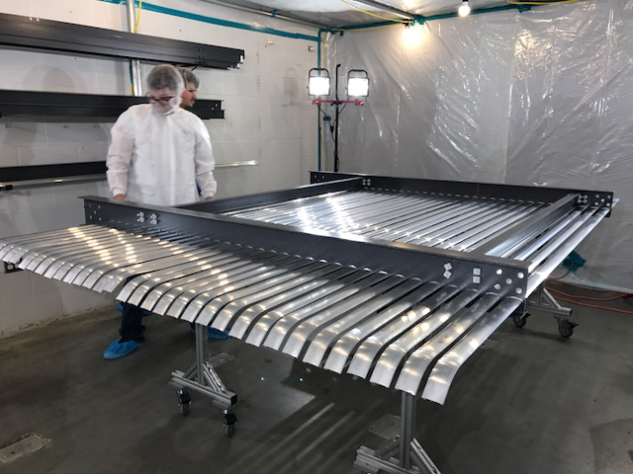
Field Cage Construction!!
Field cage provides a uniform electric field for the ionization electrons to drift toward the collection plane
Modularized design ➔ UTA responsible for ProtoDUNE DP FC

Slide 38
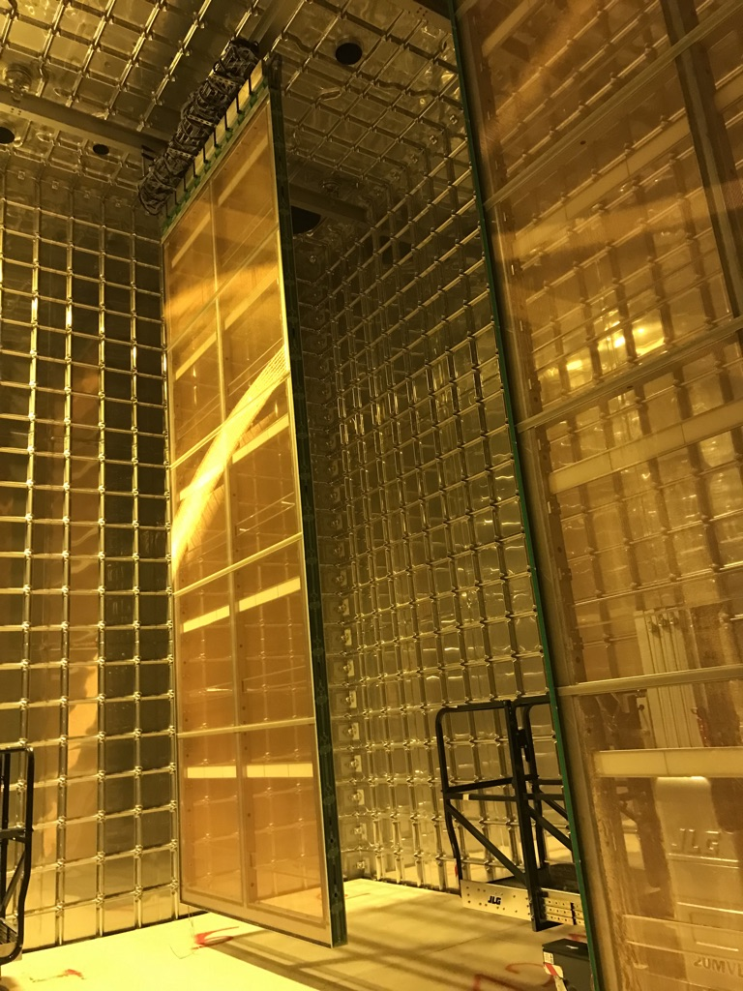
ProtoDUNE Detectors Today
SP ProtoDUNE will have the 6th & final APA in April and closed shut in May with the cooldown and fill following in the summer & Fall 2018
DP ProdoDUNE will have completed FC and CRP’s prepared for close late 2018
6m
6m

Slide 39
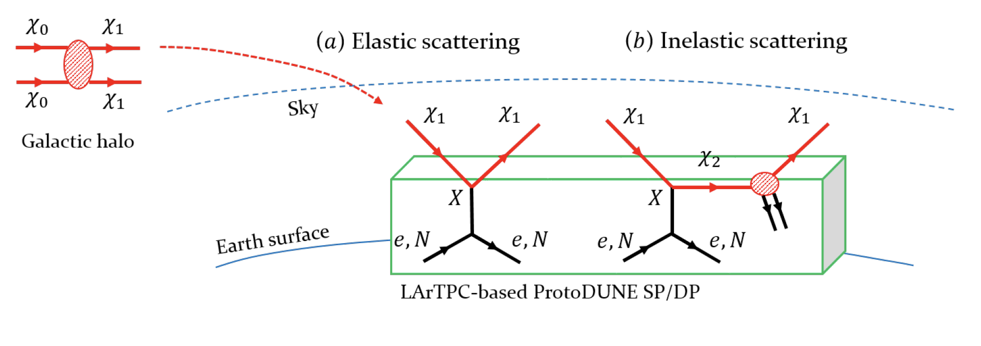
Intermediate Physics w/ ProtoDUNE?
ProtoDUNE detectors have active volume of over 600t total
Potential for searching for relativistic Boosted Dark Matter in its inelastic scattering in the detector ➔ Distinct signature of 3 lepton + missing energy final states helps over the anticipated large background on the surface

Slide 40
Dark Matter Search Motivation
No DM
LHC
DUNE potential

Slide 41
Smart Dark Matter Beam Line!!
A system that uses a string of magnets
We can have a beamline that separates neutrinos and anti-neutrinos from DM’s
Give parent particles of ν’s a magnetic kick to do this separation
Add a dipole after the mesons are fully focused with the 2nd horn
dipole
High Precision Detector
Dark Matter Experiments
p
p, π⁰, χ
Beam Dump
ν target
π⁺⁽⁻⁾, charged mesons
Focusing
horns
Precision Neutrino Experiments
Decay pipe
DUNE detector system

Slide 42
Dark Matter Searches at Fermilab
Fermi National Accelerator Laboratory is turning into a lab with very high intensity accelerator program
UTA group is part of three experiments
  Long Baseline Neutrino Experiment (LBNE), an $850M flagship experiment, with data expected in 2026
    High flux secondary beam and a near detector enables searches for DM
    In addition to precision measurements of key neutrino param.
    UTA playing very significant role in this experiment
A rich physics program for the next 20 – 30 years!!
If we see DM, we could use this to make DM Beam??

Slide 43
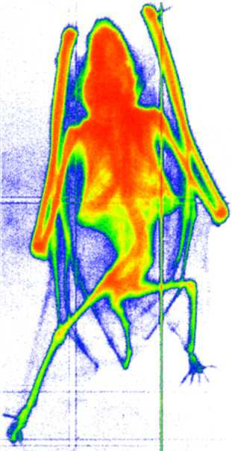
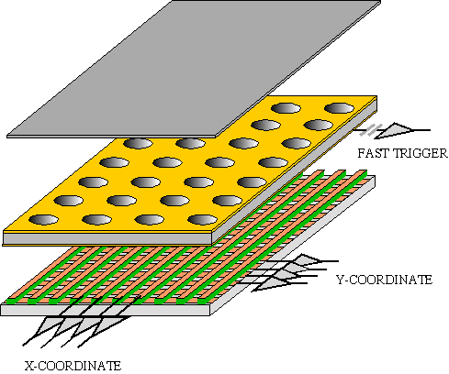
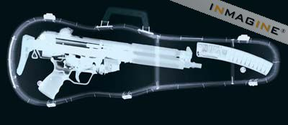
GEM Application Potential
FAST X-RAY IMAGING
Using the lower GEM signal, the readout can be self-triggered with energy discrimination:
9 keV absorption radiography of a small mammal (image size ~ 60 x 30 mm²)
A. Bressan et al,
Nucl. Instr. and Meth. A 425(1999)254
F. Sauli, Nucl. Instr. and Meth.A 461(2001)47

Slide 44
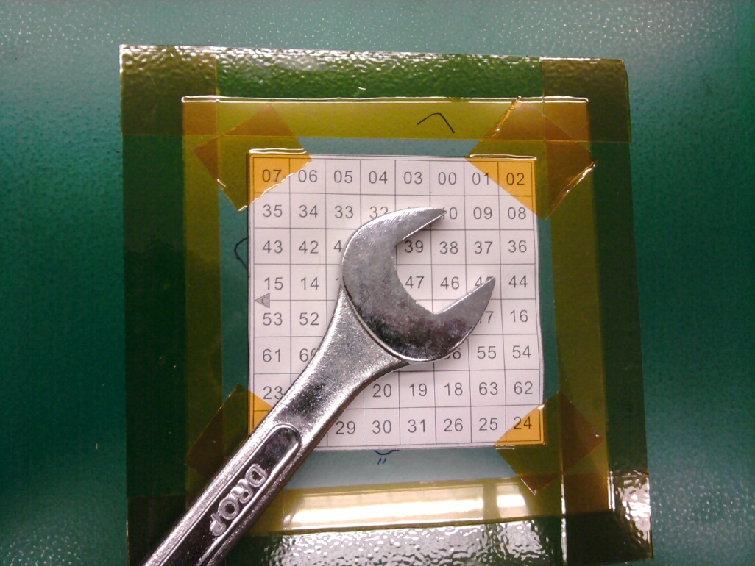
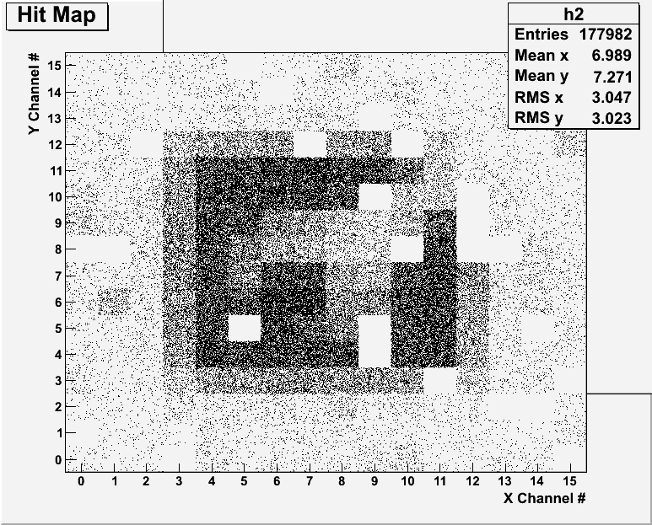
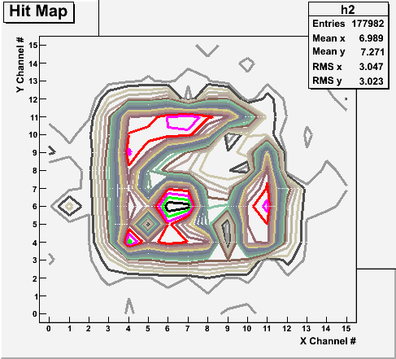
Bi-product of High Energy Physics Research
Can you see what the object is?
(GEM Detector X-ray Image)

Slide 45
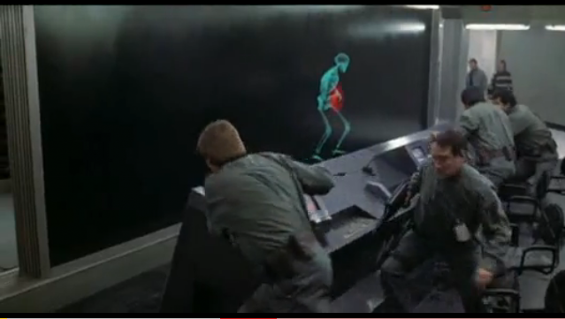
And in not too distant future, we could do …

Slide 46
Information & Communication Source
Course web page: http://www-hep.uta.edu/~yu/teaching/fall18-1444-002/fall18-1444-002.html
  Contact information & Class Schedule
  Syllabus
  Homework
  Holidays and Exam days
  Evaluation Policy
  Class Style & Communication
  Other information
Primary communication tool is e-mail: Make sure that your e-mail at the time of course registration is the one you most frequently read!!
Office Hours for Dr. Yu: 2:30 – 3:30pm, MW or by appointments

Slide 47
Evaluation Policy
Homework: 25%
Exams
  Final Comprehensive Exams (Dec. 10/18): 23%
  Mid-term Comprehensive Exam (Oct. 17/18): 20%
  One better of the two term Exams (Sept. 19/18 and 11/14/18): 12%
    Total of two non-comprehensive term exams (9/19 and 11/14)
    One better of the two exams will be used for the final grade
  Missing an exam is not permissible unless pre-approved
    No makeup test
    You will get an F if you miss any of the exams without a prior approval no matter how well you’ve been doing in class!
Lab score: 10%
Pop-quizzes: 10%
Extra credits: 10% of the total
  Random attendances
  Physics Department Colloquium Attendance (4pm Wednesdays!)
  Special projects (BIGGGGG!!!)
  Planetarium shows and Other many opportunities
Grading will be done on a sliding scale
100%

Slide 48
Homework – 1
Solving homework problems is the only way to comprehend class material ➔ 1 – 2 HW per week
An electronic homework system has been setup for you
  Details are in the material distributed today and on the web
  https://quest.cns.utexas.edu/student/courses/list
  Choose the course PHYS1444-fall18, unique number 44118
  Once you enroll, you need my approval before proceeding
  Download homeworks, solve the problems and submit them online
  Multiple unsuccessful tries will deduct points
  Roster will close at 11pm Wed. Aug. 29
  You need a UT e-ID: Go and apply at the URL https://idmanager.its.utexas.edu/eid_self_help/?createEID&qwicap-page-id=EA027EFF7E2DA39E if you don’t have one.

Slide 49
Homework – 2
Each homework carries the same weight
Home work problems will be slightly ahead of the class
Homework solutions are available 5min after the deadline
  Remember! This means no chance for a late submission!!
No homework will be dropped from the final grade!!
Home work will constitute 25% of the total ➔ A good way of keeping your grades high
Strongly encouraged to collaborate ➔ Does not mean you can copy

Slide 50
Attendances and Class Style
Attendances:
  Will be taken randomly
  Will be used for extra credit
Class style:
  Lectures will be in electronic media
    The lecture notes will be posted on the web AFTER each class
  Will be mixed with traditional methods
  Active participation through problem solving, collaboration, questions and discussions are required!
    Prepare a thick note book and a pen to keep your work in!
  Communication is extremely important
    If you have problems, please do not hesitate talking to me

Slide 51
Lab and Physics Clinic
Physics Labs: Starts Monday, Sept. 10
  Important to understand physical principles through experiments
  10% of the grade
  Prelab questions can be obtained at www.uta.edu/physics/labs
  Lab syllabus is available in your assigned lab rooms.
Physics Clinic:
  Free service
  They provide general help on physics, including help solving homework problems
    Do not expect solutions of the problem from them!
    Do not expect them to tell you whether your answers are correct!
    It is your responsibility to make sure that you have done everything correctly!
  11am – 6pm, Mon – Thu and 11am - 2pm, Fridays, SH 007
  This service begins today!
  Please take full advantage of this service!!

Slide 52
Extra credit
10% addition to the total
  Could boost a B to A, C to B or D to C
What constitute for extra credit?
  Special projects (biggest!!)
  Random attendances
  Physics department colloquium attendance
  Strong participation in the class discussions
  Watch the valid planetarium shows
  Many other opportunities

Slide 53
Valid Planetarium Shows
Regular running shows
  6pm Saturdays: Rosetta.
  1:30pm Sundays: The Hot and Energetic Universe
Shows that need special arrangements
  Black Holes (can watch up to 2 times), Phantom of the Universe
  Rosetta, Seeing, We are Astronomers, Back to the Moon for Good; From Earth to the Universe; Experience the Aurora; Magnificent Sun
  Stars of the Pharaohs; Two Small Pieces of Glass; Unseen Universe; Violent Universe and several more
How to submit for extra credit?
  Obtain the ticket stub that is signed and dated by the planetarium star lecturer of the day
  Collect the ticket stubs throughout the semester
  Tape ONLY one edge of all of the ticket stubs on a sheet of paper with your name and ID written on it
  Submit the sheet at the end of the semester at the final exam

