Slide 1
PHYS 1441 – Section 002 Lecture #3
Wednesday, Sept. 5, 2018
Dr. Jaehoon Yu
Ch 21
Static Electricity and Charge Conservation
Charges in Atom, Insulators and Conductors & Induced Charge
Coulomb’s Law
The Electric Field & Field Lines
Electric Fields and Conductors

Slide 2
Announcements
There are still one of you who haven’t registered for homework system
It will be very hard to pass this course without the homework!
I strongly suggest you to register ASAP!
1st Term exam
In class, Wednesday, Sept. 19: DO NOT MISS THE EXAM!
CH1.1 to what we learn on Monday, Sept. 17 + Appendices A1 – A8
You can bring your calculator but it must not have any relevant formula pre-input
BYOF: You may bring a one 8.5x11.5 sheet (front and back) of handwritten formulae and values of constants for the exam
No derivations, word definitions, or solutions of any problems !
No additional formulae or values of constants will be provided!
Colloquium today at 4pm! Physics faculty expo!
Submit the special project now!

Slide 3
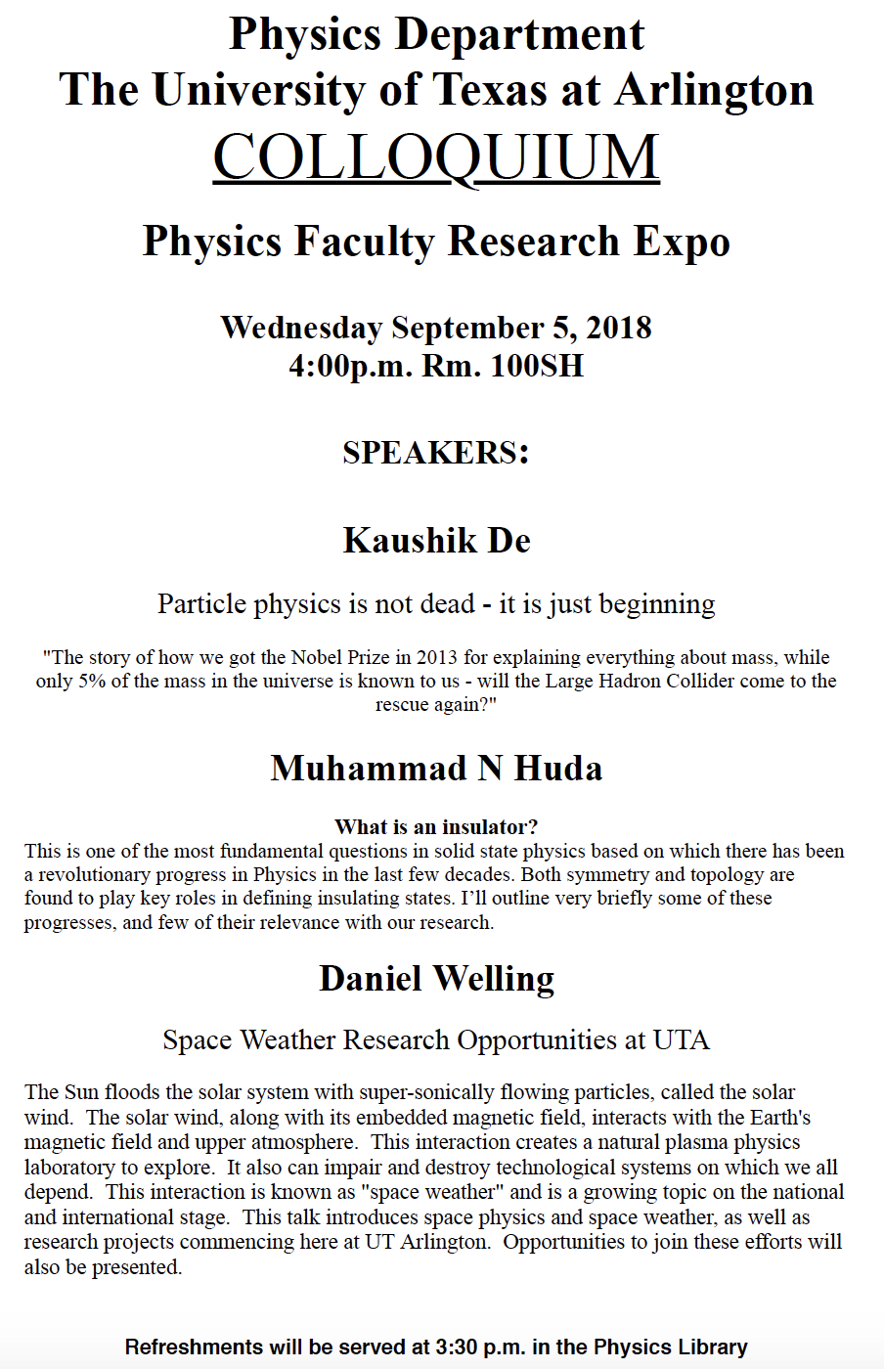

Slide 4
What does the Electric Force do?
Electric force is the bases of modern technology
Virtually everything we use every day uses electric force
Can you give a few examples?
But this force also affects many others
Making up materials with atoms and molecules
Biological metabolic processes
Nerve signals, heart pumping, etc
Virtually all the forces we have learned in Physics I:
Friction, normal force, elastic force and other contact forces are the results of electric forces acting at the atomic level

Slide 5
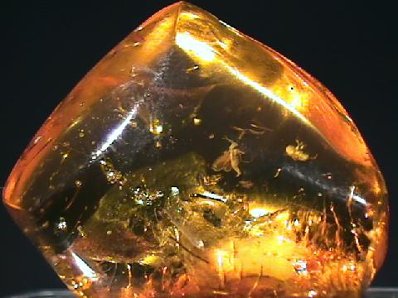
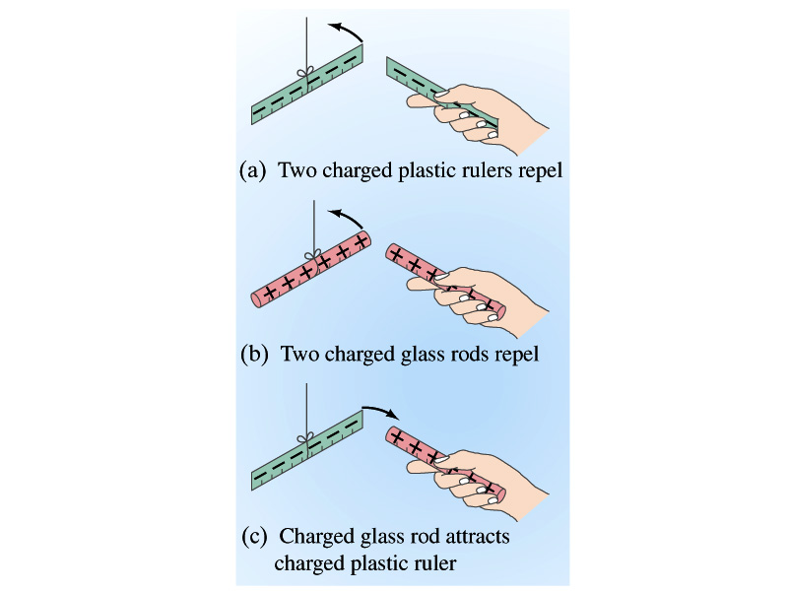
Static Electricity; Electric Charge and Its Conservation
Electricity is from Greek word elecktron=amber, a petrified tree resin that attracts matter if rubbed
Static Electricity: an amber effect
An object becomes charged or “posses a net electric charge” due to rubbing
Can you give some examples?
Two types of electric charge
Like charges repel while unlike charges attract
Benjamin Franklin referred the charge on glass rod as the positive, arbitrarily. Thus the charge that attracts glass rod is negative. ➔ This convention is still used.

Slide 6
Static Electricity; Electric Charge and Its Conservation
Franklin argued that when a certain amount of charge is produced on one body in a process, an equal amount of opposite type of charge is produced on another body.
The positive and negative are treated algebraically so that during any process the net change in the amount of produced charge is .
When you comb your hair with a plastic comb, the comb acquires a negative charge and the hair an equal amount of positive charge.
This is the law of conservation of electric charge.
The net amount of electric charge produced in any process is ZERO!!
If one object or one region of space acquires a positive charge, then an equal amount of negative charge will be found in neighboring areas or objects.
No violations have ever been observed.
This conservation law is as firmly established as that of energy or momentum.
0

Slide 7
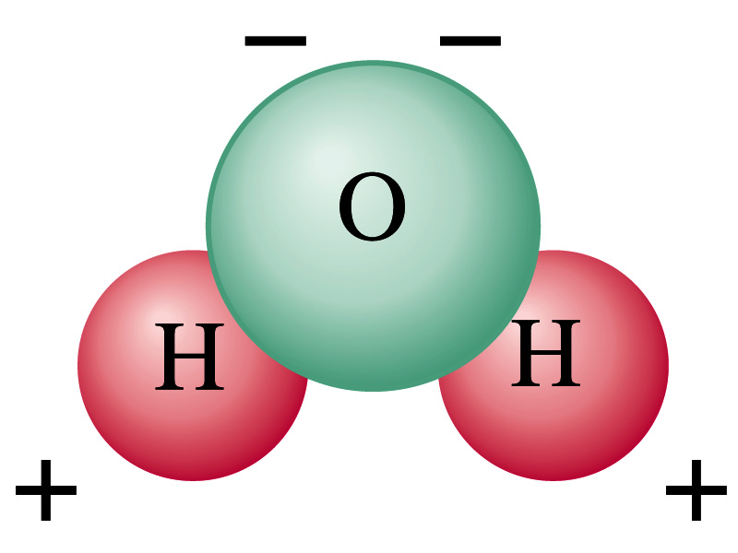
Electric Charge in an Atom
It has been understood through the past century that an atom consists of
A positively charged heavy core ⬅ What is the name?
This core is the nucleus and consists of neutrons and protons.
Many negatively charged light particles surround the core ⬅ What is the name of these light particles?
These are called electrons
How many of these in an atom?
So what is the net electrical charge of an atom?
Zero!!! Electrically neutral!!!
Can you explain what happens when a comb is rubbed on a towel?
Electrons from the towel get transferred to the comb, making the comb negatively charged while leaving positive ions on the towel.
These charges eventually get neutralized primarily by water molecules in the air.
As many as the number of protons in the nucleus!!

Slide 8
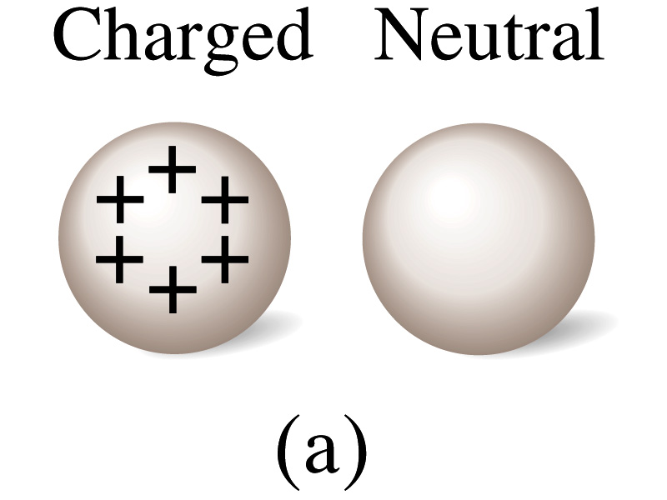
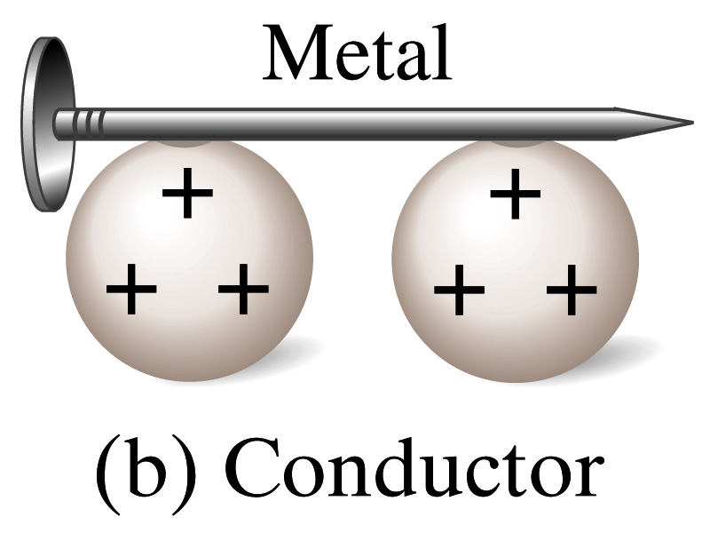
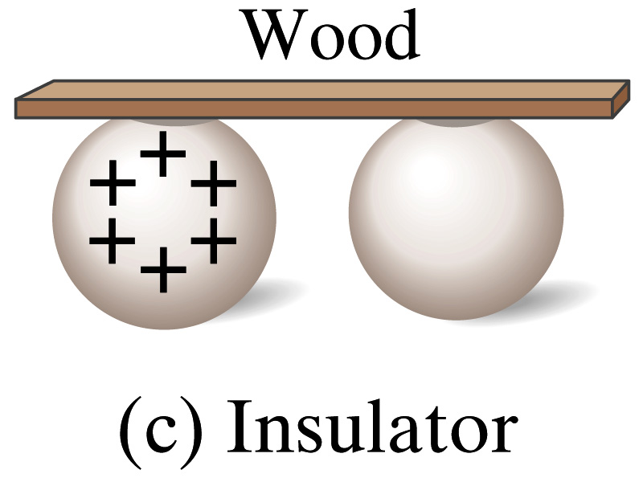
Insulators and Conductors
Let’s imagine two metal balls of which one is charged
What will happen if they are connected by
A metallic object?
Some charge is transferred.
These objects are called conductors of electricity.
An wooden object?
No charge is transferred
These objects are called nonconductors or insulators.
Metals are generally good conductors whereas most other materials are insulators.
There are third kind of materials called, semi-conductors, like silicon or germanium ➔ conduct only in certain conditions
Atomically, conductors have loosely bound electrons while insulators have them tightly bound!

Slide 9
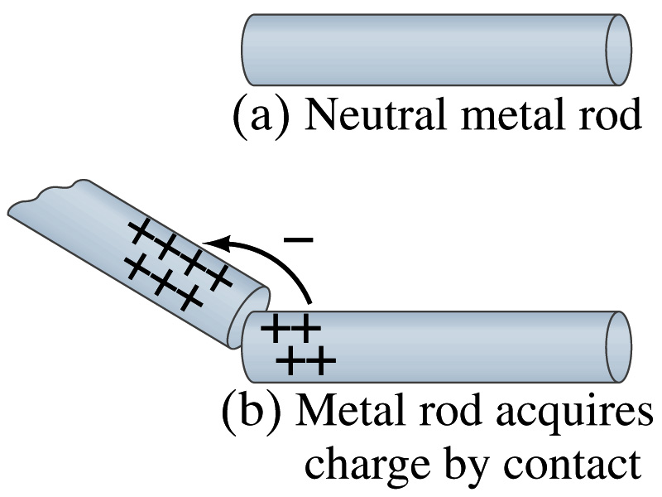
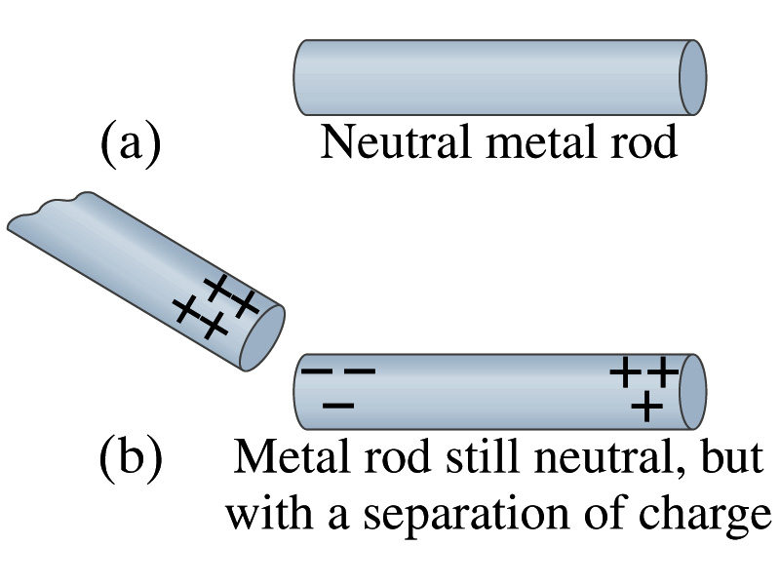
Induced Charge
When a positively charged metal object is brought close to an uncharged metal object
If two objects touch each other, the free electrons in the neutral one are attracted to the positively charged object and some will pass over to it, leaving the neutral object positively charged ➔ Charging by conduction
If the objects get close, the free electrons in the neutral one still move within the metal toward the charged object leaving the opposite side of the object positively charged.
The charges have been “induced” in the opposite ends of the object.

Slide 10
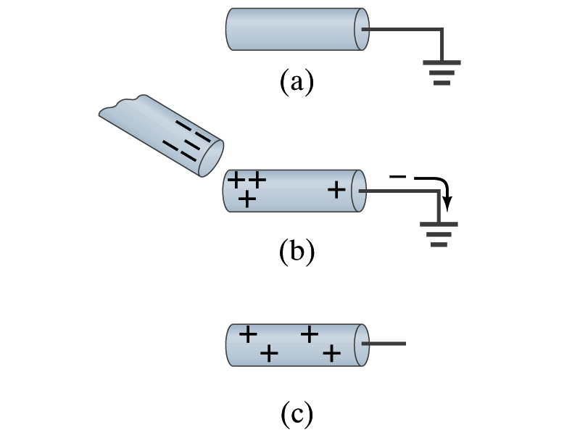
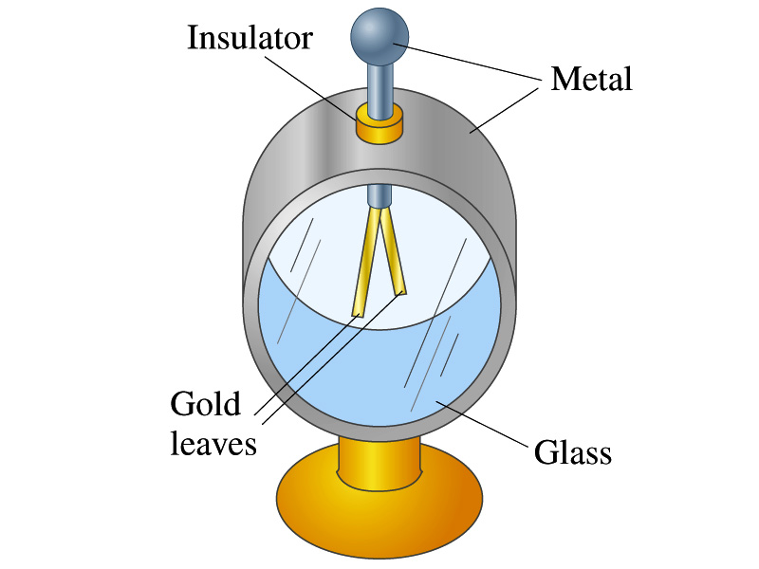
Induced Charge
ground
We can induce a net charge on a metal object by connecting a wire to the ground.
The object is “grounded” or “earthed”.
Since the Earth is so large and conducts, it can give or accept charge.
The Earth acts as a reservoir of electric charge.
If negative charge is brought close to a neutral metal
Positive charge will be induced toward the negatively charged metal.
The negative charges in the neutral metal will be gathered on the opposite side, transferring through the wire to the Earth.
If the wire is cut, the metal bar has net positive charge.
An electroscope is a device that can be used for detecting charge and signs.
How does this work?

Slide 11
Coulomb’s Law
Charges exert force to each other. What factors affect the magnitude of this force?
Any guesses?
Charles Coulomb figured this out in 1780’s.
Coulomb found that the electric force is
Proportional to the multiplication of the two charges
If one of the charges doubles, the force doubles.
If both the charges double, the force quadruples.
Inversely proportional to the square of the distances between them.
Electric charge is a fundamental property of matter, just like mass.
How would you put the above into a formula?

Slide 12
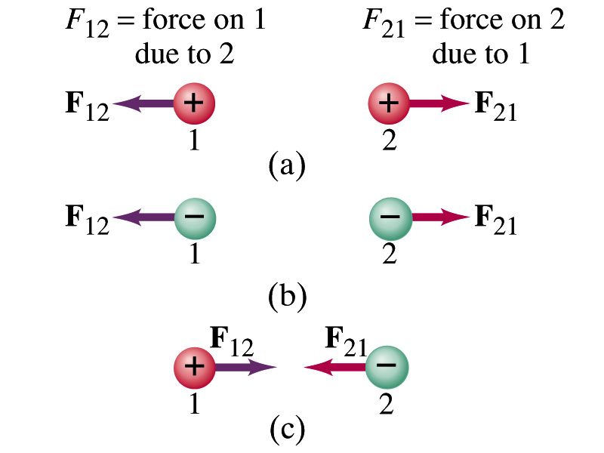
Coulomb’s Law – The Formula
Formula
Is Coulomb force a scalar quantity or a vector quantity? Unit?
A vector quantity. The unit is Newtons (N)!
The direction of electric (Coulomb) force is always along the line joining the two objects.
If the two charges are the same: forces are directed away from each other.
If the two charges are opposite: forces are directed toward each other.
Coulomb force is precise to 1 part in 10¹⁶.
Unit of charge is called Coulomb, C, in SI.
The value of the proportionality constant, k, in SI unit is
Thus, 1C is the charge that gives F~9x10⁹N of force when placed 1m apart from each other.

Slide 13
Electric Force
and Gravitational Force
Extremely
Similar
Does the electric force look similar to another force? What is it?
Gravitational Force
What are the sources of the forces?
Electric Force: Electric charges, fundamental properties of matter
Gravitational Force: Masses, fundamental properties of matter
What else is similar?
Inversely proportional to the square of the distance between the sources of the force ➔ What is this kind law called?
Inverse Square Law
What is the difference?
Gravitational force is always attractive.
Electric force depends on the type of the two charges. (must pay good attention to the signs due to the sign of the charge and the vector force directions!!)

Slide 14
The Elementary Charge and Permittivity
Elementary charge, the smallest charge, is that of an electron:
Since electron is a negatively charged particle, its charge is –e.
Object cannot gain or lose fraction of an electron.
Electric charge is quantized.
It changes always in integer multiples of e.
The proportionality constant k is often written in terms of another constant, ε₀, the permittivity* of free space. They are related and .
Thus the electric force can also be written as:
Note that this force is for “point” charges at rest.
*Mirriam-Webster, Permittivity: The ability of a material to store electric potential energy under the influence of an electric field

Slide 15
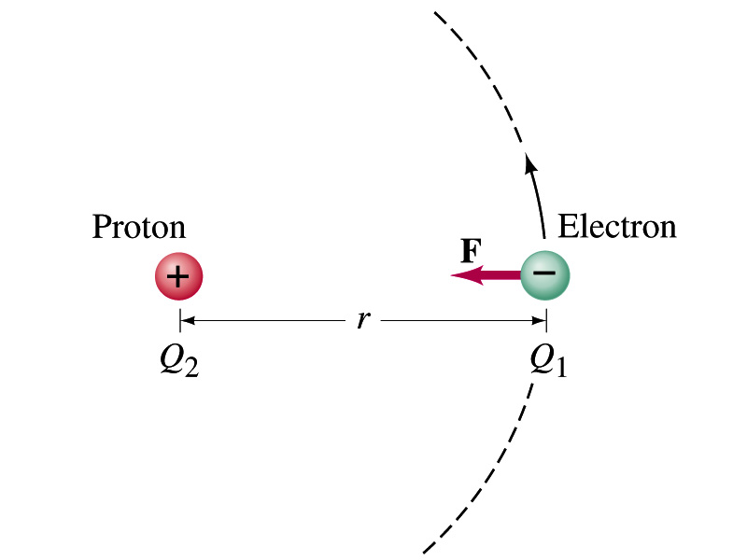
Example on Coulomb Force
Electric force on electron by proton. Determine the magnitude of the electric force on the electron of a hydrogen atom exerted by the single proton (Q₂=+e) that is its nucleus. Assume the electron “orbits” the proton at its average distance of r=0.53x10⁻¹⁰m.
Using Coulomb’s law
Each charge is
and
So the magnitude of the force is
Which direction?
Toward each other…

