Slide 1
PHYS 1441 – Section 002 Lecture #4
Monday, Sept. 10, 2018
Dr. Jaehoon Yu
Ch 21
Coulomb Force
Vector Fundamentals
The Electric Field & Field Lines
Electric Fields and Conductors
Motion of a Charged Particle in an Electric Field
Electric Dipoles
Today’s homework is homework #3, due 11pm, Monday, Sept. 17!!

Slide 2
Announcements
1st Term exam
In class, Wednesday, Sept. 19: DO NOT MISS THE EXAM!
CH21.1 to what we learn on Monday, Sept. 17 + Appendices A1 – A8
You can bring your calculator but it must not have any relevant formula pre-input
No phone or computers can be used as a calculator!
BYOF: You may bring one 8.5x11.5 sheet (front and back) of handwritten formulae and values of constants for the exam
No derivations, word definitions, or solutions of ANY problems !
No additional formulae or values of constants will be provided!

Slide 3
Special Project #2 – Angels & Demons
Compute the total possible energy released from an annihilation of xx-grams of anti-matter and the same quantity of matter, where xx is the last two digits of your SS#. (20 points)
Use the famous Einstein’s formula for mass-energy equivalence
Compute the power output of this annihilation when the energy is released in yy ns, where yy is the first two digits of your SS#. (10 points)
Compute how many cups of gasoline (8MJ) this energy corresponds to. (5 points)
Compute how many months of world electricity usage (3.6GJ/mo) this energy corresponds to. (5 points)
Due by the beginning of the class Monday, Sept. 24

Slide 4
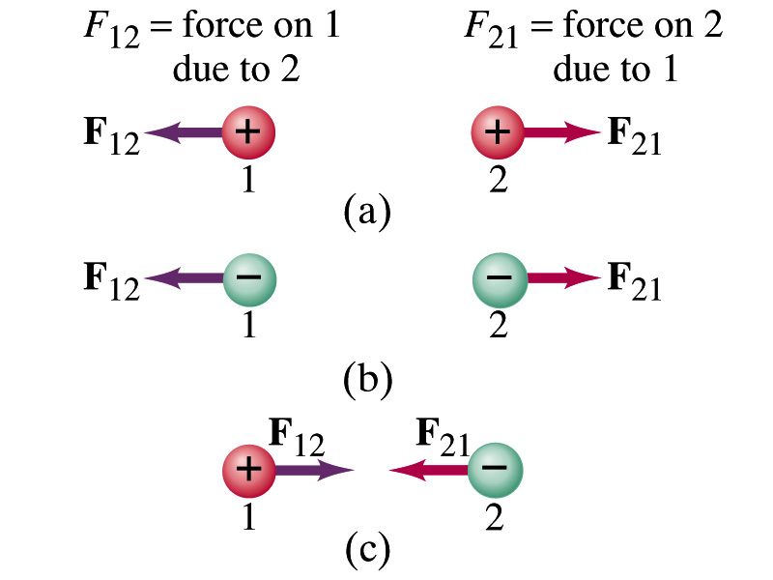
The Coulomb Force Refresher
Formula
Is Coulomb force a scalar quantity or a vector quantity? Unit?
A vector quantity. The unit is Newtons (N)!
The direction of electric (Coulomb) force is always along the line joining the two objects.
If the two charges are the same: forces are directed away from each other.
If the two charges are opposite: forces are directed toward each other.
Coulomb force is precise to 1 part in 10¹⁶.
Unit of charge is called Coulomb, C, in SI.
The value of the proportionality constant, k, in SI unit is
Thus, 1C is the charge that gives F~9x10⁹N of force when placed 1m apart from each other.
The Elementary Charge

Slide 5
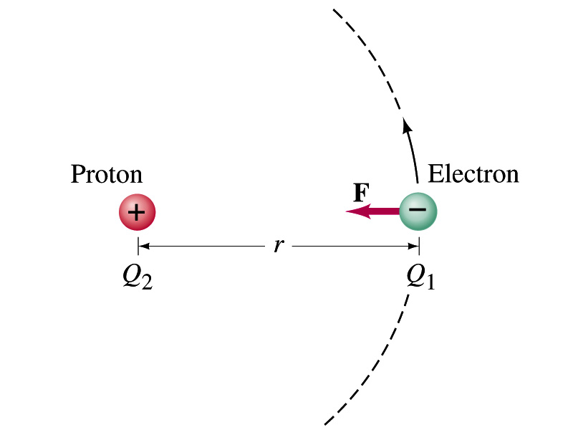
Example on Coulomb Force
Electric force on electron by proton. Determine the magnitude of the electric force on the electron of a hydrogen atom exerted by the single proton (Q₂=+e) that is its nucleus. Assume the electron “orbits” the proton at its average distance of r=0.53x10⁻¹⁰m.
Using Coulomb’s law
Each charge is
and
So the magnitude of the force is
Which direction?
Toward each other…
What is the speed of the electron circling around the proton in a hydrogen atom?

Slide 6
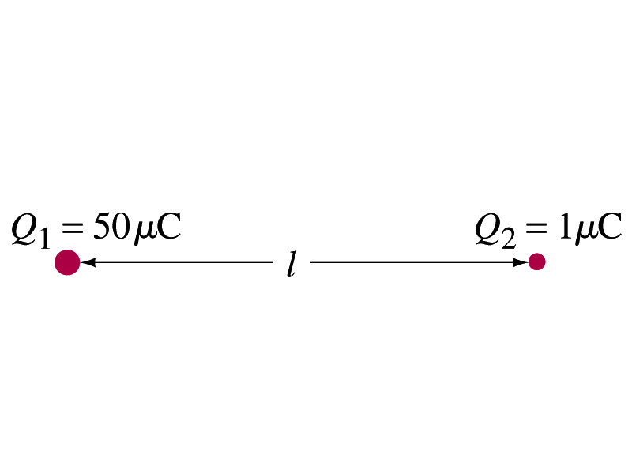
Example 21 – 1
Which charge exerts greater force? Two positive point charges, Q₁=50μC and Q₂=1μC, are separated by distance L. Which is larger in magnitude, the force that Q₁ exerts on Q₂ or the force that Q₂ exerts on Q₁?
What is the force that Q₁ exerts on Q₂?
What is the force that Q₂ exerts on Q₁?
Therefore the magnitudes of the two forces are identical!!
Well then what is different?
The direction.
Which direction?
Opposite to each other!
What is this law?
Newton’s third law, the law of action and reaction!!

Slide 7
Vector Additions and Subtractions
Addition:
Triangular Method: One can add vectors by connecting the head of one vector to the tail of the other (head-to-tail)
Parallelogram method: Connect the tails of the two vectors and extend
Addition is commutative: Changing order of operation does not affect the results A+B=B+A, A+B+C+D+E=E+C+A+B+D
A+B
A
A+B
B
=
OR
B
A+B
B
A
A
Subtraction:
The same as adding a negative vector:A - B = A + (-B)
A
-B
Since subtraction is the equivalent to adding a negative vector, subtraction is also commutative!!!
A-B
Multiplication by a scalar is increasing the magnitude A, B=2A
A
B=2A

Slide 8
Example for Vector Addition
A force of 20.0N applies to north while another force of 35.0N applies in the direction 60.0º west of north. Find the magnitude and direction of resultant force.
F₂sin60^{ο}
N
F₂
60^{ο}
F₂cos60^{ο}
20
F
θ
F₁
E
Find other ways to solve this problem…

Slide 9
Components and Unit Vectors
Coordinate systems are useful in expressing vectors in their components
y
(+,+)
F_{y}
(F_{x},F_{y})
}Components
F
(-,+)
θ
x
} Magnitude
(-,-)
(+,-)
F_{x}

Slide 10
Unit Vectors
Unit vectors are the ones that tells us the directions of the components
Dimensionless
Magnitudes are exactly 1
Unit vectors are usually expressed in i, j, k or
So the vector F can be re-written as

Slide 11
Examples of Vector Operations
Find the resultant force which is the sum of F1=(2.0i+2.0j)N and F2 =(2.0i-4.0j)N.
Find the resultant force of the sum of three forces: F₁=(15i+30j +12k)N, F₂=(23i+14j -5.0k)N, and F₃=(-13i+15j)N.
Magnitude

Slide 12
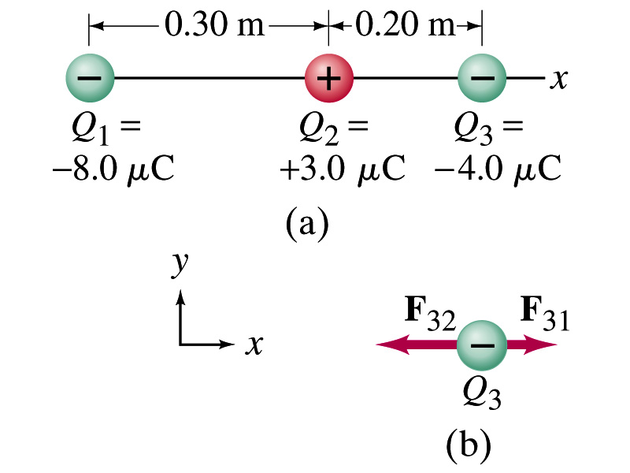
Example 21.2
Three charges on a line. Three charged particles are arranged in a line as shown in the figure. Calculate the net electrostatic force on particle 3 (the -4μC on the right) due to other two charges.
What is the force that Q₁ exerts on Q₃?
What is the force that Q₂ exerts on Q₃?
Using the vector sum of the two forces

