Slide 1
PHYS 1441 – Section 002 Lecture #5
Wednesday, Sept. 12, 2018
Dr. Jaehoon Yu
CH 21
The Electric Field & Field Lines
Electric Fields and Conductors
Motion of a Charged Particle in an Electric Field
Electric Dipoles
CH 22
Electric Flux
Gauss’ Law

Slide 2
Announcements
1st Term exam
In class, Wednesday, Sept. 19: DO NOT MISS THE EXAM!
CH21.1 to what we learn on Monday, Sept. 17 + Appendices A1 – A8
You can bring your calculator but it must not have any relevant formula pre-input
No phone or computers can be used as a calculator!
BYOF: You may bring one 8.5x11.5 sheet (front and back) of handwritten formulae and values of constants for the exam
No derivations, word definitions, or solutions of ANY problems !
No additional formulae or values of constants will be provided!
Reading Assignments: CH21.11 & CH 22.4
Quiz 1 results
Class average: 44.2/60
Equivalent to 73.7/100
Top score: 58/60
Colloquium today @ 4pm in SH100 ➔ Dr. Carlos Bertulani from TAM

Slide 3
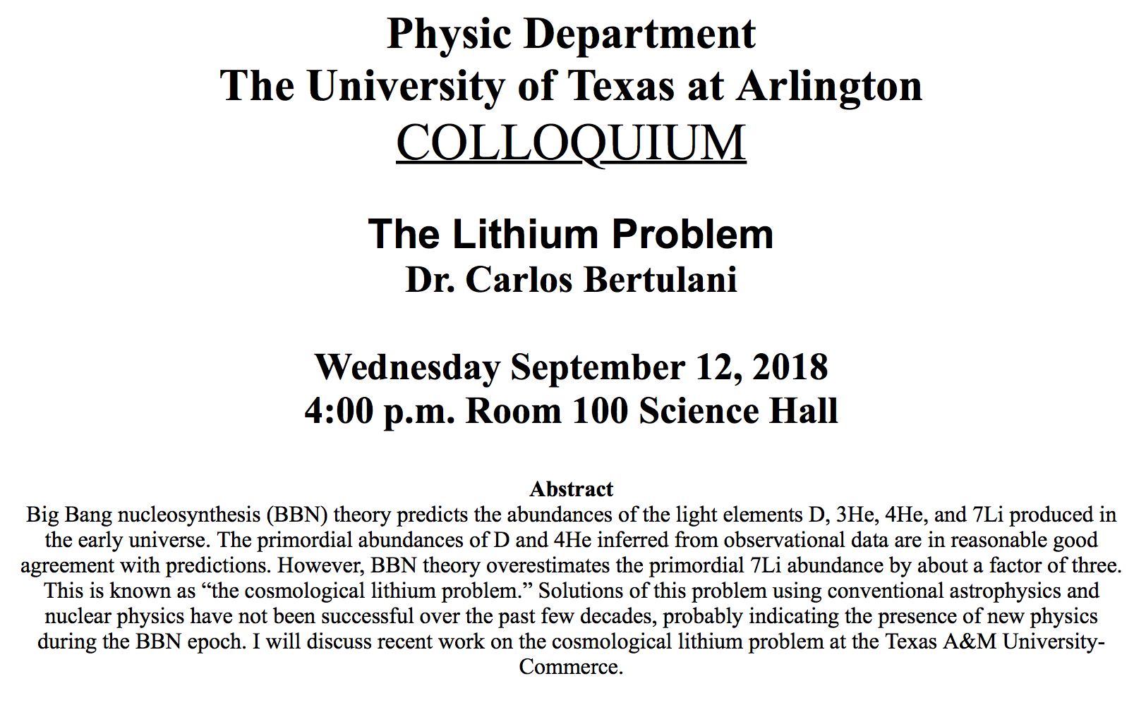

Slide 4
Reminder: Special Project #2 – Angels & Demons
Compute the total possible energy released from an annihilation of xx-grams of anti-matter and the same quantity of matter, where xx is the last two digits of your SS#. (20 points)
Use the famous Einstein’s formula for mass-energy equivalence
Compute the power output of this annihilation when the energy is released in yy ns, where yy is the first two digits of your SS#. (10 points)
Compute how many cups of gasoline (8MJ) this energy corresponds to. (5 points)
Compute how many months of world electricity usage (3.6GJ/mo) this energy corresponds to. (5 points)
Due at the beginning of the class Monday, Sept. 24

Slide 5
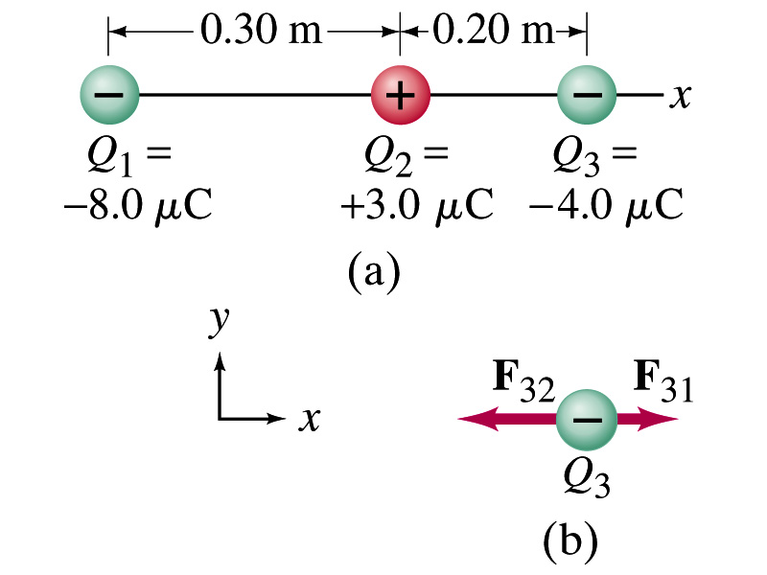
Example 21.2
Three charges on a line. Three charged particles are arranged in a line as shown in the figure. Calculate the net electrostatic force on particle 3 (the -4μC on the right) due to other two charges.
What is the force that Q₁ exerts on Q₃?
What is the force that Q₂ exerts on Q₃?
Using the vector sum of the two forces

Slide 6
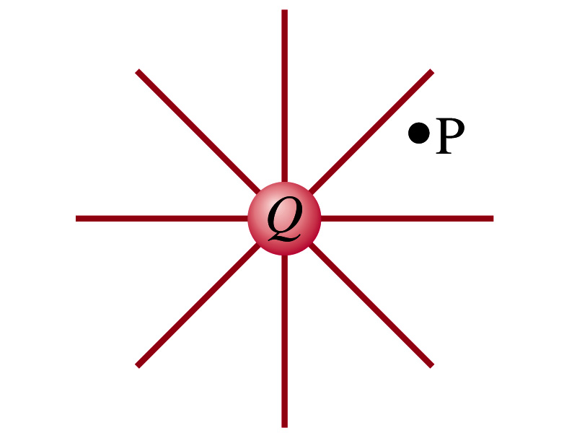
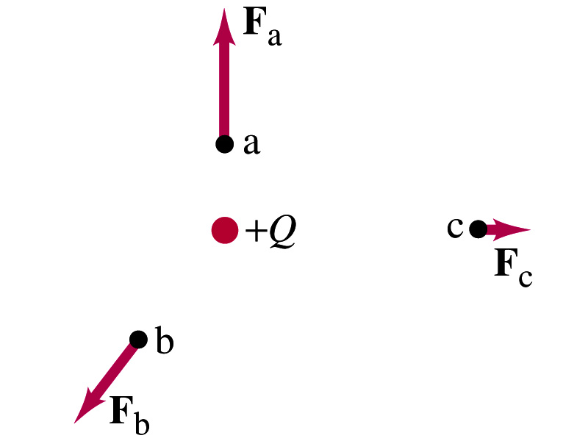
The Electric Field
Both gravitational and electrostatic forces act over a distance without contacting objects ➔ What kind of forces are these?
Field forces
Michael Faraday developed an idea of field.
Faraday (1791 – 1867) argued that the electric field extends outward from every charge and permeates through all of space.
Field by a charge or a group of charges can be inspected by placing a small positive test charge in the vicinity and measuring the force on it.

Slide 7
The Electric Field
The electric field at any point in space is defined as the force exerted on a tiny positive test charge (e.g., q) divide by the magnitude of the test charge
Electric force per unit charge
What kind of quantity is the electric field?
Vector quantity. Why?
What is the unit of the electric field?
N/C
What is the magnitude of the electric field at a distance r from a single point charge Q?

Slide 8
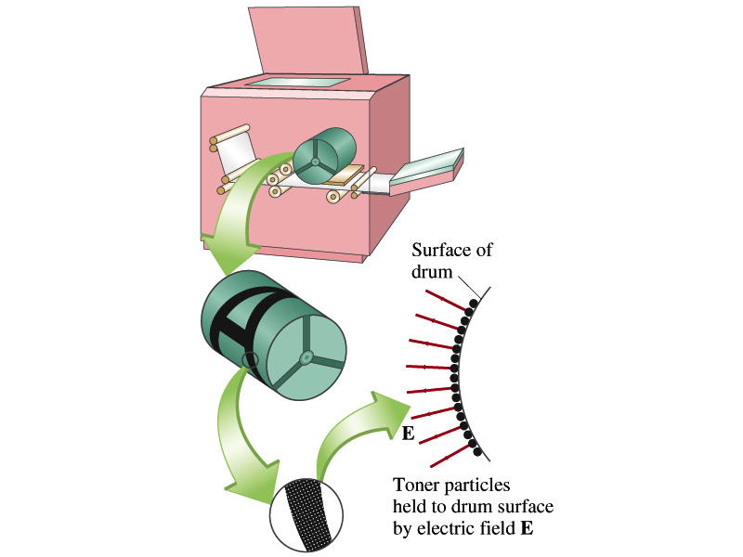
Example 21 – 5
Electrostatic copier. An electrostatic copier works by selectively arranging positive charges (in a pattern to be copied) on the surface of a non-conducting drum, then gently sprinkling negatively charged dry toner (ink) onto the drum. The toner particles temporarily stick to the pattern on the drum and are later transferred to paper and “melted” to produce the copy. Suppose each toner particle has a mass of 9.0x10⁻¹⁶kg and carries the average of 20 extra electrons to provide an electric charge. Assuming that the electric force on a toner particle must exceed twice its weight in order to ensure sufficient attraction, compute the required electric field strength near the surface of the drum.
The electric force must be the same as twice the gravitational force on the toner particle.
So we can write
Thus, the magnitude of the electric field is

Slide 9
Direction of the Electric Field
If there are more than one charge present, the individual fields due to each charge are added vectorially to obtain the total field at any point in space
This superposition principle of electric field has been verified by experiments.
For a given electric field E at a given point in space, we can calculate the force F on any charge q, F=qE.
What happens to the direction of the force on the charge placed in the field and the field depending on the sign of the charge q?
The F and E are in the same directions if q > 0
The F and E are in the opposite directions if q < 0

Slide 10
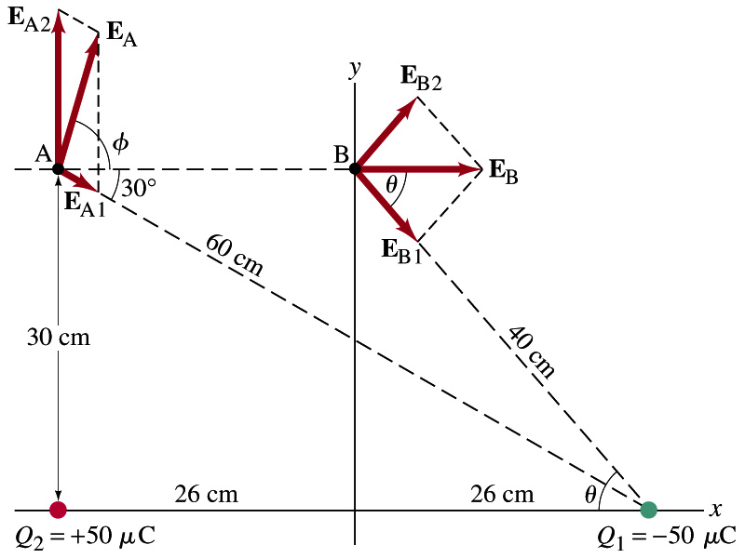
Example 21 – 8
E above two point charges: Calculate the total electric field (a) at point A and (b) at point B in the figure on the right due to both the charges Q₁ and Q₂.
How do we solve this problem?
First, compute the magnitude of fields at each point due to each of the two charges.
Then add them at each point vectorially!
First, the electric field at point A by Q₁ and then Q₂.

Slide 11
Example 21 – 8, cnt’d
Now the components of the electric field vectors by the two charges at point A.
So the electric field at point A is
The magnitude of the electric field at point A is
Now onto the electric field at point B

Slide 12
Example 21 – 8, cnt’d
Electric field at point B is easier due to symmetry!
Since the magnitude of the charges are the same and the distance to point B from the two charges are the same, the magnitude of the electric field by the two charges at point B are the same!!
Now the components!
First, the y-component!
Now, the x-component!
So the electric field at point B is
The magnitude of the electric field at point B

Slide 13
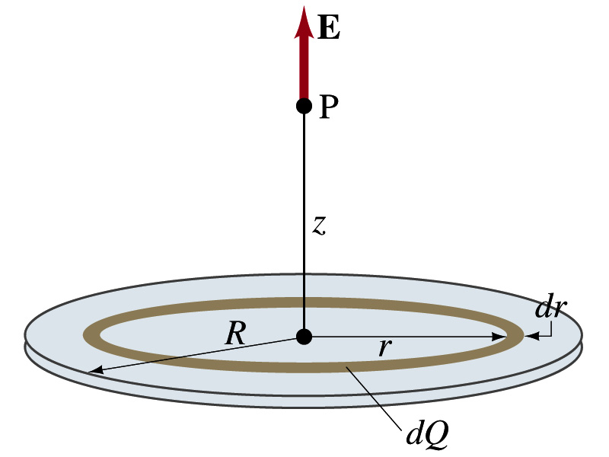
Example 21 – 12
Uniformly charged disk: Charge is distributed uniformly over a thin circular disk of radius R. The charge per unit area (C/m²) is σ. Calculate he electric field at a point P on the axis of the disk, a distance z above its center.
How do we solve this problem?
First, compute the magnitude of the field (dE) at point P due to the charge (dQ) on the ring of infinitesimal width dr.
From the result of example 21 – 11 (please do this problem yourself)
Since the surface charge density is constant, σ, and the ring has an area of 2πrdr, the infinitesimal charge of dQ is
So the infinitesimal field dE can be written

Slide 14
Example 21 – 12 cnt’d
Now integrating dE over 0 through R, we get
What happens if the disk has infinitely large area?
So the electric field due to an evenly distributed surface charge with density, σ, is

Slide 15
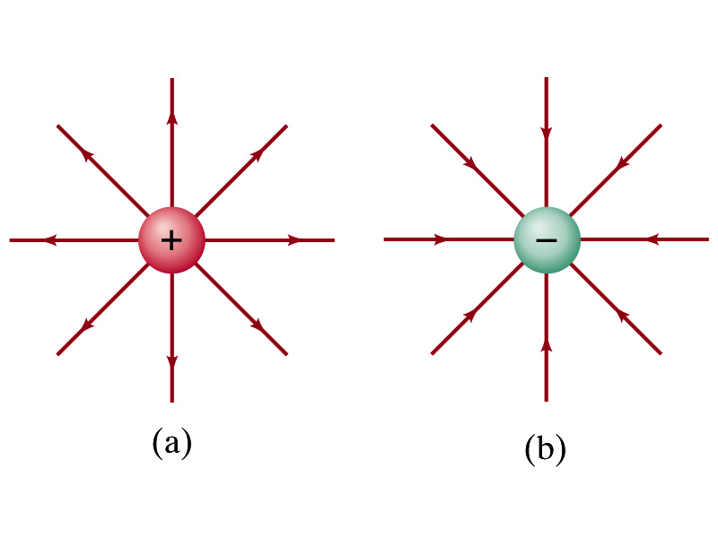
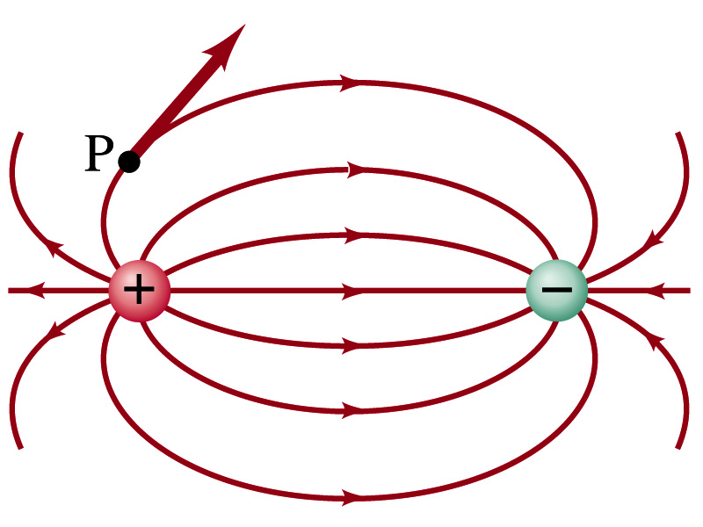
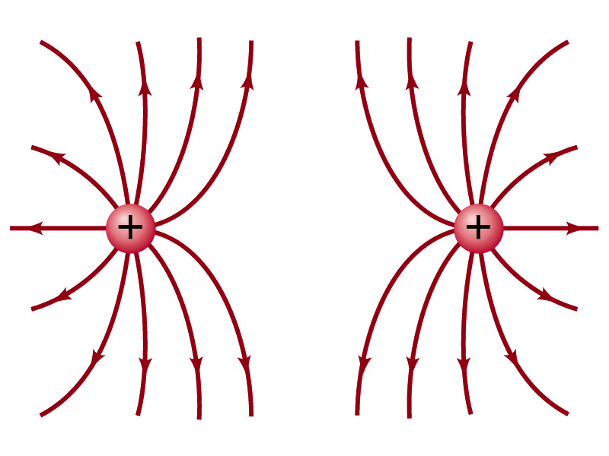
Field Lines
The electric field is a vector quantity. Thus, its magnitude can be expressed by the length of the vector and the direction by the direction the arrowhead points.
Since the field permeates through the entire space, drawing vector arrows is not a good way of expressing the field.
Electric field lines are drawn to indicate the direction of the force due to the given field on a positive test charge.
Number of lines crossing unit area perpendicular to E is proportional to the magnitude of the electric field.
The closer the lines are together, the stronger the electric field in that region.
Start on positive charges and end on negative charges.
Earth’s G-field lines

