Slide 1
PHYS 1441 – Section 002
Lecture #8
Wednesday, Sept. 26, 2018
Dr. Jaehoon Yu
Chapter 23 Electric Potential
  Electric Potential due to Point Charges
  Shape of the Electric Potential
  V due to Charge Distributions
  Equi-potential Lines and Surfaces
  Electric Potential Due to Electric Dipole
  Electrostatic Potential Energy

Slide 2
Announcements
Quiz #2
  Coming Monday, Oct. 1, at the beginning of the class
  Covers CH22.1 through what we cover in class today (CH23.8?)
  Bring your calculator but DO NOT input formula into it!
    Cell phones or any types of computers cannot replace a calculator!
  BYOF: You may bring a one 8.5x11.5 sheet (front and back) of handwritten formulae and values of constants for the quiz
  No derivations, word definitions or solutions of any problems!
  No additional formulae or values of constants will be provided!
Mid-term results
  Class average: 59.3/98
    Equivalent to 60/100
  Top score: 96/98
Colloquium today
  Dr. Amir Shamoradi of UTA Physics

Slide 3
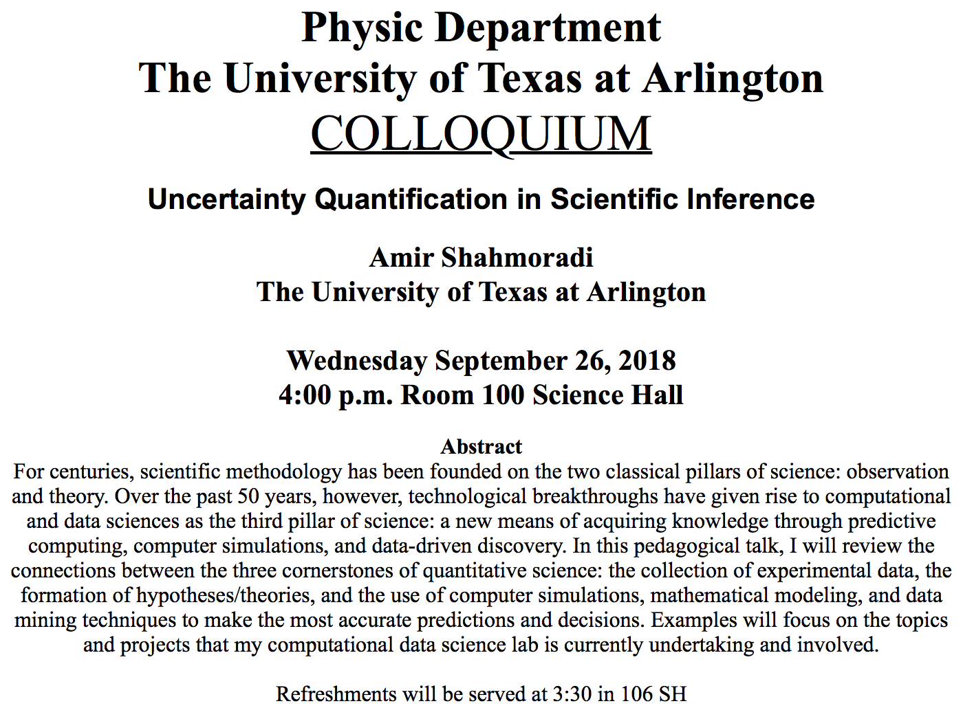

Slide 4
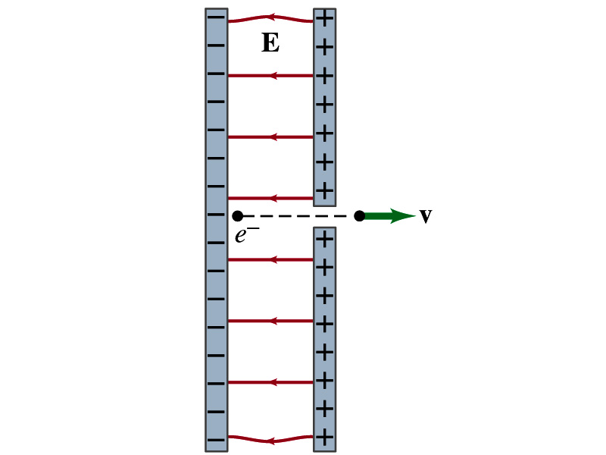
Reminder: Special Project #3
Particle Accelerator. A charged particle of mass M with charge -Q is accelerated in the uniform field E between two parallel charged plates whose separation is D as shown in the figure on the right. The charged particle is accelerated from an initial speed v₀ near the negative plate and passes through a tiny hole in the positive plate.
  Derive the formula for the electric field E to accelerate the charged particle to a fraction f of the speed of light c. Express E in terms of M, Q, D, f, c and v₀.
  (a) Using the Coulomb force and kinematic equations. (8 points)
  (b) Using the work-kinetic energy theorem. ( 8 points)
  (c) Using the formula above, evaluate the strength of the electric field E to accelerate an electron from 0.1% of the speed of light to 90% of the speed of light. You need to look up and write down the relevant constants, such as mass of the electron, charge of the electron and the speed of light. (5 points)
Must be handwritten and not copied from anyone else!
Due beginning of the class Monday, Oct. 1

Slide 5
Electric Potential and Electric Field
The effect of the charge distribution can be described in terms of electric field or electric potential.
  What kind of quantities are the electric field and the electric potential?
    Electric Field:
    Electric Potential:
  Since electric potential is a scalar quantity, it is often easier to handle.
Well other than the above, how are these two quantities related?
Vector
Scalar

Slide 6
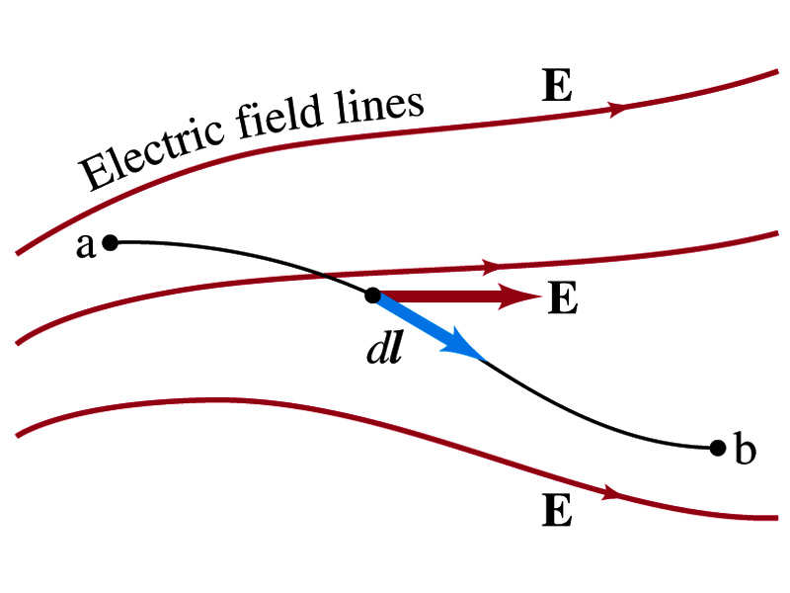
Electric Potential and Electric Field
Potential energy change is expressed in terms of a conservative force (point a at the higher potential)
For the electrical case, we are more interested in the potential difference:
  This formula can be used to determine V_{ba} when the electric field is given.
When the field is uniform
so
What does “-”sign mean?
The direction of E is along that of decreasing potential.
Unit of the electric field in terms of potential?
V/m
Can you derive this from N/C?

Slide 7
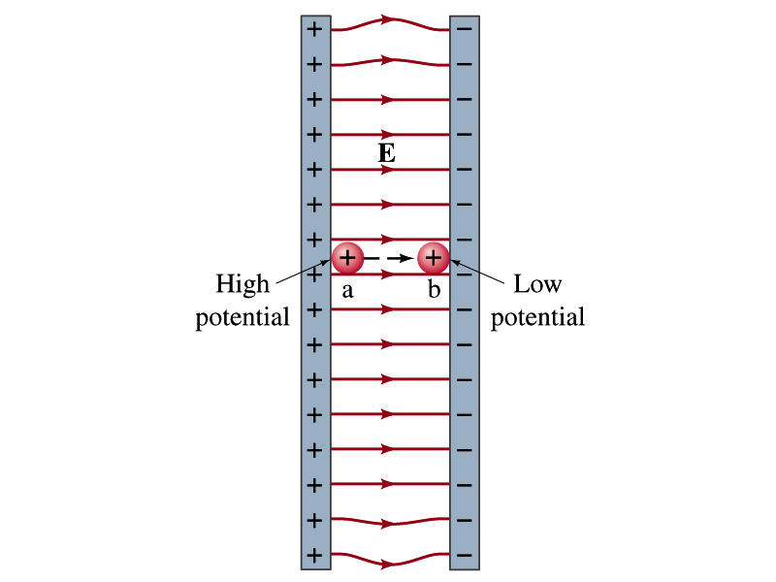
Example
Uniform electric field obtained from voltage: Two parallel plates are charged to a voltage of 50V. If the separation between the plates is 5.0cm, calculate the magnitude of the electric field between them, ignoring any fringe effect.
5cm
50V
What is the relationship between electric field and the potential for a uniform field?
Solving for E
Which direction is the field?
Direction of decreasing potential!

Slide 8
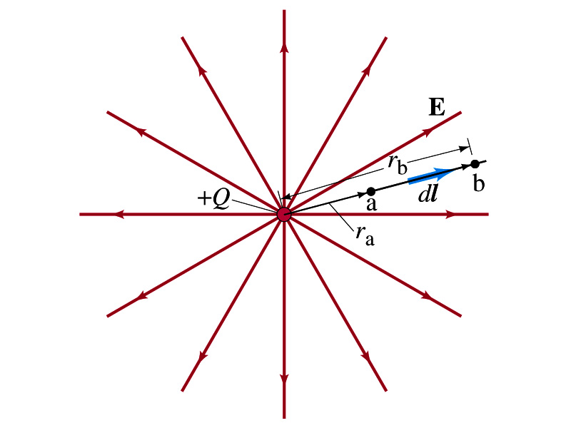
Electric Potential due to Point Charges
What is the electric field by a single point charge Q at a distance r?
Electric potential due to the field E for moving from point r_{a} to r_{b} in radial direction away from the charge Q is

Slide 9
Electric Potential due to Point Charges
Since only the differences in potential have physical meaning, we can choose at .
The electrical potential V at a distance r from a single point charge Q is
So the absolute potential by a single point charge can be thought of the potential difference by a single point charge between r and infinity

Slide 10
Properties of the Electric Potential
What are the differences between the electric potential and the electric field?
  Electric potential
    Electric potential energy per unit charge
    Inversely proportional to the distance
    Simply add the potential by each of the source charges to obtain the total potential due to multiple charges, since potential is a scalar quantity
  Electric field
    Electric force per unit charge
    Inversely proportional to the square of the distance
    Need vector sums to obtain the total field due to multiple source charges
Potential due to a positive charge is a large positive near the charge and decreases towards 0 at large distance.
Potential due to a negative charge is a large negative near the charge and increases towards 0 at large distance.

Slide 11
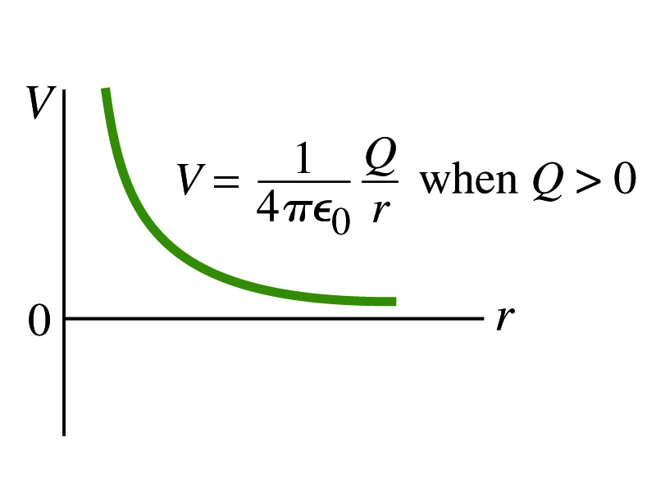
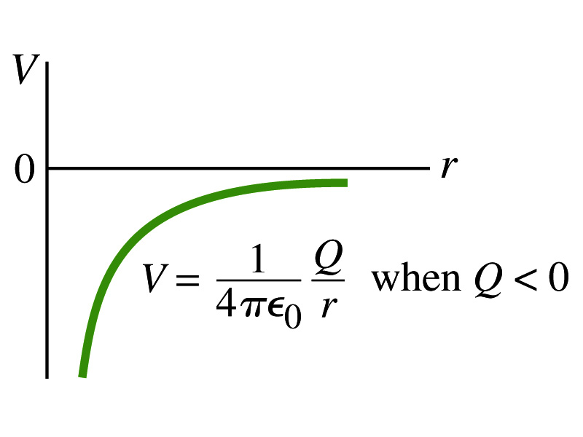
Shape of the Electric Potential
So, how does the electric potential look like as a function of distance?
  What is the formula for the potential by a single charge?
Positive Charge
Negative Charge
Uniformly charged sphere would have the potential the same as a single point charge.
What does this mean?
Uniformly charged sphere behaves like all the charge is on the single point in the center.

Slide 12
Example 23 – 6
Work to bring two positive charges close together: What is minimum work required by an external force to bring the charge q=3.00μC from a great distance away (r=∞) to a point 0.500m from a charge Q=20.0 μC?
What is the work done by the electric field in terms of potential energy and potential?
Since we obtain
Electric force does negative work. In other words, the external force must do +1.08J of work to bring the 3.00μC charge from infinity to 0.500m to the charge 20.0μC.

Slide 13
Electric Potential by Charge Distributions
Let’s consider a case of n individual point charges in a given space and V=0 at r=∞.
Then the potential V_{ia} due to the charge Q_{i} at point a, distance r_{ia} from Q_{i} is
Thus the total potential V_{a} by all n point charges is
For a continuous charge distribution, we obtain

Slide 14
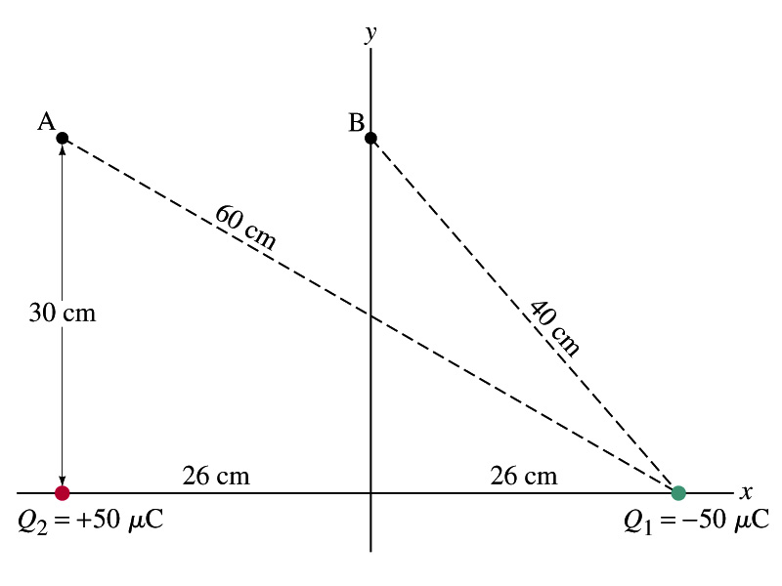
Example
Potential due to two charges: Calculate the electric potential (a) at point A in the figure due to the two charges shown, and (b) at point B.
Electric potential is a scalar quantity, so one adds the potential by each of the source charge, as if they are numbers.
(a) potential at A is
(b) How about potential at B?

Slide 15
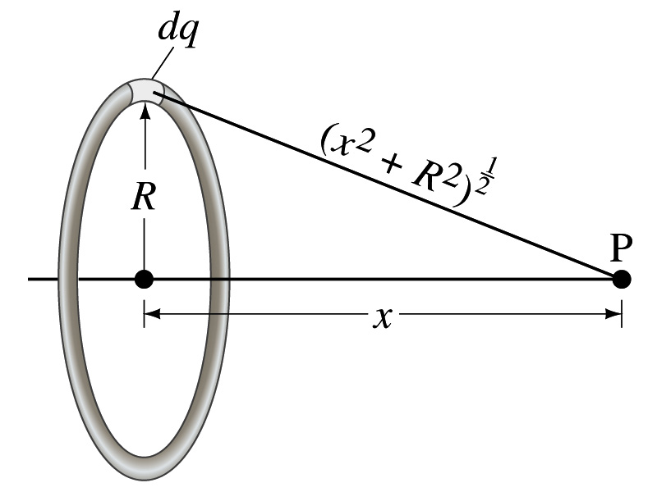
Example 23 – 8
Potential due to a ring of charge: A thin circular ring of radius R carries a uniformly distributed charge Q. Determine the electric potential at a point P on the axis of the ring a distance x from its center.
Each point on the ring is at the same distance from the point P. What is the distance?
So the potential at P is
What’s this?

