Slide 1
PHYS 1441 – Section 002
Lecture #9
Monday, Oct. 1, 2018
Dr. Jaehoon Yu
Chapter 23 Electric Potential
  Equi-potential Lines and Surfaces
  Electric Potential Due to Electric Dipole
  Electrostatic Potential Energy
Chapter 24 Capacitance etc..
  Capacitors
Today’s homework is homework #6, due 11pm, Monday, Oct. 8!!

Slide 2
Announcements
Bring out your special project #3
Colloquium 4pm this Wednesday, Oct. 3, SH101
  Dr. Xi Zhang of U.C. Santa Cruz

Slide 3
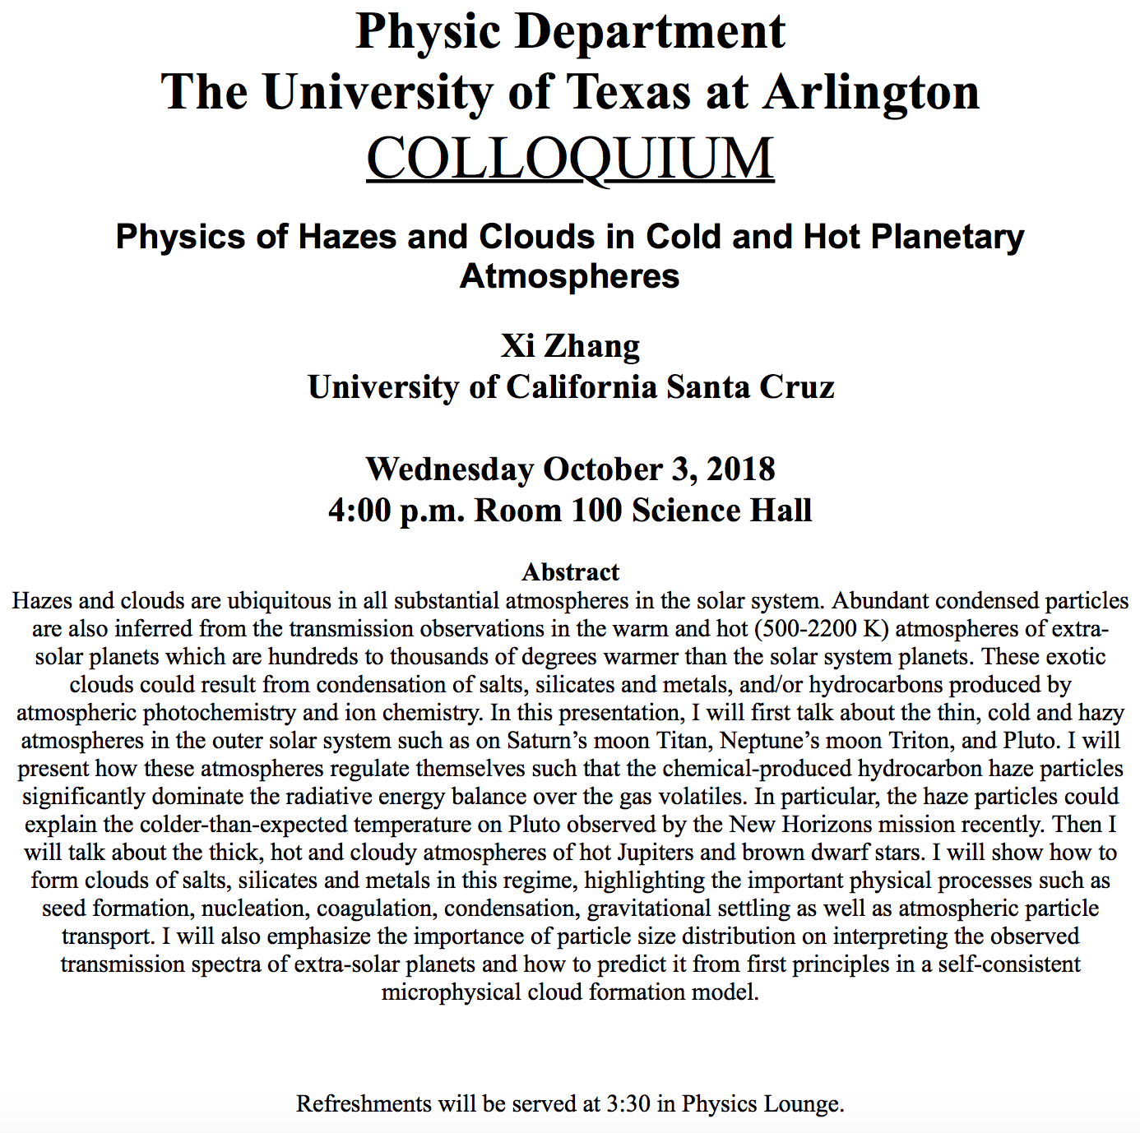

Slide 4
Equi-potential Surfaces
Electric potential can be graphically shown using the equipotential lines in 2-D or the equipotential surfaces in 3-D
Any two points on the equipotential surfaces (lines) are at the same potential
What does this mean in terms of the potential difference?
  The potential difference between any two points on an equipotential surface is 0.
How about the potential energy difference?
  Also 0.
What does this mean in terms of the work to move a charge along the surface between these two points?
  No work is necessary to move a charge between these two points.

Slide 5
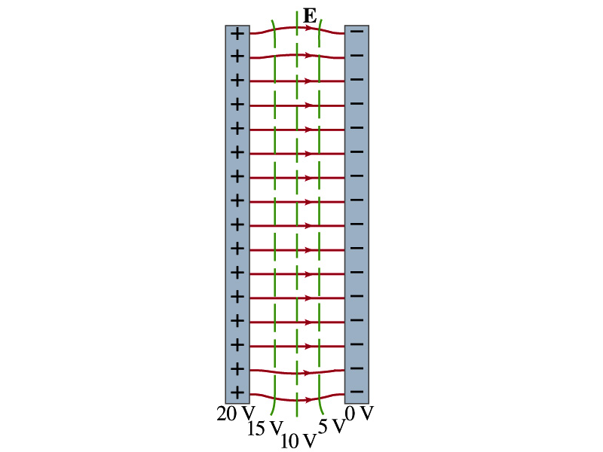
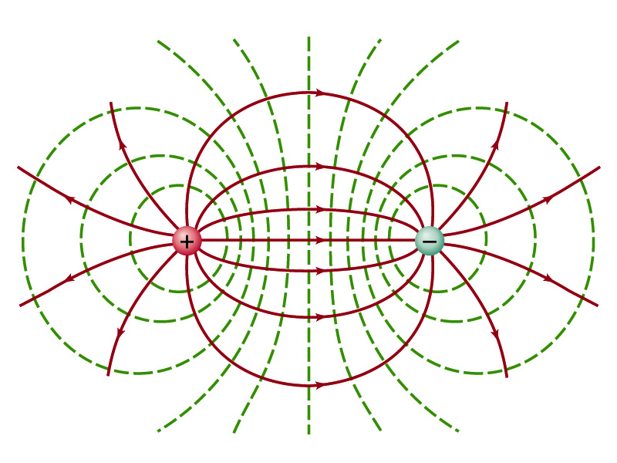

Equi-potential Surfaces
An equipotential surface (line) must be perpendicular to the electric field. Why?
  If there are any parallel components to the electric field, it would require work to move a charge along the surface.
Since the equipotential surface (line) is perpendicular to the electric field, we can draw these surfaces or lines easily.
Since there can be no electric field within a conductor in a static case, the entire volume of a solid conductor must be at the same potential.
So the electric field must be perpendicular to the conductor surface.
Parallel Plate
Point charges
Just like a topological map

Slide 6
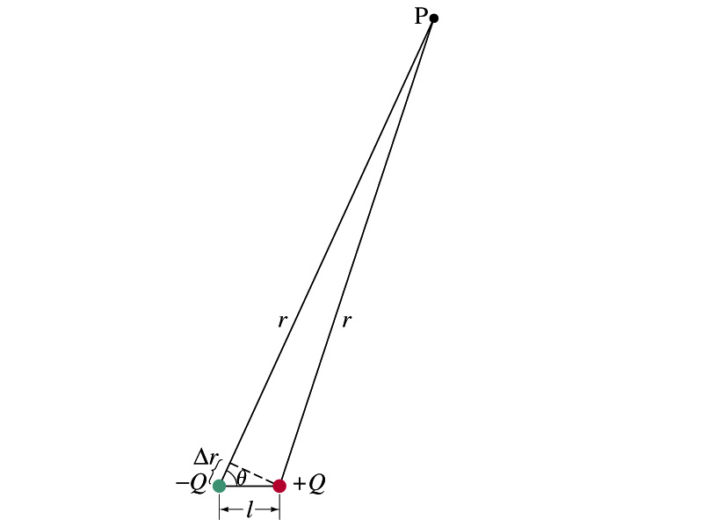
Electric Potential due to Electric Dipoles
What is an electric dipole?
  Two equal point charge Q of opposite signs separated by a distance l and behaves like one entity: p=Ql
For the electric potential due to a dipole at a point P
  We take V=0 at r=∞
The simple sum of the potential at P by the two charges is
Since Δr=lcosθ and if r>>l, r>>Δr, thus r~r+Δr and
V by a dipole at a
distance r from
the dipole

Slide 7
E Determined from V
Potential difference between two points under an electric field is
So in a differential form, we can write
  What are dV and E_{l}?
    dV is the infinitesimal potential difference between the two points separated by a distance dl
    E_{l} is the field component along the direction of dl.
Thus we can write the field component E_{l} as
The component of the electric field in any direction is equal to the negative rate of change of the electric potential as a function of distance in that direction.!!
Physical Meaning?

Slide 8
E Determined from V
The quantity dV/dl is called the gradient of V in a particular direction
  If no direction is specified, the term gradient refers to the direction on which V changes most rapidly and this would be the direction of the field vector E at that point.
  So if E and dl are parallel to each other,
If E is written as a function x, y and z, the l refers to x, y and z
is the “partial derivative” of V with respect to x, while y and z are held constant
In vector form,
is called del or the gradient operator and is a vector operator.

Slide 9
Electrostatic Potential Energy
Consider a case in which a point charge q is moved between points a and b where the electrostatic potential due to other charges in the system is V_{a} and V_{b}
The change in electrostatic potential energy of q in the field by other charges is
Now what is the electrostatic potential energy of a system of charges?
  Let’s choose V=0 at r=∞
  If there are no other charges around, single point charge Q₁ in isolation has no potential energy and is under no electric force

Slide 10
Electrostatic Potential Energy; Two charges
If a second point charge Q₂ is brought close to Q₁ at a distance r₁₂, the potential due to Q₁ at the position of Q₂ is
The potential energy of the two charges relative to V=0 at r= ∞ is
  This is the work that needs to be done by an external force to bring Q₂ from infinity to the distance r₁₂ from Q₁.
  It is also a negative of the work needed to separate them to infinity.

Slide 11
Electrostatic Potential Energy; Three Charges
So what do we do for three charges?
Work is needed to bring all three charges together
  Work needed to bring Q₁ to a certain location without the presence of any charge is 0.
  Work needed to bring Q₂ to a distance to Q₁ is
  Work need to bring Q₃ to certain distances to Q₁ and Q₂ is
So the total electrostatic potential energy of the three charge system is
  What about a four charge system or N charge system?

Slide 12
Electrostatic Potential Energy: electron Volt
What is the unit of electrostatic potential energy?
  Joules
Joules is a very large unit in dealing with electrons, atoms or molecules atomic scale problems
For convenience a new unit, electron volt (eV), is defined
  1 eV is defined as the energy acquired by a particle carrying the magnitude of the charge equal to that of an electron (q=e) when it moves across a potential difference of 1V.
  How many Joules is 1 eV then?
eV however is NOT a standard SI unit. You must convert the energy to Joules for computations.
What is the speed of an electron with kinetic energy 5000eV?

