Slide 1
PHYS 1441 – Section 002 Lecture #10
Wednesday, Oct. 3, 2018
Dr. Jaehoon Yu
Chapter 24 Capacitance etc..
Capacitors
Capacitors in Series or Parallel
Electric Energy Storage
Effect of Dielectric
Molecular description of Dielectric Material

Slide 2
Announcements
Mid Term Exam
In class Wednesday, Oct. 17
Covers CH21.1 through what we cover in class Monday, Oct. 15 + appendix
Bring your calculator but DO NOT input formula into it!
Cell phones or any types of computers cannot replace a calculator!
BYOF: You may bring a one 8.5x11.5 sheet (front and back) of handwritten formulae and values of constants
No derivations, word definitions or solutions of any kind!
No additional formulae or values of constants will be provided!
Colloquium 4pm today in SH101
Dr. Xi Zhang of U.C. Santa Cruz

Slide 3
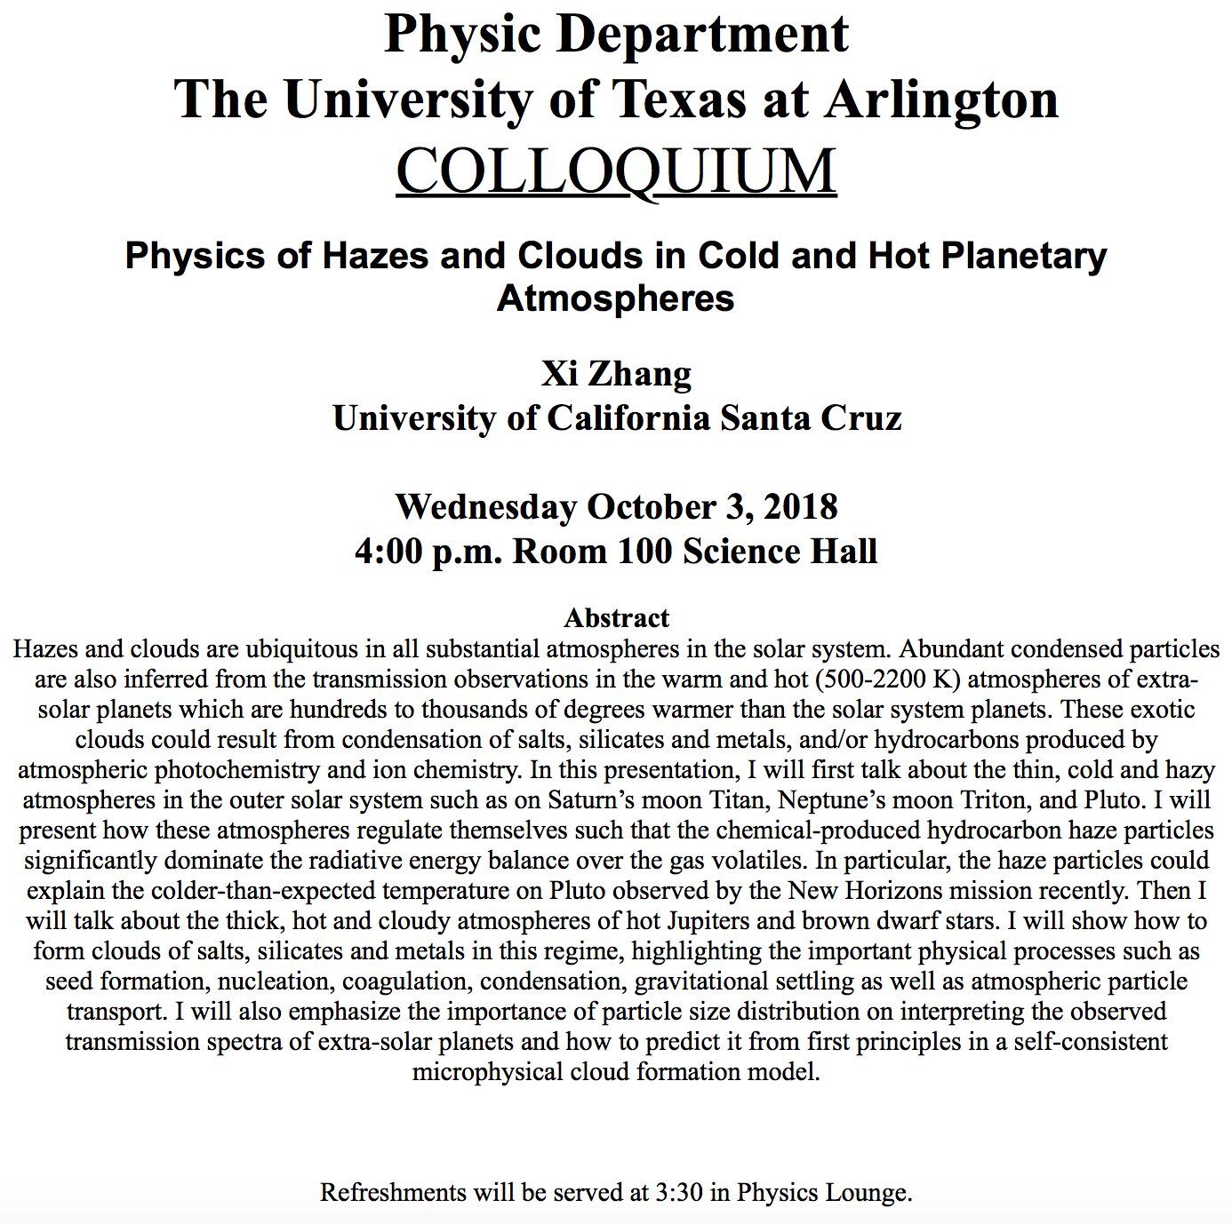

Slide 4
Capacitors (or Condensers)
What is a capacitor?
A device that can store electric charge
But does not let them flow through
What does a capacitor consist of?
Usually consists of two conducting objects (plates or sheets) placed near each other without touching
Why can’t they touch each other?
The charge will neutralize…
Can you give some examples?
Camera flash, Surge protectors, binary circuits, memory, etc…
How is the capacitor different than the battery?
Battery provides potential difference by storing energy (usually chemical energy) while the capacitor stores charges but very little energy.

Slide 5
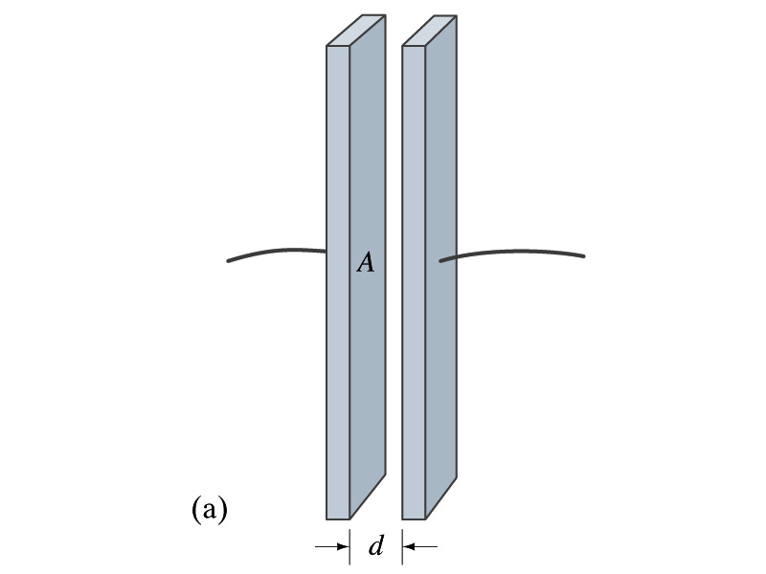
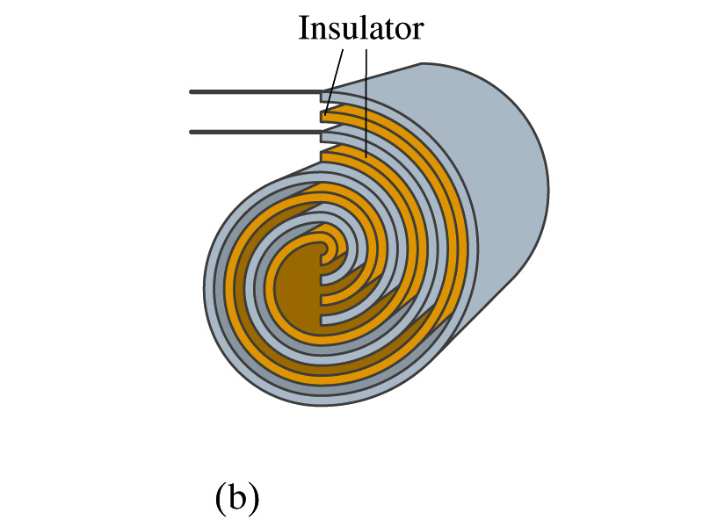
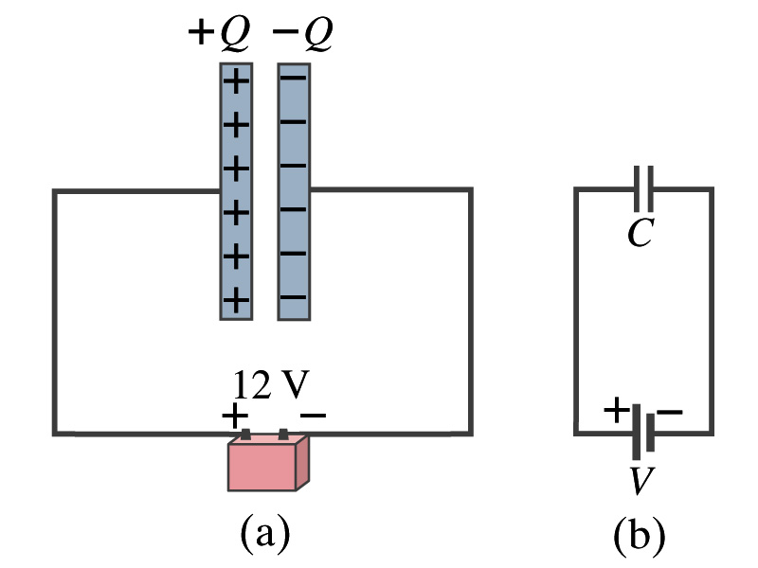
Capacitors
A simple capacitor consists of a pair of parallel plates of area A separated by a distance d.
A cylindrical capacitor is essentially parallel plates wrapped around as a cylinder.
How do you draw symbols for a capacitor and a battery in a circuit diagram?
Capacitor -||-
Battery (+) -|i- (-)
Circuit
Diagram

Slide 6
Capacitors
What do you think will happen if a battery is connected ( or the voltage is applied) to a capacitor?
The capacitor gets charged quickly, one plate positive and the other negative in equal amount.
The battery terminals, the wires and the plates are conductors. What does this mean?
All conductors are at the same potential. And?
So the full battery voltage is applied across the capacitor plates.
So for a given capacitor, the amount of charge stored on each capacitor plate is proportional to the potential difference V_{ba} between the plates. How would you write this formula?
C is a proportionality constant, called the capacitance of the device.
What is the unit?
C is the property of a capacitor so does not depend on Q or V.
C/V
or
Farad (F)
Normally use μF or pF.

Slide 7
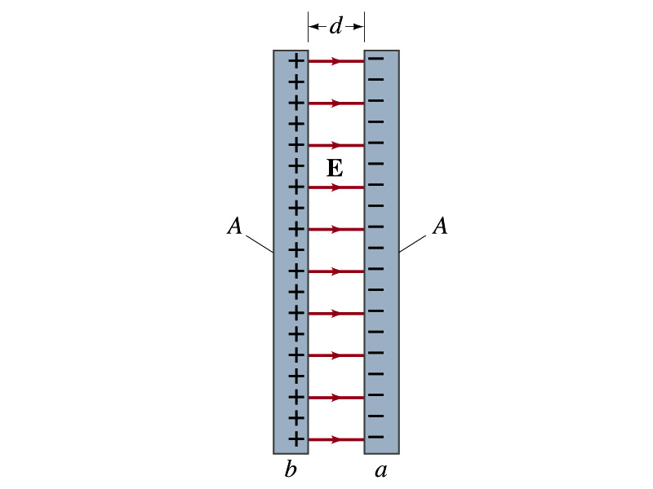
Determination of Capacitance
C can be determined analytically for a capacitor with a simple geometry and air in between.
Let’s consider a parallel plate capacitor.
Plates have area A each and separated by d.
d is smaller than the length, and so E is uniform.
E for parallel plates is E=σ/ε₀, σ=Q/A is the surface charge density.
E and V are related
Since we take the integral from the lower potential (a) to the higher potential (b) along the field line, we obtain
So from the formula:
What do you notice?
C only depends on the area and the distance of the plates and the permittivity of the medium between them.

Slide 8
Example 24 – 1
Capacitor calculations: (a) Calculate the capacitance of a capacitor whose plates are 20cmx3.0cm and are separated by a 1.0mm air gap. (b) What is the charge on each plate if the capacitor is connected to a 12-V battery? (c) What is the electric field between the plates? (d) Estimate the area of the plates needed to achieve a capacitance of 1F, given the same air gap.
(a) Using the formula for a parallel plate capacitor, we obtain
(b) From Q=CV, the charge on each plate is

Slide 9
Example 24 – 1
(C) Using the formula for the electric field in two parallel plates
Or, since
we can obtain
(d) Solving the capacitance formula for A, we obtain
Solve for A
About 40% the area of Arlington (256km²).

Slide 10
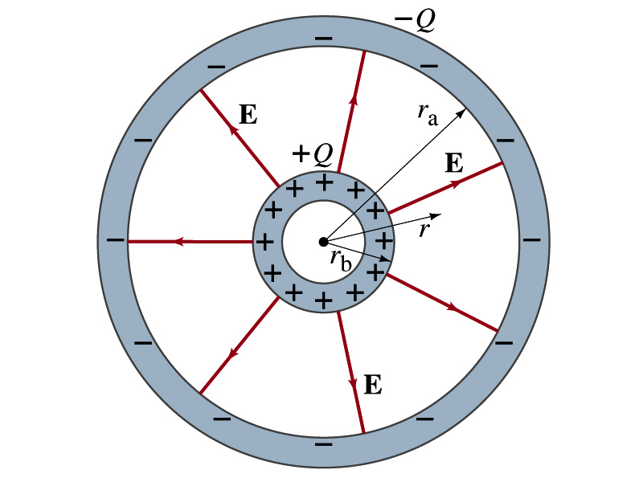
Example 24 – 3
Spherical capacitor: A spherical capacitor consists of two thin concentric spherical conducting shells, of radius r_{a} and r_{b}, as in the figure. The inner shell carries a uniformly distributed charge Q on its surface and the outer shell an equal but opposite charge –Q. Determine the capacitance of the two shells.
Using Gauss’ law, the electric field outside a uniformly charged conducting sphere is
So the potential difference between a and b is
Thus capacitance is

Slide 11
Capacitor Cont’d
A single isolated conductor can be said to have a capacitance, C.
C can still be defined as the ratio of the charge to the absolute potential V on the conductor.
So Q=CV.
The potential of a single conducting sphere of radius r_{b} can be obtained as
where
So its capacitance is

