Slide 1
PHYS 1441 – Section 002 Lecture #10
Wednesday, Oct. 3, 2018
Dr. Jaehoon Yu
Chapter 24 Capacitance etc..
Capacitors
Capacitors in Series or Parallel
Electric Energy Storage
Effect of Dielectric
Molecular description of Dielectric Material

Slide 2
Announcements
Mid Term Exam
In class Wednesday, Oct. 17
Covers CH21.1 through what we cover in class Monday, Oct. 15 + appendix
Bring your calculator but DO NOT input formula into it!
Cell phones or any types of computers cannot replace a calculator!
BYOF: You may bring a one 8.5x11.5 sheet (front and back) of handwritten formulae and values of constants
No derivations, word definitions or solutions of any kind!
No additional formulae or values of constants will be provided!
Colloquium 4pm today in SH101
Dr. Xi Zhang of U.C. Santa Cruz

Slide 3
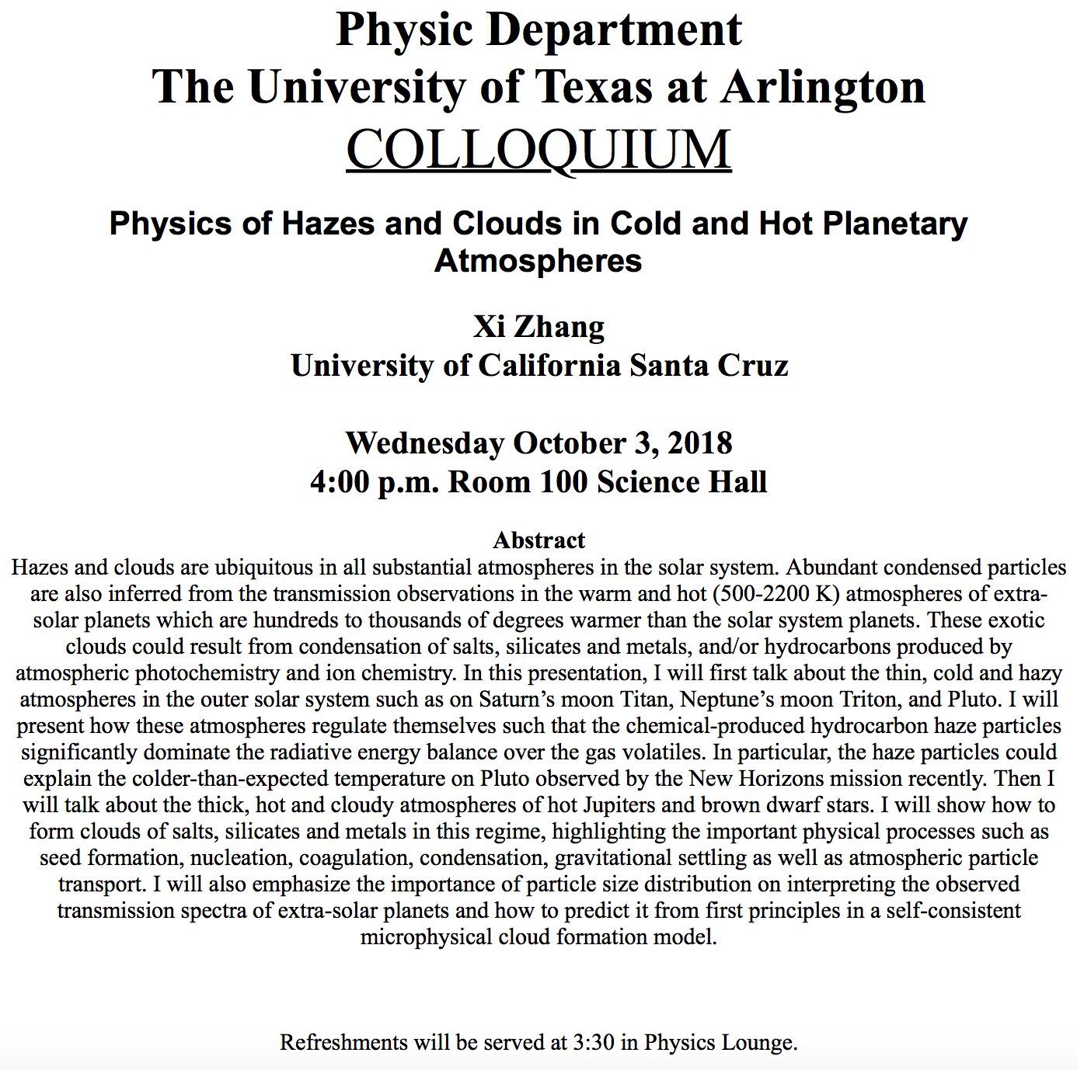

Slide 4
Capacitors (or Condensers)
What is a capacitor?
A device that can store electric charge
But does not let them flow through
What does a capacitor consist of?
Usually consists of two conducting objects (plates or sheets) placed near each other without touching
Why can’t they touch each other?
The charge will neutralize…
Can you give some examples?
Camera flash, Surge protectors, binary circuits, memory, etc…
How is the capacitor different than the battery?
Battery provides potential difference by storing energy (usually chemical energy) while the capacitor stores charges but very little energy.

Slide 5
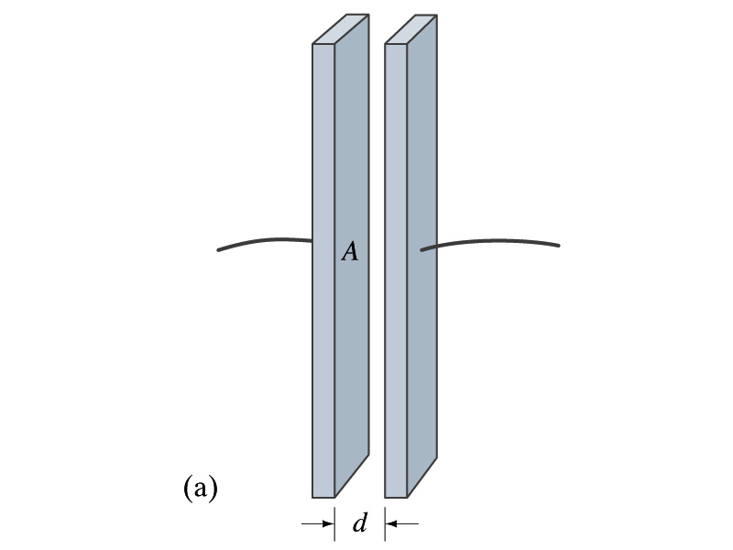
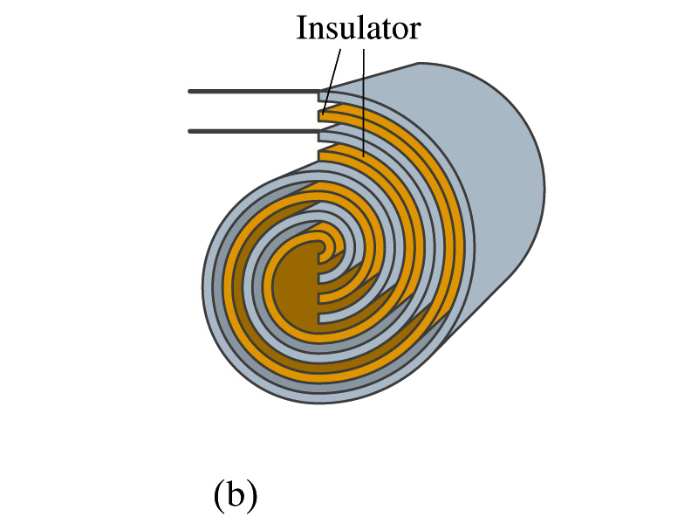
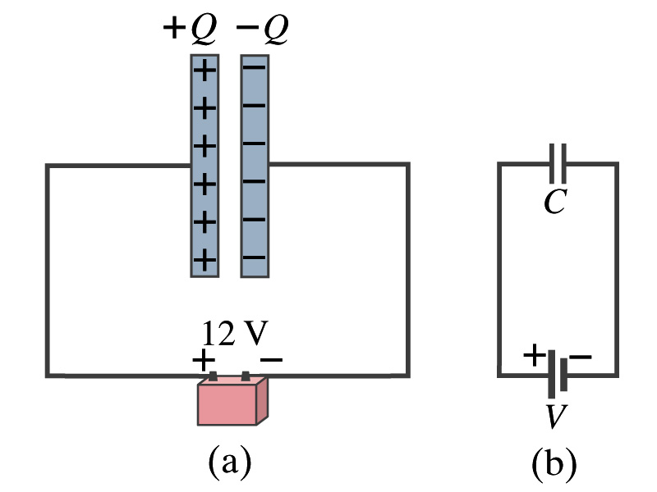
Capacitors
A simple capacitor consists of a pair of parallel plates of area A separated by a distance d.
A cylindrical capacitor is essentially parallel plates wrapped around as a cylinder.
How do you draw symbols for a capacitor and a battery in a circuit diagram?
Capacitor -||-
Battery (+) -|i- (-)
Circuit
Diagram

Slide 6
Capacitors
What do you think will happen if a battery is connected ( or the voltage is applied) to a capacitor?
The capacitor gets charged quickly, one plate positive and the other negative in equal amount.
The battery terminals, the wires and the plates are conductors. What does this mean?
All conductors are at the same potential. And?
So the full battery voltage is applied across the capacitor plates.
So for a given capacitor, the amount of charge stored on each capacitor plate is proportional to the potential difference V_{ba} between the plates. How would you write this formula?
C is a proportionality constant, called the capacitance of the device.
What is the unit?
C is the property of a capacitor so does not depend on Q or V.
C/V
or
Farad (F)
Normally use μF or pF.

Slide 7
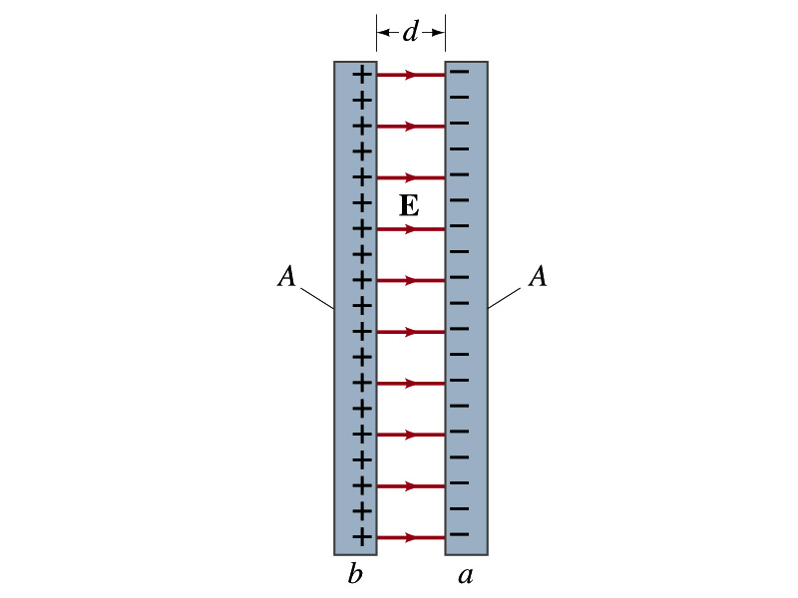
Determination of Capacitance
C can be determined analytically for a capacitor with a simple geometry and air in between.
Let’s consider a parallel plate capacitor.
Plates have area A each and separated by d.
d is smaller than the length, and so E is uniform.
E for parallel plates is E=σ/ε₀, σ=Q/A is the surface charge density.
E and V are related
Since we take the integral from the lower potential (a) to the higher potential (b) along the field line, we obtain
So from the formula:
What do you notice?
C only depends on the area and the distance of the plates and the permittivity of the medium between them.

Slide 8
Example 24 – 1
Capacitor calculations: (a) Calculate the capacitance of a capacitor whose plates are 20cmx3.0cm and are separated by a 1.0mm air gap. (b) What is the charge on each plate if the capacitor is connected to a 12-V battery? (c) What is the electric field between the plates? (d) Estimate the area of the plates needed to achieve a capacitance of 1F, given the same air gap.
(a) Using the formula for a parallel plate capacitor, we obtain
(b) From Q=CV, the charge on each plate is

Slide 9
Example 24 – 1
(C) Using the formula for the electric field in two parallel plates
Or, since
we can obtain
(d) Solving the capacitance formula for A, we obtain
Solve for A
About 40% the area of Arlington (256km²).

Slide 10
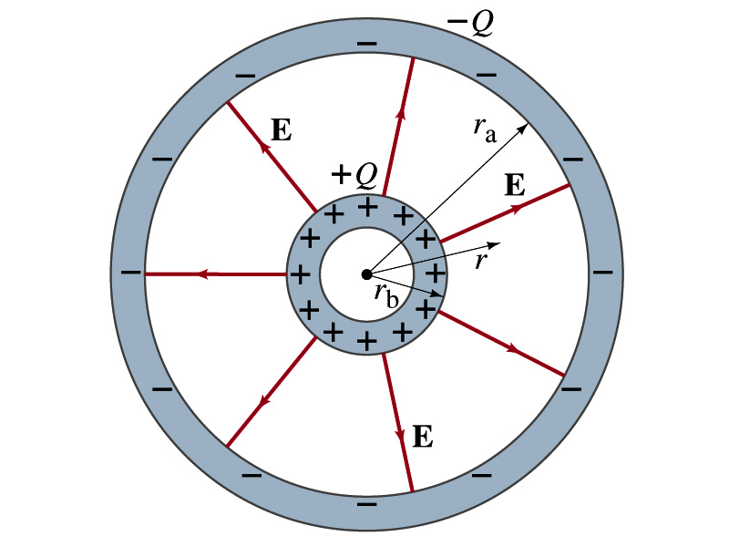
Example 24 – 3
Spherical capacitor: A spherical capacitor consists of two thin concentric spherical conducting shells, of radius r_{a} and r_{b}, as in the figure. The inner shell carries a uniformly distributed charge Q on its surface and the outer shell an equal but opposite charge –Q. Determine the capacitance of the two shells.
Using Gauss’ law, the electric field outside a uniformly charged conducting sphere is
So the potential difference between a and b is
Thus capacitance is

Slide 11
Capacitor Cont’d
A single isolated conductor can be said to have a capacitance, C.
C can still be defined as the ratio of the charge to the absolute potential V on the conductor.
So Q=CV.
The potential of a single conducting sphere of radius r_{b} can be obtained as
where
So its capacitance is

Slide 12
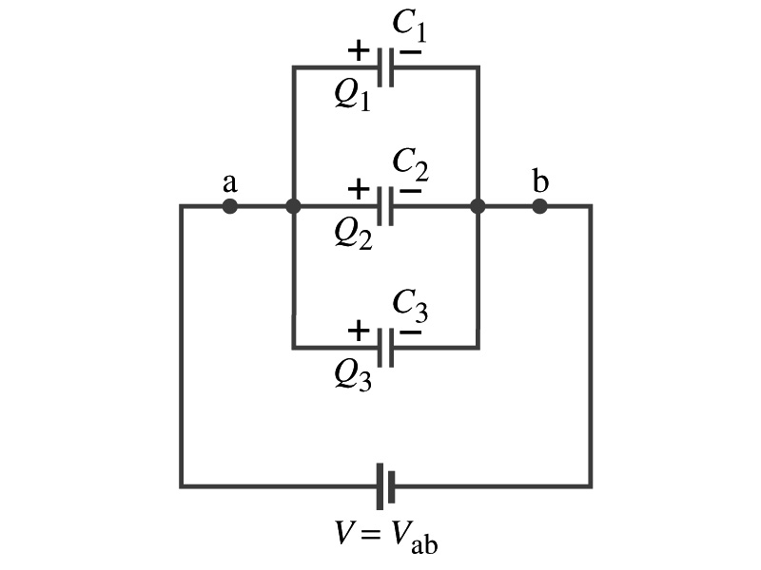
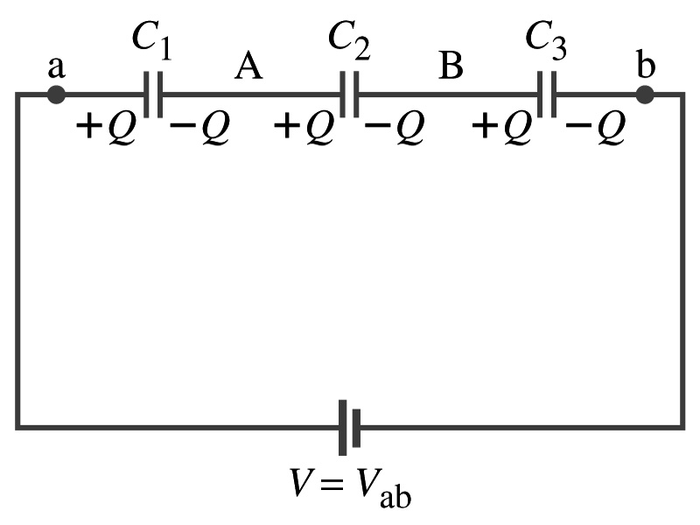
Capacitors in Series or Parallel
Capacitors may be used in electric circuits
What is an electric circuit?
A closed path of conductors, usually wires connecting capacitors and other electrical devices, in which
charges can flow
And includes a voltage source such as a battery
Capacitors can be connected in various ways.
In parallel, in series or in combination

Slide 13
Capacitors in Parallel
Parallel arrangement provides the same voltage across all the capacitors.
Left hand plates are at V_{a} and right hand plates are at V_{b}
So each capacitor plate acquires charges given by the formula
Q₁=C₁V, Q₂=C₂V, and Q₃=C₃V
The total charge Q that must leave the battery is then
Q=Q₁+Q₂+Q₃=V(C₁+C₂+C₃)
Consider that the three capacitors behave like an equivalent one
Q=C_{eq}V= V(C₁+C₂+C₃)
Thus the equivalent capacitance in parallel is
What is the net effect?
The capacitance increases!!!

Slide 14
Capacitors in Series
Series arrangement is more interesting
When battery is connected, +Q flows to the left plate of C₁ and –Q flows to the right plate of C₃.
Since capacitors in between were originally neutral, charges get induced to neutralize the ones in the middle.
So the charge on each capacitor plate is the same value, Q. (Same charge)
Consider that the three capacitors behave like an equivalent one
Q=C_{eq}V
The total voltage V across the three capacitors in series must be equal to the sum of the voltages across each capacitor.
V=V₁+V₂+V₃=Q/C₁+Q/C₂+Q/C₃
Putting all these together, we obtain:
V=Q/C_{eq}=Q(1/C₁+1/C₂+1/C₃)
Thus the equivalent capacitance is
What is the net effect?
The capacitance smaller than the smallest C!!!

Slide 15
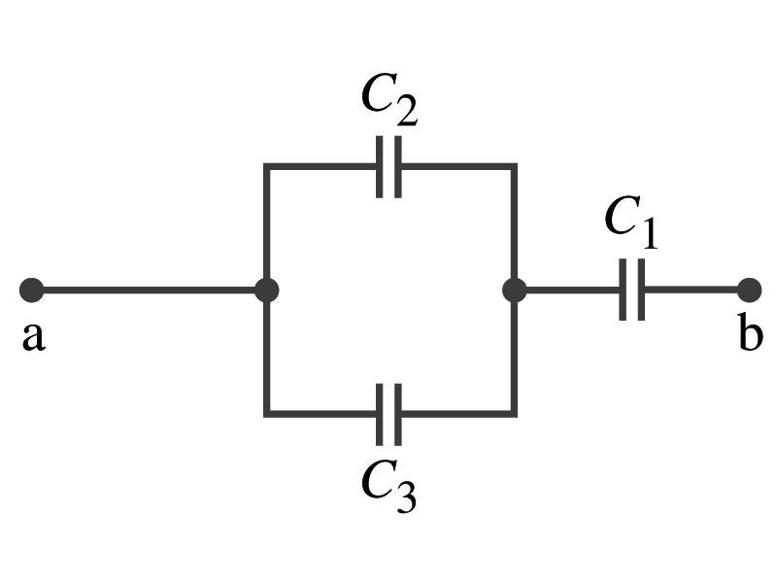
Example 24 – 5
Equivalent Capacitor: Determine the capacitance of a single capacitor that will have the same effect as the combination shown in the figure. Take C₁=C₂=C₃=C.
We should do these first!!
How?
These are in parallel so the equivalent capacitance is:
Now the equivalent capacitor is in series with C1.
Solve for C_{eq}

Slide 16
Electric Energy Storage
A charged capacitor stores energy.
The stored energy is the amount of the work done to charge it.
The net effect of charging a capacitor is removing one type of charge from one plate and put them on to the other.
Battery does this when it is connected to a capacitor.
Capacitors do not get charged immediately.
Initially when the capacitor is uncharged, no work is necessary to move the first bit of charge. Why?
Since there is no charge, there is no field that the external work needs to overcome.
When some charge is on each plate, it requires work to add more charges of the same sign due to the electric repulsion.

Slide 17
Electric Energy Storage
The work needed to add a small amount of charge, dq, when a potential difference across the plate is V: dW=Vdq.
Since V=q/C, the work needed to store total charge Q is
Thus, the energy stored in a capacitor when the capacitor carries the charges +Q and –Q is
Since Q=CV, we can rewrite

Slide 18
Example 24 – 8
Energy store in a capacitor: A camera flash unit stores energy in a 150μF capacitor at 200V. How much electric energy can be stored?
Using the formula for stored energy.
Umm.. Which one?
What do we know from the problem?
C and V
So we use the one with C and V:
How do we get J from FV²?

Slide 19
Electric Energy Density
The energy stored in a capacitor can be considered as being stored in the electric field between the two plates
For a uniform field E between two plates, V=Ed and C=ε₀A/d
Thus the stored energy is
Since Ad is the gap volume V, we can obtain the energy density, stored energy per unit volume, as
Valid for any space that is vacuum
Electric energy stored per unit volume in any region of space is proportional to the square of E in that region.

Slide 20
Dielectrics
Capacitors have an insulating sheet of material, called dielectric, between the plates to
Increase breakdown voltage greater than that in air (3MV/m)
Apply higher voltage to the gap without the charge passing across
Allow the plates get closer together without touching
Increases capacitance ( recall C=ε₀A/d)
Increase the capacitance by the dielectric constant
Where C₀ is the intrinsic capacitance when the gap is vacuum

Slide 21
Dielectrics
The value of dielectric constant K varies depending on the material (Table 24 – 1)
K for vacuum is 1.0000
K for air is 1.0006 (this is why permittivity of air and vacuum are used interchangeably.)
K for paper is 3.7
Maximum electric field before breakdown occurs is called the dielectric strength. What is its unit?
V/m
The capacitance of a parallel plate capacitor with a dielectric (K) filling the gap is

Slide 22
Dielectrics
A new quantity of the permittivity of a dielectric material is defined as ε=Kε₀
The capacitance of a parallel plate capacitor with a dielectric medium filling the gap is
The energy density stored in an electric field E in a dielectric is
Valid for any space w/ dielectric w/ permittivity ε.
What is the stored energy in between ProtoDUNE cathode (-600kV) plate (6mx6m) and the cryostat wall (0V), d=1.5m, LAr K=1.6?

Slide 23
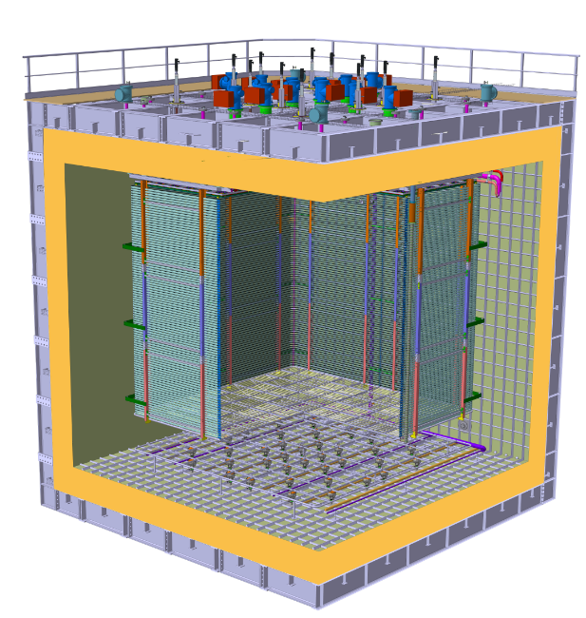
ProtoDUNE Dual Phase
Field Cage and cathode hangs off of the ceiling
Essential to have light yet sturdy structure
Based on modular concept as SP
Charge Readout Planes
6 m
Field Cage (common structural elements with SP)
1.5 m
Cathode
6 m

Slide 24
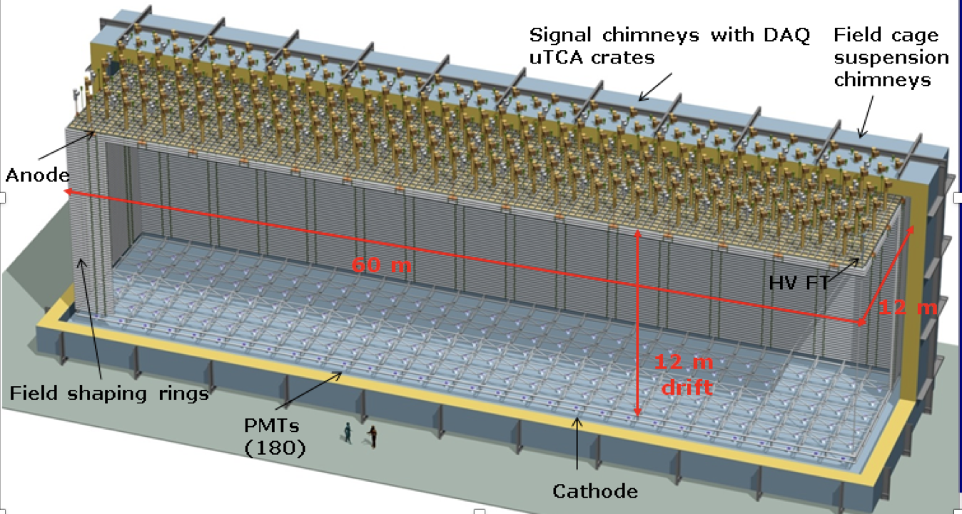
DUNE Dual Phase
Cathode

Slide 25
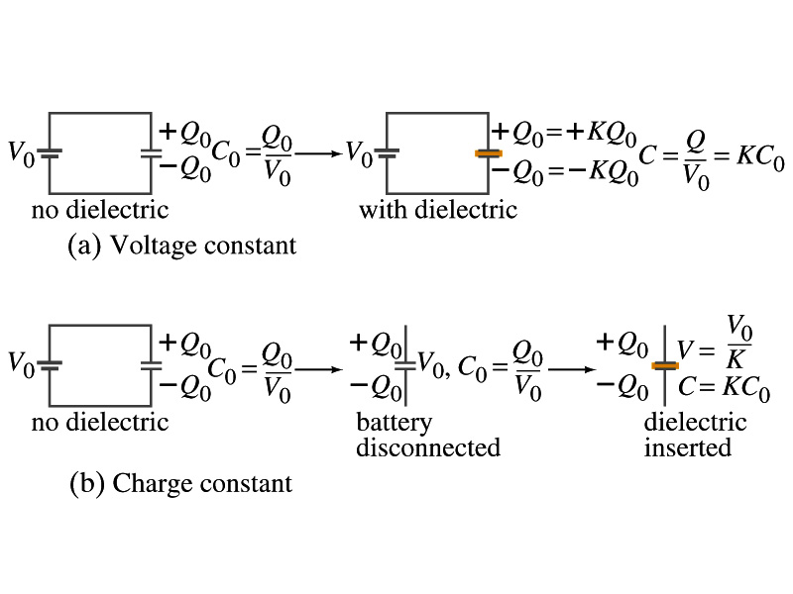
Effect of a Dielectric Material on Capacitance
Let’s consider the two cases below:
Case #1 : constant V
Case #2 : constant Q
Constant voltage: Experimentally observed that the total charge on the each plate of the capacitor increases by K as a dielectric material is inserted between the gap ➔ Q=KQ₀
The capacitance increased to C=Q/V₀=KQ₀/V₀=KC₀
Constant charge: Voltage found to drop by a factor K ➔ V=V₀/K
The capacitance increased to C=Q₀/V=KQ₀/V₀=KC₀

Slide 26
Effect of a Dielectric Material on Field
What happens to the electric field within a dielectric?
Without a dielectric, the field is
What are V₀ and d?
V₀: Potential difference between the two plates
d: separation between the two plates
For the constant voltage, the electric field remains the same
For the constant charge: the voltage drops to V=V₀/K, thus the field in the dielectric is
The field in the dielectric is reduced.

Slide 27
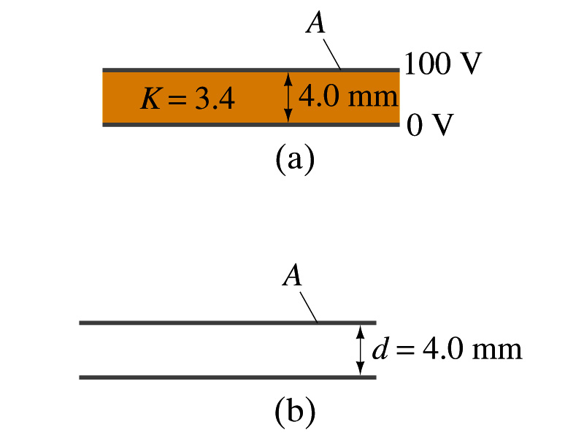
Example 24 – 11
Dielectric Removal: A parallel-plate capacitor, filled with the dielectric of K=3.4, is connected to a 100-V battery. After the capacitor is fully charged, the battery is disconnected. The plates have area A=4.0m², and are separated by d=4.0mm. (a) Find the capacitance, the charge on the capacitor, the electric field strength, and the energy stored in the capacitor. (b) The dielectric is carefully removed, without changing the plate separation nor does any charge leave the capacitor. Find the new value of capacitance, electric field strength, voltage between the plates and the energy stored in the capacitor.
(a)

Slide 28
Example 24 – 11 cont’d
(b)
Since the dielectric has been removed, the effect of dielectric constant must be removed as well.
Since charge is the same ( ) before and after the removal of the dielectric, we obtain
Wrong!
Where did the extra energy come from?
The energy conservation law is violated in electricity???
Wrong!
Wrong!
An external force has done the work of 3.6x10⁻⁴J on the system to remove dielectric!!

Slide 29
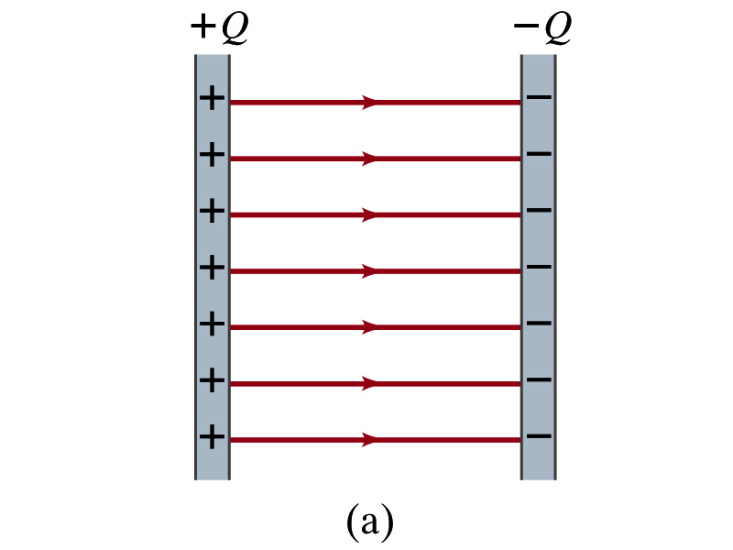
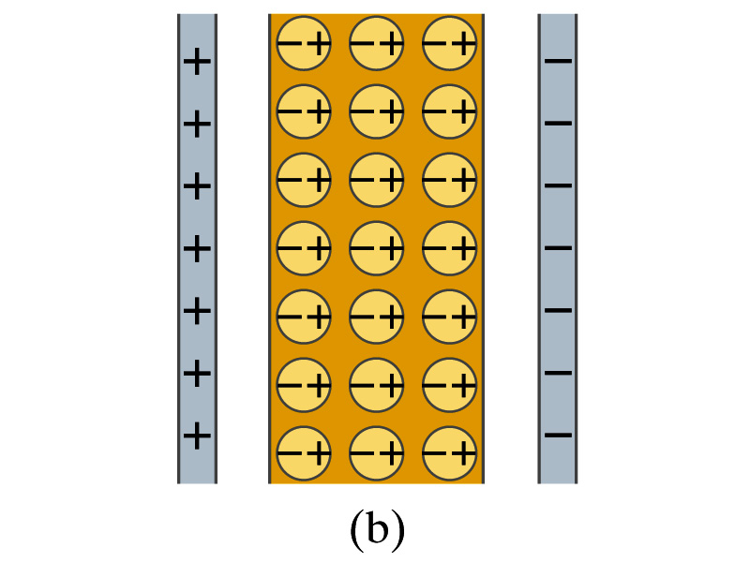
Molecular Description of Dielectric
So what in the world makes dielectrics behave the way they do?
We need to examine this in a microscopic scale.
Let’s consider a parallel plate capacitor that is charged up +Q(=C₀V₀) and –Q with air in between.
Assume there is no way any charge can flow in or out
Now insert a dielectric
Dielectric can be polar ➔ could have permanent dipole moment. What will happen?
Due to the electric field molecules will be aligned.

Slide 30
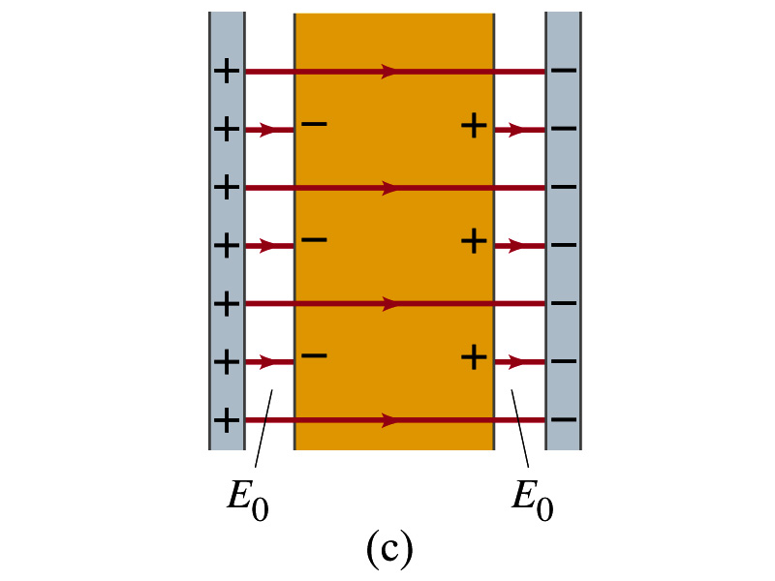
Molecular Description of Dielectric
OK. Then what happens?
Then effectively, there will be some negative charges close to the surface of the positive plate and positive charge on the negative plate
Some electric field do not pass through the whole dielectric but stops at the negative charge
So the field inside dielectric is smaller than the air
Since electric field is smaller, the force is smaller
The work need to move a test charge inside the dielectric is smaller
Thus the potential difference across the dielectric is smaller than across the air

Slide 31
Electric Current and Resistance
So far we have been studying static electricity
What is the static electricity?
The charges so far has not been moving but staying put at the location they are placed.
Now we will learn dynamics of electricity
What is the electric current?
A flow of electric charge
A few examples of the things that use electric current in everyday lives?
In an electrostatic situation, there is no electric field inside a conductor but when there is current, there is field inside a conductor. Why?
Electric field is needed to keep charges moving

Slide 32
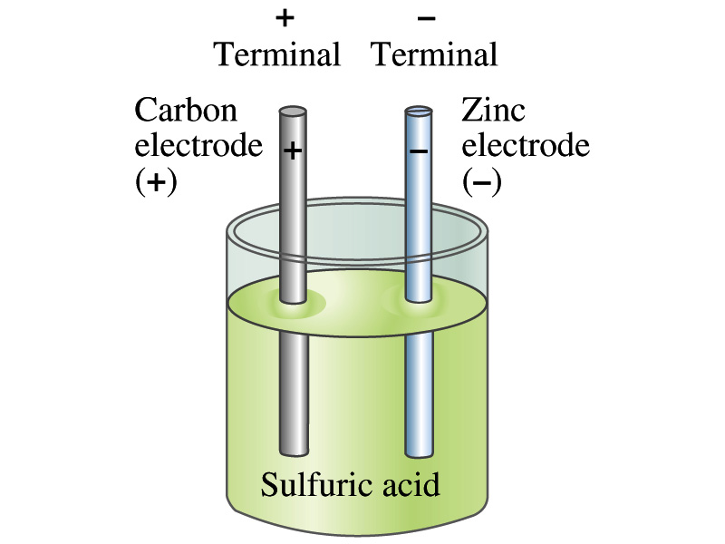
The Electric Battery
What is a battery?
A device that produces electrical energy from the stored chemical energy and produces electricity ➔ Maintains potential difference!
Electric battery was invented by Volta in 1790s in Italy
It was made of disks of zinc and silver based on his research that certain combinations of materials produce a greater electromotive force (emf), or potential, than others
Simplest batteries contain two plates made of dissimilar metals called electrodes
Electrodes are immersed in a solution, the electrolyte
This unit is called a cell and many of these form a battery
Zinc and Iron in the figure are called terminals

Slide 33
How does a battery work?
One of the electrodes in the figure is zinc and the other carbon
The acid electrolyte reacts with the zinc electrode and dissolves it.
Each zinc atom leaves two electrons in the electrode and enters into the solution as a positive ion ➔ zinc electrode acquires negative charge and the electrolyte (the solution) becomes positively charged
The carbon electrode picks up the positive charge
Since the two terminals are oppositely charged, there is a potential difference between them

Slide 34
How does a battery work?
When the terminals are not connected, only the necessary amount of zinc is dissolved into the solution.
How is a particular potential maintained?
If the terminals are not connected, as too many of zinc ion gets produced,
zinc electrode gets increasingly charged up negative
zinc ions get recombined with the electrons in zinc electrode
Why does battery go dead?
When the terminals are connected, the negative charges will flow away from the zinc electrode
More zinc atoms dissolve into the electrolyte to produce more charge
One or more electrode get used up not producing any more charge.

Slide 35
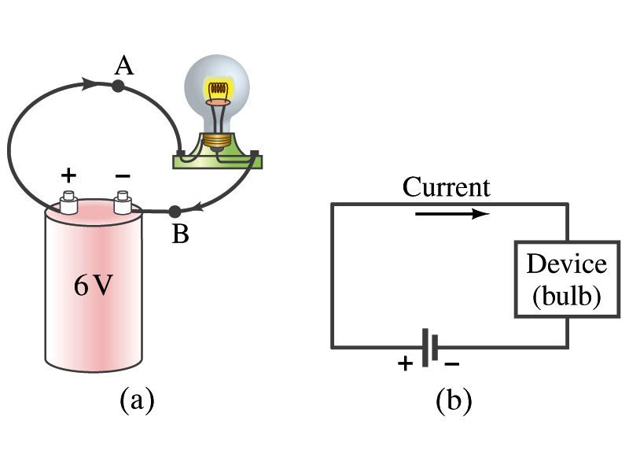
Electric Current
When a circuit is powered by a battery (or a source of emf) the charge can flow through the circuit.
Electric Current: Any flow of charge
Current can flow whenever there is a potential difference between the ends of a conductor (or when the two ends have opposite charges)
The current can flow even through the empty space under certain conditions
Electric current in a wire can be defined as the net amount of charge that passes through the wire’s full cross section at any point per unit time (just like the flow of water through a conduit.)
Average current is defined as:
The instantaneous current is:
What kind of a quantity is the current?
Unit of the current?
C/s
1A=1C/s
Scalar
In a single circuit, conservation of electric charge guarantees that the current at one point of the circuit is the same as any other points on the circuit.

Slide 36
Example 25 – 1
Current is a flow of charge: A steady current of 2.5A flows in a wire for 4.0min. (a) How much charge passed by any point in the circuit? (b) How many electrons would this be?
Current is total amount charge flown through a circuit in a given time. So from we obtain
The total number of electrons passed through the circuit is

