Slide 1
PHYS 1441 – Section 002 Lecture #11
Wednesday, Oct. 10, 2018
Dr. Jaehoon Yu
Chapter 24 Capacitance etc..
Effect of Dielectric
Molecular description of Dielectric Material
Chapter 25
Electric Current and Resistance
The Battery
Ohm’s Law: Resisters, Resistivity

Slide 2
Announcements
Reminder: Mid Term Exam
In class Wednesday, Oct. 17
Covers CH21.1 through what we cover in class Monday, Oct. 15 + appendix
Bring your calculator but DO NOT input formula into it!
Cell phones or any types of computers cannot replace a calculator!
BYOF: You may bring a one 8.5x11.5 sheet (front and back) of handwritten formulae and values of constants
No derivations, word definitions or solutions of any kind!
No additional formulae or values of constants will be provided!
Mid-term grade discussions
From 12:00 – 2:30pm, Wednesday, Oct. 24 in my office (CPB342)
Last name starts with A – D (12 – 12:30), E– K (12:30 – 1), L – O (1 – 1:30), P – S (1:30 – 2:00), T – Z (2-2:30)
Colloquium at 4pm today in SH100
Dr. G. Glass, UNT

Slide 3
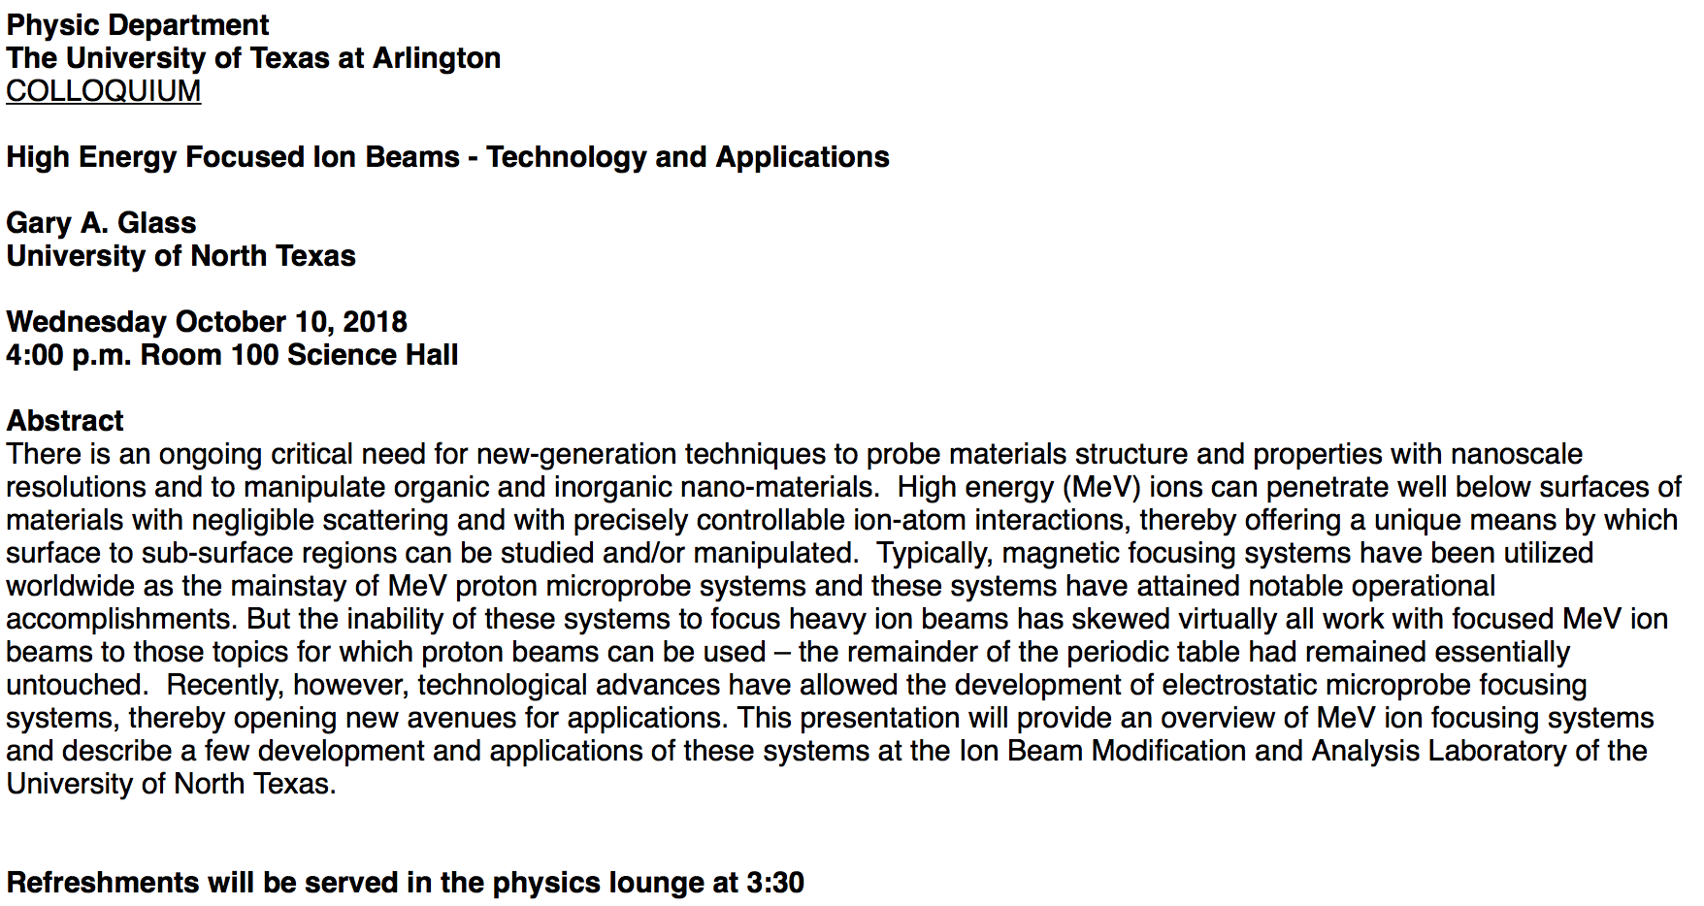

Slide 4
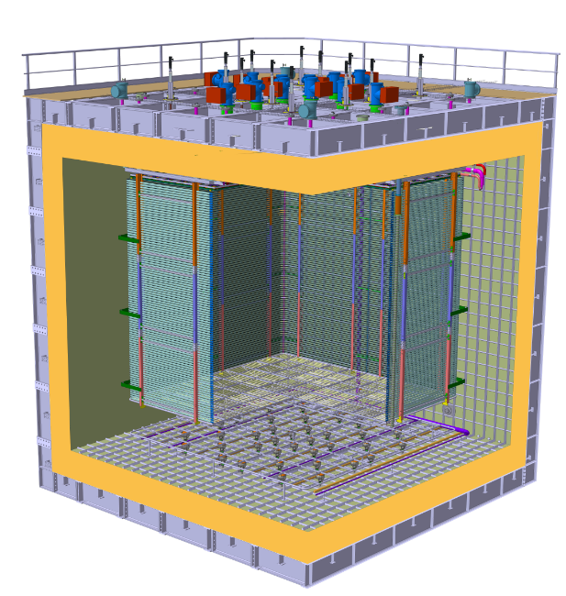
ProtoDUNE Dual Phase
Field Cage and cathode hangs off of the ceiling
Essential to have light yet sturdy structure
Based on modular concept as SP
Charge Readout Planes
6 m
Field Cage (common structural elements with SP)
0.98 m
Cathode
6 m
What is the stored energy in between ProtoDUNE cathode (-300kV) plate (6mx6m) and the cryostat wall (0V), d=98cm, LAr K=1.6?

Slide 5
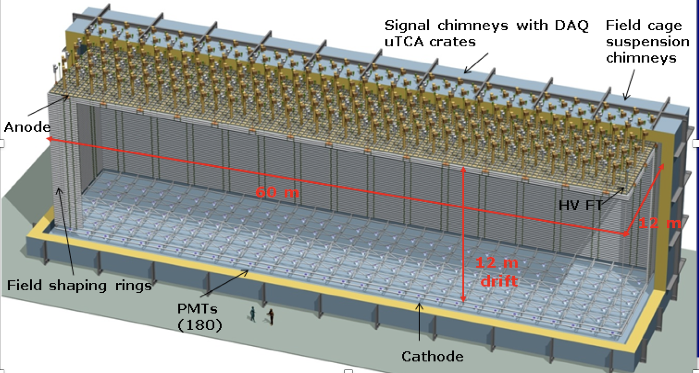
DUNE Dual Phase
Cathode
What are the stored energies in between DUNE cathode (-750kV) plate (12mx60m) and the cryostat wall (0V) and in between 3mx3m unit plate and the ground, d=98cm, LAr K=1.6?

Slide 6
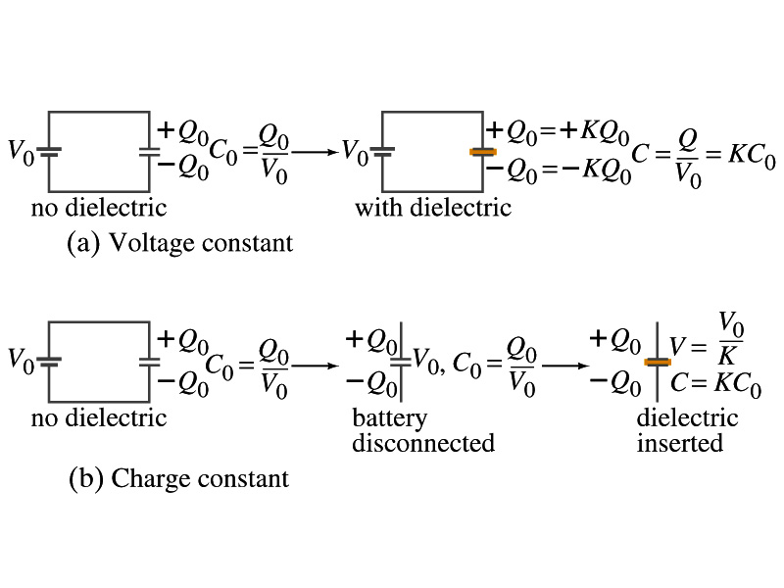
Effect of a Dielectric Material on Capacitance
Let’s consider the two cases below:
Case #1 : constant V
Case #2 : constant Q
Constant voltage: Experimentally observed that the total charge on each plate of the capacitor increases by K as a dielectric material is inserted between the gap ➔ Q=KQ₀
The capacitance increased to C=Q/V₀=KQ₀/V₀=KC₀➔Q=CV₀=KC₀V₀=KQ₀
Constant charge: Voltage found to drop by a factor K ➔ V=V₀/K
The capacitance increased to C=Q₀/V=KQ₀/V₀=KC₀➔V=Q₀/C=Q₀/(KC₀)=V₀/K

Slide 7
Effect of a Dielectric Material on Field
What happens to the electric field within a dielectric?
Without a dielectric, the field is
What are V₀ and d?
V₀: Potential difference between the two plates w/o dielectric
d: separation between the two plates
For the constant voltage, the electric field remains the same
For the constant charge: the voltage drops to V=V₀/K, thus the field in the dielectric is
The field in the dielectric is reduced.

Slide 8
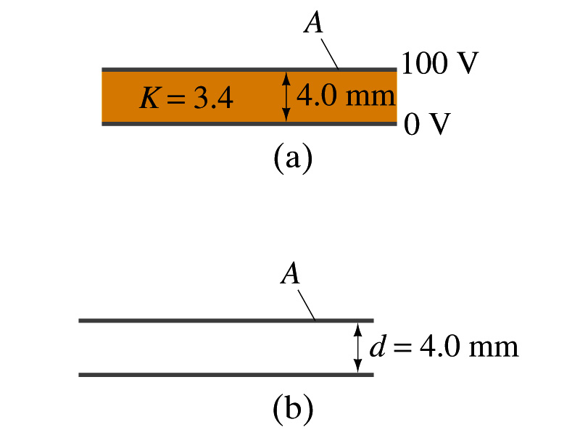
Example 24 – 11
Dielectric Removal: A parallel-plate capacitor, filled with the dielectric of K=3.4, is connected to a 100-V battery. After the capacitor is fully charged, the battery is disconnected. The plates have area A=4.0m², and are separated by d=4.0mm. (a) Find the capacitance, the charge on the capacitor, the electric field strength, and the energy stored in the capacitor. (b) The dielectric is carefully removed, without changing the plate separation nor does any charge leave the capacitor. Find the new value of capacitance, electric field strength, voltage between the plates and the energy stored in the capacitor.
(a)

Slide 9
Example 24 – 11 cont’d
(b)
Since the dielectric has been removed, the effect of dielectric constant must be removed as well.
Since charge is the same ( ) before and after the removal of the dielectric, we obtain
Wrong!
Where did the extra energy come from?
The energy conservation law is violated in electricity???
Wrong!
Wrong!
An external force has done the work of 3.6x10⁻⁴J on the system to remove dielectric!!

Slide 10
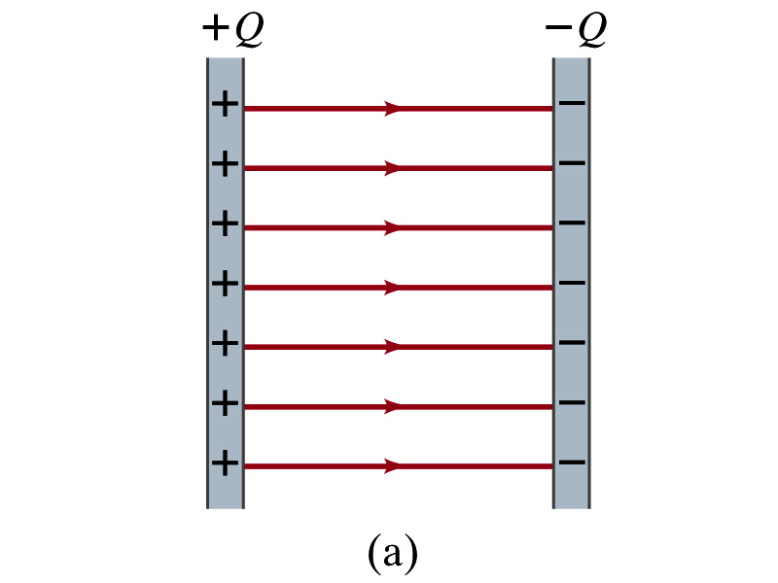
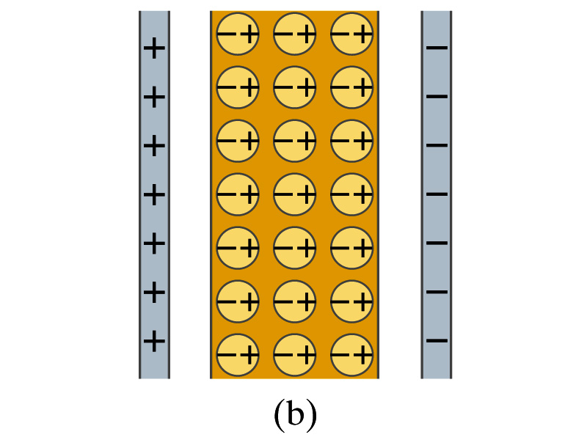
Molecular Description of Dielectric
So what in the world makes dielectrics behave the way they do?
We need to examine this in a microscopic scale.
Let’s consider a parallel plate capacitor that is charged up +Q(=C₀V₀) and –Q with air in between.
Assume there is no way any charge can flow in or out
Now insert a dielectric
Dielectric can be polar ➔ could have permanent dipole moment. What will happen?
Due to the electric field molecules will be aligned.

Slide 11
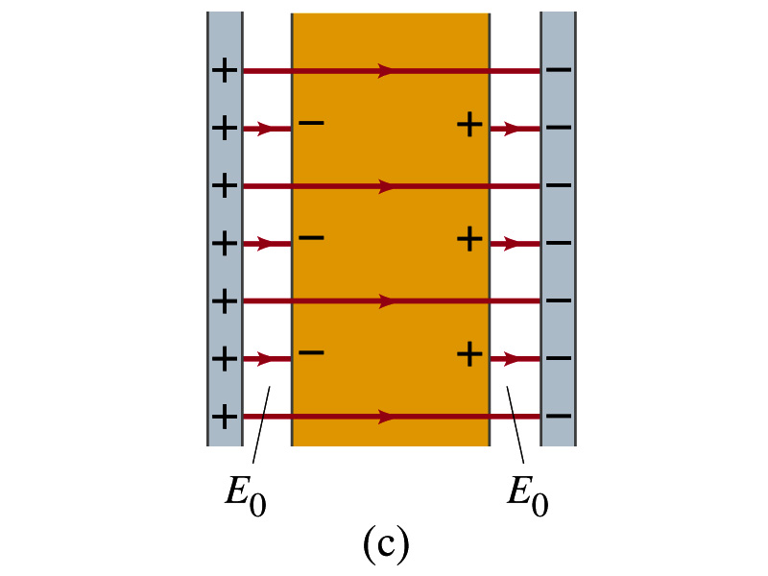
Molecular Description of Dielectric
OK. Then what happens?
Then effectively, there will be some negative charges close to the surface of the positive plate and positive charge on the negative plate
Some electric field do not pass through the whole dielectric but stops at the negative charge
So the field inside dielectric is smaller than the air
Since electric field is smaller, the force is smaller
The work need to move a test charge inside the dielectric is smaller
Thus the potential difference across the dielectric is smaller than across the air

Slide 12
Electric Current and Resistance
So far we have been studying static electricity
What is the static electricity?
The charges so far have not been moving but staying put at the location they are placed.
Now we will learn dynamics of electricity
What is the electric current?
A flow of electric charge
A few examples of the things that use electric current in everyday lives?
In an electrostatic situation, there is no electric field inside a conductor but when there is current, there is field inside a conductor. Why?
Electric field is needed to keep charges moving

Slide 13
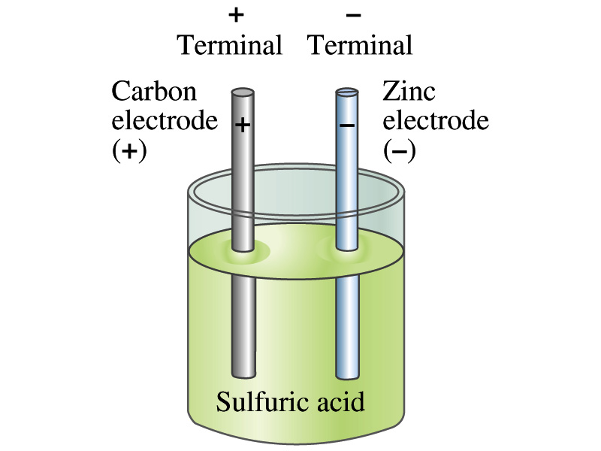
The Electric Battery
What is a battery?
A device that produces electrical energy from the stored chemical energy and produces electricity ➔ Maintains potential difference!
Electric battery was invented by Volta in 1790s in Italy
It was made of disks of zinc and silver based on his research that certain combinations of materials produce a greater electromotive force (emf), or potential, than others
Simplest batteries contain two plates made of dissimilar metals called electrodes
Electrodes are immersed in a solution, the electrolyte
This unit is called a cell and many of these form a battery
Zinc and Carbon in the figure are called terminals

Slide 14
How does a battery work?
One of the electrodes in the figure is zinc and the other carbon
The acid electrolyte reacts with the zinc electrode and dissolves it.
Each zinc atom leaves two electrons in the electrode and enters into the solution as a positive ion ➔ zinc electrode acquires negative charge and the electrolyte (the solution) becomes positively charged
The carbon electrode picks up the positive charge
Since the two terminals are oppositely charged, there is a potential difference between them

Slide 15
How does a battery work?
When the terminals are not connected, only the necessary amount of zinc is dissolved into the solution.
How is a particular potential maintained?
If the terminals are not connected, as too many of zinc ion gets produced,
zinc electrode gets increasingly charged up negative
zinc ions get recombined with the electrons in zinc electrode
Why does battery go dead?
When the terminals are connected, the negative charges will flow away from the zinc electrode
More zinc atoms dissolve into the electrolyte to produce more charge
One or more electrode get used up not producing any more charge.

Slide 16
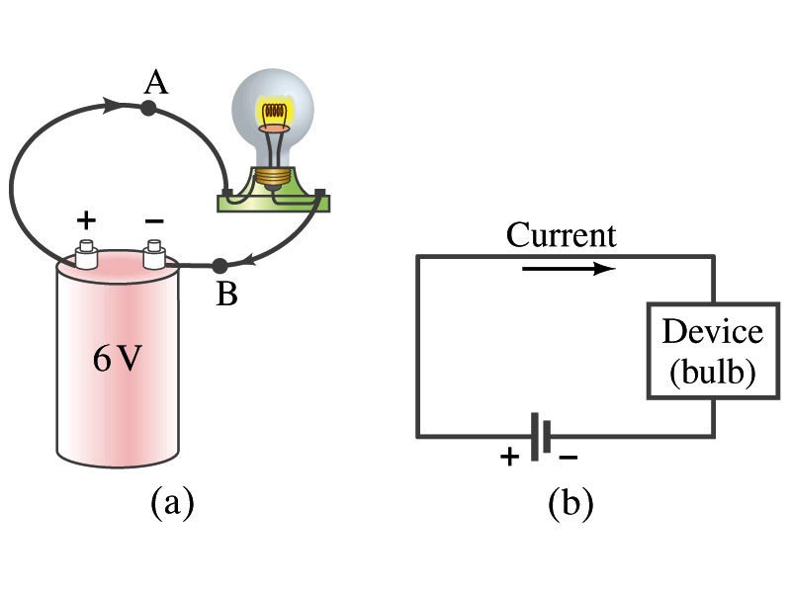
Electric Current
When a circuit is powered by a battery (or a source of emf) the charge can flow through the circuit.
Electric Current: Any flow of charge
Current can flow whenever there is a potential difference between the ends of a conductor (or when the two ends have opposite charges)
The current can flow even through the empty space under certain conditions
Electric current in a wire can be defined as the net amount of charge that passes through the wire’s full cross section at any point per unit time (just like the flow of water through a conduit.)
Average current is defined as:
The instantaneous current is:
What kind of a quantity is the current?
Unit of the current?
C/s
1A=1C/s
Scalar
In a single circuit, conservation of electric charge guarantees that the current at one point of the circuit is the same as any other points on the circuit.

Slide 17
Example 25 – 1
Current is a flow of charge: A steady current of 2.5A flows in a wire for 4.0min. (a) How much charge passed by any point in the circuit? (b) How many electrons would this be?
Current is total amount charge flown through a circuit in a given time. So from we obtain
The total number of electrons passed through the circuit is

Slide 18
Electric Current
When a circuit is powered by a battery (or a source of emf) the charge can flow through the circuit.
Electric Current: Any flow of charge
Current can flow whenever there is a potential difference between the ends of a conductor (or when the two ends have opposite charges)
The current can flow even through the empty space under certain conditions
Electric current in a wire can be defined as the net amount of charge that passes through the wire’s full cross section at any point per unit time (just like the flow of water through a conduit.)
Average current is defined as:
The instantaneous current is:
What kind of a quantity is the current?
Unit of the current?
C/s
1A=1C/s
Scalar
In a single circuit, conservation of electric charge guarantees that the current at one point of the circuit is the same as any other points on the circuit.

Slide 19
Example 25 – 1
Current is a flow of charge: A steady current of 2.5A flows in a wire for 4.0min. (a) How much charge passed by any point in the circuit? (b) How many electrons would this be?
Current is total amount charge flown through a circuit in a given time. So from we obtain
The total number of electrons passed through the circuit is

Slide 20
Direction of the Electric Current
What do conductors have in abundance?
Free electrons
What happens if a continuous loop of conducting wire is connected to the terminals of a battery?
Electrons start flowing through the wire continuously as soon as both the terminals are connected to the wire. How?
The potential difference between the battery terminals sets up an electric field inside the wire and in the direction parallel to it
Free electrons in the conducting wire get attracted to the positive terminal
The electrons leaving negative terminal flow through the wire and arrive at the positive terminal
Electrons flow from negative to positive terminal
Due to historical convention, the direction of the current is opposite to the direction of flow of electrons ➔ Conventional Current

Slide 21
Ohm’s Law: Resistance and Resistors
What do we need to produce electric current?
Potential difference
Georg S. Ohm experimentally established that the current is proportional to the potential difference ( )
If we connect a wire to a 12V battery, the current flowing through the wire is twice that of 6V, three times that of 4V and four times that of 3V battery.
What happens if we reverse the sign of the voltage?
It changes the direction of the current flow
Does not change the magnitude of the current
Just as in water flow case, if the height difference is large the flow rate is large ➔ If the potential difference is large, the current is large.

Slide 22
Ohm’s Law: Resistance
The exact amount of current flow in a wire depends on
The voltage
The resistance of the wire to the flow of electrons
Just like the gunk in water pipe slows down water flow
Electrons are slowed down due to interactions with the atoms of the wire
The higher the resistance the less the current for the given potential difference V
So how would you define resistance?
So that current is inversely proportional to the resistance
Often it is rewritten as
What does this mean?
The metal conductor’s resistance R is a constant independent of V.
This linear relationship is not valid for some materials like diodes, vacuum tubes, transistors etc. ➔ These are called non-ohmic
Unit?
Ohm’s Law
ohms

Slide 23
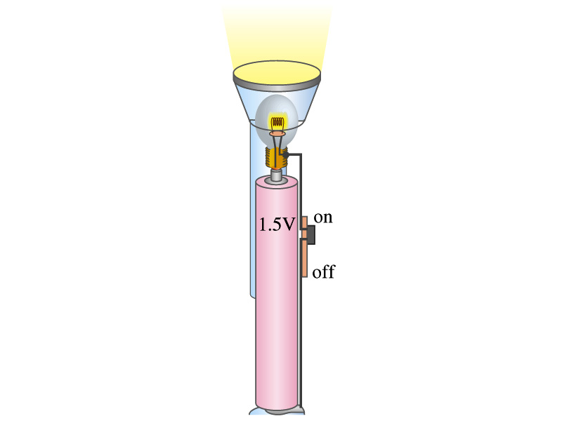
Example 25 – 4
Flashlight bulb resistance: A small flashlight bulb draws 300mA from its 1.5V battery. (a) What is the resistance of the bulb? (b) If the voltage drops to 1.2V, how would the current change?
From Ohm’s law, we obtain
Would the current increase or decrease, if the voltage reduces to 1.2V?
If the resistance did not change, the current is

