Slide 1
PHYS 1441 – Section 002
Lecture #12
Monday, Oct. 15, 2018
Dr. Jaehoon Yu
Chapter 25
  Ohm’s Law: Resisters, Resistivity
  Electric Power
  Alternating Current
  Microscopic View of Electric Current
  Ohm’s Law in Microscopic View
  EMF and Terminal Voltage
Today’s homework is #8, due 11pm, Wednesday, Oct. 24!!

Slide 2
Announcements
Reading Assignments: CH25.9 and 25.10
Reminder: Mid Term Exam
  In class this Wednesday, Oct. 17
  Covers CH21.1 through CH25.10 + appendix
  Bring your calculator but DO NOT input formula into it!
    Cell phones or any types of computers cannot replace a calculator!
  BYOF: You may bring a one 8.5x11.5 sheet (front and back) of handwritten formulae and values of constants
  No derivations, word definitions or solutions of any kind!
  No additional formulae or values of constants will be provided!
  Do NOT miss the exam!! You will get an F!
Mid-term grade discussions
  From 12:00 – 2:30pm, Wednesday, Oct. 24 in my office (CPB342)
  Last name starts with A – C (12 – 12:30), D– H (12:30 – 1), I – O (1 – 1:30), P – S (1:30 – 2:00), T – Z (2-2:30)

Slide 3
Special Extra Credit #4
Election Participation Exercise
For those with legal voting right: You can submit up to three “I Voted” sticker for 20 points total – one your own and up to two others who voted
For those without legal voting right: You can submit up to four “I Voted” sticker for 20 points total
Be sure to tape one side of the stickers on a sheet of paper with your name on it.
  Write the precinct number the vote is cast, the full name of the person voted and the signature next to the relevant sticker
None of the stickers can be from the same person on someone else’s extra credit or yours
Deadline: Beginning of the class Wednesday, Nov. 7

Slide 4
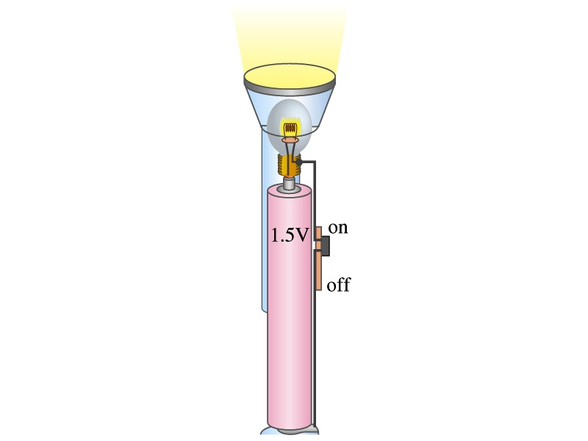
Example 25 – 4
Flashlight bulb resistance: A small flashlight bulb draws 300mA from its 1.5V battery. (a) What is the resistance of the bulb? (b) If the voltage drops to 1.2V, how would the current change?
From Ohm’s law, we obtain
Would the current increase or decrease, if the voltage reduces to 1.2V?
If the resistance did not change, the current is

Slide 5
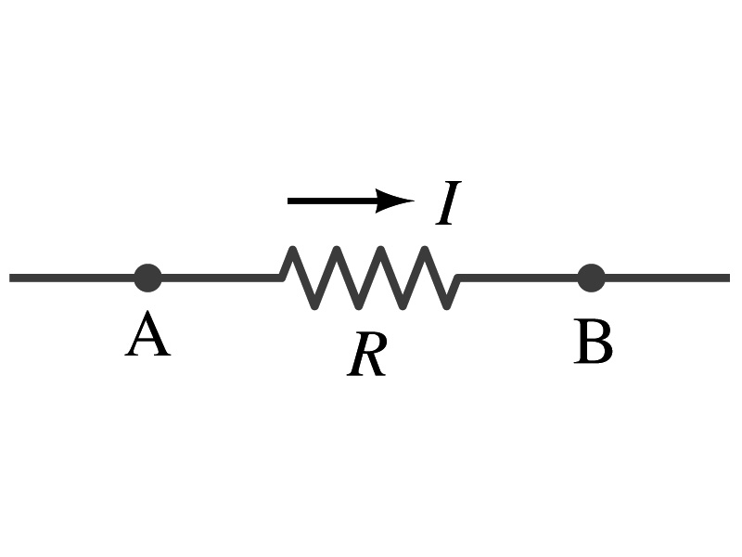
Ohm’s Law: Resistors
All electric devices offer resistance to the flow of current.
  Filaments of light bulbs or heaters are wires with high resistance to cause electrons to lose their energy in the wire
  In general connecting wires have lower resistance compared to other devices on the circuit
In circuits, resistors are used to control the amount of current
  Resistors offer resistance of less than one ohm to millions of ohms
  Main types are
    “wire-wound” resistors which consists of a coil of fine wire
    “composition” resistors which are usually made of semiconductor carbon
    thin metal films
When drawn in the circuit, the symbol for a resistor is:
Wires are drawn simply as straight lines

Slide 6
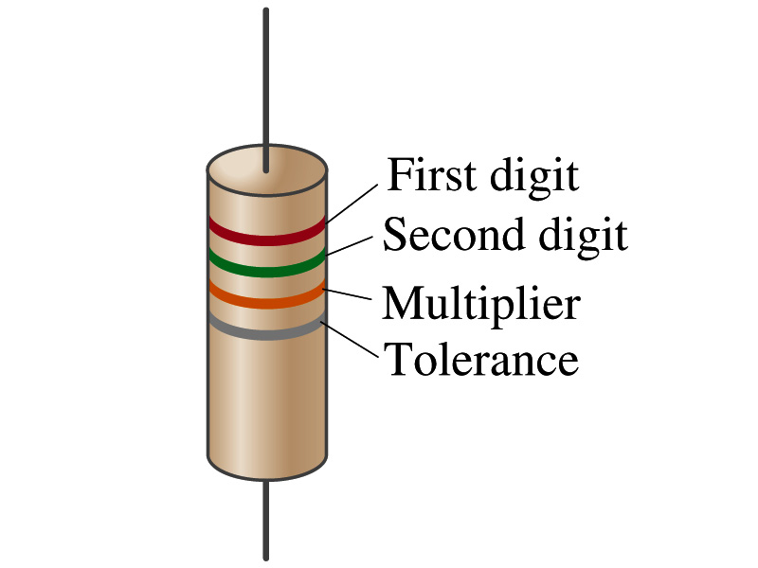
Ohm’s Law: Resistor Values
Resistors have its resistance color-coded on its body
The color-coding follows the convention below:
Color | Number | Multiplier | Tolerance
Black | 0 | 1=10⁰
Brown | 1 | 10¹
Red | 2 | 10²
Orange | 3 | 10³
Yellow | 4 | 10⁴
Green | 5 | 10⁵
Blue | 6 | 10⁶
Violet | 7 | 10⁷
Gray | 8 | 10⁸
White | 9 | 10⁹
Gold |  | 10-¹ | 5%
Silver |  | 10⁻² | 10%
None |  |  | 20%
What is the resistance of the resistor in this figure?

Slide 7
Resistivity
It is experimentally found that the resistance R of a metal wire is directly proportional to its length l and inversely proportional to its cross-sectional area A
  How would you formularize this?
  The proportionality constant ρ is called the resistivity and depends on the material used. What is the unit of this constant?
    ohm-m or Ω−m
    The values depends on purity, heat treatment, temperature, etc
  How would you interpret the resistivity?
    The higher the resistivity the higher the resistance
    The lower the resistivity the lower the resistance and the higher the conductivity ➔ Silver has the lowest resistivity.
      So silver is the best conductor
  The reciprocal of the resistivity is called conductivity, σ,
A
l

Slide 8
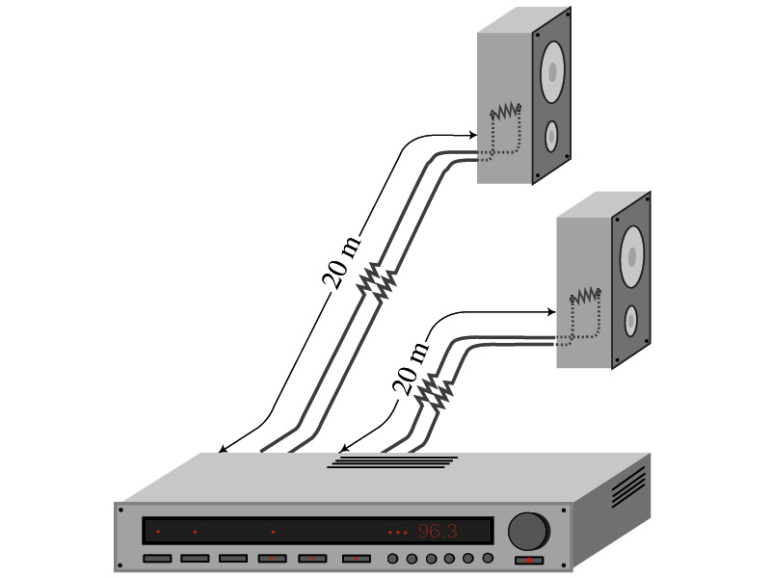
Example 25 – 5
Speaker wires: Suppose you want to connect your stereo to remote speakers. (a) If each wire must be 20m long, what diameter copper wire should you use to keep the resistance less than 0.1-Ω per wire? (b) If the current on each speaker is 4.0A, what is the voltage drop across each wire?
The resistivity of a copper is
Table 25.1
From the formula for resistance, we can obtain the formula for area
Solve for A
Solve for d
From Ohm’s law, V=IR, we obtain

Slide 9
Example 25 – 6
Stretching changes resistance: A wire of resistance R is stretched uniformly until it is twice its original length. What happens to its resistance?
What is the constant quantity in this problem?
The volume!
What is the volume of a cylinder of length L and radius r?
What happens to A if L increases factor two, L’=2L?
The cross-sectional area, A, halves. A’=A/2
The original resistance is
The new resistance is
The resistance of the wire increases by a factor of four if the length increases twice.

Slide 10
Temperature Dependence of Resistivity
Do you think the resistivity depends on temperature?
  Yes
Would it increase or decrease with the temperature?
  Increase
  Why?
  Because the atoms are vibrating more rapidly as temperature increases and are arranged in a less orderly fashion. So?
    They might interfere more with the flow of electrons.
If the temperature change is not too large, the resistivity of metals usually increase nearly linearly w/ temperature
  α is the temperature coefficient of resistivity
  α of some semiconductors can be negative due to increased number of freed electrons.

Slide 11
Electric Power
Why is the electric energy useful?
  It can transform into different forms of energy easily.
    Motors, pumps, etc, transform electric energy to mechanical energy
    Heaters, dryers, cook-tops, etc, transforms electricity to thermal energy
    Light bulb filament transforms electric energy to light energy
      Only about 10% of the energy turns to light and the 90% lost via heat
      Typical household light bulb and heating elements have resistance of order a few ohms to a few hundred ohms (what is the resistance of the filament of a 60W bulb?)
How does the electric energy transforms to thermal energy?
  Flowing electrons collide with the vibrating atoms of the wire.
  In each collision, part of electron’s kinetic energy is transferred to the atom it collides with.
  The kinetic energy of wire’s bound atoms increases, and thus the temperature of the wire increases.
  The increased thermal energy can be transferred as heat through conduction and convection to the air in a heater or to food on a pan, through radiation to bread in a toaster or radiated as light.

Slide 12
Electric Power
How do we find out the power transformed by an electric device?
  What is definition of the power?
    The rate at which work is done or the energy is transformed
What is the energy transformed when an infinitesimal charge dq moves through a potential difference V?
  dU=Vdq
  If dt is the time required for an amount of charge dq to move through the fixed potential difference V, the power P is
  Thus, we obtain .
  What is the unit?
  What kind of quantity is the electrical power?
    Scalar
  P=IV can apply to any devices while the formula with resistance can only apply to devices that has resistance.
What is this?
In terms of resistance
Watts = J/s

Slide 13
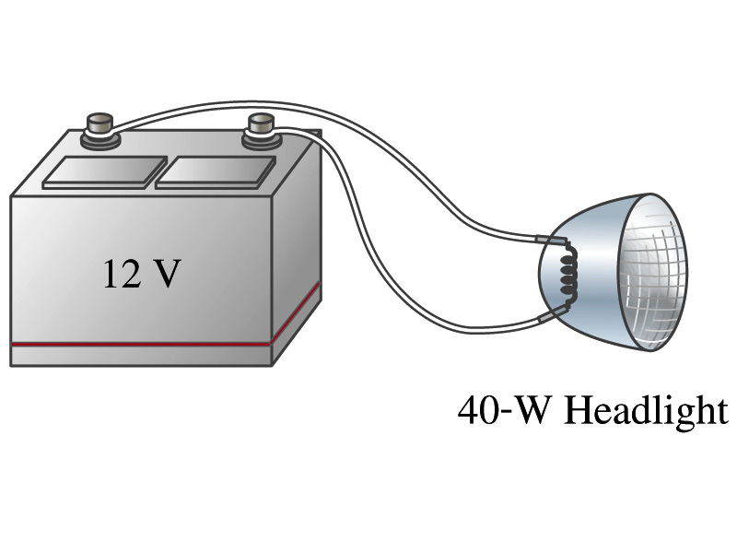
Example 25 – 8
Headlights: Calculate the resistance of a 40-W automobile headlight designed for 12V.
Since the power is 40W and the voltage is 12V, we use the formula with V and R.
Solve for R

Slide 14
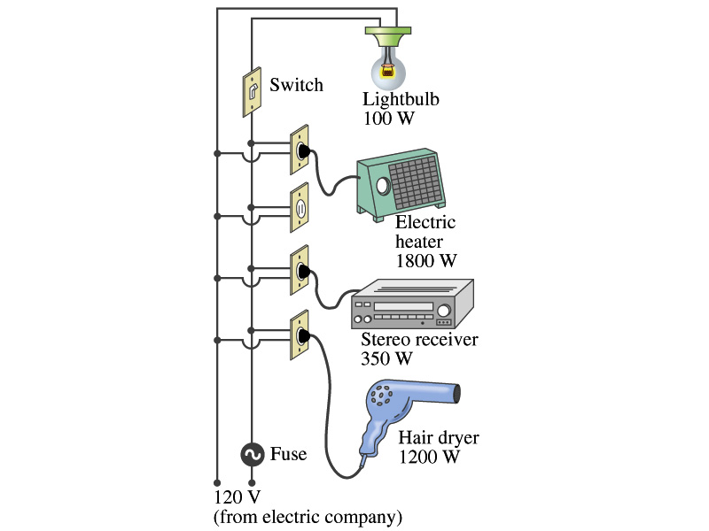
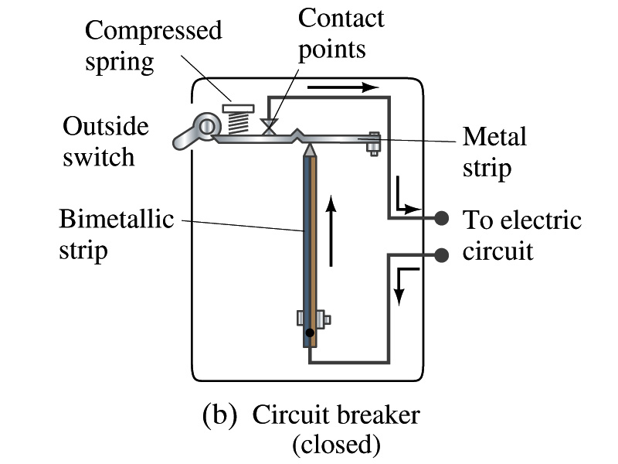
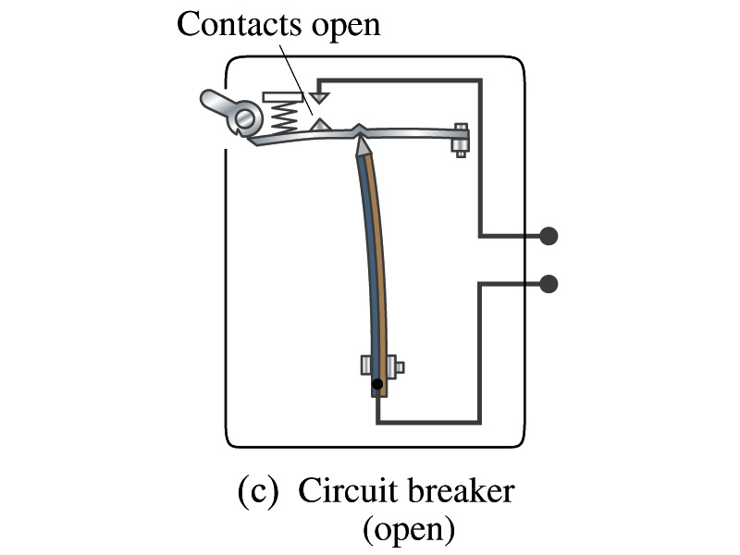
Power in Household Circuits
Household devices usually have small resistance
  But since they draw current, if they become large enough, wires can heat up (overloaded)
    Why is using thicker wires safer?
      Thicker wires has less resistance, lower heat
  Overloaded wire can set off a fire at home
How do we prevent this?
  Put in a switch that would disconnect the circuit when overloaded
    Fuse or circuit breakers
    They open up the circuit when the current is over certain value
Overload

Slide 15
Example 25 – 11
Will a fuse blow?: Determine the total current drawn by all the devices in the circuit in the figure.
The total current is the sum of current drawn by individual device.
Solve for I
Bulb
Heater
Stereo
Dryer
Total current
What is the total power?

Slide 16
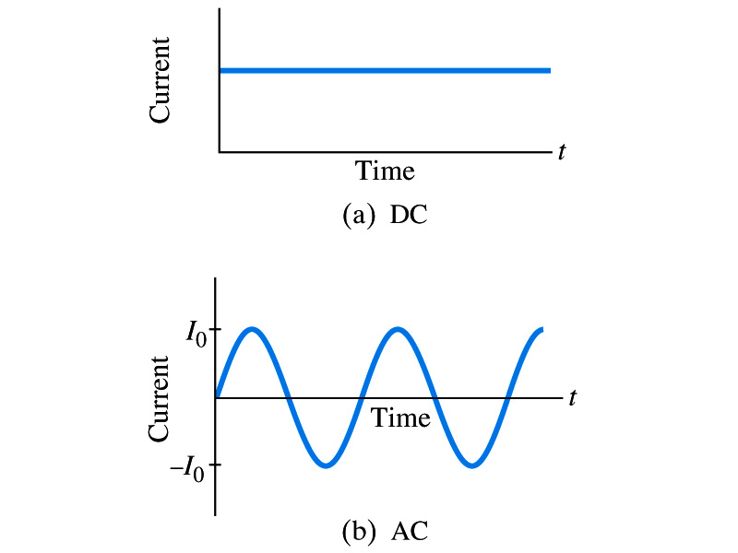
Alternating Current
Does the direction of the flow of current change while a battery is connected to a circuit?
  No. Why?
    Because its source of potential difference stays put.
  This kind of current is called the Direct Current (DC), and it does not change its direction of flow while the battery is connected.
    How would DC look as a function of time?
      A straight line
Electric generators at electric power plant produce alternating current (AC)
  AC reverses direction many times a second
  AC is sinusoidal as a function of time
Most the currents supplied to homes and business are AC.

Slide 17
The Alternating Current
The voltage produced by an AC electric generator is sinusoidal
  This is why the current is sinusoidal
Voltage produced can be written as
What are the maximum and minimum voltages?
  V₀ (–V₀) and 0
  The potential oscillates between +V₀ and –V₀, the peak voltage or the amplitude
  What is f?
    The frequency, the number of complete oscillations made per second. What is the unit of f? What is the normal size of f in the US?
      f=60Hz in the US and Canada.
      Many European countries have f=50Hz.
  ω=2πf

Slide 18
Alternating Current
Since V=IR, if a voltage V exists across a resistance R, the current I is
What are the maximum and minimum currents?
  I₀ (–I₀) and 0.
  The current oscillates between +I₀ and –I₀, the peak currents or the amplitude. The current is positive when electron flows to one direction and negative when they flow the opposite.
  AC is as many times positive as negative. What’s the average current?
    Zero. So there is no power and no heat is produced in a heater?
      Yes there is! The electrons actually flow back and forth, so power is delivered.
What is this?

Slide 19
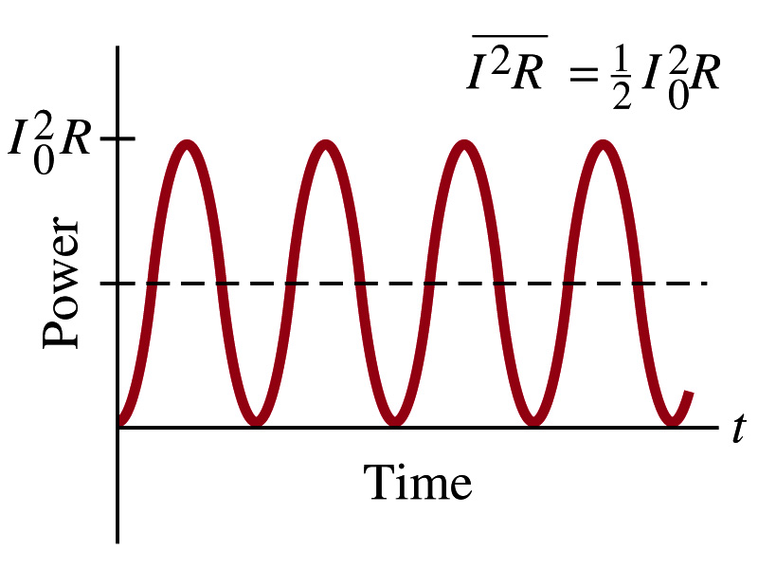
Power Delivered by Alternating Current
AC power delivered to a resistance is:
  Since the current is squared, the power is always positive
The average power delivered is
Since the power is also P=V²/R, we can obtain
The average of the square of current and voltage are important in calculating power:
Average power

Slide 20
Power Delivered by Alternating Current
The square root of each of these are called root-mean-square, or rms:
rms values are called effective values
  These are useful quantities since they can substitute current and voltage directly in power, as if they are in DC
  In other words, an AC of peak voltage V₀ or peak current I₀ produces as much power as DC voltage of V_{rms} or DC current I_{rms}.
  So normally, rms values in AC are specified or measured.
    US uses 115V rms voltage. What is the peak voltage?
    Europe uses 240V

Slide 21
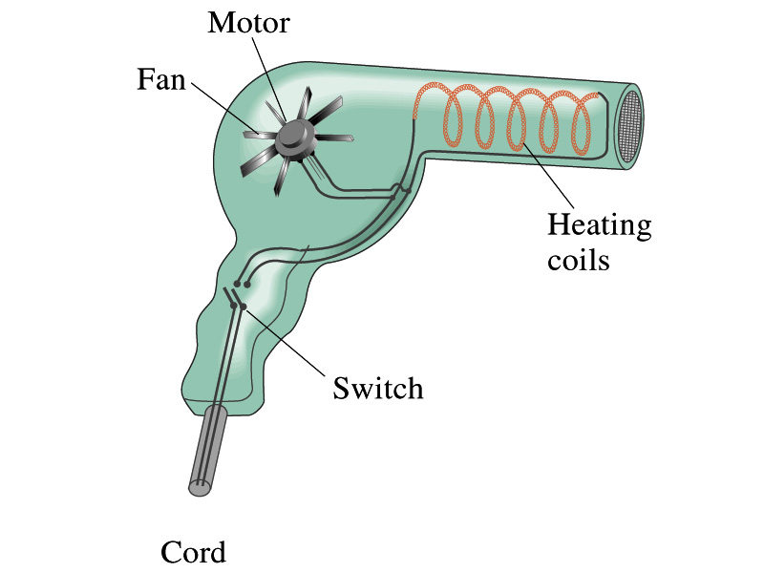
Example 25 – 13
Hair Dryer. (a) Calculate the resistance and the peak current in a 1000-W hair dryer connected to a 120-V AC line. (b) What happens if it is connected to a 240-V line in Britain?
The rms current is:
The peak current is:
Thus the resistance is:
(b) If connected to 240V in Britain …
The average power provide by the AC in UK is
So?
The heating coils in the dryer will melt!

Slide 22
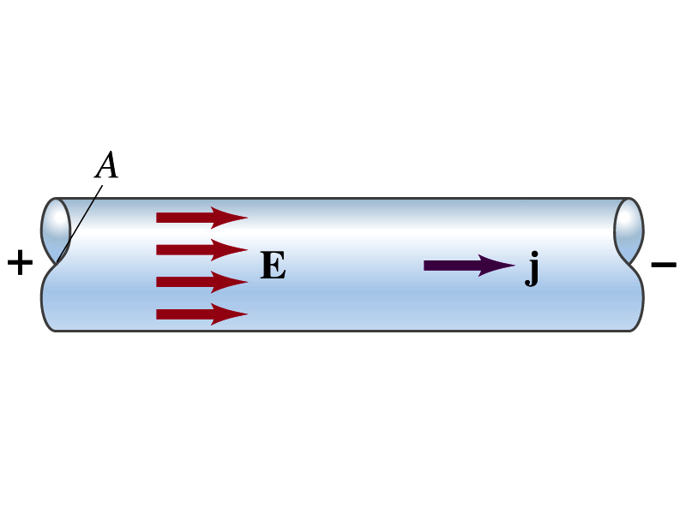
Microscopic View of Electric Current
When a potential difference is applied to the two ends of a wire w/ uniform cross-section, the direction of electric field is parallel to the walls of the wire, this is possible since the charges are moving
Let’s define a microscopic vector quantity, the current density, j, the electric current per unit cross-sectional area
  j=I/A or I = jA if the current density is uniform
  If not uniform
  The direction of j is the direction the positive charge would move when placed at that position, generally the same as E
The current density exists on any point in space while the current I refers to a conductor as a whole so a macroscopic

Slide 23
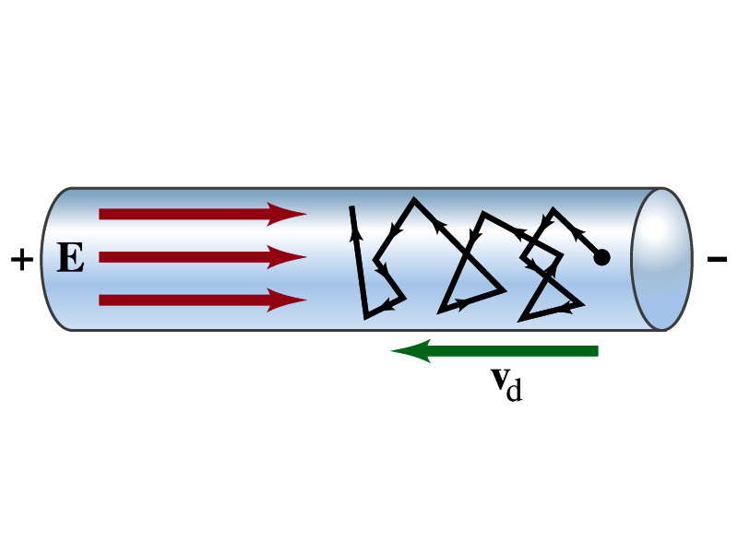
Microscopic View of Electric Current
The direction of j is the direction of a positive charge. So in a conductor, since negatively charged electrons move, the direction is –j.
Let’s think about the current in a microscopic view again:
  When voltage is applied to the end of a wire
  Electric field is generated by the potential difference
  Electrons feel force and get accelerated
  Electrons soon reach to a steady average speed due to collisions with atoms in the wire, called drift velocity, v_{d}
  The drift velocity is normally much smaller than electrons’ average random speed.

Slide 24
Microscopic View of Electric Current
The drift velocity of electrons in a wire is only about 0.05mm/s. How could we get light turned on immediately then?
  While the electrons in a wire travels slow, the electric field travels essentially at the speed of light. Then what is all the talk about electrons flowing through?
    It is just like water. When you turn on the facet, water flows right off the facet despite the fact that the water travels slow.
    Electricity is the same. Electrons fill the conductor wire and when the switch is flipped on or a potential difference is applied, the electrons close to the positive terminal flows into the bulb.
    Interesting, isn’t it? Why is the field travel at the speed of light then?

