Slide 1
PHYS 1441 – Section 002 Lecture #13
Monday, Oct. 22, 2018
Dr. Jaehoon Yu
Chapter 25
Microscopic View of Electric Current
Chapter 26 – DC Circuit
EMF and Terminal Voltage
Resisters in Series and Parallel
Kirchhoff’s Rules
EMFs in Series and Parallel
RC Circuits
Chapter 27: Magnetism and Magnetic Field
Today’s homework is #9, due 11pm, Wednesday, Oct. 31!!

Slide 2
Announcements
Reading Assignments: CH25.9 and 25.10
Mid-term grade discussions
From 12:00 – 2:30pm, this Wednesday, Oct. 24 in my office (CPB342)
Last name starts with A – C (12 – 12:30), D– H (12:30 – 1), I – O (1 – 1:30), P – S (1:30 – 2:00), T – Z (2-2:30)
Mid-term results
Class average: 71/100
Previous exam: 60.6/100
Top score: 97/100
Grade scheme reminder
Homework: 25%
Final exam: 23%
Midterm exam: 20%
Better of the two term exams: 12%
Lab: 10%
Quizzes: 10%
Extra Credit: 10%

Slide 3
Reminder: Special Extra Credit #4
Election Participation Exercise
For those with legal voting rights: You can submit three “I Voted” stickers for 20 points total – one your own and two others who voted and the remainder 2 points each
For those without legal voting rights: You can submit for the first four “I Voted” sticker for 20 points total and the remainder 2 points each
Be sure to tape one side of the stickers on a sheet of paper with your name on it.
Write the precinct number the vote was cast, the full name of the person voted and the signature of the voter next to the relevant sticker
None of the stickers can be from the same person on someone else’s extra credit or on your own. All of those with any of the identical persons on your extra credit sheet will get 0 credit.
Deadline: Beginning of the class Wednesday, Nov. 7

Slide 4
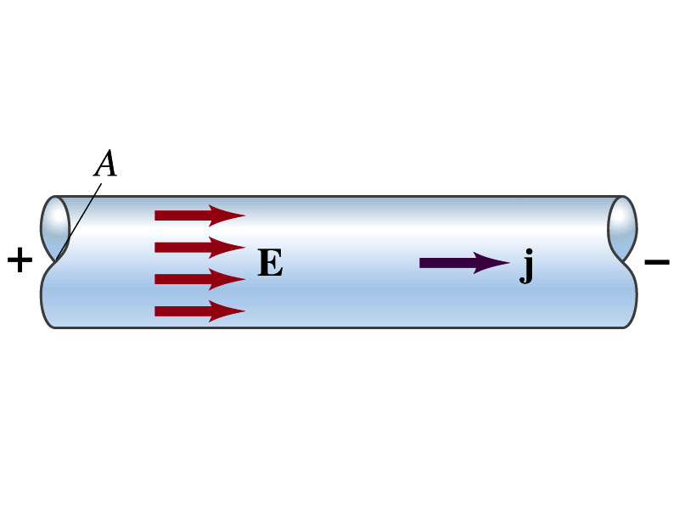
Microscopic View of Electric Current
When a potential difference is applied to the two ends of a wire w/ uniform cross-section, the direction of electric field is parallel to the walls of the wire, this is possible since the charges are moving
Let’s define a microscopic vector quantity, the current density, j, the electric current per unit cross-sectional area
j=I/A or I = jA if the current density is uniform
If not uniform
The direction of j is the direction the positive charge would move when placed at that position, generally the same as E
The current density exists on any point in space while the current I refers to a conductor as a whole so macroscopic

Slide 5
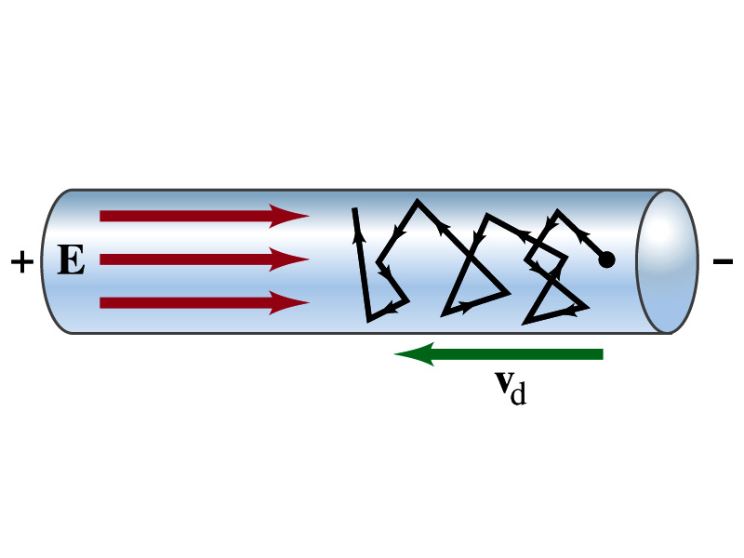
Microscopic View of Electric Current
The direction of j is the direction of the positive charge. So in a conductor, since negatively charged electrons move, the direction is –j.
Let’s think about the current in a microscopic view again:
When voltage is applied to the ends of a wire
Electric field is generated by the potential difference
Electrons feel force and get accelerated
Electrons soon reach to a steady average speed due to collisions with atoms in the wire, called drift velocity, v_{d}
The drift velocity is normally much smaller than electrons’ average random speed.

Slide 6
Microscopic View of Electric Current
The drift velocity of electrons in a wire is only about 0.05mm/s. How could we get light turned on immediately then?
While the electrons in a wire travels slow, the electric field travels essentially at the speed of light. Then what is all the talk about electrons flowing through?
It is just like water. When you turn on the facet, water flows right off the facet despite the fact that the water travels slow.
Electricity is the same. Electrons fill the conductor wire and when the switch is flipped on or a potential difference is applied, the electrons close to the positive terminal flows into the bulb.
Interesting, isn’t it? Why is the field travel at the speed of light then?

Slide 7
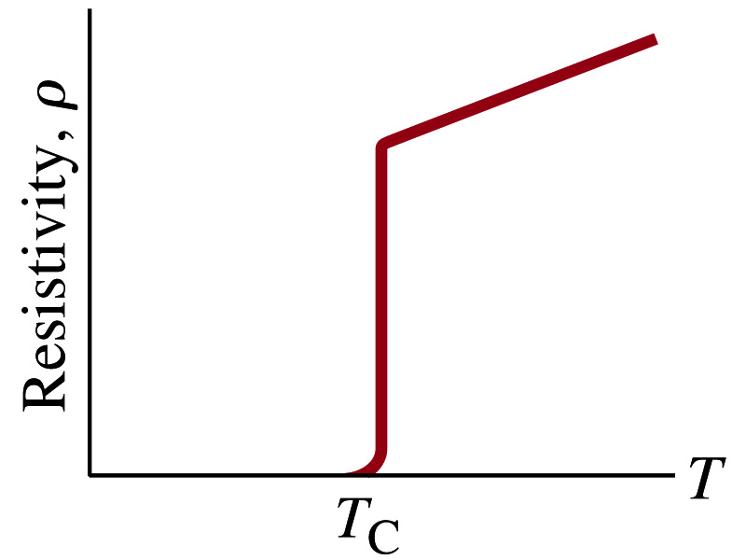
Superconductivity
At the temperature near absolute 0K, resistivity of certain material becomes 0.
This state is called the “superconducting” state.
Observed in 1911 by H. K. Onnes when he cooled mercury to 4.2K (-269ºC).
Resistance of mercury suddenly dropped to 0.
In general superconducting materials become superconducting below a transition temperature (T_{c}).
The highest temperature superconductivity seen is 160K
First observation above the boiling temperature of liquid nitrogen is in 1987 at 90k observed from a compound of yttrium, barium, copper and oxygen.
Since much smaller amount of material can carry just as much current more efficiently, superconductivity can make electric cars more practical, computers faster, and capacitors store higher energy

Slide 8
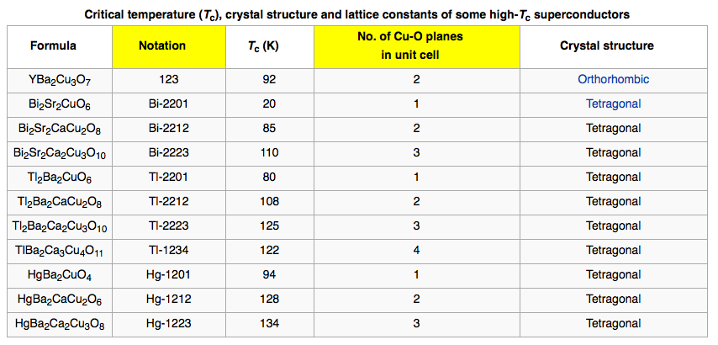
Critical Temperature of Superconductors

Slide 9
Electric Hazards: Leakage Currents
How does one feel shock by electricity?
Electric current stimulates nerves and muscles, and we feel a shock
The severity of the shock depends on the amount of current, how long it acts and through what part of the body it passes
Electric current heats the tissue and can cause burns
Currents above 70mA on a torso for a second or more is fatal, causing heart to function irregularly, “ventricular fibrillation”.
A dry human body between two points on opposite side of the body is about 10⁴ to 10⁶ Ω.
When wet, it could be 10³Ω.
A person in good contact with the ground who touches 120V DC line with wet hands can get the current:
Could be lethal

Slide 10
EMF and Terminal Voltage
What do we need to have a current in an electric circuit?
A device that provides a potential difference, such as a battery or a generator
They normally convert some types of energy into the electric energy
These devices are called source of electromotive force (emf)
This is does NOT refer to a real “force”.
Potential difference between terminals of an emf source, when no current flows to an external circuit, is called the emf (E) of the source.
The battery itself has some internal resistance (r) due to the flow of charges in the electrolyte
Why does the headlight dim when you start the car?
The starter needs a large amount of current but the battery cannot provide charge fast enough to supply current to both the starter and the headlight

Slide 11
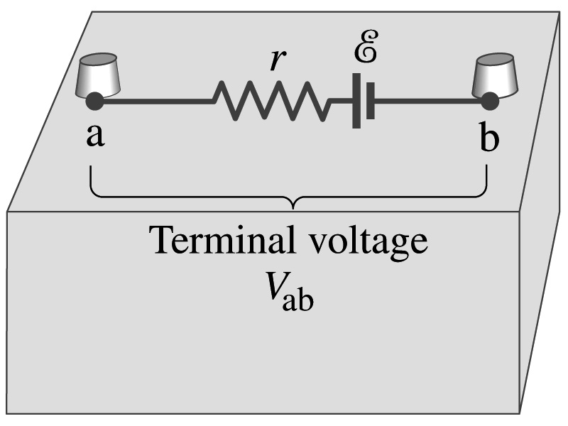
EMF and Terminal Voltage
Since the internal resistance is inside the battery, we can never separate them out.
So the terminal voltage difference is V_{ab}=V_{a}-V_{b}.
When no current is drawn from the battery, the terminal voltage equals the emf which is determined by the chemical reaction; V_{ab}= E.
However when the current I flows naturally from the battery, there is an internal drop in voltage which is equal to Ir. Thus the actual delivered terminal voltage is

Slide 12
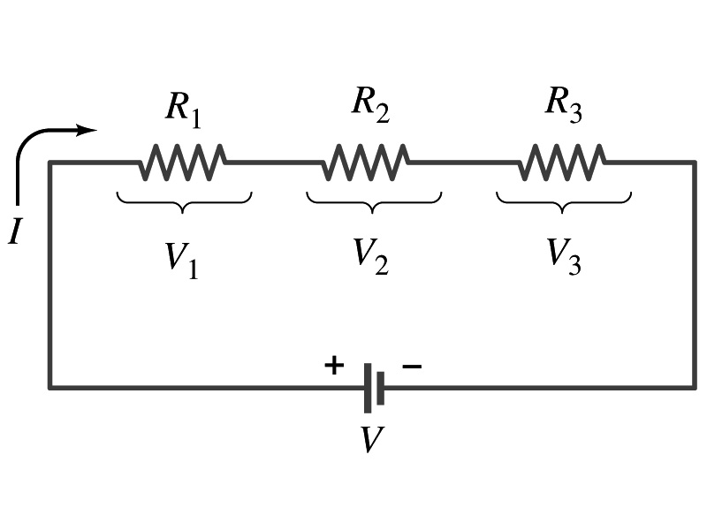
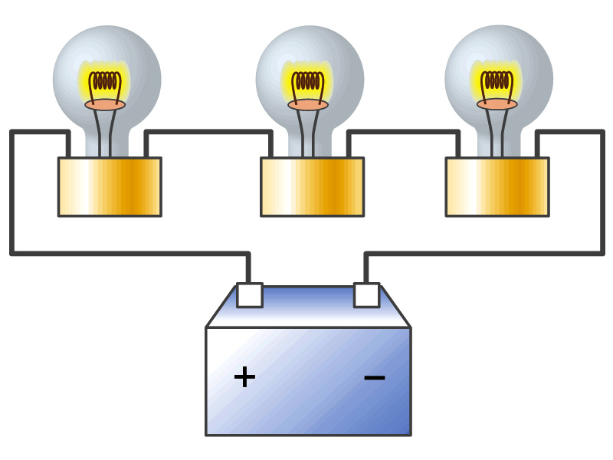
Resisters in Series
Resisters are in series when two or more resisters are connected end to end
These resisters represent simple resisters in circuit or electrical devices, such as light bulbs, heaters, dryers, etc
What is common for devices in a series circuit?
Current is the same through all the elements in series
Potential difference across every element in the circuit is
V₁=IR₁, V₂=IR₂ and V₃=IR₃
Since the total potential difference is V, we obtain
V=IR_{eq}=V₁+V₂+V₃=I(R₁+R₂+R₃)
Thus, R_{eq}=R₁+R₂+R₃
Resisters in series
When resisters are connected in series, the total resistance increases and the current decreases.

Slide 13
Energy Losses in Resisters
Why is it true that V=V₁+V₂+V₃?
What is the potential energy loss when charge q passes through resisters R₁, R₂ and R₃
ΔU₁=qV₁, ΔU₂=qV₂, ΔU₃=qV₃
Since the total energy loss should be the same as the total energy provided to the system, we obtain
ΔU=qV=ΔU₁+ΔU₂+ΔU₃=q(V₁+V₂+V₃)
Thus, V=V₁+V₂+V₃

Slide 14
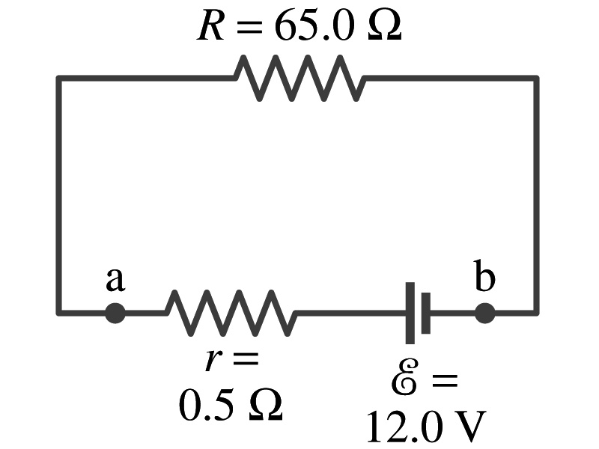
Example 26 – 1
Battery with internal resistance. A 65.0-Ω resistor is connected to the terminals of a battery whose emf is 12.0V and whose internal resistance is 0.5-Ω. Calculate (a) the current in the circuit, (b) the terminal voltage of the battery, V_{ab}, and (c) the power dissipated in the resistor R and in the battery’s internal resistor.
(a) Since
We obtain
What is this?
Solve for I
A battery or a source of emf.
(b) The terminal voltage V_{ab} is
(c) The power dissipated in R and r are

