Slide 1
PHYS 1441 – Section 002 Lecture #14
Monday, Oct. 29, 2018
Dr. Jaehoon Yu
Chapter 26 – DC Circuit
Resisters in Series and Parallel
Kirchhoff’s Rules
EMFs in Series and Parallel
RC Circuits – Charging and Discharging
Chapter 27: Magnetism and Magnetic Field
Today’s homework is #10, due 11pm, Monday, November 12!!

Slide 2
Announcements
Reading Assignments: CH26.5, 6 and 7
Quiz #3
At the beginning of the class Monday, Nov. 5
Covers CH25.5 to what we learn this Wednesday
Bring your calculator but DO NOT input formula into it!
Cell phones or any types of computers cannot replace a calculator!
BYOF: You may bring a one 8.5x11.5 sheet (front and back) of handwritten formulae and values of constants
No derivations, word definitions or solutions of any kind!
No additional formulae or values of constants will be provided!

Slide 3
Reminder: Special Extra Credit #4
Election Participation Exercise
For those with legal voting rights: You can submit three “I Voted” stickers for 20 points total – one your own and two others who voted and the remainder 2 points each
For those without legal voting rights: You can submit for the first four “I Voted” sticker for 20 points total and the remainder 2 points each
Be sure to tape one side of the stickers on a sheet of paper with your name on it.
Write the precinct number the vote was cast, the full name of the person voted and the signature of the voter next to the relevant sticker
None of the stickers can be from the same person on someone else’s extra credit or on your own. All of those with any of the identical persons on your extra credit sheet will get 0 credit.
Deadline: Beginning of the class Wednesday, Nov. 7

Slide 4
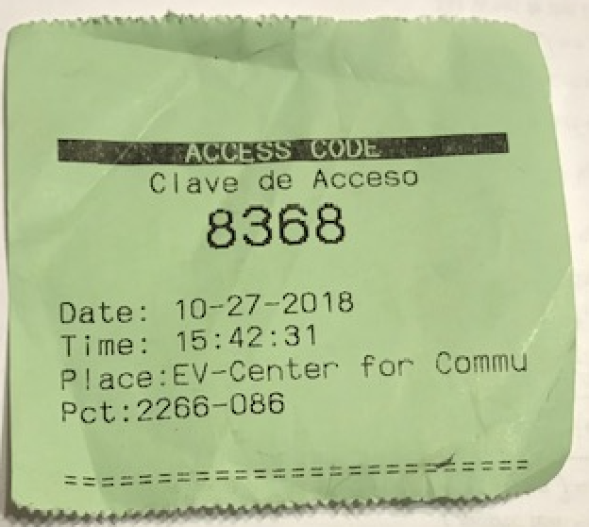
These are acceptable!

Slide 5
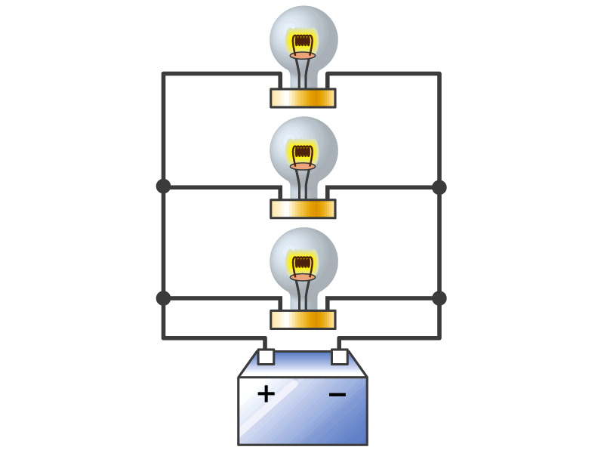
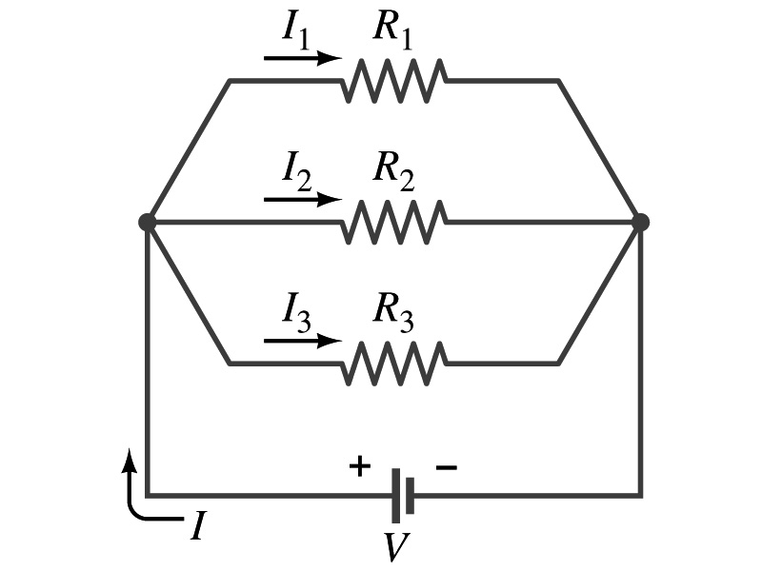
Resisters in Parallel
Resisters are in parallel when two or more resisters are connected in separate branches
Most the house and building wirings are arranged this way.
What is common for the devices in a parallel circuit?
The voltage is the same across all the resisters in the same circuit
The total current that leaves the battery is, however, split.
The current that passes through every element is
I₁=V/R₁, I₂=V/R₂, I₃=V/R₃
Since the total current is I, we obtain
I=V/R_{eq}=I₁+I₂+I₃=V(1/R₁+1/R₂+1/R₃)
Thus, 1/R_{eq}=1/R₁+1/R₂+1/R₃
Resisters in parallel
When resisters are connected in parallel, the total resistance decreases and the current increases.

Slide 6
Resister and Capacitor Arrangements
Parallel Capacitor arrangements
Parallel Resister arrangements
Series Capacitor arrangements
Series Resister arrangements

Slide 7
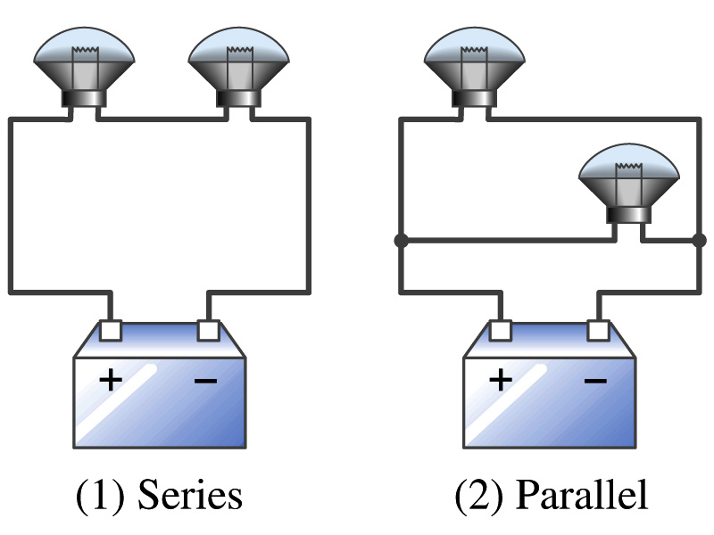
Example 26 – 2
Series or parallel? (a) The light bulbs in the figure are identical and have identical resistance R. Which configuration produces more light? (b) Which way do you think the headlights of a car are wired?
(a) What are the equivalent resistances for the two cases?
Series
Parallel
So
The bulbs get brighter when the total power transformed is larger.
series
parallel
So parallel circuit provides brighter lighting.
(b) Car’s headlights are in parallel to provide brighter lighting and also to prevent both lights going out at the same time when one burns out.
So what is bad about parallel circuits?
Uses more energy in a given time.

Slide 8
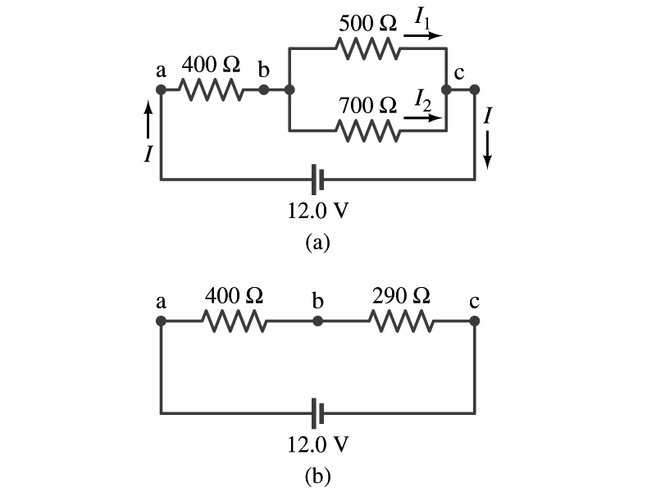
Example 26 – 5
Current in one branch. What is the current flowing through the 500-Ω resister in the figure?
We need to find the total current.
What do we need to find first?
To do that we need to compute the equivalent resistance.
R_{eq} of the small parallel branch is:
R_{eq} of the circuit is:
Thus the total current in the circuit is
The voltage drop across the parallel branch is
The current flowing across 500-Ω resister is therefore
What is the current flowing 700-Ω resister?

Slide 9
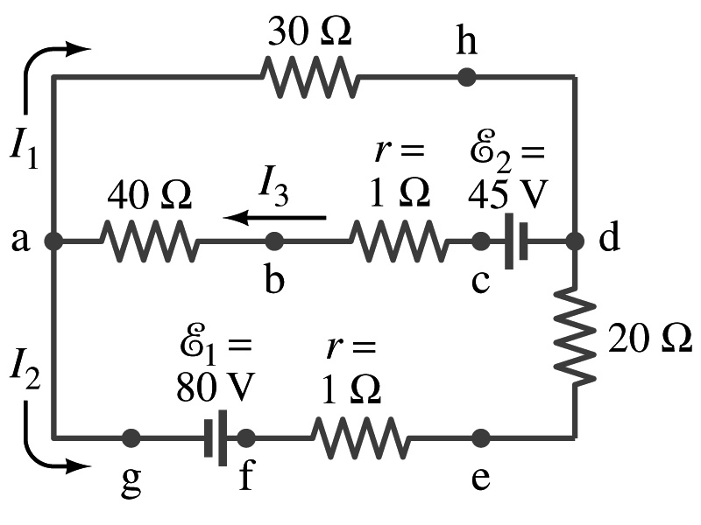
Kirchhoff’s Rules – 1st Rule
Some circuits are very complicated to do the analysis using the simple combinations of resisters
G. R. Kirchhoff devised two rules to deal with complicated circuits.
Kirchhoff’s rules are based on conservation of charge and energy
Kirchhoff’s 1st rule: The junction rule, charge conservation.
At any junction point, the sum of all currents entering the junction must be equal to the sum of all currents leaving the junction.
In other words, what goes in must come out.
At junction a in the figure, I₃ comes into the junction while I₁ and I₂ leaves: I₃ = I₁+ I₂

Slide 10
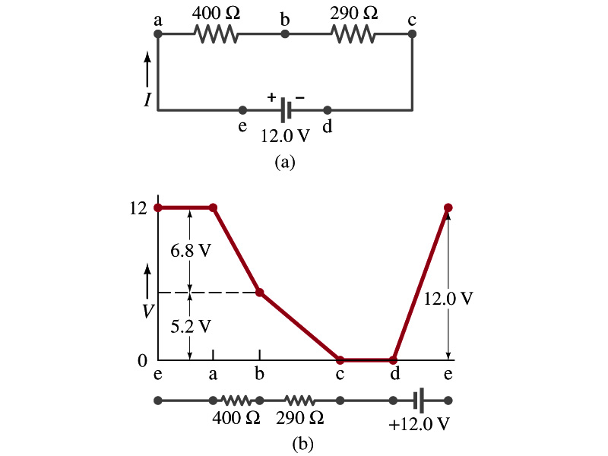
Kirchhoff’s Rules – 2nd Rule
Kirchoff’s 2nd rule: The loop rule, uses conservation of energy.
The sum of the changes in potential in any closed path of a circuit must be zero.
I=12/690=0.017A.
The current in the circuit in the figure is
Point e is the high potential point while point d is the lowest potential.
When the test charge starts at e and returns to e, the total potential change is 0.
Between point e and a, no potential change since there is no source of potential nor any resistance.
Between a and b, there is a 400Ω resistance, causing IR=0.017*400 =6.8V drop.
Between b and c, there is a 290Ω resistance, causing IR=0.017*290 =5.2V drop.
Since these are voltage drops, we use negative sign for these, -6.8V and -5.2V.
No change between c and d while from d to e there is +12V change.
Thus the total change of the voltage through the loop is: -6.8V-5.2V+12V=0V.

Slide 11
How to use Kirchhoff’s Rules??
Determine the flow of currents at the junctions and label each and everyone of the currents.
It does not matter which direction, you decide but keep it!
You cannot have all current coming in or going out of a junction, though!
If the value of the current after completing the calculations are negative, you just need to flip the direction of the current flow.
Write down the current equation based on Kirchhoff’s 1st rule at various junctions.
Be sure to see if any of them are the same.
Choose closed loops in the circuit
Write down the potential in each interval of the junctions, keeping the proper signs as you decided in step 1 above.
Write down the potential equations for each loop.
Solve the equations for unknowns.

Slide 12
Example 26 – 9
Use Kirchhoff’s rules. Calculate the currents I₁, I₂ and I₃ in each of the branches of the circuit in the figure.
The directions of the current through the circuit is not known a priori but since the current tends to move away from the positive terminal of a battery, we arbitrarily choose the direction of the currents as shown.
We have three unknowns so we need three equations.
Using Kirchhoff’s junction rule at point a, we obtain
This is the same for junction d as well, so no additional information.
Now the second rule on the loop ahdcba.
The total voltage change in the loop ahdcba is.

Slide 13
Example 26 – 9, cnt’d
Now the second rule on the other loop agfedcba.
The total voltage change in loop agfedcba is.
So the three equations become
We can obtain the three current by solving these equations for I₁, I₂ and I₃.
Do this yourselves!!

