Slide 1
PHYS 1441 – Section 002 Lecture #15
Wednesday, Oct. 31, 2018
Dr. Jaehoon Yu
Chapter 26 – DC Circuit
EMFs in Series and Parallel
RC Circuits – Charging and Discharging
Chapter 27: Magnetism & Magnetic Field
Electric Current and Magnetism
Magnetic Forces on Electric Current

Slide 2
Announcements
Reading Assignments: CH26.5, 6 and 7
Reminder: Quiz #3
At the beginning of the class Monday, Nov. 5
Covers CH25.5 to what we learn today (CH27.4?)
Bring your calculator but DO NOT input formula into it!
Cell phones or any types of computers cannot replace a calculator!
BYOF: You may bring a one 8.5x11.5 sheet (front and back) of handwritten formulae and values of constants
No derivations, word definitions or solutions of any kind!
No additional formulae or values of constants will be provided!
2nd non-comprehensive term exam: Nov. 14
Covers CH25.5 to what we learn Monday, Nov. 12
BYOF
Final exam date and time: 11am – 2:30pm, Wednesday, Dec. 12
Colloquium today: Dr. D. Winklehner of MIT

Slide 3
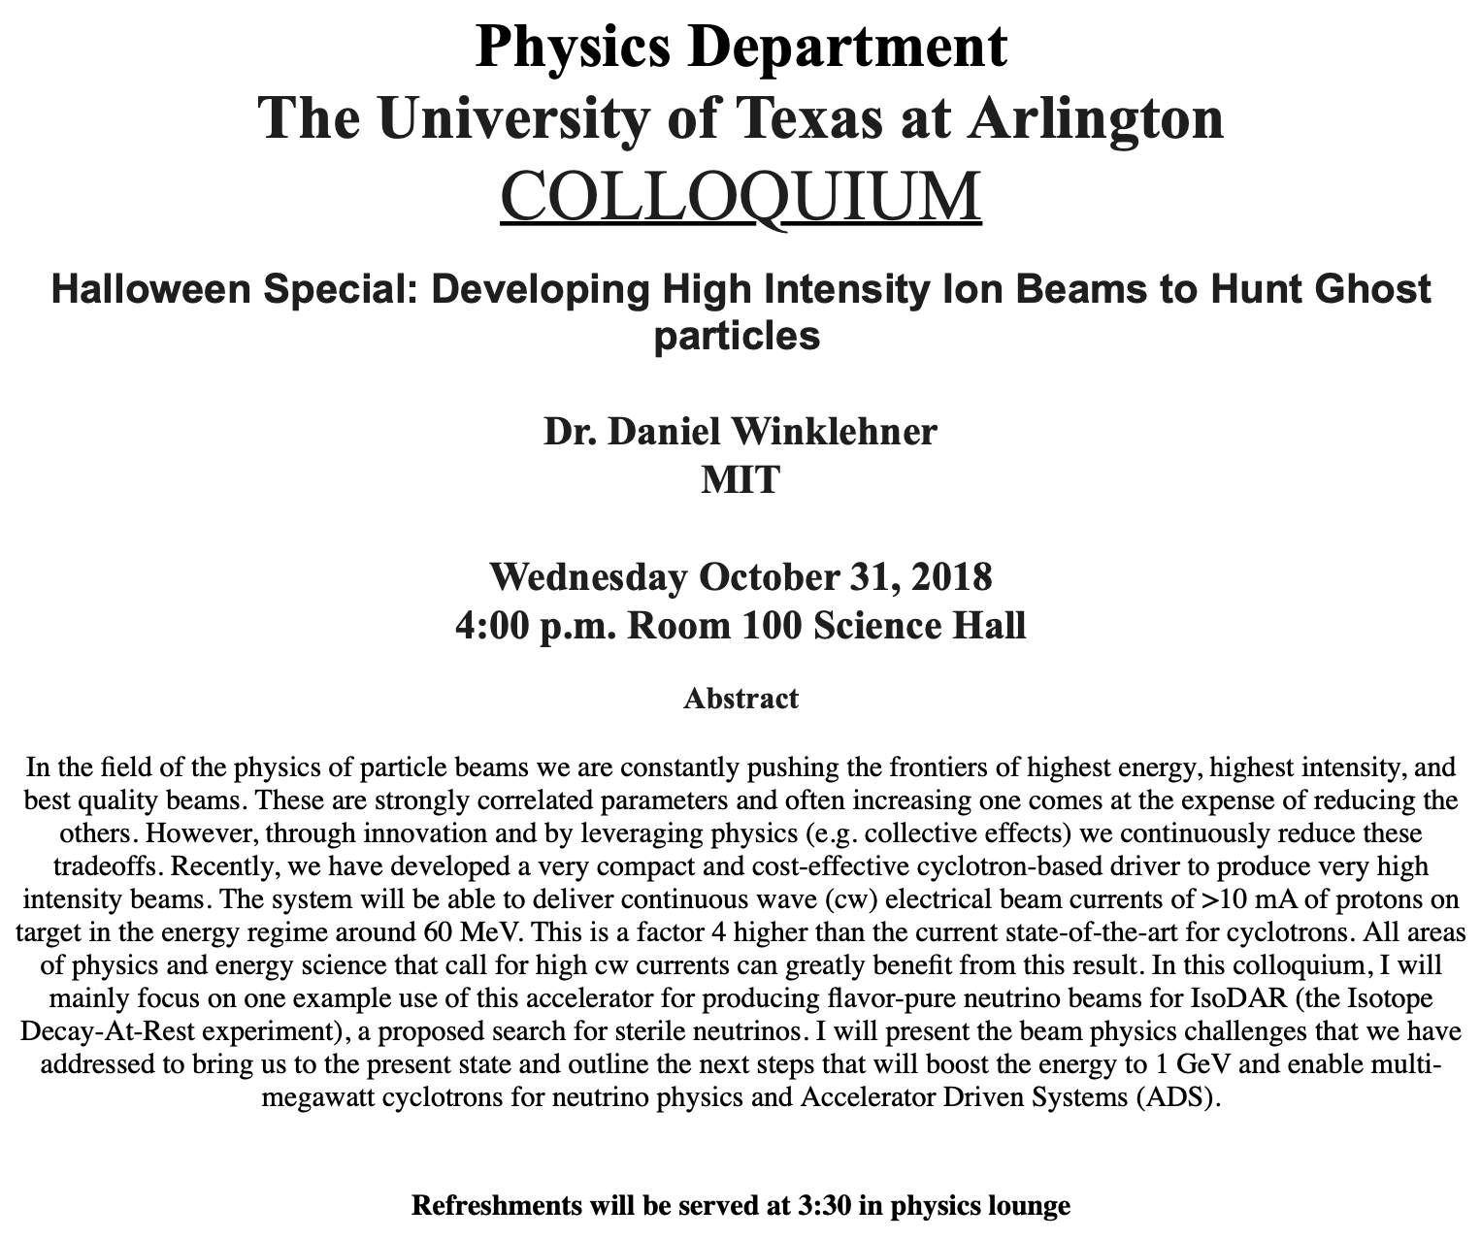

Slide 4
Reminder: Special Extra Credit #4
Election Participation Exercise
For those with legal voting rights: You can submit three “I Voted” stickers or the access code green sheet for 20 points total – one your own and two others who voted and the remainder 2 points each
For those without legal voting rights: You can submit for the first four “I Voted” sticker or the access code green sheet for 20 points total and the remainder 2 points each
Be sure to tape one side of the stickers on a sheet of paper with your name on it.
Write the precinct number the vote was cast, the full name of the person voted and the signature of the voter next to the relevant sticker
None of the stickers can be from the same person on someone else’s extra credit or on your own. All of those with any of the identical persons on your extra credit sheet will get 0 credit.
Deadline: Beginning of the class Wednesday, Nov. 7

Slide 5
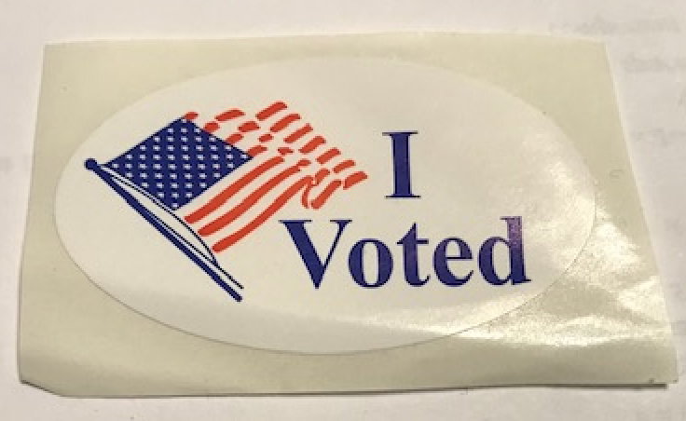
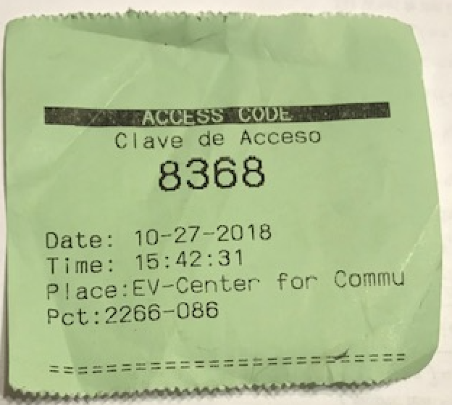
These are acceptable!

Slide 6
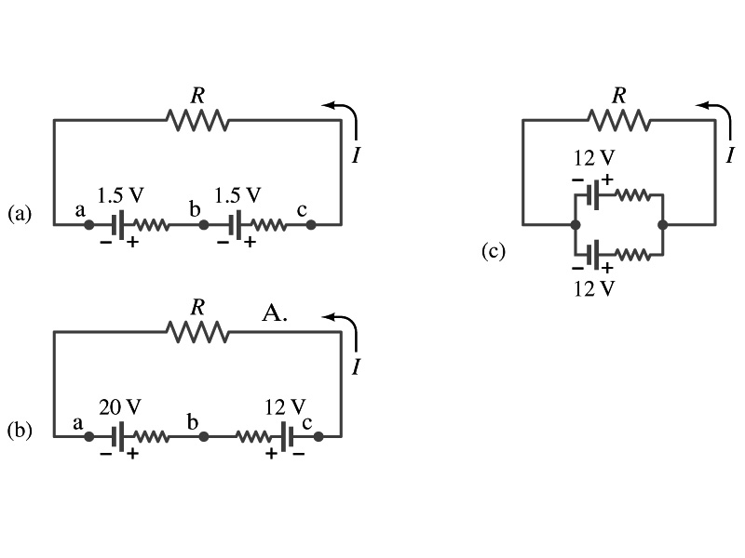
EMFs in Series and Parallel: Charging a Battery
When two or more sources of emfs, such as batteries, are connected in series
The total voltage is the algebraic sum of their voltages, if their direction is the same
V_{ab}=1.5 + 1.5=3.0V in figure (a).
If the batteries are arranged in the opposite direction, the total voltage is the difference between them
Parallel arrangements (c) are used only to increase currents. An example?
V_{ac}=20 – 12=8.0V in figure (b)
Connecting batteries in opposite direction is wasteful.
This, however, is the way a battery charger works.
Since the 20V battery is at a higher voltage, it forces charges into 12V battery
Some battery are rechargeable since their chemical reactions are reversible but most the batteries do not reverse their chemical reactions

Slide 7
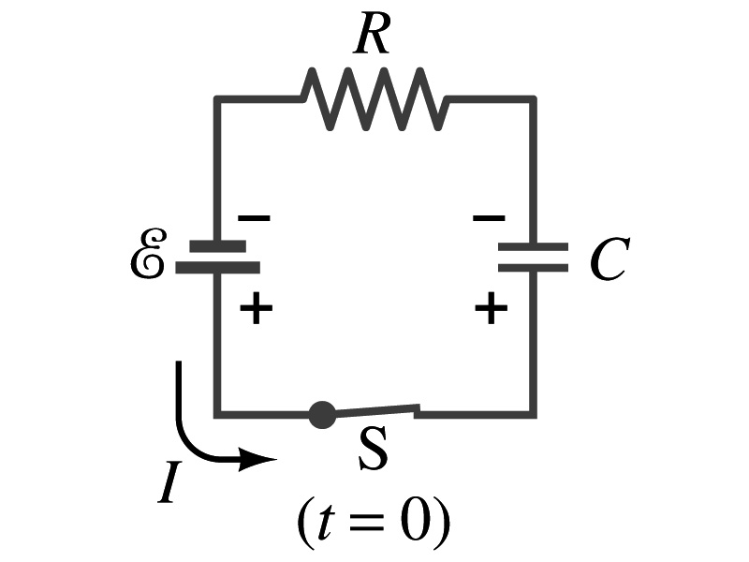
RC Circuits
Circuits containing both resisters and capacitors
RC circuits are used commonly in everyday life
Control windshield wiper timer
Timing of the traffic light
Camera flashes and heart pacemakers
How does an RC circuit look?
There should be a source of emf, capacitors and resisters
What happens when the switch S is closed?
Current immediately starts flowing through the circuit.
Electrons flow out of negative terminal of the emf source, through the resister R and accumulates on the upper plate of the capacitor.
The electrons from the bottom plate of the capacitor will flow into the positive terminal of the battery, leaving only positive charge on the bottom plate.
As the charge accumulates on the capacitor, the potential difference across it increases
The current reduces gradually to 0 till the voltage across the capacitor is the same as emf.
The charge on the capacitor increases till it reaches to its maximum CE.

Slide 8
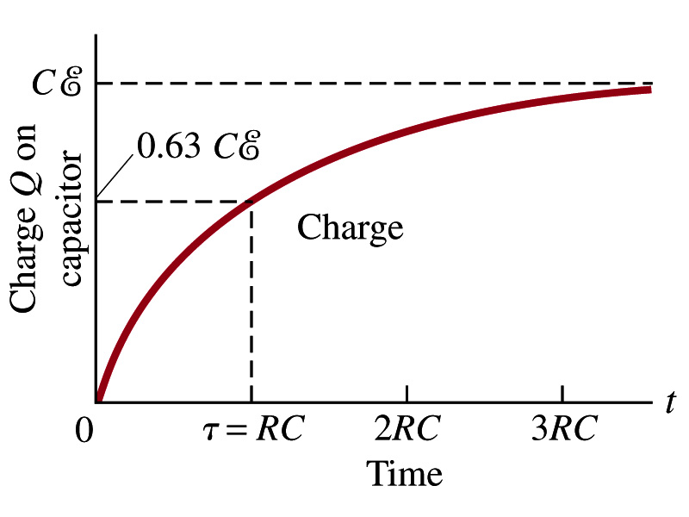
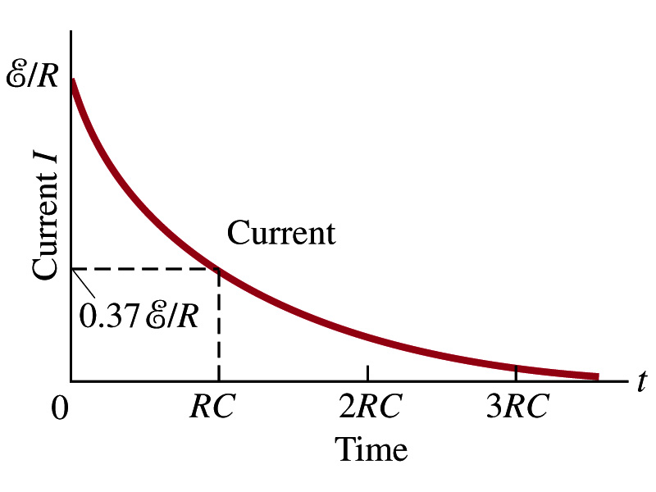
RC Circuits
How does all this look like in graphs?
The charge and the current on the capacitor as a function of time
From energy conservation (Kirchhoff’s 2nd rule), the emf E must be equal to the voltage drop across the capacitor and the resister
E=IR+Q/C
R includes all resistance in the circuit, including the internal resistance of the battery, I is the current in the circuit at any instance, and Q is the charge of the capacitor at that same instance.

Slide 9
Analysis of RC Circuits
In an RC circuit and
What can we see from the above equations?
Q and V_{C} increase from 0 at t=0 to the maximum value Q_{max}=CE and V_{C}= E.
In how much time?
The quantity RC is called the time constant of the circuit, τ
τ=RC, What is the unit?
What is the physical meaning?
The time required for a capacitor to reach (1 - e⁻¹)=0.63 or 63% of the full charge
The current is
Sec.

Slide 10
Example 26 – 12
RC circuit, with emf. The capacitance in the circuit of the figure is C=0.30μF, the total resistance is 20kΩ, and the battery emf is 12V. Determine (a) the time constant, (b) the maximum charge the capacitor could acquire, (c) the time it takes for the charge to reach 99% of this value, (d) the current I when the charge Q is half its maximum value, (e) the maximum current, and (f) the charge Q when, the current I is 0.20 its maximum value.
(a) Since
We obtain
(b) Maximum charge is
(c) Since
For 99% we obtain
(d) Since
We obtain
The current when Q is 0.5Q_{max}
(e) When is I maximum?
when Q=0:
(f) What is Q when I=120mA?

Slide 11
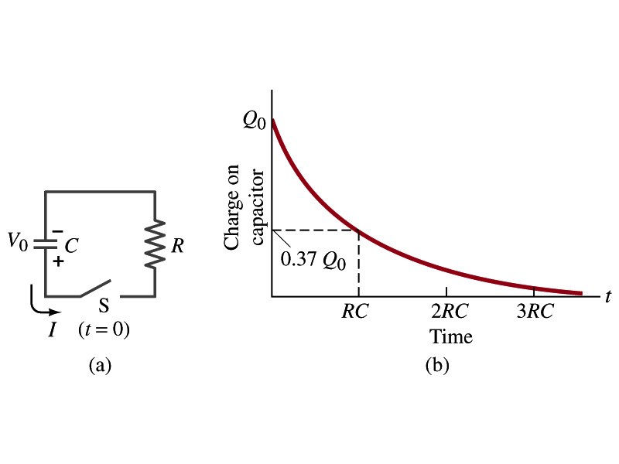
Discharging RC Circuits
When a capacitor is already charged, it is allowed to discharge through a resistance R.
When the switch S is closed, the voltage across the resistor at any instant equals that across the capacitor. Thus IR=Q/C.
The rate at which the charge leaves the capacitor equals the negative of the current through the resistor
I= - dQ/dt
This is because the current is leaving the capacitor
Thus the voltage equation becomes a differential equation
Rearrange terms

Slide 12
Discharging RC Circuits
Now, let’s integrate from t=0 when the charge is Q₀ to t when the charge is Q
The result is
Thus, we obtain
What does this tell you about the charge on the capacitor?
It decreases exponentially w/ time at the time constant RC
Just like the case of charging
The current is:
The current also decreases exponentially w/ time w/ the time constant RC
What is this?

Slide 13
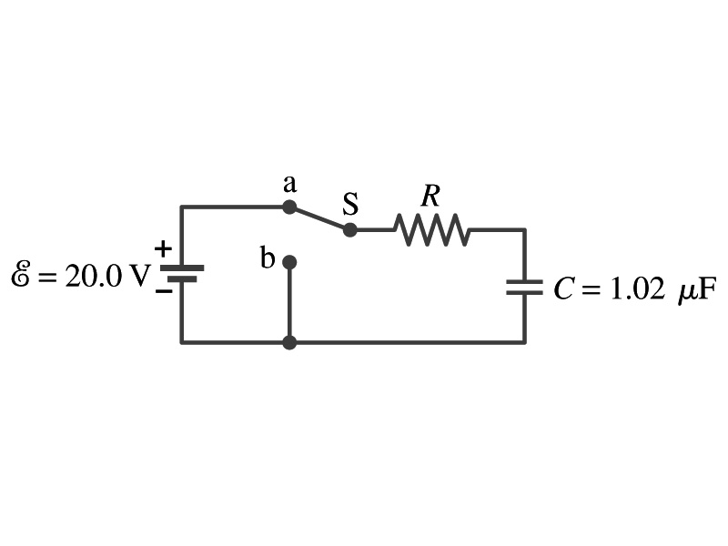
Example 26 – 13
Discharging RC circuit. In the RC circuit shown in the figure the battery has fully charged the capacitor, so Q₀=CE. Then at t=0, the switch is thrown from position a to b. The battery emf is 20.0V, and the capacitance C=1.02μF. The current I is observed to decrease to
0.50 of its initial value in 40μs. (a) what is the value of R? (b) What is the value of Q, the charge on the capacitor, at t=0? (c) What is Q at t=60μs?
(a) Since the current reaches to 0.5 of its initial value in 40μs, we can obtain
For 0.5I₀
Rearrange terms
Solve for R
(b) The value of Q at t=0 is
(c) What do we need to know first for the value of Q at t=60μs?
The RC time
Thus

Slide 14
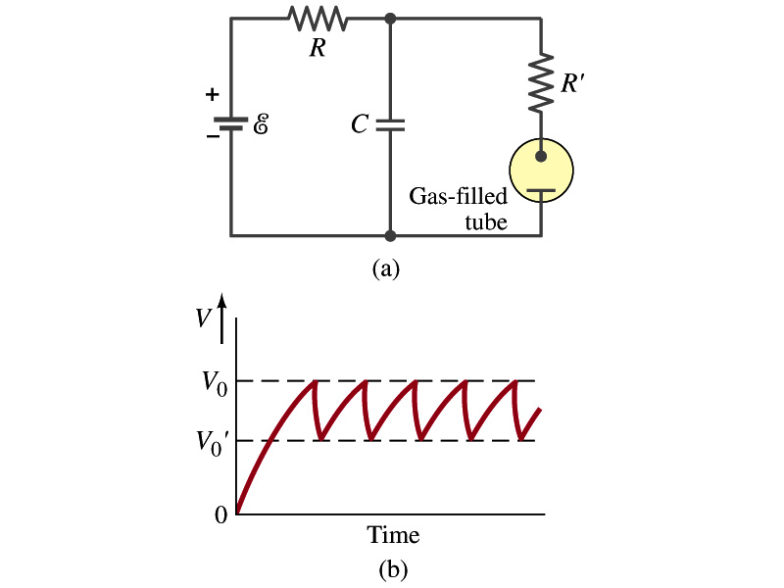
Application of RC Circuits
What do you think the charging and discharging characteristics of RC circuits can be used for?
To produce voltage pulses at a regular frequency
How?
The capacitor charges up to a particular voltage and discharges
A simple way of doing this is to use breakdown of voltage in a gas filled tube
The discharge occurs when the voltage breaks down at V₀
After the completion of discharge, the tube no longer conducts
Then the voltage is at V₀’ and it starts charging up
How do you think the voltage as a function of time look?
A sawtooth shape
Pace maker, intermittent windshield wiper, etc

Slide 15
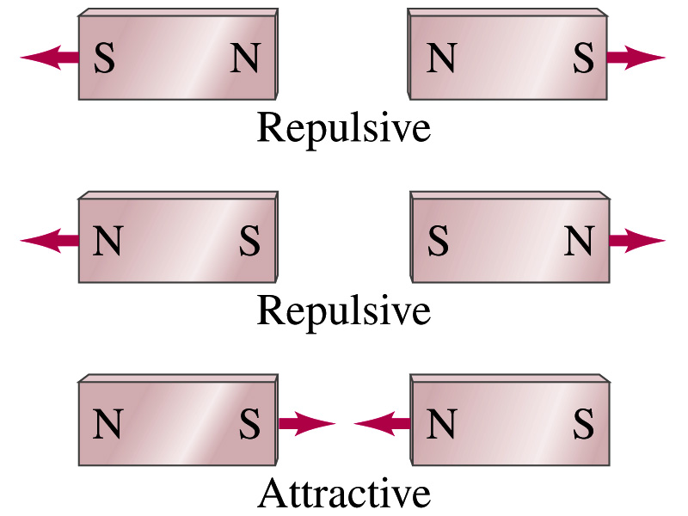
Magnetism
What are magnets?
Objects with two poles, North and South poles
The pole that points to the geographical North is the North pole and the other is the South pole
Principle of compass
These are called magnets due to the name of the region, Magnesia, where rocks that attract each other were found
What happens when two magnets are brought to each other?
They exert force onto each other
What kind?
Both repulsive and attractive forces depending on the configurations
Like poles repel each other while the unlike poles attract

Slide 16
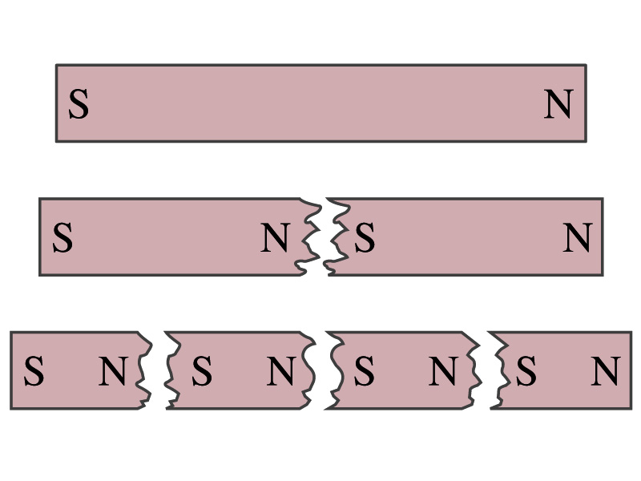
Magnetism
So the magnetic poles are the same as the electric charge?
No. Why not?
While the electric charges (positive and negative) can be isolated, the magnetic poles cannot be isolated.
So what happens when a magnet is cut?
If a magnet is cut, two magnets are made.
The more they get cut, the more magnets are made
Single pole magnets are called the monopole but it has not been seen yet
Ferromagnetic materials: Materials that show strong magnetic effects
Iron, cobalt, nickel, gadolinium and certain alloys
Other materials show very weak magnetic effects

