Slide 1
PHYS 1441 – Section 002
Lecture #16
Monday, Nov. 5, 2018
Dr. Jaehoon Yu
Chapter 27: Magnetism & Magnetic Field
  Electric Current and Magnetism
  Magnetic Field
  Magnetic Force on a Moving Charge
  About Magnetic Field
  Charged Particle Path in a Magnetic Field
Today’s homework is homework #11, due 11pm, Monday, Nov. 19!!

Slide 2
Announcements
Reminder:2nd non-comprehensive term exam
  In class Wednesday, Nov. 14
  Covers CH25.5 to what we learn Monday, Nov. 12
  Bring your calculator but DO NOT input formula into it!
    Cell phones or any types of computers cannot replace a calculator!
  BYOF: You may bring a one 8.5x11.5 sheet (front and back) of handwritten formulae and values of constants
  No derivations, word definitions or solutions of any kind!
  No additional formulae or values of constants will be provided

Slide 3
Reminder: Special Extra Credit #4
Election Participation Exercise
For those with legal voting rights: You can submit three “I Voted” stickers or the access code green sheet for 20 points total – one your own and two others who voted and the remainder 2 points each
For those without legal voting rights: You can submit for the first four “I Voted” sticker or the access code green sheet for 20 points total and the remainder 2 points each
Be sure to tape one side of the stickers on a sheet of paper with your name on it.
  Write the precinct number the vote was cast, the full name of the person voted and the signature of the voter next to the relevant sticker
None of the stickers can be from the same person on someone else’s extra credit or on your own. All of those with any of the identical persons on your extra credit sheet will get 0 credit.
Deadline: Beginning of the class this Wednesday, Nov. 7

Slide 4
Special Project #5
Make a list of the power consumption and the resistance of all electric and electronic devices at your home and compile them in a table. (10 points total for the first 10 items and 0.5 points each additional item.)
Estimate the cost of electricity for each of the items on the table using your own electric cost per kWh (if you don’t find your own, use $0.12/kWh) and put them in the relevant column. (5 points total for the first 10 items and 0.2 points each additional items)
Estimate the the total amount of energy in Joules and the total electricity cost per day, per month and per year for your home. (8 points)
Due: Beginning of the class Wednesday, Dec. 5

Slide 6
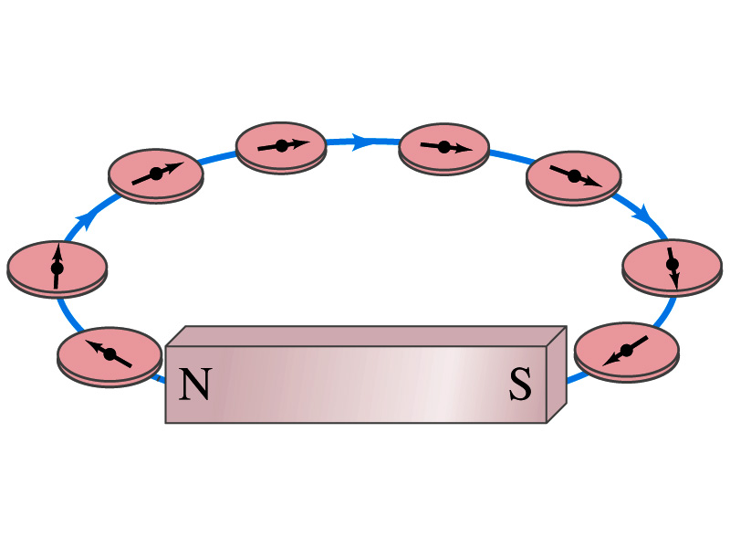
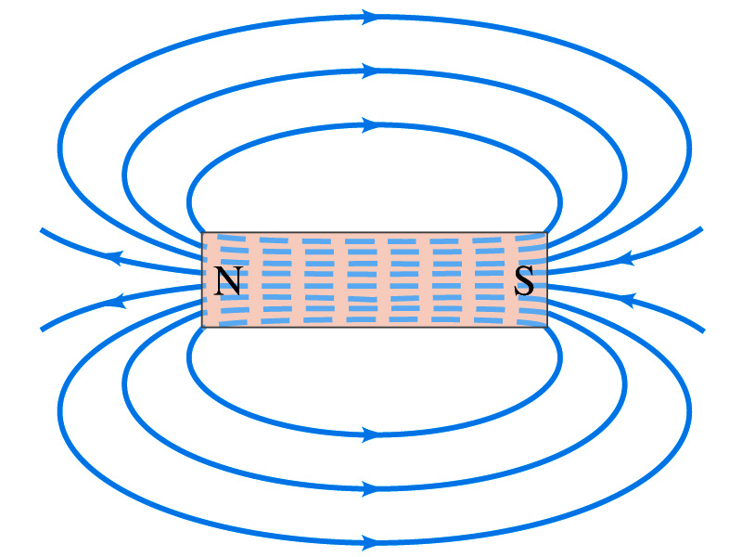
Magnetic Field
Just like the electric field that surrounds electric charge, the magnetic field surrounds a magnet
What does this mean?
  Magnetic force is also a field force
  The force one magnet exerts onto another can be viewed as the interaction between the magnet and the magnetic field produced by the other magnets
  What kind of quantity is the magnetic field? Vector or Scalar?
So one can draw magnetic field lines, too.
Vector
  The direction of the magnetic field is tangential to the line at any point
  The direction of the field is the direction the north pole of a compass would point to
  The number of lines per unit area is proportional to the strength of the magnetic field
  Magnetic field lines continue inside the magnet
  Since magnets always have both the poles, magnetic field lines form closed loops unlike electric field lines

Slide 7
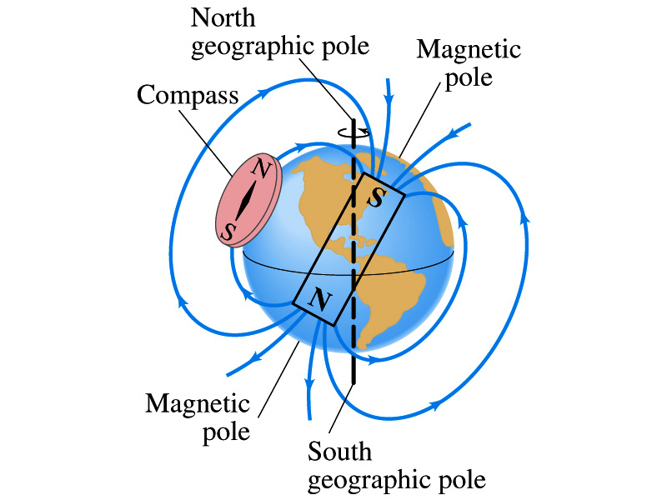
Earth’s Magnetic Field
What magnetic pole does the geographic North pole has to have?
  Magnetic South pole. What? How do you know that?
  Since the magnetic North pole points to the geographic North, the geographic north must have magnetic south pole
    The pole in the North is still called geomagnetic North pole just because it is in the North
  Similarly, South pole has magnetic North pole
The Earth’s magnetic poles do not coincide with the geographic poles ➔ magnetic declination
  Geomagnetic North pole is in Northern Canada, some 900km off the true North pole
Earth’s magnetic field line is not tangent to the earth’s surface at all points
  The angle the Earth’s field makes to the horizontal line is called the angle dip

Slide 8
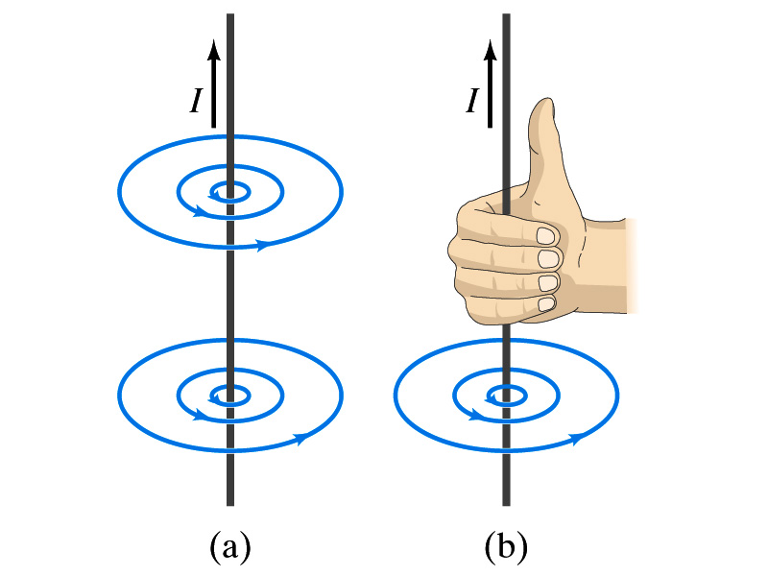
Electric Current and Magnetism
In 1820, Oersted found that when a compass needle is placed near an electric wire, the needle deflects as soon as the wire is connected to a battery and the current flows
  Electric current produces a magnetic field
    The first indication that electricity and magnetism are of the same origin
  What about a stationary electric charge and magnet?
    They don’t affect each other.
The magnetic field lines produced by a current in a straight wire is in the form of circles following the “right-hand” rule
  The field lines follow right-hand fingers wrapped around the wire when the thumb points to the direction of the electric current

Slide 9
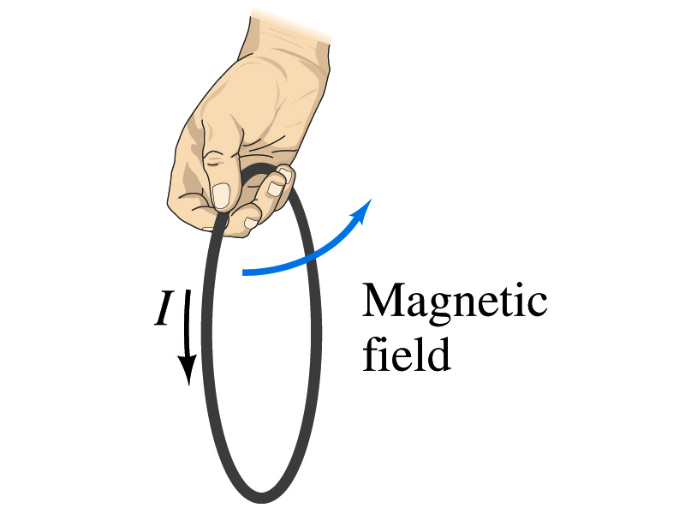
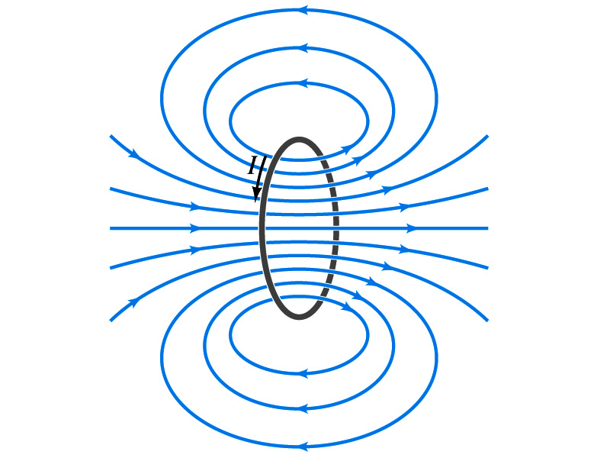
Directions in a Circular Wire?
OK, then what is the direction of the magnetic field generated by the current flowing through a circular loop?

Slide 10
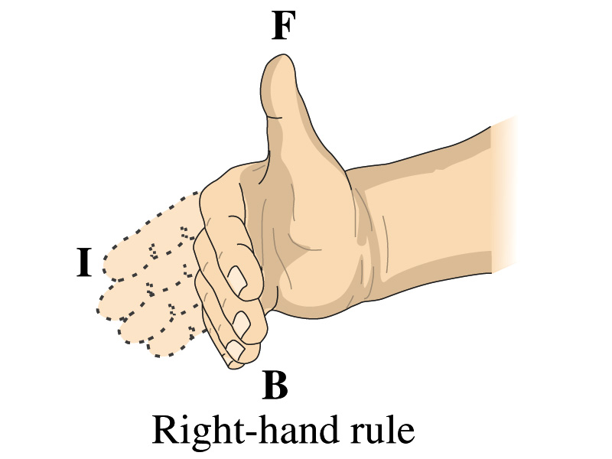
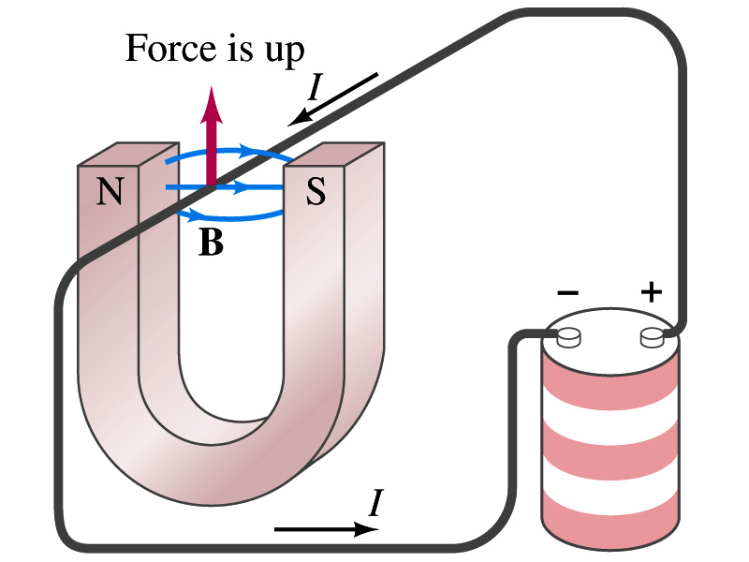
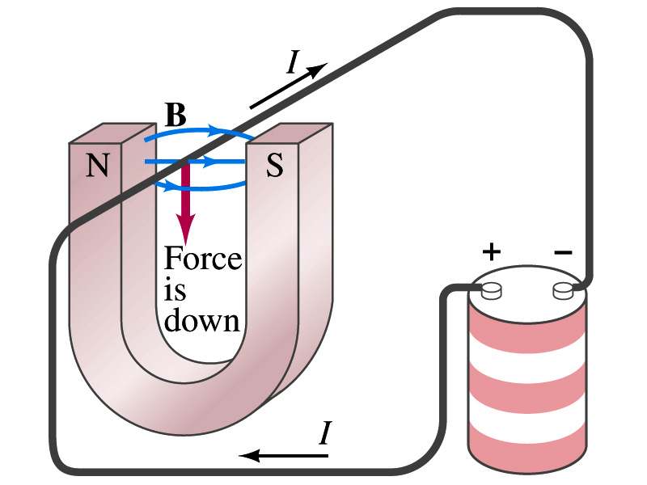
Magnetic Forces on Electric Current
Since the electric current exerts force on a magnet, the magnet should also exert force on the electric current
  Which law justifies this?
    Newton’s 3rd law
  This was also discovered by Oersted
Direction of the force is always
  perpendicular to the direction of the current and
  perpendicular to the direction of the magnetic field, B
Experimentally the direction of the force is given by another right-hand rule ➔ When the fingers of the right-hand points to the direction of the current and the finger tips bent to the direction of magnetic field B, the direction of thumb points to the direction of the force

Slide 11
Magnetic Forces on Electric Current
OK, we are set for the direction but what about the magnitude?
It is found that the magnitude of the force is directly proportional
  To the current in the wire
  To the length of the wire in the magnetic field (if the field is uniform)
  To the strength of the magnetic field
The force also depends on the angle θ between the directions of the current and the magnetic field
  When the wire is perpendicular to the field, the force is the strongest
  When the wire is parallel to the field, there is no force at all
Thus the force on current I in the wire w/ length l in a uniform field B is

Slide 12
Magnetic Forces on Electric Current
Magnetic field strength B can be defined using the previous proportionality relationship w/ the constant 1:
if θ=90º, and if θ=0º
So the magnitude of the magnetic field B can be defined as
  where F_{max} is the magnitude of the force on a straight length l of the wire carrying the current I when the wire is perpendicular to B
The relationship between F, B and I can be written in a vector formula:
  l is the vector whose magnitude is the length of the wire and its direction is along the wire in the direction of the conventional current
  This formula works if B is uniform.
If B is not uniform or l does not form the same angle with B everywhere, the infinitesimal force acting on a differential length dl is

Slide 13
Fundamentals on the Magnetic Field, B
The magnetic field is a vector quantity
The SI unit for B is tesla (T)
  What is the definition of 1 Tesla in terms of other known units?
  1T=1N/A-m
  In older names, tesla is the same as weber per meter-squared
    1Wb/m²=1T
The cgs unit for B is gauss (G)
  How many T is one G?
    1G=10⁻⁴ T
  For computation, one MUST convert G to T at all times
Magnetic field on the Earth’s surface is about 0.5G=0.5x10⁻⁴T
On a diagram, for field coming out and for going in.

Slide 14
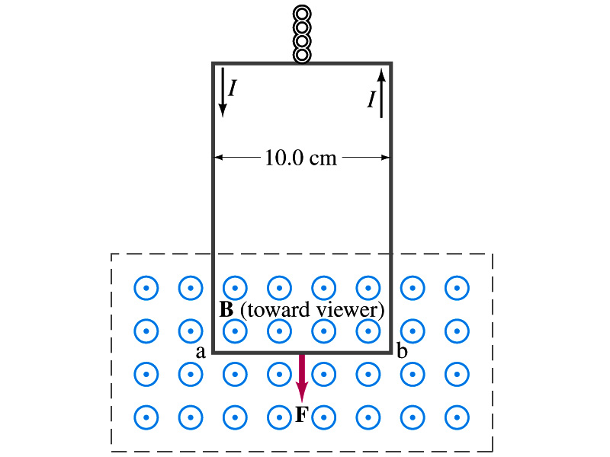
Example 27 – 2
Measuring a magnetic field. A rectangular loop of wire hangs vertically as shown in the figure. A magnetic field B is directed horizontally perpendicular to the wire, and points out of the page. The magnetic field B is very nearly uniform along the horizontal portion of wire ab (length l=10.0cm) which is near the center of a large magnet producing the field. The top portion of the wire loop is free of the field. The loop hangs from a balance which measures a downward force ( in addition to the gravitational force) of F=3.48x10⁻²N when the wire carries a current I=0.245A. What is the magnitude of the magnetic field B at the center of the magnet?
Magnetic force exerted on the wire due to the uniform field is
Since
Magnitude of the force is
Solving for B
Something is not right! What happened to the forces on the loop on the side?
The two forces cancel out since they are in opposite direction with the same magnitude.

Slide 15
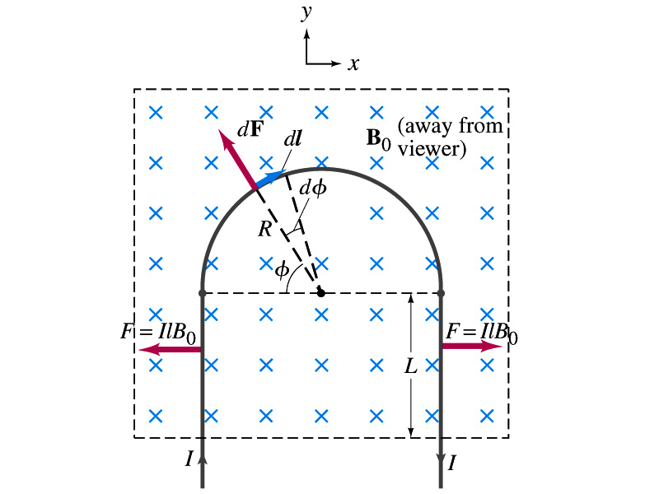
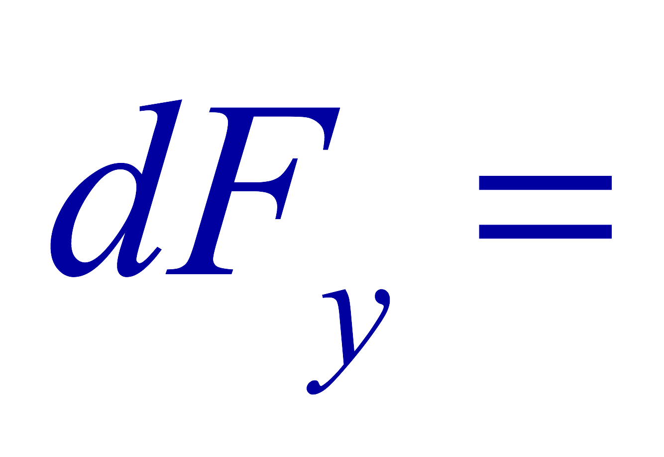
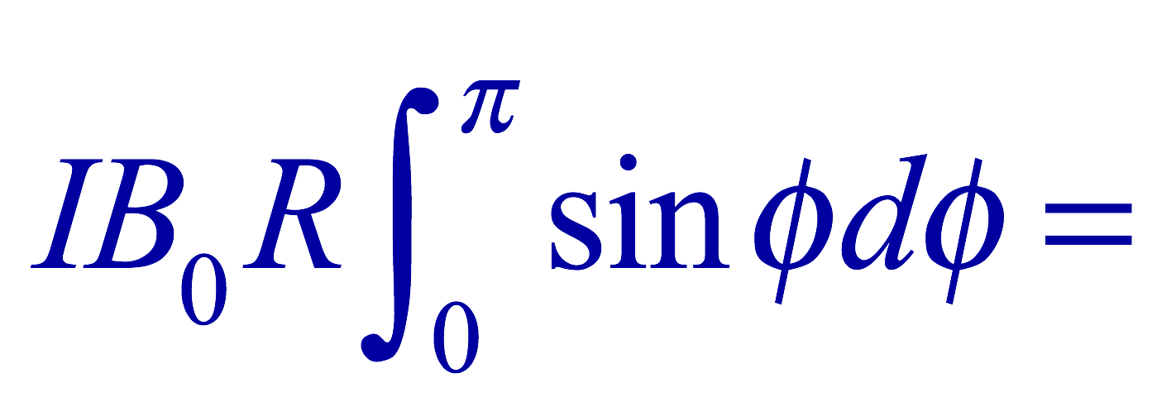
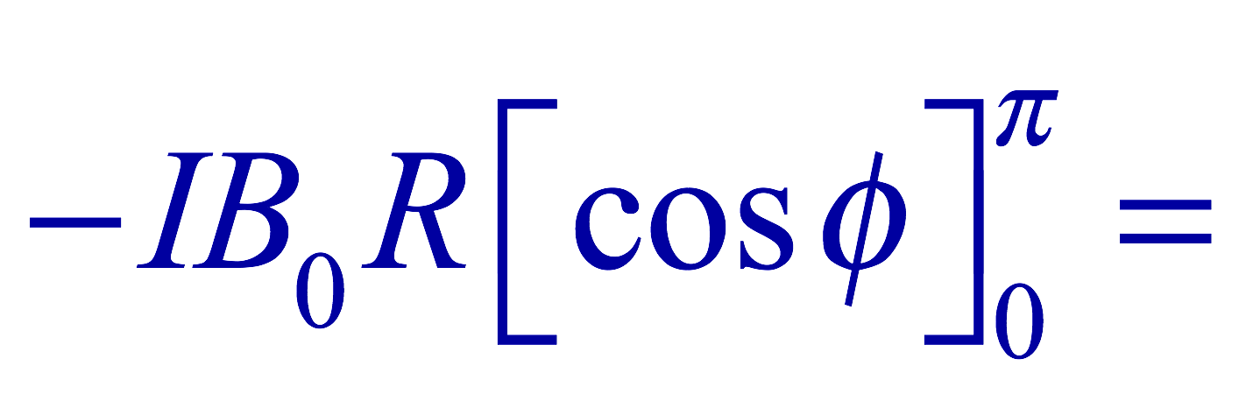

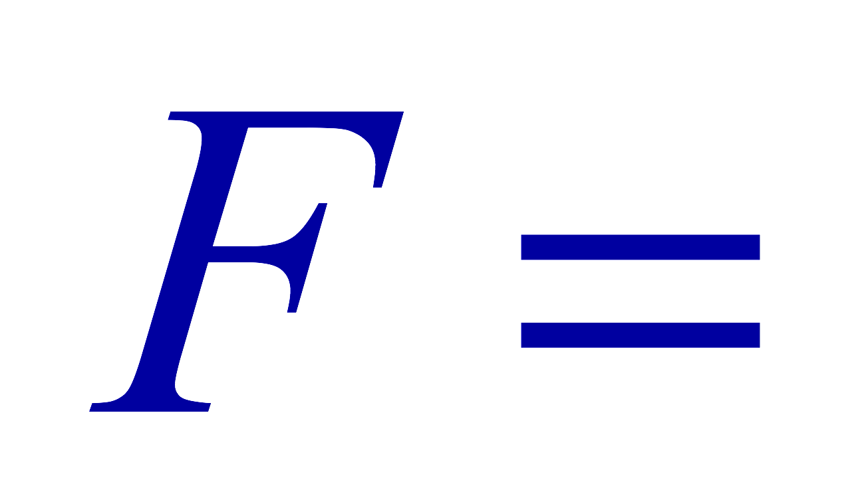
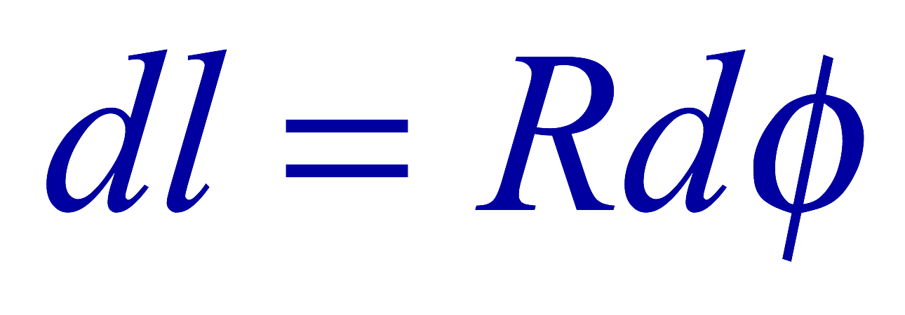
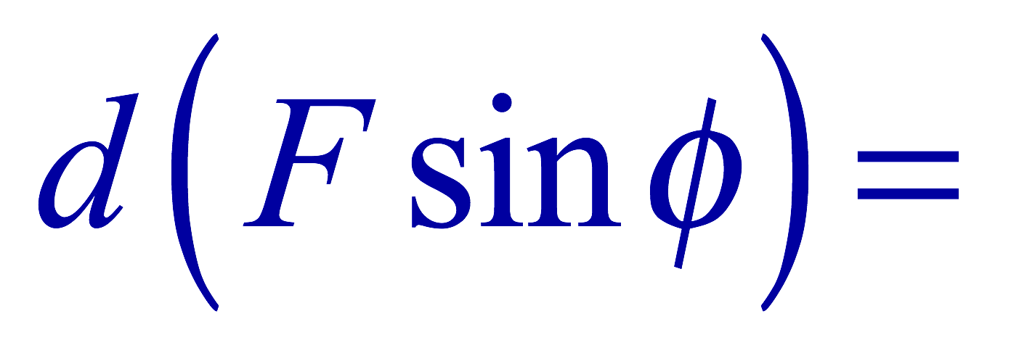
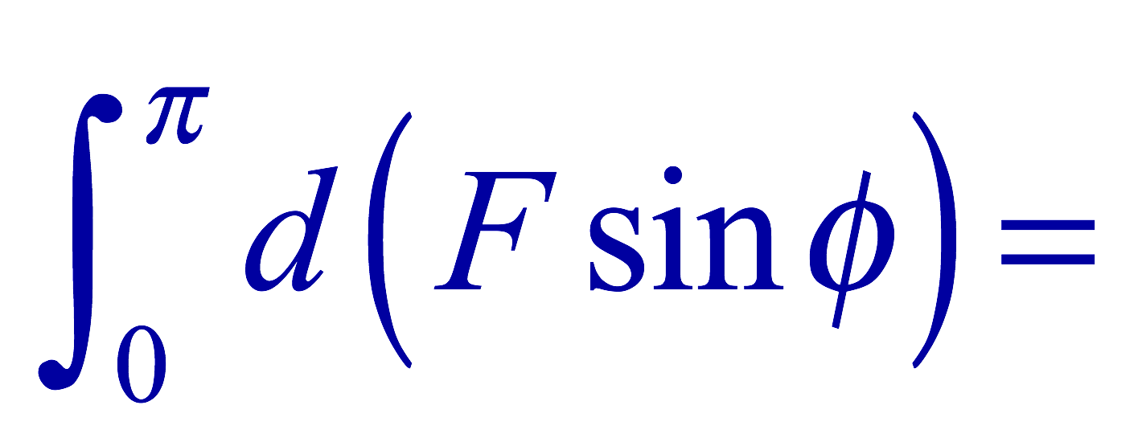
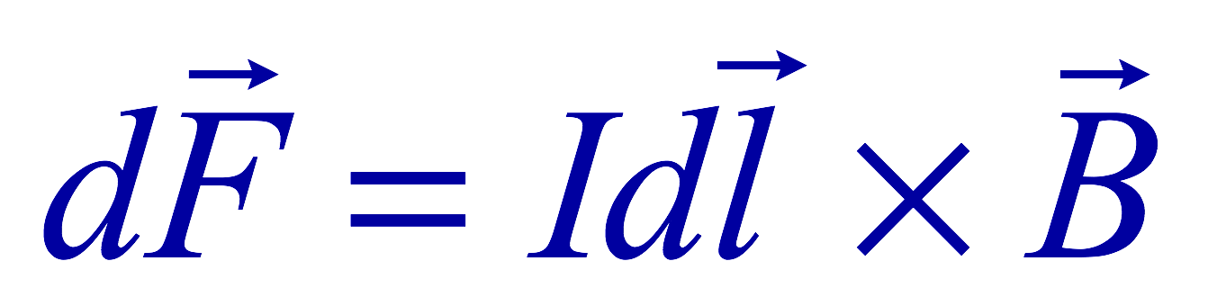
Example 27 – 3
Magnetic force on a semi-circular wire. A rigid wire, carrying the current I, consists of a semicircle of radius R and two straight portions as shown in the figure. The wire lies in a plane perpendicular to the uniform magnetic field B₀. The straight portions each have length l within the field. Determine the net force on the wire due to the magnetic field B₀.
As in the previous example, the forces on the straight sections of the wire is equal and in opposite direction. Thus they cancel.
What do we use to figure out the net force on the semicircle?
We divide the semicircle into infinitesimal straight sections.
What is the net x component of the force exerting on the circular section?
0
Why?
Because the forces on left and the right-hand sides of the semicircle balance.
Since
Y-component of the force dF is
Integrating over ϕ=0 - π
Which direction?
Vertically upward direction. The wire will be pulled deeper into the field.

