Slide 1
PHYS 1441 – Section 002
Lecture #17
Wednesday, Nov. 7, 2018
Dr. Jaehoon Yu
Chapter 27: Magnetism & Magnetic Field
  Magnetic Force on a Moving Charge
  About Magnetic Field
  Charged Particle Path in a Magnetic Field
  The cyclotron frequency
  Magnetic dipole Moment
  The Hall Effect

Slide 2
Announcements
Reading Assignments: CH27.6, 27.8 and 27.9
Bring out your special project #4!
Reminder:2nd non-comprehensive term exam
  In class Wednesday, Nov. 14
  Covers CH25.5 to what we learn Monday, Nov. 12
  Bring your calculator but DO NOT input formula into it!
    Cell phones or any types of computers cannot replace a calculator!
  BYOF: You may bring a one 8.5x11.5 sheet (front and back) of handwritten formulae and values of constants
  No derivations, word definitions or solutions of any kind!
  No additional formulae or values of constants will be provided
No class on Thanksgiving Wednesday, Nov. 21
The final exam will be in class Wednesday, Dec. 5
Colloquium at 4pm today in SH100
  Dr. E. Gramellini of Fermilab

Slide 3
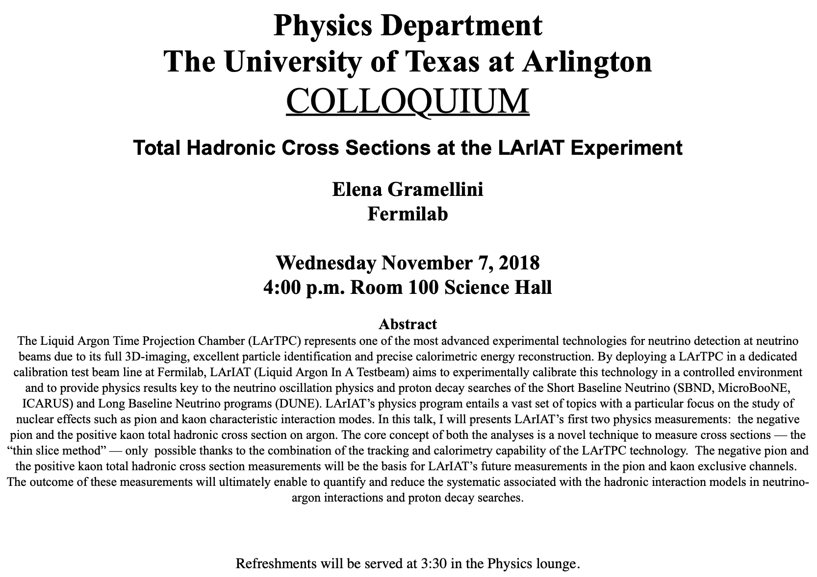

Slide 4
Reminder: Special Project #5
Make a list of the power consumption and the resistance of all electric and electronic devices at your home and compile them in a table. (10 points total for the first 10 items and 0.5 points each additional item.)
Estimate the cost of electricity for each of the items on the table using your own electric cost per kWh (if you don’t find your own, use $0.12/kWh) and put them in the relevant column. (5 points total for the first 10 items and 0.2 points each additional items)
Estimate the the total amount of energy in Joules and the total electricity cost per day, per month and per year for your home. (8 points)
Due: Beginning of the class Wednesday, Nov. 28

Slide 6
Recap: Magnetic Force on Electric Current
Magnetic field strength B can be defined using the previous proportionality relationship w/ the constant 1:
if θ=90º, and if θ=0º
So the magnitude of the magnetic field B can be defined as
  where F_{max} is the magnitude of the force on a straight length l of the wire carrying the current I when the wire is perpendicular to B
The relationship between F, B and I can be written in a vector formula:
  l is the vector whose magnitude is the length of the wire and its direction is along the wire in the direction of the conventional current
  This formula works if B is uniform.
If B is not uniform or l does not form the same angle with B everywhere, the infinitesimal force acting on a differential length dl is

Slide 7
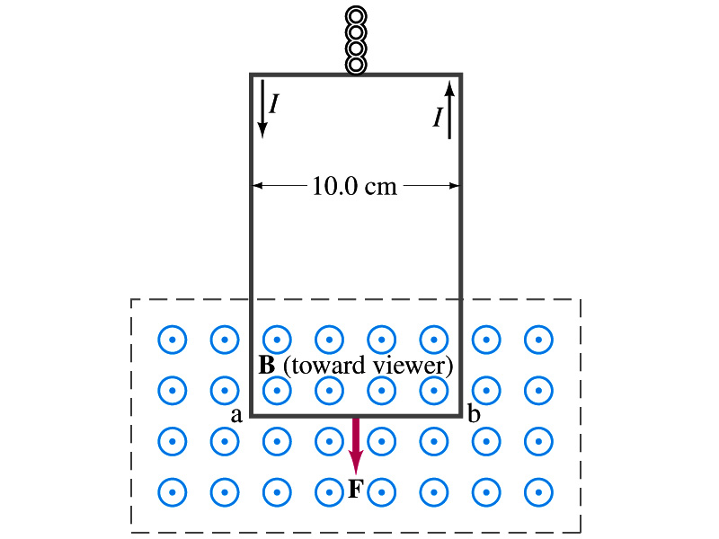
Example 27 – 2
Measuring a magnetic field. A rectangular loop of wire hangs vertically as shown in the figure. A magnetic field B is directed horizontally perpendicular to the wire, and points out of the page. The magnetic field B is very nearly uniform along the horizontal portion of wire ab (length l=10.0cm) which is near the center of a large magnet producing the field. The top portion of the wire loop is free of the field. The loop hangs from a balance which measures a downward force ( in addition to the gravitational force) of F=3.48x10⁻²N when the wire carries a current I=0.245A. What is the magnitude of the magnetic field B at the center of the magnet?
Magnetic force exerted on the wire due to the uniform field is
Since
Magnitude of the force is
Solving for B
Something is not right! What happened to the forces on the loop on the side?
The two forces cancel out since they are in opposite direction with the same magnitude.

Slide 8
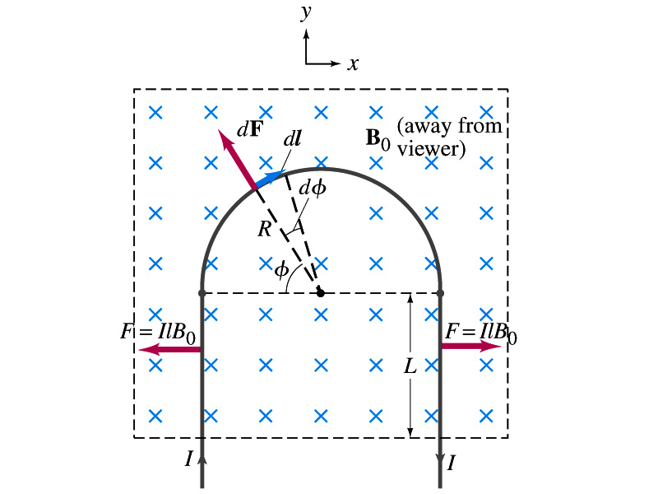
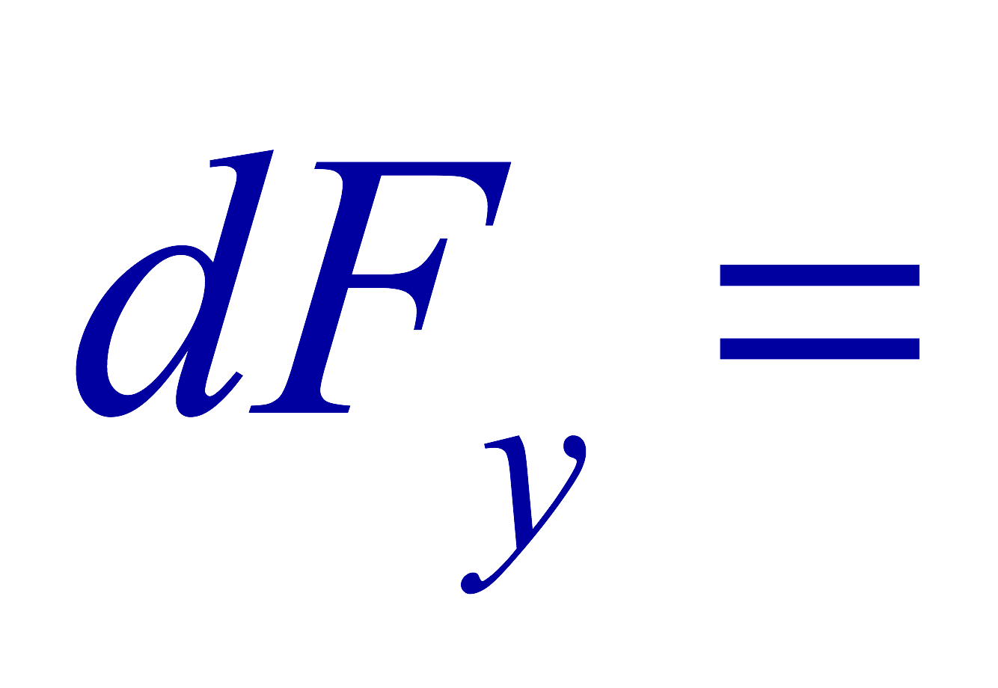
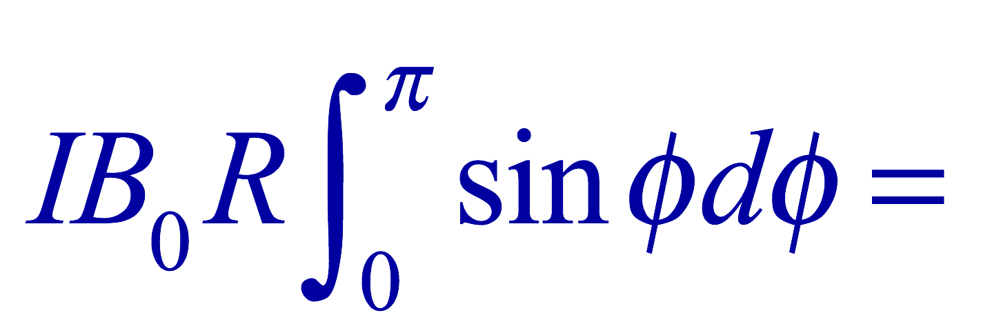
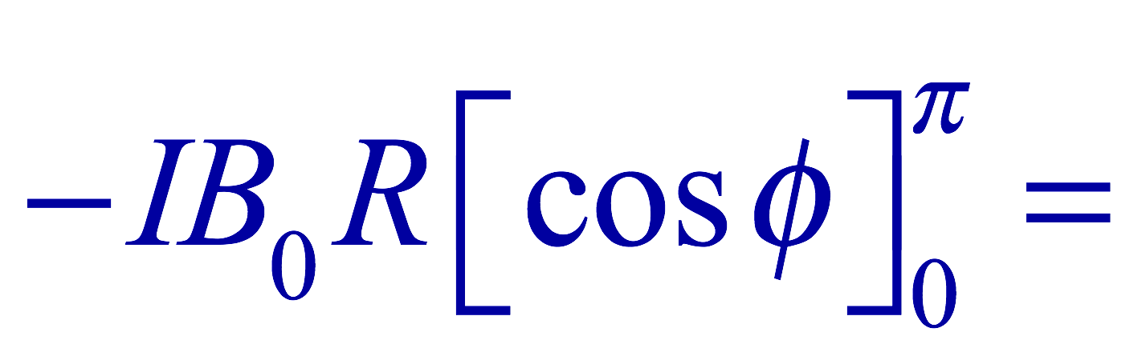


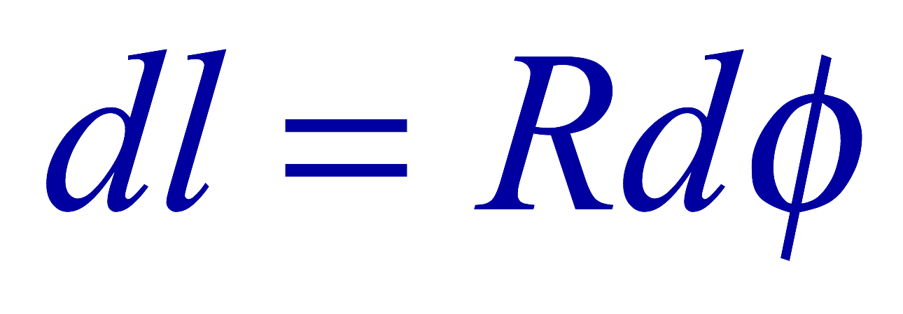
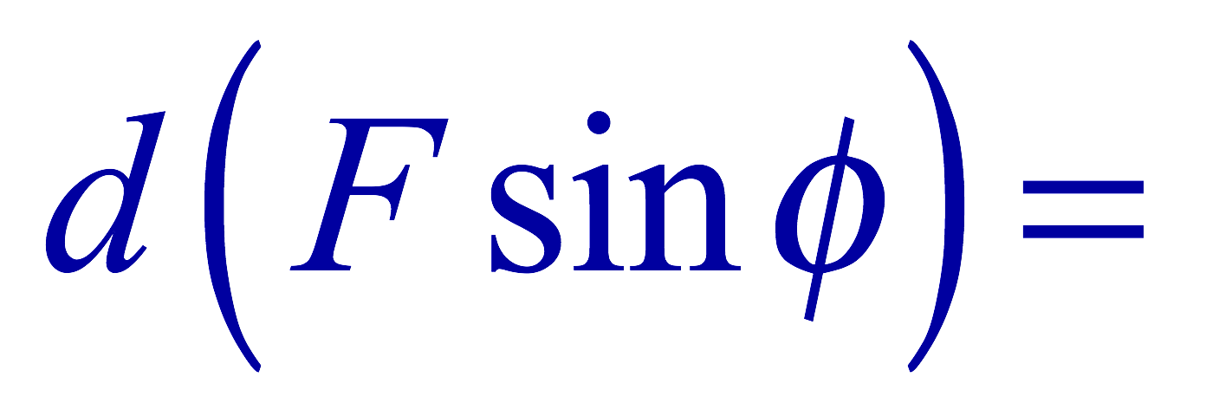
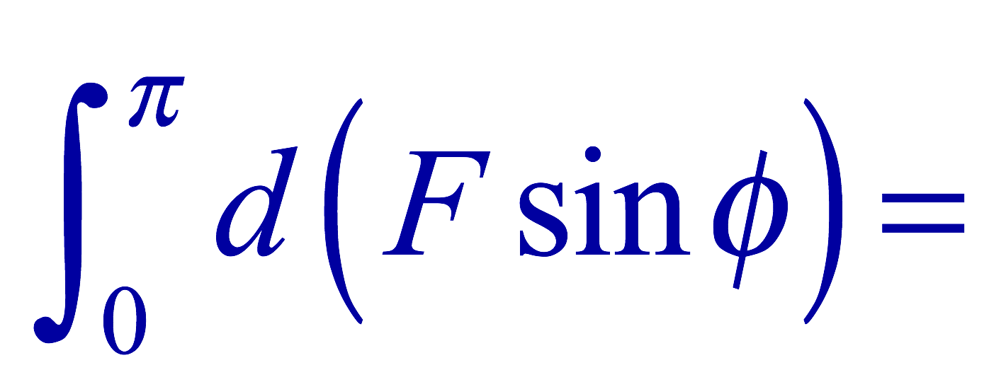
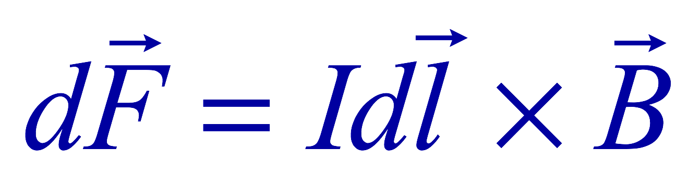
Example 27 – 3
Magnetic force on a semi-circular wire. A rigid wire, carrying the current I, consists of a semicircle of radius R and two straight portions as shown in the figure. The wire lies in a plane perpendicular to the uniform magnetic field B₀. The straight portions each have length l within the field. Determine the net force on the wire due to the magnetic field B₀.
As in the previous example, the forces on the straight sections of the wire is equal and in opposite direction. Thus they cancel.
What do we use to figure out the net force on the semicircle?
We divide the semicircle into infinitesimal straight sections.
What is the net x component of the force exerting on the circular section?
0
Why?
Because the forces on left and the right-hand sides of the semicircle balance.
Since
Y-component of the force dF is
Integrating over ϕ=0 - π
Which direction?
Vertically upward direction. The wire will be pulled deeper into the field.

Slide 9
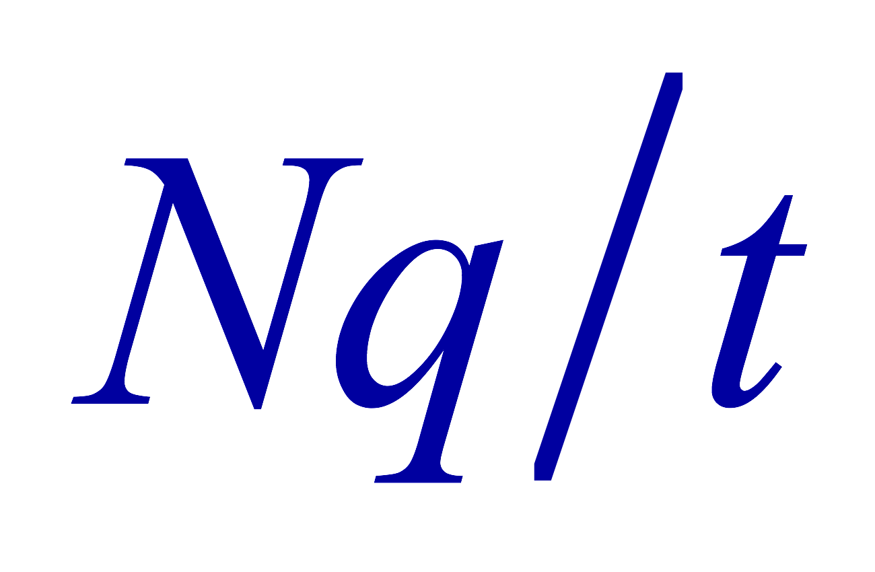
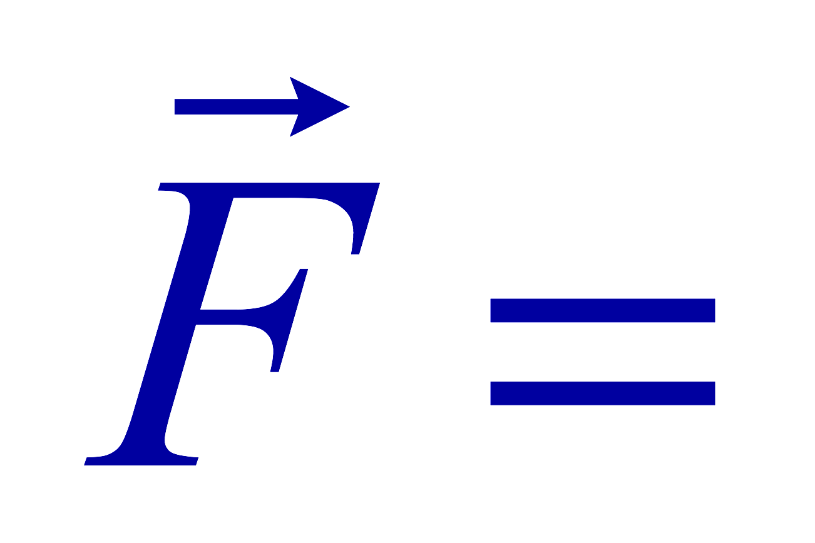
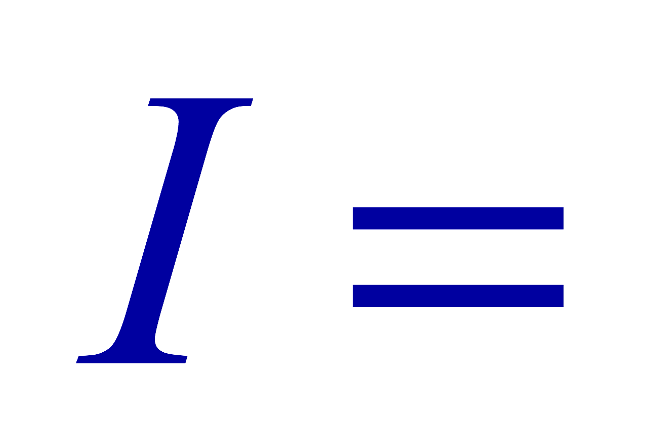
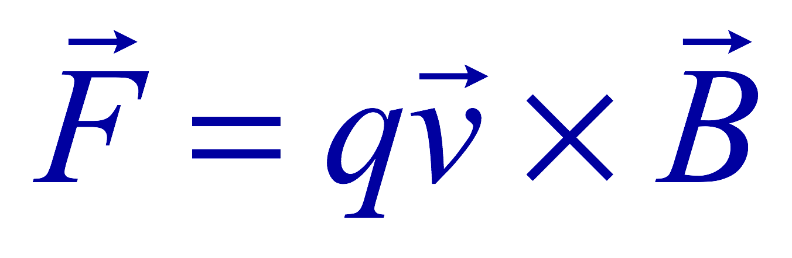
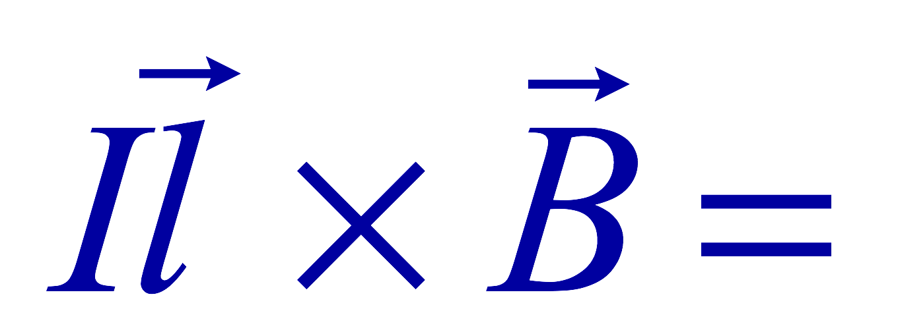
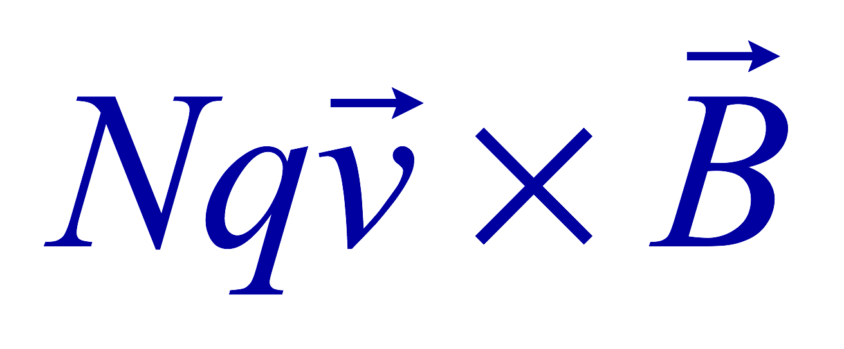
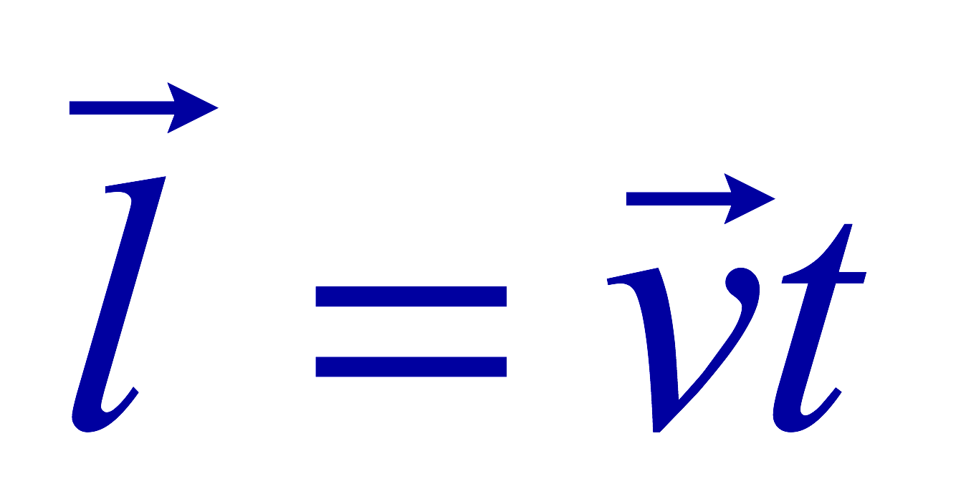
Magnetic Forces on a Moving Charge
Will moving charge in a magnetic field experience force?
  Yes
  Why?
  Since the wire carrying a current (moving charge) experiences force in a magnetic field, a free moving charge must feel the same kind of force…☺
OK, then how much force would it experience?
  Let’s consider N moving particles with charge q each, and they pass by a given point in a time interval t.
    What is the current?
  Let t be the time for the charge q to travel a distance L in a magnetic field B
    Then, the length vector l becomes
    Where v is the velocity of the particle
Thus the force on N particles by the field is
The force on one particle with charge q,

Slide 10
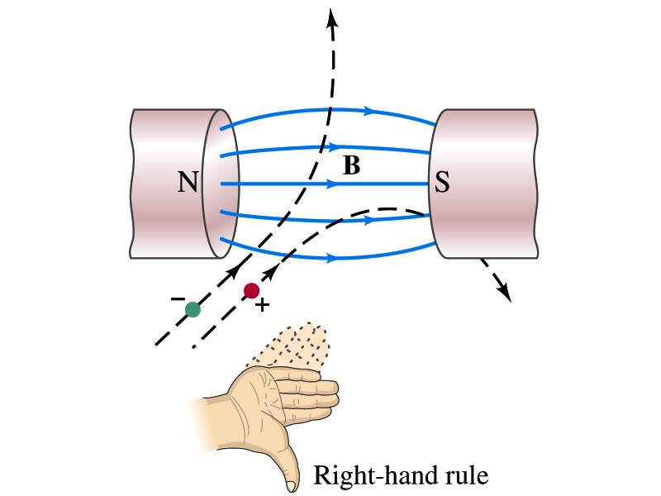

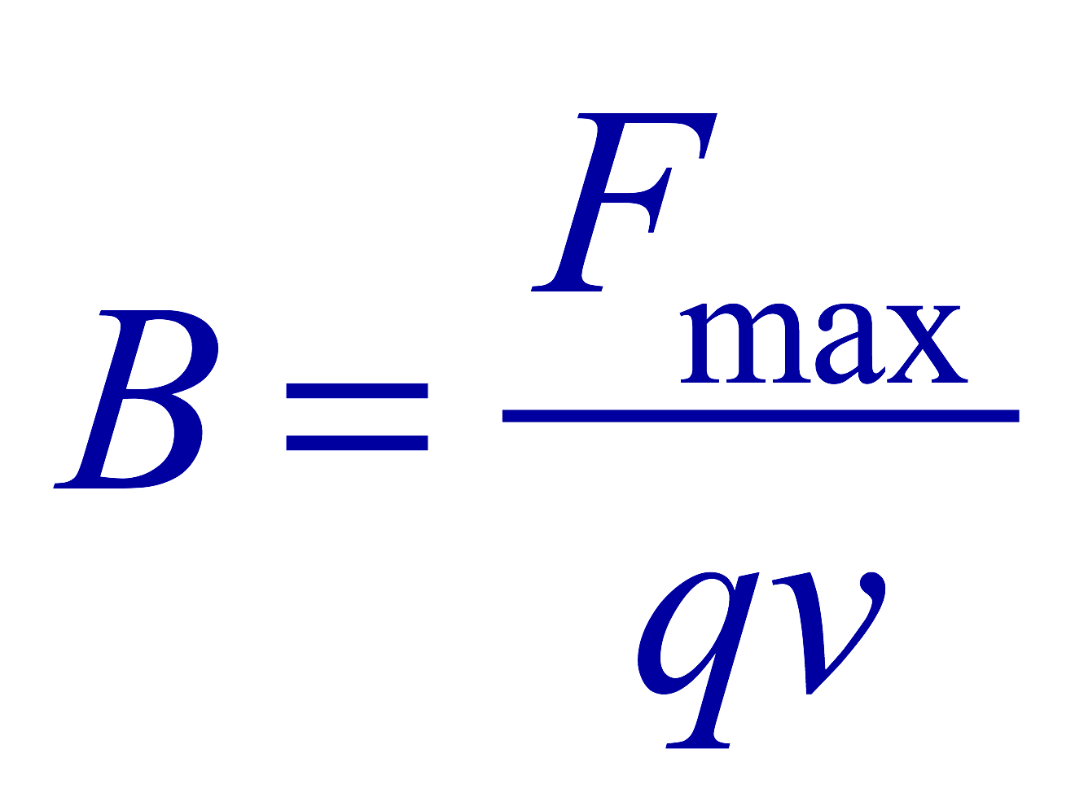
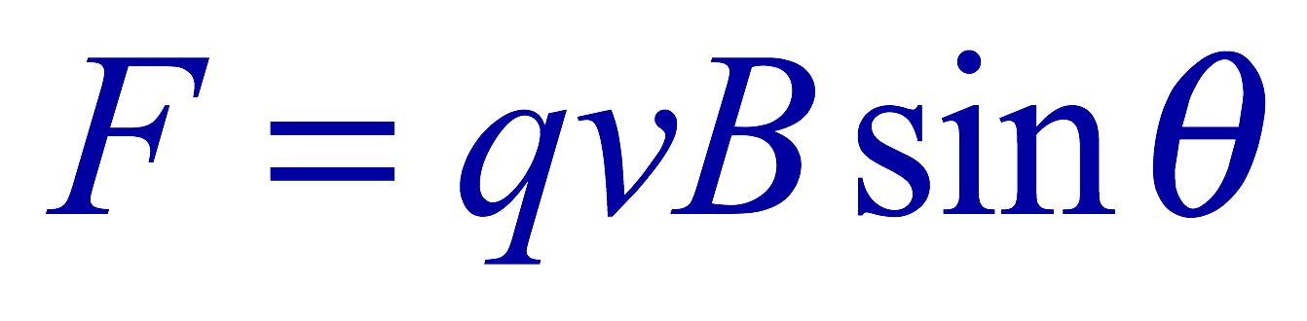
Magnetic Forces on a Moving Charge
This can be an alternative way of defining the magnetic field.
  How?
  The magnitude of the force on a particle with charge q moving with a velocity v in a field B is
    What is θ?
      The angle between the magnetic field and the direction of particle’s movement
    When is the force maximum?
      When the angle between the field and the velocity vector is perpendicular.
    ➔
  The direction of the force follows the right-hand-rule and is perpendicular to the direction of the magnetic field

Slide 11
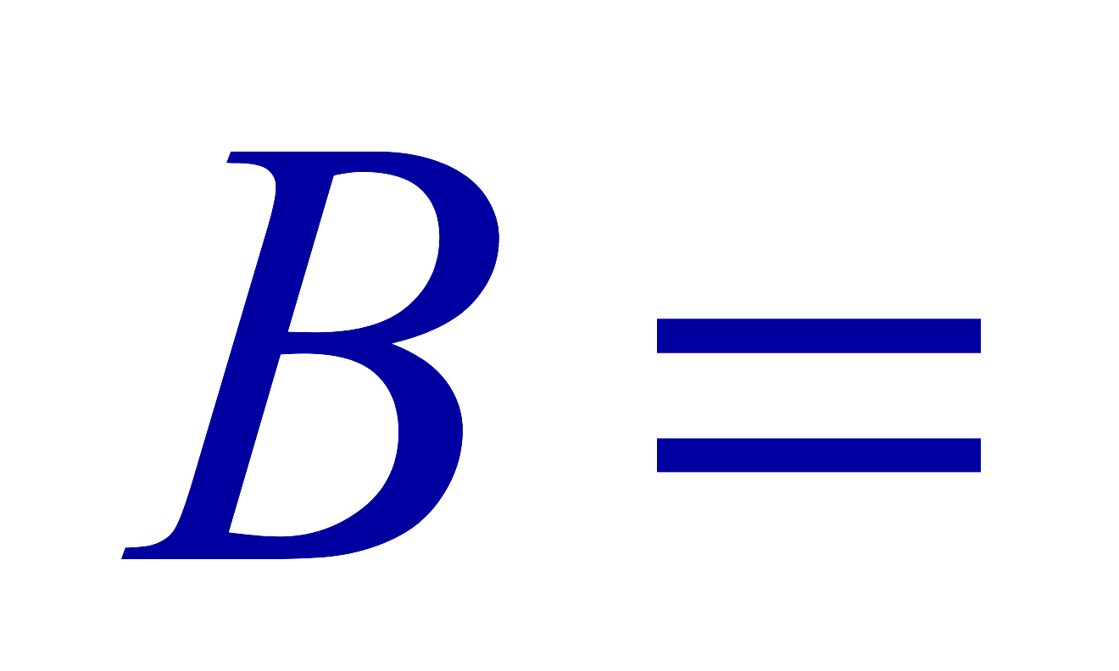
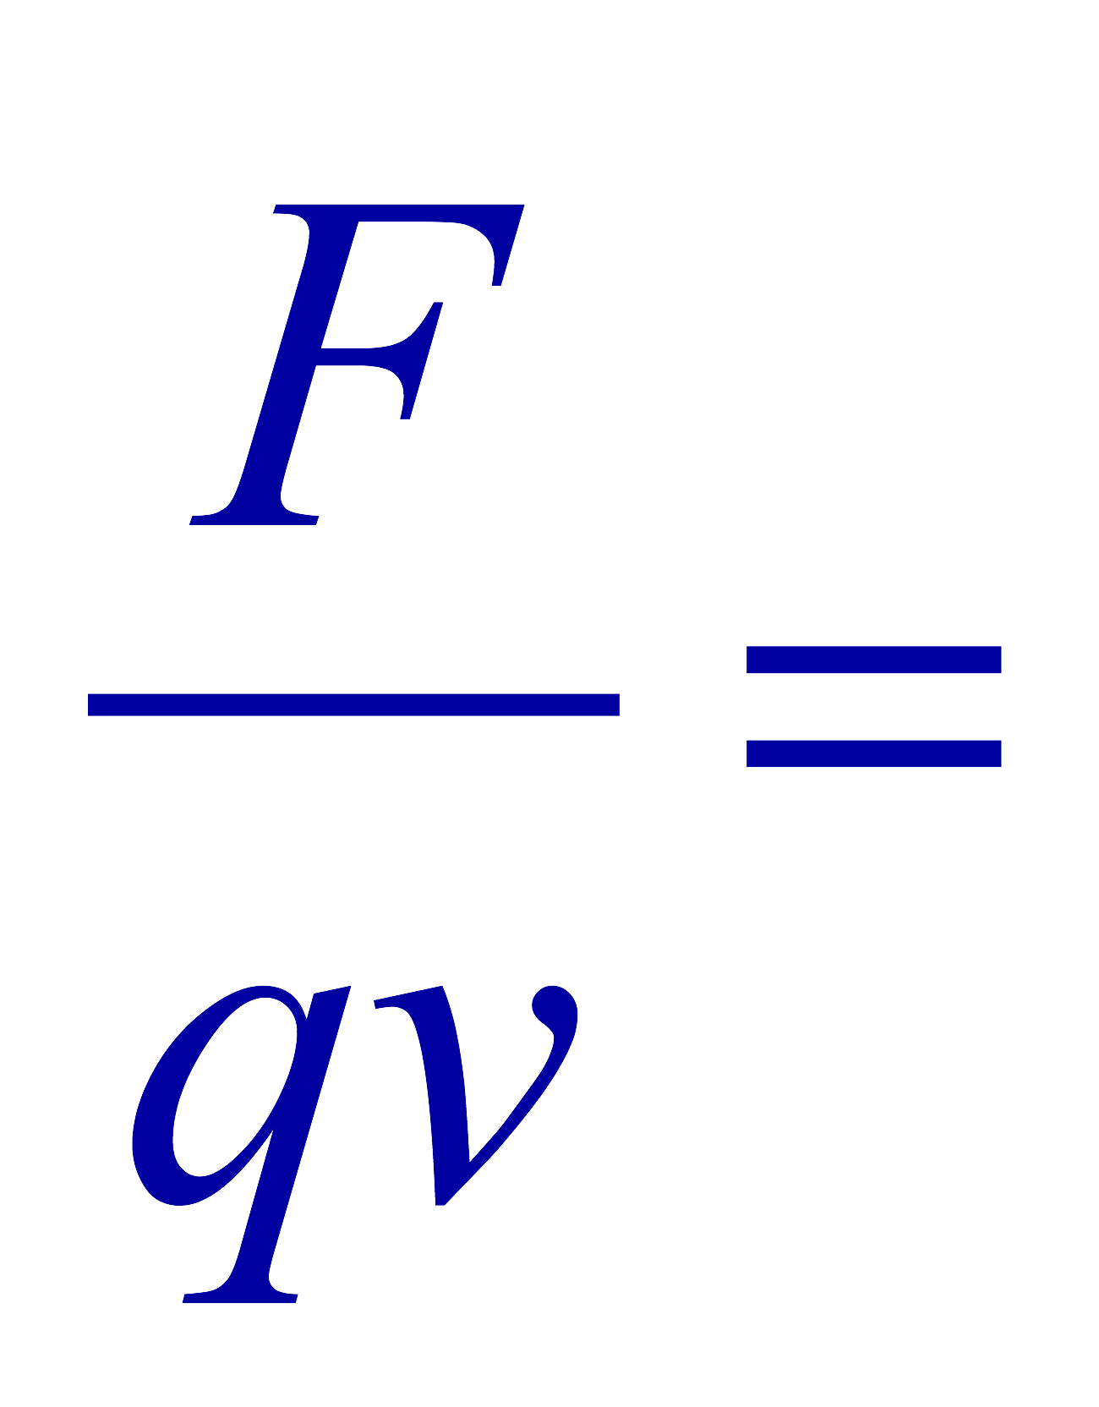
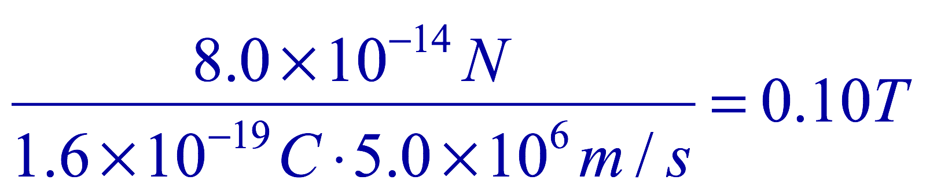
Example 27 – 5
Magnetic force on a proton. A proton having a speed of 5x10⁶m/s in a magnetic field feels a force of F=8.0x10⁻¹⁴N toward West when it moves vertically upward. When moving horizontally in a northerly direction, it feels zero force. What is the magnitude and the direction of the magnetic field in this region?
What is the charge of a proton?
What does the fact that the proton does not feel any force in a northerly direction tell you about the magnetic field?
The field is along the north-south direction.
Why?
Because the particle does not feel any magnetic force when it is moving along the direction of the field.
Since the particle feels force toward West, the field should be pointing to ….
North
Using the formula for the magnitude of the field B, we obtain
We can use magnetic field to measure the momentum of a particle. How?

Slide 12
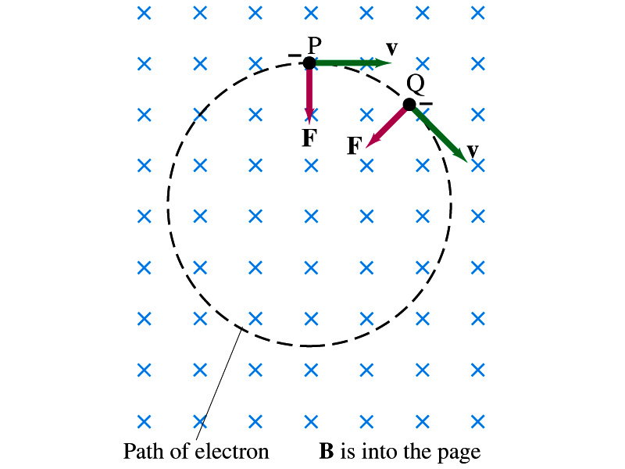
Charged Particle’s Path in Magnetic Field
What shape do you think is the path of a charged particle on a plane perpendicular to a uniform magnetic field?
  Circle!! Why?
  An electron moving to right at the point P in the figure will be pulled downward
  At a later time, the force is still perpendicular to the velocity
  Since the force is always perpendicular to the velocity, the magnitude of the velocity is constant
  The direction of the force follows the right-hand-rule and is perpendicular to the direction of the magnetic field
  Thus, the electron moves on a circular path with a centripetal force F.

Slide 13
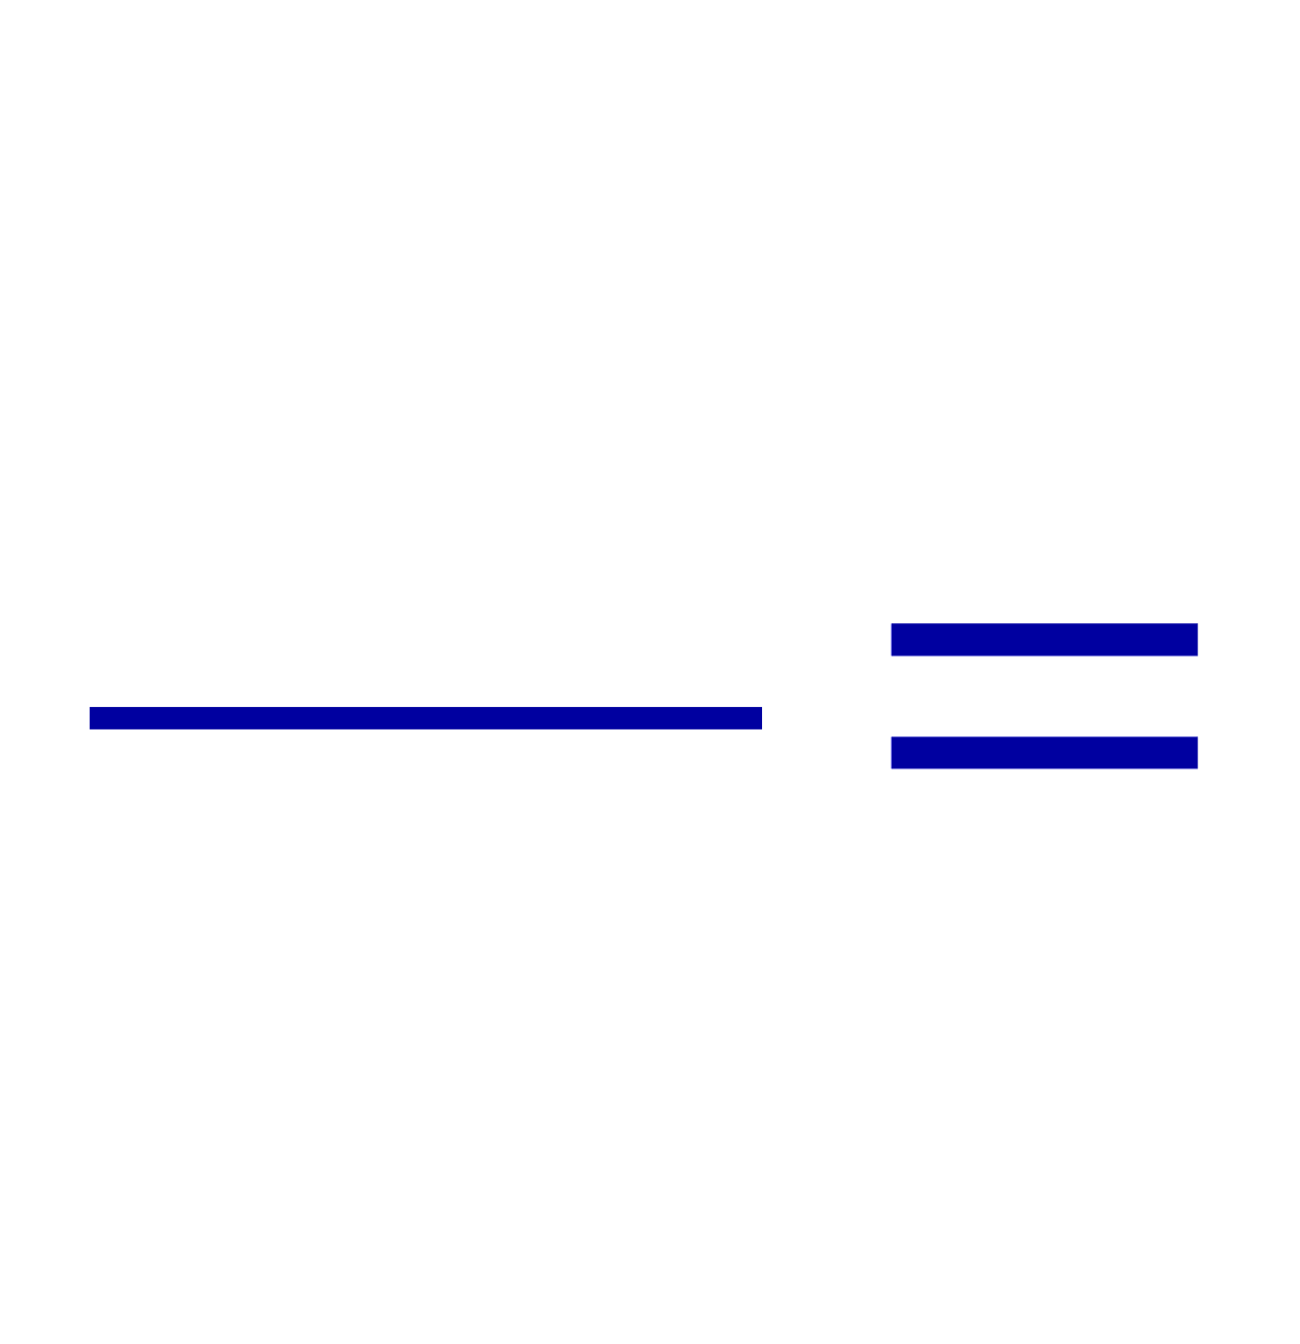
Example 27 – 7
Electron’s path in a uniform magnetic field. An electron travels at the speed of 2.0x10⁷m/s in a plane perpendicular to a 0.010-T magnetic field. What is the radius of the electron’s path?
What is formula for the centripetal force?
Since the magnetic field is perpendicular to the motion of the electron, the magnitude of the magnetic force is
Since the magnetic force provides the centripetal force, we can establish an equation with the two forces
Solving for r

Slide 14
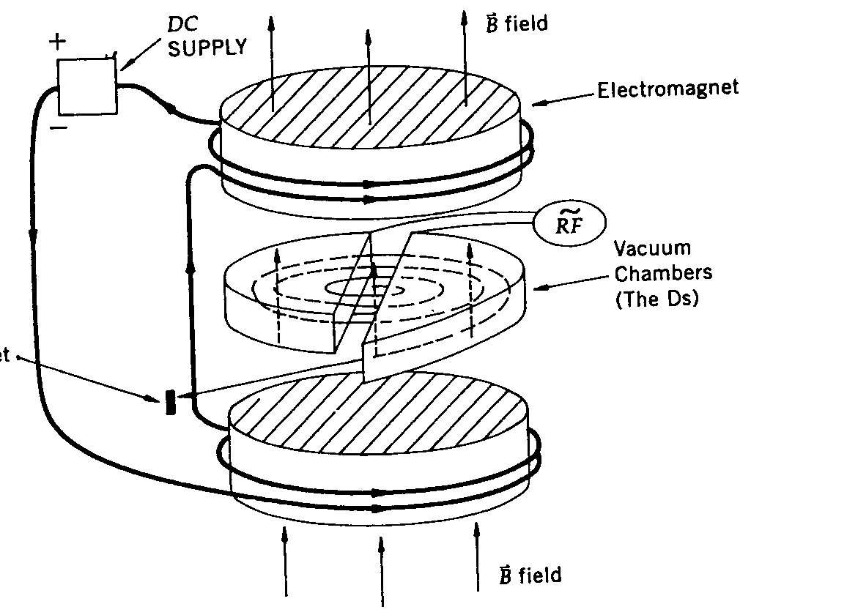
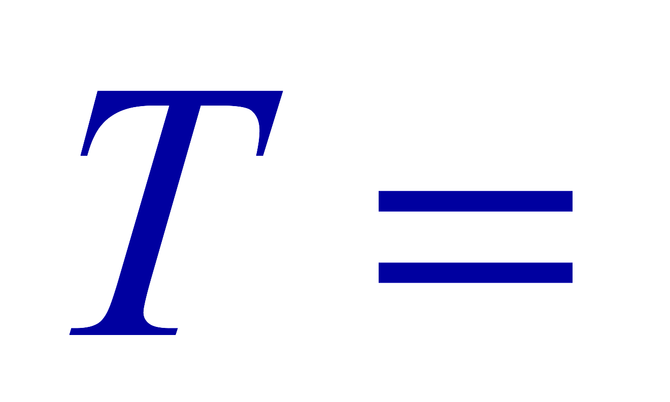
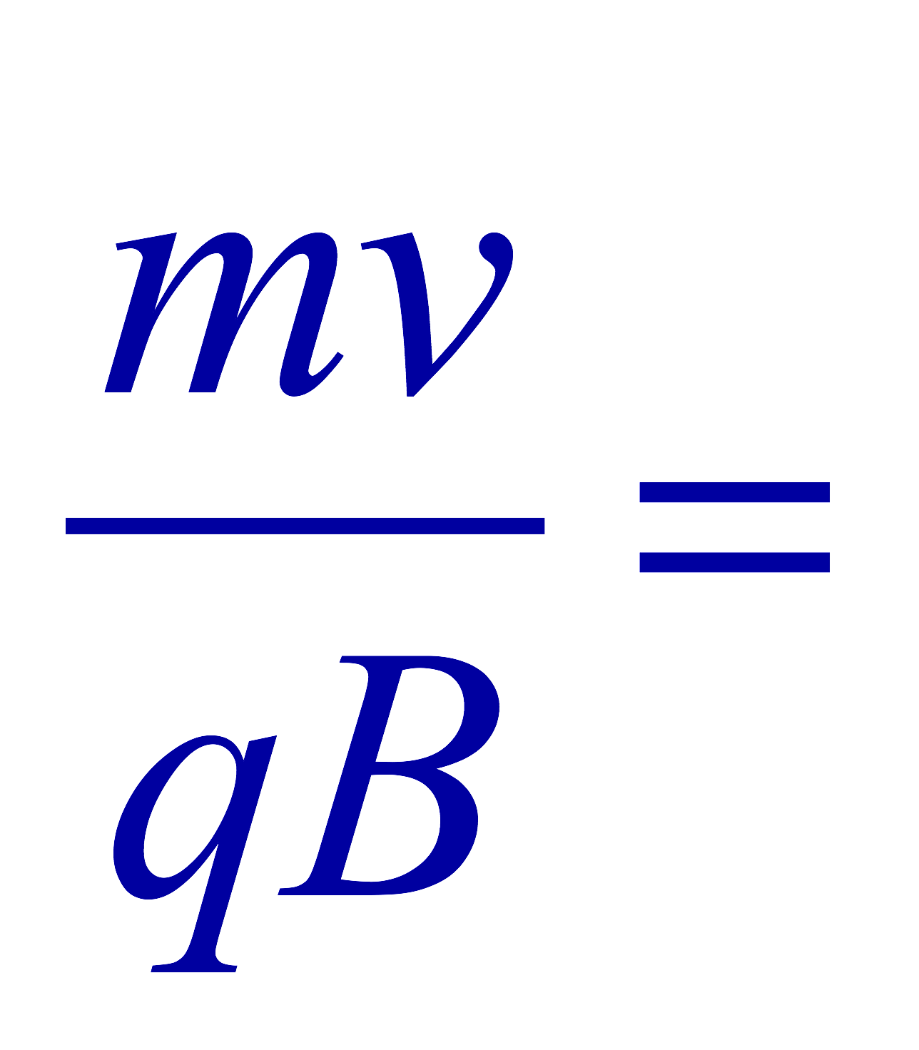
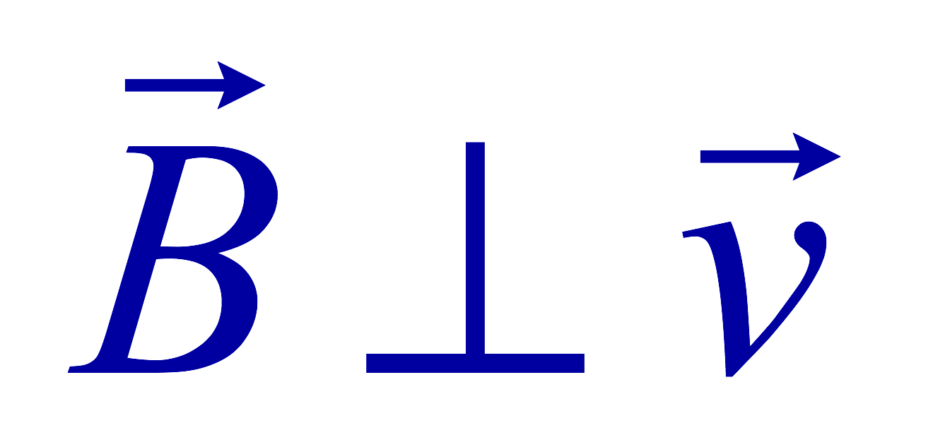
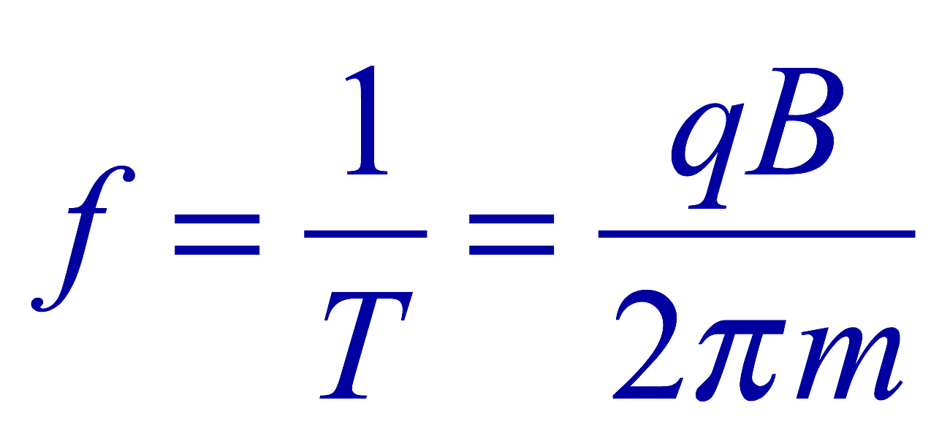
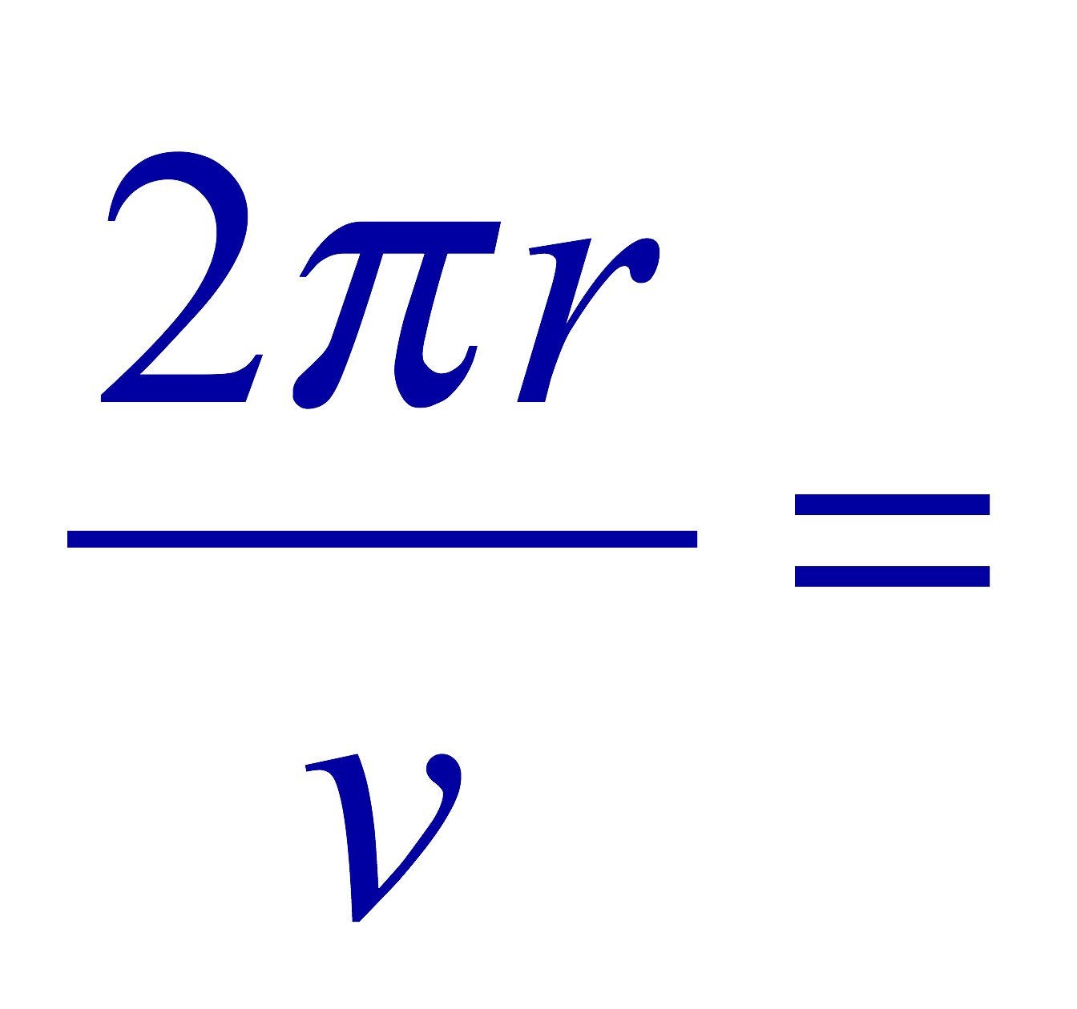
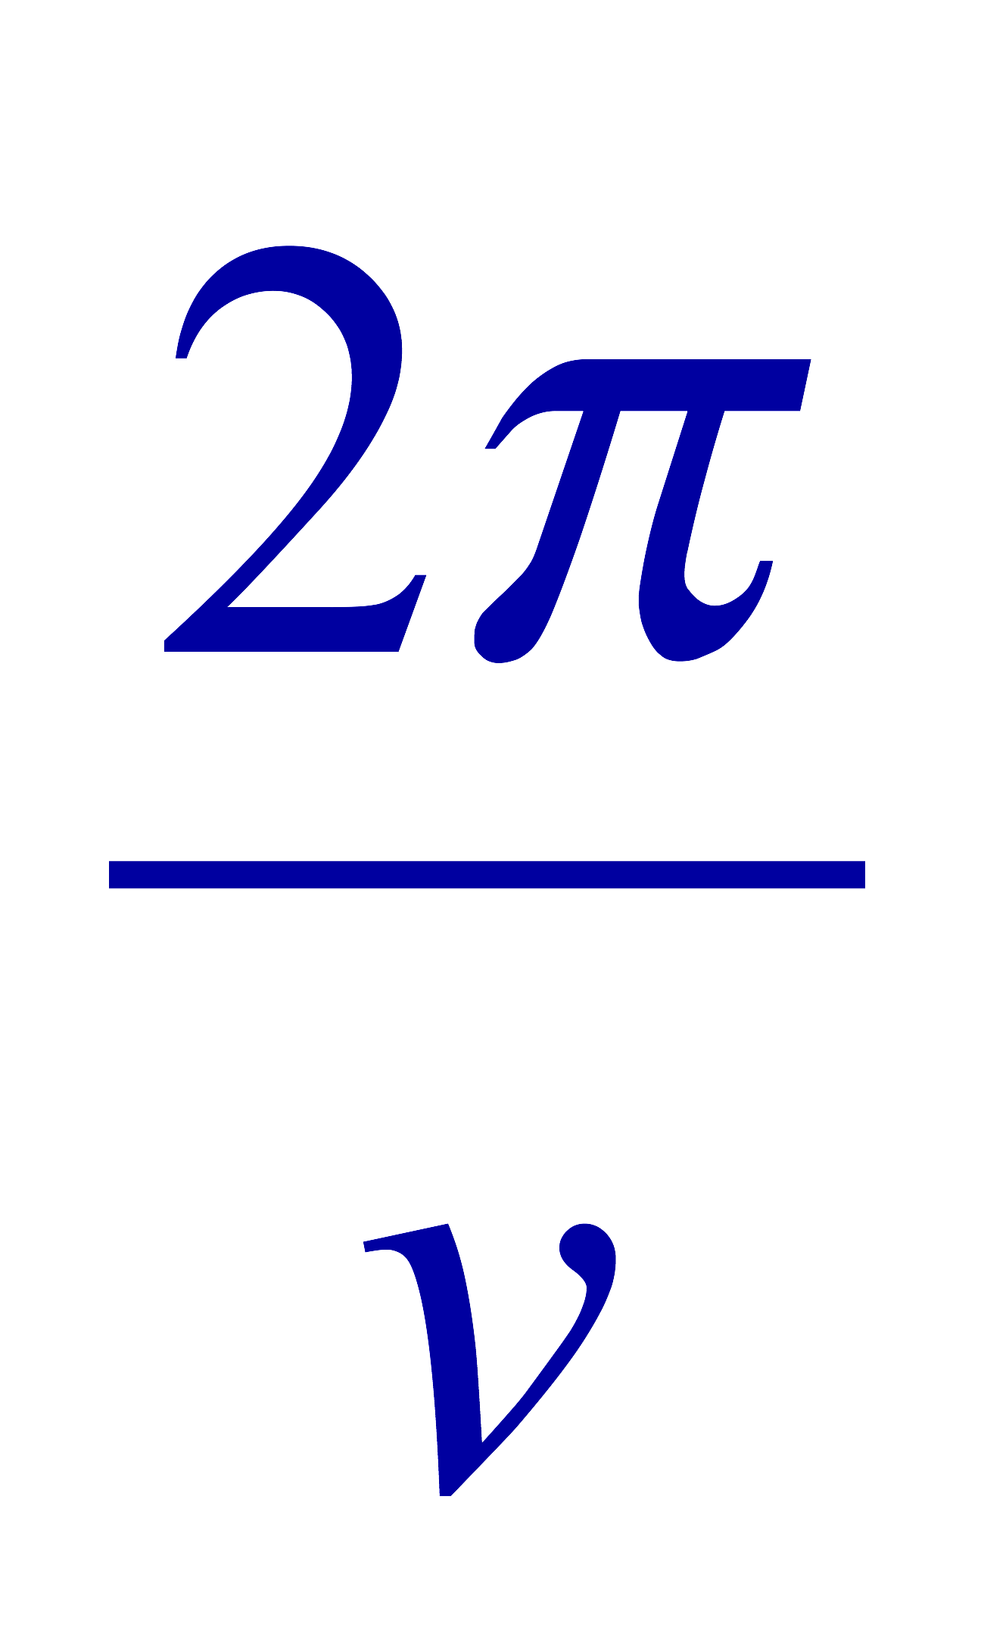
Cyclotron Frequency
The time required for a particle of charge q moving w/ constant speed v to make one circular revolution in a uniform magnetic field, , is
Since T is the period of rotation, the frequency of the rotation is
This is the cyclotron frequency, the frequency of a particle with charge q in a cyclotron accelerator
  While r depends on v, the frequency is independent of v and r.

Slide 15
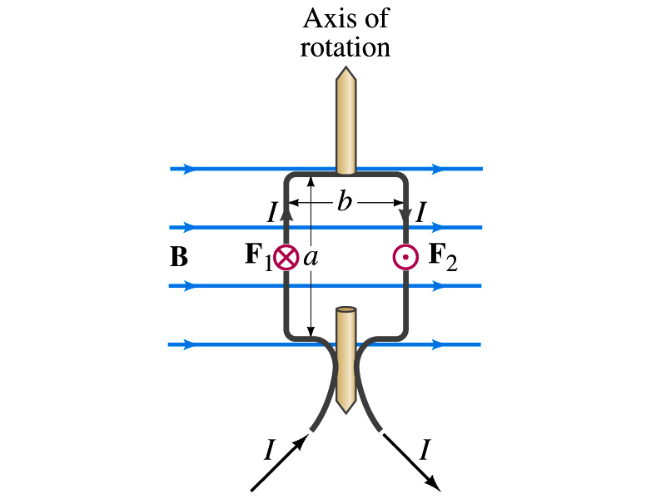
Torque on a Current Loop
What do you think will happen to a closed rectangular loop of wire with electric current as shown in the figure?
  It will rotate! Why?
  The magnetic field exerts a force on both vertical sections of wire.
  Where is this principle used in?
    Ammeters, motors, volt-meters, speedometers, etc
The two forces on the different sections of the wire exerts net torque to the same direction about the rotational axis along the symmetry axis of the wire.
What happens when the wire turns 90 degrees?
  It will not turn unless the direction of the current changes

Slide 16
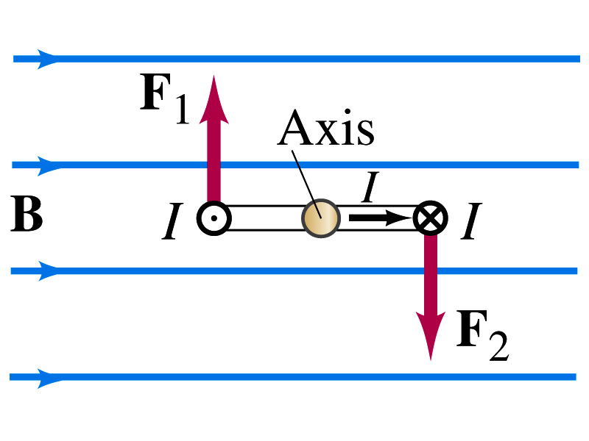
Torque on a Current Loop
So what would be the magnitude of this torque?
  What is the magnitude of the force on the section of the wire with length a?
    F_{a}=IaB
    The moment arm of the coil is b/2
  So the total torque is the sum of the torques by each of the forces
    Where A=ab is the area of the coil loop
  What is the total net torque if the coil consists of N loops of wire?
  If the coil makes an angle θ w/ the field

Slide 17
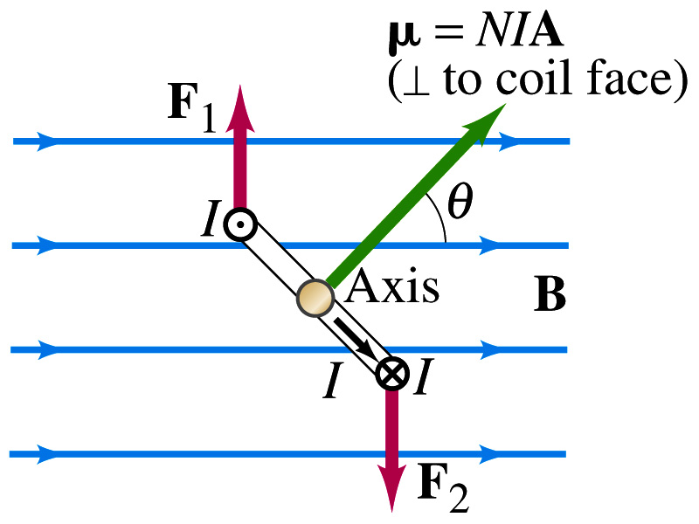
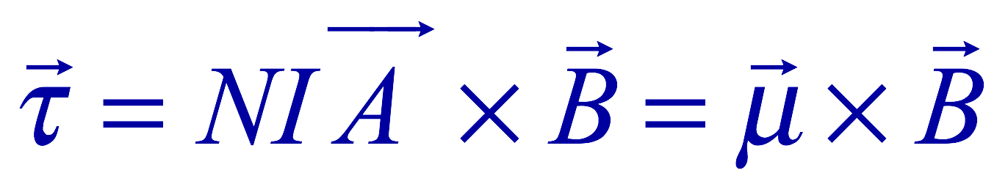
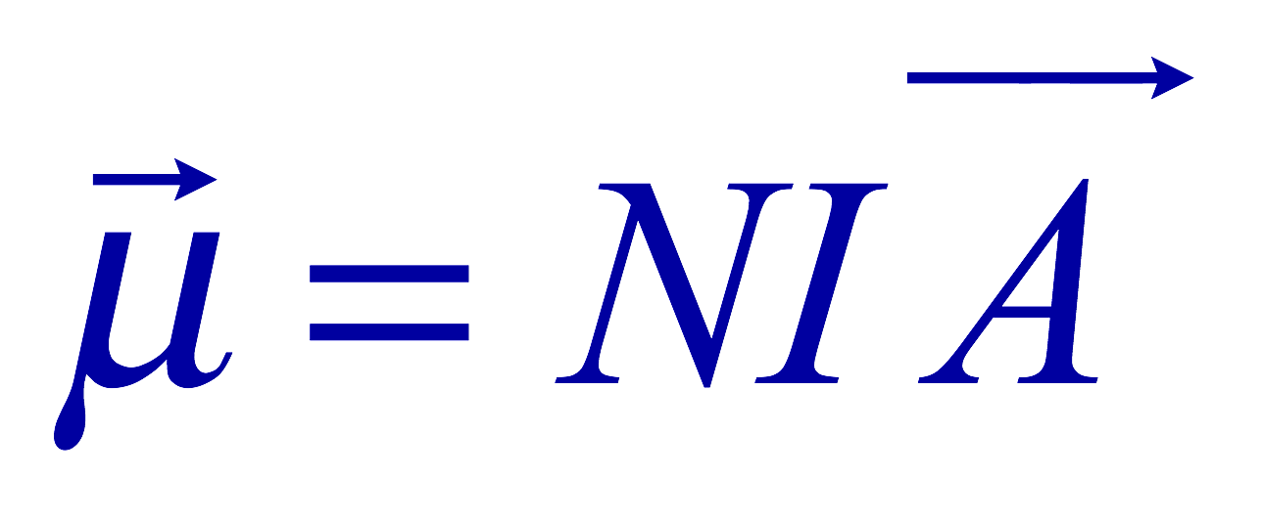
Magnetic Dipole Moment
The formula derived in the previous page for a rectangular coil is valid for any shape of the coil
The quantity NIA is called the magnetic dipole moment of the coil
  It is considered a vector
    Its direction is the same as that of the area vector A and is perpendicular to the plane of the coil consistent with the right-hand rule
      Your thumb points to the direction of the magnetic moment when your finer cups around the loop in the direction of the current
  Using the definition of magnetic moment, the torque can be written in vector form

Slide 18
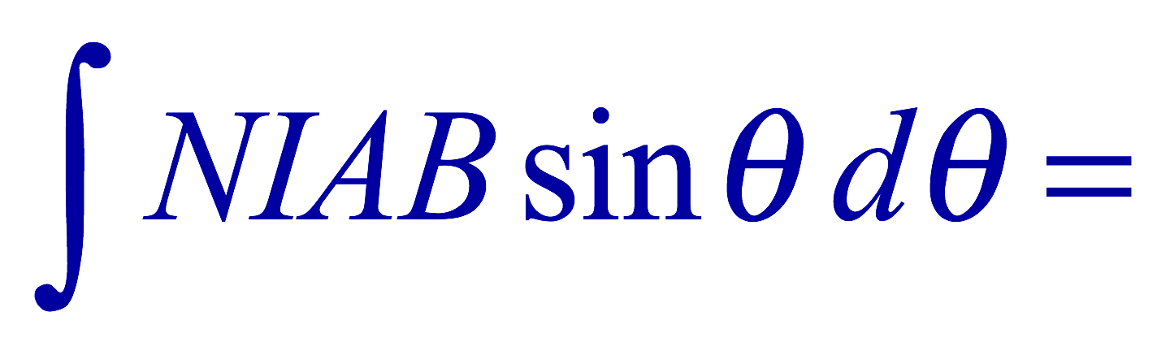
Magnetic Dipole Potential Energy
Where else did you see the same form of the torque?
  Remember the torque due to electric field on an electric dipole?
  The potential energy of the electric dipole is
How about the potential energy of a magnetic dipole?
  The work done by the torque is
  If we chose U=0 at θ=π/2, then C=0
  Thus the potential energy is
    Very similar to the electric dipole

Slide 19


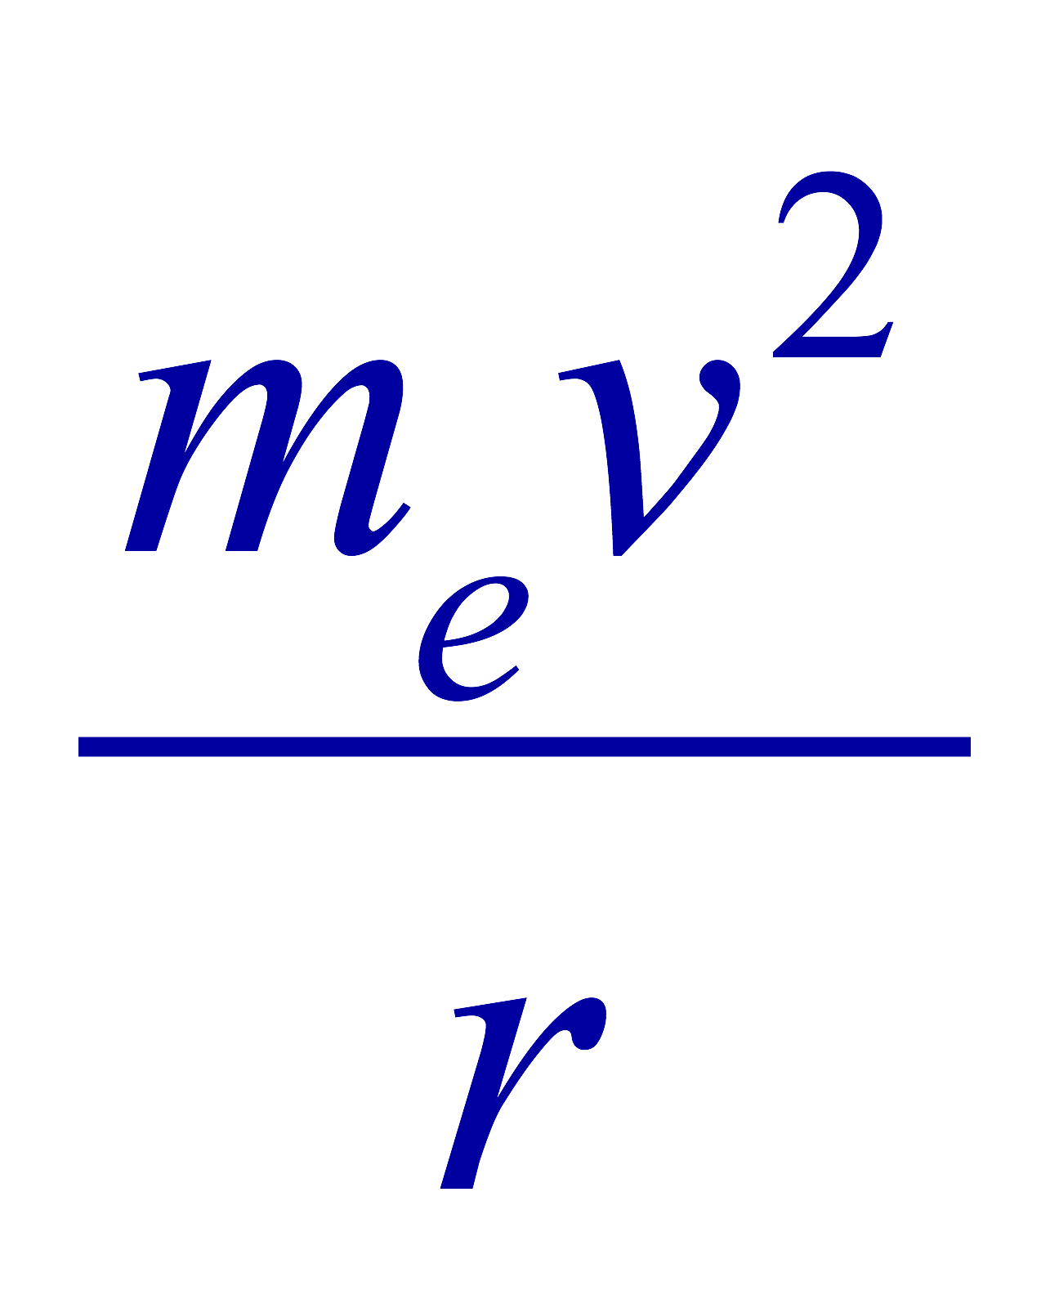

Example 27 – 12
Magnetic moment of a hydrogen atom. Determine the magnetic dipole moment of the electron orbiting the proton of a hydrogen atom, assuming (in the Bohr model) it is in its ground state with a circular orbit of radius 0.529x10⁻¹⁰m.
What provides the centripetal force?
The Coulomb force
So we can obtain the speed of the electron from
Solving for v
Since the electric current is the charge that passes through the given point per unit time, we can obtain the current
Since the area of the orbit is A=πr², we obtain the hydrogen magnetic moment

Slide 20
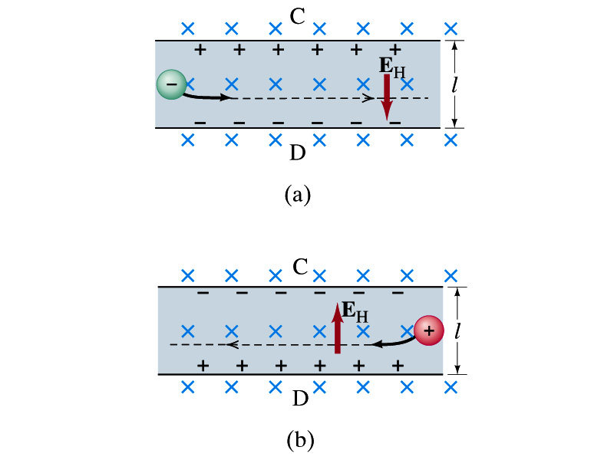
The Hall Effect
What do you think will happen to the electrons flowing through a conductor immersed in a magnetic field?
  Magnetic force will push the electrons toward one side of the conductor. Then what happens?
  A potential difference will be created due to continued accumulation of electrons on one side. Till when? Forever?
  Nope. Till the electric force inside the conductor is equal and opposite to the magnetic force
This is called the Hall Effect
  The potential difference produced is called
    The Hall emf
  The electric field due to the separation of charge is called the Hall field, E_{H}, and it points to the direction opposite to the magnetic force

Slide 21
The Hall Effect
In the equilibrium, the force due to Hall field is balanced by the magnetic force ev_{d}B, so we obtain
and
The Hall emf is then
  Where l is the width of the conductor
What do we use the Hall effect for?
  The current of negative charge moving to right is equivalent to the positive charge moving to the left
  The Hall effect can distinguish these since the direction of the Hall field or direction of the Hall emf is opposite
  Since the magnitude of the Hall emf is proportional to the magnetic field strength ➔ can measure the B-field strength
    Hall probe

