Slide 1
PHYS 1441 – Section 002
Lecture #18
Monday, Nov. 12, 2018
Dr. Jaehoon Yu
Chapter 28:Sources of Magnetic Field
  Sources of Magnetic Field
  Magnetic Field Due to Straight Wire
  Forces Between Two Parallel Wires
  Ampére’s Law and Its Verification
  Solenoid and Toroidal Magnetic Field
  Biot-Savart Law
Today’s homework is homework #12, due 11pm, Thursday, Nov. 29!!

Slide 2
Announcements
Reading Assignments: CH27.6, 27.8, 27.9 and 28.6 – 10
Reminder:2nd non-comprehensive term exam
  In class this Wednesday, Nov. 14
  Covers CH25.5 to what we finish today
  Bring your calculator but DO NOT input formula into it!
    Cell phones or any types of computers cannot replace a calculator!
  BYOF: You may bring a one 8.5x11.5 sheet (front and back) of handwritten formulae and values of constants
  No derivations, word definitions or solutions of any kind!
  No additional formulae or values of constants will be provided
No class on the Thanksgiving Wednesday, Nov. 21
Final comprehensive: in class 1:00 – 2:20pm Wed. Dec. 5
Planetarium Extra Credit: bring to class Mon. Dec. 3
  Be sure to tape one end of the ticket stub on a sheet of paper with your name on it

Slide 3
Reminder: Special Project #5
Make a list of the power consumption and the resistance of all electric and electronic devices at your home and compile them in a table. (10 points total for the first 10 items and 0.5 points each additional item.)
Estimate the cost of electricity for each of the items on the table using your own electric cost per kWh (if you don’t find your own, use $0.12/kWh) and put them in the relevant column. (5 points total for the first 10 items and 0.2 points each additional items)
Estimate the the total amount of energy in Joules and the total electricity cost per day, per month and per year for your home. (8 points)
Due: Beginning of the class Wednesday, Nov. 28

Slide 4
Sources of Magnetic Field
We have learned so far about the effects of magnetic field on electric current and a moving charge
We will now learn about the dynamics of magnetism
  How do we determine magnetic field strengths in certain situations?
  How do two wires with electric current interact?
  What is the general approach to finding the connection between the electric current and the magnetic field?

Slide 5
Magnetic Field due to a Straight Wire
The magnetic field due to the current flowing through a straight wire forms a circular pattern around the wire
  What do you imagine the strength of the field is as a function of the distance from the wire?
    It must be weaker as the distance increases
  How about as a function of the electric current?
    Directly proportional to the current
  Indeed, the above are experimentally verified
    This is valid as long as r << the length of the wire
  The proportionality constant is μ₀/2π, thus the field strength becomes
  μ₀ is the permeability of free space
Merriam-Webster: Permeability is the property of a magnetizable substance that determines the degree in which it modifies the magnetic flux in the region occupied by it in a magnetic field

Slide 6
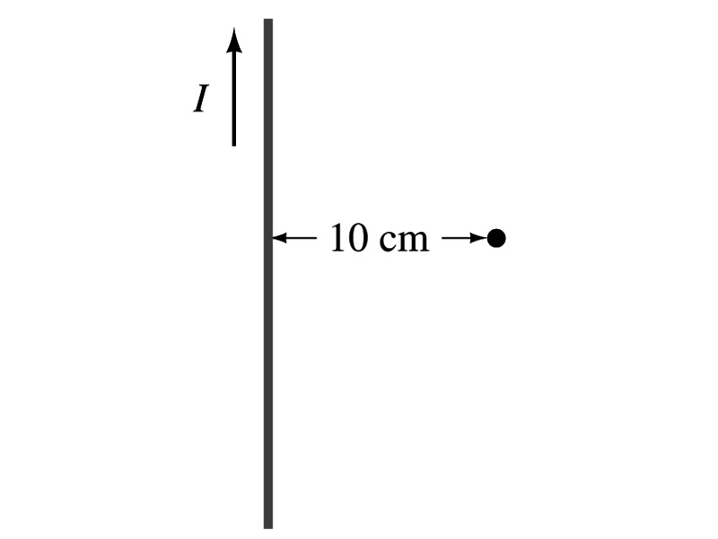
Example 28 – 1
Calculation of B near wire. A vertical electric wire in the wall of a building carries a DC current of 25A upward. What is the magnetic field at a point 10cm due East of this wire?
Using the formula for the magnetic field near a straight wire
So we can obtain the magnetic field at 10cm away as

Slide 7
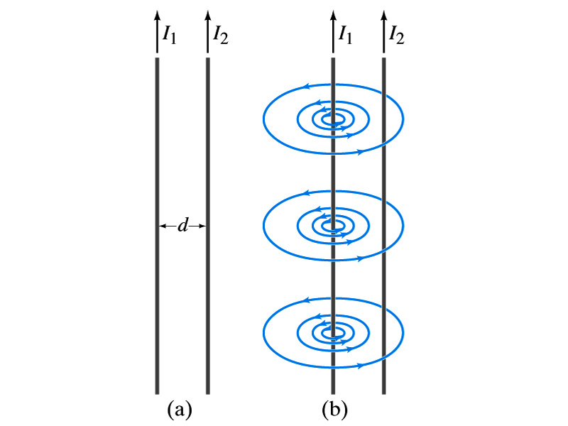
Force Between Two Parallel Wires
We have learned that a wire carrying electric current produces magnetic field
Now what do you think will happen if we place two current carrying wires next to each other?
  They will exert force onto each other. Repel or attract?
  Depending on the direction of the currents
This was first pointed out by Ampére.
Let’s consider two long parallel conductors separated by a distance d, carrying currents I₁ and I₂.
At the location of the second conductor, the magnitude of the magnetic field produced by I₁ is

Slide 8
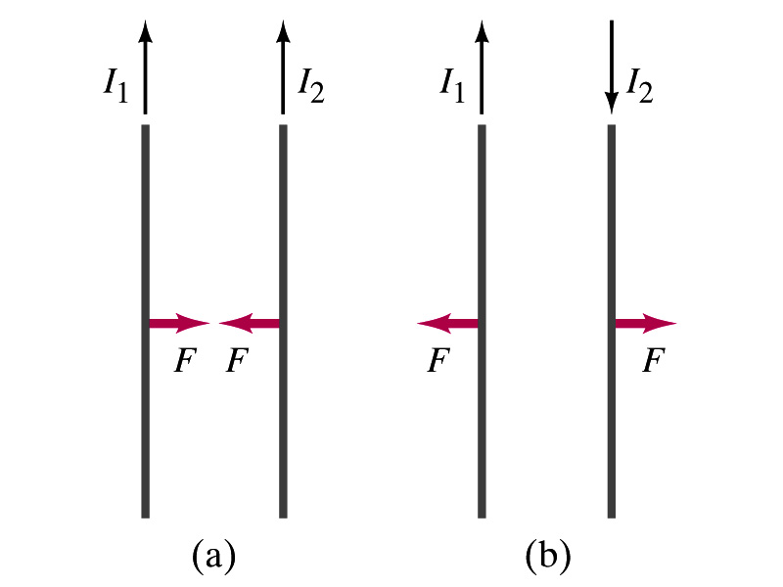
Force Between Two Parallel Wires
The force F by a magnetic field B₁ on a wire of length l, carrying the current I₂ when the field and the current are perpendicular to each other is:
  So the force per unit length is
  This force is only due to the magnetic field generated by the wire carrying the current I₁
    There is the force exerted on the wire carrying the current I₁ by the wire carrying current I₂ of the same magnitude but in opposite direction
So the force per unit length is
How about the direction of the force?
If the currents are in the same direction, the attractive force. If opposite, repulsive.

Slide 9
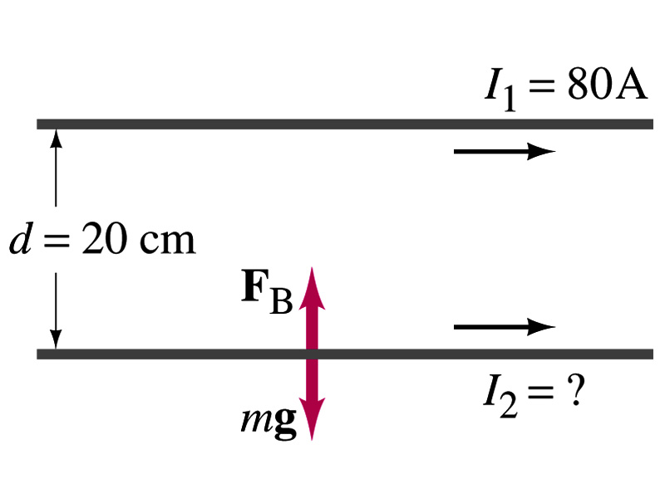
Example 28 – 5
Suspending a wire with current. A horizontal wire carries a current I₁=80A DC. A second parallel wire 20cm below it must carry how much current I₂ so that it doesn’t fall due to the gravity? The lower has a mass of 0.12g per meter of length.
Which direction is the gravitational force?
Down to the center of the Earth
This force must be balanced by the magnetic force exerted on the wire by the first wire.
Solving for I₂

Slide 10
Operational Definition of Ampere and Coulomb
The permeability of free space is defined to be exactly
The unit of current, ampere, is defined using the definition of the force between two wires each carrying 1A of current and separated by 1m
  So 1A is defined as: the current flowing each of two long parallel conductors 1m apart, which results in a force of exactly 2x10⁻⁷N/m.
Coulomb is then defined as exactly 1C=1A s.
We do it this way since the electric current is measured more accurately and controlled more easily than the charge.

Slide 11
Ampére’s Law
What is the relationship between the magnetic field strength and the current?
  Does this work in all cases?
    Nope!
    OK, then when?
    Only valid for a long straight wire
Then what would be the more generalized relationship between the current and the magnetic field for any shapes of the wire?
  French scientist André Marie Ampére proposed such a relationship soon after Oersted’s discovery

Slide 12
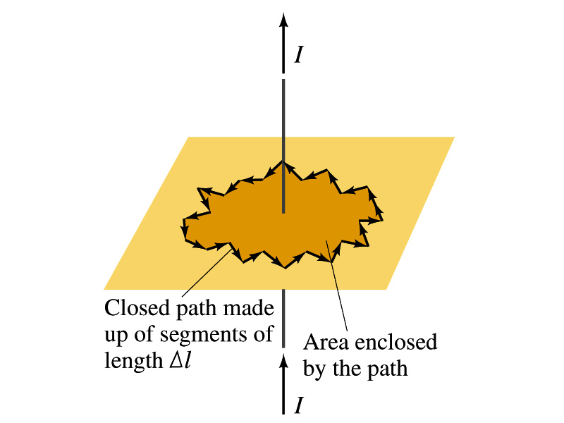
Ampére’s Law
Let’s consider an arbitrary closed path around the current as shown in the figure.
  Let’s cut this path in small segments, each of Δl long.
  The sum of all the products of the length of each segment and the component of B parallel to that segment is equal to μ₀ times the net current I_{encl} that passes through the surface enclosed by the path
  In the limit Δl →0, this relation becomes
Ampére’s Law
Looks very similar to a law in the electricity. Which law is it?
Gauss’ Law

Slide 13
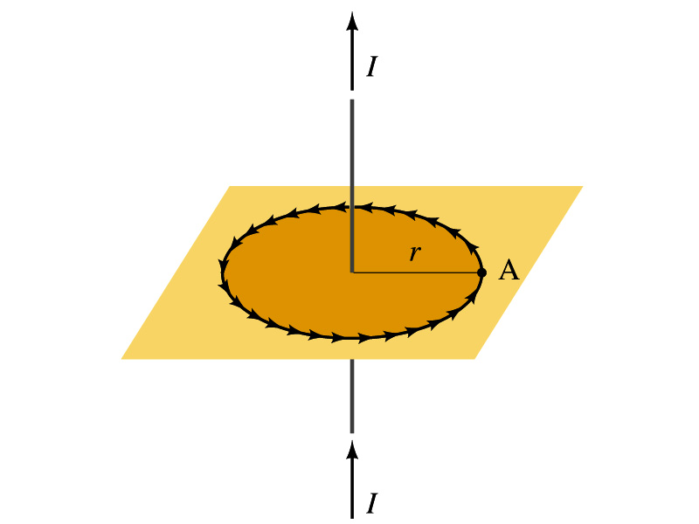
Verification of Ampére’s Law
Let’s find the magnitude of B at a distance r away from a long straight wire w/ current I
  This is a verification of Ampere’s Law
  We can apply Ampere’s law to a circular path of radius r.
Solving for B
  We just verified that Ampere’s law works in a simple case
  Experiments verified that it works for other cases too
  The importance of this formula, however, is that it provides means to relate magnetic field to current

Slide 14
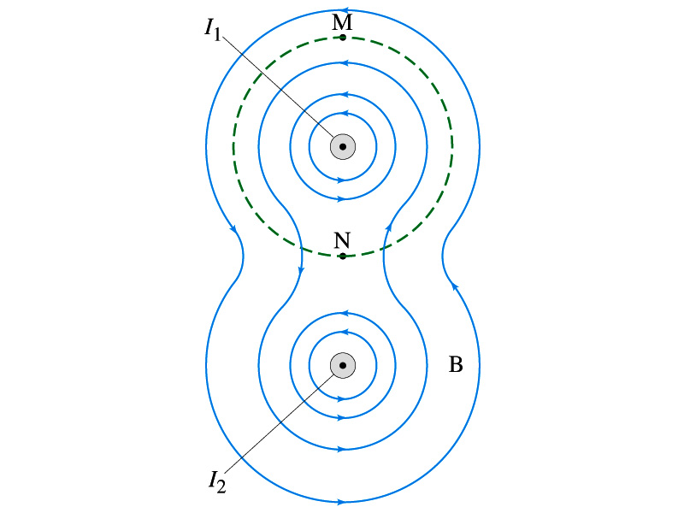
Verification of Ampére’s Law
Since Ampere’s law is valid in general, B in Ampere’s law is not just due to the current I_{encl}.
B is the field at each point in space along the chosen path due to all sources
  Including the current I enclosed by the path but also due to any other sources
  How do you obtain B in the figure at any point?
    Vector sum of the field by the two currents
  The result of the closed path integral in Ampere’s law for green dashed path is still μ₀I₁. Why?
  While B in each point along the path varies, the integral over the closed path still comes out the same whether there is the second wire or not.

Slide 15
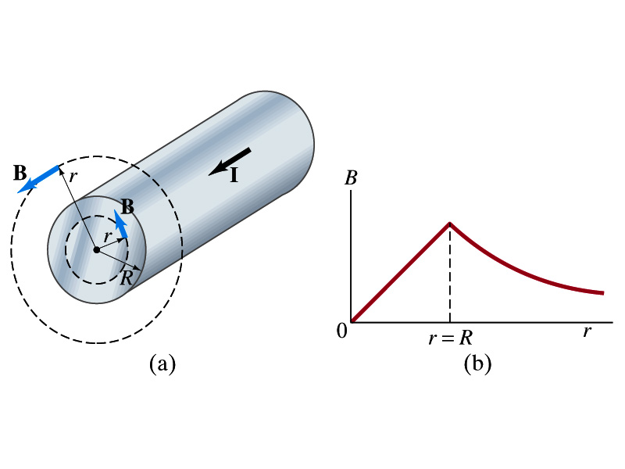
Example 28 – 6
Field inside and outside a wire. A long straight cylindrical wire conductor of radius R carries current I of uniform density in the conductor. Determine the magnetic field at (a) points outside the conductor (r>R) and (b) points inside the conductor (r<R). Assume that r, the radial distance from the axis, is much less than the length of the wire. (c) If R=2.0mm and I=60A, what is B at r=1.0mm, r=2.0mm and r=3.0mm?
Since the wire is long, straight and symmetric, the field should be the same at any point the same distance from the center of the wire.
Since B must be tangential to circles around the wire, let’s choose a circular path of the closed-path integral outside the wire (r>R). What is I_{encl}?
So using Ampere’s law
Solving for B

Slide 16
Example 28 – 6 cont’d
For r<R, the current inside the closed path is less than I. How much is it?
So using Ampere’s law
Solving for B
What does this mean?
The field is 0 at r=0 and increases linearly as a function of the distance from the center of the wire up to r=R then decreases as 1/r beyond the radius of the conductor.

Slide 17
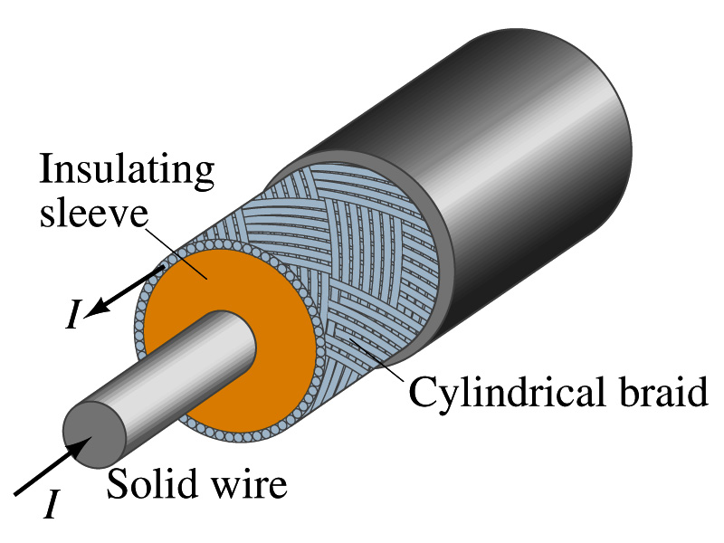
Example 28 – 7
Coaxial cable. A coaxial cable is a single wire surrounded by a cylindrical metallic braid, as shown in the figure. The two conductors are separated by an insulator. The central wire carries current to the other end of the cable, and the outer braid carries the return current and is usually considered ground. Describe the magnetic field (a) in the space between the conductors and (b) outside the cable.
(a) The magnetic field between the conductors is the same as the long, straight wire case since the current in the outer conductor does not impact the enclosed current.
(b) Outside the cable, we can draw a similar circular path, since we expect the field to have a circular symmetry. What is the sum of the total current inside the closed path?
So there is no magnetic field outside a coaxial cable. In other words, the coaxial cable self-shields. The outer conductor also shields against an external electric field. Cleaner signal and less noise.

Slide 18
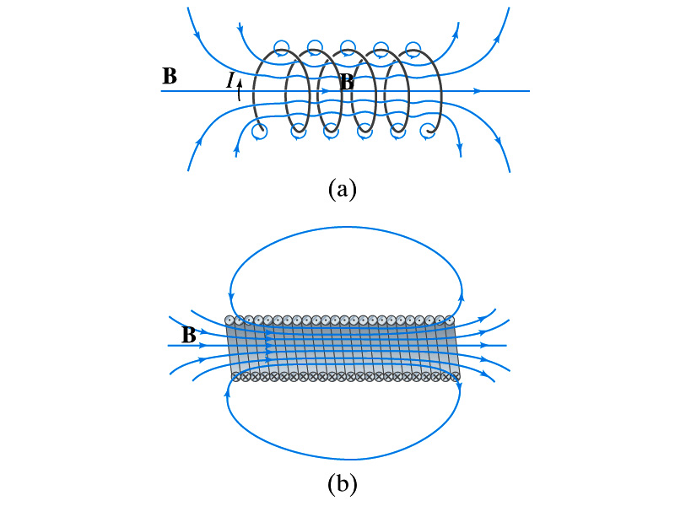
Solenoid and Its Magnetic Field
What is a solenoid?
  A long coil of wire consisting of many loops
  If the space between loops are wide
    The field near the wires are nearly circular
    Between any two wires, the fields due to each loop cancel
    Toward the center of the solenoid, the fields add up to give a field that can be fairly large and uniform
  For a long, densely packed loops
    The field is nearly uniform and parallel to the solenoid axes within the entire cross section
    The field outside the solenoid is very small compared to the field inside, except the ends
      The same number of field lines spread out to an open space
Solenoid Axis

Slide 19
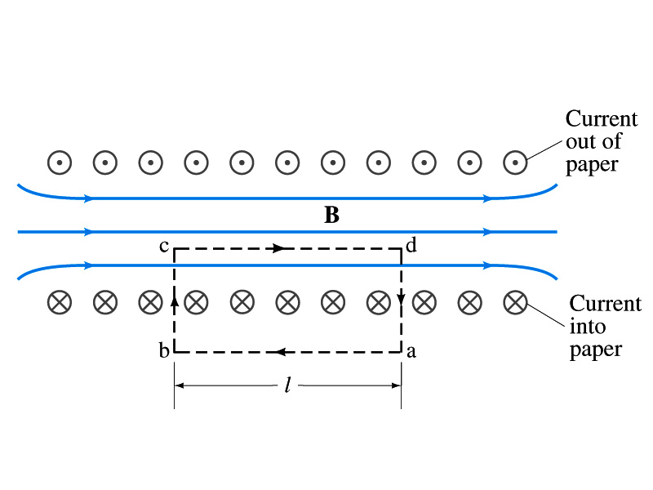
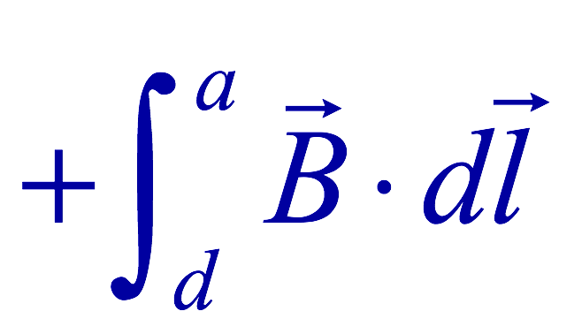
Solenoid Magnetic Field
Now let’s use Ampere’s law to determine the magnetic field inside a very long, densely packed solenoid
Let’s choose the path abcd, far away from the ends
  We can consider four segments of the loop for integral
  The field outside the solenoid is negligible. So the integral on a→b is 0.
  Now the field B is perpendicular to the bc and da segments. So these integrals become 0, also.

Slide 20
Solenoid Magnetic Field
  So the sum becomes:
  If the current I flows in the wire of the solenoid, the total current enclosed by the closed path is NI
    Where N is the number of loops (or turns of the coil) enclosed
  Thus Ampere’s law gives us
  If we let n=N/l be the number of loops per unit length, the magnitude of the magnetic field within the solenoid becomes
    B depends on the number of loops per unit length, n, and the current I
      Does not depend on the position within the solenoid but uniform inside it, like a bar magnet

Slide 21
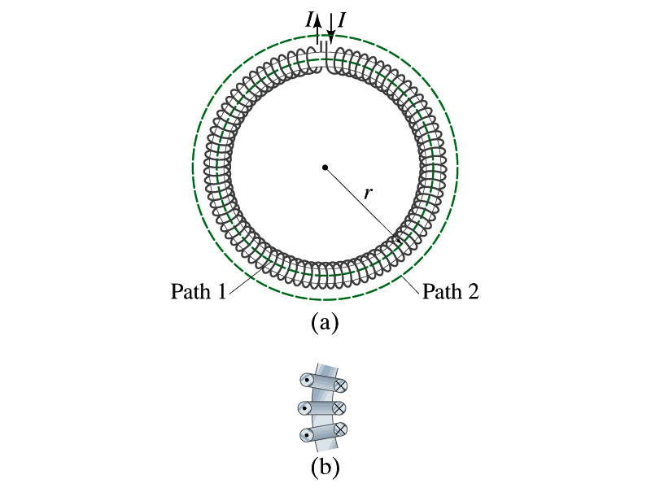
Example 28 – 10
Toroid. Use Ampere’s law to determine the magnetic field (a) inside and (b) outside a toroid, which is like a solenoid bent into the shape of a circle.
(a) How do you think the magnetic field lines inside the toroid look?
Since it is a bent solenoid, it should be a circle concentric with the toroid.
If we choose path of integration one of these field lines of radius r inside the toroid, path 1, to use the symmetry of the situation, making B the same at all points on the path, we obtain from Ampere’s law
Solving for B
So the magnetic field inside a toroid is not uniform. It is larger on the inner edge. However, the field will be uniform if the radius is large and the toroid is thin. The filed in this case is B = μ₀nI.
(b) Outside the solenoid, the field is 0 since the net enclosed current is 0.

