Slide 1
PHYS 1441 – Section 002
Lecture #21
Wednesday, Nov. 28, 2018
Dr. Jaehoon Yu
Chapter 29:EM Induction & Faraday’s Law
  Electric Field Due to Changing Magnetic Flux
Chapter 30: Inductance
  Inductance
  Mutual and Self Inductance
  Energy Stored in the Magnetic Field
  LR Circuit
  LC circuit and EM Oscillation

Slide 2
Announcements – II
Final comprehensive exam
  In class 1:00 – 2:20pm, Wed. Dec. 5
  Covers CH21.1 through what we finish next Monday, Dec. 3
  Bring your calculator but DO NOT input formula into it!
    Cell phones or any types of computers cannot replace a calculator!
  BYOF: You may bring a one 8.5x11.5 sheet (front and back) of handwritten formulae and values of constants
  No derivations, word definitions or solutions of any kind!
  No additional formulae or values of constants will be provided!
Planetarium extra credit
  Due next Wednesday, Dec. 5
  Tape one end of the ticket stub on a sheet of paper with your name on it
Colloquium today
  4pm in SH100
  Dr. C. Li, MD Anderson

Slide 3
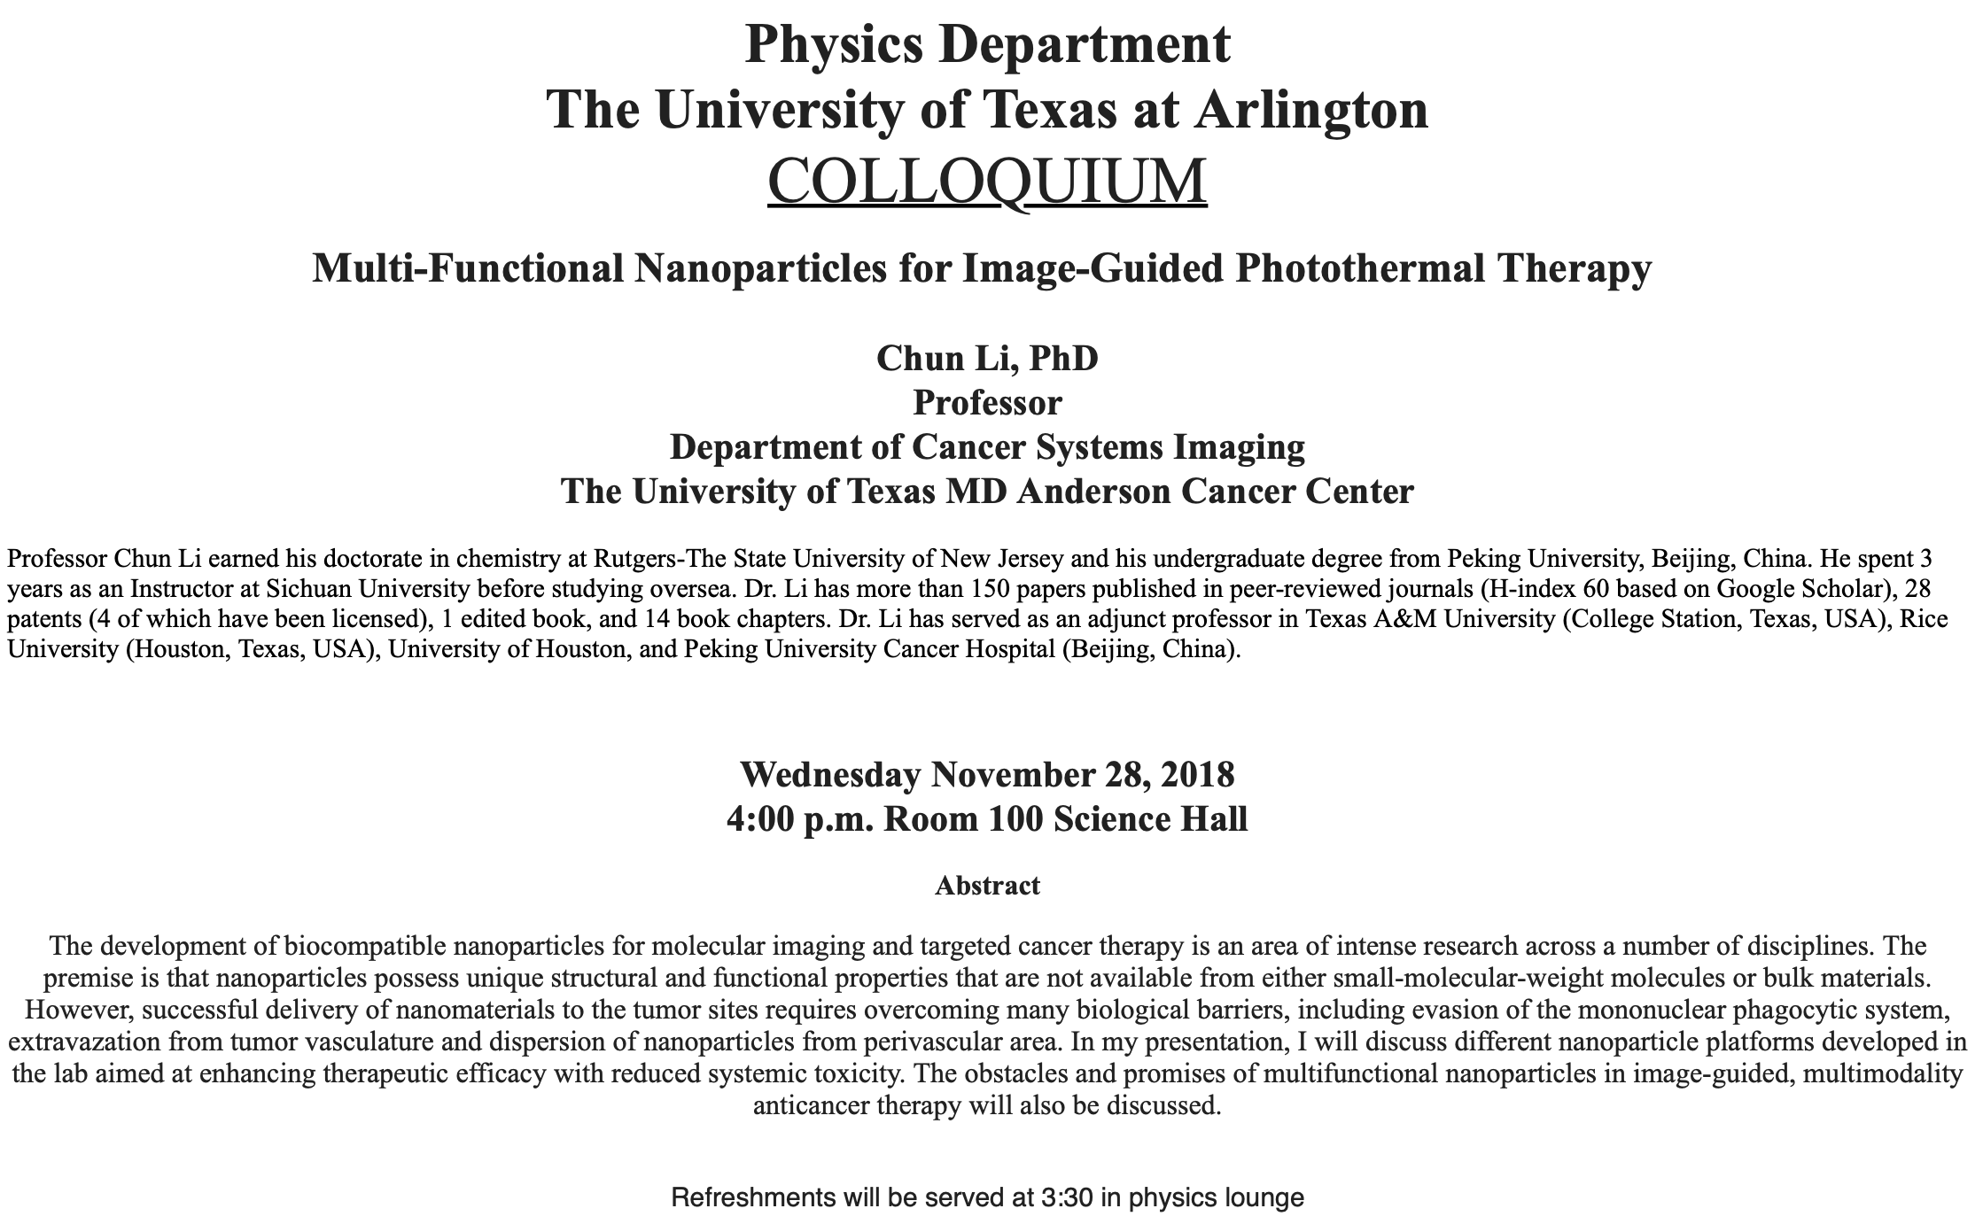

Slide 4
Electric Field due to Magnetic Flux Change
When the electric current flows through a wire, there is an electric field in the wire that moves electrons
We saw, however, that changing magnetic flux induces a current in the wire. What does this mean?
  There must be an electric field induced by the changing magnetic flux.
In other words, a changing magnetic flux produces an electric field
This result applies not just to wires but to any conductor or any region in space

Slide 5
Generalized Form of Faraday’s Law
Recall the relationship between the electric field and the potential difference
Induced emf in a circuit is equal to the work done per unit charge by the electric field
So we obtain
The integral is taken around a path enclosing the area through which the magnetic flux Φ_{Β} is changing.

Slide 6
Inductance
A changing magnetic flux through a circuit induces an emf in that circuit
An electric current produces a magnetic field
From these, we can deduce
  A changing current in one circuit must induce an emf in a nearby circuit ➔ Mutual inductance
  Or induce an emf in itself ➔ Self inductance

Slide 7
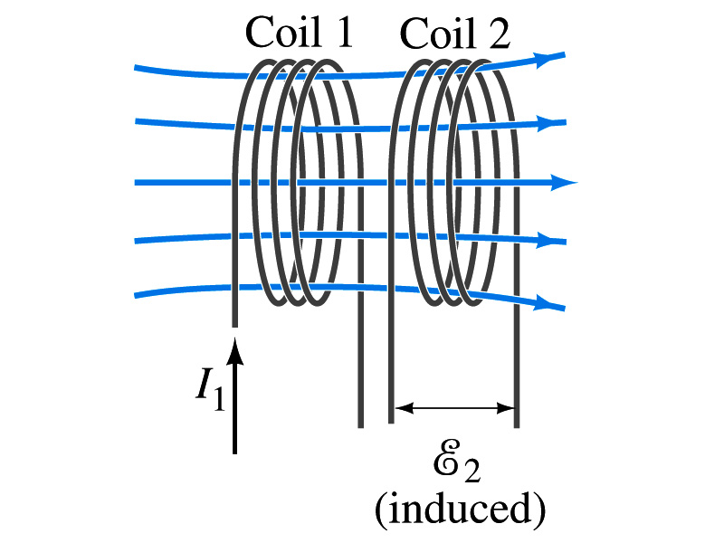
Mutual Inductance
If two coils of wire are placed near each other, a changing current in one will induce an emf in the other.
What is the induced emf, ε₂, in coil 2 proportional to?
  Rate of the change of the magnetic flux passing through it
This flux is due to current I₁ in coil 1
If Φ₂₁ is the magnetic flux in each loop of coil 2 created by coil1 and N₂ is the number of closely packed loops in coil 2, then N₂Φ₂₁ is the total flux passing through coil 2.
If the two coils are fixed in space, N₂Φ₂₁ is proportional to the current I₁ in coil 1, .
The proportionality constant for this is called the Mutual Inductance and defined as .
The emf induced in coil 2 due to the changing current in coil 1 is

Slide 8
Mutual Inductance
The mutual induction of coil 2 with respect to coil 1, M₂₁,
  is a constant and does not depend on I₁.
  depends only on “geometric” factors such as the size, shape, number of turns and relative position of the two coils, and whether a ferromagnetic material is present
    The farther apart the two coils are the less flux can pass through coil, 2, so M₂₁ will be less.
  In most cases the mutual inductance is determined experimentally
Conversely, the changing current in coil 2 will induce an emf in coil 1
  M₁₂ is the mutual inductance of coil1 with respect to coil2 and M₁₂ = M₂₁
  We can put M=M₁₂=M₂₁ and obtain
  SI unit for mutual inductance is Henry (H)
What? Does this make sense?

Slide 9
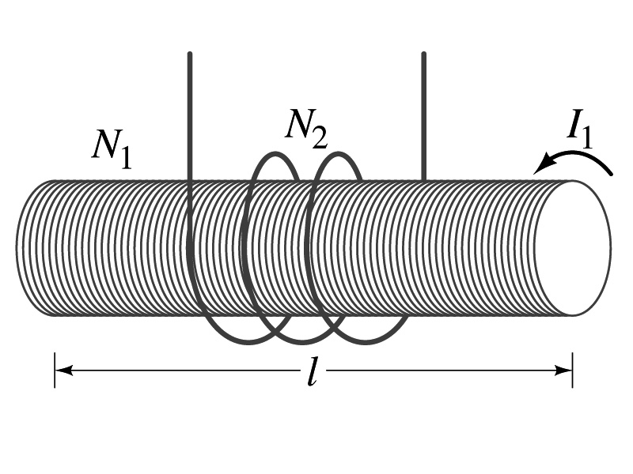
Example 30 – 1
Solenoid and coil. A long thin solenoid of length l and cross-sectional area A contains N₁ closely packed turns of wire. Wrapped around it is an insulated coil of N₂ turns. Assuming all the flux from coil 1 (the solenoid) passes through coil 2, calculate the mutual inductance.
First we need to determine the flux produced by the solenoid.
What is the magnetic field inside the solenoid?
Since the solenoid is closely packed, we can assume that the field lines are perpendicular to the surface area of the coils. Thus the flux through coil 2 is
Thus the mutual inductance of coil 2 is
Note that M₂₁ only depends on geometric factors!

Slide 10
Self Inductance
The concept of inductance applies to a single isolated coil of N turns. How does this happen?
  When a changing current passes through a coil
  A changing magnetic flux is produced inside the coil
  The changing magnetic flux in turn induces an emf in the same coil
  This emf opposes the change in flux. Whose law is this?
    Lenz’s law
What would this do?
  When the current through the coil is increasing?
    The increasing magnetic flux induces an emf that opposes the original current
    This tends to impedes its increase, trying to maintain the original current
  When the current through the coil is decreasing?
    The decreasing flux induces an emf in the same direction as the current
    This tends to increase the flux, trying to maintain the original current

Slide 11
Self Inductance
Since the magnetic flux Φ_{B} passing through N turn coil is proportional to current I in the coil,
We define self-inductance, L:
The induced emf in a coil of self-inductance L is
  What is the unit for self-inductance?
What does magnitude of L depend on?
  Geometry and the presence of a ferromagnetic material
Self inductance can be defined for any circuit or part of a circuit
Self Inductance

Slide 12
So what in the world is the Inductance?
It is an impediment onto the electrical current due to the existence of changing magnetic flux
So what?
In other words, it behaves like a resistance to the varying current, such as AC, that causes the constant change of magnetic flux
But it also provides means to store energy, just like the capacitance

Slide 13
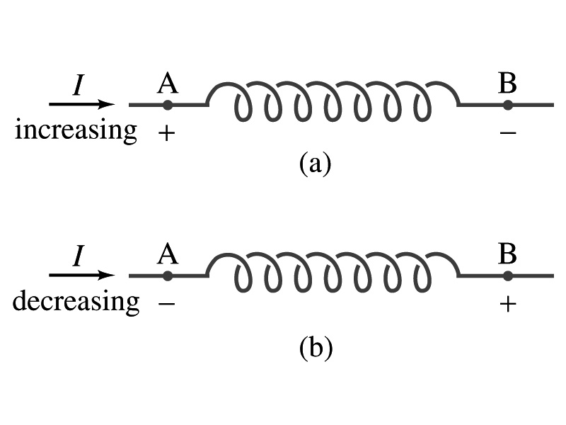
Inductor
An electrical circuit always contains some inductance but is normally negligibly small
  If a circuit contains a coil of many turns, it could have large inductance
A coil that has significant inductance, L, is called an inductor and is express with the symbol
  Precision resisters are normally wire wound
    Would have both resistance and inductance
    The inductance can be minimized by winding the wire back on itself in opposite direction to cancel magnetic flux
    This is called a “non-inductive winding”
If an inductor has negligible resistance, inductance controls the changing current
For an AC current, the greater the inductance the less the AC current
  An inductor thus acts like a resistor to impede the flow of alternating current (not to DC, though. Why?)
  The quality of an inductor is indicated by the term reactance or impedance

Slide 14
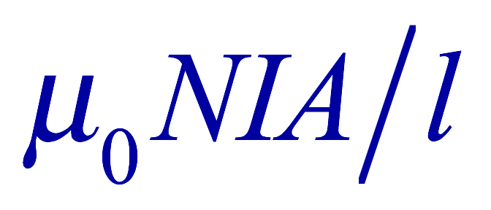
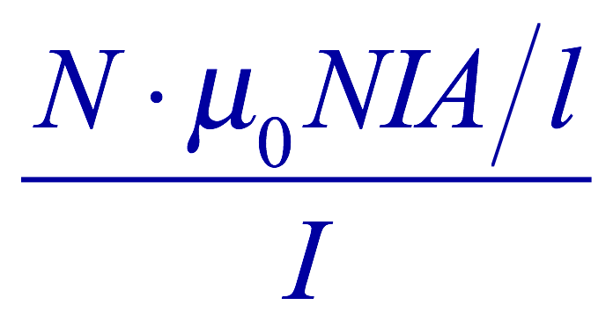
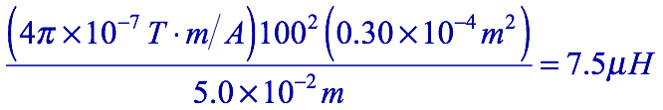
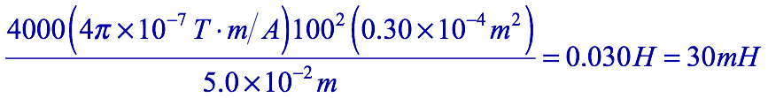
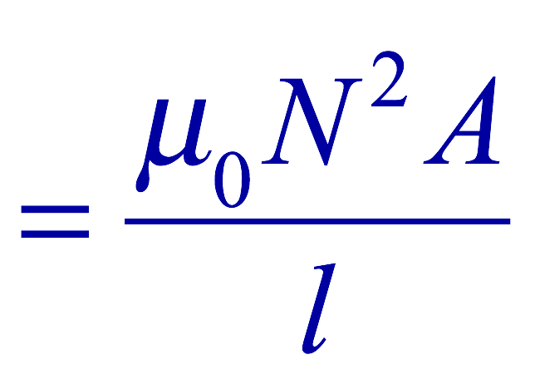
Example 30 – 3
Solenoid inductance. (a) Determine the formula for the self inductance L of a tightly wrapped solenoid ( a long coil) containing N turns of wire in its length l and whose cross-sectional area is A. (b) Calculate the value of L if N=100, l=5.0cm, A=0.30cm² and the solenoid is air filled. (c) calculate L if the solenoid has an iron core with μ=4000μ₀.
What is the magnetic field inside a solenoid?
The flux is, therefore,
Using the formula for self inductance:
(b) Using the formula above
(c) The magnetic field with an iron core solenoid is

Slide 15
Energy Stored in the Magnetic Field
The work done to the system is the same as the energy stored in the inductor when it is carrying current I
  This is compared to the energy stored in a capacitor, C, when the potential difference across it is V:
  Just like the energy stored in a capacitor is considered to reside in the electric field between its plates
  The energy in an inductor can be considered to be stored in its magnetic field
Energy Stored in a magnetic field inside an inductor

Slide 16
Stored Energy in terms of B
So how is the stored energy written in terms of magnetic field B?
  Inductance of an ideal solenoid without a fringe effect
  The magnetic field in a solenoid is
  Thus the energy stored in an inductor is
  Thus the energy density is
  This formula is valid in any region of space
  If a ferromagnetic material is present, μ₀ becomes μ.
E
What is this?
E density
Volume V
What volume does Al represent?
The volume inside a solenoid!!

Slide 17
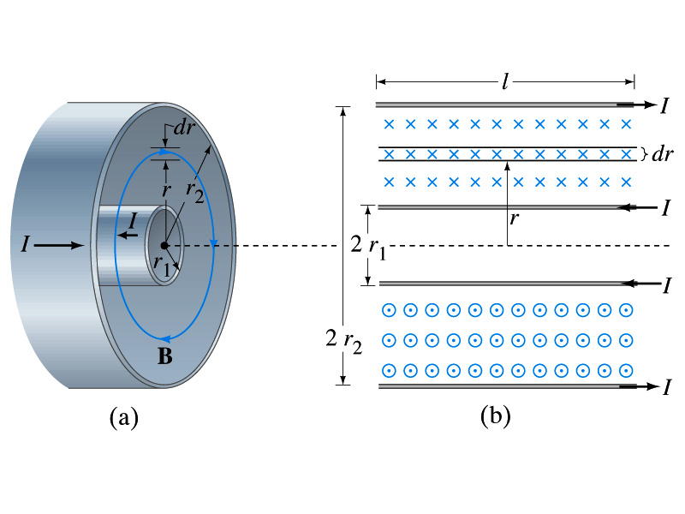

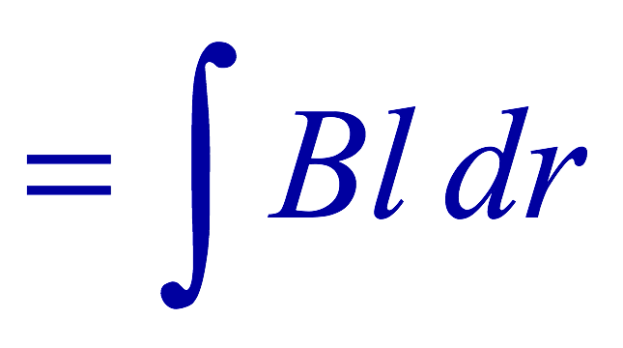
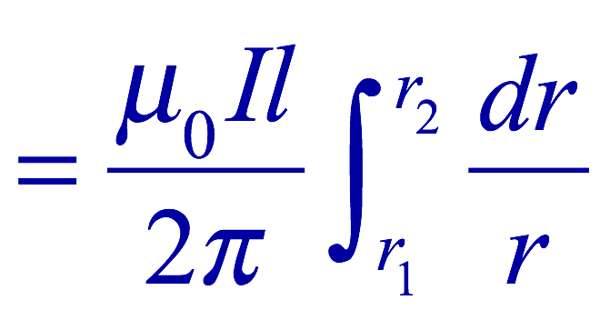
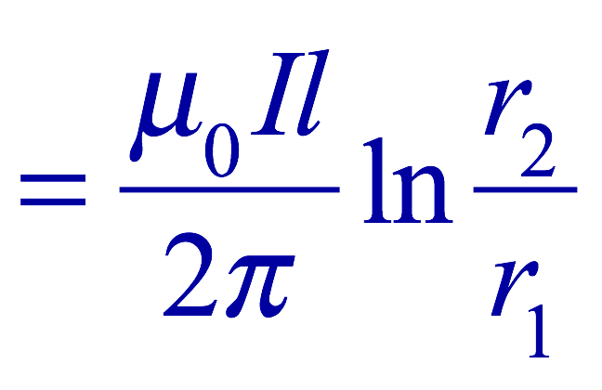
Example 30 – 5
Energy stored in a coaxial cable. (a) How much energy is being stored per unit length in a coaxial cable whose conductors have radii r₁ and r₂ and which carry a current I? (b) Where is the energy density highest?
(a) The total flux through l of the cable is
Thus inductance per unit length for a coaxial cable is
Thus the energy stored per unit length is
(b) Since the magnetic field is
The energy density is highest where B is highest. Since B is highest close to r=r₁, near the surface of the inner conductor.
And the energy density is

Slide 18
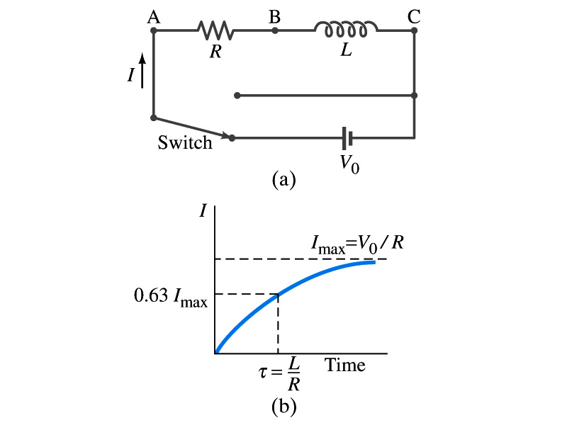
LR Circuits
What happens when an emf is applied to an inductor?
  An inductor has some resistance, however negligible
    So an inductor can be drawn as a circuit of separate resistance and coil. What is the name this kind of circuit?
  What happens at the instance the switch is thrown to apply emf to the circuit?
    The current starts to flow, gradually increasing from 0
    This change is opposed by the induced emf in the inductor ➔ the emf at point B is higher than point C
    However there is a voltage drop at the resistance which reduces the voltage across inductance
    Thus the current increases less rapidly
    The overall behavior of the current is a gradual increase, reaching to the maximum current I_{max}=V₀/R.
LR Circuit

Slide 19
LR Circuits
This can be shown w/ Kirchhoff loop rules
  The emfs in the circuit are the battery voltage V₀ and the emf ε=-L(dI/dt) in the inductor opposing the current increase
  The sum of the potential changes through the circuit is
  Where I is the current at any instance
  By rearranging the terms, we obtain a differential eq.
  We can integrate just as in RC circuit
  So the solution is
  Where τ=L/R
    This is the time constant τ of the LR circuit and is the time required for the current I to reach 0.63 of the maximum

Slide 20
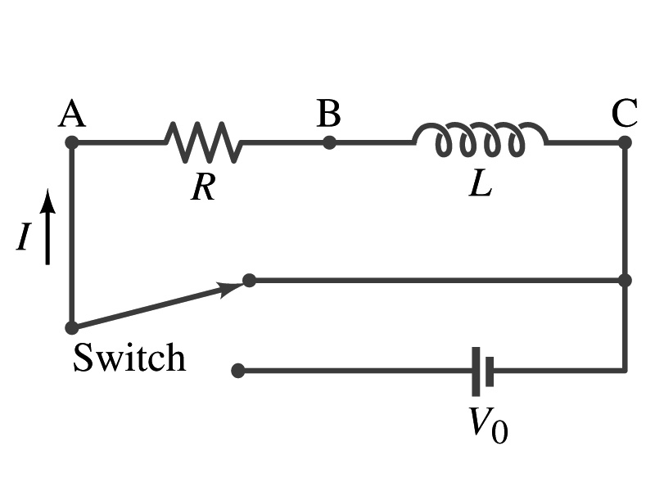
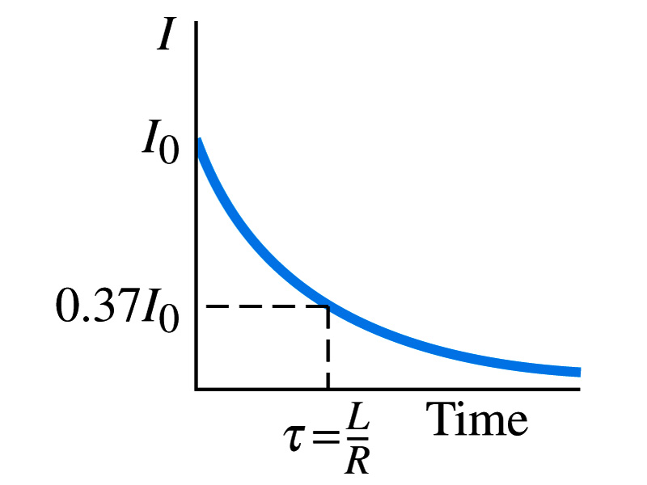
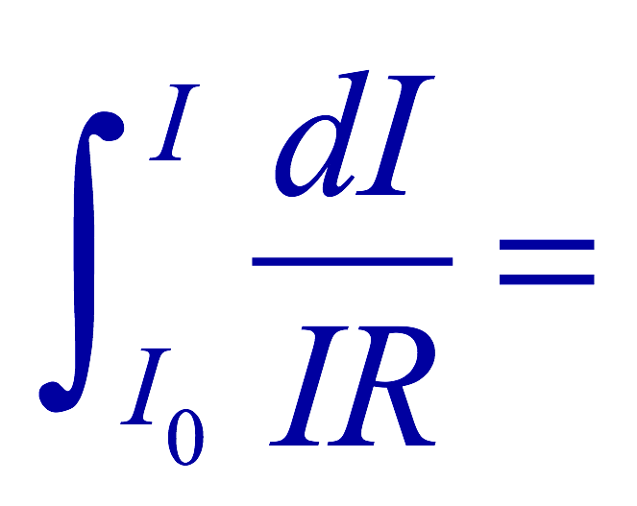
Discharge of LR Circuits
If the switch is flipped away from the battery
  The differential equation becomes
  So the integration is
  Which results in the solution
  The current decays exponentially to zero with the time constant τ=L/R
  So there always is a reaction time when a system with a coil, such as an electromagnet, is turned on or off.
  The current in LR circuit behaves almost the same as that in RC circuit but the time constant is inversely proportional to R in LR circuit unlike the RC circuit

Slide 21
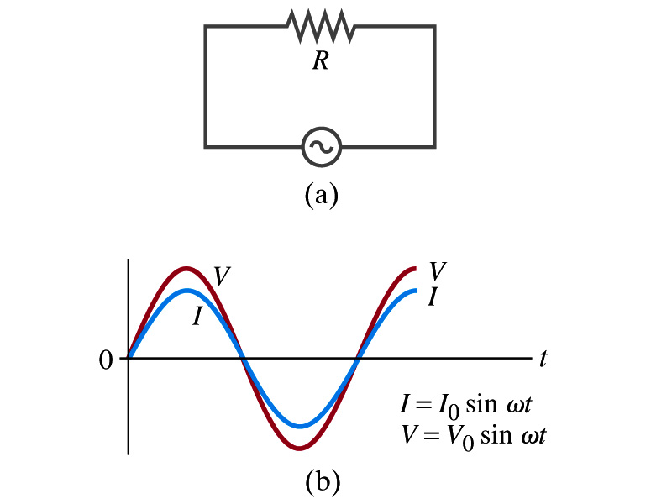
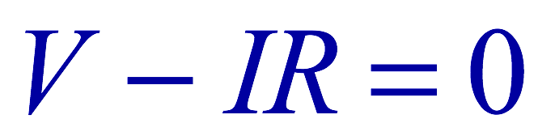
AC Circuit w/ Resistance only
What do you think will happen when an AC source is connected to a resistor?
From Kirchhoff’s loop rule, we obtain
Thus
  where
What does this mean?
  Current is 0 when voltage is 0 and current is in its peak when voltage is in its peak.
  Current and voltage are “in phase”
Energy is lost via the transformation into heat at an average rate

Slide 22
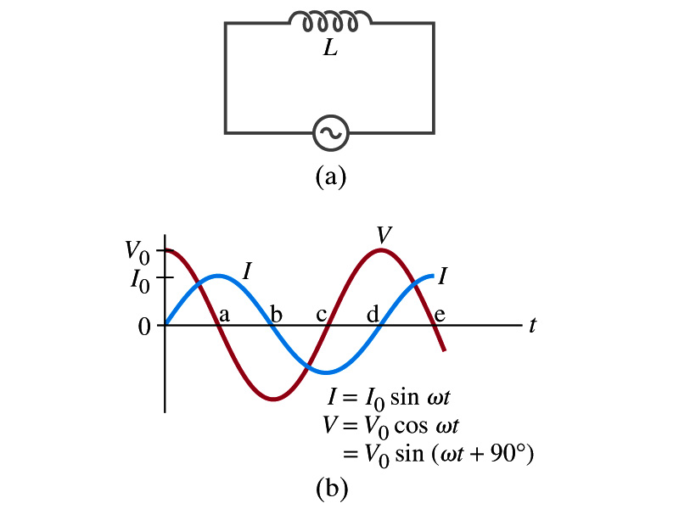
AC Circuit w/ Inductance only
From Kirchhoff’s loop rule, we obtain
Thus
  Using the identity
  where
What does this mean?
  Current and voltage are “out of phase by π/2 or 90º”. In other words the current reaches its peak ¼ cycle after the voltage
What happens to the energy?
  No energy is dissipated
  The average power is 0 at all times
  The energy is stored temporarily in the magnetic field
  Then released back to the source

Slide 23
AC Circuit w/ Inductance only
How are the resistor and inductor different in terms of energy?
  Inductor
  Resistor
How are they the same?
  They both impede the flow of charge
  For a resistance R, the peak voltage and current are related to
  Similarly, for an inductor we may write
    Where X_{L} is the inductive reactance of the inductor
    What do you think is the unit of the reactance?
    The relationship is not valid at a particular instance. Why not?
      Since V₀ and Ι₀ do not occur at the same time
Stores the energy temporarily in the magnetic field and then releases it back to the emf source
Does not store energy but transforms it to thermal energy, losing it to the environment
0 when ω=0.
Ω
is valid!

Slide 24
Example 30 – 9
Reactance of a coil. A coil has a resistance R=1.00Ω and an inductance of 0.300H. Determine the current in the coil if (a) 120 V DC is applied to it; (b) 120 V AC (rms) at 60.0Hz is applied.
Is there a reactance for DC?
Nope. Why not?
Since ω=0,
So for DC power, the current is from Kirchhoff’s rule
For an AC power with f =60Hz, the reactance is
Since the resistance can be ignored compared to the reactance, the rms current is

Slide 25
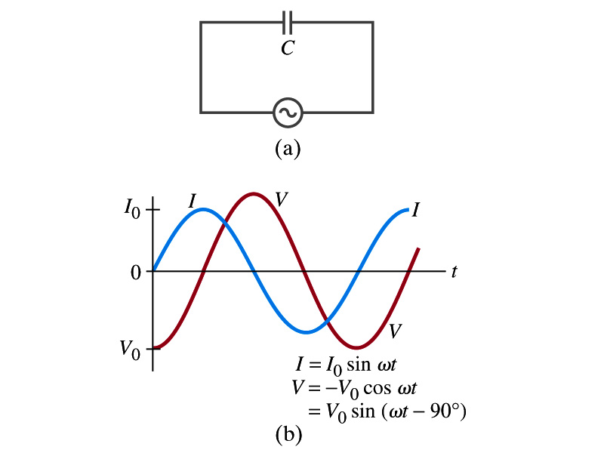
AC Circuit w/ Capacitance only
What happens when a capacitor is connected to a DC power source?
  The capacitor quickly charges up.
  There is no steady current flow in the circuit
    Since the capacitor prevents the flow of the DC current
What do you think will happen if it is connected to an AC power source?
  The current flows continuously. Why?
  When the AC power turns on, charge begins to flow one direction, charging up the plates
  When the direction of the power reverses, the charge flows in the opposite direction

Slide 26
AC Circuit w/ Capacitance only
From Kirchhoff’s loop rule, we obtain
The current at any instance is
The charge Q on the plate at any instance is
Thus the voltage across the capacitor is
  Using the identity
  Where

Slide 27
AC Circuit w/ Capacitance only
So the voltage is
What does this mean?
  Current and voltage are “out of phase by π/2 or 90º” but in this case, the voltage reaches its peak ¼ cycle after the current
What happens to the energy?
  No energy is dissipated
  The average power is 0 at all times
  The energy is stored temporarily in the electric field
  Then released back to the source
Applied voltage and the current in the capacitor can be written as
  Where the capacitive reactance X_{C} is defined as
  Again, this relationship is only valid for rms quantities
Infinite when ω=0.

Slide 28
Example 30 – 10
Capacitor reactance. What are the peak and rms current in the circuit in the figure if C=1.0μF and V_{rms}=120V? Calculate for (a) f=60Hz, and then for (b) f=6.0x10⁵Hz.
The peak voltage is
The capacitance reactance is
Thus the peak current is
The rms current is

Slide 29
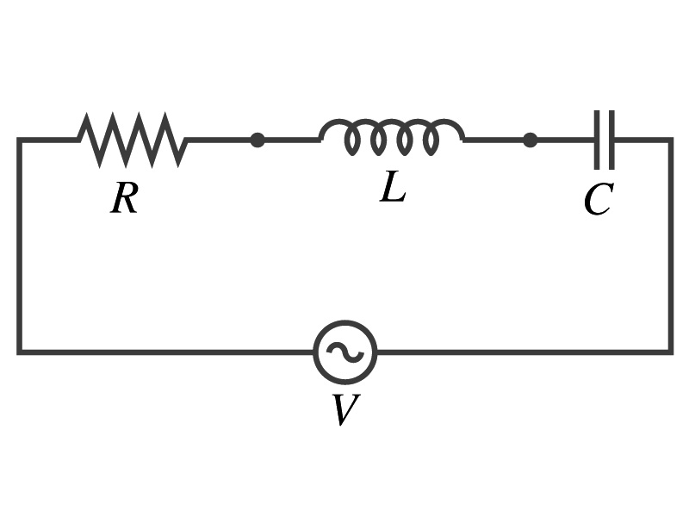
AC Circuit w/ LRC
The voltage across each element is
  V_{R} is in phase with the current
  V_{L} leads the current by 90º
  V_{C} lags the current by 90º
From Kirchhoff’s loop rule
V=V_{R}+V_{L}+V_{C}
  However since they do not reach the peak voltage at the same time, the peak voltage of the source V₀ will not equal V_{R0}+V_{L0}+V_{C0}
  The rms voltage also will not be the simple sum of the three
Let’s try to find the total impedance, peak current Ι₀ and the phase difference between Ι₀ and V₀.

Slide 30
AC Circuit w/ LRC
The current at any instance is the same at all point in the circuit
  The currents in each elements are in phase
  Why?
    Since the elements are in series
  How about the voltage?
    They are not in phase.
The current at any given time is
The analysis of LRC circuit is done using the “phasor” diagram in which arrows are drawn in an xy plane to represent the amplitude of each voltage, just like vectors
  The lengths of the arrows represent the magnitudes of the peak voltages across each element; V_{R0}=I₀R, V_{L0}=I₀X_{L} and V_{C0}=I₀X_{C}
  The angle of each arrow represents the phase of each voltage relative to the current, and the arrows rotate at the angular frequency ω to take into account the time dependence.
    The projection of each arrow on y axis represents voltage across each element at any given time

Slide 31
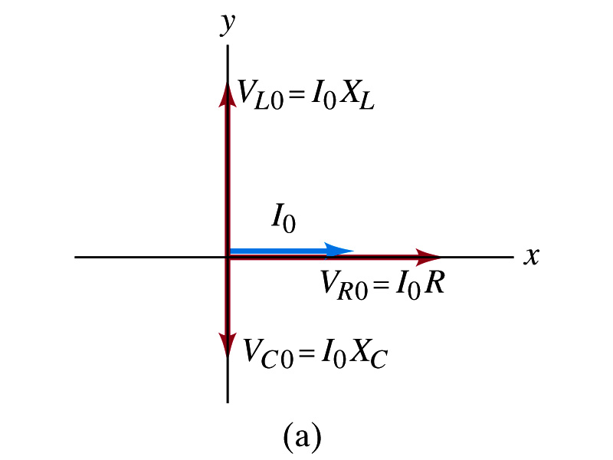
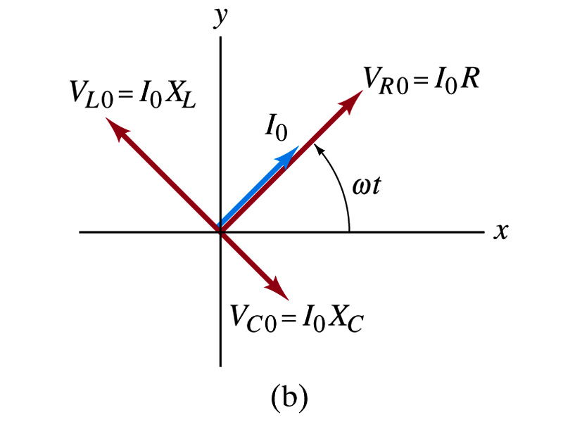
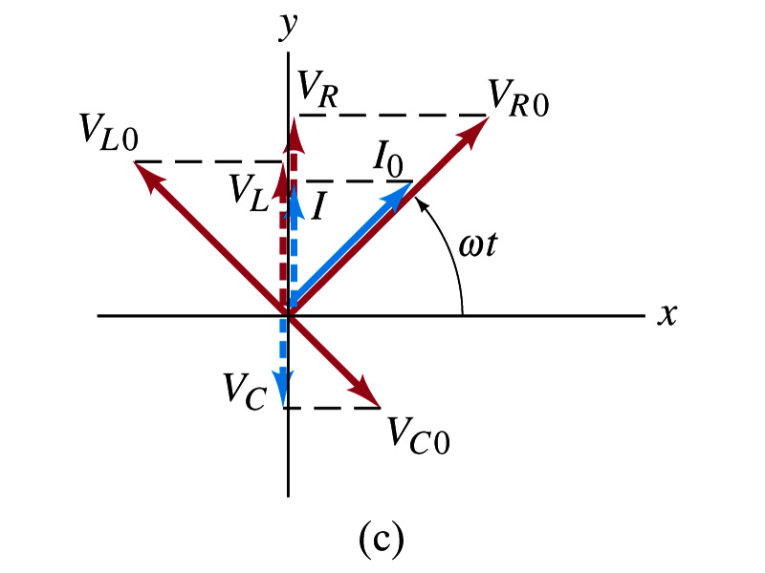
Phasor Diagrams
At t=0, Ι=0.
  Thus V_{R0}=0, V_{L0}=Ι₀X_{L}, V_{C0}=Ι₀X_{C}
At t=t,
Thus, the voltages (y-projections) are
+90º
-90º

Slide 32
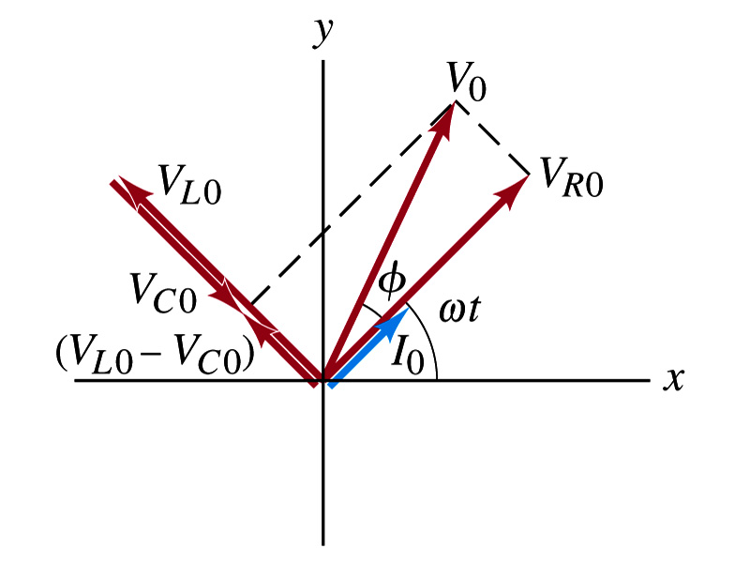
AC Circuit w/ LRC
Since the sum of the projections of the three vectors on the y axis is equal to the projection of their sum.
  The sum of the projections represents the instantaneous voltage across the whole circuit which is the source voltage
  So we can use the sum of all vectors as the representation of the peak source voltage V₀.
V₀ forms an angle φ to V_{R0} and rotates together with the other vectors as a function of time,
We determine the total impedance Z of the circuit defined by the relationship or
From Pythagorean theorem, we obtain
Thus the total impedance is

Slide 33
AC Circuit w/ LRC
The phase angle φ is
or
What is the power dissipated in the circuit?
  Which element dissipates the power?
  Only the resistor
The average power is
  Since R=Zcosφ
  We obtain
  The factor cosφ is referred as the power factor of the circuit
  For a pure resistor, cosφ=1 and
  For a capacitor or inductor alone φ=-90º or +90º, so cosφ=0 and

