Slide 1
PHYS 1441 – Section 002
Lecture #22
Monday, Dec. 3, 2018
Dr. Jaehoon Yu
Chapter 31: Maxwell’s Equations
  Expansion of Ampere’s Law
  Gauss’ Law for Magnetism
  Production of EM Waves
  Light as EM Waves

Slide 2
Maxwell’s Equations
The development of EM theory by Oersted, Ampere and others was not done in terms of EM fields
  The idea of fields was introduced somewhat by Faraday
Scottish physicist James C. Maxwell unified all the phenomena of electricity and magnetism in one theory with only four equations (Maxwell’s Equations) using the concept of fields
  This theory provided the prediction of EM waves
  As important as Newton’s law since it provides dynamics of electromagnetism
  This theory is also in agreement with Einstein’s special relativity
The biggest achievement of 19th century electromagnetic theory is the prediction and experimental verifications that the electromagnetic waves can travel through the empty space
  What do you think this accomplishment did?
    Open a new world of communication
    It also yielded the prediction that the light is an EM wave
Since all of Electromagnetism is contained in the four Maxwell’s equations, this is considered as one of the greatest achievements of human intellect

Slide 3
Announcements – II
Reading assignments: CH30.4 – 11 & CH31.7 – 10
Final comprehensive exam
  In class 1:00 – 2:20pm, this Wed. Dec. 5
  Covers CH21.1 through what we finish today (CH31.6) + appendix
  Bring your calculator but DO NOT input formula into it!
    Cell phones or any types of computers cannot replace a calculator!
  BYOF: You may bring a one 8.5x11.5 sheet (front and back) of handwritten formulae and values of constants
  No derivations, word definitions or solutions of any kind!
  No additional formulae or values of constants will be provided!
Planetarium extra credit
  Due this Wednesday, Dec. 5
  Tape one end of the ticket stub on a sheet of paper with your name on it

Slide 4
Ampere’s Law
Do you remember the mathematical expression of Oersted discovery of a magnetic field produced by an electric current, given by Ampere?
We’ve learned that a varying magnetic field produces an electric field
Then can the reverse phenomena, that a changing electric field producing a magnetic field, possible?
  If this is the case, it would demonstrate a beautiful symmetry in nature between electricity and magnetism

Slide 5
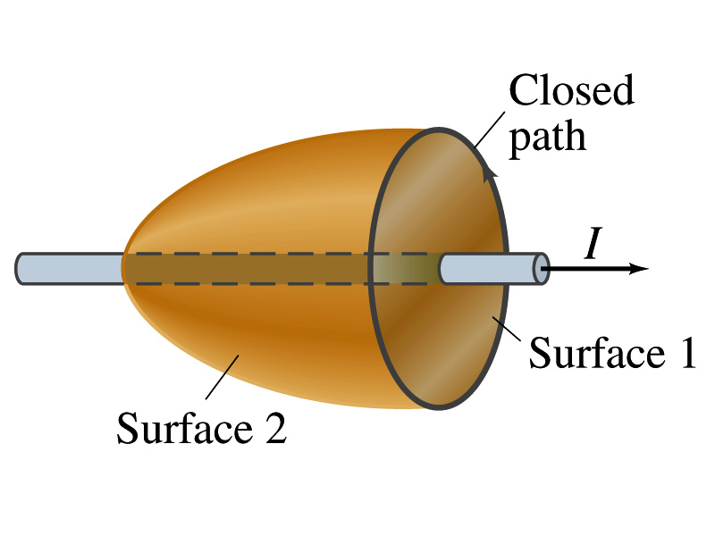
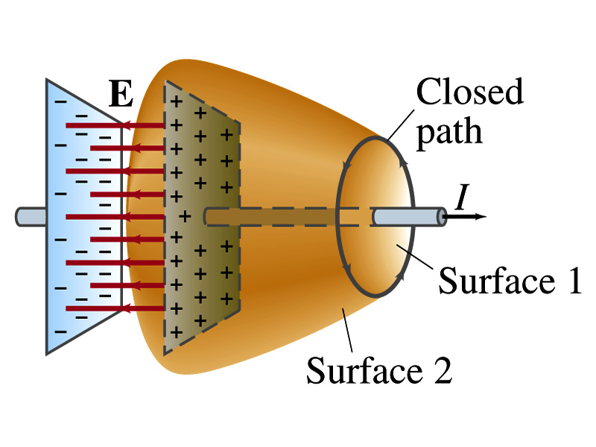
Expanding Ampere’s Law
Let’s consider a wire carrying current Ι
  The current that is enclosed in the loop passes through the surface # 1 in the figure
  We could imagine a different surface # 2 that shares the same enclosed path but cuts through the wire in a different location. What is the current that passes through the surface?
    Still Ι.
  So the Ampere’s law still works
We could then consider a capacitor being charged up or being discharged.
  The current Ι enclosed in the loop passes through the surface #1
  However the surface #2 that shares the same closed loop do not have any current passing through it.
    There is magnetic field present since there is current ➔ In other words there is a changing electric field in between the plates
    Maxwell resolved this by adding an additional term to Ampere’s law involving the changing electric field

Slide 6
Modifying Ampere’s Law
To determine what the extra term should be, we first have to figure out what the electric field between the two plates is
  The charge Q on the capacitor with capacitance C is Q=CV
    Where V is the potential difference between the plates
  Since V=Ed
    Where E is the uniform field between the plates, and d is the separation of the plates
  And for parallel plate capacitor C=ε₀A/d
  We obtain

Slide 7
Modifying Ampere’s Law
  If the charge on the plate changes with time, we can write
  Using the relationship between the current and charge we obtain
    Where Φ_{Ε}=EA is the electric flux through the surface between the plates
  So in order to make Ampere’s law work for the surface 2 in the figure, we must write it in the following form
  This equation represents the general form of Ampere’s law
    This means that a magnetic field can be caused not only by an ordinary electric current but also by a changing electric flux
Extra term by Maxwell

Slide 8
Example 31 – 1
Charging capacitor. A 30-pF air-gap capacitor has circular plates of area A=100cm². It is charged by a 70-V battery through a 2.0-Ω resistor. At the instance the battery is connected, the electric field between the plates is changing most rapidly. At this instance, calculate (a) the current into the plates, and (b) the rate of change of electric field between the plates. (c) Determine the magnetic field induced between the plates. Assume E is uniform between the plates at any instant and is zero at all points beyond the edges of the plates.
Since this is an RC circuit, the charge on the plates is:
For the initial current (t=0), we differentiate the charge with respect to time.
The electric field is
Change of the electric field is

Slide 9
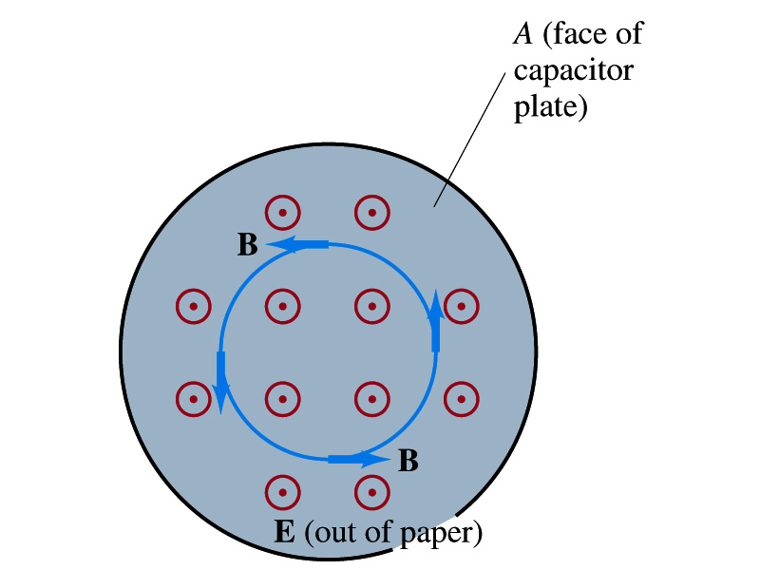
Example 31 – 1
(c) Determine the magnetic field induced between the plates. Assume E is uniform between the plates at any instant and is zero at all points beyond the edges of the plates.
The magnetic field lines generated by changing electric field is perpendicular to E and is circular due to symmetry
Whose law can we use to determine B?
Extended Ampere’s Law w/ Ι_{encl}=0!
We choose a circular path of radius r, centered at the center of the plane, following the B.
For r<r_{plate}, the electric flux is
since E is uniform throughout the plate
So from Ampere’s law, we obtain
Solving for B
For r<r_{plate}
Since we assume E=0 for r>r_{plate}, the electric flux beyond the plate is fully contained inside the surface.
So from Ampere’s law, we obtain
Solving for B
For r>r_{plate}

Slide 10
Displacement Current
Maxwell interpreted the second term in the generalized Ampere’s law equivalent to an electric current
  He called this term as the displacement current, Ι_{D}
  While the other term is called as the conduction current, Ι
Ampere’s law then can be written as
  Where
  While it is in effect equivalent to an electric current, a flow of electric charge, this actually does not have anything to do with the flow itself

Slide 11
Gauss’ Law for Magnetism
If there is a symmetry between electricity and magnetism, there must be an equivalent law in magnetism as the Gauss’ Law in electricity
For a magnetic field B, the magnetic flux Φ_{B} through the surface is defined as
  Where the integration is over the area of either an open or a closed surface
The magnetic flux through a closed surface which completely encloses a volume is
What was the Gauss’ law in the electric case?
  The electric flux through a closed surface is equal to the total net charge Q enclosed by the surface divided by ε₀.
Similarly, we can write Gauss’ law for magnetism as
Why is result of the integral zero?
  There is no isolated magnetic poles, the magnetic equivalent of single electric charges
Gauss’ Law for electricity
Gauss’ Law for magnetism

Slide 12
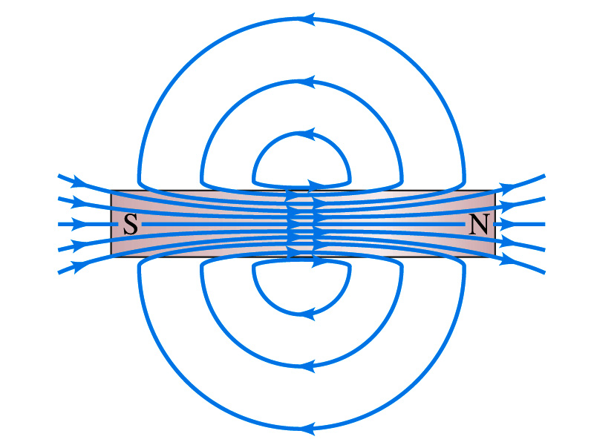
Gauss’ Law for Magnetism
What does the Gauss’ law in magnetism mean physically?
  There are as many magnetic flux lines that enter the enclosed volume as leave it
  If magnetic monopole does not exist, there is no starting or stopping point of the flux lines
    Electricity do have the source and the sink
  Magnetic field lines must be continuous
  Even for a bar magnet, the field lines exist both insides and outside of the magnet

Slide 13
Maxwell’s Equations
In the absence of dielectric or magnetic materials, the four equations developed by Maxwell are:
Gauss’ Law for electricity
A generalized form of Coulomb’s law relating electric field to its sources, the electric charge
Gauss’ Law for magnetism
A magnetic equivalent of Coulomb’s law relating magnetic field to its sources. This says there are no magnetic monopoles.
Faraday’s Law
An electric field is produced by a changing magnetic field
Ampére’s Law
A magnetic field is produced by an electric current or by a changing electric field

Slide 14
Maxwell’s Amazing Leap of Faith
According to Maxwell, a magnetic field will be produced even in an empty space if there is a changing electric field
  He then took this concept one step further and concluded that
    If a changing magnetic field produces an electric field, the electric field is also changing in time.
    This changing electric field in turn produces the magnetic field that also changes.
    This changing magnetic field then in turn produces the electric field that changes.
    This process continues.
  With the manipulation of the equations, Maxwell found that the net result of this interacting changing fields is a wave of electric and magnetic fields that can actually propagate (travel) through the space

Slide 15
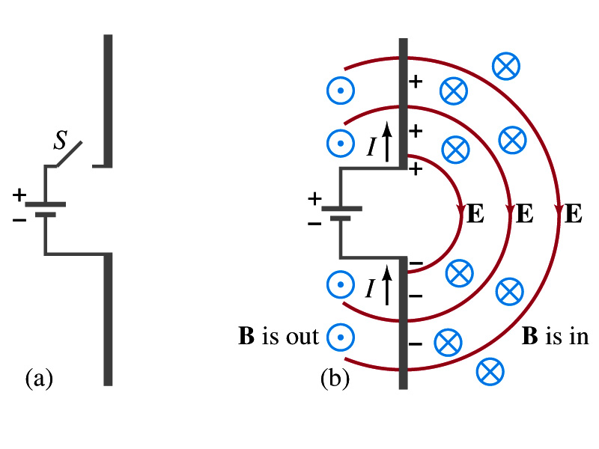
Production of EM Waves
Consider two conducting rods that will serve as an antenna are connected to a DC power source
  What do you think will happen when the switch is closed?
    The rod connected to the positive terminal is charged positive and the other negatively
    Then the electric field will be generated between the two rods
    Since there is current that flows through, the rods generates a magnetic field around them
How far would the electric and magnetic fields extend?
  In static case, the field extends indefinitely
  When the switch is closed, the fields are formed nearby the rods quickly but
  The stored energy in the fields won’t propagate w/ infinite speed

Slide 16
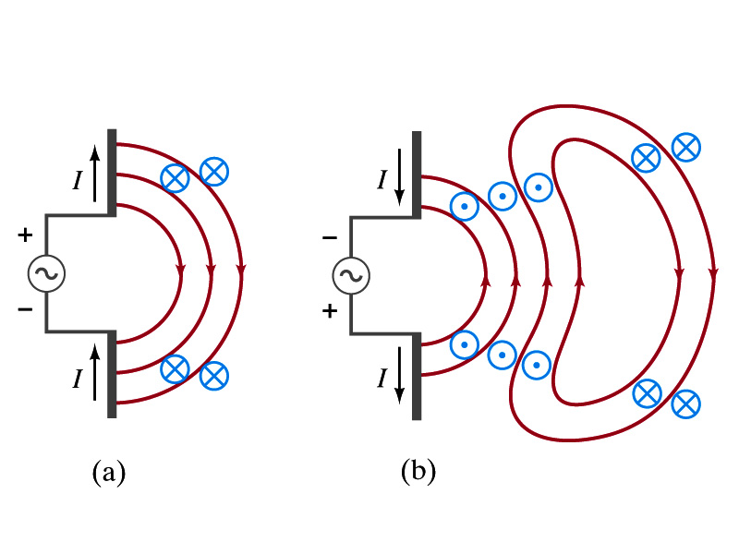
Production of EM Waves
What happens if the antenna is connected to an AC power source?
  When the connection was initially made, the rods are charging up quickly w/ the current flowing in one direction as shown in the figure
    The field lines form as in the dc case
    The field lines propagate away from the antenna
  Then the direction of the voltage reverses
    The new field lines with the opposite direction forms
    While the original field lines still propagates away from the rod reaching out far
      Since the original field propagates through an empty space, the field lines must form a closed loop (no charge exist)
    Since changing electric and magnetic fields produce changing magnetic and electric fields, the fields moving outward is self supporting and do not need antenna with flowing charge
  The fields far from the antenna is called the radiation field
  Both electric and magnetic fields form closed loops perpendicular to each other

Slide 17
Properties of Radiation Fields
The fields travel on the other side of the antenna as well
The field strength are the greatest in the direction perpendicular to the oscillating charge while along the direction of the current is 0
The magnitude of E and B in the radiation field decrease with distance as 1/r
The energy carried by the EM wave is proportional to the square of the amplitude, E² or B²
  So the intensity of wave decreases as 1/r²

Slide 18
Properties of Radiation Fields
The electric and magnetic fields at any point are perpendicular to each other and to the direction of motion
The fields alternate in direction
  The field strengths vary from maximum in one direction, to 0 and to max in the opposite direction
The electric and magnetic fields are in phase
Very far from the antenna, the field lines are pretty flat over a reasonably large area
  Called plane waves

Slide 19
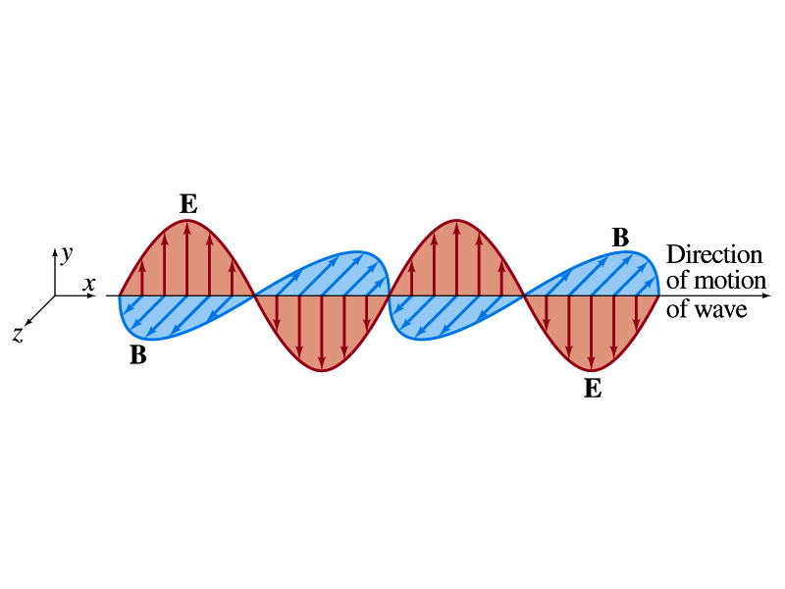
EM Waves
If the voltage of the source varies sinusoidal, the field strengths of the radiation field vary sinusoidal
We call these waves EM waves
They are transverse waves
EM waves are always waves of fields
  Since these are fields, they can propagate through an empty space
In general accelerating electric charges give rise to electromagnetic waves
This prediction from Maxwell’s equations was experimentally proven by Heinrich Hertz through the discovery of radio waves

Slide 20
EM Waves and Their Speeds
Let’s consider a region of free space. What’s a free space?
  An area of space where there is no charges or conduction currents
  In other words, far from emf sources so that the wave fronts are essentially flat or not distorted over a reasonable area
  What are these flat waves called?
    Plane waves
    At any instance E and B are uniform over a large plane perpendicular to the direction of propagation
  So we can also assume that the wave is traveling in the x-direction w/ velocity, v=vi, and that E is parallel to y axis and B is parallel to z axis

Slide 21
Maxwell’s Equations w/ Q=Ι=0
In this region of free space, Q=0 and Ι=0, thus the four Maxwell’s equations become
Q_{encl}=0
No Changes
No Changes
I_{encl}=0
One can observe the symmetry between electricity and magnetism.
The last equation is the most important one for EM waves and their propagation!!

Slide 22
EM Waves from Maxwell’s Equations
If the wave is sinusoidal w/ wavelength λ and frequency f, such traveling wave can be written as
  Where
  What is v?
    It is the speed of the traveling wave
  What are E₀ and B₀?
    The amplitudes of the EM wave. Maximum values of E and B field strengths.
Thus

Slide 23
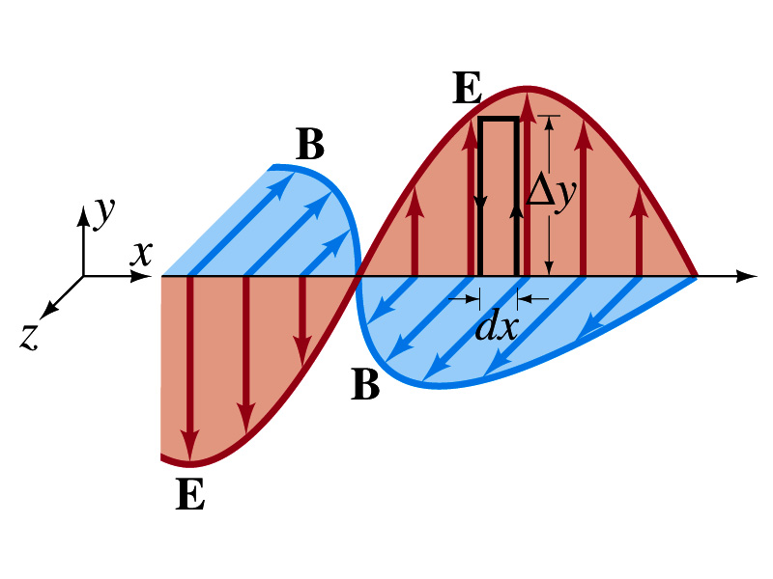
From Faraday’s Law
Let’s apply Faraday’s law
  to the rectangular loop of height Δy and width dx
along the top and bottom of the loop is 0. Why?
  Since E is perpendicular to dl.
  So the result of the integral through the loop counterclockwise becomes
  For the right-hand side of Faraday’s law, the magnetic flux through the loop changes as
Thus
Since E and B
depend on x and t

Slide 24
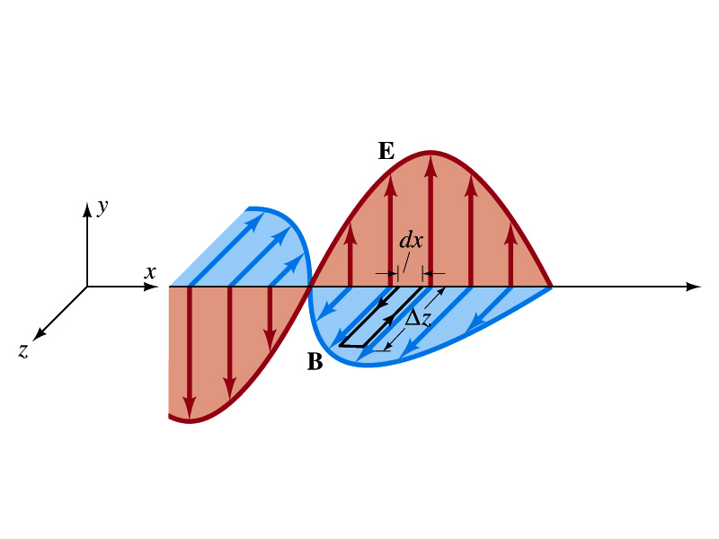
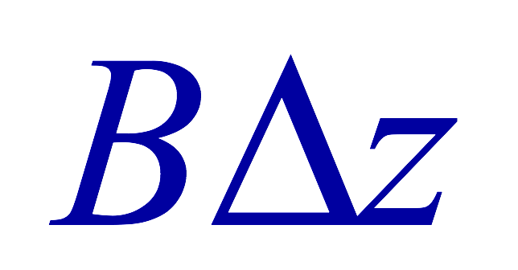
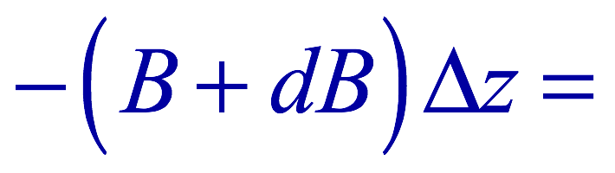
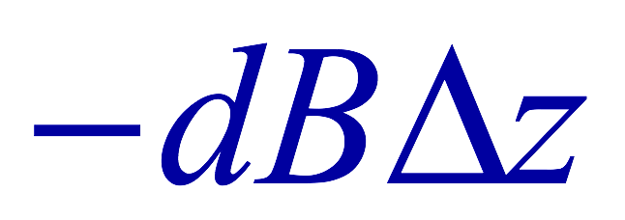
From Modified Ampére’s Law
Let’s apply Maxwell’s 4th equation
  to the rectangular loop of length Δz and width dx
along the x-axis of the loop is 0
  Since B is perpendicular to dl.
  So the result of the integral through the loop counterclockwise becomes
  For the right-hand side of the equation is
Thus
Since E and B
depend on x and t

Slide 25
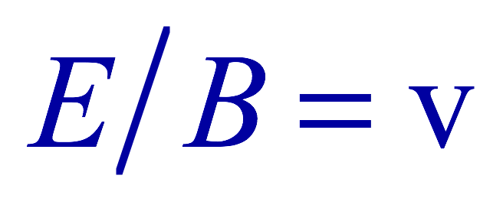

Relationship between E, B and v
Let’s now use the relationship from Faraday’s law
Taking the derivatives of E and B as given their traveling wave form, we obtain
  Since E and B are in phase, we can write
    This is valid at any point and time in space. What is v?
      The velocity of the wave
We obtain
Since
Thus

Slide 26

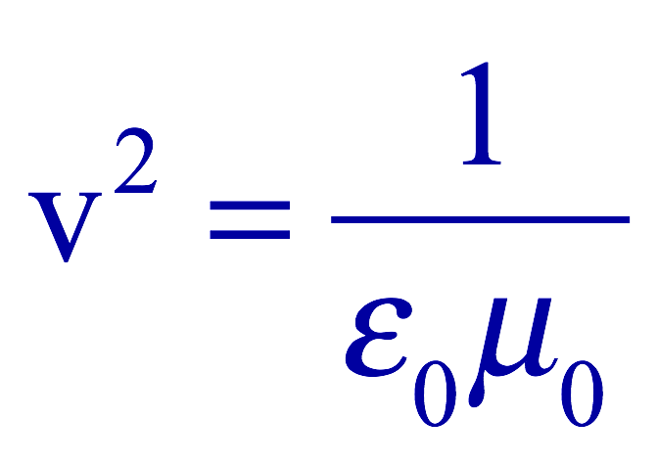

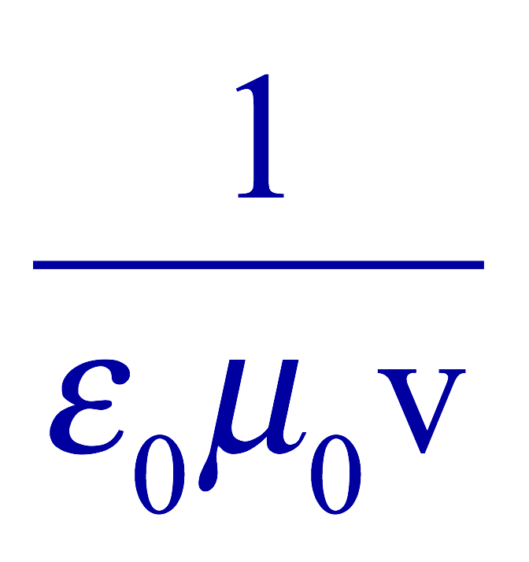
Speed of EM Waves
Let’s now use the relationship from Apmere’s law
Taking the derivatives of E and B as given their traveling wave form, we obtain
  However, from the previous page we obtain
  Thus
Since
We obtain
Thus
The speed of EM waves is the same as the speed of light. EM waves behaves like the light.

Slide 27
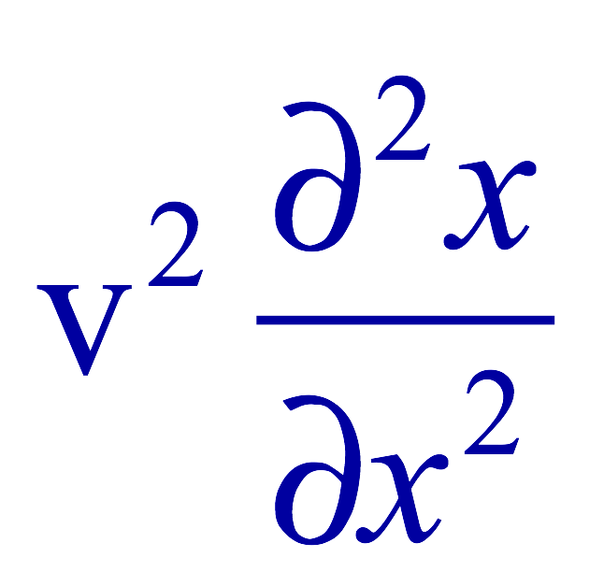
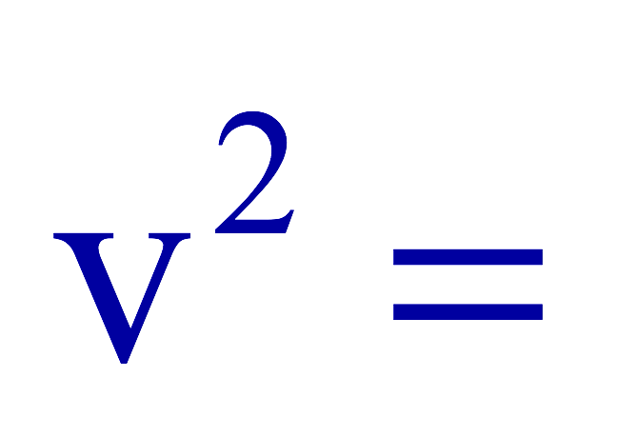
Speed of Light w/o Sinusoidal Wave Forms
Taking the time derivative on the relationship from Ampere’s laws, we obtain
By the same token, we take position derivative on the relationship from Faraday’s law
From these, we obtain
Since the equation for traveling wave is
By correspondence, we obtain
A natural outcome of Maxwell’s equations is that E and B obey the wave equation for waves traveling w/ speed
  Maxwell predicted the existence of EM waves based on this
and

Slide 28
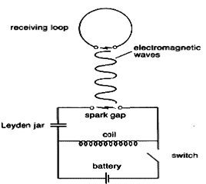
Light as EM Wave
People knew some 60 years before Maxwell that light behaves like a wave, but …
  They did not know what kind of waves they are.
    Most importantly what is it that oscillates in light?
Heinrich Hertz first generated and detected EM waves experimentally in 1887 using a spark gap apparatus
  Charge was rushed back and forth in a short period of time, generating waves with frequency about 10⁹Hz (these are called radio waves)
  He detected using a loop of wire in which an emf was produced when a changing magnetic field passed through
  These waves were later shown to travel at the speed of light and behave exactly like the light just not visible

Slide 29
Light as EM Wave
The wavelengths of visible light were measured in the first decade of the 19th century
  The visible light wave length were found to be between 4.0x10⁻⁷m (400nm) and 7.5x10⁻⁷m (750nm)
  The frequency of visible light is fλ=c
    Where f and λ are the frequency and the wavelength of the wave
      What is the range of visible light frequency?
      4.0x10¹⁴Hz to 7.5x10¹⁴Hz
    c is 3x10⁸m/s, the speed of light
EM Waves, or EM radiation, are categorized using EM spectrum

Slide 30
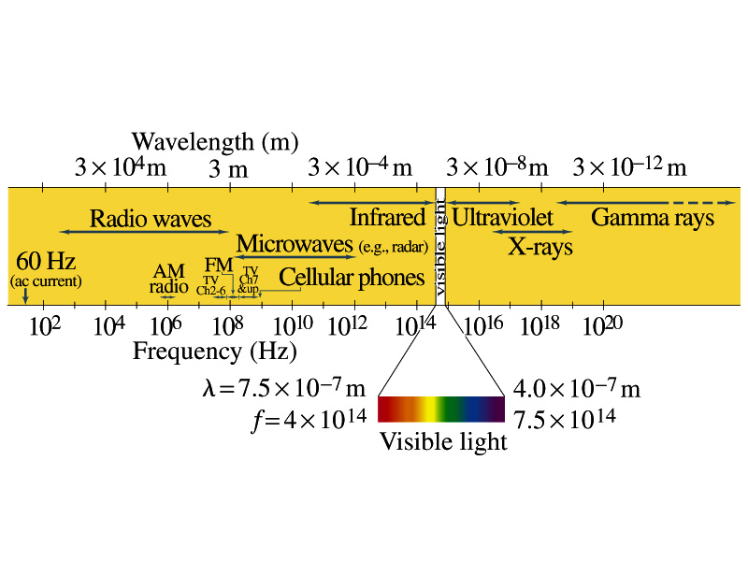
Electromagnetic Spectrum
Low frequency waves, such as radio waves or microwaves can be easily produced using electronic devices
Higher frequency waves are produced natural processes, such as emission from atoms, molecules or nuclei
Or they can be produced from acceleration of charged particles
Infrared radiation (IR) is mainly responsible for the heating effect of the Sun
  The Sun emits visible lights, IR and UV
    The molecules of our skin resonate at infrared frequencies so IR is preferentially absorbed and thus warm up

Slide 31
Example 31 – 3
Wavelength of EM waves. Calculate the wavelength (a) of a 60-Hz EM wave, (b) of a 93.3-MHz FM radio wave and (c) of a beam of visible red light from a laser at frequency 4.74x10¹⁴Hz.
What is the relationship between speed of light, frequency and the wavelength?
Thus, we obtain
For f=60Hz
For f=93.3MHz
For f=4.74x10¹⁴Hz

Slide 32
EM Wave in the Transmission Lines
Can EM waves travel through a wire?
  Can it not just travel through the empty space?
  Nope. It sure can travel through a wire.
When a source of emf is connected to a transmission line, the electric field within the wire does not set up immediately at all points along the line
  When two wires are separated via air, the EM wave travel through the air at the speed of light, c.
  However, through medium w/ permittivity ε and permeability μ, the speed of the EM wave is given
    Is this faster than c?
Nope! It is slower.

Slide 33
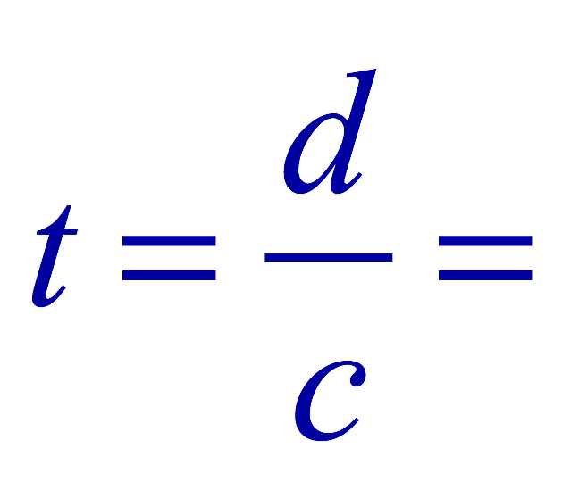
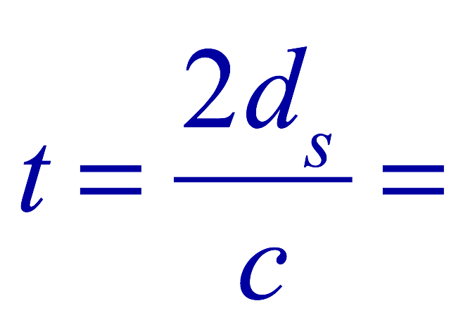
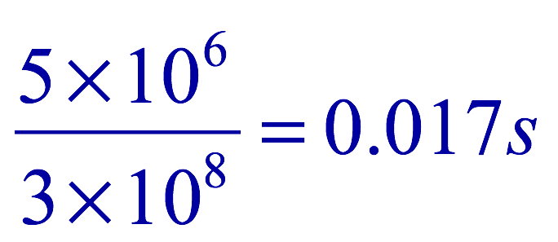
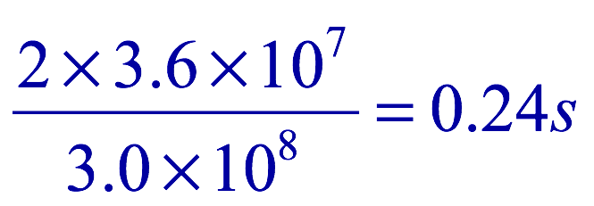
Example 31 – 5
Phone call time lag. You make a telephone call from New York to London. Estimate the time the electrical signal to travel to reach London (a) carried on a 5000km telephone cable under the Atlantic Ocean and (b) sent via satellite 36,000km above the ocean. Would this cause a noticeable delay in either case?
Time delay via the cable:
Delay via satellite
So in case of satellite, the delay is likely noticeable!!

Slide 34
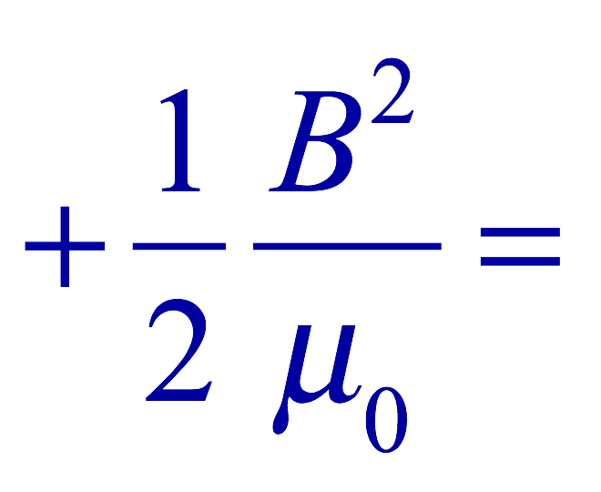
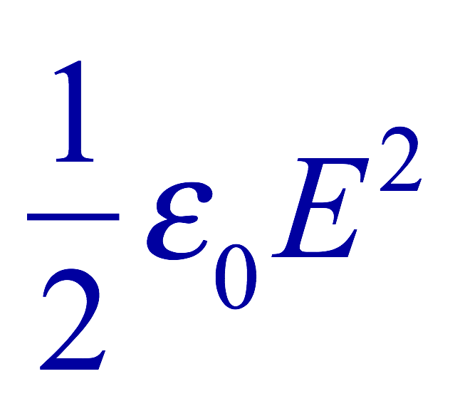
Energy in EM Waves
Since B=E/c and , we can rewrite the energy density
  Note that the energy density associate with B field is the same as that associate with E
  So each field contribute half to the total energy
By rewriting in B field only, we obtain
We can also rewrite to contain both E and B

Slide 35
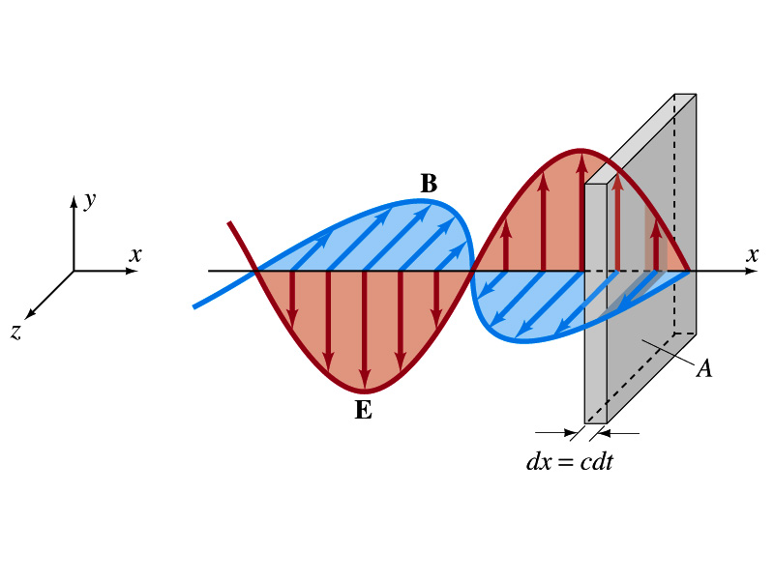
Energy Transport
What is the energy the wave transport per unit time per unit area?
  This is given by the vector S, the Poynting vector
    The unit of S is W/m².
    The direction of S is the direction in which the energy is transported. Which direction is this?
      The direction the wave is moving
Let’s consider a wave passing through an area A perpendicular to the x-axis, the axis of propagation
  How much does the wave move in time dt?
    dx=cdt
  The energy that passes through A in time dt is the energy that occupies the volume dV,
  Since the energy density is u=ε₀E², the total energy, dU, contained in the volume V is

Slide 36
Energy Transport
Thus, the energy crossing the area A per time dt is
Since E=cB and , we can also rewrite
Since the direction of S is along v, perpendicular to E and B, the Poynting vector S can be written
  This gives the energy transported per unit area per unit time at any instant
What is the unit?
W/m²

Slide 37
Average Energy Transport
The average energy transport in an extended period of time is useful since sometimes we do not detect the rapid variation with respect to time because the frequency is so high.
If E and B are sinusoidal,
Thus we can write the magnitude of the average Poynting vector as
  This time averaged value of S is the intensity, defined as the average power transferred across unit area. E₀ and B₀ are maximum values.
We can also write
  Where E_{rms} and B_{rms} are the rms values ( )

Slide 38
Example 31 – 6
E and B from the Sun. Radiation from the Sun reaches the Earth (above the atmosphere) at a rate of about 1350W/m². Assume that this is a single EM wave and calculate the maximum values of E and B.
What is given in the problem?
The average S!!
For E₀,
For B₀

