Slide 1
PHYS 1444 – Section 002 Lecture #1
Wednesday, Aug. 21, 2019
Dr. Jaehoon Yu
Who am I?
How is this class organized?
What is Physics?
What do we want from this class?
Brief history of physics
Standards and units
Today’s homework is homework #1, due 11pm, Monday, Aug. 26!!

Slide 2
Announcements
Plea to you: Please turn off all your electronic devices, including cell-phones and all types of computers before the start of each class!
Reading assignment #1: Read and follow through all sections in appendix A by Wednesday, Aug. 28
A-1 through A-8
There will be a quiz on this and what we’ve learned in CH21 and 22 on Wednesday, Sept. 4

Slide 3
Who am I?
Name: Dr. Jaehoon Yu (You can call me Dr. Yu)
Office: Rm 342, Chemistry and Physics Building
Extension: x22814, E-mail: jaehoonyu@uta.edu
My profession: High Energy Particle Physics (HEP)
Collide particles (protons on anti-protons or electrons on anti-electrons, positrons) at the energies equivalent to 10,000 Trillion degrees
To understand
Fundamental constituents of matter
Fundamental forces between the constituents (gravitational, electro-magnetic, weak and strong forces)
Origin of Mass
Search for Dark Matter and Making of Dark Matter Beams
Creation of Universe (Big Bang Theory)
A pure scientific research endeavor
Direct use of the fundamental laws we find may take longer than we want but
Indirect product of research contribute to every day lives; eg. WWW
Why do we do with this in the first place?
Make everyday lives better to help the whole humanity live well as an integral part of the universe

Slide 4
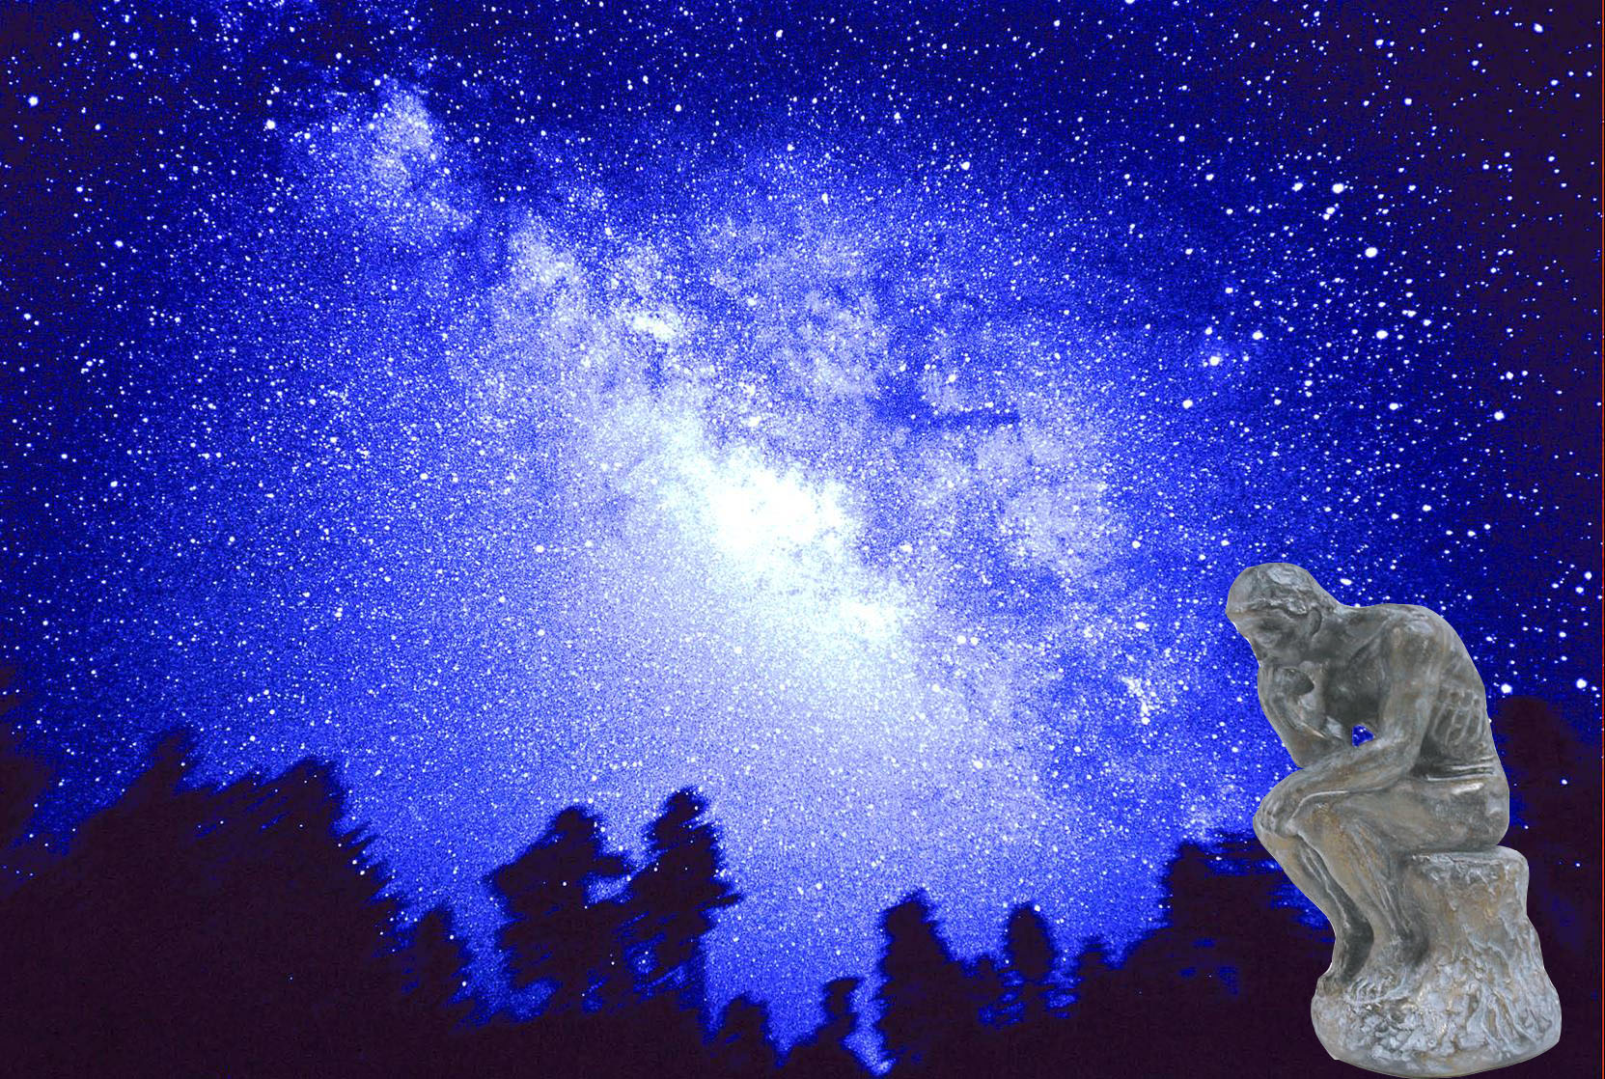
We always wonder…
What makes up the universe?
How does the universe work?
What holds the universe together?
How can we live in the universe well?
Where do we all come from?

Slide 5
High Energy Physics
Definition: A field of physics that pursues understanding the fundamental constituents of matter and basic principles of interactions between them.
Known interactions (forces):
Gravitational Force
Electromagnetic Force
Weak Nuclear Force
Strong Nuclear Force
Current theory: The Standard Model of Particle Physics

Slide 7
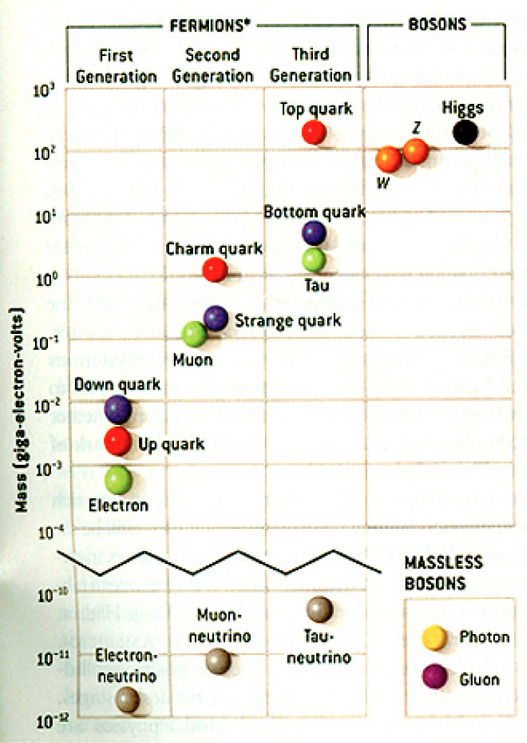
HEP and the Standard Model
Discovered in 1995, ~175m_{p}
Make up most ordinary matters ~0.1m_{p}
Total of 16 particles (12+4 force mediators) make up all the visible matter in the universe! ➔ Simple and elegant!!!
Tested to a precision of 1 part per million!

Slide 8
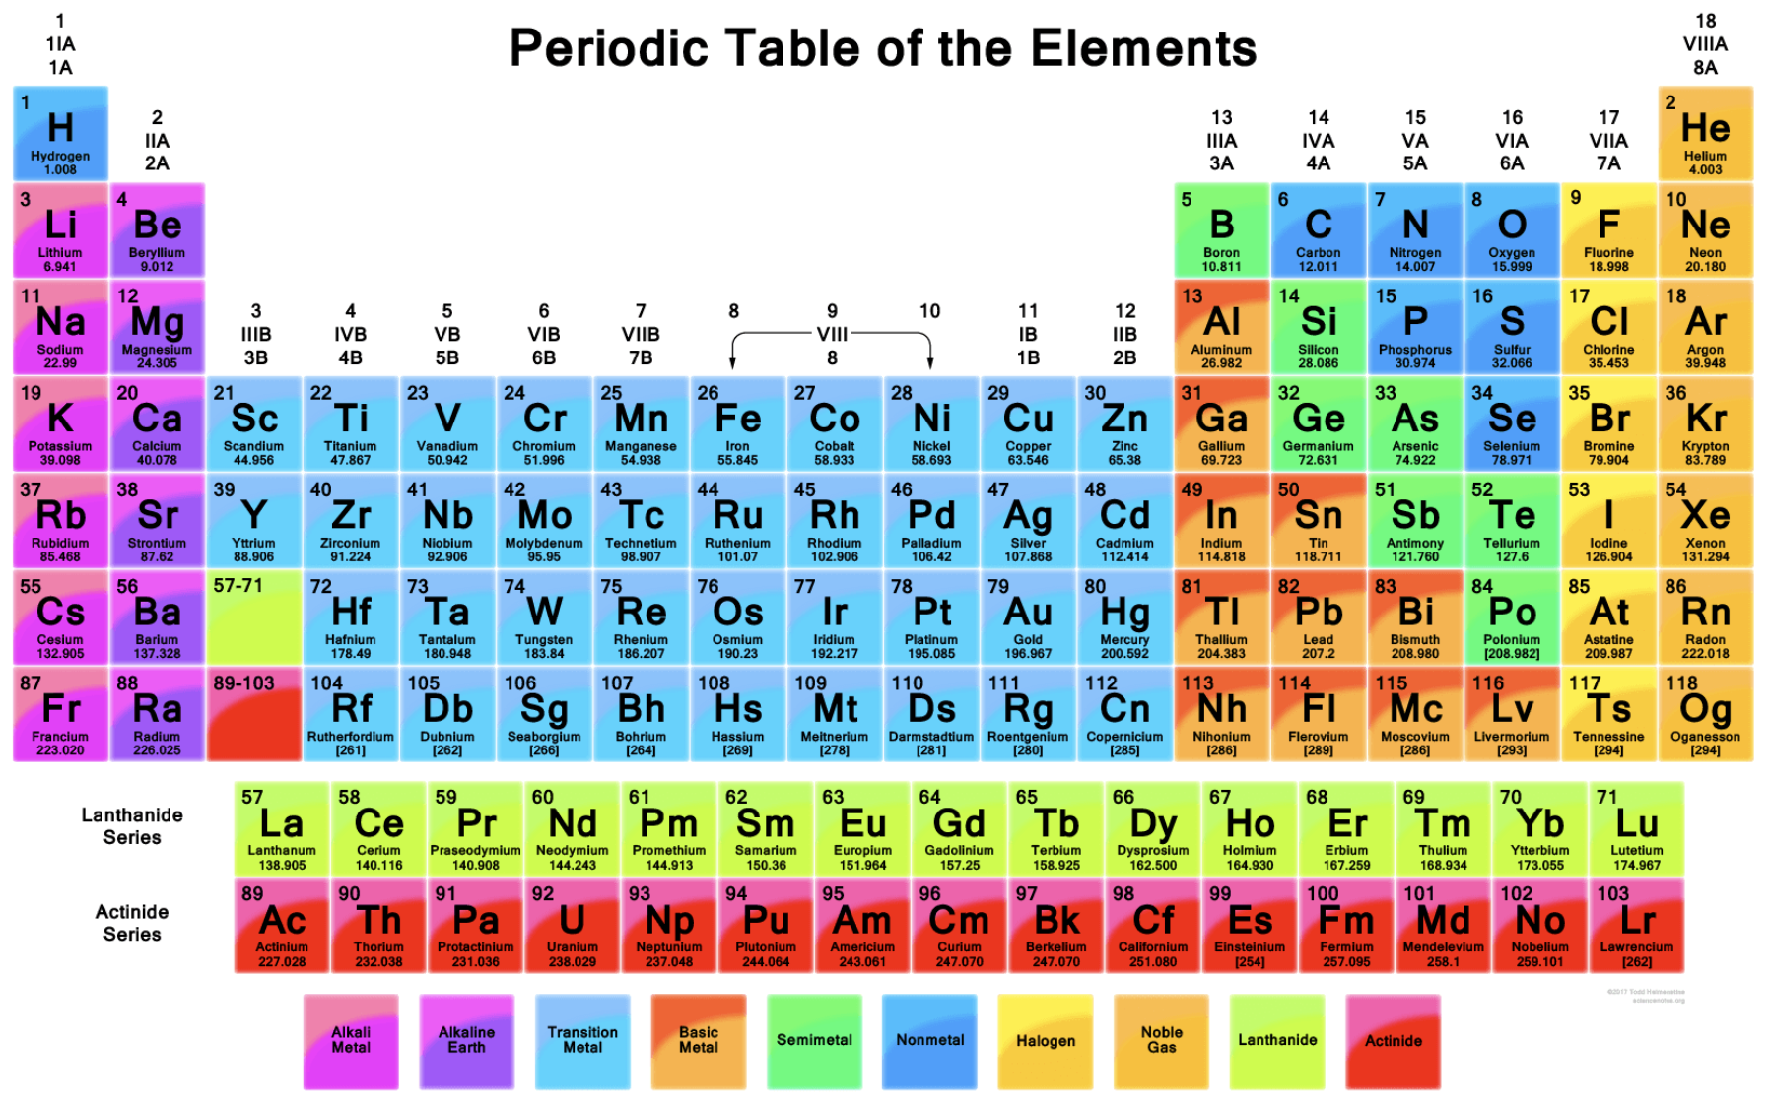

Slide 9
What are some issues in HEP?
Why is the mass range so large (0.1m_{p} – 175 m_{p})?
Is the particle discovered at the LHC really the Higgs particle?
Why is the matter in the universe made only of particles?
Neutrinos have mass!! (OMG!! The SM is broken!!! )
What are the mixing parameters, particle-anti particle asymmetry and the neutrino mass ordering?
Why are there only four apparent forces?
Were they all unified at the Big Bang?
Me!
Notes:
----- Meeting Notes (2/12/14 10:16) -----

Slide 10
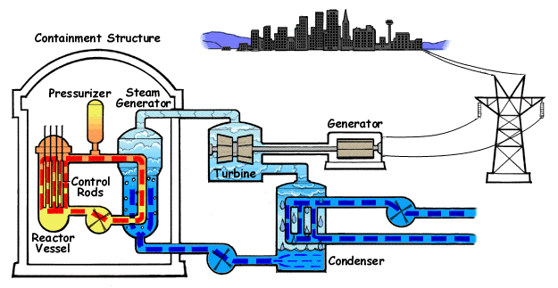
How does a nuclear power plant work?
Duke Energy
My 1000 year dream: Skip the whole thing!
Make electricity directly from nuclear force!

Slide 11
So what’s the problem?
Why is the mass range so large (0.1m_{p} – 175 m_{p})?
Is the particle we discovered really the Higgs particle?
Why is the matter in the universe made only of particles?
Neutrinos have mass!! What are the mixing parameters, particle-anti particle asymmetry and mass ordering?
Why are there only four apparent forces?
Were they all unified at the Big Bang?
Is the picture we present the real thing?
Notes:
----- Meeting Notes (2/12/14 10:16) -----

Slide 12
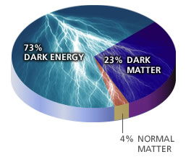
What makes up the universe?
~95% unknown!!
Notes:
----- Meeting Notes (2/12/14 10:16) -----

Slide 13
So what’s the problem?
Why is the mass range so large (0.1m_{p} – 175 m_{p})?
Is the particle we discovered really the Higgs particle?
Why is the matter in the universe made only of particles?
Neutrinos have mass!! What are the mixing parameters, particle-anti particle asymmetry and mass ordering?
Why are there only four apparent forces?
Were they all unified at the Big Bang?
Is the picture we present the real thing?
What makes up the remaining ~95% of the universe?
Are there any other particles we don’t know of?
Big deal for the new LHC Run!
Where do we all come from?
How can we live well in the universe as an integral partner?
Notes:
----- Meeting Notes (2/12/14 10:16) -----

Slide 14
Accelerators are Powerful Microscopes.
They make high energy particle beams
that allow us to see small things.
seen by
low energy beam
(poorer resolution)
seen by
high energy beam
(better resolution)

Slide 15
Accelerators are also Time Machines.
They make particles last seen
in the earliest moments of the universe.
Energy
particle beam
energy
anti-particle beam
energy
Particle and anti-particle annihilate.
E = mc²

Slide 16
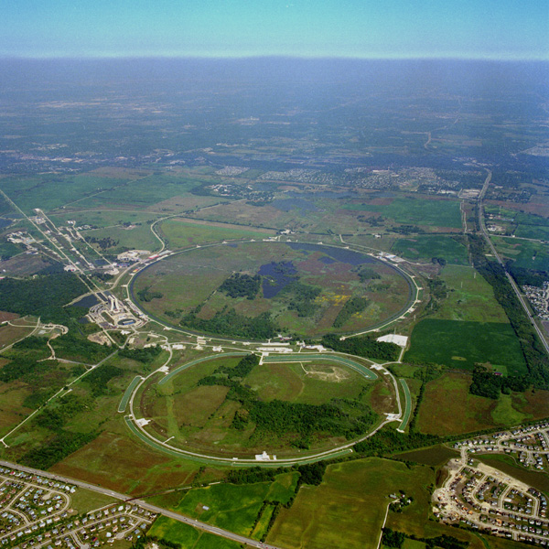
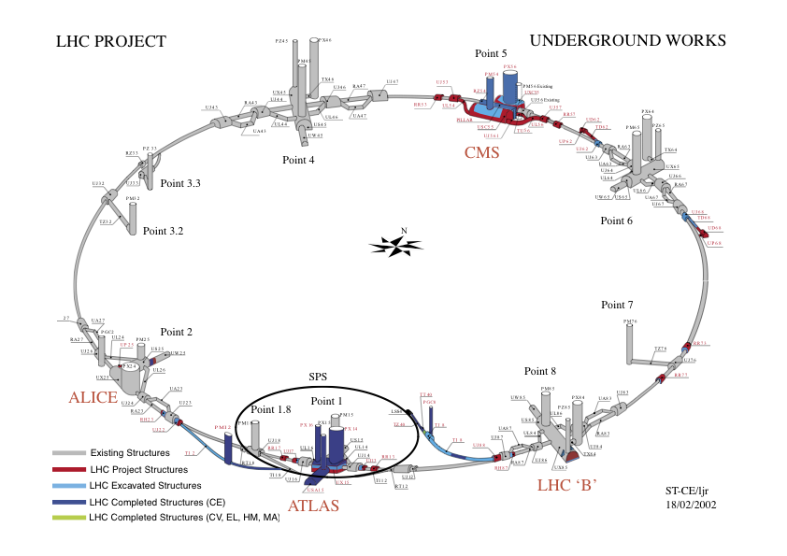
Fermilab Tevatron and LHC at CERN
World’s Highest Energy proton-anti-proton collider
4km (2.5mi) circumference
E_{cm}=1.96 TeV (=6.3x10⁻⁷J/p➔ 13M Joules on the area smaller than 10⁻⁴m²)
Equivalent to the kinetic energy of a 20t truck at the speed 130km/hr
~100,000 times the energy density at the ground 0 of the Hiroshima atom bomb
Tevatron was shut down in 2011
New frontiers with high intensity proton beams including the search for dark matter with beams!!
World’s Highest Energy p-p collider
27km (17mi) circumference, 100m (300ft) underground
Design E_{cm}=14 TeV (=44x10⁻⁷J/p➔ 362M Joules on the area smaller than 10⁻⁴m²)
Equivalent to the kinetic energy of a B727 (80tons) at the speed 310km/hr
~3M times the energy density at the ground 0 of the Hiroshima atom bomb
Discovered a new heavy particle that looks Higgs in 2012
Search for new particles has been ongoing!!
Shut down for two years begun for high stat. upgrade!
Chicago
CDF
p
DØ
Tevatron
p

Slide 17
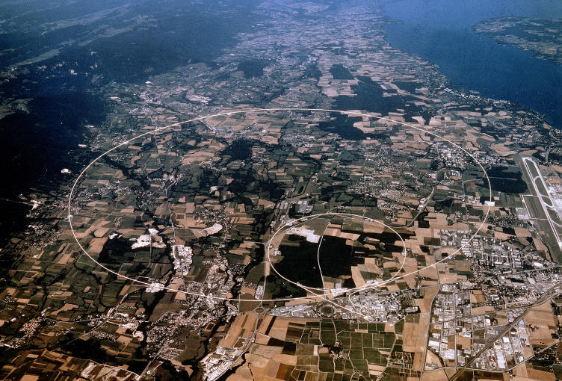
LHC @ CERN Aerial View
CMS
France
Geneva Airport
ATLAS
Swizerland

Slide 18
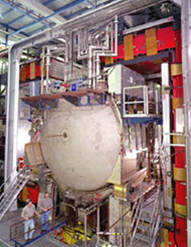
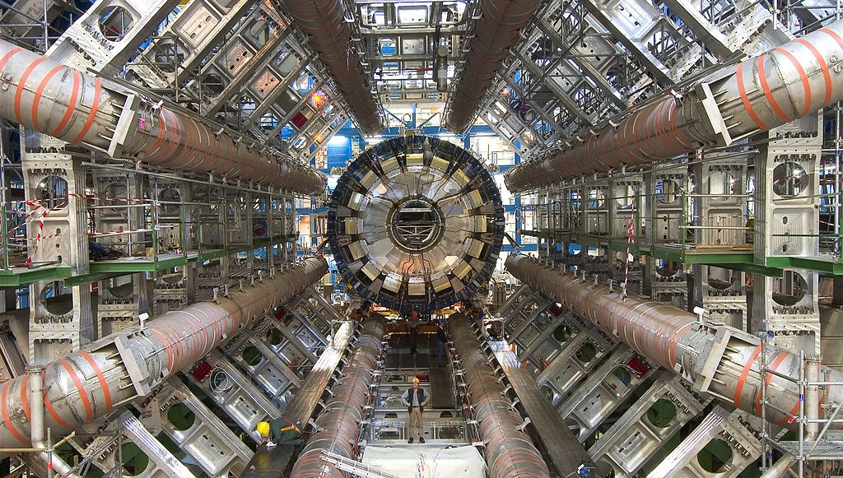
DZero Detector at Fermilab near Chicago
ATLAS Detector in Geneva Switzerland

Slide 19
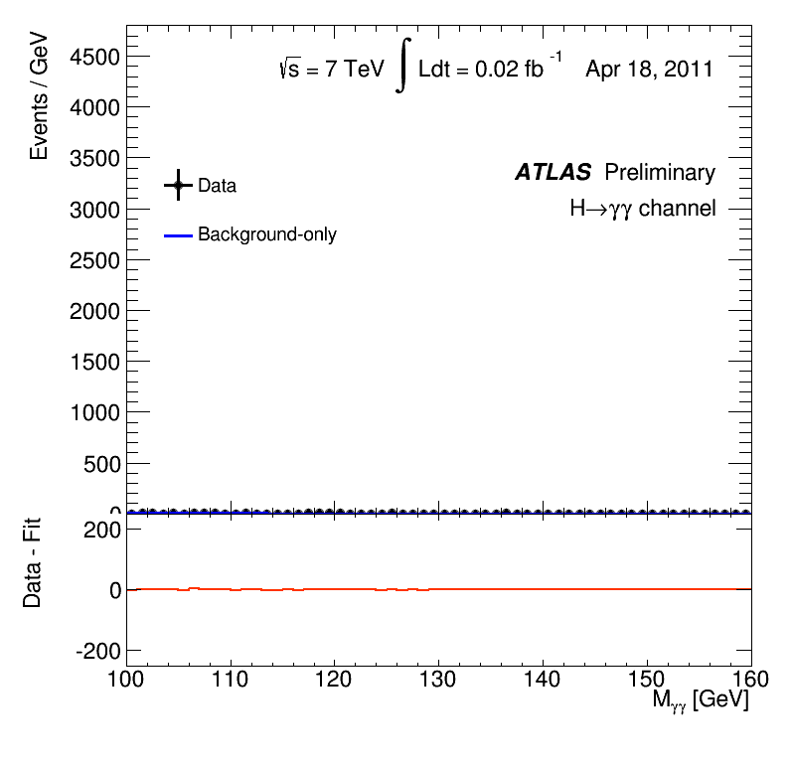
What did statistics do for Higgs→ γγ?
Excess of 7.4 σ at M_{H}=126.5GeV

Slide 20
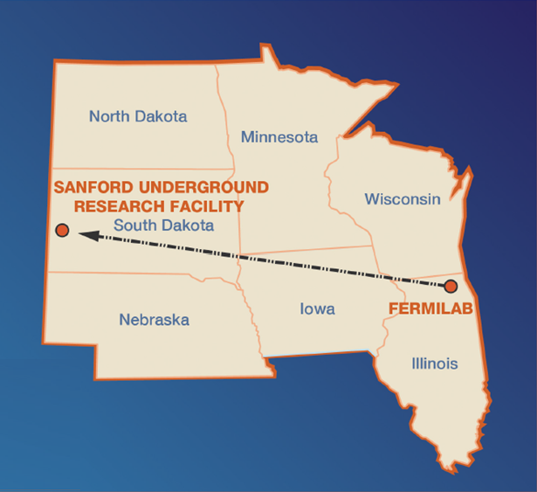
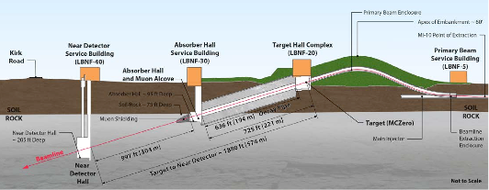
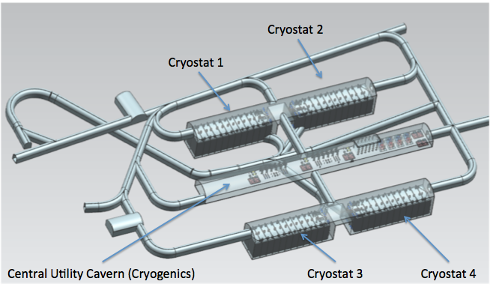
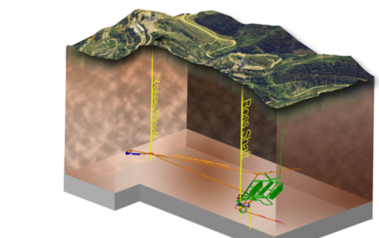
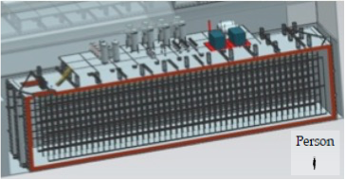
The Next Big Thing - DUNE Experiment
Stands for Deep Under Ground Neutrino Experiment
The $1.5B flagship long baseline (1300km) ν experiment
1500m underground in South Dakota
1300km (800 miles)
4 caverns with ~20,000t of Liquid Argon total each
15m
66m
15m

Slide 21
The Map of the DUNE Experiment
1132 collaborators
179 institutions
32 countries

Slide 22
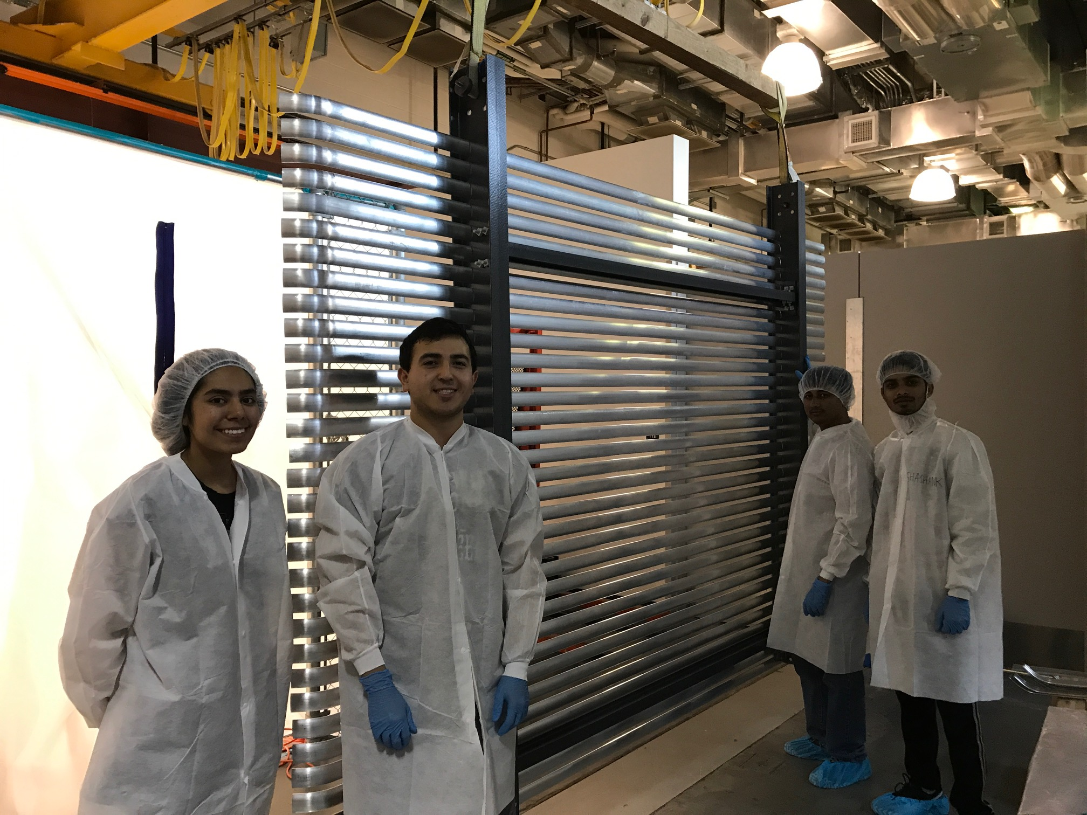
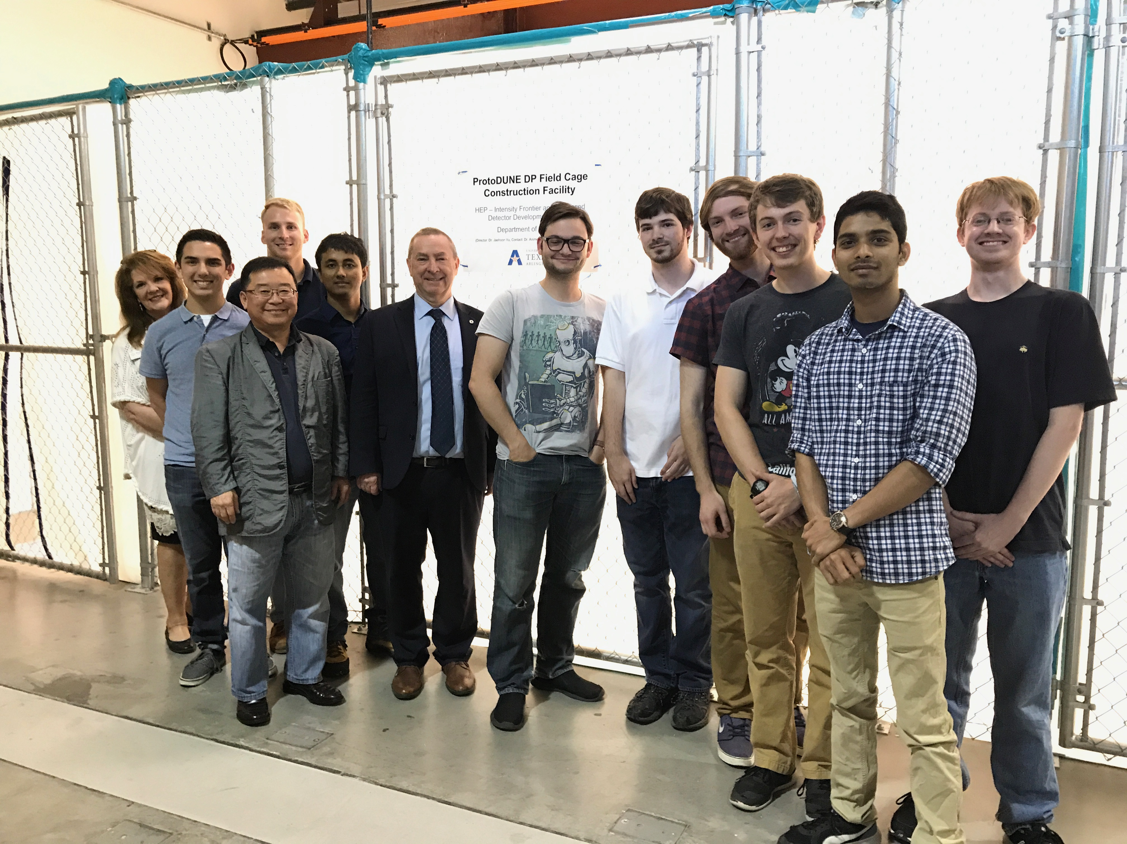
The UTA Field Cage Team

Slide 23
DUNE Prototype Detector @ CERN
6m
6m
Fermilab official poster!!

Slide 24
ProtoDUNE Event
Beam halo (high energy) muon with bremsstrahlung initiated E.M. shower
Collection plane view

Slide 25
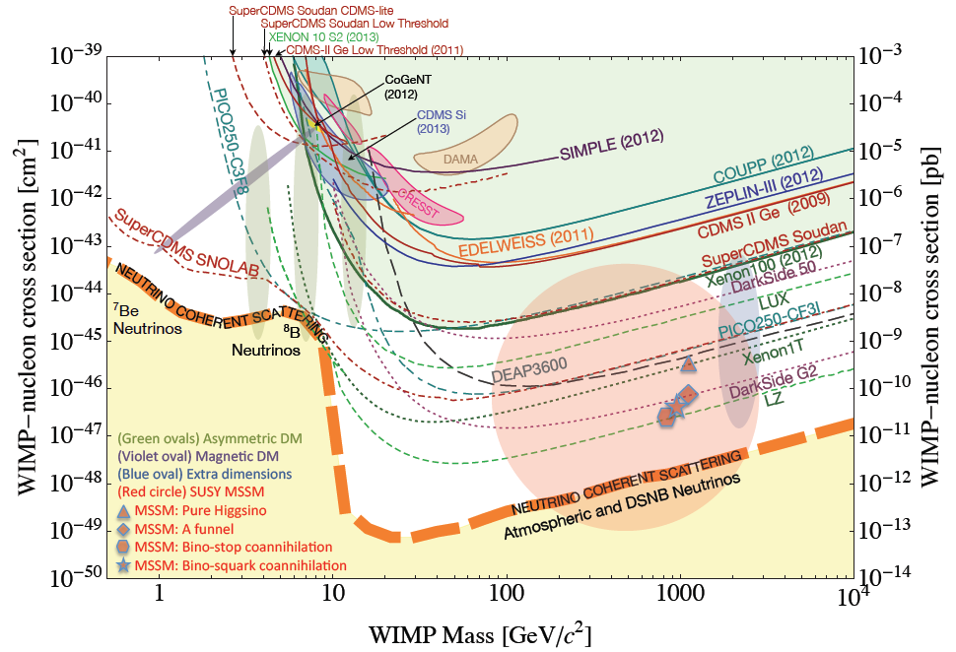
Let’s Look for Dark Matter!!
No DM
LHC
DUNE potential

Slide 26
So why is HEP relevant to me?
HEP explores the most fundamentals of the Universe!
Discoveries will realize our 1000 year dreams
The discovery of the dark matter and making of dark matter beams will take us to the next Quantum level
Outcome and bi-products of HEP research improves our daily lives directly and indirectly
WWW came from HEP

Slide 27
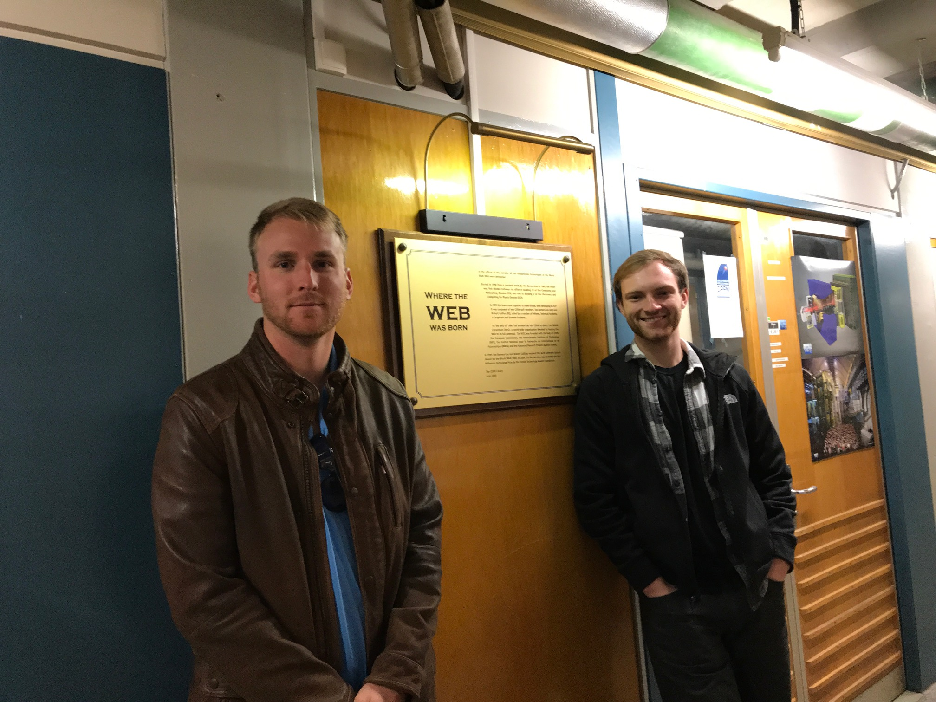

Slide 28
So why is HEP relevant to me?
HEP explores the most fundamentals of the Universe!
Discoveries will realize our 1000 year dreams
The discovery of the dark matter and making of dark matter beams will take us to the next Quantum level
Outcome and bi-products of HEP research improves our daily lives directly and indirectly
WWW came from HEP
Advanced detector technologies like GEM will make a large screen low dosage X-ray imaging possible

Slide 29
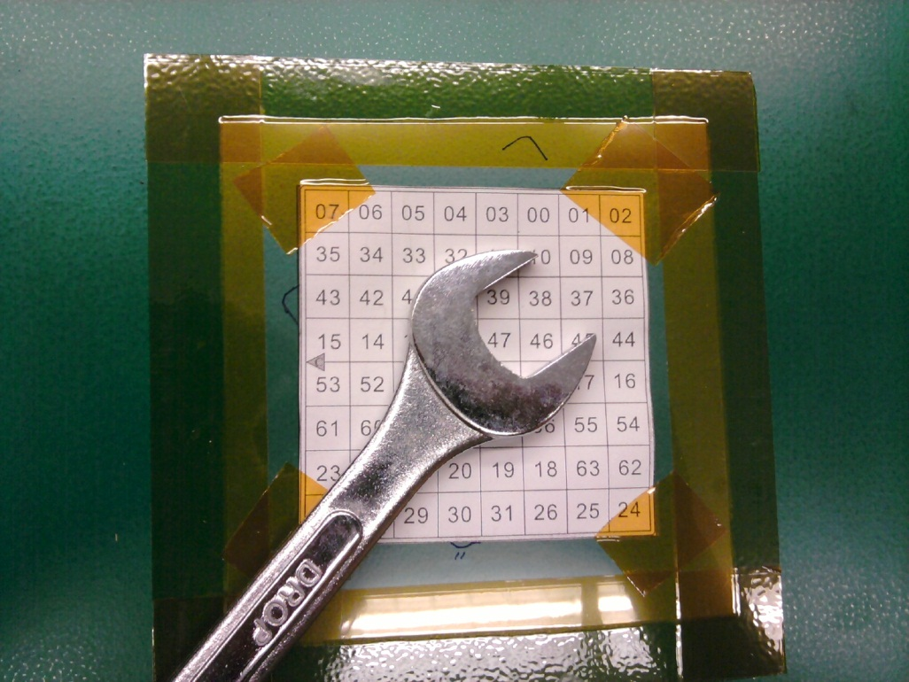
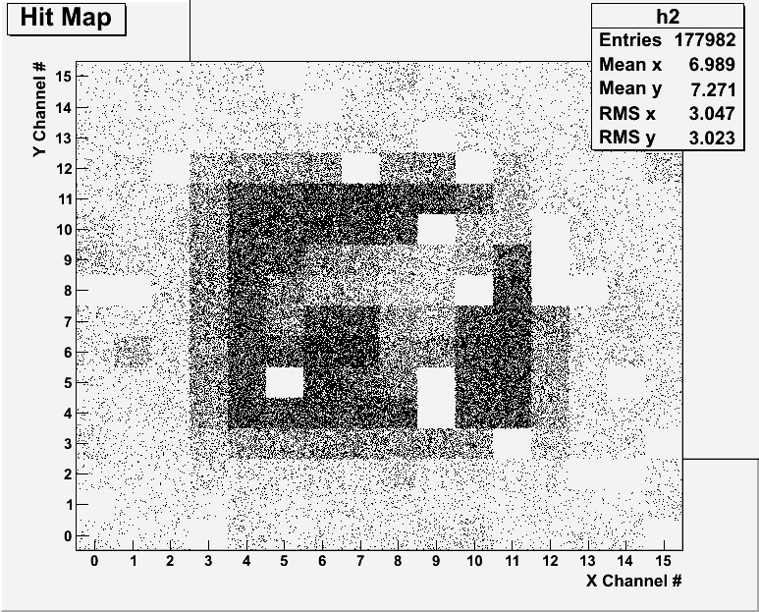
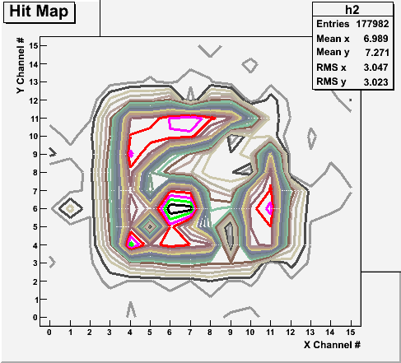
Bi-product of High Energy Physics Research
Can you see what the object is?
(GEM Detector X-ray Image)

Slide 30
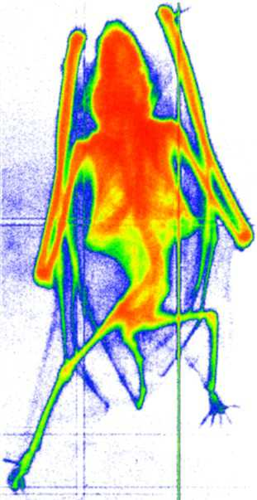
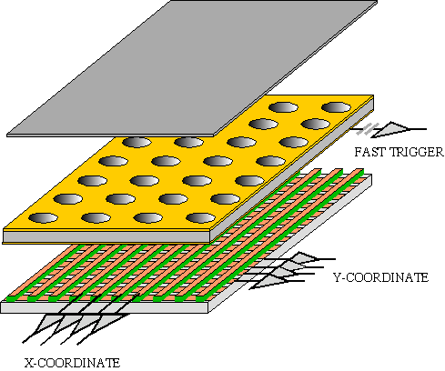
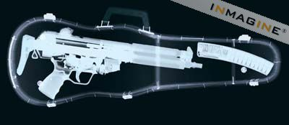
GEM Application Potential
FAST X-RAY IMAGING
Using the lower GEM signal, the readout can be self-triggered with energy discrimination:
9 keV absorption radiography of a small mammal (image size ~ 60 x 30 mm²)
A. Bressan et al,
Nucl. Instr. and Meth. A 425(1999)254
F. Sauli, Nucl. Instr. and Meth.A 461(2001)47

Slide 31
not just for tomorrow,
Let’s all dream,
not just for the next year,
but for 1000 years into the future for the whole humanity!!

Slide 32
Textbook
Title: Physics for Scientists and Engineers with Modern Physics
4th edition
Authors: D.C. Giancoli
ISBN13: 978-0132273596
ISBN10: 9780132273596

Slide 33
Information & Communication Source
Course web page: http://www-hep.uta.edu/~yu/teaching/fall19-1444-002/fall19-1444-002.html
Contact information & Class Schedule
Syllabus
Homework
Holidays and Exam days
Evaluation Policy
Class Style & Communication
Other information
Primary communication tool is e-mail: Make sure that your e-mail at the time of course registration is the one you most often read!!
Office Hours for Dr. Yu: 2:30 – 3:30pm, MW or by appointments

Slide 34
Evaluation Policy
Homework: 25%!!!
Exams
Final Comprehensive Exam (12/4/19): 23%
Mid-term Comprehensive Exam (10/16/19): 20%
One better of the two term Exams (9/18/19 and 11/11/19): 12%
Missing an exam is not permissible unless pre-approved
No makeup test
You will get an F if you miss any of the exams without a prior approval no matter how well you’ve been doing in class!
Lab score: 10%
Pop-quizzes: 10%
Extra credits: 10% of the total
Random attendances
Colloquium attendances
Special projects (BIGGGGG!!!)
Planetarium shows and many other opportunities
Grading will be done on a sliding scale
100%

Slide 35
Homework
Solving homework problems is the only way to comprehend class material
An electronic homework system has been setup for you
Details are in the material distributed today and on the web
https://quest.cns.utexas.edu/student/courses/list
Choose the course PHYS1444-Fall19, unique number 44119
Download homeworks, solve the problems and submit them online
Multiple unsuccessful tries will deduct points
Roster will close at 11pm next Wednesday, Aug. 28
You need a UT e-ID (NOT the UTA NetID): Go and apply at the URL https://idmanager.its.utexas.edu/eid_self_help/?createEID&qwicap-page-id=EA027EFF7E2DA39E if you don’t have one.
Each homework carries the same weight
Home work problems will be slightly ahead of the class and tough!
No homework will be dropped from the final grade!!
Home work will constitute 25% of the total ➔ A good way of keeping your grades high
Strongly encouraged to collaborate ➔ Does not mean you can copy

Slide 36
Attendances and Class Style
Attendances:
Will be taken randomly
Will be used for extra credits
Class style:
Lectures will be on electronic media
The lecture notes will be posted on the web AFTER each class
Will be mixed with traditional methods
Active participation through example problem work and discussions are required!
You take your own studies in your hands!
Your will be called out to give answers to examples and questions!!
Communication between you and me is extremely important
If you have problems, please do not hesitate talking to me

Slide 37
Lab and Physics Clinic
Physics Labs: Begins in the week of Sept. 9
Important to understand physical principles through experiments
10% of the grade
Prelab questions can be obtained at www.uta.edu/physics/labs
Lab syllabus is available in your assigned lab rooms.
Physics Clinic:
Free service
They provide general help on physics, including help solving homework problems
Do not expect solutions of the problem from them!
Do not expect them to tell you whether your answers are correct!
It is your responsibility to make sure that you have done everything correctly!
11am – 6pm, Mon – Thu in SH 007
This service begins today!
Please take full advantage of this service!!

Slide 38
Extra credit
10% addition to the total
Could boost a B to A, C to B or D to C
What constitute for extra credit?
Special projects (biggest!!)
Random attendances
Participating in the physics department colloquium
4pm Wednesdays
Two special colloquia already scheduled – triple extra credit!!
Oct. 30: Prof. Liangtao Wang of Univ. of Chicago
Nov. 13: Prof. Hitoshi Murayama of Univ. of California, Berkeley
Strong participation in the class discussions
Watching the valid planetarium shows
Many other opportunities

Slide 39
Valid Planetarium Shows
Regular running show schedule: https://www.uta.edu/planetarium/shows/schedule.php
Valid shows ( some need special arrangements)
Black Holes and Phantom of the Universe (Count up to 2 times!!)
Astronaut; Bad Astronomy; Back to the Moon for Good; From Earth to the Universe; Experience the Aurora; IBEX; Ice Worlds; Magnificent Sun
Mayan Prophecies; MicroCosm; Nano Cam; Stars of the Pharaohs; TimeSpace, Two Small Pieces of Glass; Unseen Universe; Violent Universe; Out there, Out Violent Planet
How to submit for extra credit?
Obtain the ticket stub that is signed and dated by the planetarium star lecturer at the show
Collect the ticket stubs throughout the semester
Tape one edge of all of the ticket stubs on a sheet of paper with your name and ID written on it
Submit the sheet at the end of the semester at the final exam

Slide 40
What can you expect from this class?
All A’s?
This would be really nice, wouldn’t it?
But if it is too easy it is not fulfilling or meaningful….
This class is not going to be a stroll in the park!!
You will earn your grade in this class.
You will need to put in sufficient time and sincere efforts
Exams and quizzes will be tough!!
Sometimes problems might not look exactly like what you learned in the class
Show your work! Just putting the right answer for free response problems does not work!
But you have a great control (up to 45%) of your grade in your hands!!
Homework is 25% of the total grade!!
Means you will have many homework problems
Sometimes much more than any other classes
Some homework problems will be something that you have yet to learn in class
Exam problems will be easier than homework problems but the same principles!!
Lab 10%
Extra credit 10%
Play a proactive role in your own study and grades
I will work with you so that your efforts are properly rewarded

Slide 41
What do we want to learn in this class?
Physics is everywhere around you.
Skills to understand the fundamental principles that surrounds you in everyday lives…
Skills to identify what laws of physics applies to what phenomena and use them appropriately
Understand the impact of physical laws and apply them
Learn skills to think, research and analyze observations.
Learn skills to express observations and measurements in mathematical language
Learn skills to express your research in a systematic manner in writing
But most importantly the confidence in your physics ability and to take on any challenges laid in front of you!!
Even more importantly, let us have a lot of FUN!!

Slide 42
Specifically, in this course, you will learn…
Concept of Electricity and Magnetism
Electric charge and magnetic poles
Electric and Magnetic Forces and fields
Electric and magnetic potential and energies
Propagation of electric and magnetic fields
Relationship between electro-magnetic forces and light
Behaviors of light and optics
Special relativity and quantum theories

Slide 43
How to study for this course?
Keep up with the class for comprehensive understanding of materials
Come to the class and participate in discussions and in solving example problems
Follow through lecture notes
Work out other example problems in the book yourself without the solutions
Have many tons of fun in the class, asking lots of questions!!!!!
Keep up with the homework to put the last nail on the coffin
Do NOT wait till you are done with all the problems. One can always input the answers as you solve problems.
Form a study group and discuss how to solve problems with your friends, then work the problems out yourselves! ➔ Use physics clinic!!
Prepare for upcoming classes
Read the textbook for the material to be covered in the next class
The extra mile
Work out additional problems in the back of the book starting the easiest problems to harder ones

