Slide 1
PHYS 1444 – Section 002
Lecture #4
Wednesday, Sept. 4, 2019
Dr. Jaehoon Yu
Ch 21
  The Electric Field & Field Lines
  Electric Fields and Conductors
  Motion of a Charged Particle in an E Field
Today’s homework is homework #3, due 11pm, Tuesday, Sept. 10!!

Slide 2
Announcements
Homework:
  All of you have registered to the homework system! Good job!
  5 of you, however, did not submit HW#1.
  DO NOT WAIT until you are done! Please input your answers as you solve problems!
1st Term Exam
  In class, Wednesday, Sept. 18: DO NOT MISS THE EXAM!
  CH1.1 to what we learn on Monday, Sept. 16 + Appendices A1 – A8
  You can bring your calculator but it must not have any relevant formula pre-input
  BYOF: You may bring a one 8.5x11.5 sheet (front and back) of handwritten formulae and values of constants for the exam
  No derivations, word definitions, or solutions of any problems !
  No additional formulae or values of constants will be provided!
Physics department colloquium today at 4pm, SH100
  Dr. Zdzislaw Musielak
Submit the special project now!

Slide 3
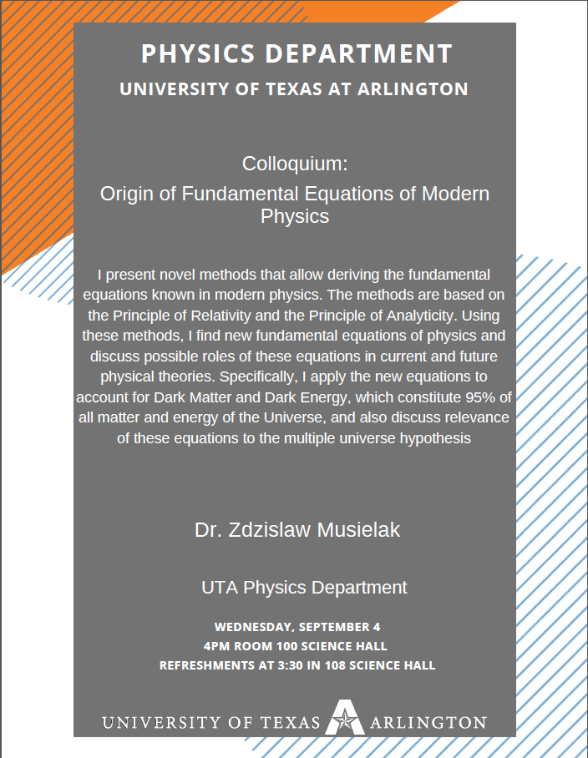

Slide 4
Special Project #2 – Angels & Demons
Compute the total possible energy released from an annihilation of xx-grams of anti-matter and the same quantity of matter, where xx is the last two digits of your SS#. (20 points)
  Use the famous Einstein’s formula for mass-energy equivalence
Compute the power output of this annihilation when the energy is released in yy ns, where yy is the first two digits of your SS#. (10 points)
Compute how many cups of gasoline (8MJ) this energy corresponds to. (5 points)
Compute how many months of world electricity usage (3.6GJ/mo) this energy corresponds to. (5 points)
Due at the beginning of the class Monday, Sept. 23

Slide 5
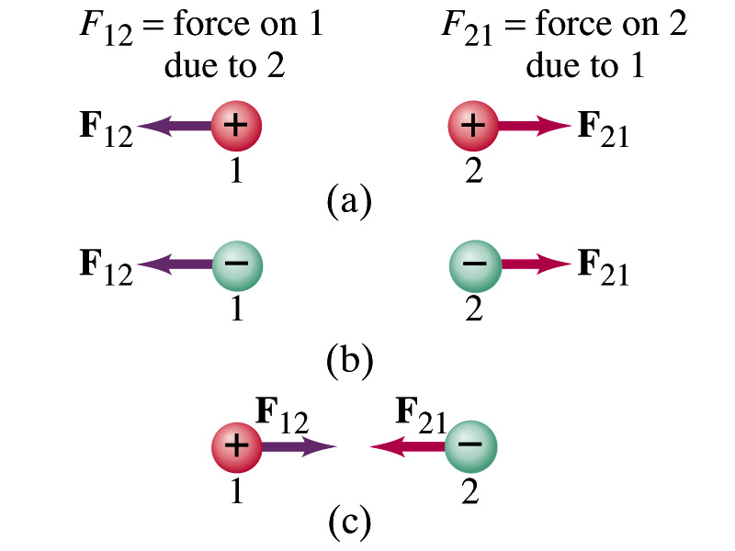
The Coulomb Force Refresher
Formula
Is Coulomb force a scalar quantity or a vector quantity? Unit?
  A vector quantity. The unit is Newtons (N)!
The direction of electric (Coulomb) force is always along the line joining the two objects.
  If the two charges are the same: forces are directed away from each other.
  If the two charges are opposite: forces are directed toward each other.
Coulomb force is precise to 1 part in 10¹⁶.
Unit of charge is called Coulomb, C, in SI.
The value of the proportionality constant, k, in SI unit is
Thus, 1C is the charge that gives F~9x10⁹N of force when placed 1m apart from each other.
The Elementary Charge

Slide 6
Reminder: Components and Unit Vectors
Coordinate systems are useful in expressing vectors in their components
y
(+,+)
F_{y}
(F_{x},F_{y})
}Components
F
(-,+)
θ
x
} Magnitude
(-,-)
(+,-)
F_{x}

Slide 7
Reminder: Unit Vectors
Unit vectors are the ones that tells us the directions of the components
Dimensionless
Magnitudes are exactly 1
Unit vectors are usually expressed in i, j, k or
So the vector F can be re-written as

Slide 8
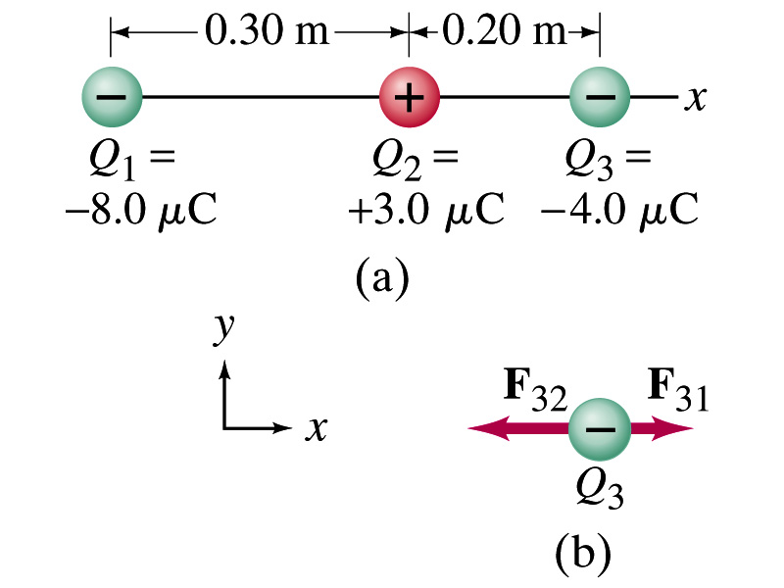
Example 21.2
Three charges on a line. Three charged particles are arranged in a line as shown in the figure. Calculate the net electrostatic force on particle 3 (the -4μC on the right) due to the other two charges.
What is the force that Q₁ exerts on Q₃?
What is the force that Q₂ exerts on Q₃?
Using the vector sum of the two forces

Slide 9
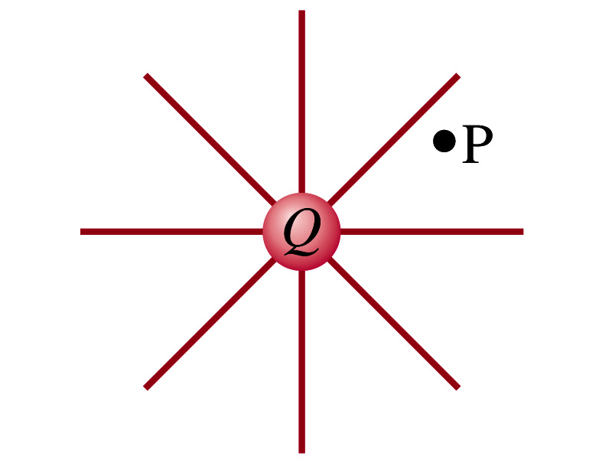
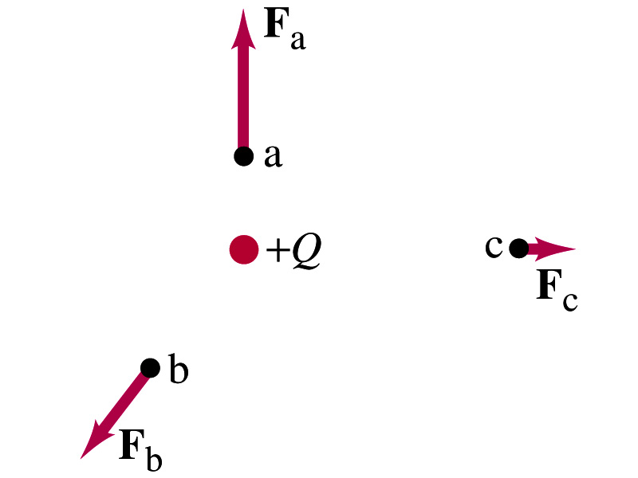
The Electric Field
Both gravitational and electrostatic forces act over a distance without contacting objects ➔ What kind of forces are these?
  Field forces
Michael Faraday developed an idea of field.
  Faraday (1791 – 1867) argued that the electric field extends outward from every charge and permeates through all of space.
Field by a charge or a group of charges can be inspected by placing a small positive test charge in the vicinity and measuring the force on it.

Slide 10
The Electric Field
The electric field at any point in space is defined as the force exerted on a tiny positive test charge (e.g., q) divide by the magnitude of the test charge
  Electric force per unit charge
What kind of quantity is the electric field?
  Vector quantity. Why?
What is the unit of the electric field?
  N/C
What is the magnitude of the electric field by a single point charge Q at a distance r from it?

Slide 11
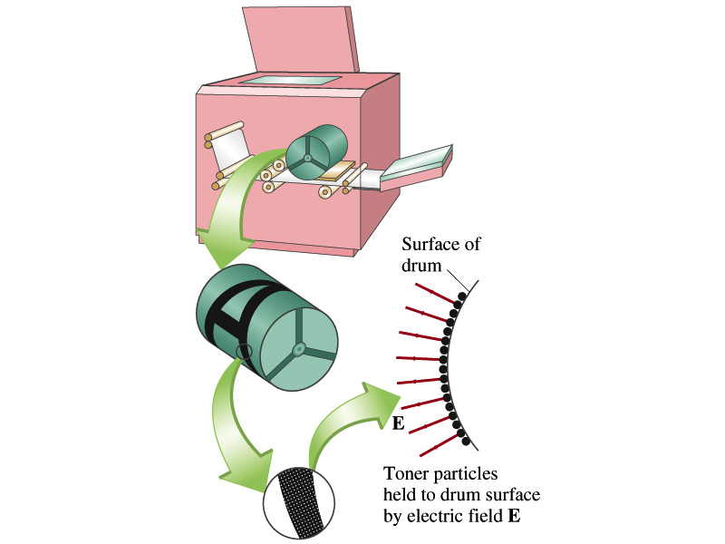
Example 21 – 5
Electrostatic copier. An electrostatic copier works by selectively arranging positive charges (in a pattern to be copied) on the surface of a non-conducting drum, then gently sprinkling negatively charged dry toner (ink) onto the drum. The toner particles temporarily stick to the pattern on the drum and are later transferred to paper and “melted” to produce the copy. Suppose each toner particle has a mass of 9.0x10⁻¹⁶kg and carries the average of 20 extra electrons to provide an electric charge. Assuming that the electric force on a toner particle must exceed twice its weight in order to ensure sufficient attraction, compute the required electric field strength near the surface of the drum.
The electric force must be the same as twice the gravitational force on the toner particle.
So we can write
Thus, the magnitude of the electric field is

