Slide 1
PHYS 1444 – Section 002 Lecture #6
Wednesday, Sept. 11, 2019
Dr. Jaehoon Yu
CH 22
Gauss’ Law
Electric Flux
Gauss’ Law with Multiple Charges
CH 23
Electric Potential Energy
Electric Potential

Slide 2
Announcements
Reading assignments
CH21.11, CH21.12, CH21.13 and CH22.4
1st Term Exam
In class, Wednesday, Sept. 18: DO NOT MISS THE EXAM!
CH1.1 to what we learn on Monday, Sept. 16 + Appendices A1 – A8
You can bring your calculator but it must not have any relevant formula pre-input
BYOF: You may bring a one 8.5x11.5 sheet (front and back) of handwritten formulae and values of constants for the exam
No derivations, word definitions, or solutions of any problems !
No additional formulae or values of constants will be provided!
Colloquium at 4pm today in SH100
Dr. Isaac Rutel of U. of Oklahoma

Slide 4
Reminder: Special Project #2 – Angels & Demons
Compute the total possible energy released from an annihilation of xx-grams of anti-matter and the same quantity of matter, where xx is the last two digits of your SS#. (20 points)
Use the famous Einstein’s formula for mass-energy equivalence
Compute the power output of this annihilation when the energy is released in yy ns, where yy is the first two digits of your SS#. (10 points)
Compute how many cups of gasoline (8MJ) this energy corresponds to. (5 points)
Compute how many months of world electricity usage (3.6GJ/mo) this energy corresponds to. (5 points)
Due at the beginning of the class Monday, Sept. 23

Slide 5
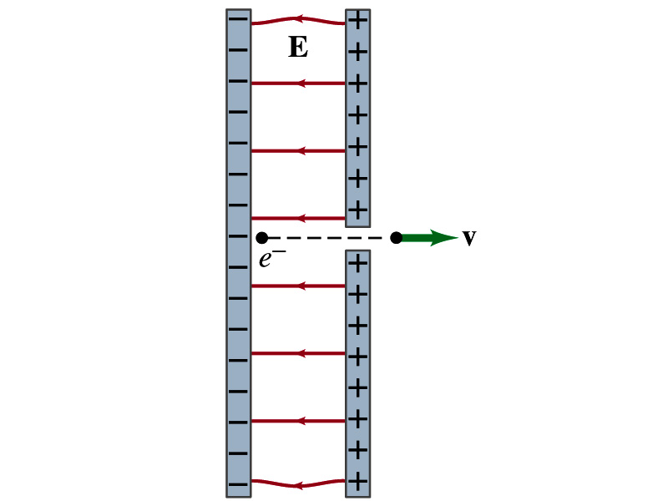
Example 21 – 14
Electron accelerated by electric field. An electron (mass m = 9.1x10⁻³¹kg) is accelerated in a uniform field E (E=2.0x10⁴N/C) between two parallel charged plates. The separation of the plates is 1.5cm. The electron is accelerated from rest near the negative plate and passes through a tiny hole in the positive plate. (a) With what speed does it leave the hole? (b) Show that the gravitational force can be ignored. Assume the hole is so small that it does not affect the uniform field between the plates.
The magnitude of the force on the electron is F=qE and is directed to the right. The equation to solve this problem is
The magnitude of the electron’s acceleration is
Between the plates the field E is uniform, thus the electron undergoes a uniform acceleration

Slide 6
Example 21 – 14
Since the travel distance is 1.5x10⁻²m, using one of the kinetic eq. of motions,
Since there is no electric field outside the conductor, the electron continues moving with this speed after passing through the hole.
(b) Show that the gravitational force can be ignored. Assume the hole is so small that it does not affect the uniform field between the plates.
The magnitude of the electric force on the electron is
The magnitude of the gravitational force on the electron is
Thus the gravitational force on the electron is negligible compared to the electromagnetic force.

Slide 7
Gauss’ Law
Gauss’ law states the relationship between electric charge and the electric field.
More generalized and elegant form of Coulomb’s law.
The electric field by a distribution of charges can be obtained using Coulomb’s law by summing (or integrating) over the charge distributions vectorially.
Gauss’ law, however, gives an additional insight into the nature of the electrostatic field and a more general relationship between the charge and the field

Slide 8
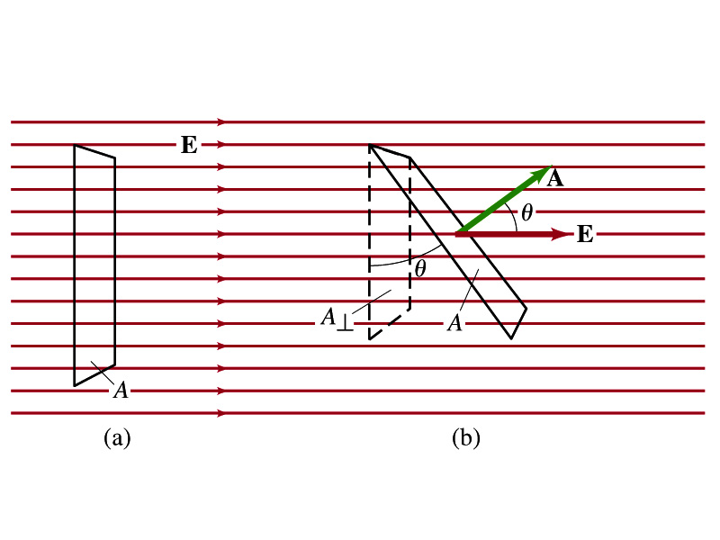
Electric Flux
Let’s imagine a surface of area A through which a uniform electric field E passes
The electric flux Φ_{E} is defined as
Φ_{E}=EA, if the field is perpendicular to the surface
Φ_{E}=EAcosθ, if the field makes an angle θ to the surface
So the electric flux is defined as .
How would you define the electric flux in words?
The total number of field lines passing through the unit area perpendicular to the field.
Unit?

Slide 9
Example 22 – 1
Electric flux. (a) Calculate the electric flux through the rectangle in the figure (a). The rectangle is 10cm by 20cm and the electric field is uniform with magnitude 200N/C. (b) What is the flux in figure if the angle is 30 degrees?
The electric flux is defined as
So when (a) θ=0, we obtain
And when (b) θ=30 degrees, we obtain

Slide 10
A Brain Teaser of Electric Flux
What would change the electric flux through a circle lying in the xz plane where the electric field is (10N/C)j?
Changing the magnitude of the electric field
Changing the surface area of the circle
Tipping the circle so that it is lying in the xy plane
All of the above
None of the above

Slide 11
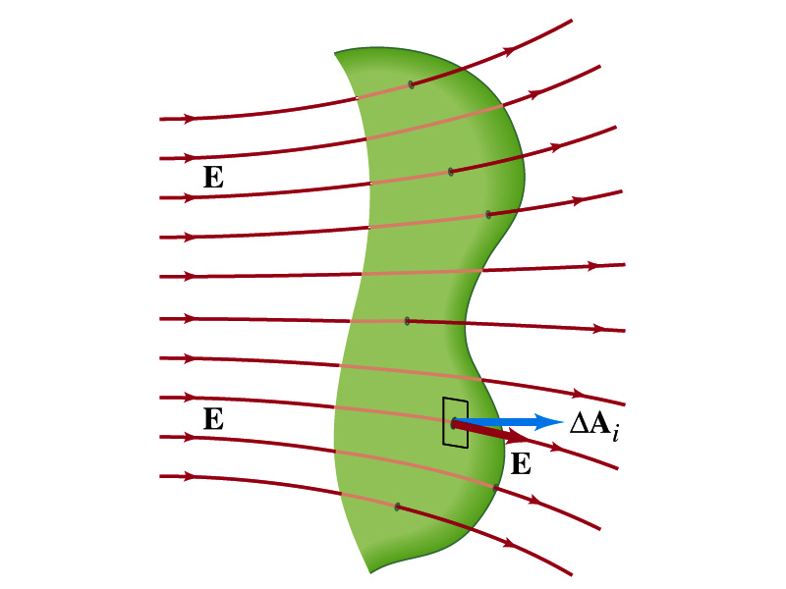
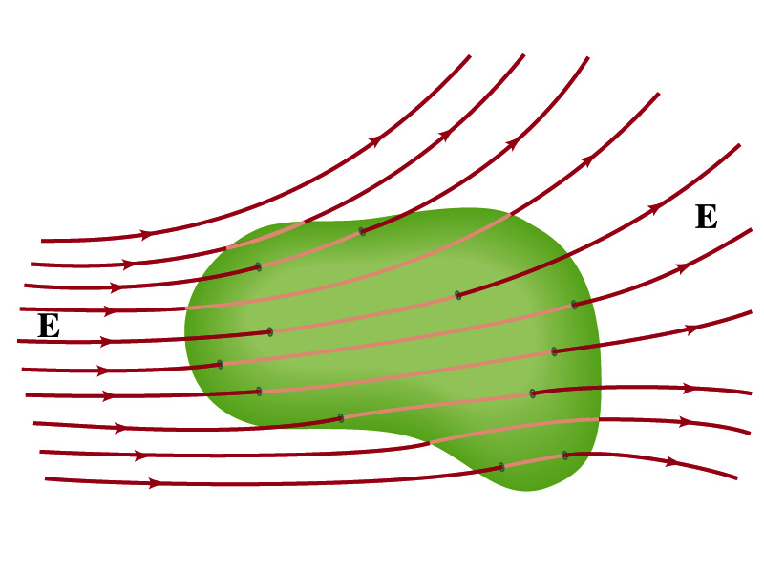
Generalization of the Electric Flux
Let’s consider a surface of area A that is not a square or flat but in some random shape, and that the field is not uniform.
The surface can be divided up into infinitesimally small areas of ΔA_{i} that can be considered flat.
And the electric field through this area can be considered uniform since the area is very small.
Then the electric flux through the entire surface is approximately
In the limit where ΔA_{i} → 0, the discrete summation becomes an integral.
open surface
enclosed surface

Slide 12
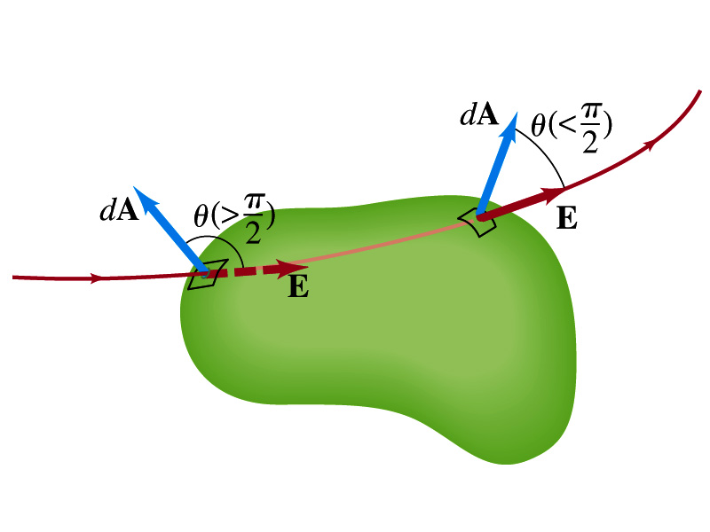
Generalization of the Electric Flux
We arbitrarily define that the area vector points outward from the enclosed volume.
For the line leaving the volume, θ<π/2 and cosθ>0. The flux is positive.
For the line coming into the volume, θ>π/2 and cosθ<0. The flux is negative.
If Φ_{E}>0, there is net flux out of the volume.
If Φ_{E}<0, there is flux into the volume.
In the above figures, each field that enters the volume also leaves the volume, so
The flux is non-zero only if one or more lines start or end inside the surface.

Slide 13
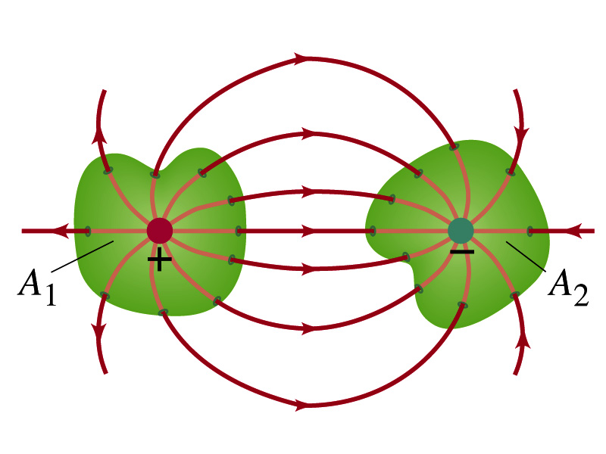
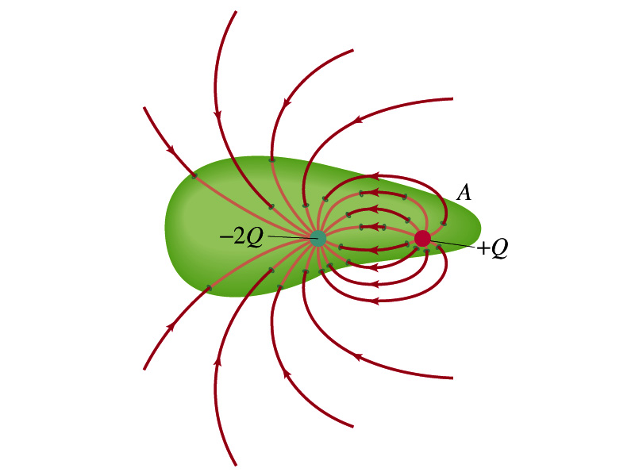
Generalization of the Electric Flux
The field line starts or ends only on a charge.
Sign of the net flux on the surface A₁?
The net outward flux (positive flux)
How about A₂?
Net inward flux (negative flux)
What is the flux in the bottom figure?
There should be a net inward flux (negative flux) since the total charge inside the volume is negative.
The net flux that crosses an enclosed surface is proportional to the total charge inside the surface. ➔ This is the crux of Gauss’ law.

Slide 14
Gauss’ Law
q
q’
Let’s consider the case in the above figure.
What are the results of the closed integral of the Gaussian surfaces A₁ and A₂?
For A₁
For A₂

Slide 15
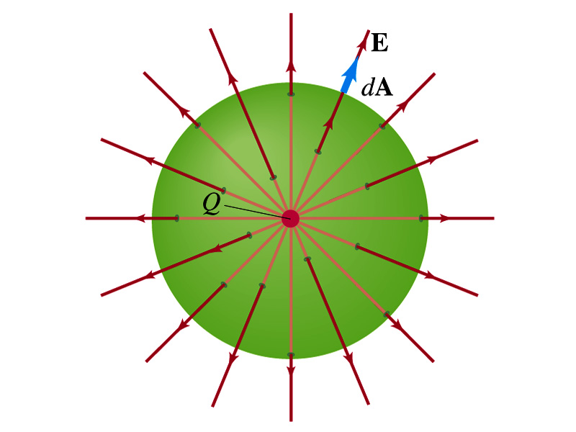
Coulomb’s Law from Gauss’ Law
Let’s consider a charge Q enclosed inside our imaginary Gaussian surface of sphere of radius r.
Since we can choose any surface enclosing the charge, we choose the simplest possible one! ☺
The surface is symmetric about the charge.
What does this tell us about the field E?
Must have the same magnitude (uniform) at any point on the surface
Points radially outward parallel to the surface vector dA.
The Gaussian integral can be written as
Solve
for E
Electric Field of
Coulomb’s Law

Slide 16
Gauss’ Law from Coulomb’s Law
Let’s consider a single static point charge Q surrounded by an imaginary spherical surface.
Coulomb’s law tells us that the electric field at a spherical surface of radius r is
Performing a closed integral over the surface, we obtain
Gauss’ Law

