Slide 1
PHYS 1444 – Section 002
Lecture 9
Wednesday, Sept. 25, 2019
Dr. Jaehoon Yu
CH 23
  Electric Potential due to Point Charges
  Shape of the Electric Potential
  V due to Charge Distributions
  Equi-potential Lines and Surfaces
  Electric Potential Due to Electric Dipole
  Electrostatic Potential Energy

Slide 2
Announcements
Quiz #2
  Next Wednesday, Oct. 2 at the beginning of the class
  Covers CH22.1 through what we cover in class today (CH23.8?)
  Bring your calculator but DO NOT input formula into it!
    Cell phones or any types of computers cannot replace a calculator!
  BYOF: You may bring a one 8.5x11.5 sheet (front and back) of handwritten formulae and values of constants for the quiz
  No derivations, word definitions or solutions of any problems!
  No additional formulae or values of constants will be provided!
Mid-term results
  Class average: 51.7/101
    Equivalent to 51.2/100
  Top score: 94/101
Colloquium today
  Dr. Maura Hagan of Utah State University and a member of US National Academy of Sciences

Slide 3


Slide 4
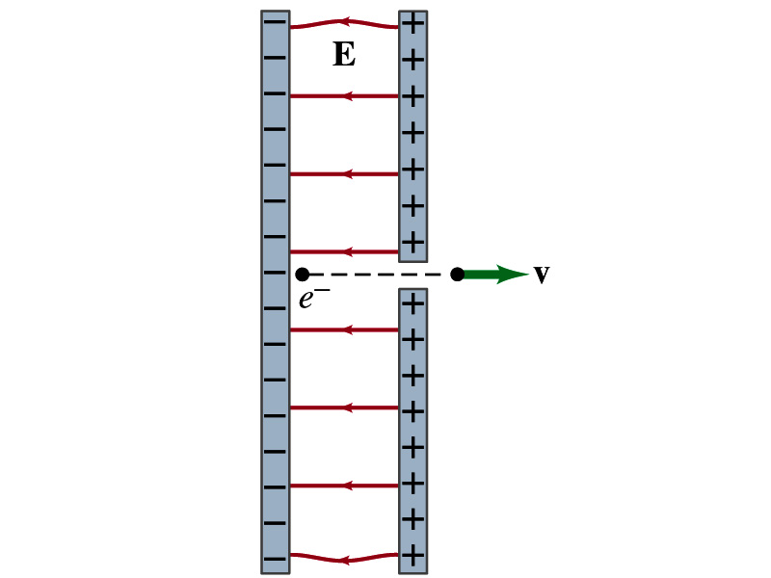
Reminder: Special Project #3
Particle Accelerator. A charged particle of mass M with charge -Q is accelerated in the uniform field E between two parallel charged plates whose separation is D as shown in the figure on the right. The charged particle is accelerated from an initial speed v₀ near the negative plate and passes through a tiny hole in the positive plate.
  Derive the formula for the electric field E to accelerate the charged particle to a fraction f of the speed of light c. Express E in terms of M, Q, D, f, c and v₀.
  (a) Using the Coulomb force and the kinematic equations. (8 points)
  (b) Using the work-kinetic energy theorem. ( 8 points)
  (c) Using the formula above, evaluate the strength of the electric field E to accelerate an electron from 0.1% of the speed of light to 90% of the speed of light. You need to look up and write down the relevant constants, such as mass of the electron, charge of the electron and the speed of light. (5 points)
Must be handwritten and not copied from anyone else!
Due beginning of the class Monday, Sept. 30

Slide 5
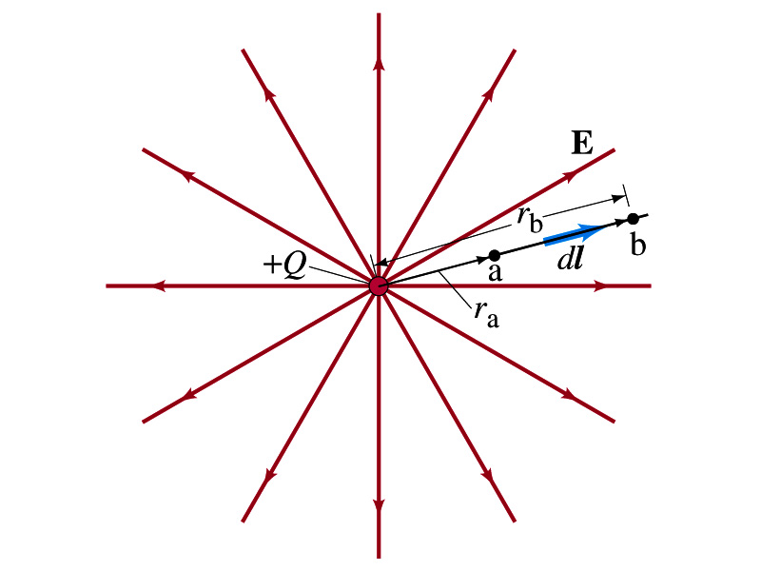
Electric Potential due to Point Charges
What is the electric field by a single point charge Q at a distance r?
Electric potential due to the field E for moving from point r_{a} to r_{b} in the radial direction away from the charge Q is

Slide 6
Electric Potential due to Point Charges
Since only the differences in potential have physical meaning, we can choose at .
The electrical potential V at a distance r from a single point charge Q is
So the absolute potential by a single point charge can be thought of the potential difference by a single point charge between r and infinity

Slide 7
Properties of the Electric Potential
What are the differences between the electric potential and the electric field?
  Electric potential
    Electric potential energy per unit charge
    Inversely proportional to the distance
    Simply add the potential by each of the source charges to obtain the total potential due to multiple charges, since potential is a scalar quantity
  Electric field
    Electric force per unit charge
    Inversely proportional to the square of the distance
    Need vector sums to obtain the total field due to multiple source charges
Potential due to a positive charge is a large positive near the charge and decreases towards 0 at large distance.
Potential due to a negative charge is a large negative near the charge and increases towards 0 at large distance.

Slide 8
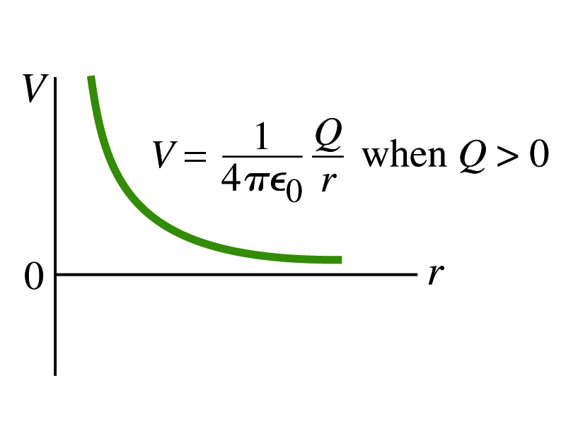
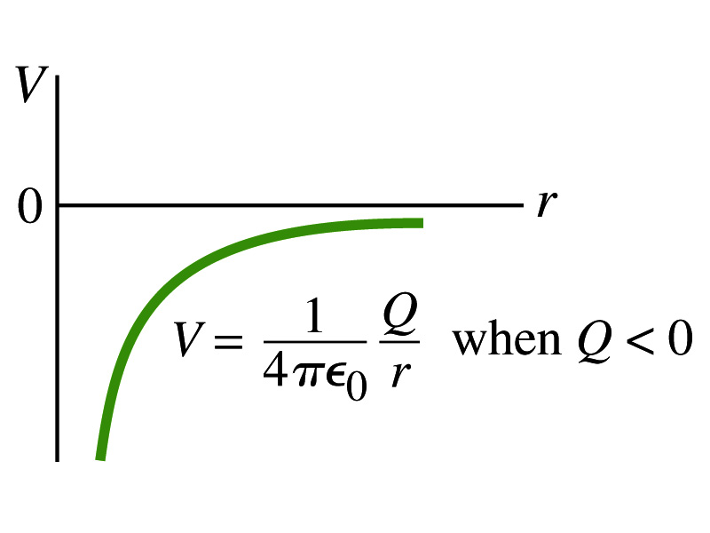
Shape of the Electric Potential
So, what does the electric potential look like as a function of distance?
  What is the formula for the potential by a single charge again?
Positive Charge
Negative Charge
Uniformly charged sphere would have the potential the same as a single point charge.
What does this mean?
Uniformly charged sphere behaves like all the charge is on the single point in the center.

Slide 9
Example 23 – 6
Work to bring two positive charges close together: What is minimum work required by an external force to bring the charge q=3.00μC from a great distance away (r=∞) to a point 0.500m from a charge Q=20.0 μC?
What is the work done by the electric field in terms of potential energy and potential?
Since we obtain
Electric force does negative work. In other words, an external force must do +1.08J of work to bring the 3.00μC charge from infinity to 0.500m to the charge 20.0μC.

Slide 10
Electric Potential by Charge Distributions
Let’s consider a case of n individual point charges in a given space, and let V=0 at r=∞.
Then the potential V_{ia} due to the charge Q_{i} at point a, distance r_{ia} from Q_{i} is
Thus the total potential V_{a} by all n point charges is
For a continuous charge distribution, we obtain

Slide 11
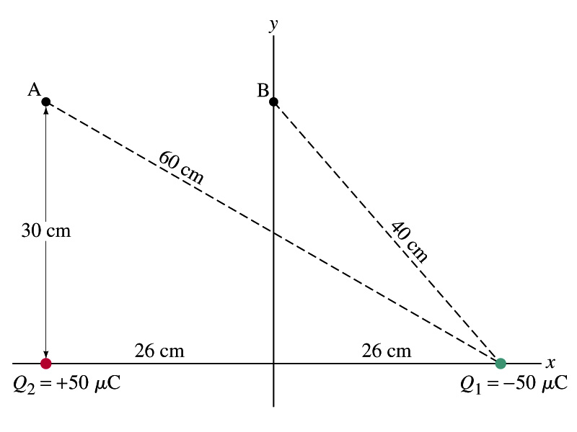
Example
Potential due to two charges: Calculate the electric potential (a) at point A in the figure due to the two charges shown, and (b) at point B.
Electric potential is a scalar quantity, so one adds the potential by each of the source charge, as if they are numbers.
(a) potential at A is
(b) How about potential at B?

Slide 12
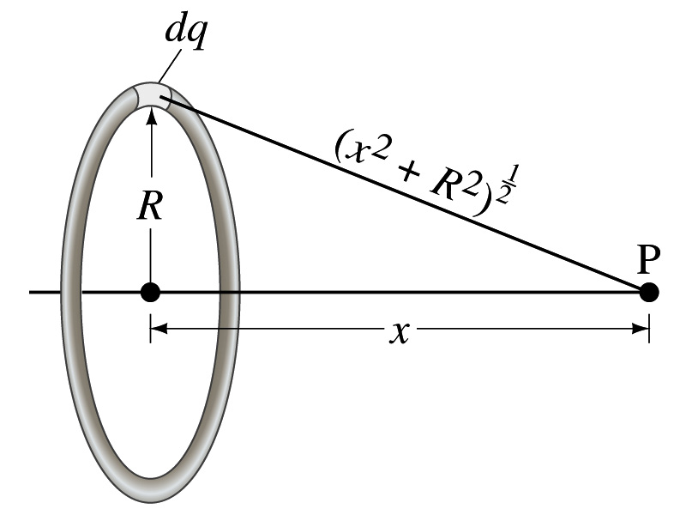
Example 23 – 8
Potential due to a ring of charge: A thin circular ring of radius R carries a uniformly distributed charge Q. Determine the electric potential at a point P on the axis of the ring at distance x from its center.
Each point on the ring is at the same distance from the point P. What is the distance?
So the potential at P is
What’s this?

Slide 13
Equi-potential Surfaces
Electric potential can be graphically shown using the equipotential lines in 2-D or the equipotential surfaces in 3-D
Any two points on the equipotential surfaces (lines) are at the same potential
What does this mean in terms of the potential difference?
  The potential difference between any two points on an equipotential surface is 0.
How about the potential energy difference?
  Also 0.
What does this mean in terms of the work to move a charge along the surface between these two points?
  No work is necessary to move a charge between these two points.

Slide 14
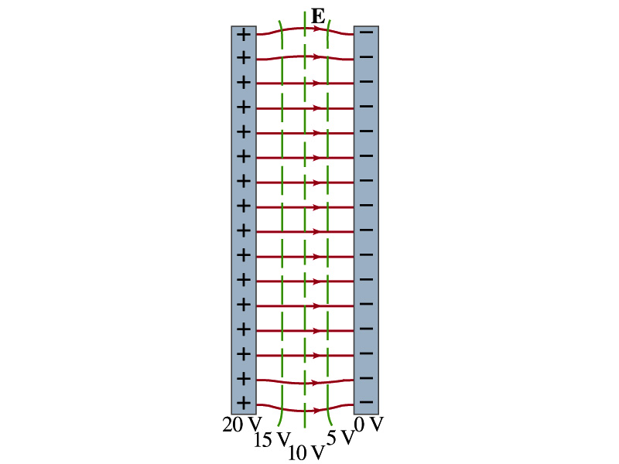
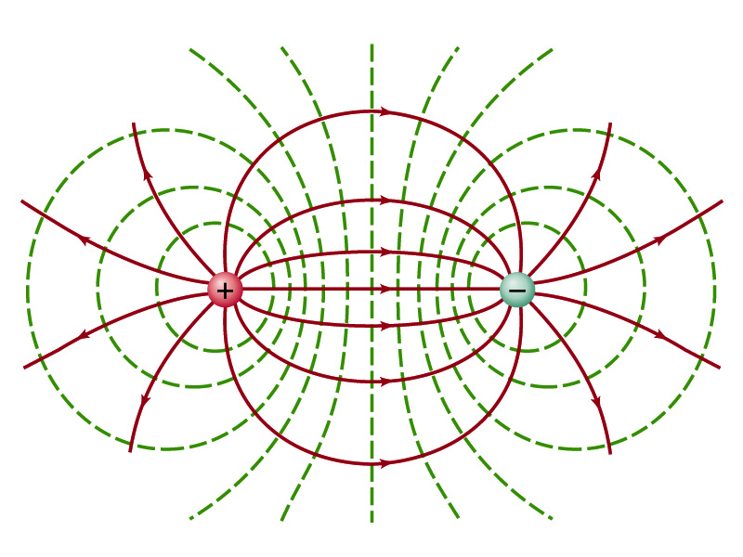

Equi-potential Surfaces
An equipotential surface (line) must be perpendicular to the electric field. Why?
  If there are any parallel components to the electric field, it would require work to move a charge along the surface.
Since the equipotential surface (line) is perpendicular to the electric field, we can draw these surfaces or lines easily.
Since there can be no electric field within a conductor in a static case, the entire volume of a solid conductor must be at the same potential.
So the electric field must be perpendicular to the conductor surface.
Parallel Plate
Point charges
Just like a topological map

Slide 15
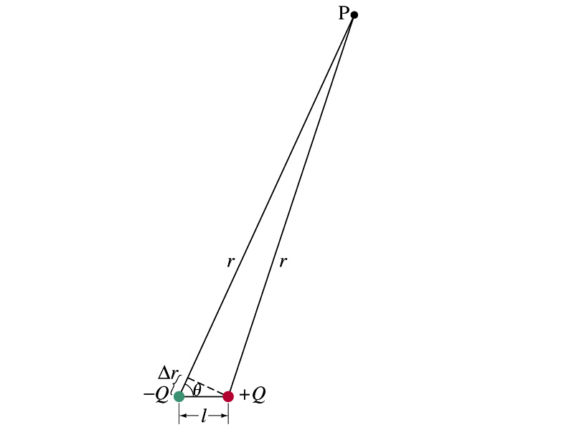
Electric Potential due to Electric Dipoles
What is an electric dipole?
  Two equal point charge Q of opposite signs separated by a distance l and behaves like one entity: p=Ql
For the electric potential due to a dipole at a point P
  We take V=0 at r=∞
The simple sum of the potential at P by the two charges is
Since Δr=lcosθ and if r>>l, r>>Δr, thus r~r+Δr and
V by a dipole at a
distance r from
the dipole

Slide 16
E Determined from V
Potential difference between two points under an electric field is
So in a differential form, we can write
  What are dV and E_{l}?
    dV is the infinitesimal potential difference between the two points separated by a distance dl
    E_{l} is the field component along the direction of dl.
Thus we can write the field component E_{l} as
The component of the electric field in any direction is equal to the negative rate of change of the electric potential as a function of distance in that direction.!!
Physical Meaning?

Slide 17
E Determined from V
The quantity dV/dl is called the gradient of V in a particular direction
  If no direction is specified, the term gradient refers to the direction on which V changes most rapidly and this would be the direction of the field vector E at that point.
  So if E and dl are parallel to each other,
If E is written as a function x, y and z, the l refers to x, y and z
is the “partial derivative” of V with respect to x, while y and z are held constant
In vector form,
is called del or the gradient operator and is a vector operator.

Slide 18
Electrostatic Potential Energy
Consider a case in which a point charge q is moved between points a and b where the electrostatic potential due to other charges in the system is V_{a} and V_{b}
The change in electrostatic potential energy of q in the field by other charges is
Now what is the electrostatic potential energy of a system of charges?
  Let’s choose V=0 at r=∞
  If there are no other charges around, single point charge Q₁ in isolation has no potential energy and is under no electric force

Slide 19
Electrostatic Potential Energy; Two charges
If a second point charge Q₂ is brought close to Q₁ at a distance r₁₂, the potential due to Q₁ at the position of Q₂ is
The potential energy of the two charges relative to V=0 at r= ∞ is
  This is the work that needs to be done by an external force to bring Q₂ from infinity to the distance r₁₂ from Q₁.
  It is also a negative of the work needed to separate them to infinity.

Slide 20
Electrostatic Potential Energy; Three Charges
So what do we do for three charges?
Work is needed to bring all three charges together
  Work needed to bring Q₁ to a certain location without the presence of any charge is 0.
  Work needed to bring Q₂ to a distance to Q₁ is
  Work need to bring Q₃ to certain distances to Q₁ and Q₂ is
So the total electrostatic potential energy of the three charge system is
  What about a four charge system or N charge system?

Slide 21
Electrostatic Potential Energy: electron Volt
What is the unit of electrostatic potential energy?
  Joules
Joules is a very large unit in dealing with electrons, atoms or molecules atomic scale problems
For convenience a new unit, electron volt (eV), is defined
  1 eV is defined as the energy acquired by a particle carrying the magnitude of the charge equal to that of an electron (q=e) when it moves across a potential difference of 1V.
  How many Joules is 1 eV then?
eV however is NOT a standard SI unit. You must convert the energy to Joules for computations.
What is the speed of an electron with kinetic energy 5000eV?

