Slide 1
PHYS 1444 – Section 002 Lecture 11
Wednesday, Oct. 2, 2019
Dr. Jaehoon Yu
CH 24
Capacitors in Series or Parallel
Electric Energy Storage
Effect of Dielectric
Molecular description of Dielectric Material
CH 25
Electric Current and Resistance

Slide 2
Announcements
Mid-term exam
Wednesday, Oct. 16 at the beginning of the class
Comprehensive exam which covers CH21.1 through what we cover in class Monday, Oct. 14 + the math refresher in A1 – A8
Bring your calculator but DO NOT input formula into it!
Cell phones or any types of computers cannot replace a calculator!
BYOF: You may bring a one 8.5x11.5 sheet (front and back) of handwritten formulae and values of constants for the quiz
No derivations, word definitions, set ups or solutions of any problems!
No additional formulae or values of constants will be provided!
Reading assignment: CH24.6
Colloquium today
Dr. A. Zimmermann of U.T. Austin

Slide 4
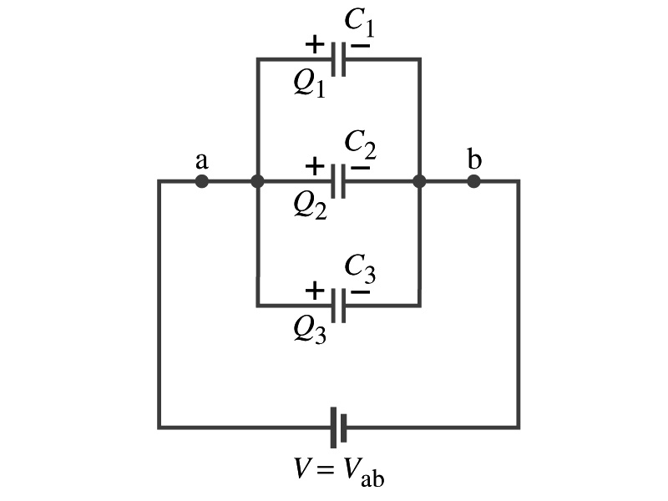
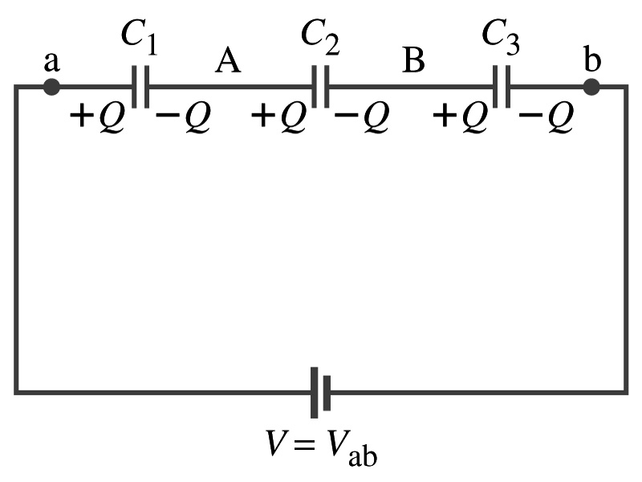
Capacitors in Series or Parallel
Capacitors may be used in electric circuits
What is an electric circuit?
A closed path of conductors, usually wires connecting capacitors and other electrical devices, in which
charges can flow
And includes a voltage source such as a battery
Capacitors can be connected in various ways.
In parallel, in series or in combination

Slide 5
Capacitors in Parallel
Parallel arrangement provides the same voltage across all the capacitors.
Left hand plates are at V_{a} and the right hand plates are at V_{b}
So each capacitor plate acquires charges given by the formula
Q₁=C₁V, Q₂=C₂V, and Q₃=C₃V
The total charge Q that must leave the battery is then
Q=Q₁+Q₂+Q₃=V(C₁+C₂+C₃)
Consider that the three capacitors behave like an equivalent one
Q=C_{eq}V= V(C₁+C₂+C₃)
Thus the equivalent capacitance in parallel is
What is the net effect?
The capacitance increases!!!

Slide 6
Capacitors in Series
Series arrangement is more interesting
When battery is connected, +Q flows to the left plate of C₁ and –Q flows to the right plate of C₃.
Since capacitors in between were originally neutral, charges get induced to neutralize the ones in the middle.
So the charge on each capacitor plate is the same value, Q. (Same charge)
Consider that the three capacitors behave like an equivalent one
Q=C_{eq}V
The total voltage V across the three capacitors in series must be equal to the sum of the voltages across each capacitor.
V=V₁+V₂+V₃=Q/C₁+Q/C₂+Q/C₃
Putting all these together, we obtain:
V=Q/C_{eq}=Q(1/C₁+1/C₂+1/C₃)
Thus the equivalent capacitance is
What is the net effect?
The capacitance smaller than the smallest C!!!

Slide 7
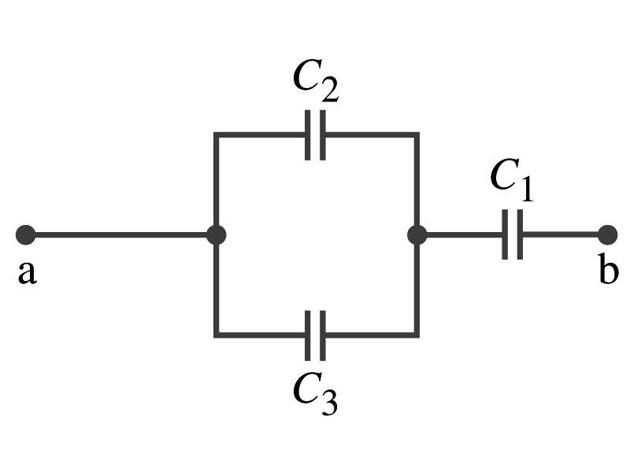
Example 24 – 5
Equivalent Capacitor: Determine the capacitance of a single capacitor that will have the same effect as the combination shown in the figure. Take C₁=C₂=C₃=C.
We should do these first!!
How?
These are in parallel so the equivalent capacitance is:
Now the equivalent capacitor is in series with C1.
Solve for C_{eq}

Slide 8
Electric Energy Storage
A charged capacitor stores energy.
The stored energy is the amount of the work done to charge it.
The net effect of charging a capacitor is removing one type of charge from one plate and put them on to the other.
Battery does this when it is connected to a capacitor.
Capacitors do not get charged immediately.
Initially when the capacitor is uncharged, no work is necessary to move the first bit of charge. Why?
Since there is no charge, there is no field that the external force needs to work to overcome.
When some charge is on each plate, it requires work to add more charges of the same sign due to the electric repulsion.

Slide 9
Electric Energy Storage
The work needed to add a small amount of charge, dq, when a potential difference across the plate is V: dW=Vdq.
Since V=q/C, the work needed to store total charge Q is
Thus, the energy stored in a capacitor when the capacitor carries the charges +Q and –Q is
Since Q=CV, we can rewrite

Slide 10
Example 24 – 8
Energy store in a capacitor: A camera flash unit stores energy in a 150μF capacitor at 200V. How much electric energy can be stored?
Using the formula for stored energy.
Umm.. Which one?
What do we know from the problem?
C and V
So we use the one with C and V:
How do we get J from FV²?

Slide 11
Electric Energy Density
The energy stored in a capacitor can be considered as being stored in the electric field between the two plates
For a uniform field E between two plates, V=Ed and C=ε₀A/d
Thus the stored energy is
Since Ad is the gap volume V, we can obtain the energy density, stored energy per unit volume, as
Valid for any space that is vacuum
Electric energy stored per unit volume in any region of space is proportional to the square of E in that region.

Slide 12
Dielectrics
Capacitors have an insulating sheet of material, called dielectric, between the plates to
Increase breakdown voltage greater than that in air (3MV/m)
Apply higher voltage to the gap without the charge passing across
Allow the plates get closer together without touching
Increases capacitance ( recall C=ε₀A/d)
Increase the capacitance by the dielectric constant
Where C₀ is the intrinsic capacitance when the gap is vacuum

Slide 13
Dielectrics
The value of dielectric constant K varies depending on the material (Table 24 – 1)
K for vacuum is 1.0000
K for air is 1.0006 (this is why permittivity of air and vacuum are used interchangeably.)
K for paper is 3.7
The maximum electric field before breakdown occurs is called the dielectric strength. What is its unit?
V/m
The capacitance of a parallel plate capacitor with a dielectric (K) filling the gap is

Slide 14
Dielectrics
A new quantity of the permittivity of a dielectric material is defined as ε=Kε₀
The capacitance of a parallel plate capacitor with a dielectric medium filling the gap is
The energy density stored in an electric field E in a dielectric is
Valid for any space w/ dielectric w/ permittivity ε.
What is the stored energy in between ProtoDUNE cathode (-300kV) plate (6mx6m) and the cryostat wall (0V), d=1.5m, LAr K=1.6?

Slide 15
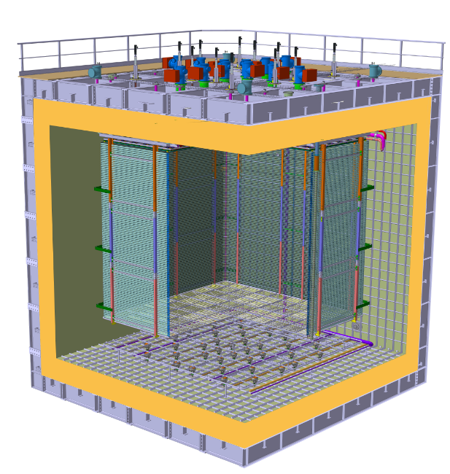
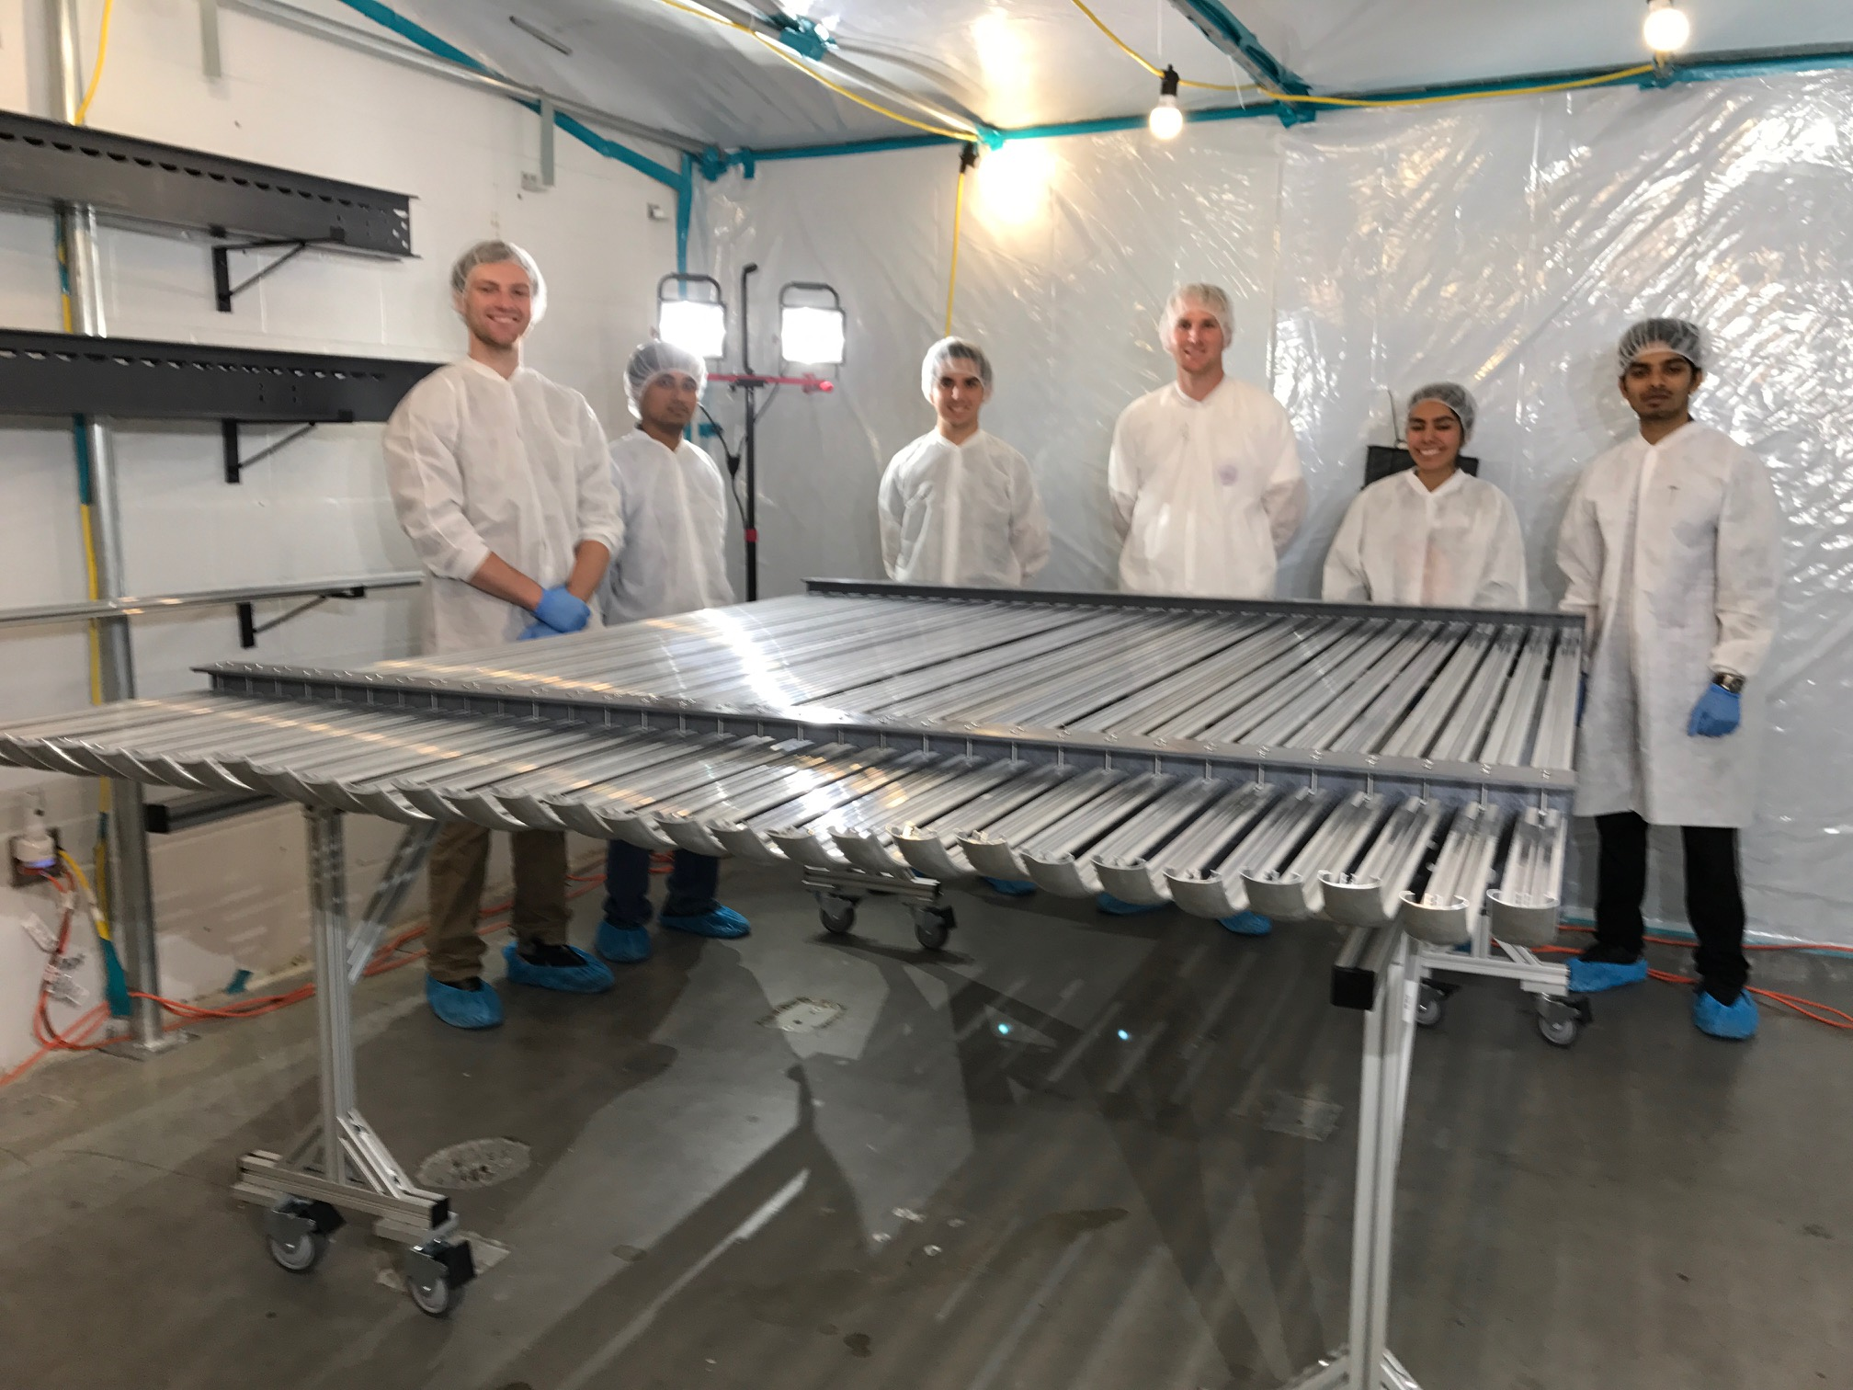
ProtoDUNE Dual Phase
Field Cage and cathode hangs off of the ceiling
Essential to have light yet sturdy structure
Based on modular concept as SP
Charge Readout Planes
6 m
Field Cage (common structural elements with SP)
1.5 m
Cathode
6 m

Slide 16
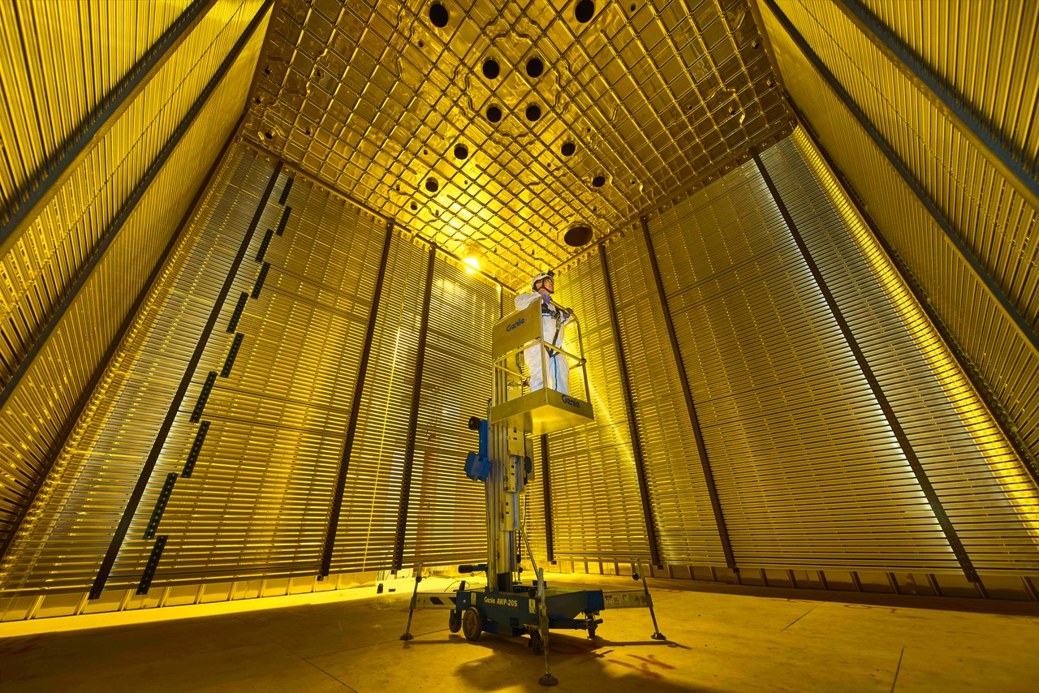
6m
6m
April 26, 2019

Slide 17
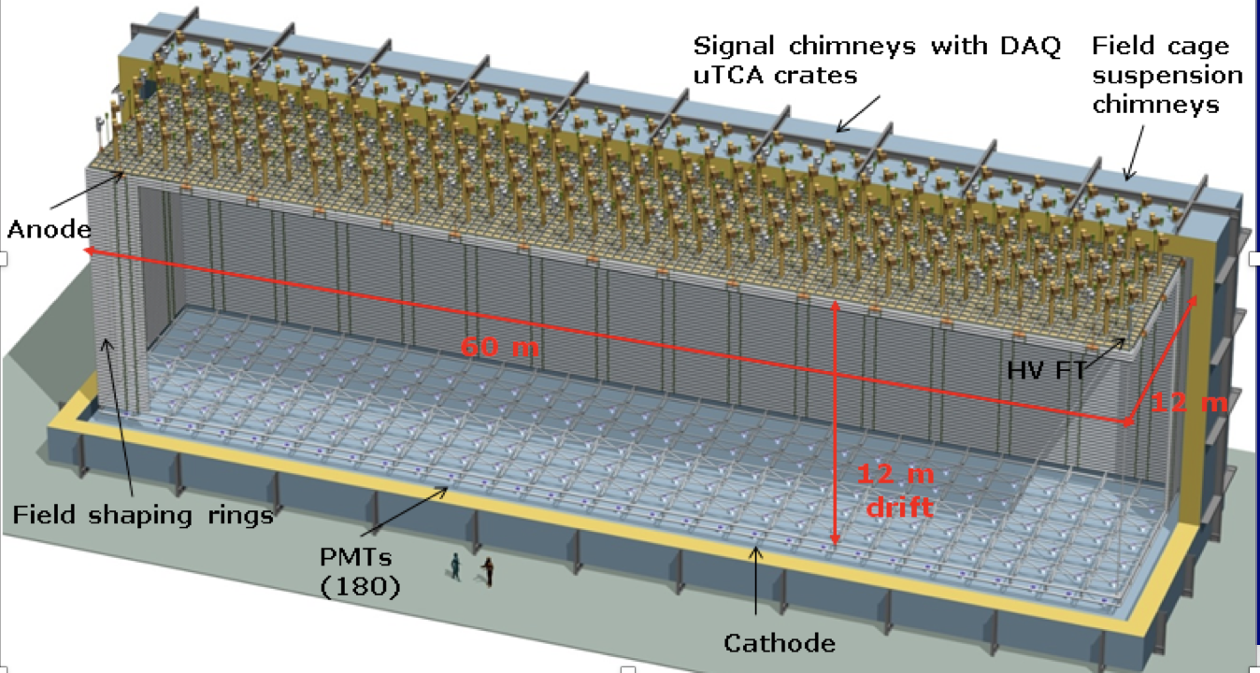
DUNE Dual Phase
Cathode

