Slide 1
PHYS 1444 – Section 002
Lecture 13
Wednesday, Oct. 9, 2019
Dr. Jaehoon Yu
CH 25
  Ohm’s Law: Resisters, Resistivity
  Electric Power
  Alternating Current
  Microscopic View of Electric Current
  Ohm’s Law in Microscopic View
  EMF and Terminal Voltage

Slide 2
Announcements
Reading Assignments: CH25.9 and 25.10
Mid-term exam
  Wednesday, Oct. 16 at the beginning of the class
  Comprehensive exam which covers CH21.1 through what we cover in class Monday, Oct. 14 + the math refresher in A1 – A8
  Bring your calculator but DO NOT input formula into it!
    Cell phones or any types of computers cannot replace a calculator!
  BYOF: You may bring a one 8.5x11.5 sheet (front and back) of handwritten formulae and values of constants for the quiz
  No derivations, word definitions, set ups or solutions of any problems!
  No additional formulae or values of constants will be provided!
Mid-term grade discussions
  From 12:00 – 2:30pm, Wednesday, Oct. 24 in my office (CPB342)
  Last name starts with A – D (12 – 12:30), E– K (12:30 – 1), L – O (1 – 1:30), P – S (1:30 – 2:00), T – Z (2-2:30)
Quiz 2 results
  Class average: 27.4/60 equivalent to 45.7/100; previous result: 56.4/100; Class top: 59/60
Colloquium at 4pm today: Dr. P. Jena of Virginia Commonwealth Univ.

Slide 3


Slide 4
Special Extra Credit #4
Civic Duty Participation Exercise
You can submit up to four “I Voted” stickers for 20 points total
Be sure to tape one side of the stickers on a sheet of paper with your name on it along with the following info for each sticker
  The number and the name of the precinct the vote was cast
  The full name of the person voted next to the relevant sticker
  The signature of the person voted next to the full name
None of the stickers can be from the same person on someone else’s extra credit or yours
Deadline: Beginning of the class Wednesday, Nov. 6

Slide 6
Direction of the Electric Current
What do conductors have in abundance?
  Free electrons
What happens if a continuous loop of conducting wire is connected to the terminals of a battery?
  Electrons start flowing through the wire continuously as soon as both the terminals are connected to the wire. Why?
    The potential difference between the battery terminals sets up an electric field inside the wire and in the direction parallel to the field
    Free electrons in the conducting wire get attracted to the positive terminal
    The electrons leaving negative terminal flow through the wire and arrive at the positive terminal
      Electrons flow from negative to positive terminal
  Due to historical convention, the direction of the current is opposite to the direction of flow of electrons ➔ Conventional Current

Slide 7
Ohm’s Law: Resistance and Resistors
What do we need to produce electric current?
  Potential difference
Georg S. Ohm experimentally established that the current is proportional to the potential difference ( )
  If we connect a wire to a 12V battery, the current flowing through the wire is twice that of 6V, three times that of 4V and four times that of 3V battery.
  What happens if we reverse the sign of the voltage?
    It changes the direction of the current flow
    Does not change the magnitude of the current
  Just as in water flow case, if the height difference is large the flow rate is large ➔ If the potential difference is large, the current is large.

Slide 8
Ohm’s Law: Resistance
The exact amount of the current flow in a wire depends on
  The voltage
  The resistance of the wire to the flow of electrons
    Just like the gunk in water pipe slows down water flow
    Electrons are slowed down due to interactions with the atoms of the wire
The higher the resistance, the less the current for the given potential difference V
  So how would you define resistance?
    Such that current is inversely proportional to the resistance
  Often it is rewritten as
  What does this mean?
    The metal conductor’s resistance R is a constant independent of V.
  This linear relationship is not valid for some materials like diodes, vacuum tubes, transistors etc. ➔ These are called non-ohmic
Unit?
Ohm’s Law
ohms

Slide 9
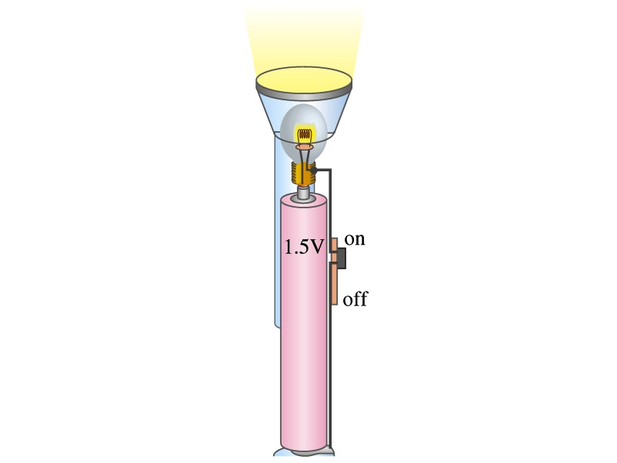
Example 25 – 4
Flashlight bulb resistance: A small flashlight bulb draws 300mA from its 1.5V battery. (a) What is the resistance of the bulb? (b) If the voltage drops to 1.2V, how would the current change?
From Ohm’s law, we obtain
Would the current increase or decrease, if the voltage reduces to 1.2V?
If the resistance did not change, the current is

Slide 10
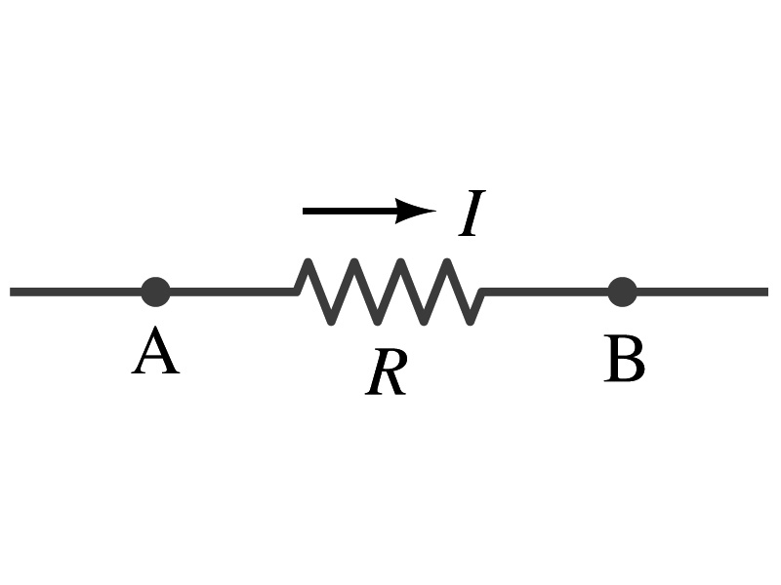
Ohm’s Law: Resistors
All electric devices offer resistance to the flow of current.
  Filaments of light bulbs or heaters are wires with high resistance to cause electrons to lose their energy in the wire
  In general connecting wires have lower resistance compared to other devices in the circuit
In circuits, resistors are used to control the amount of current
  Resistors offer resistance of less than one ohm to millions of ohms
  Main types are
    “wire-wound” resistors which consists of a coil of fine wire
    “composition” resistors which are usually made of semiconductor carbon
    thin metal films
When drawn in the circuit, the symbol for a resistor is:
Wires are drawn simply as straight lines

Slide 11
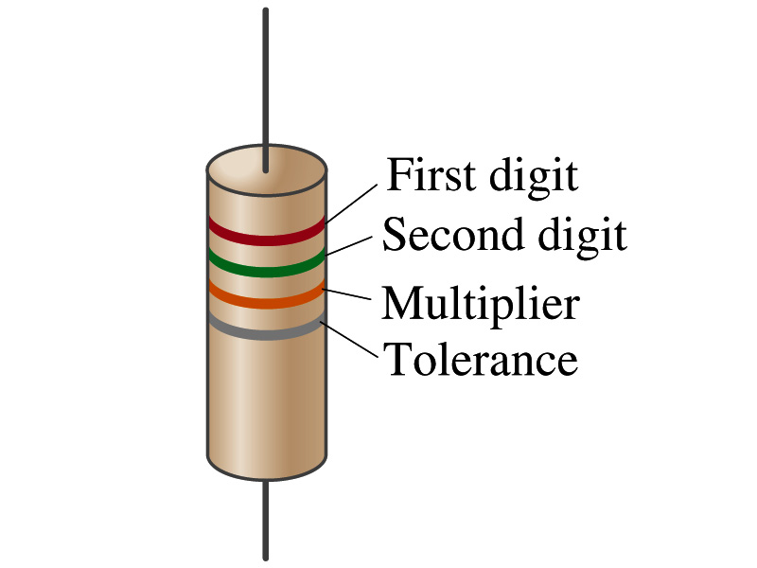
Ohm’s Law: Resistor Values
Resistors have its resistance color-coded on its body
The color-coding follows the convention below:
Color | Number | Multiplier | Tolerance
Black | 0 | 1=10⁰
Brown | 1 | 10¹
Red | 2 | 10²
Orange | 3 | 10³
Yellow | 4 | 10⁴
Green | 5 | 10⁵
Blue | 6 | 10⁶
Violet | 7 | 10⁷
Gray | 8 | 10⁸
White | 9 | 10⁹
Gold |  | 10-¹ | 5%
Silver |  | 10⁻² | 10%
None |  |  | 20%
What is the resistance of the resistor in this figure?

Slide 12
Resistivity
It is experimentally found that the resistance R of a metal wire is directly proportional to its length l and inversely proportional to its cross-sectional area A
  How would you formularize this?
  The proportionality constant ρ is called the resistivity and depends on the material used. What is the unit of this constant?
    ohm-m or Ω−m
    The values depends on purity, heat treatment, temperature, etc
  How does the resistance change depending on the resistivity?
    The higher the resistivity the higher the resistance
    The lower the resistivity the lower the resistance and the higher the conductivity ➔ Silver has the lowest resistivity.
      So silver is the best conductor
  The reciprocal of the resistivity is called conductivity, σ,
A
l

Slide 13
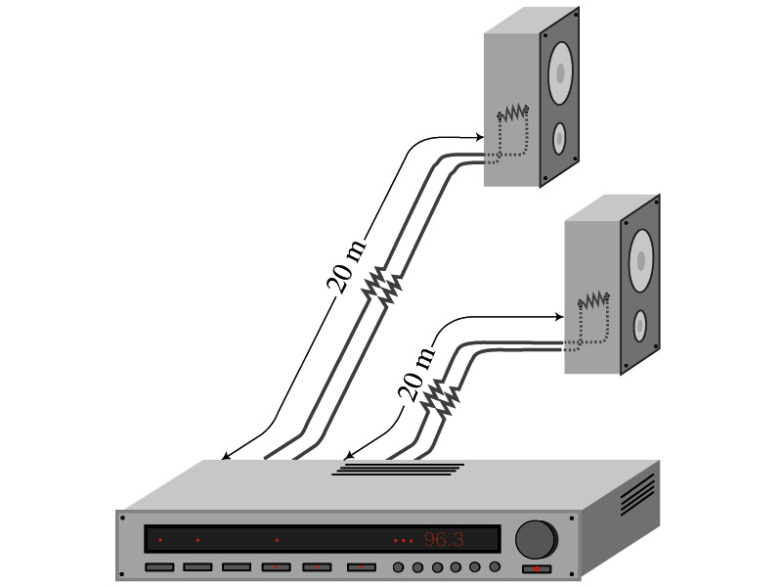
Example 25 – 5
Speaker wires: Suppose you want to connect your stereo to remote speakers. (a) If each wire must be 20m long, what diameter copper wire should you use to keep the resistance less than 0.1-Ω per wire? (b) If the current on each speaker is 4.0A, what is the voltage drop across each wire?
The resistivity of a copper is
Table 25.1
From the formula for resistance, we can obtain the formula for area
Solve for A
Solve for d
From Ohm’s law, V=IR, we obtain

Slide 14
Example 25 – 6
Stretching changes resistance: A wire of resistance R is stretched uniformly until it is twice its original length. What happens to its resistance?
What is the constant quantity in this problem?
The volume!
What is the volume of a cylinder of length L and radius r?
What happens to A if L increases factor two, L’=2L?
The cross-sectional area, A, halves. A’=A/2
The original resistance is
The new resistance is
The resistance of the wire increases by a factor of four if the length increases twice.

Slide 15
Temperature Dependence of Resistivity
Do you think the resistivity depends on temperature?
  Yes
Would it increase or decrease with the temperature?
  Increase
  Why?
  Because the atoms are vibrating more rapidly as temperature increases and are arranged in a less orderly fashion. So?
    They might interfere more with the flow of electrons.
If the temperature change is not too large, the resistivity of metals usually increase nearly linearly with temperature
  α is the temperature coefficient of resistivity
  α of some semiconductors can be negative due to increased number of freed electrons.

Slide 16
Electric Power
Why is the electric energy useful?
  It can transform into different forms of energy easily.
    Motors, pumps, etc, transform electric energy to mechanical energy
    Heaters, dryers, cook-tops, etc, transforms electricity to thermal energy
    Light bulb filament transforms electric energy to light energy
      Only about 10% of the energy turns to light and the 90% lost via heat
      Typical household light bulb and heating elements have resistance of order a few ohms to a few hundred ohms
How does the electric energy transforms to thermal energy?
  Flowing electrons collide with the vibrating atoms of the wire.
  In each collision, part of electron’s kinetic energy is transferred to the atom it collides
  KE of wire’s bound atoms increases, and thus the temperature of the wire increases.
  The increased thermal energy can be transferred as heat through conduction and convection to the air in a heater or to food on a pan, through radiation to bread in a toaster or radiated as light.

Slide 17
Electric Power
How do we find out the power transformed by an electric device?
  What is definition of the power?
    The rate at which work is done or the energy is transformed
What is the energy transformed when an infinitesimal charge dq moves through a potential difference V?
  dU=Vdq
  If dt is the time required for an amount of charge dq to move through the fixed potential difference V, the power P is
  Thus, we obtain .
  What is the unit?
  What kind of quantity is the electrical power?
    Scalar
  P=IV can apply to any devices while the formula with resistance can only apply to devices that has resistance.
What is this?
In terms of resistance
Watts = J/s

Slide 18
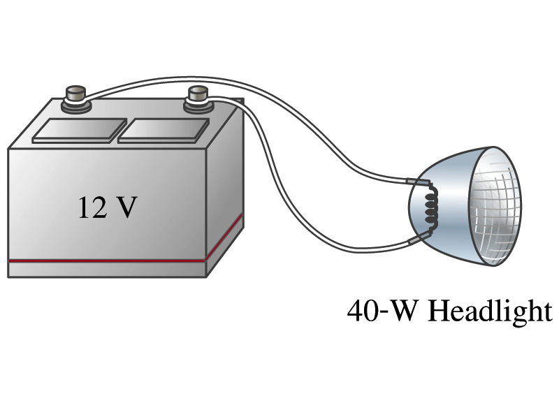
Example 25 – 8
Headlights: Calculate the resistance of a 40-W automobile headlight designed for 12V.
Since the power is 40W and the voltage is 12V, we use the formula with V and R.
Solve for R
What is the resistance of the filament of a 60W bulb?
A 60W equivalent LED bulb draws 9.5W power. What is its resistance?
A 100W equivalent LED bulb draws 17.5W power. What is its resistance?

