Slide 1
PHYS 1444 – Section 002 Lecture 14
Monday, Oct. 14, 2019
Dr. Jaehoon Yu
CH 25
Electric Power
Alternating Current
Microscopic View of Electric Current
Ohm’s Law in Microscopic View
CH 26
EMF and Terminal Voltage
Resistors in Series and Parallel

Slide 2
Announcements
Reading Assignments: CH25.9 and 25.10
Mid-term exam
This Wednesday, Oct. 16 in class
Comprehensive exam which covers CH21.1 through what we cover in class today (CH26.1?) + the math refresher in A1 – A8
Bring your calculator but DO NOT input formula into it!
Cell phones or any types of computers cannot replace a calculator!
BYOF: You may bring a one 8.5x11.5 sheet (front and back) of handwritten formulae and values of constants for the quiz
No derivations, word definitions, set ups or solutions of any problems!
No additional formulae or values of constants will be provided!
Mid-term grade discussions
From 12:00 – 2:30pm, Wednesday, Oct. 24 in my office (CPB342)
Last name starts with A – D (12 – 12:30), E– K (12:30 – 1), L – O (1 – 1:30), P – S (1:30 – 2:00), T – Z (2-2:30)
Suspension of Colloquium extra credit until further notice, except for
The two triple extra credit ones on Oct. 30 and Nov. 13 still valid. Will have a special sign-in sheet.
You are welcomed and encouraged to attend the seminar

Slide 3
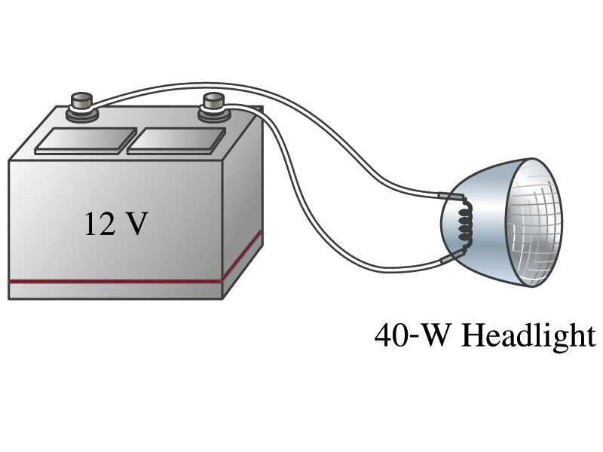
Example 25 – 8
Headlights: Calculate the resistance of a 40-W automobile headlight designed for 12V.
Since the power is 40W and the voltage is 12V, we use the formula with V and R.
Solve for R
What is the resistance of the filament of a 60W bulb?
A 60W equivalent LED bulb draws 9.5W power. What is its resistance?
A 100W equivalent LED bulb draws 17.5W power. What is its resistance?

Slide 4
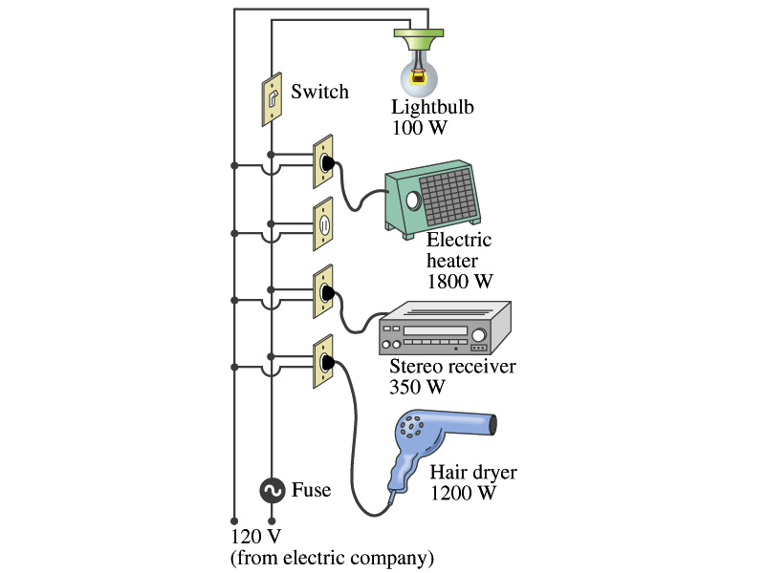
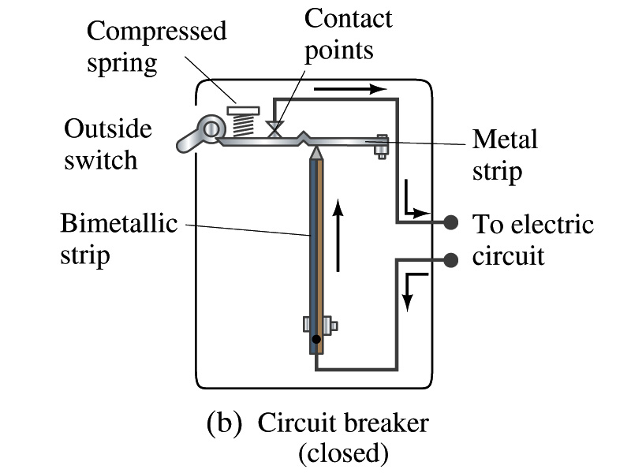
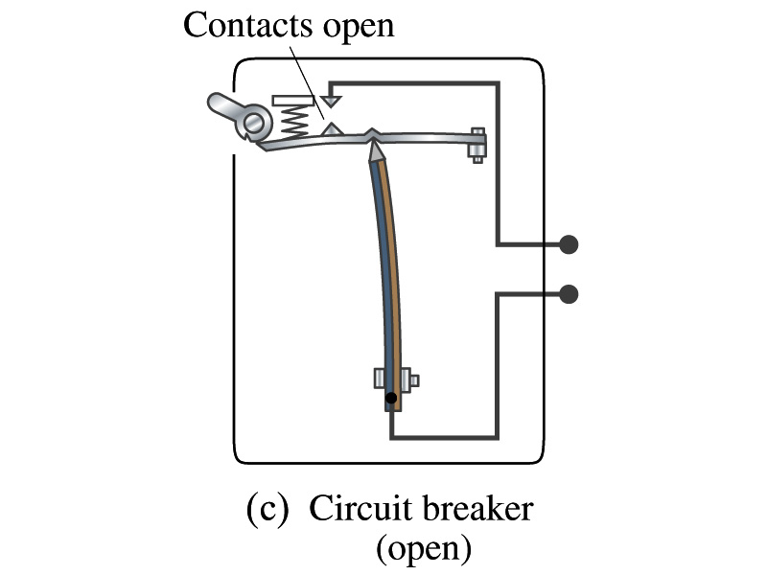
Power in Household Circuits
Household devices usually have small resistance
But since they draw current, if they become large enough, wires can heat up (overloaded)
Why is using thicker wires safer?
Thicker wires has less resistance, lower heat
Overloaded wire can set off a fire at home
How do we prevent this?
Put in a switch that would disconnect the circuit when overloaded
Fuse or circuit breakers
They open up the circuit when the current is over certain value
Overload

Slide 5
Example 25 – 11
Will a fuse blow?: Determine the total current drawn by all the devices in the circuit in the figure. Will a 20A breaker trip if all devices are on?
The total current is the sum of current drawn by individual device.
Solve for I
Bulb
Heater
Stereo
Dryer
Total current
What is the total power?

Slide 6
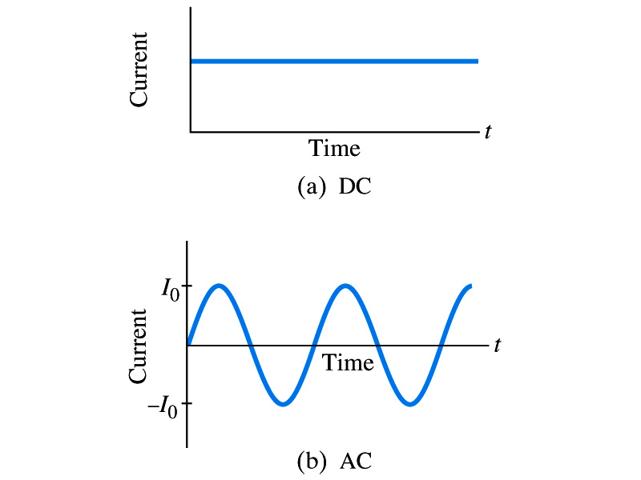
Alternating Current
Does the direction of the flow of current change while a battery is connected to a circuit?
No. Why?
Because its source of potential difference stays put.
This kind of current is called the Direct Current (DC), and it does not change its direction of flow while the battery is connected.
How would DC current look as a function of time?
Straight lines
The generators at electric power plant produce alternating current (AC)
AC reverses direction many times a second
AC is sinusoidal as a function of time
Most the currents supplied to homes and business are AC.

Slide 7
The Alternating Current
The voltage produced by an AC electric generator is sinusoidal
This is why the current is sinusoidal
Voltage produced can be written as
What are the maximum and minimum voltages?
V₀ (–V₀) and 0
The potential oscillates between +V₀ and –V₀, the peak voltage or the amplitude
What is f?
The frequency, the number of complete oscillations made per second.
What is the unit of f? What is the normal size of f in the US?
f=60Hz in the US and Canada.
Many European countries have f=50Hz.
ω=2πf

Slide 8
Alternating Current
Since V=IR, if a voltage V exists across a resistance R, the current I is
What are the maximum and minimum currents?
I₀ (–I₀) and 0.
The current oscillates between +I₀ and –I₀, the peak currents or the amplitude. The current is positive when electron flows to one direction and negative when they flow the opposite.
AC is as many times positive as negative. What’s the average current?
Zero. So there is no power and no heat is produced in a heater?
Yes there is! The electrons actually flow back and forth, so power is delivered.
What is this?

Slide 9
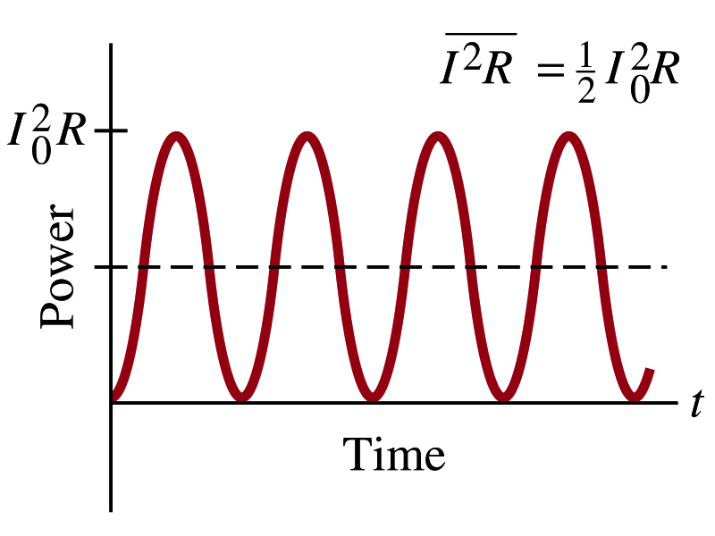
Power Delivered by Alternating Current
AC power delivered to a resistance is:
Since the current is squared, the power is always positive
The average power delivered is
Since the power is also P=V²/R, we can obtain
The average of the square of current and voltage are important in calculating power:
Average power

Slide 10
Power Delivered by Alternating Current
The square root of each of these are called root-mean-square, or rms:
rms values are called the effective values
These are useful quantities since they can substitute current and voltage directly in power, as if they are in DC
In other words, an AC of peak voltage V₀ or peak current I₀ produces as much power as DC voltage of V_{rms} or DC current I_{rms}.
So normally, rms values in AC are specified or measured.
US uses 115V rms voltage. What is the peak voltage?
Europe uses 240V

Slide 11
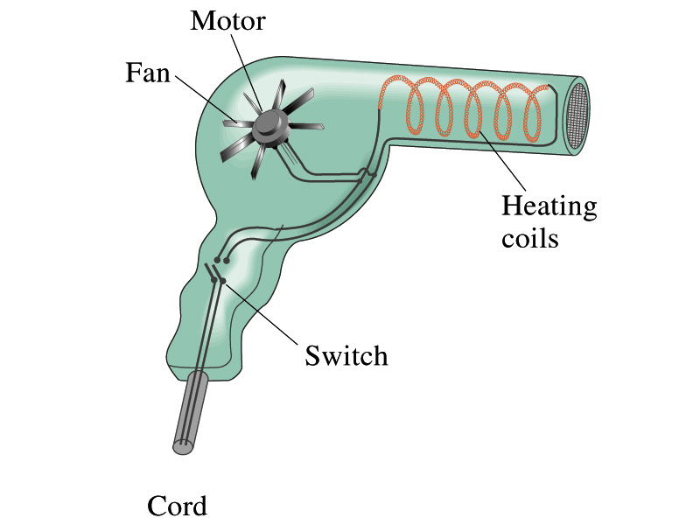
Example 25 – 13
Hair Dryer. (a) Calculate the resistance and the peak current in a 1000-W hair dryer connected to a 120-V AC line. (b) What happens if it is connected to a 240-V line in Britain?
The rms current is:
The peak current is:
Thus the resistance is:
(b) If connected to 240V in Britain …
The average power provide by the AC in UK is
So?
The heating coils in the dryer will melt!

Slide 12
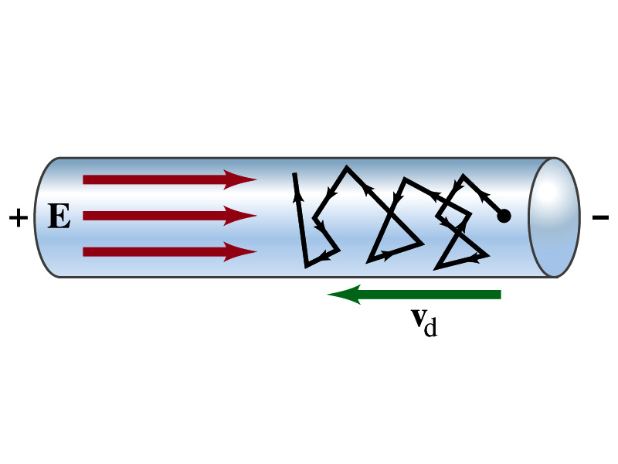
Microscopic View of Electric Current
When voltage is applied across the ends of a wire
Electric field is generated by the potential difference
Electrons feel force and get accelerated
Electrons soon reach to a steady average speed due to collisions with atoms in the wire, called drift velocity, v_{d}
The drift velocity is normally much smaller than electrons’ average random speed.

Slide 13
Microscopic View of Electric Current
The drift velocity of electrons in a wire is only about 0.05mm/s. How could we get light turned on immediately then?
While the electrons in a wire travel slow, the electric field travels essentially at the speed of light. Then what is all the talk about electrons flowing through?
It is just like water. When you turn on the facet, water flows right off the facet despite the fact that the water travels slow.
Electricity is the same. Electrons fill the conductor wire and when the switch is flipped on or a potential difference is applied, the electrons close to the positive terminal flows into the device.
Interesting, isn’t it? Why is the field travel at the speed of light then?

Slide 14
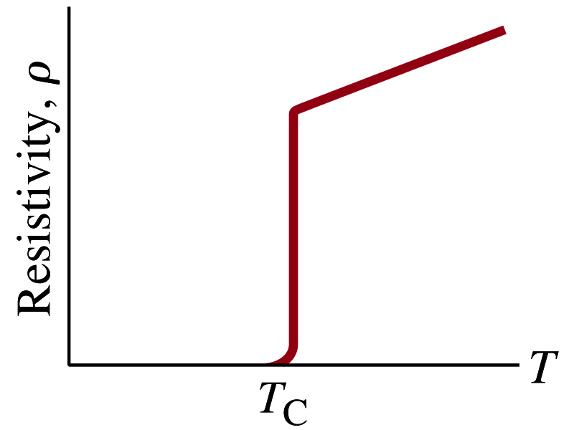
Superconductivity
At the temperature near absolute 0K, resistivity of certain material becomes 0.
This state is called the “superconducting” state.
Observed in 1911 by H. K. Onnes when he cooled mercury to 4.2K (-269ºC). ➔ 1913 Nobel physics prize
Resistance of mercury suddenly dropped to 0.
In general superconducting materials become superconducting below a transition temperature (T_{c}).
The highest temperature superconductivity seen is 160K
First observation above the boiling temperature of liquid nitrogen is in 1987 at 90k observed from a compound of yttrium, barium, copper and oxygen.
Since much smaller amount of material can carry just as much current more efficiently, superconductivity can make electric cars more practical, computers faster, and capacitors store higher energy

Slide 15
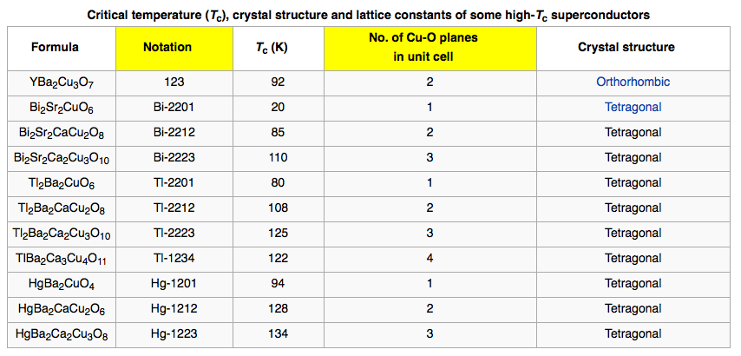
Critical Temperature of Superconductors

Slide 16
Electric Hazards: Leakage Currents
How does one feel shock by electricity?
Electric current stimulates nerves and muscles, and we feel a shock
The severity of the shock depends on the amount of current, how long it acts and through what part of the body it passes
Electric current heats the tissue and can cause burns
Currents above 70mA on a torso for a second or more is fatal, causing heart to function irregularly, “ventricular fibrillation”.
A dry human body between two points on opposite side of the body is about 10⁴ to 10⁶ Ω.
When wet, it could be 10³Ω.
A person in good contact with the ground who touches 120V DC line with wet hands can get the current:
Could be lethal

