Slide 1
PHYS 1444 – Section 002
Lecture #16
Monday, Oct. 28, 2019
Dr. Jaehoon Yu
CH 26
  How to use Kirchhoff’s rules
  RC Circuit
CH 27: Magnetism & Magnetic Field
  Electric Current and Magnetism
Homework #9 due extended to 11pm, Monday, Nov. 4!!
Today’s Homework is #10 due 11pm, Friday, Nov. 8!!

Slide 2
Announcements
Reading Assignments: CH26.5, 6 and 7
Quiz #3
  This Wednesday, Oct. 30, beginning of the class
  Covers: CH25.5 through what we finish today (CH. 27.1?)
  Bring your calculator but DO NOT input formula into it!
    Cell phones or any types of computers cannot replace a calculator!
  BYOF: You may bring a one 8.5x11.5 sheet (front and back) of handwritten formulae and values of constants for the quiz
  No derivations, word definitions, set ups or solutions of any problems!
  No additional formulae or values of constants will be provided!
2nd non-comprehensive term exam: Nov. 11
  Covers CH25.5 to what we learn Wednesday, Nov. 6
  BYOF
Final exam date and time: 1pm – 2:30pm, Wednesday, Dec. 4
Remember the triple extra credit colloquia
  This Wed. Oct. 30: Prof. Liantao Wang of U. of Chicago
  Wed. Nov. 13: Prof Hitoshi Murayama of U.C. Berkeley

Slide 3
Reminder: Special Extra Credit #4
Civic Duty Participation Exercise
You can submit up to four “I Voted” stickers for 20 points total
  If voted, they give 3 pieces of paper of which one has pricinct info.
Be sure to tape one side of the stickers on a sheet of paper with your name on it along with the following info for each sticker
  The number and the name of the precinct the vote was cast
  The full name of the person voted next to the relevant sticker
  The signature of the person voted next to the full name
None of the stickers can be from the same person on someone else’s extra credit or yours
Deadline: Beginning of the class next Wednesday, Nov. 6

Slide 5
Reminder: Special Project #5
Make a list of the power consumption and the resistance of all electric and electronic devices at your home and compile them in a table. (10 points total for the first 10 items and 0.5 points each additional item.)
Estimate the cost of electricity for each of the items on the table using your own electric cost per kWh (if you don’t find your own, use $0.12/kWh) and put them in the relevant column. (5 points total for the first 10 items and 0.2 points each additional items)
Estimate the the total amount of energy in Joules and the total electricity cost per day, per month and per year for your home. (8 points)
Spreadsheet: http://www-hep.uta.edu/%7Eyu/teaching/fall19-1444-002/sp5-spreadsheet.xlsx
Due: Beginning of the class Monday, Nov. 11

Slide 7
Kirchhoff’s Rules
Kirchoff’s 1st rule: The junction rule uses charge conservation
  At any junction point, the sum of all currents entering the junction must be equal to the sum of all currents leaving the junction.
Kirchoff’s 2nd rule: The loop rule uses conservation of energy.
  The sum of the changes in potential in any closed path of a circuit must be zero.

Slide 8
How to use Kirchhoff’s Rules??
Determine the flow of currents at the junctions and label each and everyone of the indepent currents.
  It does not matter which direction, you decide but keep it!
    You cannot have all current coming in or going out of a junction, though!
  If the value of the current after completing the calculations are negative, you just need to flip the direction of the current flow.
Write down the current equation based on Kirchhoff’s 1st rule at various junctions.
  Be sure to see if any of them are the same.
Choose closed loops in the circuit
Write down the potential in each interval of the junctions, keeping the proper signs as you decided in step 1 above.
Write down the potential equations for each loop.
Solve the equations for unknowns.

Slide 9
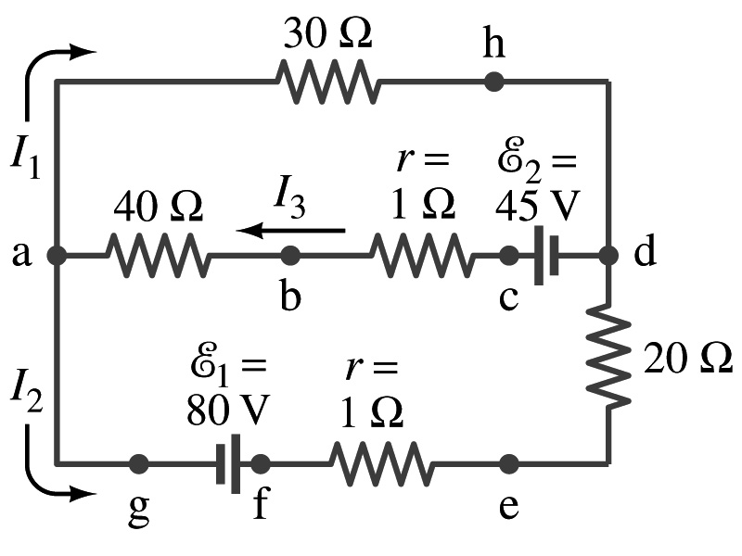
Example 26 – 9
Use Kirchhoff’s rules. Calculate the currents I₁, I₂ and I₃ in each of the branches of the circuit in the figure.

Slide 10
Example 26 – 9
Use Kirchhoff’s rules. Calculate the currents I₁, I₂ and I₃ in each of the branches of the circuit in the figure.
The directions of the current through the circuit is not known a priori but since the current tends to move away from the positive terminal of a battery, we arbitrarily choose the direction of the currents as shown.
We have three unknowns so we need three equations.
Using Kirchhoff’s junction rule at point a, we obtain
This is the same for junction d as well, so no additional information.
Now the second rule on the loop ahdcba.
The total voltage change in the loop ahdcba is.

Slide 11
Example 26 – 9, cnt’d
Now the second rule on the other loop agfedcba.
The total voltage change in loop agfedcba is.
So the three equations become
We can obtain the three current by solving these equations for I₁, I₂ and I₃.
Do this yourselves!!

Slide 12
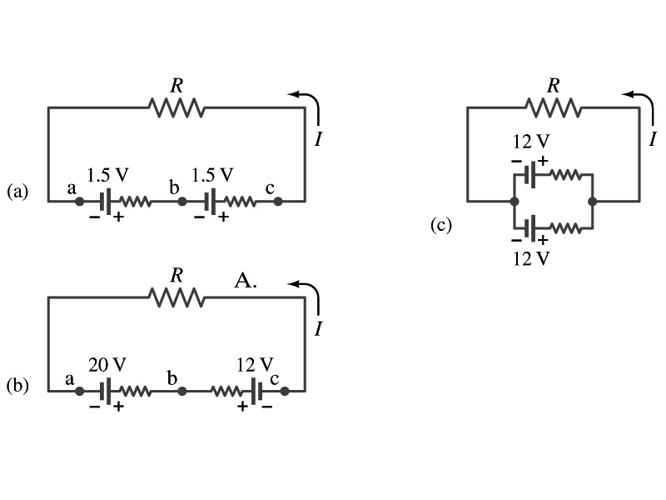
EMFs in Series and Parallel: Charging a Battery
When two or more sources of emfs, such as batteries, are connected in series
  The total voltage is the algebraic sum of their voltages, if their direction is the same
    V_{ab}=1.5 + 1.5=3.0V in figure (a).
  If the batteries are arranged in an opposite direction, the total voltage is the difference between them
Parallel arrangements (c) are used only to increase currents. An example?
    V_{ac}=20 – 12=8.0V in figure (b)
    Connecting batteries in opposite direction is wasteful.
    This, however, is the way a battery charger works.
    Since the 20V battery is at a higher voltage, it forces charges into 12V battery
    Some battery are rechargeable since their chemical reactions are reversible but most the batteries do not reverse their chemical reactions

Slide 13
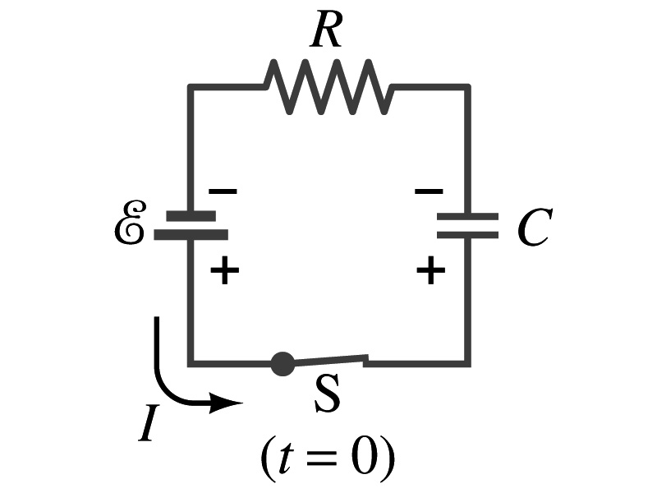
RC Circuits
Circuits containing both resisters and capacitors
  RC circuits are used commonly in everyday life
    Control windshield wiper timer
    Timing of traffic light from one color to another
    Camera flashes and heart pacemakers
How does an RC circuit look?
  There should be a source of emf, capacitors and resisters
What happens when the switch S is closed?
  Current immediately starts flowing through the circuit.
  Electrons flow out of negative terminal of the emf source, through the resister R and accumulates on the upper plate of the capacitor.
  The electrons from the bottom plate of the capacitor will flow into the positive terminal of the battery, leaving only positive charge on the bottom plate.
  As the charge accumulates on the capacitor, the potential difference across it increases
  The current reduces gradually to 0 till the voltage across the capacitor is the same as emf.
  The charge on the capacitor increases until it reaches to its maximum CE.

Slide 14
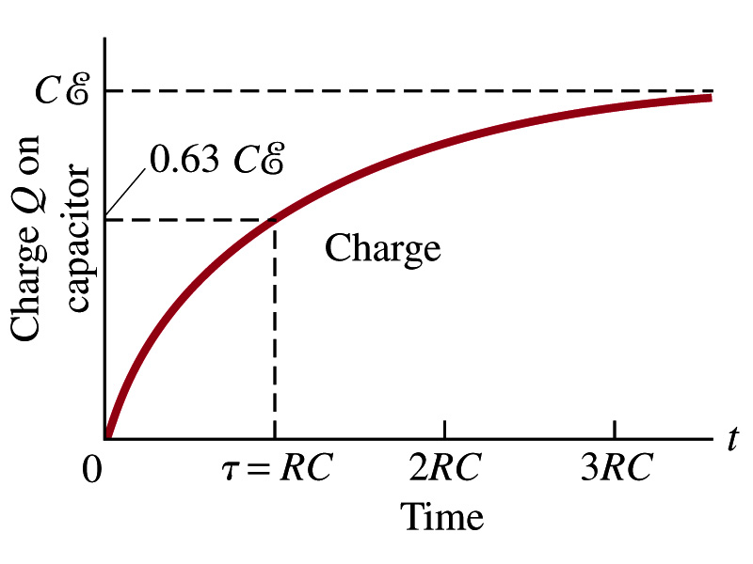
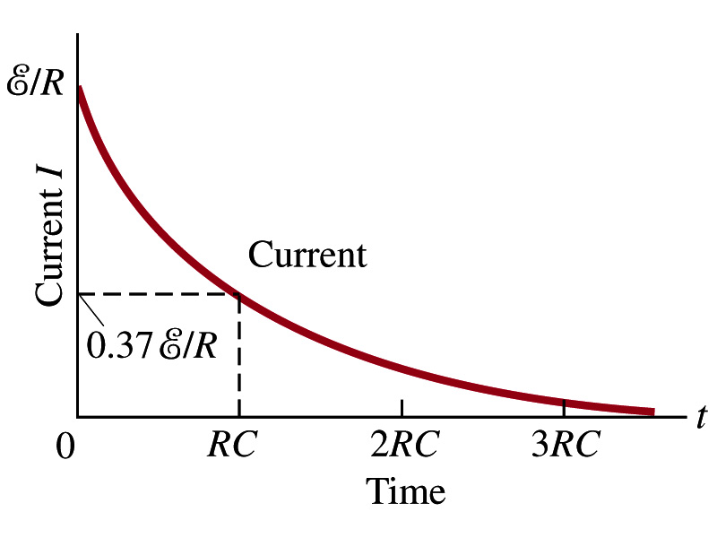
RC Circuits
How does all this look like in graphs?
  The charge and the current on the capacitor as a function of time
  From energy conservation (Kirchhoff’s 2nd rule), the emf E must be equal to the voltage drop across the capacitor and the resister
    E=IR+Q/C
    R includes all resistance in the circuit, including the internal resistance of the battery, I is the current in the circuit at any instance, and Q is the charge of the capacitor at that same instance.

Slide 15
Analysis of RC Circuits
In an RC circuit and
What can we see from the above equations?
  Q and V_{C} increase from 0 at t=0 to maximum value Q_{max}=CE and V_{C}= E.
In how much time?
  The quantity RC is called the time constant of the circuit, τ
    τ=RC, What is the unit?
  What is the physical meaning?
    The time required for a capacitor to reach (1 - e⁻¹)=0.63 or 63% of the full charge
The current is
Sec.

Slide 16
Example 26 – 12
RC circuit, with emf. The capacitance in the circuit of the figure is C=0.30μF, the total resistance is 20kΩ, and the battery emf is 12V. Determine (a) the time constant, (b) the maximum charge the capacitor could acquire, (c) the time it takes for the charge to reach 99% of this value, (d) the current I when the charge Q is half its maximum value, (e) the maximum current, and (f) the charge Q when, the current I is 0.20 its maximum value.
(a) Since
We obtain
(b) Maximum charge is
(c) Since
For 99% we obtain
(d) Since
We obtain
The current when Q is 0.5Q_{max}
(e) When is I maximum?
when Q=0:
(f) What is Q when I=120mA?

Slide 17
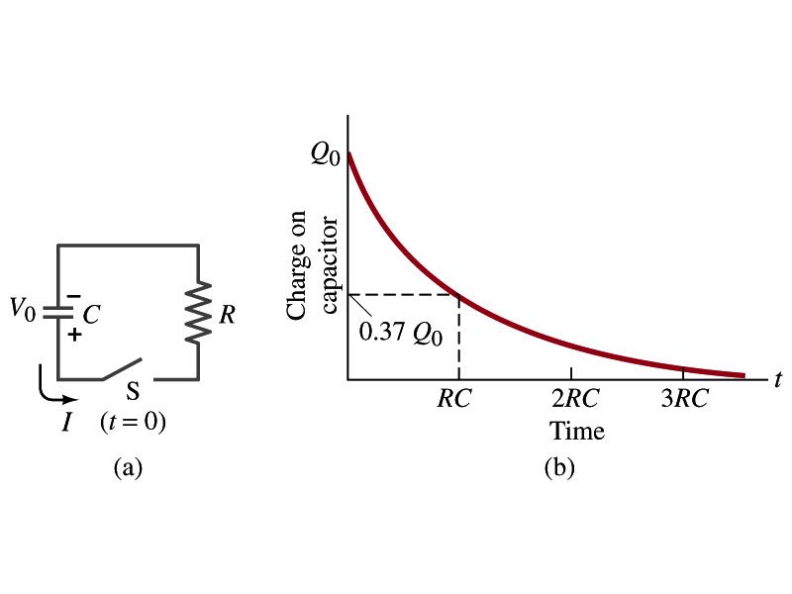
Discharging an RC Circuit
When a capacitor is already charged, it is allowed to discharge through a resistance R.
  When the switch S is closed, the voltage across the resistor at any instant equals that across the capacitor. Thus IR=Q/C.
  The rate at which the charge leaves the capacitor equals the negative the current flows through the resistor
    I= - dQ/dt
    Since the current is leaving the capacitor
  Thus the voltage equation becomes a differential equation
Rearrange terms

Slide 18
Discharging an RC Circuit
  Now, let’s integrate from t=0 when the charge is Q₀ to t when the charge is Q
  The result is
  Thus, we obtain
  What does this tell you about the charge on the capacitor?
    It decreases exponentially w/ time at the time constant RC
    Just like the case of charging
  The current is:
    The current also decreases exponentially w/ time w/ the constant RC
What is this?

Slide 19
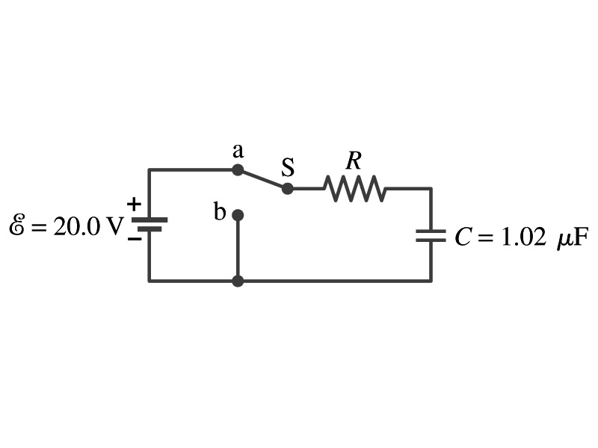
Example 26 – 13
Discharging RC circuit. In the RC circuit shown in the figure the battery has fully charged the capacitor, so Q₀=CE. Then at t=0, the switch is thrown from position a to b. The battery emf is 20.0V, and the capacitance C=1.02μF. The current I is observed to decrease to
0.50 of its initial value in 40μs. (a) what is the value of R? (b) What is the value of Q, the charge on the capacitor, at t=0? (c) What is Q at t=60μs?
(a) Since the current reaches to 0.5 of its initial value in 40μs, we can obtain
For 0.5I₀
Rearrange terms
Solve for R
(b) The value of Q at t=0 is
(c) What do we need to know first for the value of Q at t=60μs?
The RC time
Thus

Slide 20
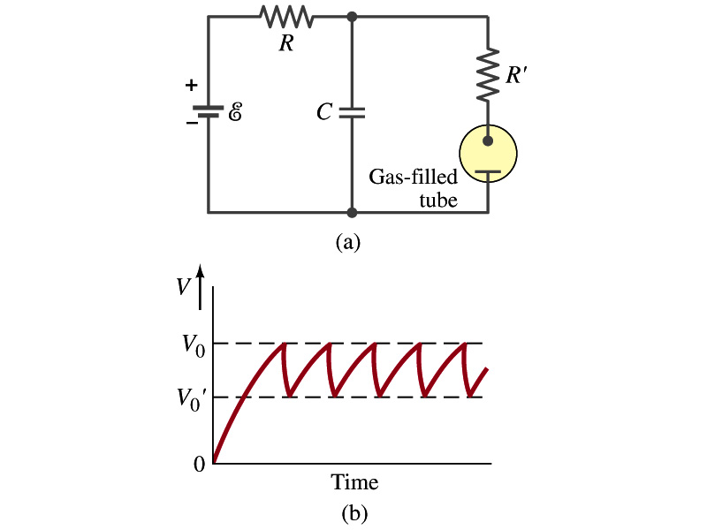
Application of RC Circuits
What do you think the charging and discharging characteristics of RC circuits can be used for?
  To produce voltage pulses at a regular frequency
  How?
    The capacitor charges up to a particular voltage and discharges
    A simple way of doing this is to use breakdown of voltage in a gas filled tube
      The discharge occurs when the voltage breaks down at V₀
      After the completion of discharge, the tube no longer conducts
      Then the voltage is at V₀’ and it starts charging up
      How do you think the voltage as a function of time look?
        A sawtooth shape
    Pace maker, intermittent windshield wiper, etc

