Slide 1
PHYS 1444 – Section 002
Lecture #17
Wednesday, Oct. 30, 2019
Dr. Jaehoon Yu
Chapter 27: Magnetism & Magnetic Field
  Electric Current and Magnetism
  Magnetic Field
  Magnetic Force on a Moving Charge
  About Magnetic Field
  Charged Particle Path in a Magnetic Field

Slide 2
Announcements
Reading Assignments: CH27.6, 27.8 and 27.9
2nd non-comprehensive term exam: Nov. 11
  Monday, Nov. 11 in class
  Covers: CH25.5 through what we finish next Wednesday, Nov. 6
  Bring your calculator but DO NOT input formula into it!
    Cell phones or any types of computers cannot replace a calculator!
  BYOF: You may bring a one 8.5x11.5 sheet (front and back) of handwritten formulae and values of constants for the quiz
  No derivations, word definitions, set ups or solutions of any problems!
  No additional formulae or values of constants will be provided!
Remember the triple extra credit colloquia
  At 4pm today in SH100
    Prof. Liantao Wang of U. of Chicago

Slide 3
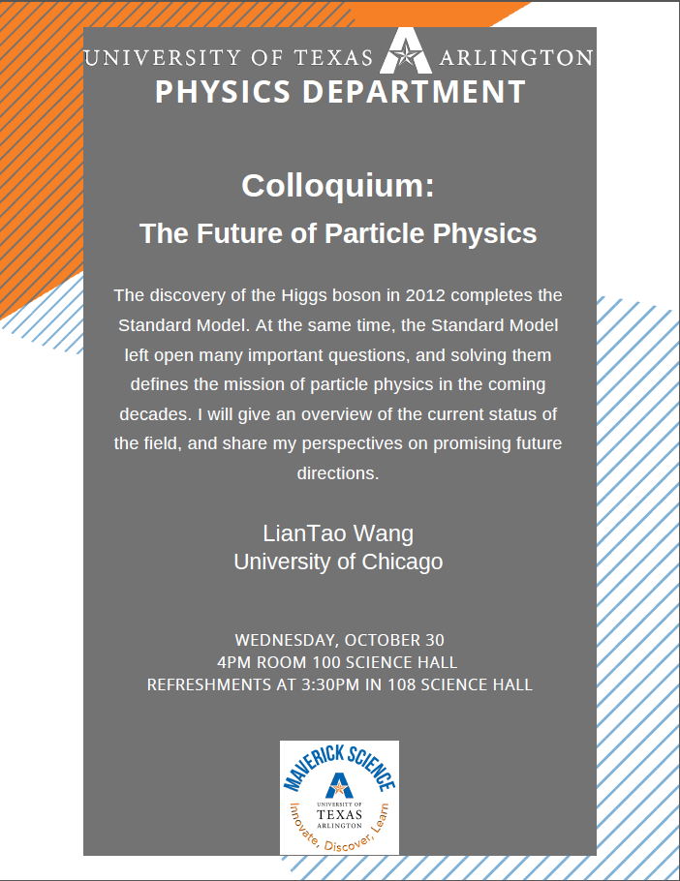

Slide 4
Reminder: Special Project #5
Make a list of the power consumption and the resistance of all electric and electronic devices at your home and compile them in a table. (10 points total for the first 10 items and 0.5 points each additional item.)
Estimate the cost of electricity for each of the items on the table using your own electric cost per kWh (if you don’t find your own, use $0.12/kWh) and put them in the relevant column. (5 points total for the first 10 items and 0.2 points each additional items)
Estimate the the total amount of energy in Joules and the total electricity cost per day, per month and per year for your home. (8 points)
Spreadsheet: http://www-hep.uta.edu/%7Eyu/teaching/fall19-1444-002/sp5-spreadsheet.xlsx
Due: Beginning of the class Monday, Nov. 11

Slide 6
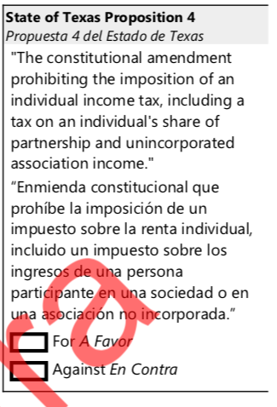
What would be your vote?

Slide 7
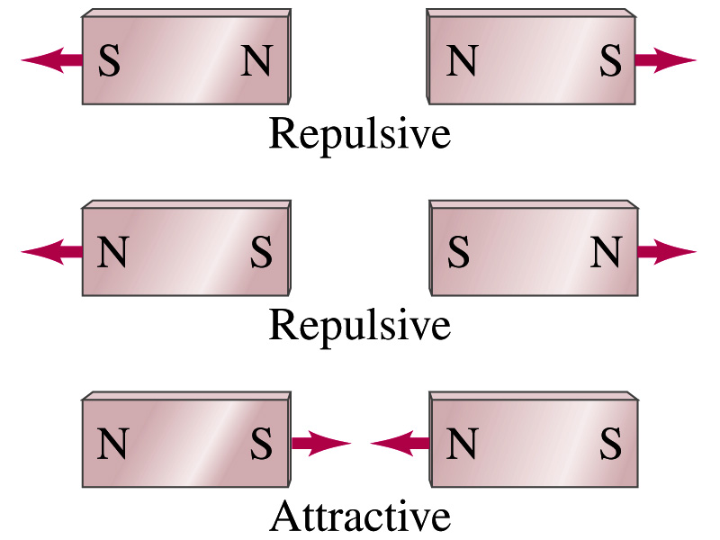
Magnetism
What are magnets?
  Objects with two poles, North and South poles
    The pole that points to the geographical North is the North pole and the other is the South pole
      Principle of compass
  These are called magnets due to the name of the region, Magnesia, where rocks that attract each other were found
What happens when two magnets are brought to each other?
  They exert force onto each other
  What kind?
  Both repulsive and attractive forces depending on the configurations
    Like poles repel each other while the unlike poles attract

Slide 8
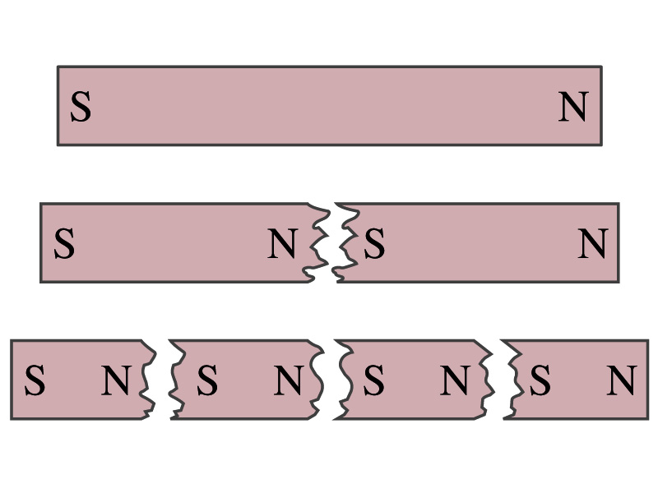
Magnetism
So the magnetic poles are the same as the electric charge?
  No. Why not?
  While the electric charges (positive and negative) can be isolated, the magnetic poles cannot be isolated.
  So what happens when a magnet is cut?
    If a magnet is cut, two magnets are made.
    The more they get cut, the more magnets are made
  Single pole magnets are called the monopole but it has not been seen yet
Ferromagnetic materials: Materials that show strong magnetic effects
  Iron, cobalt, nickel, gadolinium and certain alloys
Other materials show very weak magnetic effects

Slide 9
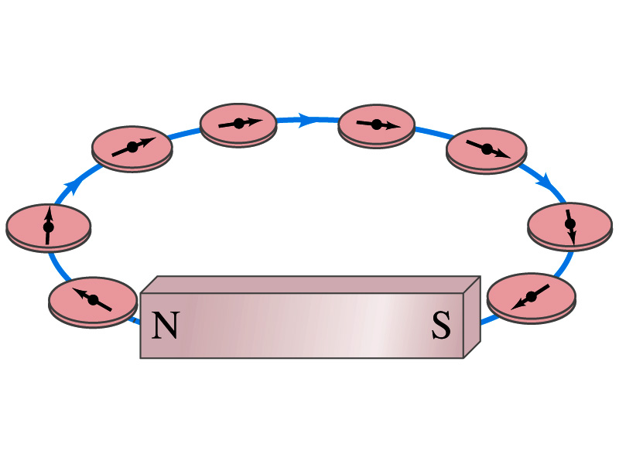
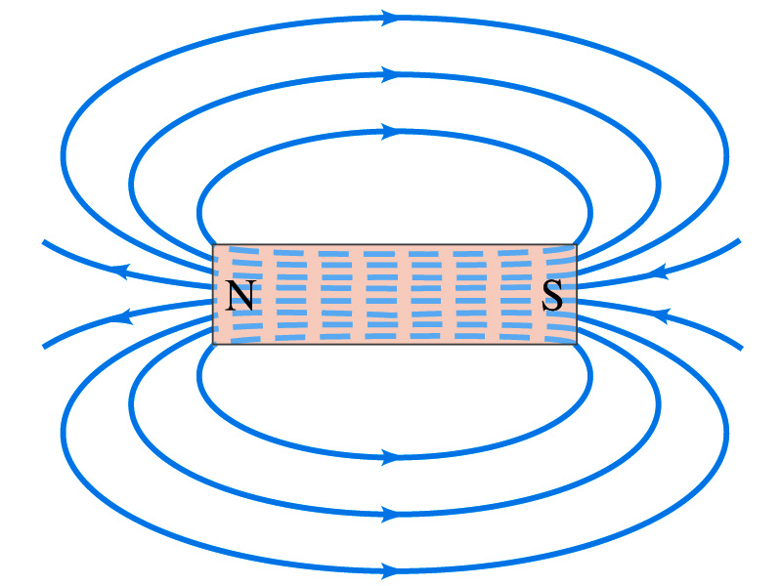
Magnetic Field
Just like the electric field that surrounds electric charge, the magnetic field surrounds a magnet
What does this mean?
  Magnetic force is also a field force
  The force one magnet exerts onto another can be viewed as the interaction between the magnet and the magnetic field produced by the other magnets
  What kind of quantity is the magnetic field? Vector or Scalar?
So one can draw magnetic field lines, too.
Vector
  The direction of the magnetic field at any given point along the line is tangential to the line at that point
  The direction of the field is the direction the north pole of a compass would point to (from N to S)
  The number of lines per unit area is proportional to the strength of the magnetic field
  Magnetic field lines continue inside the magnet
  Since magnets always have both the poles, magnetic field lines form closed loops unlike electric field lines

Slide 10
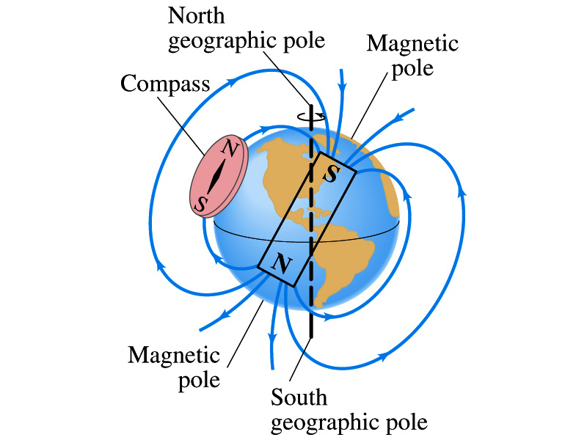
Earth’s Magnetic Field
What magnetic pole does the geographic North pole has to have?
  Magnetic South pole. What? How do you know that?
  Since the magnetic North pole points to the geographic North, the geographic north must have magnetic south pole
    The pole in the North is still called geomagnetic North pole just because it is in the North
  Similarly, South pole has magnetic North pole
The Earth’s magnetic poles do not coincide with the geographic poles ➔ magnetic declination
  Geomagnetic North pole is in Northern Canada, some 900km off the true North pole
Earth’s magnetic field line is not tangent to the earth’s surface at all points
  The angle the Earth’s field makes to the horizontal line is called the angle dip

Slide 11
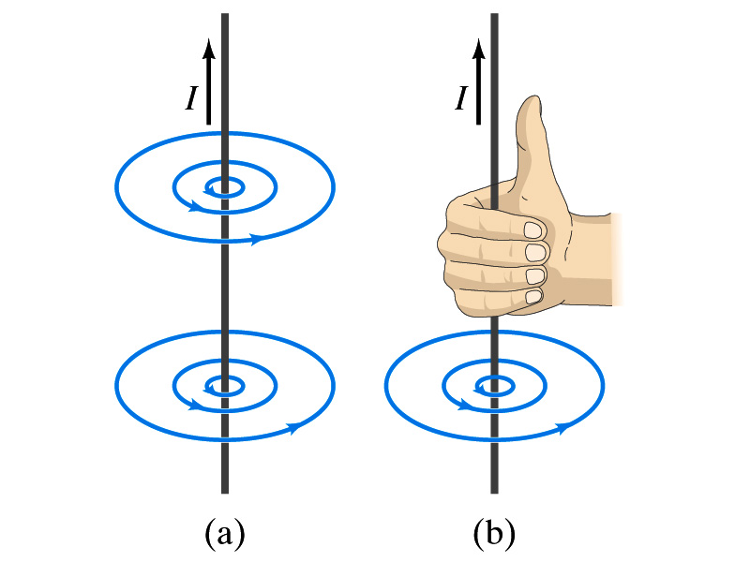
Electric Current and Magnetism
In 1820, Oersted found that when a compass needle is placed near an electric wire, the needle deflects as soon as the wire is connected to a battery and the current flows
  Electric current produces a magnetic field
    The first indication that electricity and magnetism are of the same origin
  What about a stationary electric charge and magnet?
    They don’t affect each other.
The magnetic field lines produced by a current in a straight wire is in the form of circles following the “right-hand” rule
  The field lines follow right-hand fingers wrapped around the wire when the thumb points to the direction of the electric current

Slide 12
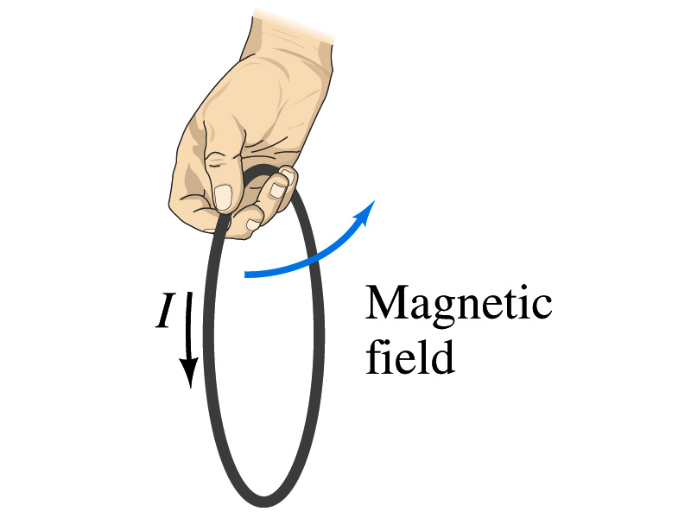
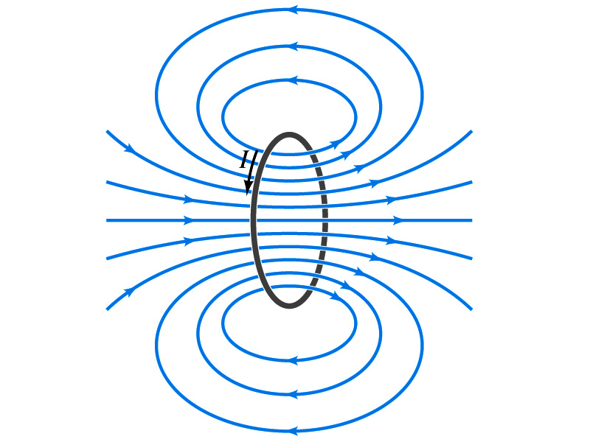
Directions in a Circular Wire?
OK, then what is the direction of the magnetic field generated by the current flowing through a circular loop?

Slide 13
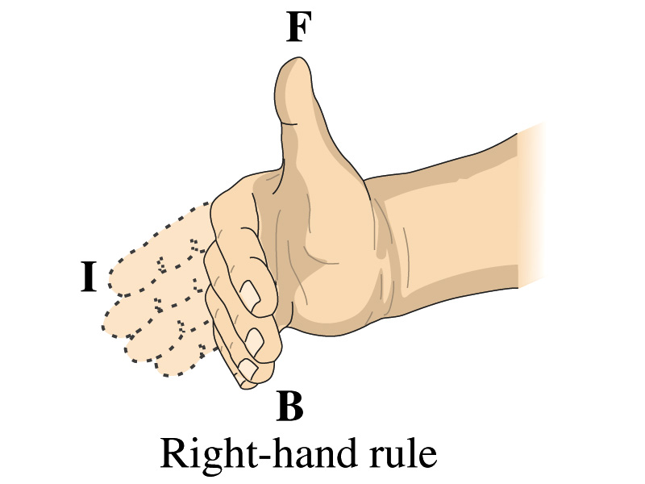
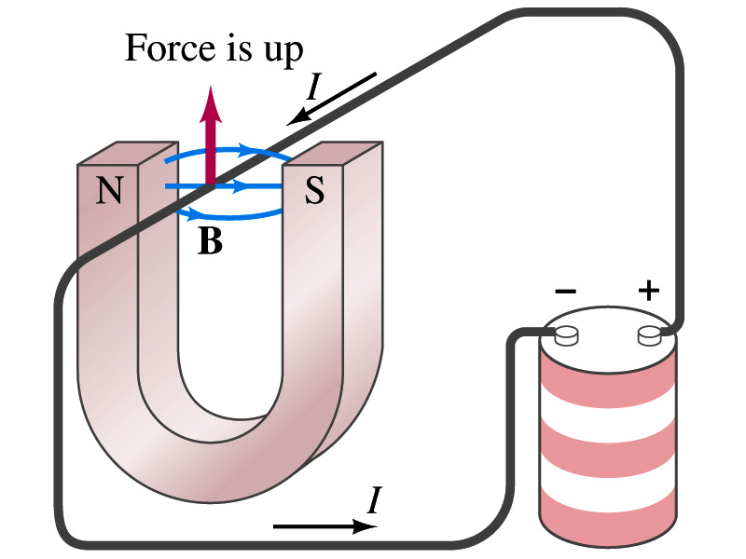
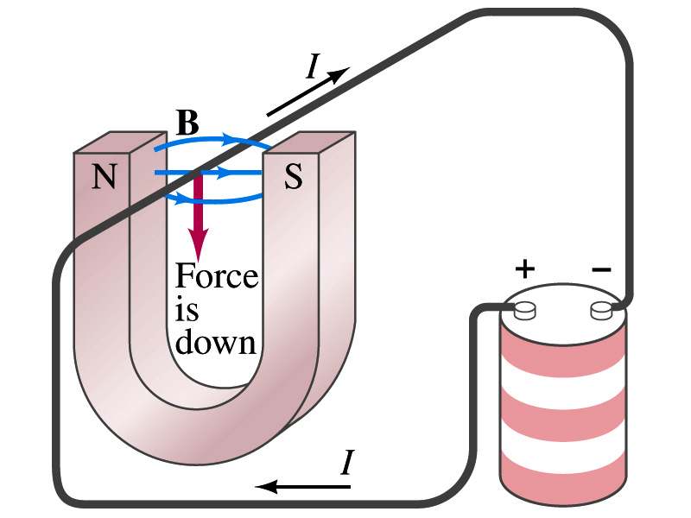
Magnetic Forces on Electric Current
Since the electric current exerts force on a magnet, the magnet should also exert force on the electric current
  Which law justifies this?
    Newton’s 3rd law
  This was also discovered by Oersted
Direction of the force is always
  perpendicular to the direction of the current and
  perpendicular to the direction of the magnetic field, B
Experimentally the direction of the force is given by another right-hand rule ➔ When the fingers of the right-hand points to the direction of the current and the finger tips bent to the direction of magnetic field B, the direction of thumb points to is the direction of the magnetic force

Slide 14
Magnetic Forces on Electric Current
OK, we are set for the direction but what about the magnitude?
It is found that the magnitude of the force is directly proportional
  To the current in the wire
  To the length of the wire in the magnetic field (if the field is uniform)
  To the strength of the magnetic field
The force also depends on the angle θ between the directions of the current and the magnetic field
  When the wire is perpendicular to the field, the force is the strongest
  When the wire is parallel to the field, there is no force at all
Thus the force on current I in the wire w/ length l in a uniform field B is

Slide 15
Magnetic Forces on Electric Current
Magnetic field strength B can be defined using the previous proportionality relationship w/ the constant 1:
if θ=90º, and if θ=0º
So the magnitude of the magnetic field B can be defined as
  where F_{max} is the magnitude of the force on a straight length l of the wire carrying the current I when the wire is perpendicular to B
The relationship between F, B and I can be written in a vector formula:
  l is the vector whose magnitude is the length of the wire and its direction is along the wire in the direction of the conventional current
  This formula works if B is uniform.
If B is not uniform or l does not form the same angle with B everywhere, the infinitesimal force acting on a differential length dl is

Slide 16
Fundamentals on the Magnetic Field, B
The magnetic field is a vector quantity
The SI unit for B is tesla (T)
  What is the definition of 1 Tesla in terms of other known units?
  1T=1N/A-m
  In older names, tesla is the same as weber per meter-squared
    1Wb/m²=1T
The cgs unit for B is gauss (G)
  How many T is one G?
    1G=10⁻⁴ T
  For computation, one MUST convert G to T at all times
Magnetic field on the Earth’s surface is about 0.5G=0.5x10⁻⁴T
On a diagram, for field coming out and for going in.

Slide 17
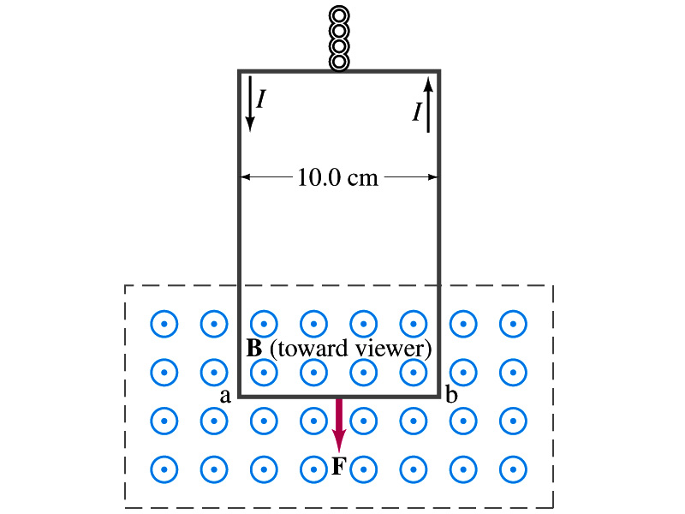
Example 27 – 2
Measuring a magnetic field. A rectangular loop of wire hangs vertically as shown in the figure. A magnetic field B is directed horizontally perpendicular to the wire, and points out of the page. The magnetic field B is very nearly uniform along the horizontal portion of wire ab (length l=10.0cm) which is near the center of a large magnet producing the field. The top portion of the wire loop is free of the field. The loop hangs from a balance which measures a downward force ( in addition to the gravitational force) of F=3.48x10⁻²N when the wire carries a current I=0.245A. What is the magnitude of the magnetic field B at the center of the magnet?
Magnetic force exerted on the wire due to the uniform field is
Since
Magnitude of the force is
Solving for B
Something is not right! What happened to the forces on the loop on the sides?
The two forces cancel out since they are in opposite direction with the same magnitude.

Slide 18
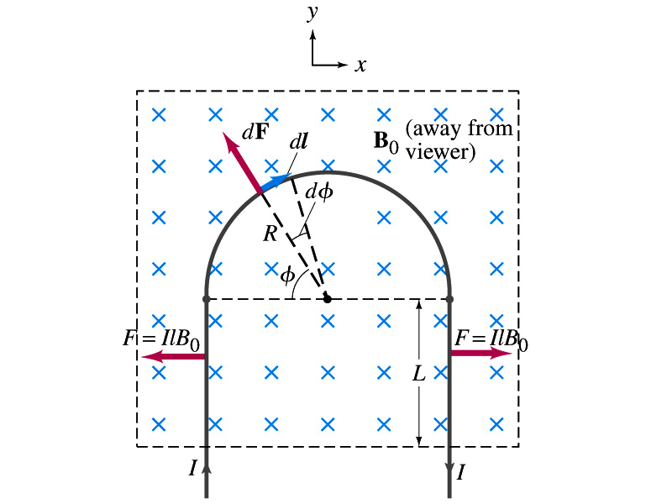
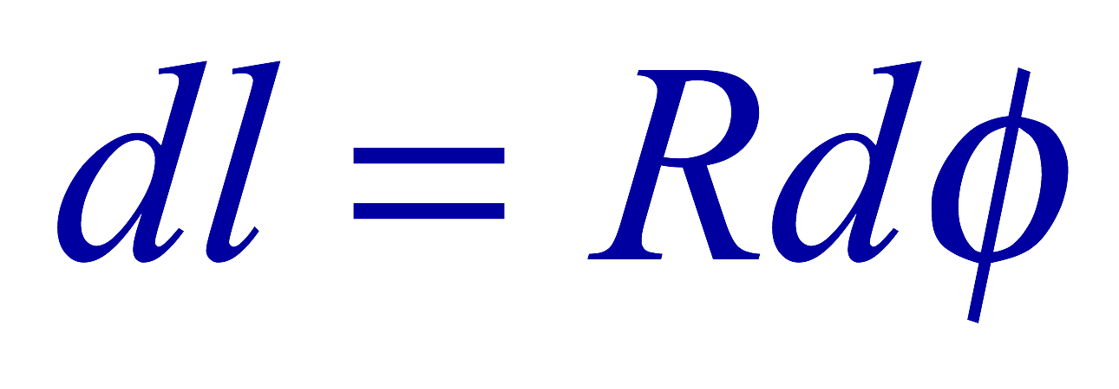
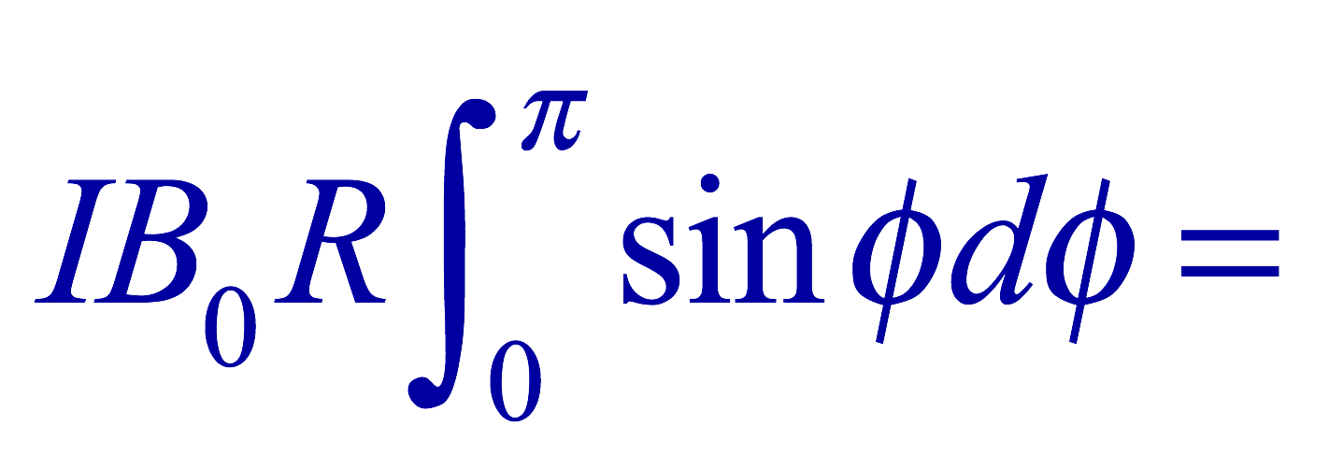
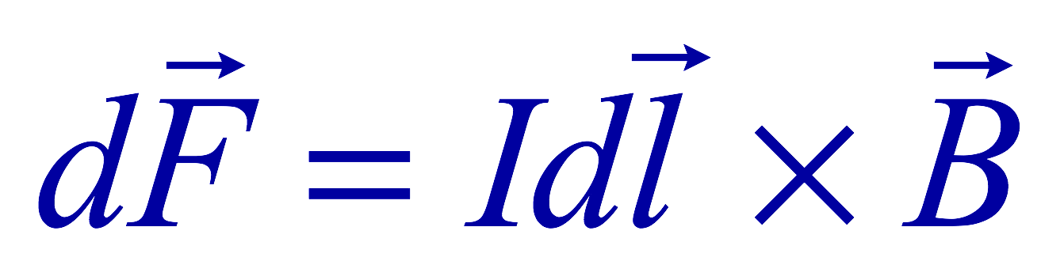

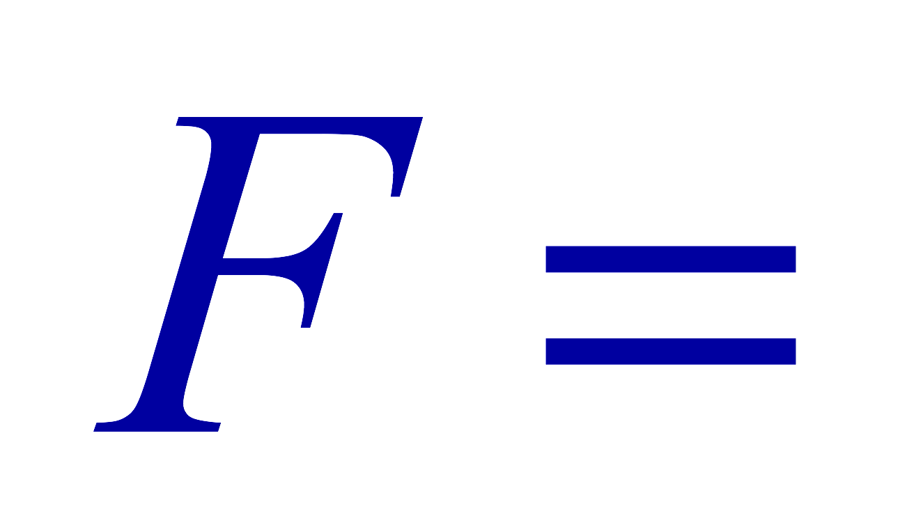
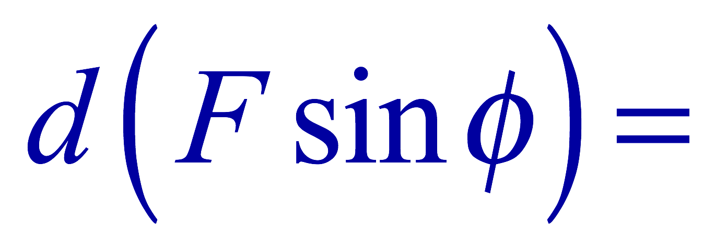
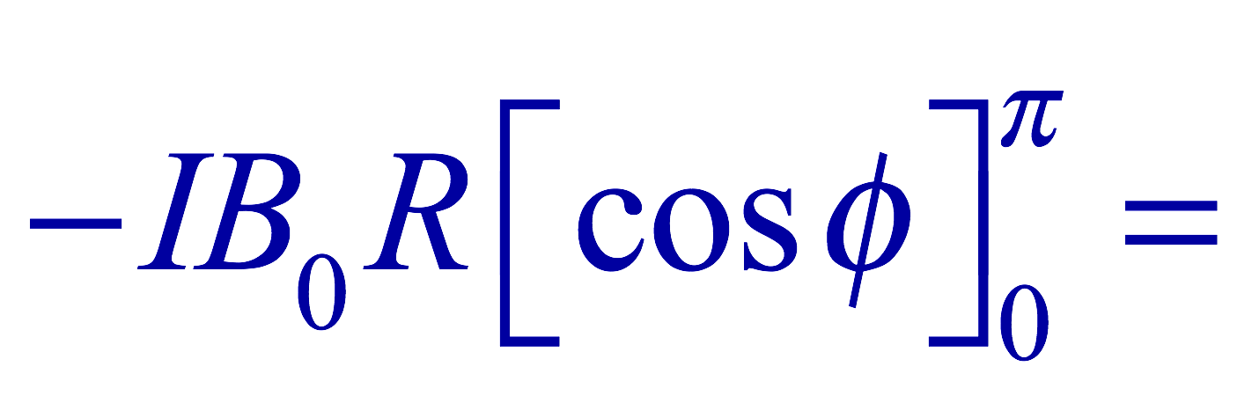
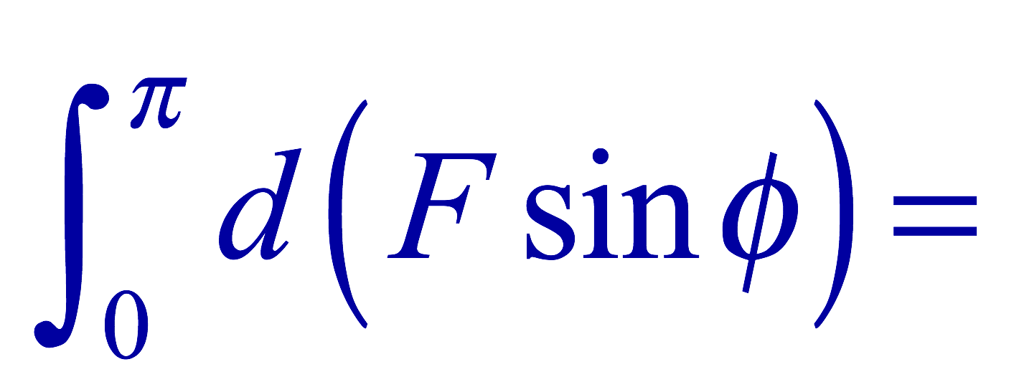
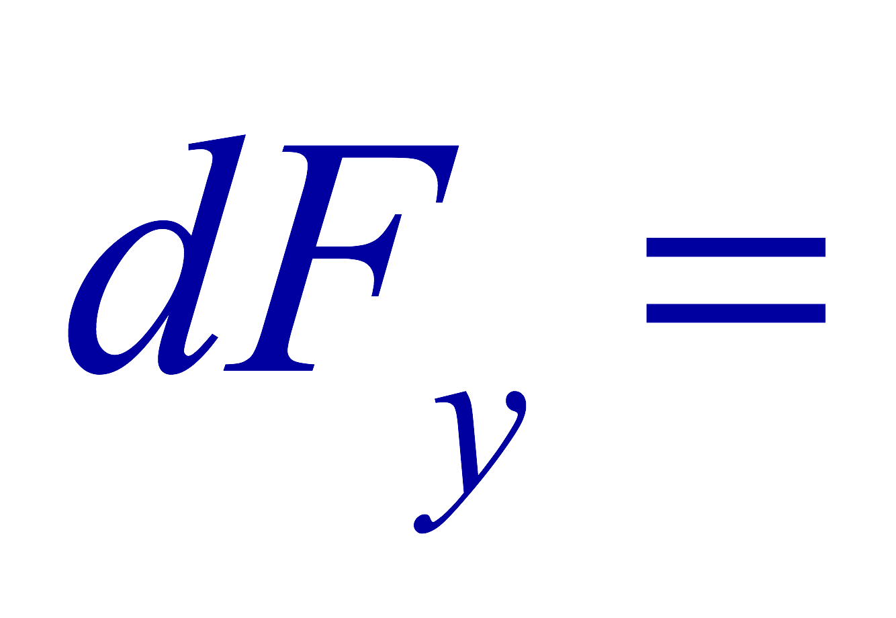
Example 27 – 3
Magnetic force on a semi-circular wire. A rigid wire, carrying the current I, consists of a semicircle of radius R and two straight portions as shown in the figure. The wire lies in a plane perpendicular to the uniform magnetic field B₀. The straight portions each have length l within the field. Determine the net force on the wire due to the magnetic field B₀.
As in the previous example, the forces on the straight sections of the wire is equal and in opposite direction. Thus they cancel.
What do we use to figure out the net force on the semicircle?
We divide the semicircle into infinitesimal straight sections.
What is the net x component of the force exerting on the circular section?
0
Why?
Because the forces on left and the right-hand sides of the semicircle balance.
Since
Y-component of the force dF is
Integrating over ϕ=0 - π
Which direction?
Vertically upward direction. The wire will be pulled deeper into the field.

