Slide 1
PHYS 1444 – Section 002
Lecture #21
Monday, Nov. 18, 2019
Dr. Jaehoon Yu
Chapter 29:EM Induction & Faraday’s Law
  Generation of Electricity
  Transformer
  Electric Field Due to Changing Magnetic Flux
Chapter 30: Inductance
  Inductance
  Mutual and Self Inductance
Today’s Homework is #12 due 11pm, Monday, Dec. 2!!

Slide 2
Announcements
Reading Assignments: 28.6 – 10, CH29.5 and 29.8
Final comprehensive: in class 1:00 – 2:20pm Wed. Dec. 4
Planetarium Extra Credit: bring to class Mon. Dec. 2
  Be sure to tape one end of the ticket stub on a sheet of paper with your name on it
Quiz #4
  Beginning of the class Monday, Nov. 25
  Covers: CH28.6 – what we finish this Wednesday, Nov. 20
  BYOF
Term 2 results
  Class average: 66.5/98
    Equivalent to 67.9/100 (previous exams: 51.2/100 and 73.3/100)
  Top score: 94/98
Next Wednesday: Class or no class?

Slide 3
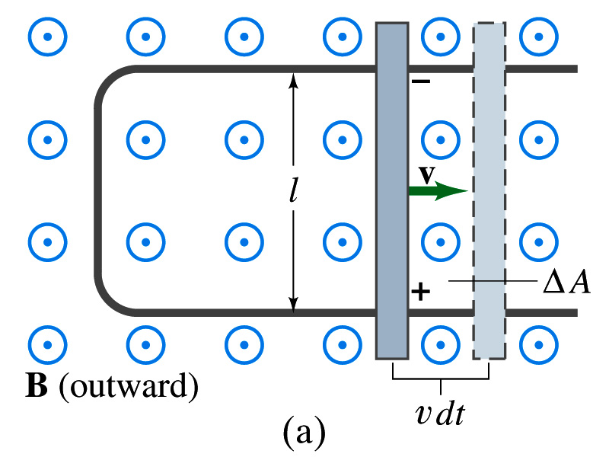
EMF Induced on a Moving Conductor
Another way of inducing emf is using a U-shaped conductor with a movable rod resting on it.
As the rod moves at speed v, it travels vdt in time dt, changing the area of the loop by dA=lvdt.
Using Faraday’s law, the induced emf for this loop is
  This equation is valid as long as B, l and v are perpendicular to each other. What do we do if not?
    Use the scalar product of the vector quantities
An emf induced on a conductor moving in a magnetic field is called the motional emf

Slide 4
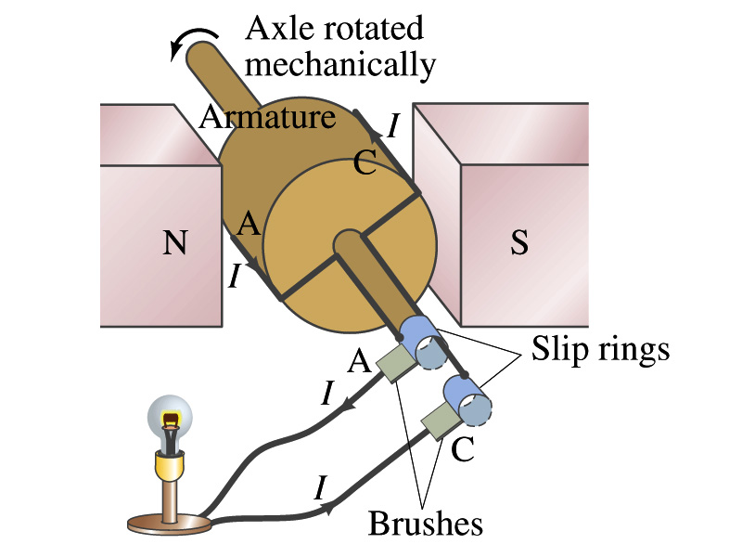
Electric Generators
What does a generator do?
  Transforms mechanical energy into electrical energy
  What does this look like?
    An inverse of an electric motor which transforms electrical energy to mechanical energy
  An electric generator is also called a dynamo
Whose law does the generator based on?
  Faraday’s law of induction

Slide 5
How does an Electric Generator work?
An electric generator consists of
  Many coils of wires wound on an armature that can rotate by mechanical means in a magnetic field
An emf is induced in the rotating coil
Electric current is the output of a generator
Which direction does the output current flow when the armature rotates counterclockwise?
  The conventional current flows outward on wire A toward the brush
  After half the revolution the wire A will be where the wire C is and the current flow on A is reversed
Thus the current produced is alternating its direction

Slide 6
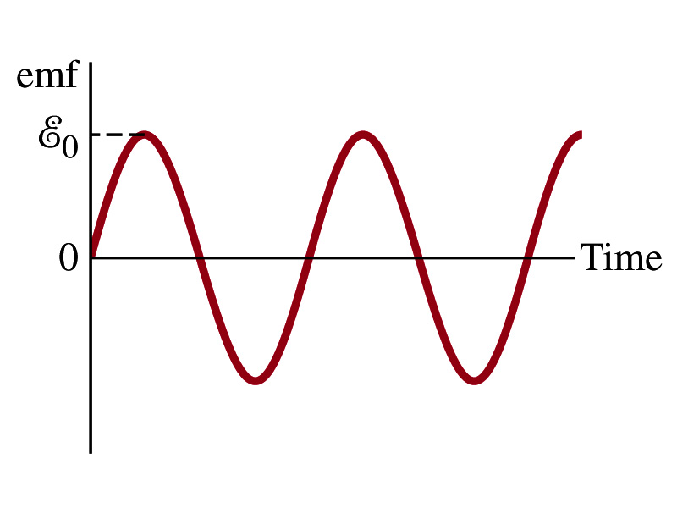

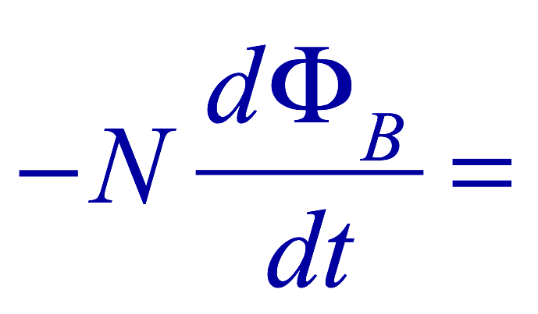
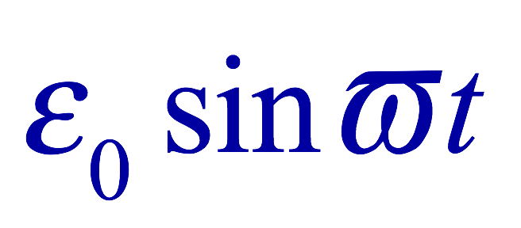
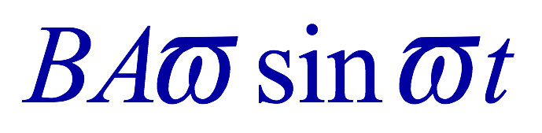
How does an Electric Generator work?
Let’s assume the loop is rotating in a uniform B field w/ a constant angular velocity ω. The induced emf is
What is the variable that changes above?
  The angle θ. What is dθ/dt?
    The angular speed ω.
  So θ=θ₀+ωt
  If we choose θ₀=0, we obtain
  If the coil contains N loops:
  What is the shape of the output?
    Sinusoidal w/ an amplitude ε₀=NBAω
USA frequency is 60Hz. Europe is at 50Hz
  Most the U.S. power is generated at steam plants

Slide 7
Example 29 – 9
An AC generator. The armature of a 60-Hz AC generator rotates in a 0.15-T magnetic field. If the area of the coil is 2.0x10⁻²m², how many loops must the coil contain if the peak output is to be ε₀=170V?
The maximum emf of a generator is
Solving for N
Since
We obtain

Slide 8
US Electricity Sources

Slide 9
US Electric E Consumption by Users
US Energy Information Administration http://www.eia.gov/electricity/

Slide 10
The World Energy Consumption
In 2016, total worldwide energy consumption was 567 EJ (567×10¹⁸ J=157 PWh)➔ expected >1000EJ by 2050
  Equivalent to an average energy consumption rate of 18 terawatts (1.8×10¹³ W)
  US uses 39.1 PWh (1.38kWh/person, as of 2014)
The potential for renewable energy
  solar energy 1600 EJ (444,000 TWh)
  wind power 600 EJ (167,000 TWh)
  geothermal energy 500 EJ (139,000 TWh),
  biomass 250 EJ (70,000 TWh)
  hydropower 50 EJ (14,000 TWh) an
  ocean energy 1 EJ (280 TWh)
  Read this paper if you want to learn more

Slide 11
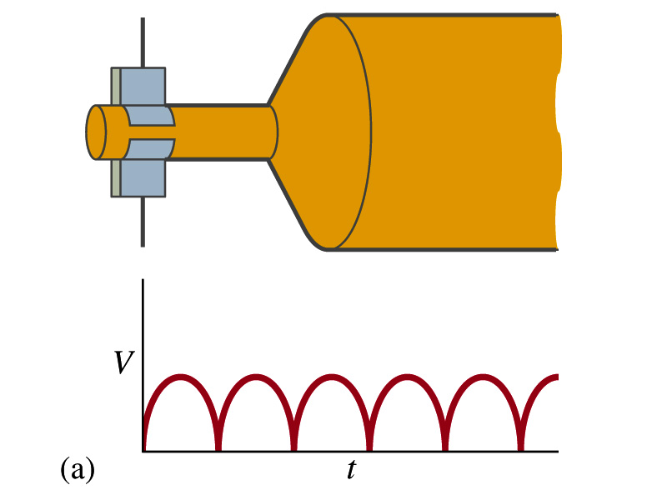
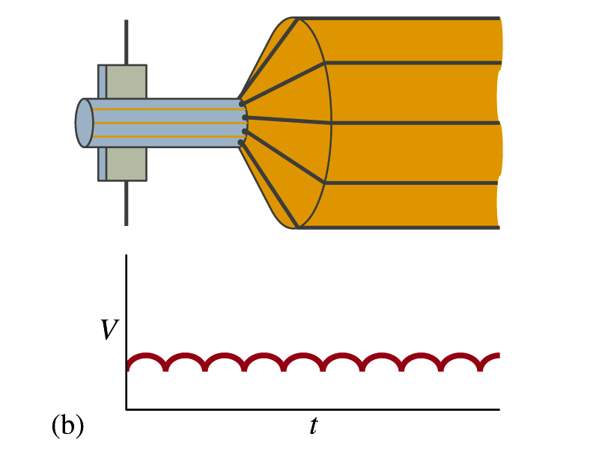
A DC Generator
A DC generator is almost the same as an AC generator except the slip rings are replaced by split-ring commutators
Output can be smoothed out by placing a capacitor in parallel to the output
  More commonly done using many armature windings
Smooth output using many windings

Slide 12
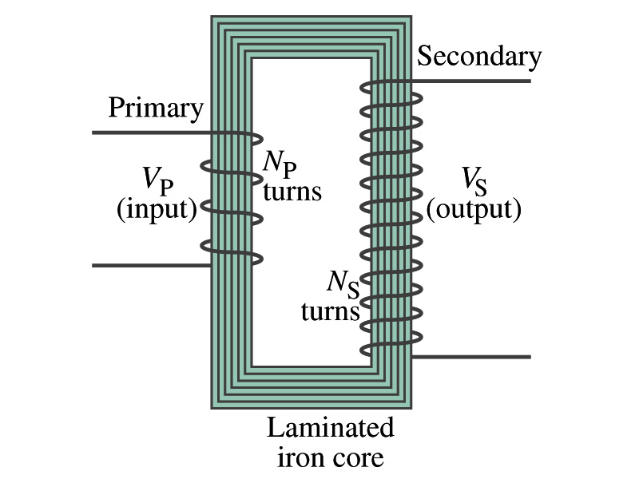
Transformer
What is a transformer?
  A device for increasing or decreasing an AC voltage
  A few examples?
    TV sets to provide the high voltage to picture tubes, portable electronic device converters, transformers on the pole, etc
A transformer consists of two coils of wires known as the primary and the secondary
  The two coils can be interwoven or linked by a laminated soft iron core to reduce losses due to Eddy current
Transformers are designed so that all magnetic flux produced by the primary coil pass through the secondary

Slide 13
How does a transformer work?
When an AC voltage is applied to the primary, the changing B it produces will induce voltage of the same frequency in the secondary wire
So how would we make the voltage different?
  By varying the number of loops in each coil
  From Faraday’s law, the induced emf in the secondary is
  The input primary voltage is
  Since dΦ_{B}/dt is the same, we obtain
Transformer Equation

Slide 14
Transformer Equation
The transformer equation does not work for DC current
  Since there is no change of magnetic flux!!
If N_{S}>N_{P}, the output voltage is greater than the input so it is called a step-up transformer while N_{S}<N_{P} is called step-down transformer
Now, it looks like energy conservation is violated since we can get more emf from smaller ones, right?
  Wrong! Wrong! Wrong! Energy is always conserved!
  A well designed transformer can be more than 99% efficient
  The power output is the same as the input:
The output current for a step-up transformer will be lower than the input, while it is larger for a step-down x-former than the input.

Slide 15
Example for A Transformer
Portable radio transformer. A transformer for home use of a portable radio reduces 120-V AC to 9.0V AC. The secondary contains 30 turns, and the radio draws 400mA. Calculate (a) the number of turns in the primary (b) the current in the primary and (c) the power transformed.
(a) What kind of a transformer is this?
A step-down x-former
Since
We obtain
We obtain
(b) Also from the transformer equation
(c) Thus the power transformed is
How about the input power?
The same assuming 100% efficiency.

Slide 16
Example 29 – 13: Power Transmission
Transmission lines. An average of 120kW of electric power is sent to a small town from a power plant 10km away. The transmission lines have a total resistance of 0.4Ω. Calculate the power loss if the power is transmitted at (a) 240V and (b) 24,000V.
We cannot use P=V²/R since we do not know the voltage along the transmission line. We, however, can use P=I²R.
(a) If 120kW is sent at 240V, the total current is
Thus the power loss due to transmission line is
(b) If 120kW is sent at 24,000V, the total current is
Thus the power loss due to transmission line is
The higher the transmission voltage, the smaller the current, causing less loss of energy. This is why power is transmitted w/ HV, as high as 170kV.

