Slide 1
PHYS 1444 – Section 002
Lecture #22
Wednesday, Nov. 20, 2019
Dr. Jaehoon Yu
Chapter 29:EM Induction & Faraday’s Law
  Electric Field Due to Changing Magnetic Flux
Chapter 30: Inductance
  Inductance
  Mutual and Self Inductance
  Energy Stored in the Magnetic Field
  LR Circuit
  LC circuit and EM Oscillation

Slide 2
Announcements
Reading Assignments: 28.6 – 10, CH29.5 and 29.8
Final comprehensive: in class 1:00 – 2:20pm Wed. Dec. 4
Planetarium Extra Credit: bring to class Mon. Dec. 2
  Be sure to tape one end of the ticket stub on a sheet of paper with your name on it
Quiz #4
  Beginning of the class Monday, Nov. 25
  Covers: CH28.6 – what we finish this today (CH30.4?)
  Bring your calculator but DO NOT input formula into it!
    Cell phones or any types of computers cannot replace a calculator!
  BYOF: You may bring a one 8.5x11.5 sheet (front and back) of handwritten formulae and values of constants for the quiz
  No derivations, word definitions, set ups or solutions of any problems!
  No additional formulae or values of constants will be provided!
No class Wednesday, Nov. 27

Slide 3
Electric Field due to Magnetic Flux Change
When the electric current flows through a wire, there is an electric field in the wire that moves electrons
We saw, however, that changing magnetic flux induces a current in the wire. What does this mean?
  There must be an electric field induced by the changing magnetic flux.
In other words, a changing magnetic flux produces an electric field
This result applies not just to wires but to any conductor or any region in space

Slide 4
Generalized Form of Faraday’s Law
Recall the relationship between the electric field and the potential difference
Induced emf in a circuit is equal to the work done per unit charge by the electric field
So we obtain
The integral is taken around the path enclosing the area through which the magnetic flux Φ_{Β} is changing.

Slide 5
Inductance
A changing magnetic flux through a circuit induces an emf in that circuit
An electric current produces a magnetic field
From these, we can deduce
  A changing current in one circuit must induce an emf in a nearby circuit ➔ Mutual inductance
  Or induce an emf in itself ➔ Self inductance

Slide 6
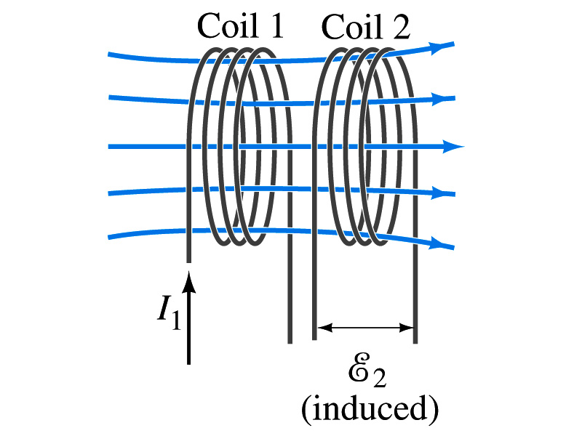
Mutual Inductance
If two coils of wire are placed near each other, a changing current in one will induce an emf in the other.
What is the induced emf, ε₂, in coil 2 proportional to?
  Rate of the change of the magnetic flux passing through it
This flux is due to current I₁ in coil 1
If Φ₂₁ is the magnetic flux in each loop of coil 2 created by coil1 and N₂ is the number of closely packed loops in coil 2, then N₂Φ₂₁ is the total flux passing through coil 2.
If the two coils are fixed in space, N₂Φ₂₁ is proportional to the current I₁ in coil 1, .
The proportionality constant for this is called the Mutual Inductance and defined as .
The emf induced in coil 2 due to the changing current in coil 1 is

Slide 7
Mutual Inductance
The mutual induction of coil 2 with respect to coil 1, M₂₁,
  is a constant and does not depend on I₁.
  depends only on “geometric” factors such as the size, shape, number of turns and relative position of the two coils, and whether a ferromagnetic material is present
    The farther apart the two coils are the less flux can pass through coil, 2, so M₂₁ will be less.
  In most cases the mutual inductance is determined experimentally
Conversely, the changing current in coil 2 will induce an emf in coil 1
  M₁₂ is the mutual inductance of coil1 with respect to coil2 and M₁₂ = M₂₁
  We can put M=M₁₂=M₂₁ and obtain
  SI unit for mutual inductance is Henry (H)
What? Does this make sense?

Slide 8
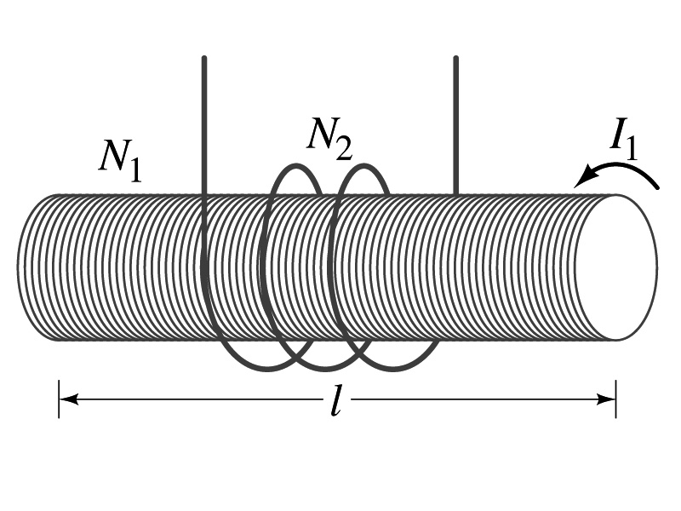
Example 30 – 1
Solenoid and coil. A long thin solenoid of length l and cross-sectional area A contains N₁ closely packed turns of wire. Wrapped around it is an insulated coil of N₂ turns. Assuming all the flux from coil 1 (the solenoid) passes through coil 2, calculate the mutual inductance.
First, we need to determine the flux produced by the solenoid.
What is the magnetic field inside the solenoid?
Since the solenoid is closely packed, we can assume that the field lines are perpendicular to the surface area of the coils. Thus the flux through coil 2 is
Thus the mutual inductance of coil 2 is
Note that M₂₁ only depends on geometric factors!

Slide 9
Self Inductance
The concept of inductance applies to a single isolated coil of N turns. How does this happen?
  When a changing current passes through a coil
  A changing magnetic flux is produced inside the coil
  The changing magnetic flux in turn induces an emf in the same coil
  This emf opposes the change in flux. Whose law is this?
    Lenz’s law
What would this do?
  When the current through the coil is increasing?
    The increasing magnetic flux induces an emf that opposes the original current
    This tends to impedes its increase, trying to maintain the original current
  When the current through the coil is decreasing?
    The decreasing flux induces an emf in the same direction as the current
    This tends to increase the flux, trying to maintain the original current

Slide 10
Self Inductance
Since the magnetic flux Φ_{B} passing through N turn coil is proportional to current I in the coil,
We define self-inductance, L:
The induced emf in a coil of self-inductance L is
  What is the unit for self-inductance?
What does magnitude of L depend on?
  Geometry and the presence of a ferromagnetic material
Self inductance can be defined for any circuit or part of a circuit
Self Inductance

Slide 11
So what in the world is the Inductance?
It is an impediment onto the electrical current due to the existence of changing magnetic flux
So what?
In other words, it behaves like a resistance to the varying current, such as AC, that causes the constant change of magnetic flux
But it also provides means to store energy, just like the capacitance

Slide 12
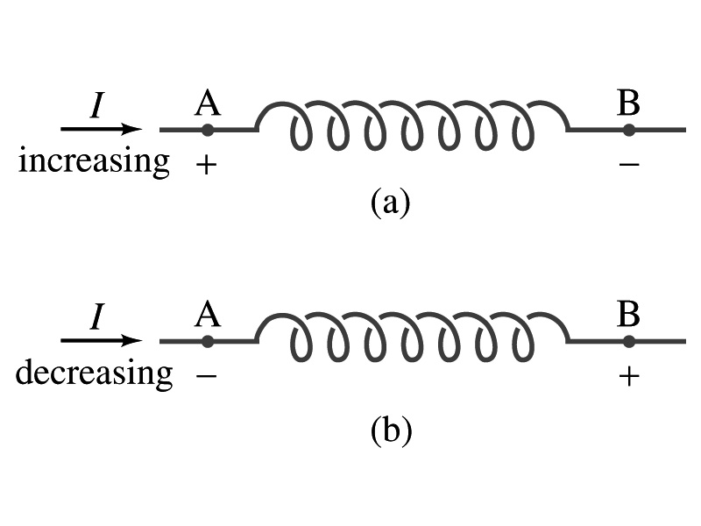
Inductor
An electrical circuit always contains some inductance but is normally negligibly small
  If a circuit contains a coil of many turns, it could have large inductance
A coil that has significant inductance, L, is called an inductor and is express with the symbol
  Precision resistors are normally wire wound
    Would have both resistance and inductance
    The inductance can be minimized by winding the wire back on itself in opposite direction to cancel magnetic flux
    This is called a “non-inductive winding”
If an inductor has negligible resistance, inductance controls the changing current
For an AC current, the greater the inductance the less the AC current
  An inductor thus acts like a resistor to impede the flow of alternating current (not to DC, though. Why?)
  The quality of an inductor is indicated by the term reactance or impedance

Slide 13
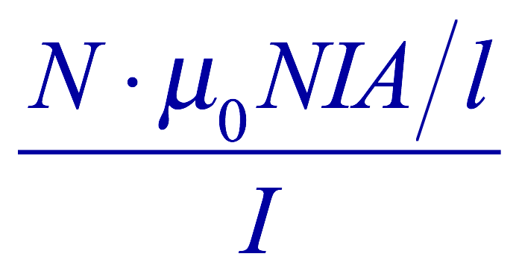
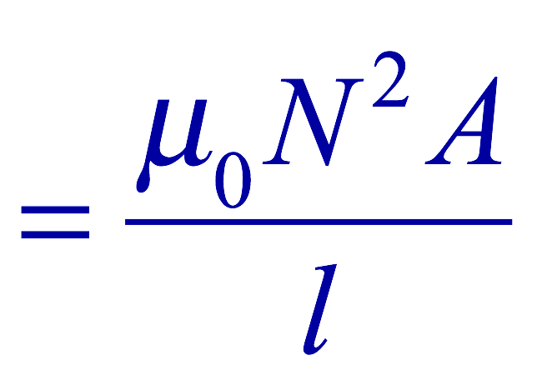
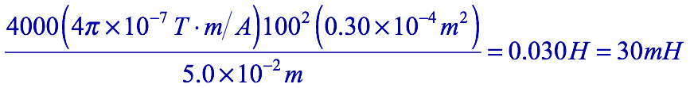
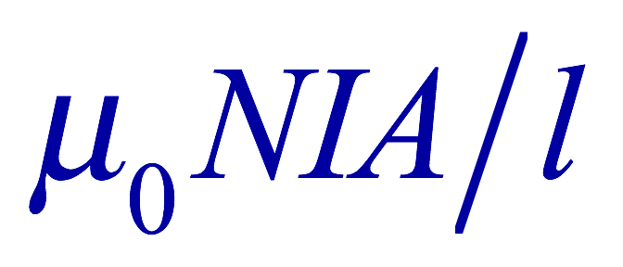
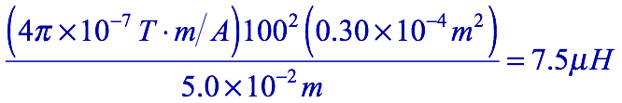
Example 30 – 3
Solenoid inductance. (a) Determine the formula for the self inductance L of a tightly wrapped solenoid ( a long coil) containing N turns of wire in its length l and whose cross-sectional area is A. (b) Calculate the value of L if N=100, l=5.0cm, A=0.30cm² and the solenoid is air filled. (c) calculate L if the solenoid has an iron core with μ=4000μ₀.
What is the magnetic field inside a solenoid?
The flux is, therefore,
Using the formula for self inductance:
(b) Using the formula above
(c) The magnetic field with an iron core solenoid is

Slide 14
Energy Stored in the Magnetic Field
The work done to the system is the same as the energy stored in the inductor when it is carrying current I
  This is compared to the energy stored in a capacitor, C, when the potential difference across it is V:
  Just like the energy stored in a capacitor is considered to reside in the electric field between its plates
  The energy in an inductor can be considered to be stored in its magnetic field
Energy Stored in a magnetic field inside an inductor

Slide 15
Stored Energy in terms of B
So how is the stored energy written in terms of magnetic field B?
  Inductance of an ideal solenoid without the fringe effect
  The magnetic field in a solenoid is
  Thus the energy stored in an inductor is
  Thus the energy density is
  This formula is valid in any region of space
  If a ferromagnetic material is present, μ₀ becomes μ.
E
What is this?
E density
Volume V
What volume does Al represent?
The volume inside a solenoid!!

Slide 16
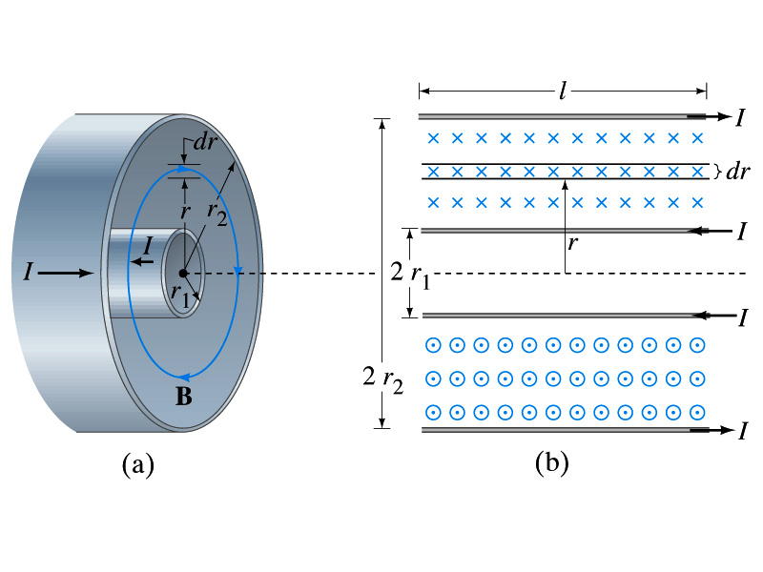
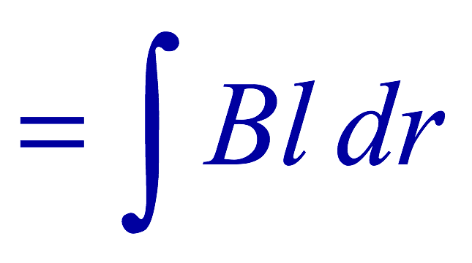
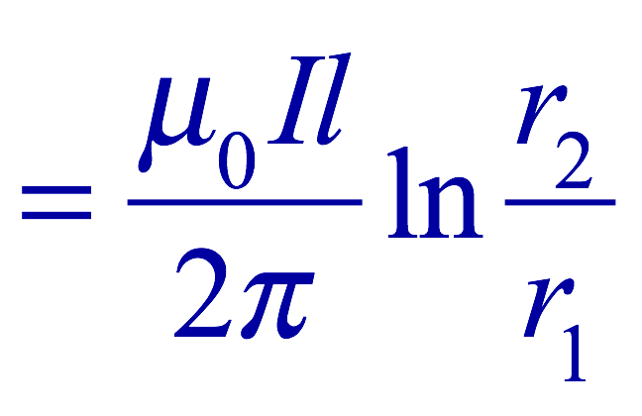

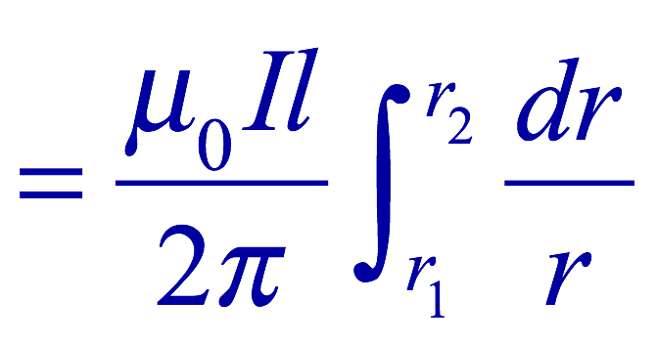
Example 30 – 5
Energy stored in a coaxial cable. (a) How much energy is being stored per unit length in a coaxial cable whose conductors have radii r₁ and r₂ and which carry a current I? (b) Where is the energy density highest?
(a) The total flux through l of the cable is
Thus inductance per unit length for a coaxial cable is
Thus the energy stored per unit length is
(b) Since the magnetic field is
The energy density is highest where B is highest. Since B is highest close to r=r₁, near the surface of the inner conductor.
And the energy density is

