Slide 1
PHYS 1444 – Section 002 Lecture #23
Monday, Nov. 25, 2019
Dr. Jaehoon Yu
Chapter 30: Inductance
LR Circuit
LC circuit and EM Oscillation
AC circuit with Inductor Only & Capacitor Only
Chapter 31: Maxwell’s equations
Expansion of Ampere’s Law
Gauss’ Law for Magnetism
Production of EM Waves
Light as EM Waves

Slide 2
Announcements
Reading assignments: CH30.7 – 30.11
Planetarium Extra Credit: bring to class Mon. Dec. 2
Be sure to tape one end of the ticket stub on a sheet of paper with your name on it
Final comprehensive exam
In class 1:00 – 2:20pm, Wednesday, Dec. 4
Covers: CH21.1 – what we finish Monday, Dec. 2
Bring your calculator but DO NOT input formula into it!
Cell phones or any types of computers cannot replace a calculator!
BYOF: You may bring a one 8.5x11.5 sheet (front and back) of handwritten formulae and values of constants for the quiz
No derivations, word definitions, set ups or solutions of any problems!
NO MAXWELL’s Equations!!
No additional formulae or values of constants will be provided!
No class this Wednesday, Nov. 27
Happy Thanksgiving!
Course evaluation survey!!

Slide 3
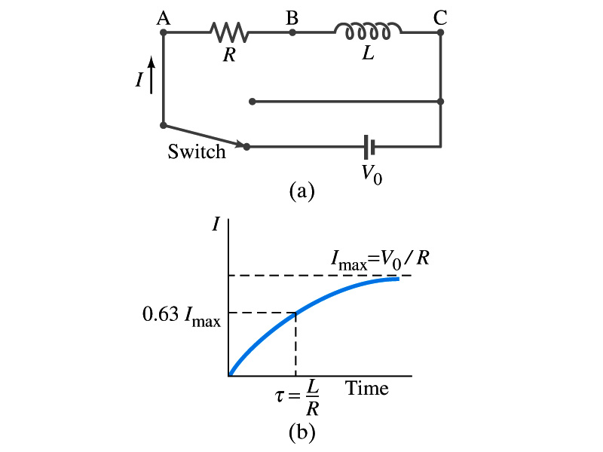
LR Circuits
What happens when an emf is applied to an inductor?
An inductor has some resistance, however negligible
So an inductor can be drawn as a circuit of separate resistance and coil. What is the name this kind of circuit?
What happens at the instance the switch is thrown to apply emf to the circuit?
The current starts to flow, gradually increasing from 0
This change is opposed by the induced emf in the inductor ➔ the emf at point B is higher than point C
However there is a voltage drop at the resistance which reduces the voltage across inductance
Thus the current increases less rapidly
The overall behavior of the current is a gradual increase, reaching to the maximum current I_{max}=V₀/R.
LR Circuit

Slide 4
LR Circuits
This can be shown w/ Kirchhoff loop rules
The emfs in the circuit are the battery voltage V₀ and the emf ε=-L(dI/dt) in the inductor opposing the current increase
The sum of the potential changes through the circuit is
Where I is the current at any instance
By rearranging the terms, we obtain the differential eq.
We can integrate just as in RC circuit
So the solution is
Where τ=L/R
This is the time constant τ of the LR circuit and is the time required for the current I to reach 0.63 of the maximum

Slide 5
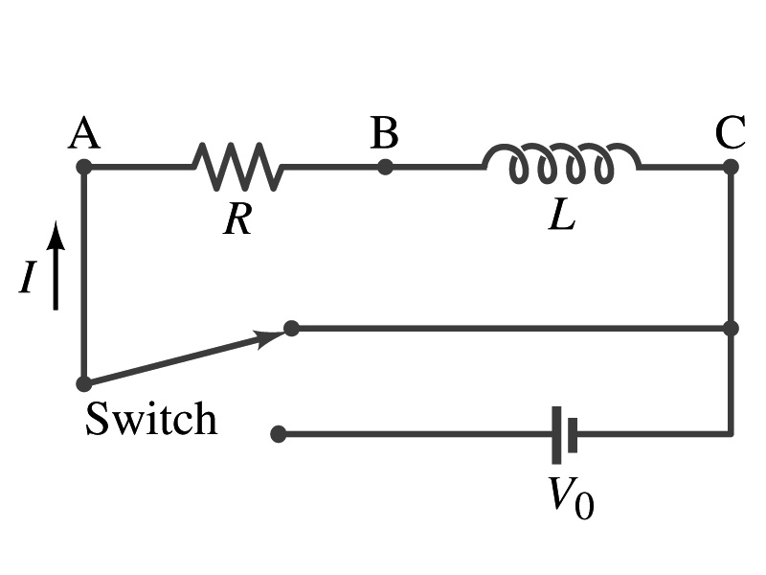
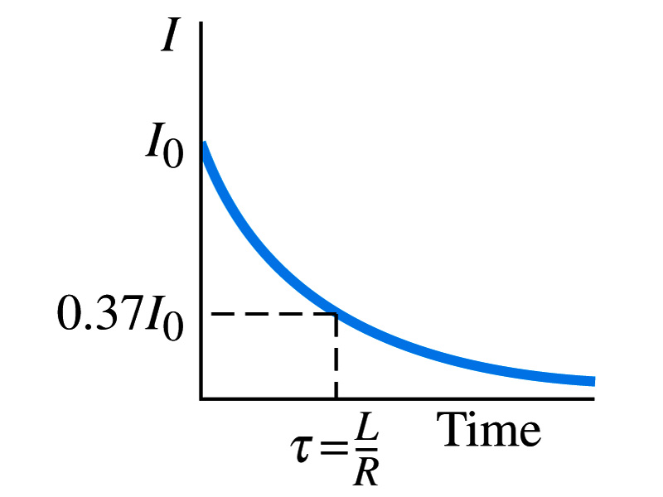
Discharge of LR Circuits
If the switch is flipped away from the battery
The differential equation becomes
So the integration is
Which results in the solution
The current decays exponentially to zero with the time constant τ=L/R
So there always is a reaction time when a system with a coil, such as an electromagnet, is turned on or off.
The current in LR circuit behaves almost the same as that in RC circuit but the time constant is inversely proportional to R in LR circuit unlike the RC circuit

Slide 6
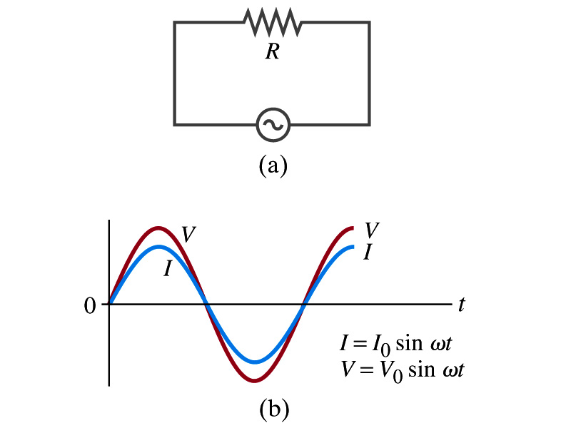
AC Circuit w/ Resistance only
What do you think will happen when an AC source is connected to a resistor?
From Kirchhoff’s loop rule, we obtain
Thus
where
What does this mean?
Current is 0 when voltage is 0 and current is in its peak when voltage is in its peak.
Current and voltage are “in phase”
Energy is lost via the transformation into heat at an average rate

Slide 7
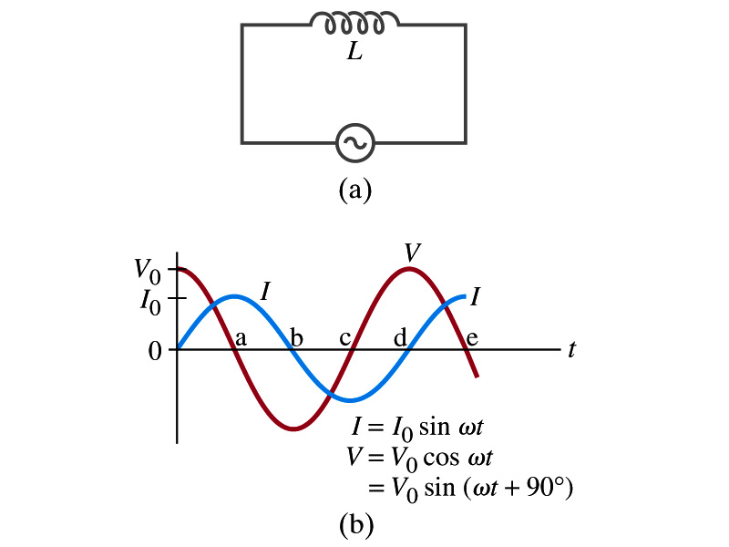
AC Circuit w/ Inductance only
From Kirchhoff’s loop rule, we obtain
Thus
Using the identity
where
What does this mean?
Current and voltage are “out of phase by π/2 or 90º”. In other words the current reaches its peak ¼ cycle after the voltage
What happens to the energy?
No energy is dissipated
The average power is 0 at all times
The energy is stored temporarily in the magnetic field
Then released back to the source

Slide 8
AC Circuit w/ Inductance only
How are the resistor and inductor different in terms of energy?
Inductor
Resistor
How are they similar?
They both impede the flow of charge
For a resistance R, the peak voltage and current are related to
Similarly, for an inductor we may write
Where X_{L} is the inductive reactance of the inductor
What do you think is the unit of the reactance?
The relationship is not valid at a particular instance. Why not?
Since V₀ and Ι₀ do not occur at the same time
Stores the energy temporarily in the magnetic field and then releases it back to the emf source
Does not store energy but transforms it to thermal energy, losing it to the environment
0 when ω=0.
Ω
is valid!

Slide 9
Example 30 – 9
Reactance of a coil. A coil has a resistance R=1.00Ω and an inductance of 0.300H. Determine the current in the coil if (a) 120 V DC is applied to it; (b) 120 V AC (rms) at 60.0Hz is applied.
Is there a reactance for DC?
Nope. Why not?
Since ω=0,
So for DC power, the current is from Kirchhoff’s rule
For an AC power with f =60Hz, the reactance is
Since the resistance can be ignored compared to the reactance, the rms current is

Slide 10
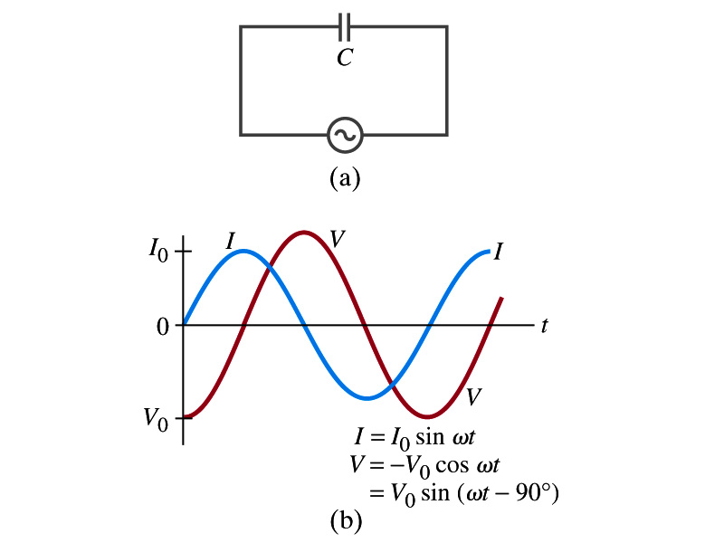
AC Circuit w/ Capacitance only
What happens when a capacitor is connected to a DC power source?
The capacitor quickly charges up.
There is no steady current flow in the circuit
Since the capacitor prevents the flow of the DC current
What do you think will happen if it is connected to an AC power source?
The current flows continuously. Why?
When the AC power turns on, charge begins to flow one direction, charging up the plates
When the direction of the power reverses, the charge flows in the opposite direction

Slide 11
AC Circuit w/ Capacitance only
From Kirchhoff’s loop rule, we obtain
The current at any instance is
The charge Q on the plate at any instance is
Thus the voltage across the capacitor is
Using the identity
Where

Slide 12
AC Circuit w/ Capacitance only
So the voltage is
What does this mean?
Current and voltage are “out of phase by π/2 or 90º” but in this case, the voltage reaches its peak ¼ cycle after the current
What happens to the energy?
No energy is dissipated
The average power is 0 at all times
The energy is stored temporarily in the electric field
Then released back to the source
Applied voltage and the current in the capacitor can be written as
Where the capacitive reactance X_{C} is defined as
Again, this relationship is only valid for rms quantities
Infinite when ω=0.

Slide 13
Example 30 – 10
Capacitor reactance. What are the peak and rms current in the circuit in the figure if C=1.0μF and V_{rms}=120V? Calculate for (a) f=60Hz, and then for (b) f=6.0x10⁵Hz.
The peak voltage is
The capacitance reactance is
Thus the peak current is
The rms current is

