Slide 1
PHYS 1441 – Section 002 Lecture #2
Monday, Aug. 31, 2020
Dr. Jaehoon Yu
Brief history of physics
Standards and units and other basics
CH21
Static Electricity and Charge Conservation
Charges in Atom
Insulators and Conductors & Induced Charge
Coulomb’s Law
Today’s homework is homework #2, due 11pm, Wednesday, Sept. 9!!

Slide 2
Announcements
Reading assignment: CH21 – 7
129/143 of you have registered in the homework system.
115/129 submitted the homework!
Fantastic job!!
You need my enrollment approval. So move quickly.
Remember, the deadline for the first homework is 11pm, today, Monday, Aug. 31
You MUST submit the homework to obtain 100% credit!
Also please be sure to make the payment in time otherwise your access as well as my access to the site for grading is cut.
Quiz at the beginning of the class Wed., Sept. 2
Appendix A1 – A9 and what we’ve learned today (CH21 – 3 or 4?)!
BYOF: You may bring a one 8.5x11.5 sheet (front and back) of handwritten formulae and values of constants for the exam
No derivations, word definitions or setups or solutions of any problems!
No additional formulae or values of constants will be provided!
Must send me the photos of both front & back of the formula sheet, including the blank!
File name must be FS-Q1-LastName-FirstName-fall20.pdf

Slide 3
Basic Rules for Online Exams
All quizzes and exams will be online on Quest, the same system as your online homework
Academic integrity is very important to keep the system the fairest to all
We all have to work together to maintain the integrity!
Leave the camera ON showing you and UNMUTE the mic at all times
If you have questions, type into the zoom chat window to me
POWER OFF your phone, iPADs and any other computing devices except for the computer you take exam with
Quit all other applications and web pages, except zoom and the Quest
Have your calculator, formula sheet and clean scrap sheets out
Strongly suggest to write down the answers before entering
Send me the photos of the front and back of your formula sheet no later than 1 hour prior to the exam (E)/quizzes (Q)
File name must be FS-Q1-LastName-FirstName-fall20.pdf

Slide 4
Extra Credit Special Project #1
Compare the Coulomb force to the Gravitational force in the following cases by expressing Coulomb force (F_{C}) in terms of the gravitational force (F_{G})
Between the two protons separated by 1m
Between the two protons separated by an arbitrary distance R
Between the two electrons separated by 1m
Between the two electrons separated by an arbitrary distance R
Five points each, totaling 20 points
BE SURE to show all the details of your own work, including all formulae, proper references to them and explanations
Must be handwritten and submit all pages in a single PDF file
File name must be: SP1-LastName-FirstName-Fall20.pdf
Due at the beginning of the class Wednesday, Sept. 9

Slide 5
What do we want to learn in this class?
Physics is everywhere around you.
Skills to understand the fundamental principles that surrounds you in everyday lives…
Skills to identify what laws of physics applies to what phenomena and use them appropriately
Understand the impact of physical laws and apply them
Learn skills to think, research and analyze observations.
Learn skills to express the observations and measurements in a mathematical language
Learn skills to express your research in a systematic manner in writing
But most importantly the confidence in your physics ability and to take on any challenges laid down in front of you!!
Even more importantly, let us have a lot of FUN!!

Slide 6
Specifically, in this course, you will learn…
Concept of Electricity and Magnetism
Electric charge and magnetic poles
Electric and Magnetic Forces and fields
Electric and magnetic potential and energies
Propagation of electric and magnetic fields
Relationship between electro-magnetic forces and light
Behaviors of light and optics, the theory of light
Special relativity and quantum theories

Slide 7
What can you expect from this class?
All A’s?
This would be really nice, wouldn’t it?
But if it is too easy it is not fulfilling or meaningful….
This class is not going to be a stroll in the park!!
You will earn your grade in this class.
You will need to put in sufficient time and sincere efforts
Exams and quizzes will be tough!!
Sometimes problems might not look exactly like what you learned in the class
Do the work with your own hands!
But you have a great control (up to 45%) of your grade in your hands
Homework is 25% of the total grade!!
Means you will have many homework problems
Sometimes much more than any other classes
Some homework problems will be something that you have yet to learn in class
Exam problems will be easier than homework problems but the same principles!!
Lab 10%
Extra credit 10%
I will work with you so that your sincere efforts, despite COVID –19 related hardship are properly rewarded

Slide 8
How to study for this course?
Keep up with the class for comprehensive understanding of materials
Come to the class and participate in the discussions and problems solving sessions
Follow through lecture notes
Work out example problems in the book yourself without looking at the solution
Have many tons of fun in the class, asking lots of questions!!!!!
Keep up with the homework to put the last nail on the coffin
One can always input the answers as you solve problems. Do NOT wait till you are done with all the problems.
Form a study group and discuss how to solve problems with your friends, then work the problems out yourselves!
Prepare for upcoming classes
Read the textbook for the material to be covered in the next class
The extra mile
Work out additional problems in the back of the book starting the easiest problems to harder ones

Slide 9
Why do Physics?
Exp.{
To understand nature through experimental observations and measurements (Research)
Establish limited number of fundamental laws, usually with mathematical expressions
Predict the nature’s course
Theory and Experiment work hand-in-hand
Discrepancies between experimental measurements and theory are good for improvements
The general principles formulated through theory is used to improve our everyday lives, even though some laws can take a while until we see them amongst us
Theory {
9

Slide 10
Brief History of Physics
AD 17th and 18th century:
Newton’s Classical Mechanics: A theory of mechanics based on observations and measurements
AD 18th and 19th Century:
Electricity, Magnetism, and Thermodynamics
Late AD 19th and early 20th century (Modern Physics Era)
Einstein’s theory of relativity: Generalized theory of space, time, and energy (mechanics)
Quantum Mechanics: Theory of atomic phenomena
Physics has come very far, very fast, and is still progressing, yet we’ve got a long way to go
What is matter made of?
How does matter get mass?
How and why do matters interact with each other?
How is the universe created?
10

Slide 11
Terminology: Models, Theories and Laws
Models: An analogy or a mental image of a phenomena in terms of something we are familiar with
Thinking light as waves that behave just like water waves
Often provide insights for new experiments and ideas
Theories: More systematically improved version of models
Can provide quantitative predictions that are testable and more precise
Laws: Certain concise but general statements about how nature behaves (Poll 5)
Energy & momentum conservations, charge conservation, etc
The statement must be found experimentally valid to become a law
Principles: Less general statements of how nature behaves
Has some level of arbitrariness
11

Slide 12
Uncertainties
Physical measurements have limited precision, however good they are, due to:
Number of measurements (Normally scales by )
Quality of the instruments (meter stick vs micro-meter)
Experience of the person doing measurements
Etc
In many cases, uncertainties are more important and difficult to estimate than the central (or mean) values
Stat.{
{
Syst.
12

Slide 13
Significant Figures
Denote the precision of the measured values
The number 80 implies precision of +/- 1, between 79 and 81
If you are sure to +/-0.1, the number should be written 80.0
Significant figures: non-zero numbers or zeros that are not place-holders
34, 34.2, 0.001, 34.100
34 has two significant digits
34.2 has 3
0.001 has one because the 0’s before 1 are place holders to position “.”
34.100 has 5, because the 0’s after 1 indicate that the numbers in these digits are indeed 0’s.
When there are many 0’s, use scientific notation for simplicity:
31400000=3.14x10⁷ (on Quest 3.14E7 format is used)
0.00012=1.2x10⁻⁴
13

Slide 14
Significant Figures
Operational rules:
Addition or subtraction: Keep the smallest number of decimal place in the result, independent of the number of significant digits: 12.001+ 3333.1=
Multiplication or Division: Keep the smallest number of significant digits in the result: 12.001 x 3.1 = , because the smallest significant figures is ?.
3345.1
37
What does this mean?
The worst precision determines the precision of the overall operation!!
In English?
Can’t get any better than the worst of the measurements!
14

Slide 15
SI Base Quantities and Units
Quantity | Unit | Unit Abbrevation
Length | Meter | m
Time | Second | s
Mass | Kilogram | kg
Electric current | Ampere | A
Temperature | Kelvin | K
Amount of substance | Mole | mol
Luminous Intensity | Candela | cd
There are prefixes that scales the units larger or smaller for convenience (see pg. 9)
These simplifies the expression of numbers: 20,000,000,000 bytes
➔20GB

Slide 16
Prefixes, expressions and their meanings
Larger
Smaller
deca (da): 10¹
hecto (h): 10²
kilo (k): 10³
mega (M): 10⁶
giga (G): 10⁹
tera (T): 10¹²
peta (P): 10¹⁵
exa (E): 10¹⁸
zetta (Z): 10²¹
yotta (Y): 10²⁴
deci (d): 10⁻¹
centi (c): 10⁻²
milli (m): 10⁻³
micro (μ): 10⁻⁶
nano (n): 10⁻⁹
pico (p): 10⁻¹²
femto (f): 10⁻¹⁵
atto (a): 10⁻¹⁸
zepto (z): 10⁻²¹
yocto (y): 10⁻²⁴
16

Slide 17
How do we convert quantities from one unit to another?
Unit 1 =
Conversion factor X
Unit 2
1 inch | 2.54 | cm
1 inch | 0.0254 | m
1 inch | 2.54x10⁻⁵ | km
1 ft | 30.3 | cm
1 ft | 0.303 | m
1 ft | 3.03x10⁻⁴ | km
1 hr | 60 | minutes
1 hr | 3600 | seconds
And many | More | Here….
17

Slide 18
What does the Electric Force do?
Electric force is the bases of modern technology
Virtually everything we use every day uses the electric force
Can you give a few examples?
But this force also affects much more
Making up materials with atoms and molecules
Biological and metabolic processes
Nerve signals, heart pumping, etc
Virtually all contact forces we have learned in Physics I:
Friction, normal force, elastic force and other contact forces are the results of electric forces acting at the atomic level

Slide 19
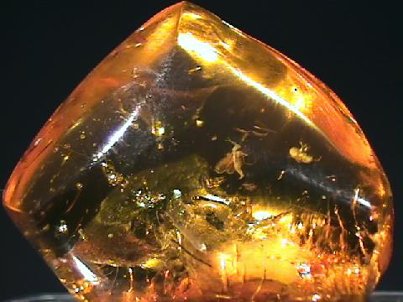
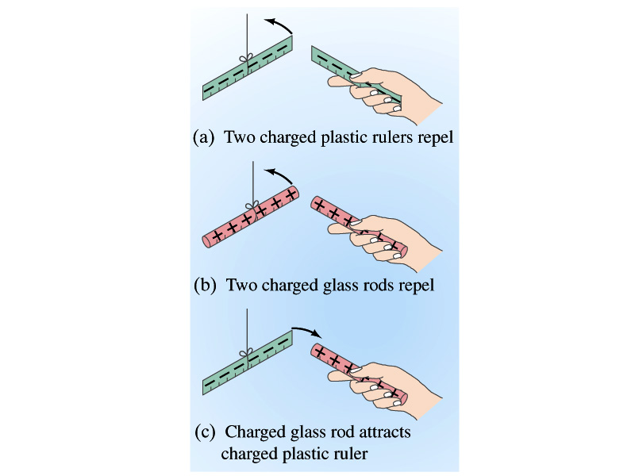
Static Electricity; Electric Charge and Its Conservation
Electricity is from Greek word elecktron=amber, a petrified tree resin that attracts matter if rubbed
Static Electricity: an amber effect
An object becomes charged or “possesses a net electric charge” due to rubbing
Can you give some examples?
Two types of electric charge, positive/negative
Like charges repel while unlike charges attract
Benjamin Franklin referred the charge on glass rod as the positive, arbitrarily. Thus the charge that attracts glass rod is negative. ➔ This convention is still used.

Slide 20
Static Electricity; Electric Charge and Its Conservation
Franklin argued that when a certain amount of charge is produced on one body in a process, an equal amount of opposite type of charge is produced on another body.
The positive and negative are treated algebraically so that during any process the net change in the amount of produced charge is 0.
When you comb your hair with a plastic comb, it acquires the negative charge, and the hair gets an equal amount of positive charge.
This is the law of conservation of electric charge.
The net amount of electric charge produced in any process is ZERO!!
If an object or one region of space acquires a positive charge, then an equal amount of negative charge will be found in neighboring areas or objects.
No violations have ever been observed.
This conservation law is as firmly established as that of energy or momentum.

Slide 21
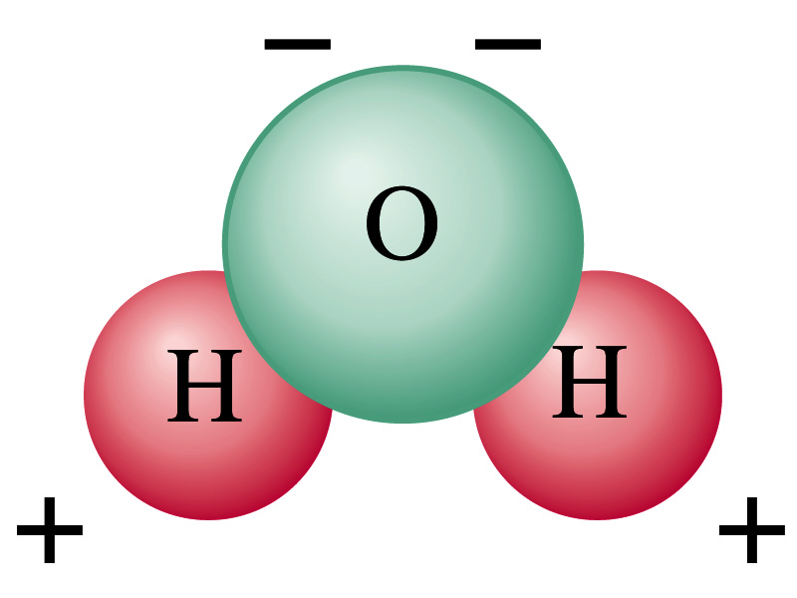
Electric Charge in an Atom
It has been understood through the past century that an atom consists of
A positively charged heavy core ⬅ What is the name?
This core is called the nucleus and consists of neutrons and protons.
Many negatively charged particles with small mass surround the core ⬅ What is the name of these light particles?
These are called the electrons
How many of these in an atom?
So what is the net electrical charge of an atom?
ZERO!!! Electrically neutral!!!
Can you explain what happens when a comb is rubbed on a towel?
The electrons from the towel get transferred to the comb, making the comb negatively charged while leaving positive ions on the towel.
These charges eventually get neutralized primarily by water molecules in the air.
As many as the number of protons in the nucleus!!

