Slide 1
PHYS 1441 – Section 002 Lecture #3
Wednesday, Sept. 2, 2020
Dr. Jaehoon Yu
CH21
Insulators and Conductors & Induced Charge
Coulomb’s Law

Slide 2
Announcements
Reading assignment: CH21 – 7
Virtual Physics Clinic: (M: 9am – 1pm, TuWTh: 9am – 5pm) https://teams.microsoft.com/l/channel/19%3ae5b118c00e8d4baa8c0b2b4be09bbcd5%40thread.tacv2/General?groupId=a272a438-e2fd-42e7-8c18-1a8166647940&tenantId=5cdc5b43-d7be-4caa-8173-729e3b0a62d9
No class Labor Day coming Monday, Sept. 7

Slide 3
Reminder: Extra Credit Special Project #1
Compare the Coulomb force to the Gravitational force in the following cases by expressing Coulomb force (F_{C}) in terms of the gravitational force (F_{G})
Between the two protons separated by 1m
Between the two protons separated by an arbitrary distance R
Between the two electrons separated by 1m
Between the two electrons separated by an arbitrary distance R
Five points each, totaling 20 points
BE SURE to show all the details of your own work, including all formulae, proper references to them and explanations
Must be handwritten and submit all pages in a single PDF file
File name must be: SP1-LastName-FirstName-Fall20.pdf
Due at the beginning of the class Wednesday, Sept. 9

Slide 4
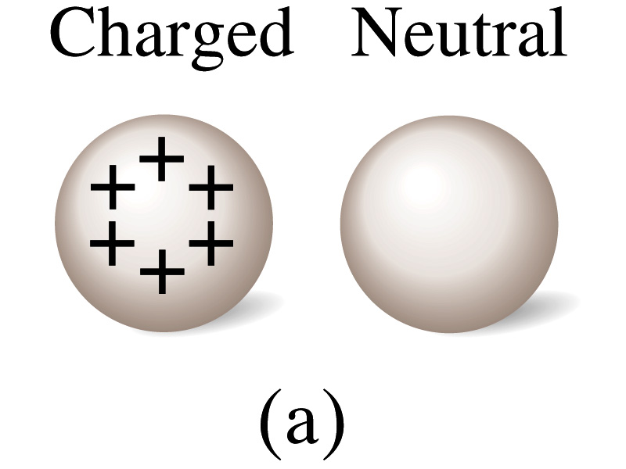
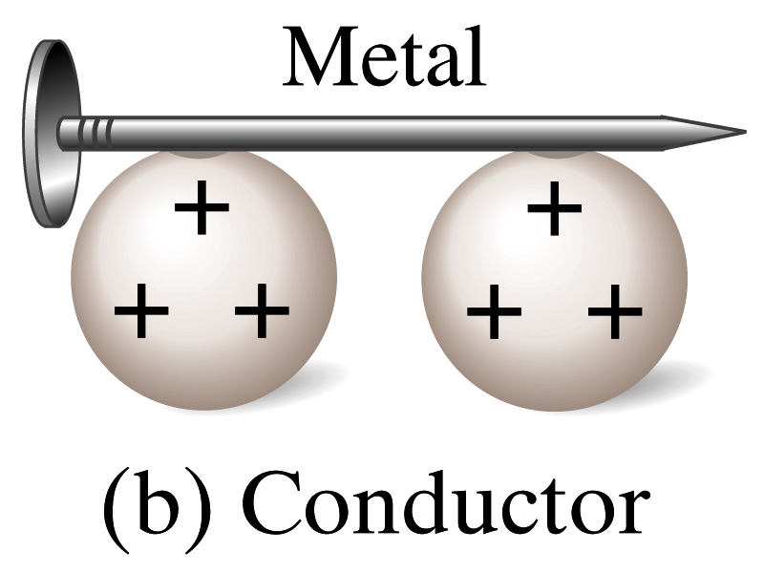
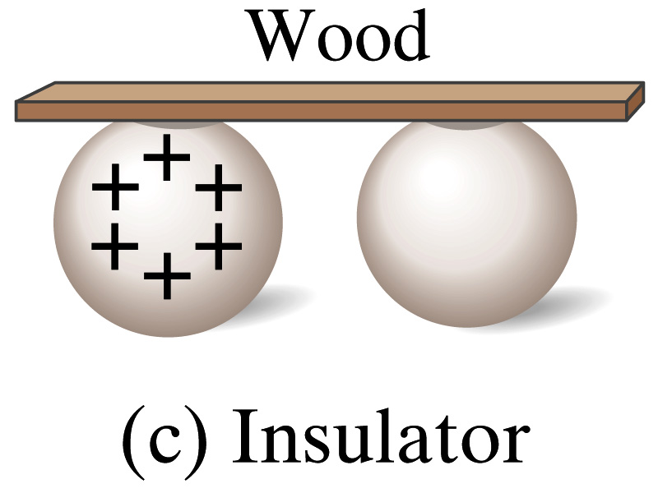
Insulators and Conductors
Let’s imagine two metal balls of which one is charged
What will happen if they are connected by
A metallic object?
Some charge is transferred through this object.
These objects are called the conductors of electricity.
An wooden object?
No charge is transferred
These objects are called the nonconductors or insulators.
Metals are generally a good conductor whereas most other materials are insulators.
There are third kind of materials called, semi-conductors, like silicon or germanium ➔ conduct only in certain conditions
Atomically, conductors have loosely bound electrons, while insulators have them tightly bound!

Slide 5
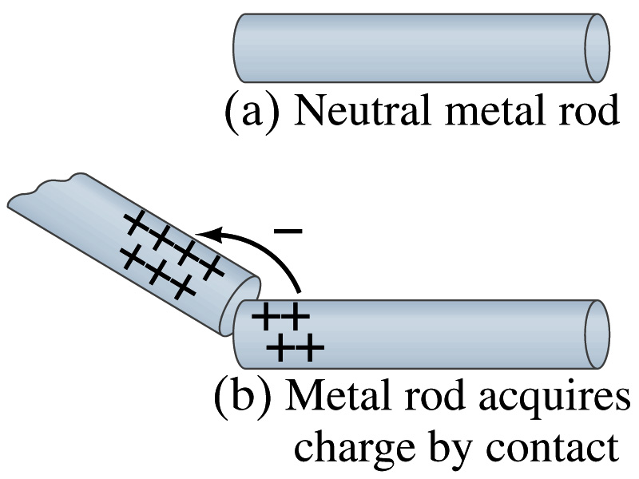
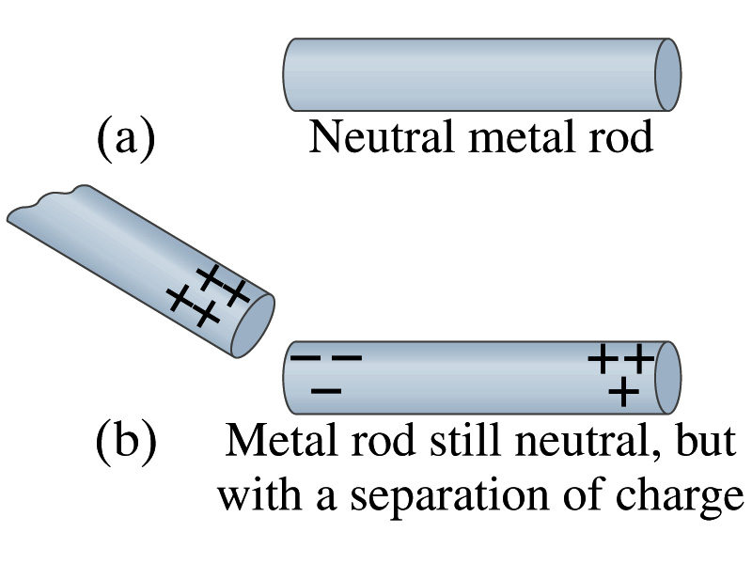
Induced Charge
When a positively charged metallic object is brought close to an uncharged metal object
If two objects touch each other, the free electrons in the neutral one are attracted to the positively charged object and some will pass over to it, leaving the neutral object positively charged ➔ Charging by conduction
If the objects get close, the free electrons in the neutral one still move within the metal toward the charged object leaving the opposite side of the object positively charged.
The charges have been “induced” in the opposite ends of the object.

Slide 6
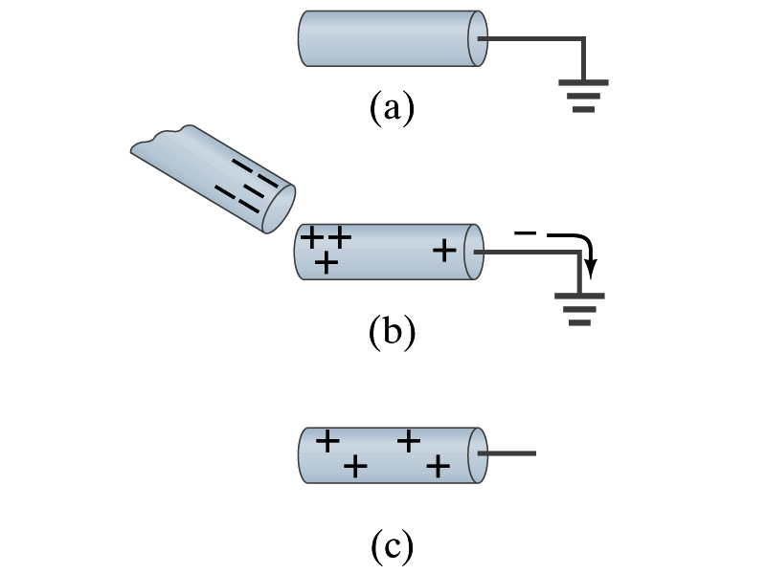
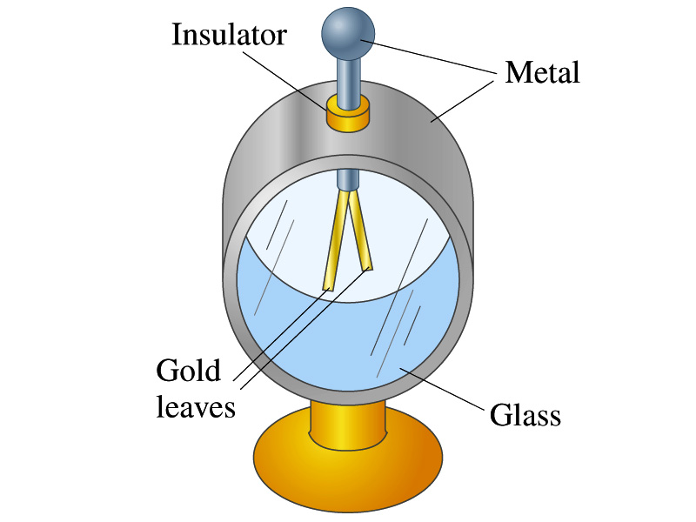
Induced Charge
ground
We can induce a net charge on a metal object by connecting a wire to the ground.
The object is “grounded” or “earthed”.
Since the Earth is so large and conducts, it can give or accept charge.
The Earth acts as a reservoir of electric charge.
If negative charge is brought close to a neutral metal
Positive charge will be induced toward the negatively charged metal.
The negative charges in the neutral metal will be gathered on the opposite side, transferring through the wire to the Earth.
If the wire is cut, the metal bar has net positive charge.
An electroscope is a device that can be used for detecting charge and signs.
How does this work?

Slide 7
Coulomb’s Law
Charges exert force to each other. What factors affect the magnitude of this force?
Any guesses?
Charles Coulomb figured this out in 1780’s through an experiment using a torsion balance
Coulomb found that the electric force is
Proportional to the multiplication of the two charges
If one of the charges doubles, the force doubles.
If both the charges double, the force quadruples.
Inversely proportional to the square of the distances between them.
Electric charge is the fundamental property of matter, just like mass.
How would you put the above into a formula?

Slide 8
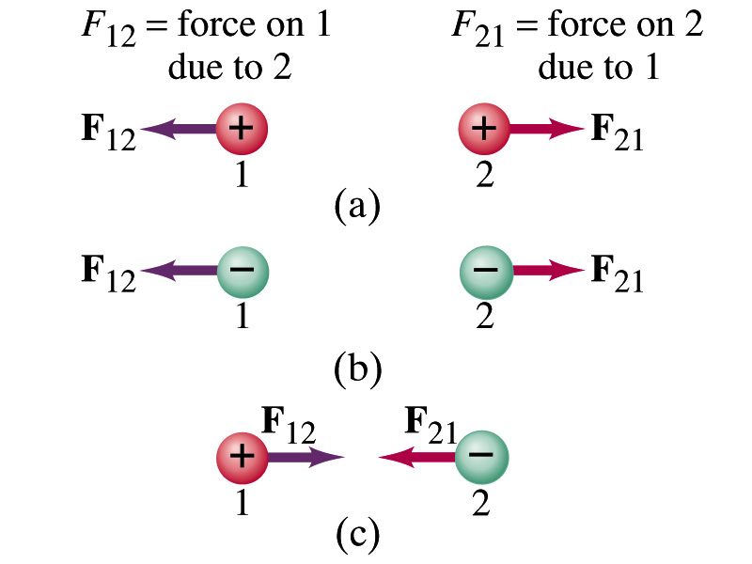
Coulomb’s Law – The Formula
Formula
Is Coulomb force a scalar quantity or a vector quantity? Unit?
A vector quantity. The unit is Newtons (N)!
The direction of electric (Coulomb) force is always along the straight line joining the two objects.
If the two charges are the same: forces are directed away from each other.
If the two charges are the opposite: forces are directed toward each other.
Coulomb force is precise to 1 part in 10¹⁶.
Unit of charge is called Coulomb, C, in SI.
The value of the proportionality constant, k, in SI unit is
Thus, 1C is the charge that gives F~9x10⁹N of force when placed 1m apart from each other.

