Slide 1
PHYS 1441 – Section 002 Lecture #4
Wednesday, Sept. 9, 2020
Dr. Jaehoon Yu
CH21
Coulomb’s Law
Vector Refresh
The Electric Field & Field Lines
Electric Fields and Conductors
Today’s homework is homework #3, due 11pm, Friday, Sept. 18!!

Slide 2
Announcements
Virtual physics clinic on MS Teams
Monday: 9am-2:30; 4pm-5pm
Tuesday: 9am-5pm
Wednesday: 9am-1pm; 4pm-5pm
Thursday: 9am-3:30pm; 4:30-5pm
Friday: 9am-5pm
Direct link: https://teams.microsoft.com/l/channel/19%3ae5b118c00e8d4baa8c0b2b4be09bbcd5%40thread.tacv2/General?groupId=a272a438-e2fd-42e7-8c18-1a8166647940&tenantId=5cdc5b43-d7be-4caa-8173-729e3b0a62d9
1st term exam in class Wed., Sept. 23 ➔ Mark your calendar
Will cover CH21.1 through what we learn on Mon. Sept. 21 + A1 – A9
BYOF
Special project submission changed to CANVAS uploads
Quiz 1 results
Class average: 56.7/70
Equivalent to 81/100
Stop score: 70/70

Slide 3
SP#2 – Angels & Demons
Compute the total possible energy released from an annihilation of x-grams of anti-matter and the same quantity of matter, where x is the last two digits of your SS# or DL#. (20 points)
Use the famous Einstein’s formula for mass-energy equivalence
Compute the power output of this annihilation when the energy is released in x ns, where x is again the first two digits of your SS# or DL#. (10 points)
Compute how many cups of gasoline (8MJ) this energy corresponds to. (5 points)
Compute how many months of world electricity usage (3.6GJ/mo) this energy corresponds to. (5 points)
Due by the beginning of the class, 1pm, Wednesday, Sept. 23
Must be HANDWRITTEN
All pages must be in one PDF file with the name SP2-LastName-FirstName-fall20.pdf uploaded to CANVAS.

Slide 4
SP#3 – Civic Duty I: Voter Registration
Voter registration in Texas ends on Monday, Oct. 5, 2020
Registration can be done: https://www.votetexas.gov/register/index.html
Check your registration: https://teamrv-mvp.sos.texas.gov/MVP/mvp.do
For those who are legal to take part in the election
Your own registration to vote: 10 points
Include the screen shot your own voter registration check
You can have up to 3 more people who are not registered to register: 5 points each
Must include before and after the registration screen shots of the same person next to each other to show these are newly registered
For those who are not legal to take part in the election
You can have up to 5 people who are not registered to register: 5 points each
Must include before and after the registration screen shots of the same person next to each other to show these are newly registered
Deadline: 1pm Wednesday, Oct. 7, 2020
Put all screen shots in one pdf file following the naming convention – SP3-LastName-FirstName-Fall20.pdf and upload to the CANVAS assignment

Slide 5
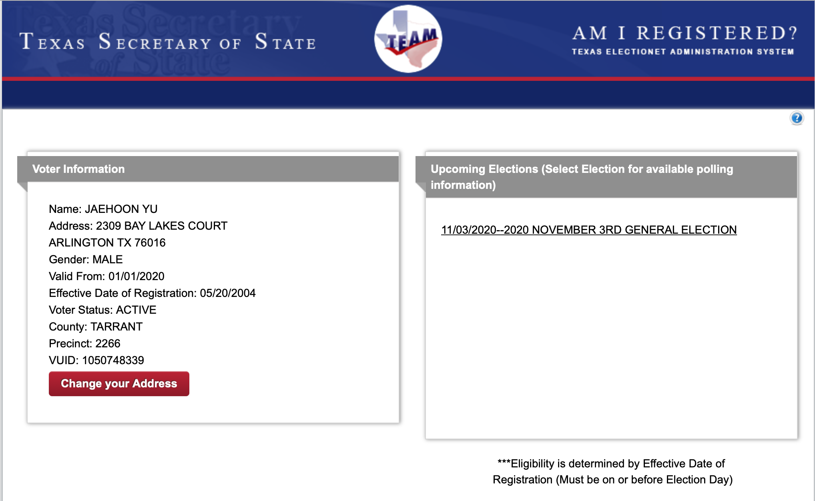
SP#3 – Civic Duty I: Voter Registration – 2

Slide 6
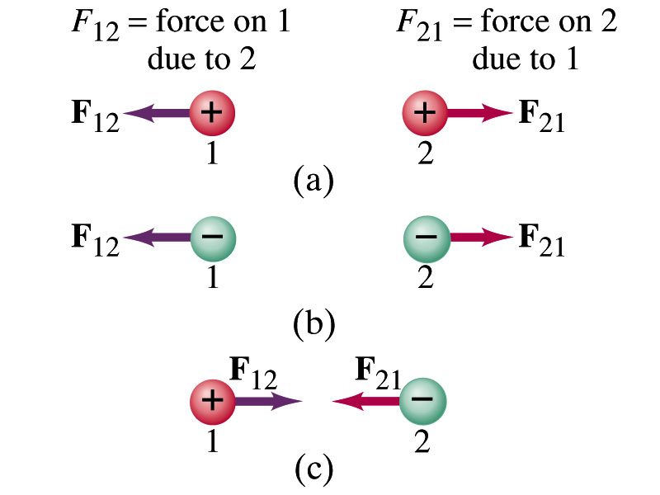
Coulomb’s Law – The Formula
Formula
Is Coulomb force a scalar quantity or a vector quantity? Unit? (polls 1&2)
A vector quantity. The unit is Newtons (N)!
The direction of electric (Coulomb) force is always along the straight line joining the two objects. (poll 7)
If the two charges are the same: forces are directed away from each other.
If the two charges are the opposite: forces are directed toward each other.
Coulomb force is precise to 1 part in 10¹⁶.
Unit of the charge is called Coulomb, C, in SI.
The value of the proportionality constant, k, in SI unit is
Thus, 1C is the charge that gives F~9x10⁹N of force when placed 1m apart from each other.

Slide 7
Electric Force
and Gravitational Force
Extremely
Similar
Does the electric force look similar to another force? What is it? (poll 4)
Gravitational Force
What are the sources of the forces?
Electric Force: Electric charges, fundamental properties of matter
Gravitational Force: Masses, fundamental properties of matter
What else is similar?
Inversely proportional to the square of the distance between the sources of the force ➔ What is this kind law called?
Inverse Square Law
What is the difference? (poll 6)
Gravitational force is always attractive.
Electric force depends on the signs of the two charges. (must pay good attention to the signs due to the sign of the charge and the vector force directions!!)

Slide 8
The Elementary Charge and Permittivity
The elementary charge, the smallest unit charge, is that of an electron:
Since electron is a negatively charged particle, its charge is –e.
Object cannot gain or lose fraction of an electron.
Electric charge is quantized.
Charge of an object changes always in an integer multiples of e.
What kind of quantity is the electric charge? (poll 2)
The proportionality constant k is often written in terms of another constant, ε₀, the permittivity* of free space. They are related and .
Thus the electric force can also be written as:
Note that this force is for “point” charges at rest.
Scalar!!
*Mirriam-Webster, Permittivity: The ability of a material to store electric potential energy under the influence of an electric field

Slide 9
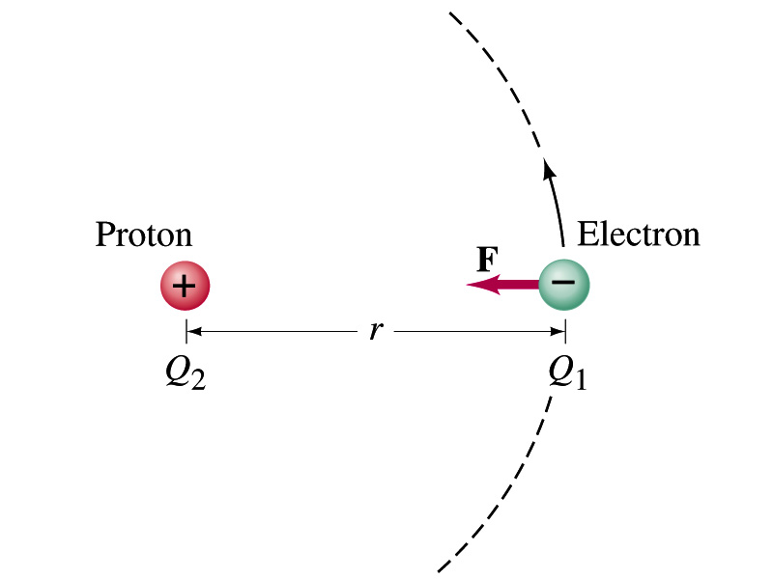
Example on the Coulomb Force
Electric force on electron by proton. Determine the magnitude of the electric force on the electron of a hydrogen atom exerted by the single proton (Q₂=+e) that is its nucleus. Assume the electron “orbits” the proton at its average distance of r=0.53x10⁻¹⁰m. What is the orbital speed of the electron (m_{e}=9.12x10⁻³¹kg)?
Using Coulomb’s law
Each charge is
and
So the magnitude of the force is
Which direction? (poll 7)
Toward each other…
What is the orbital speed of the election?

Slide 10
Example on the Coulomb Force, cnt’d
Orbital Speed of the electron in a hydrogen atom? Assume the electron “orbits” the proton at its average distance of r=0.53x10⁻¹⁰m. What is the orbital speed of the electron (m_{e}=9.12x10⁻³¹kg)?
Coulomb force acts as the centripetal force!!
So the set up is
Solve the equation for v_{e}

Slide 11
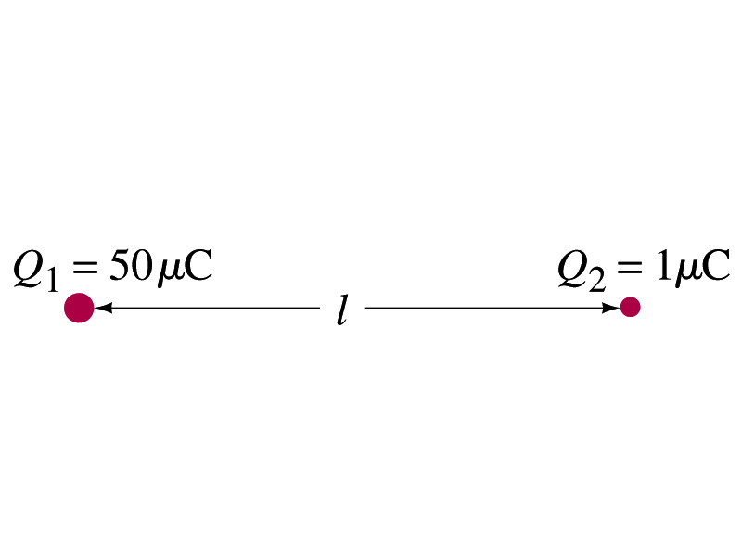
Example 21 – 1
Which charge exerts greater force? Two positive point charges, Q₁=50μC and Q₂=1μC, are separated by a distance L. Which is larger in magnitude, the force that Q₁ exerts on Q₂ or the force that Q₂ exerts on Q₁?
What is the force that Q₁ exerts on Q₂?
What is the force that Q₂ exerts on Q₁?
Therefore the magnitudes of the two forces are identical!!
Well then what is different?
The direction.
Which direction?
Opposite to each other!
What is this law?
Newton’s third law, the law of action and reaction!!

Slide 12
Vector Additions and Subtractions
Addition:
Triangular Method: One can add vectors by connecting the head of one vector to the tail of the other (head-to-tail)
Parallelogram method: Connect the tails of the two vectors and extend
Addition is commutative: Changing order of operation does not affect the results A+B=B+A, A+B+C+D+E=E+C+A+B+D
A+B
A
A+B
B
=
OR
B
A+B
B
A
A
Subtraction:
The same as adding a negative vector:A - B = A + (-B)
A
-B
Since subtraction is equivalent to adding a negative vector, subtraction is also commutative!!!
A-B
Multiplication by a scalar is increasing the magnitude A, B=2A
A
B=2A

Slide 13
Example for Vector Addition
A force of 20.0N applies to north while another force of 35.0N applies in the direction 60.0º West of North. Find the magnitude and direction of resultant force.
F₂sin60^{ο}
N
F₂
60^{ο}
F₂cos60^{ο}
20
F
θ
F₁
E
Find other ways to solve this problem…

