Slide 1
PHYS 1441 – Section 002
Lecture #5
Monday, Sept. 14, 2020
Dr. Jaehoon Yu
CH21
  Vector component refresh
  The Electric Field
  The Directions of The Electric Field and the Electric Force
  Electric Fields and Conductors
  Motion of a Charged Particle in an Electric Field

Slide 2
Announcements
1st term exam in class Wed., Sept. 23
  DO NOT MISS THE EXAM! You will get an F!
  Come to class by 12:40pm, roll call will start at that time
  CH21.1 to what we’ve learned on next Monday, Sept. 21 + Appendices A1 – A9, the math refresher
  BYOF: You may bring a one 8.5x11.5 sheet (front and back) of handwritten formulae and values of constants for the exam
  No derivations, word definitions, figures, pictures, setups or solutions of any problems!
  No additional formulae or values of constants will be provided!
  Must send me the photos of both front & back of the formula sheet, including the blank, in a single file by 11:00am, Sept. 23
    File name must be FS-E1-LastName-FirstName-fall20.pdf
  Once submitted, no changes allowed

Slide 3
Reminder: SP#2 – Angels & Demons
Compute the total possible energy released from an annihilation of x-grams of anti-matter and the same quantity of matter, where x is the last two digits of your SS# or DL#. (20 points)
  Use the famous Einstein’s formula for mass-energy equivalence
Compute the power output of this annihilation when the energy is released in x ns, where x is again the first two digits of your SS# or DL#. (10 points)
Compute how many cups of gasoline (8MJ) this energy corresponds to. (5 points)
Compute how many months of world electricity usage (3.6GJ/mo) this energy corresponds to. (5 points)
Due by the beginning of the class, 1pm, Wednesday, Sept. 23
  Must be HANDWRITTEN
  All pages must be in one PDF file with the name SP2-LastName-FirstName-fall20.pdf uploaded to CANVAS.

Slide 4
Reminder: SP#3 – Civic Duty I: Voter Registration
Voter registration in Texas ends on Monday, Oct. 5, 2020
  Registration can be done: https://www.votetexas.gov/register/index.html
  Check your registration: https://teamrv-mvp.sos.texas.gov/MVP/mvp.do
For those who are legal to take part in the election
  Your own registration to vote: 10 points
    Include the screen shot your own voter registration check
  You can have up to 3 more people who are not registered to register: 5 points each
    Must include before and after the registration screen shots of the same person next to each other to show these are newly registered
For those who are not legal to take part in the election
  You can have up to 5 people who are not registered to register: 5 points each
    Must include before and after the registration screen shots of the same person next to each other to show these are newly registered
Deadline: 1pm Wednesday, Oct. 7, 2020
Put all screen shots in one pdf file following the naming convention – SP3-LastName-FirstName-Fall20.pdf and upload to the CANVAS assignment

Slide 5
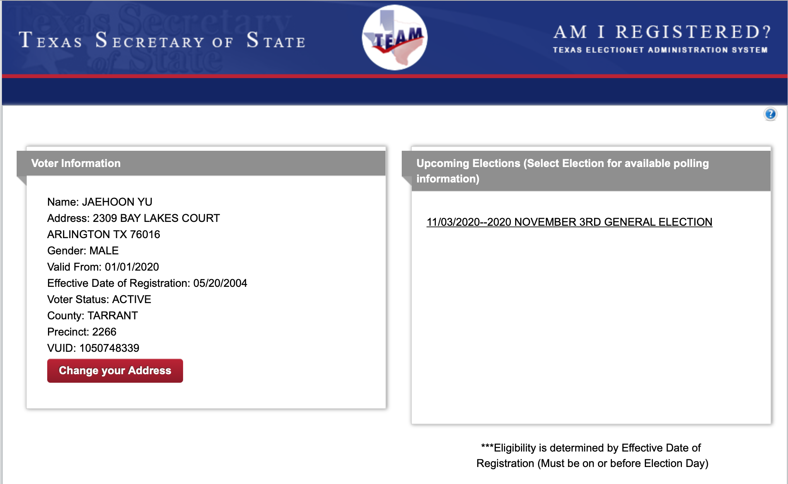
SP#3 – Civic Duty I: Voter Registration – 2

Slide 6
Components and Unit Vectors
Coordinate systems are useful in expressing vectors in their components
y
(+,+)
F_{y}
(F_{x},F_{y})
}Components
F
(-,+)
θ
x
} Magnitude
(-,-)
(+,-)
F_{x}

Slide 7
Unit Vectors
A unit vector is the vector that indicates only the directions of the components
Dimensionless
Magnitudes are exactly 1
Unit vectors are usually expressed in i, j, k or (⬅preferred method in this class!)
So the vector F can be re-written as

Slide 8
Examples of Vector Operations
Find the resultant force which is the sum of F1=(2.0i+2.0j)N and F2 =(2.0i-4.0j)N.
Find the resultant force of the sum of three forces: F₁=(15i+30j +12k)N, F₂=(23i+14j -5.0k)N, and F₃=(-13i+15j)N.
Magnitude

Slide 9
Coulomb Force, The Formula
Unit charge

Slide 10
How to solve electric F problems?
Typical problem: Find out the net force on a subject charge at the given position by some source charges
Compute the magnitude of the force by each source charge on the subject charge at the given position using Coulomb force formula
Compute the components of the force by the pair of the charges, taking into account the signs of the two charges – subject and source
Repeat 1 and 2 for all pairs of each of the source charges to the subject charge
Add all values on each component – x, y and z, etc
Express F vector using the component and the unit vector

Slide 11
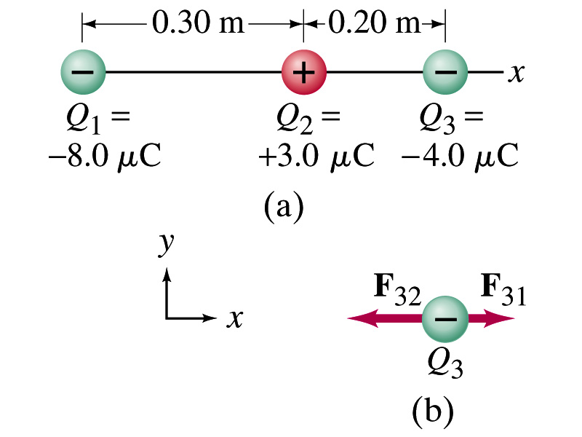
Example 21.2
Three charges on a line. Three charged particles are arranged in a line as shown in the figure. Calculate the net electrostatic force on particle 3 (the -4μC on the right) due to other two charges.
What is the force that Q₁ exerts on Q₃?
What is the force that Q₂ exerts on Q₃?
Using the vector sum of the two forces

Slide 12
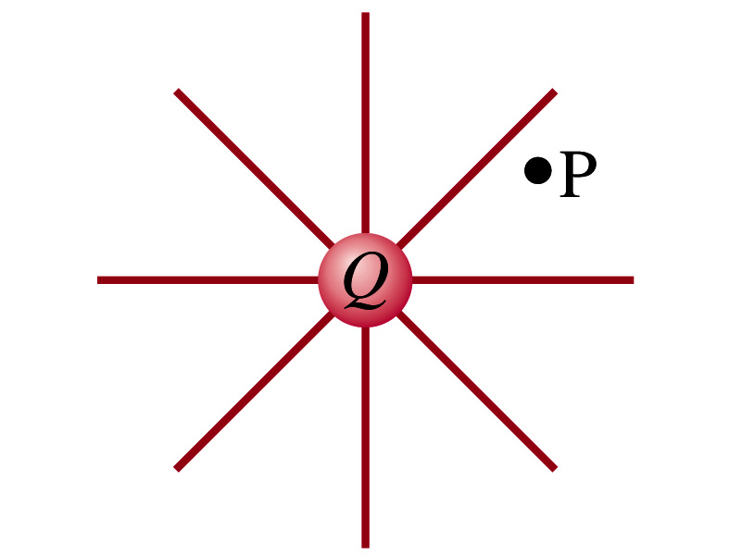
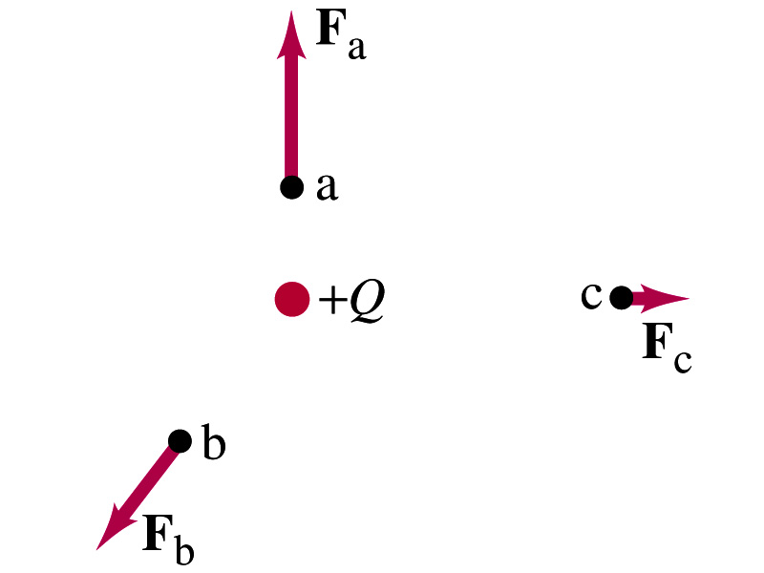
The Electric Field
Both gravitational and electric forces act over distance without contacting objects ➔ What kind of forces are these?
  Field forces
Michael Faraday developed the idea of the field.
  Faraday (1791 – 1867) argued that the electric field extends outward/inward from every charge and permeates through all of space
Field by a charge or a group of charges can be inspected by placing a small positive test charge in the vicinity and measuring the force on it.
  You imagine what would happen to the test charge!
  E due to a charge is independent of the other charge

Slide 13
What are the directions of the field?
E
+
+
+
E
+
E
-
E
Direction of the field depends only on the sign of the source charge
+

Slide 14
The Electric Field
The electric field at any point in space is defined as the force exerted on a tiny positive test charge divide by magnitude of the test charge
  Electric force per unit charge
What kind of quantity is the electric field? (poll 2)
  Vector quantity. Why?
What is the unit of the electric field? (poll 3)
  N/C
What is the magnitude of the electric field at a distance r from a single point charge Q (source)?

Slide 15
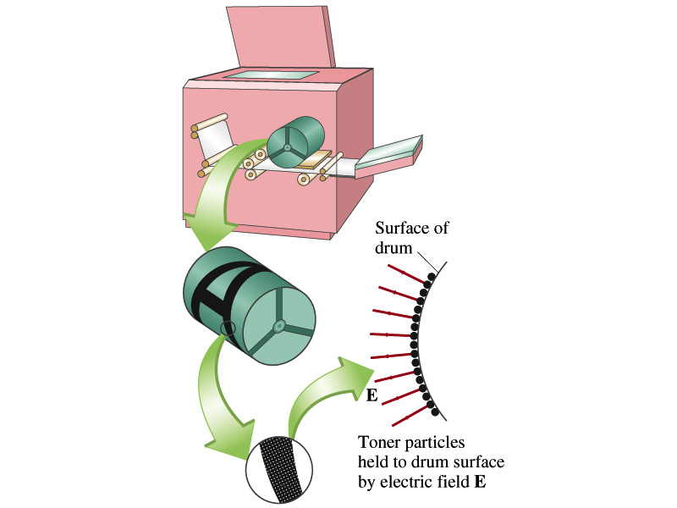
Example 21 – 5
Electrostatic copier. An electrostatic copier works by selectively arranging positive charges (in a pattern to be copied) on the surface of a non-conducting drum, then gently sprinkling negatively charged dry toner (ink) onto the drum. The toner particles temporarily stick to the pattern on the drum and are later transferred to paper and “melted” to produce the copy. Suppose each toner particle has a mass of 9.0x10⁻¹⁶kg and carries the average of 20 extra electrons to provide an electric charge. Assuming that the electric force on a toner particle must exceed twice its weight in order to ensure sufficient attraction, compute the required electric field strength near the surface of the drum.
The electric force must be the same as twice the gravitational force on the toner particle.
So we can write
Thus, the magnitude of the electric field is

Slide 16
Direction of the Electric Field
If there are more than one charge present, the individual fields due to each charge are added vectorially to obtain the total field at any point.
This superposition principle of electric field has been verified by experiments.
For a given electric field E at a given point in space, we can calculate the force F on any charge q, F=qE.
  What happens to the direction of the force and the field depending on the sign of the charge q?
  The F and E are in the same directions if q > 0
  The F and E are in the opposite directions if q < 0

Slide 17
What are the directions of the field vs F?
+
+
E
F
-
F
E
Direction of the field depends only on the sign of the source charge
Direction of the force depends on both the signs of the source and subject charge

Slide 18
How to solve electric F and E problems?
Typical problem: Find out the field by some charges at the given position and the net force on a charge at the position by these charges.
Compute the magnitude of the field by each charge at the position
Compute the components of the field by the charge, taking into account the sign of the charge
Repeat 1 and 2 for all charges that affects the field at the position
Add all values on each component – x, y and z, etc
Express E field vector using the component and the unit vector
The net electric force on a subject charge q at the position is then simply using the formula , taking into account the sign of the subject charge for the direction

Slide 19
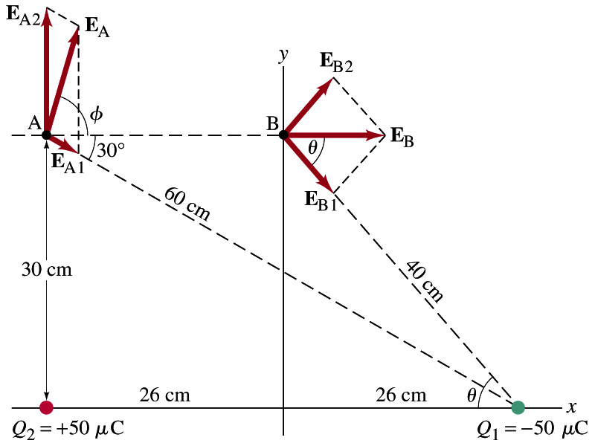
Example 21 – 8
E above two point charges: Calculate the total electric field (a) at point A and (b) at point B in the figure on the right due to both the charges Q₁ and Q₂.
How do we solve this problem?
First, compute the magnitude of fields at each point due to each of the two charges.
Then add them at each point vectorially!
First, the electric field at point A by Q₁ and then Q₂.

Slide 20
Example 21 – 8, cnt’d
Now the components of the electric field vectors by the two charges at point A.
So the electric field at point A is
The magnitude of the electric field at point A is
Now onto the electric field at point B

Slide 21
Example 21 – 8, cnt’d
Electric field at point B is easier due to symmetry!
Since the magnitude of the charges are the same and the distance to point B from the two charges are the same, the magnitude of the electric field by the two charges at point B are the same!!
Now the components!
First, the y-component!
Now, the x-component!
So the electric field at point B is
The magnitude of the electric field at point B

