Slide 1
PHYS 1441 – Section 002 Lecture #6
Wednesday, Sept. 16, 2020
Dr. Jaehoon Yu
CH21
Electric Fields and Conductors
Motion of a Charged Particle in an Electric Field
CH22
Electric Flux
Today’s homework is homework #4, due 11pm, Tuesday, Sept. 29!!

Slide 2
Announcements
1st term exam in class Wed., Sept. 23
DO NOT MISS THE EXAM! You will get an F!
Come to class by 12:40pm, roll call will start at that time
CH21.1 to what we’ve learned on next Monday, Sept. 21 + Appendices A1 – A9, the math refresher
BYOF: You may bring a one 8.5x11.5 sheet (front and back) of handwritten formulae and values of constants for the exam
No derivations, word definitions, figures, pictures, setups or solutions of any problems!
No additional formulae or values of constants will be provided!
Must send me the photos of both front & back of the formula sheet, including the blank, in a single file by 11:00am, Sept. 23
File name must be FS-E1-LastName-FirstName-fall20.pdf
Once submitted, no changes allowed

Slide 3
Reminder: SP#2 – Angels & Demons
Compute the total possible energy released from an annihilation of x-grams of anti-matter and the same quantity of matter, where x is the last two digits of your SS# or DL#. (20 points)
Use the famous Einstein’s formula for mass-energy equivalence
Compute the power output of this annihilation when the energy is released in x ns, where x is again the first two digits of your SS# or DL#. (10 points)
Compute how many cups of gasoline (8MJ) this energy corresponds to. (5 points)
Compute how many months of world electricity usage (3.6GJ/mo) this energy corresponds to. (5 points)
Due by the beginning of the class, 1pm, Wednesday, Sept. 23
Must be HANDWRITTEN
All pages must be in one PDF file with the name SP2-LastName-FirstName-fall20.pdf uploaded to CANVAS.

Slide 4
Reminder: SP#3 – Civic Duty I: Voter Registration
Voter registration in Texas ends on Monday, Oct. 5, 2020
Registration can be done: https://www.votetexas.gov/register/index.html
Check your registration: https://teamrv-mvp.sos.texas.gov/MVP/mvp.do
For those who are legal to take part in the election
Your own registration to vote: 10 points
Include the screen shot your own voter registration check
You can have up to 3 more people who are not registered to register: 5 points each
Must include before and after the registration screen shots of the same person next to each other to show these are newly registered
For those who are not legal to take part in the election
You can have up to 5 people who are not registered to register: 5 points each
Must include before and after the registration screen shots of the same person next to each other to show these are newly registered
Deadline: 1pm Wednesday, Oct. 7, 2020
Put all screen shots in one pdf file following the naming convention – SP3-LastName-FirstName-Fall20.pdf and upload to the CANVAS assignment

Slide 5
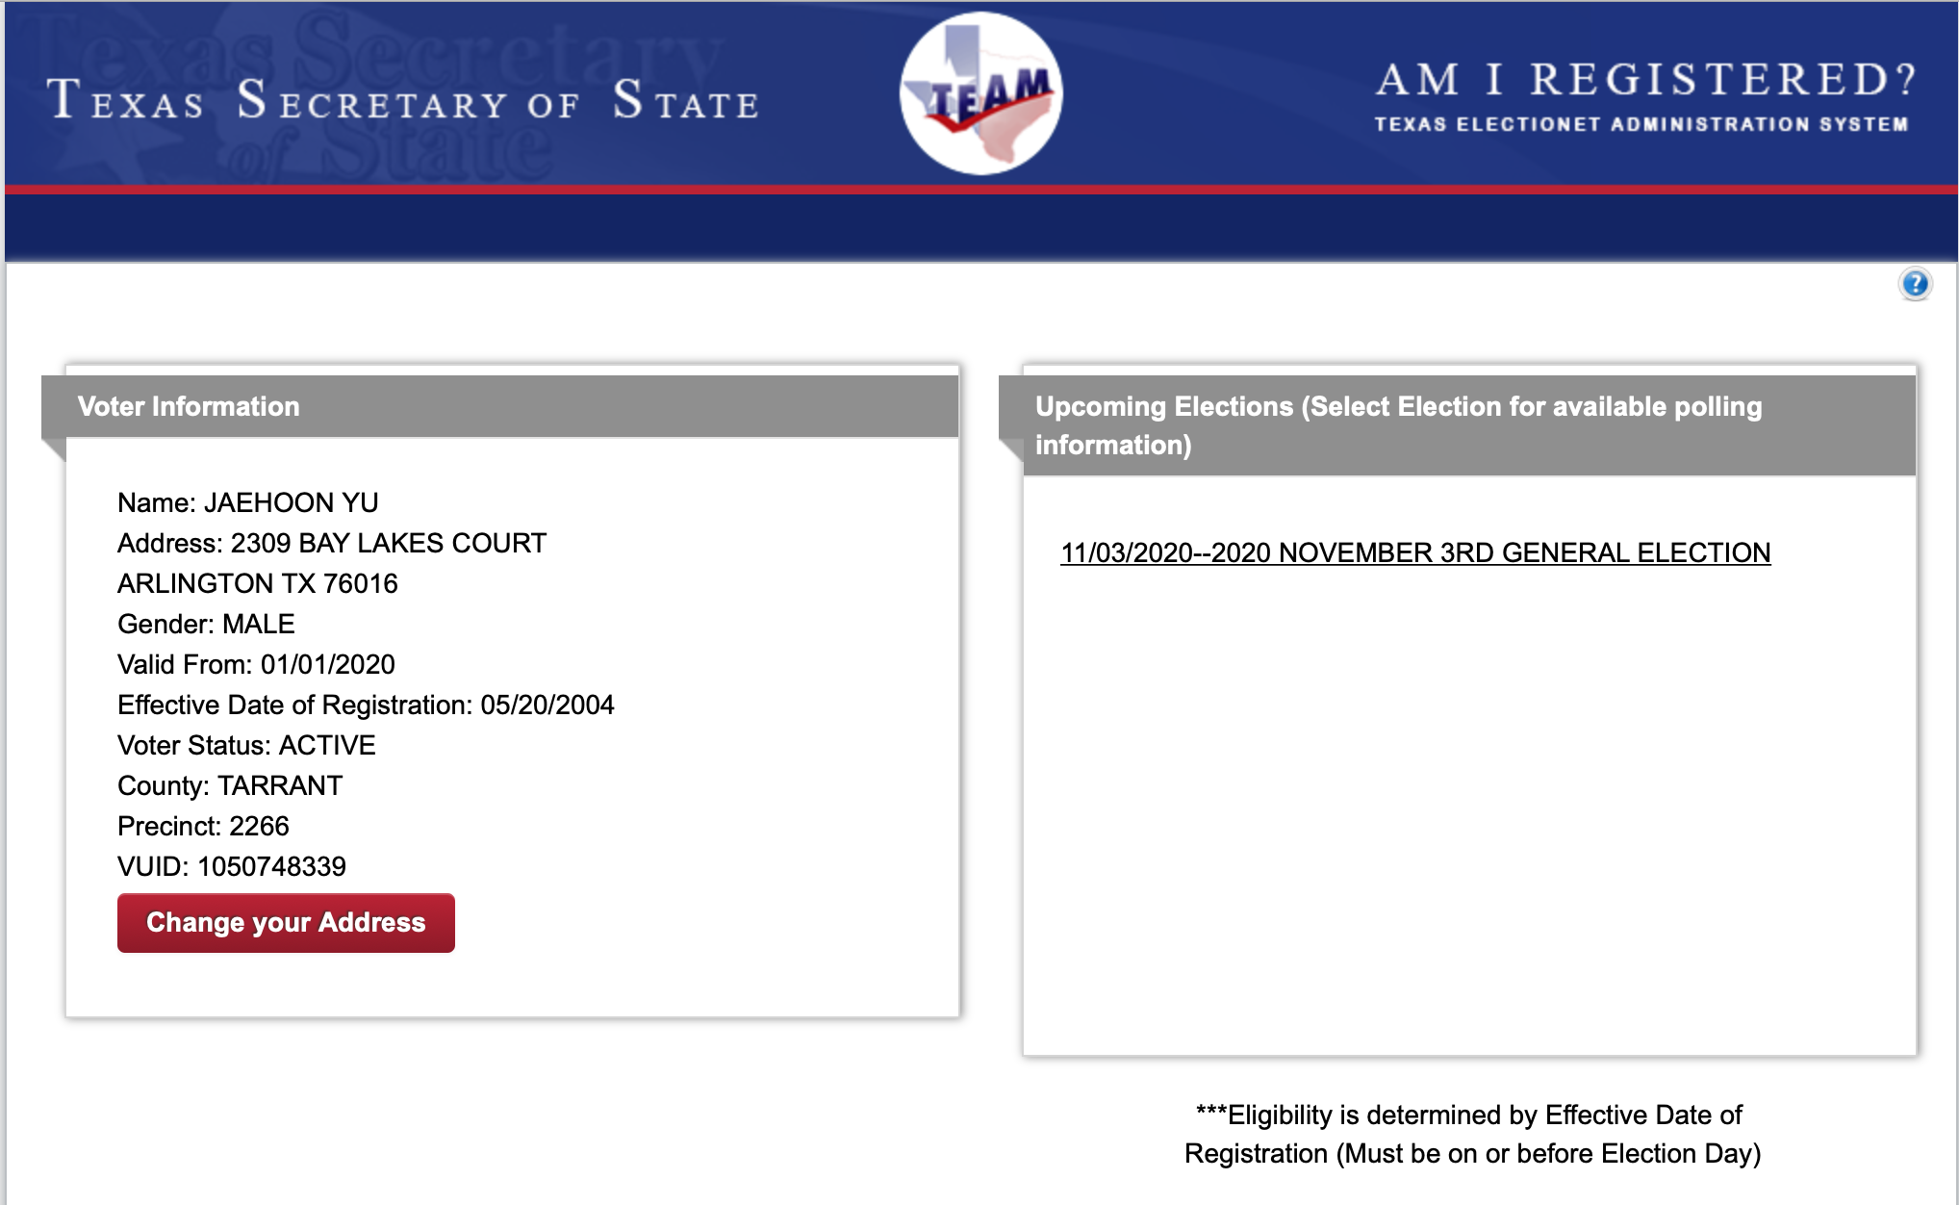
SP#3 – Civic Duty I: Voter Registration – 2

Slide 6
How to solve electric E and F problems?
Typical problem: Find the field by some configurations of charges at the given position and the net force on a subject charge at the position by these charges.
Compute the magnitude of the field by each charge at the position
Compute the components of the field by the charge, taking into account the sign of the charge
If positive, away from the charge on the straight line connecting the charge to the point
If negative, toward the charge on the straight line connecting the charge to the point
Repeat steps 1 and 2 for all charges that affects the field at the position
Add all values on each component – x, y and z, etc
Express E field vector using the component and the unit vector
The net electric force on a subject charge q at the position is then simply using the formula , be sure to include the sign of the charge

Slide 7
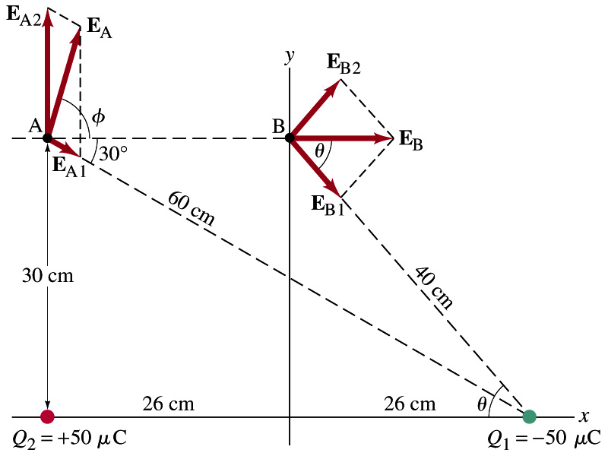
Example 21 – 8
E above two point charges: Calculate the total electric field (a) at point A and (b) at point B in the figure on the right due to both the charges Q₁ and Q₂.
How do we solve this problem?
First, compute the magnitude of fields at each point due to each of the two charges.
Then add them at each point vectorially!
First, the electric field at point A by Q₁ and then Q₂.

Slide 8
Example 21 – 8, cnt’d
Now the components of the electric field vectors by the two charges at point A.
So the electric field at point A is
The magnitude of the electric field at point A is
Now onto the electric field at point B

Slide 9
Example 21 – 8, cnt’d
Electric field at point B is easier due to symmetry!
Since the magnitude of the charges are the same and the distance to point B from the two charges are the same, the magnitude of the electric field by the two charges at point B are the same!!
Now the components!
First, the y-component!
Now, the x-component!
So the electric field at point B is
The magnitude of the electric field at point B

Slide 10
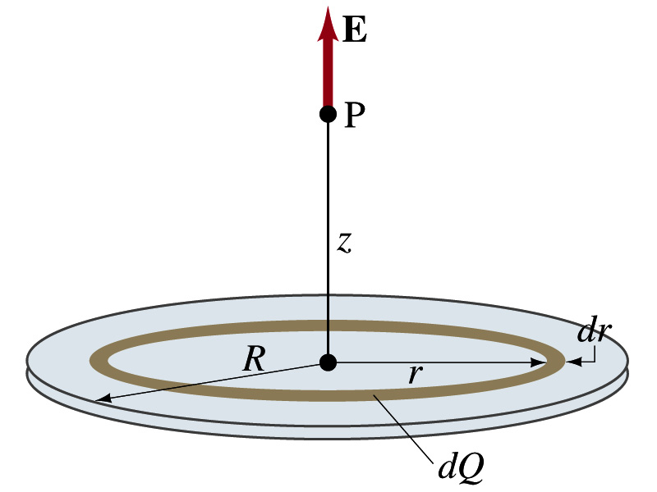
Challenger Example 21 – 12
Uniformly charged disk: Charge is distributed uniformly over a thin circular disk of radius R. The charge per unit area (C/m²) is σ. Calculate he electric field at a point P on the axis of the disk, a distance z above its center.
How do we solve this problem?
First, compute the magnitude of the field (dE) at point P due to the charge (dQ) on the ring of infinitesimal width dr.
From the result of example 21 – 11 (please do this problem yourself)
Since the surface charge density is constant, σ, and the ring has an area of 2πrdr, the infinitesimal charge of dQ is
So the infinitesimal field dE can be written

Slide 11
Example 21 – 12 cnt’d
Now integrating dE over 0 through R, we get
What happens if the disk has infinitely large area?
So the electric field due to an evenly distributed surface charge with density, σ, is

Slide 12
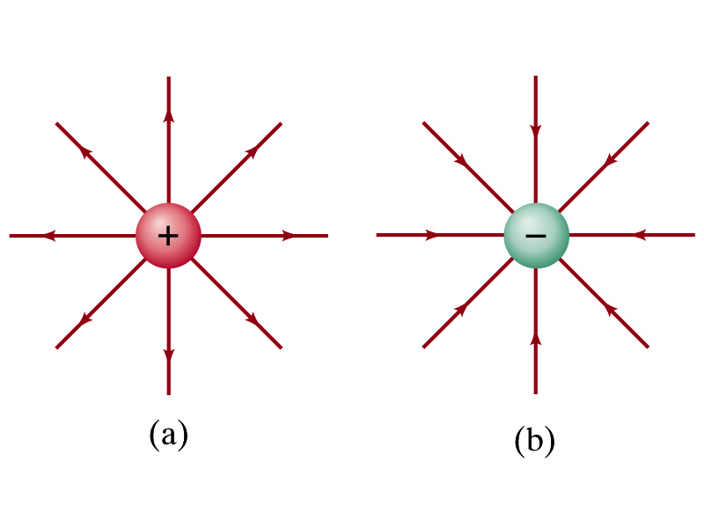
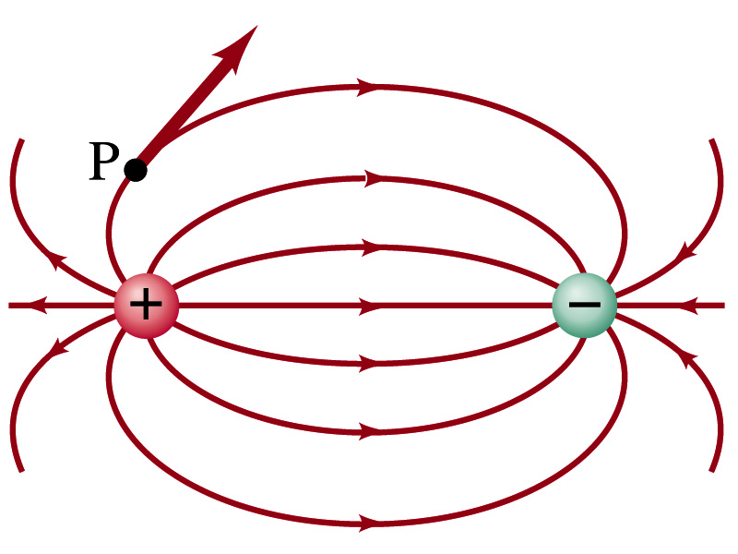
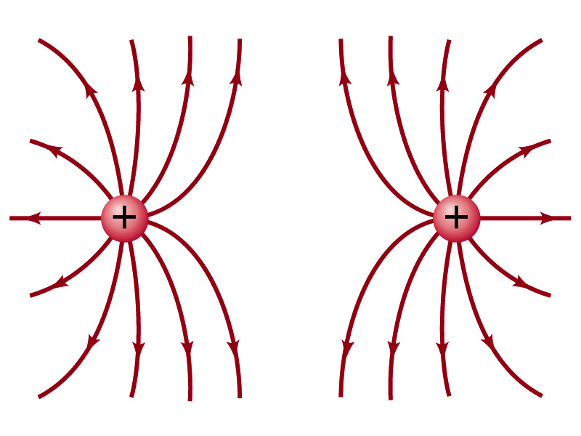
Field Lines
The electric field is a vector quantity (poll2). Thus, its magnitude can be expressed by the length of an arrow and its direction by the direction the arrowhead points.
Since the field permeates through the entire space, drawing vector arrows is not a good way of expressing the field.
Electric field lines are drawn to indicate the direction of the force due to the given field on a positive test charge.
Number of lines crossing unit area perpendicular to E is proportional to the magnitude of the electric field.
The closer the lines are together, the stronger the electric field in that region.
Start on positive charges and end on negative charges.
Earth’s G-field lines

Slide 13
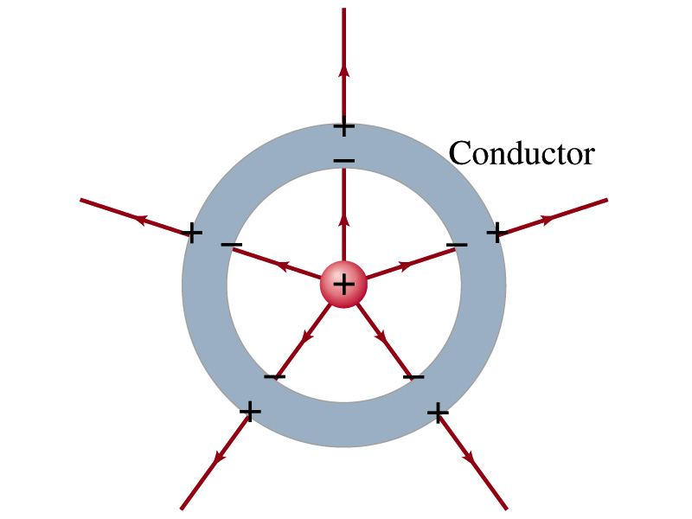
Electric Field and Conductors
The electric field inside a conductor is ZERO in a static situation. (If the charge is at rest.) Why?
If there were an electric field within a conductor, there would be a force on its free electrons.
The electrons will move until they reached the position where the electric field becomes zero.
Electric field inside a non-conductor, however, CAN exist.
Consequences of the above
Any net charge on a conductor distributes itself on the surface.
Although no E field exists inside a conductor, the field can exist outside the conductor due to induced charges on the surface
The electric field is always perpendicular to the surface outside of a conductor.

Slide 14
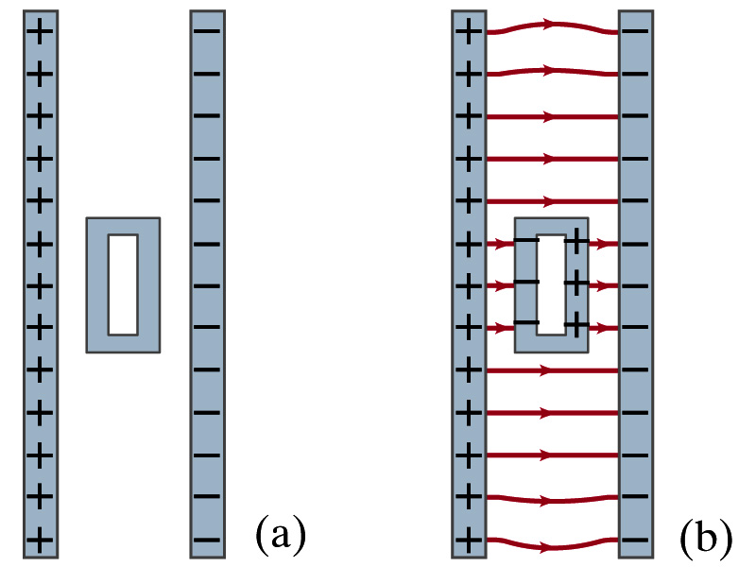
Example 21-13
Shielding, and safety in a storm. A hollow metal box is placed between two parallel charged plates. What is the field like in the box?
If the metal box were solid
The free electrons in the box would redistribute themselves along the surface so that the field lines would not penetrate into the metal.
The free electrons do the same in hollow metal boxes just as well as it did in a solid metal box.
Thus a conducting box is an effective device for shielding. ➔ Faraday cage
So what do you think will happen if you were inside a car when the car was struck by a lightening?

Slide 15
Motion of a Charged Particle in an Electric Field
If an object with an electric charge q is placed at a point in space where the electric field is E, the force exerting on the object by this field is .
What do you think will happen to the charge?
Let’s think about the cases like these on the right.
The object will move along the field line…Which way? (poll 7)
Depends on the sign of the charge
The charge gets accelerated under the electric field.

Slide 16
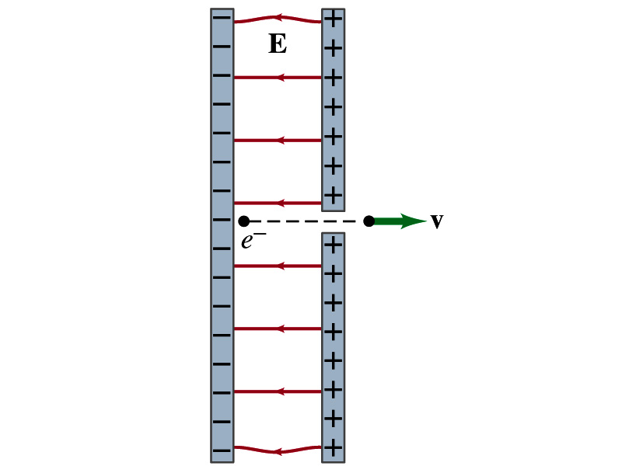
Example 21 – 14, particle acceleration
Electron accelerated by electric field. An electron (mass m = 9.1x10⁻³¹kg) is accelerated in a uniform field E (E=2.0x10⁴N/C) between two parallel charged plates. The separation of the plates is 1.5cm. The electron is accelerated from rest near the negative plate and passes through a tiny hole in the positive plate. (a) With what speed does it leave the hole? (b) Show that the gravitational force can be ignored. Assume the hole is so small that it does not affect the uniform field between the plates.
The magnitude of the force on the electron is F=qE and is directed to the right. The equation to solve this problem is
The magnitude of the electron’s acceleration is
Between the plates the field E is uniform, thus the electron undergoes a uniform acceleration

Slide 17
Example 21 – 14
Since the travel distance is 1.5x10⁻²m, using one of the kinetic eq. of motions,
Since there is no electric field outside the conductor, the electron continues moving with this speed after passing through the hole.
(b) Show that the gravitational force can be ignored. Assume the hole is so small that it does not affect the uniform field between the plates.
The magnitude of the electric force on the electron is
The magnitude of the gravitational force on the electron is
Thus the gravitational force on the electron is negligible compared to the electromagnetic force.

