Slide 1
PHYS 1441 – Section 002 Lecture #7
Monday, Sept. 21, 2020
Dr. Jaehoon Yu
CH22
Electric Flux
Gauss’ Law with Multiple Charges
CH23
Electric Potential Energy

Slide 2
Announcements
1st term exam in class this Wed., Sept. 23
DO NOT MISS THE EXAM! You will get an F!
Come to class by 12:40pm, roll call will start at that time
CH21.1 to what we’ve learned on next Monday, Sept. 21 + Appendices A1 – A9, the math refresher (this includes calculus)
BYOF: You may bring a one 8.5x11.5 sheet (front and back) of handwritten formulae and values of constants for the exam
No derivations, word definitions, figures, pictures, setups or solutions of any problems!
No additional formulae or values of constants will be provided!
Must send me the photos of both front & back of the formula sheet, including the blank, in a single file by 11:00am, Sept. 23
File name must be FS-E1-LastName-FirstName-fall20.pdf
Once submitted, no changes allowed

Slide 3
Reminder: SP#2 – Angels & Demons
Compute the total possible energy released from an annihilation of x-grams of anti-matter and the same quantity of matter, where x is the last two digits of your SS# or DL#. (20 points)
Use the famous Einstein’s formula for mass-energy equivalence
Compute the power output of this annihilation when the energy is released in x ns, where x is again the first two digits of your SS# or DL#. (10 points)
Compute how many cups of gasoline (8MJ) this energy corresponds to. (5 points)
Compute how many months of world electricity usage (3.6GJ/mo) this energy corresponds to. (5 points)
Due by the beginning of the class, 1pm, Wednesday, Sept. 23
Must be HANDWRITTEN
All pages must be in one PDF file with the name SP2-LastName-FirstName-fall20.pdf uploaded to CANVAS.

Slide 4
Reminder: SP#3 – Civic Duty I: Voter Registration
Voter registration in Texas ends on Monday, Oct. 5, 2020
Registration can be done: https://www.votetexas.gov/register/index.html
Check your registration: https://teamrv-mvp.sos.texas.gov/MVP/mvp.do
For those who are legal to take part in the election
Your own registration to vote: 10 points
Include the screen shot your own voter registration check
You can have up to 3 more people who are not registered to register: 5 points each
Must include before and after the registration screen shots of the same person next to each other to show these are newly registered
For those who are not legal to take part in the election
You can have up to 5 people who are not registered to register: 5 points each
Must include before and after the registration screen shots of the same person next to each other to show these are newly registered
Deadline: 1pm Wednesday, Oct. 7, 2020
Put all screen shots in one pdf file following the naming convention – SP3-LastName-FirstName-Fall20.pdf and upload to the CANVAS assignment

Slide 5
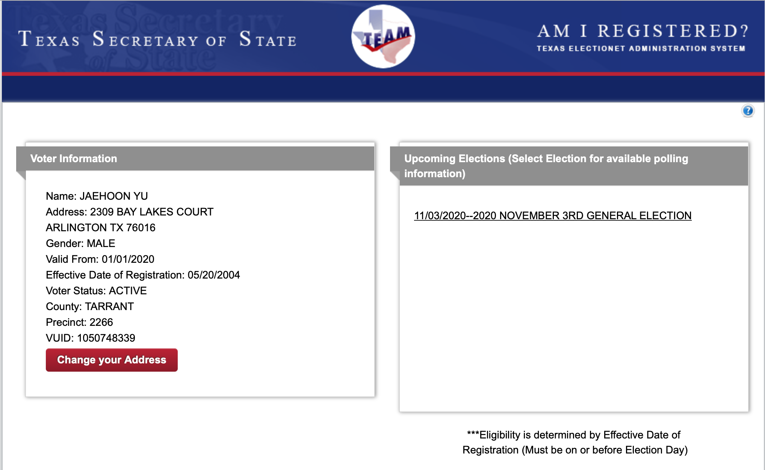
SP#3 – Civic Duty I: Voter Registration – 2

Slide 6
Gauss’ Law
Gauss’ law states the relationship between the electric charge and the electric field.
More generalized and elegant form of Coulomb’s law.
The electric field by the distribution of charges can be obtained using Coulomb’s law by vector summing (or integrating) over the charge distributions.
Gauss’ law, however, gives an additional insight into the nature of electrostatic field and a more general relationship between the charge and the field
Provides a powerful tool to solving problems in electricity

Slide 7
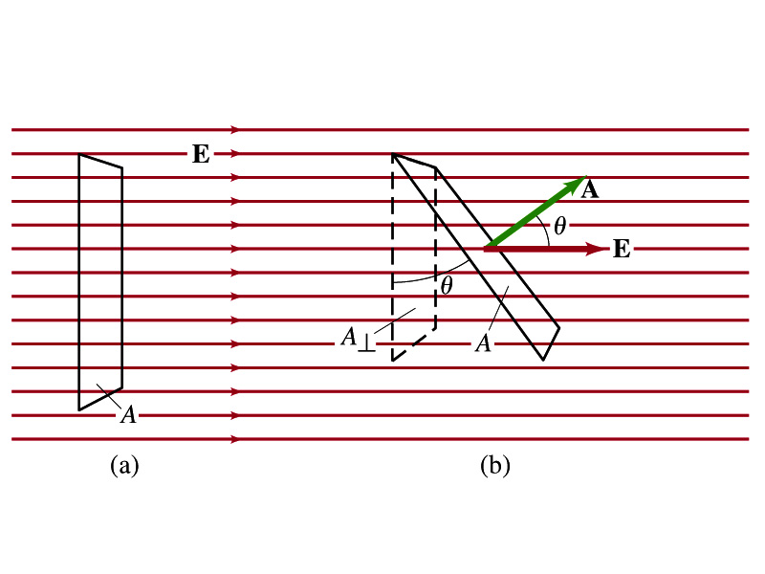
Electric Flux
Let’s imagine a surface of area A through which a uniform electric field E passes
The electric flux Φ_{E} is defined as
Φ_{E}=EA, if the field is perpendicular to the surface
Φ_{E}=EAcosθ, if the field makes an angle θ to the surface
So the electric flux is defined as .
How would you define the electric flux in words?
The total number of field lines passing through the unit area perpendicular to the field.
What kind? (poll 2)

Slide 8
Example 22 – 1
Electric flux. (a) Calculate the electric flux through the rectangle in the figure (a). The rectangle is 10cm by 20cm and the electric field is uniform with magnitude 200N/C. (b) What is the flux if the angle is 30 degrees?
The electric flux is defined as
So when (a) θ=0, we obtain
And when (b) θ=30 degrees, we obtain

Slide 9
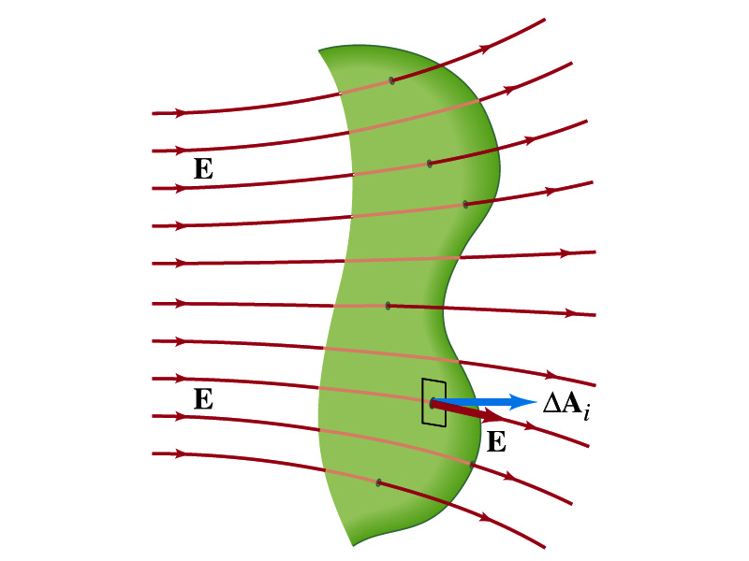
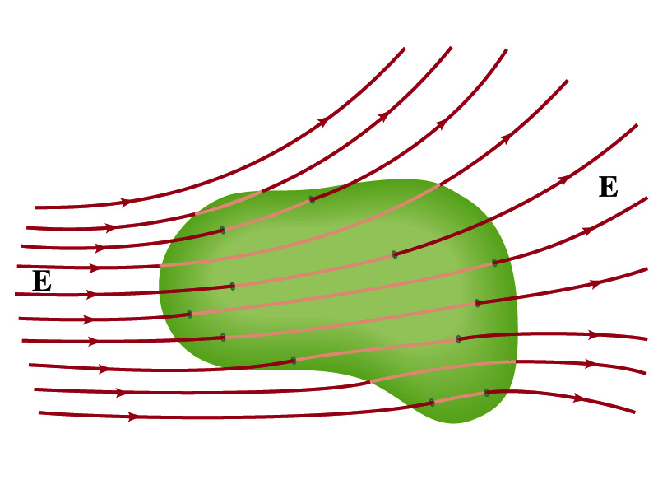
Generalization of the Electric Flux
Let’s consider a surface of area A that is not a square or flat but in some random shape, and that the field is not uniform.
The surface can be divided to infinitesimally small areas of ΔA_{i} that can be considered flat.
And the electric field through this area can be considered uniform since the area is very small.
Then the electric flux through the entire surface is approximately
In the limit where ΔA_{i} → 0, the discrete summation becomes an integral.
open surface
enclosed surface

Slide 10
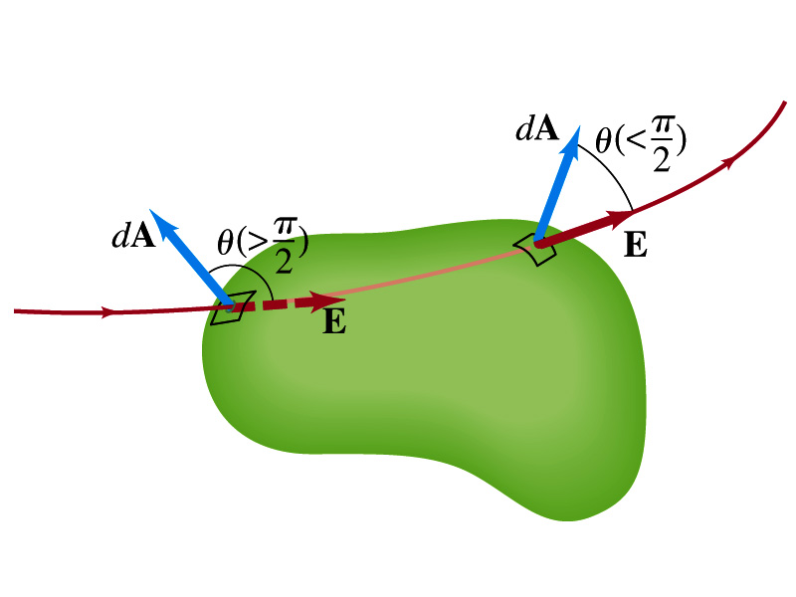
Generalization of the Electric Flux
We arbitrarily define that the area vector points outward from the enclosed volume.
For the line leaving the volume, |θ|<π/2 and cosθ>0. The flux Φ_{E} is positive.
For the line coming into the volume, |θ|>π/2 and cosθ<0. The flux Φ_{E} is negative.
If Φ_{E}>0, there is net flux out of the volume.
If Φ_{E}<0, there is flux into the volume.
In the above figures, each field line that enters the volume also leaves the volume, so
The flux is non-zero only if one or more lines start or end inside the surface.

Slide 11
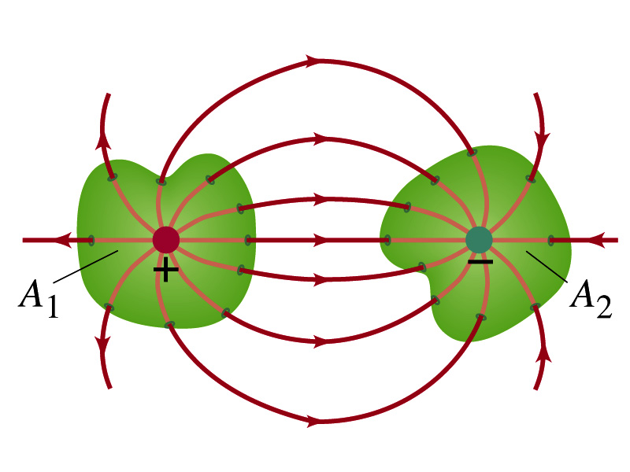
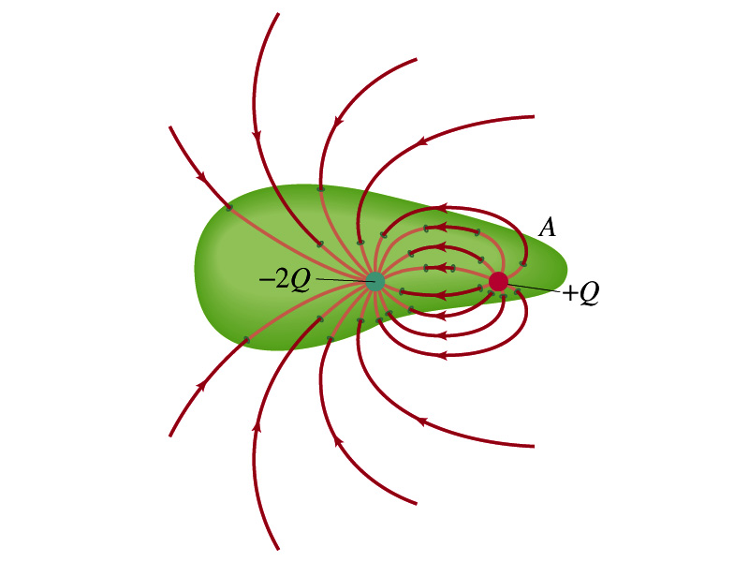
Generalization of the Electric Flux
The field line starts or ends only on a charge.
Sign of the net flux on the surface A₁?
Net outward flux (positive flux)
How about A₂?
Net inward flux (negative flux)
What is the flux in the figure bottom right?
There should be a net inward flux (negative flux) since the total charge inside the volume is negative.
The net flux that crosses an enclosed surface is proportional to the total charge inside the surface. ➔ This is the crux of Gauss’ law.

Slide 12
Electric Flux Recap
The electric flux is defined as . (What kind? poll 2)
Electric flux can be interpreted as the total amount of field that passes through the area perpendicular to the field and is proportional to the field strength for the given surface area.
Then the electric flux through the surface are defined as
For the line coming into the volume, |θ|>π/2 and cosθ<0. The flux Φ_{E} is negative.
For the line leaving the volume, |θ|<π/2 and cosθ>0. The flux Φ_{E} is positive.
If Φ_{E}>0, there is net flux out of the volume.
If Φ_{E}<0, there is flux into the volume.
What can change the flux? (Poll 8)
open surface
enclosed surface

Slide 13
Gauss’ Law
Let’s consider the case in the figure below.
What are the results of the closed integral of the Gaussian surfaces A₁ and A₂?
For A₁
For A₂
Which of the following are correct? (Poll 9)
q’
q

Slide 14
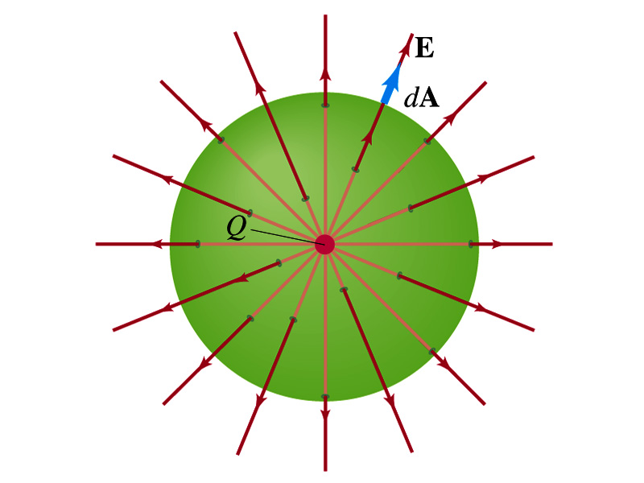
Coulomb’s Law from Gauss’ Law
Let’s consider a charge Q enclosed inside our imaginary Gaussian surface of sphere of radius r.
Since we can choose any surface enclosing the charge, we choose the simplest possible one! ☺
The surface is symmetric about the charge.
What does this tell us about the field E?
Have the same magnitude (uniform) at any point on the surface
Points radially outward parallel to the area vector dA.
The Gaussian integral can be written as
Solve
for E
Electric Field of
Coulomb’s Law

Slide 15
Gauss’ Law from Coulomb’s Law
Let’s consider a single static point charge Q surrounded by an imaginary spherical surface.
Coulomb’s law tells us that the electric field at a spherical surface of radius r is
Performing a closed integral over the surface, we obtain
Gauss’ Law

Slide 16
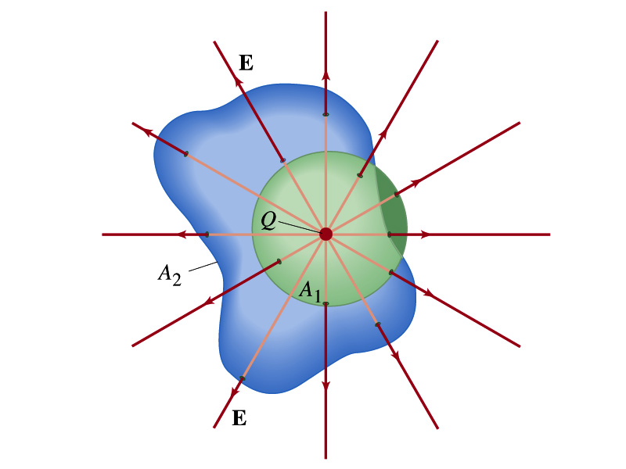
Gauss’ Law from Coulomb’s Law Irregular Surface
Let’s consider the same single static point charge Q surrounded by a symmetric spherical surface A₁ and a randomly shaped surface A₂.
What is the difference in the total number of field lines due to the charge Q, passing through the two surfaces?
None. What does this mean?
The total number of field lines passing through the surface is the same no matter what the shape of the enclosed surface is.
So we can write:
What does this mean?
The flux due to the given enclosed charge is the same independent of the shape of the surface enclosing it is. ➔ Gauss’ law, , is valid for any surface surrounding a single point charge Q.

Slide 17
Gauss’ Law w/ more than one charge
Let’s consider several charges inside a closed surface.
For each charge, Q_{i} inside the chosen closed surface,
What is ?
The electric field produced by Q_{i} alone!
Since electric fields can be added vectorially, following the superposition principle, the total field E is equal to the sum of the fields due to each charge and any external fields. So
The value of the flux depends only on the charge enclosed in the surface!! ➔ Gauss’ law.
What is Q_{encl}?
The total enclosed charge!

Slide 18
So what is Gauss’ Law good for?
Gauss’ law is more general than Coulomb’s law.
Can be used to obtain electric field, forces or obtain charges
Derivation of Gauss’ law from Coulomb’s law is only valid for static electric charge.
Electric field can also be produced by changing magnetic fields.
Coulomb’s law cannot describe this field while Gauss’ law is still valid
Gauss’ Law: Any differences between the input and output flux of the electric field over any enclosed surface is due to the charge inside that surface!!!

Slide 19
Solving problems with Gauss’ Law
Identify the symmetry of the charge distributions
Draw an appropriate Gaussian surface, making sure it passes through the point you want to know the electric field
Use the symmetry of charge distribution to determine the direction of E at the point of the Gaussian surface
Evaluate the flux
Calculate the enclosed charge by the Gaussian surface
Ignore all the charges outside the Gaussian surface
Equate the flux to the enclosed charge and solve for E

Slide 20
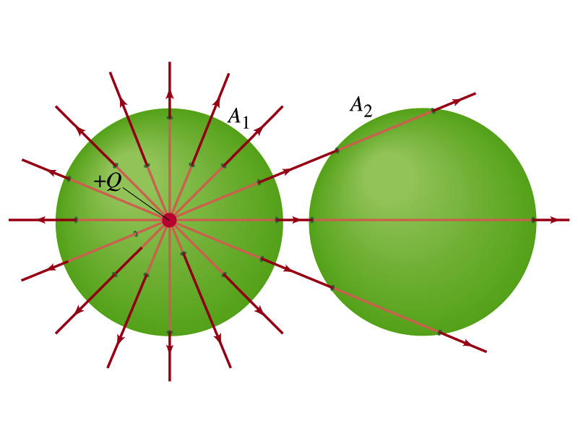
Example 22 – 2
Flux from Gauss’ Law: Consider two Gaussian surfaces, A₁ and A₂, shown in the figure. The only charge present is the charge +Q at the center of surface A₁. What is the net flux through each surface A₁ and A₂? (Poll 9)
The surface A₁ encloses the charge +Q, so from Gauss’ law we obtain the total net flux
The surface A₂ the charge, +Q, is outside the surface, so the total net flux is 0.

Slide 21
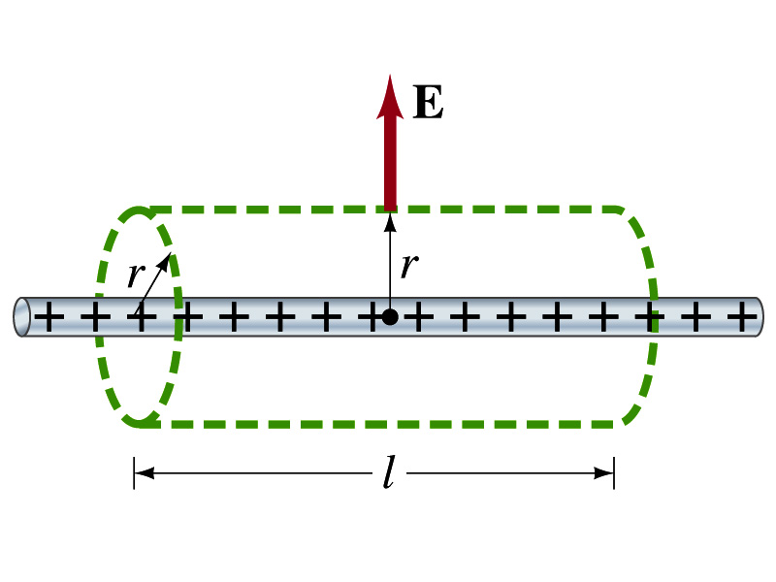
Example 22 – 6
Long uniform line of charge: A very long straight wire possesses a uniform positive charge per unit length, λ. Calculate the electric field a point near but outside the wire, far from the ends.
Which direction do you think the field due to the charge on the wire is?
Radially outward from the wire, the direction of the radial vector r.
Due to the cylindrical symmetry, the field is the same on the Gaussian surface of a cylinder surrounding the wire.
The end surfaces do not contribute to the flux at all. Why?
Because the field vector E is perpendicular to the surface vector dA.
From Gauss’ law
Solving for E

Slide 22
A Brain Teaser of Electric Flux
What would change the electric flux through a circle lying in the xz plane where the electric field is (10N/C)j? (poll 8)
Changing the magnitude of the electric field
Changing the surface area of the circle
Tipping the circle so that it lies on a plane off the xz plane
All of the above
None of the above

Slide 23
Gauss’ Law Summary
The precise relationship between flux and the enclosed charge is given by Gauss’ Law
ε₀ is the permittivity of free space in the Coulomb’s law
A few important points on Gauss’ Law
Freedom to choose!!
The surface integral is performed over the value of E on a closed surface of your choice in any given situation.
Test of existence of electrical charge!!
The charge Q_{encl} is the net charge enclosed by the arbitrary closed surface of your choice.
Universality of the law!
It does NOT matter where or how much charge is distributed inside the surface. Gauss’ law still applies!
The charge outside the surface does not contribute to Q_{encl}. Why?
The charge outside the surface might impact the field lines but not the total number of lines entering or leaving the surface.

