Slide 1
PHYS 1441 – Section 002 Lecture #8
Monday, Sept. 28, 2020
Dr. Jaehoon Yu
CH22
Electric Dipole
CH23
Electric Potential Energy
Electric Potential Due to Point Charges
Equi-potential Lines and Surfaces
Today’s homework is #5, due 11pm, Tuesday, Oct. 6!!

Slide 2
Announcements
Reading assignments: CH22 – 4 and CH23 – 9
Course evaluation policy
Homework: 25%!!!
Exams
Final Comprehensive Exam (11am, Wed., 12/16/20): 23%
Mid-term Comprehensive Exam (1pm, Mon., 10/19/20): 20%
One better of the two term Exams (9/23/20 and 11/11/20): 12%
Missing an exam is not permissible unless pre-approved
Lab score: 10%
Pop-quizzes: 10%
Extra credit: 10% of the total
Grading done on a sliding scale, based on the final grades
1st term results
Class average: 63.4/96
Equivalent to 66/100
Top score: 96/96

Slide 3
Reminder: SP#3 – Civic Duty I: Voter Registration
Voter registration in Texas ends on Monday, Oct. 5, 2020
Registration can be done: https://www.votetexas.gov/register/index.html
Check your registration: https://teamrv-mvp.sos.texas.gov/MVP/mvp.do
For those who are legal to take part in the election
Your own registration to vote: 10 points
Include the screen shot your own voter registration check
You can have up to 3 more people who are not registered to register: 5 points each
Must include before and after the registration screen shots of the same person next to each other to show these are newly registered
For those who are not legal to take part in the election
You can have up to 5 people who are not registered to register: 5 points each
Must include before and after the registration screen shots of the same person next to each other to show these are newly registered
Deadline: 1pm Wednesday, Oct. 7, 2020
Put all screen shots in one pdf file following the naming convention – SP3-LastName-FirstName-Fall20.pdf and upload to the CANVAS assignment

Slide 4
SP#3 – Civic Duty I: Voter Registration – 2

Slide 5
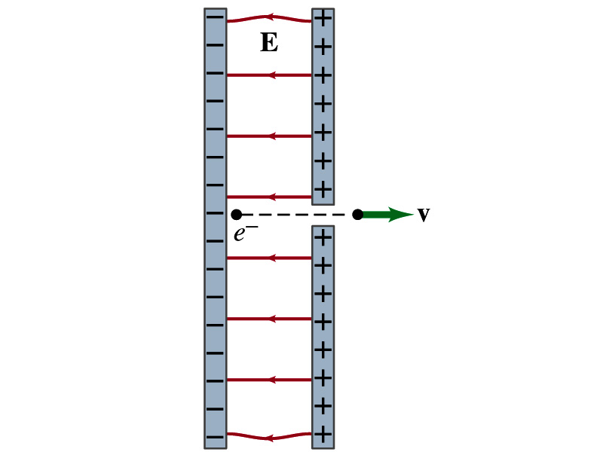
Special Project #4
Particle Accelerator. A charged particle of mass M with charge -Q is accelerated in the uniform field E between two parallel charged plates whose separation is D as shown in the figure on the right. The charged particle is accelerated from an initial speed v₀ near the negative plate and passes through a tiny hole in the positive plate.
Derive the formula for the electric field E to accelerate the charged particle to a fraction f of the speed of light c. Express E in terms of M, Q, D, f, c and v₀.
(a) Using the Coulomb force and the kinematic equations. (8 points)
(b) Using the work-kinetic energy theorem. ( 8 points)
(c) Using the formula above, evaluate the strength of the electric field E to accelerate an electron from the initial speed of 0.1% to 90% of the speed of light. You need to look up and write down the relevant constants, such as mass of the electron, charge of the electron and the speed of light. (5 points)
Must be handwritten and not copied from anyone else!
Follow the SP naming convention: SP4-first-last-fall20.pdf which includes all pages in one file ➔ Be sure to write your name onto all pages of the project report!
Due beginning of the class Monday, Oct. 12, submitted on CANVAS!

Slide 6
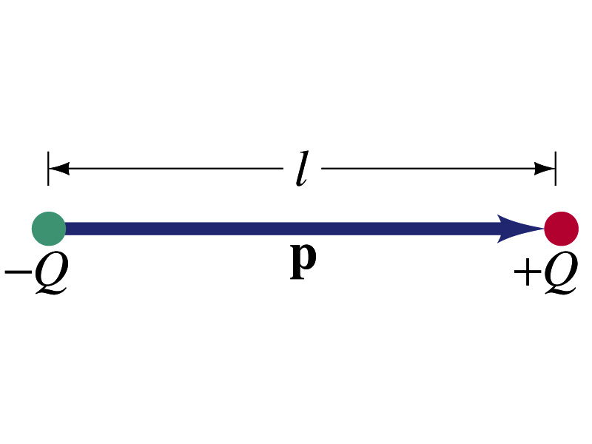
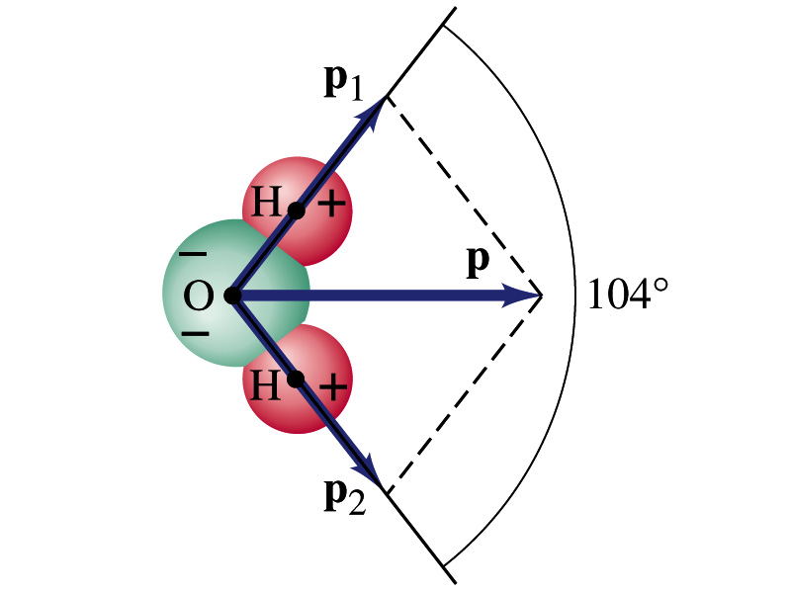
Electric Dipoles
An electric dipole is the combination of two equal charges of opposite signs, +Q and –Q, separated by a distance l, which behaves as one entity.
The quantity Ql is called the electric dipole moment and is represented by the symbol p.
The dipole moment is a vector quantity (poll 2)
The magnitude of the dipole moment is Ql. Unit? (poll 3)
Its direction is from the negative charge to the positive charge.
Many of diatomic molecules like CO have a dipole moment. ➔ These are referred as polar molecules.
Even if the molecule is electrically neutral, their sharing of electrons causes separation of charges in a microscopic scale
Symmetric diatomic molecules, such as O₂, do not have dipole moment.
C-m
The water molecule also has a dipole moment which is the vector sum of two dipole moments between Oxygen and each of Hydrogen atoms.

Slide 7
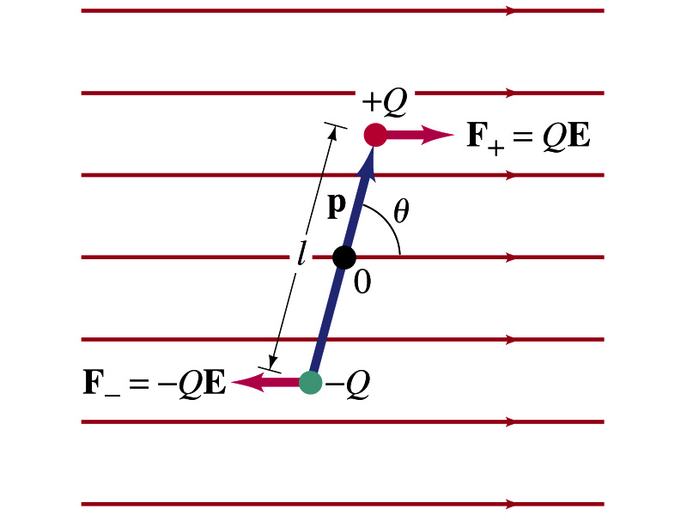
Dipoles in an External Field
Let’s consider a dipole placed in a uniform electric field E.
What do you think will happen to the dipole in the figure?
Force will be exerted on the charges.
The positive charge will get pushed toward right while the negative charge will get pulled toward left.
What is the net force acting on the dipole?
Zero
So will the dipole not move?
Yes, it will.
Why?
There is a torque applied on the dipole.

Slide 8
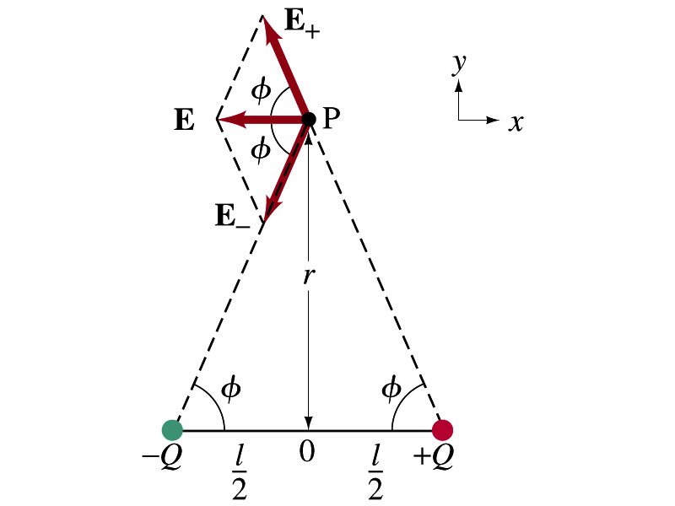
Electric Field by a Dipole
Let’s consider the case in the picture. (poll 7)
There are fields by both the charges. So the total electric field by the dipole is
The magnitudes of the two fields are equal
Now we must work out the x and y components of the total field.
Sum of the two y components is
Zero since they are the same but in opposite direction
So the magnitude of the total field is the same as the sum of the two x-components:

Slide 9
Dipole Electric Field from Afar
What happens when r>>l?.
Why does this make sense?
Since from a long distance, the two charges are very close so that the overall charge gets close to 0!!
This dependence works for the point not on the bisecting line as well

Slide 10
Electric Potential Energy
Concept of energy is very useful solving mechanics problems
Conservation of energy makes solving complex problems easier.
When can the potential energy be defined? (Poll 2)
Only for a conservative force.
The work done by a conservative force is independent of the path. What does it only depend on??
The difference between the initial and final positions
Can you give me an example of a conservative force?
Gravitational force
Is the electrostatic force between two charges a conservative force?
Yes. Why?
The dependence of the force to the distance is identical to that of the gravitational force.
The only thing matters is the direct linear distance between the objects not the path.

Slide 11
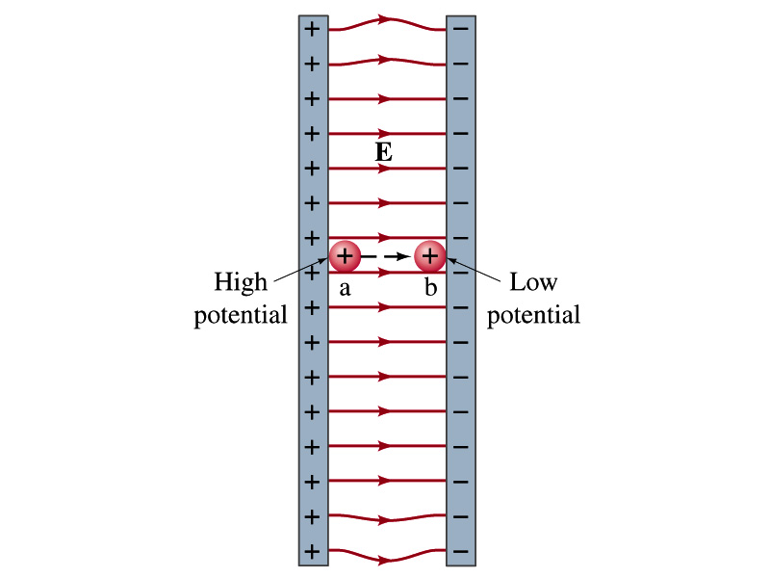
Electric Potential Energy
How would you define the change in electric potential energy U_{b} – U_{a}?
The potential to work gained by the charge as it moves from point a to point b.
Negative of the work done on the charge by the electric force to move it from b to a.
Let’s consider an electric field between two parallel plates w/ equal but opposite charges
The field between the plates is uniform since the gap is small and the plates are infinitely long…
What happens when we place a small charge, +q, on a point at the positive plate and let go?
The electric force will accelerate the charge toward the negative plate.
What kind of energy does this charged particle gain? (poll 10)
Kinetic energy

Slide 12
Electric Potential Energy
What does this mean in terms of energies?
The electric force is a conservative force.
Thus, the mechanical energy (K+U) is conserved under this force.
The positively charged object has only the electric potential energy (no KE) at the positive plate.
The electric potential energy decreases and
Turns into kinetic energy as the electric force works on the charged object, and the charged object gains speed.
Point of the greatest potential energy for
Positively charged object
Negatively charged object
PE=
U_{a}
0
KE=
0
K_{b}=(U_{a})
ME=
U_{a}
K_{b}=(U_{a})
U+K=(U_{a})

Slide 13
Electric Potential
How is the electric field defined?
Electric force per unit charge: F/q
We can define electric potential (potential) as
The electric potential energy per unit charge
This is the same as the voltage of a battery…
Electric potential is written with the symbol V (poll 2)
If a positive test charge q has the potential energy U_{a} at the point a, the electric potential of the charge at that point is

Slide 14
Electric Potential, cont’d
Since only the difference in potential energy is meaningful, only the potential difference between two points is measurable
What happens when the electric force does a “positive work”?
The charge gains kinetic energy
Electric potential energy of the charge decreases
Thus the difference in potential energy is the same as the negative of the work, W_{ba}, done on the charge by the electric field to move the charge from point a to b.
The potential difference V_{ba} is
Electric potential is independent of the test charge!! Unit? (Poll 8)

Slide 15
A Few Things about the Electric Potential
What does the electric potential depend on?
Other charges that creates the field
What about the test charge?
No, the electric potential is independent of the test charge
Test charge gains potential energy by existing within the potential created by other charges
Which plate is at the higher potential?
Positive plate. Why?
Since positive charge has the greatest potential energy on it.
What happens to the positive charge if it is let go?
It moves from higher potential to lower potential
How about the negative charge?
Its potential energy is higher on the negative plate. Thus, it moves from negative plate to positive. Potential difference is still the same.
The unit of the electric potential is Volt (V).
From the definition, 1V = 1J/C.
Zero point of electric potential can be chosen arbitrarily.
Often the ground, a conductor connected to Earth, is zero.

Slide 16
Example 23 – 1
A negative charge: Suppose a negative charge, such as an electron, is placed at point b in the figure. If the electron is free to move, will its electric potential energy increase or decrease? How will the electric potential change?
-
An electron placed at point b will move toward the positive plate since it was released at its highest potential energy point.
It will gain kinetic energy as it moves toward left, decreasing its potential energy.
The electron, however, moves from the point b at a lower potential to point a at a higher potential. ΔV=V_{a} – V_{b}>0.
This is because the potential is generated by the charges on the plates not by the electron.

Slide 17
Electric Potential and Potential Energy
What is the definition of the electric potential?
The potential energy difference per unit charge
OK, then, how would you express the potential energy that a charge q would obtain when it is moved between point a and b with the potential difference V_{ba}?
In other words, if an object with charge q moves through a potential difference V_{ba}, its potential energy changes by qV_{ba}.
So based on this, how differently would you describe the electric potential in words?
A measure of how much kinetic energy an electric charge can acquire under the given field
A measure of how much work a given charge can do.

Slide 18
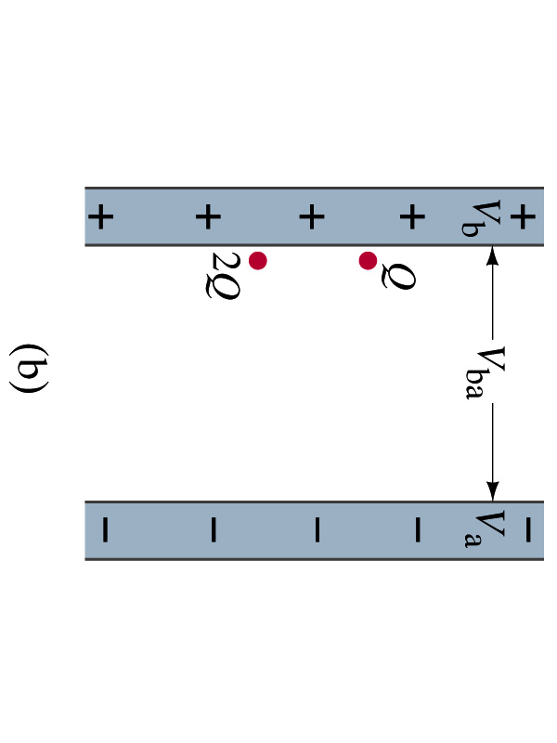
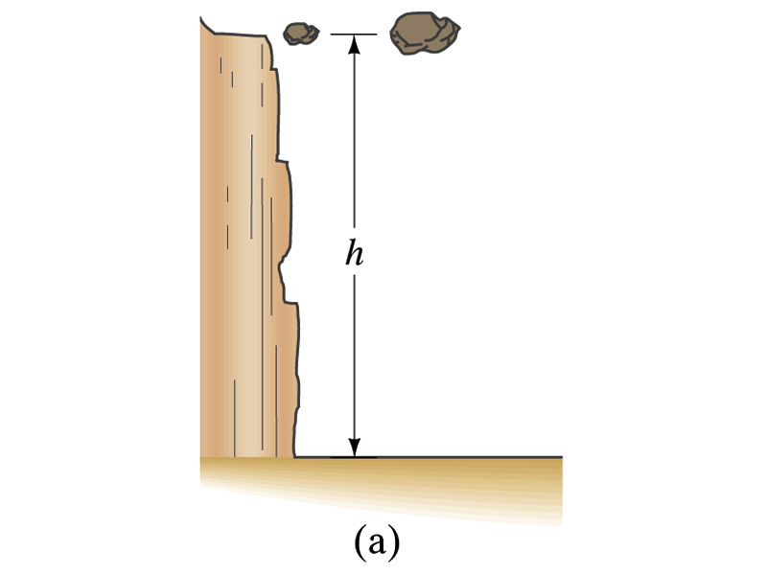
Comparisons of Potential Energies
Let’s compare gravitational and electric potential energies
m
2m
What are the potential energies of the rocks?
mgh and 2mgh
Which rock has a bigger potential energy?
The rock with a larger mass
Why?
It’s got a bigger mass.
What are the potential energies of the charges?
QV_{ba} and 2QV_{ba}
Which object has a bigger potential energy?
The object with a larger charge.
Why?
It’s got a bigger charge.
The potential is the same but the heavier rock or larger charge can do a greater work.

Slide 19
Electric Potential and Potential Energy
The electric potential difference gives potential energy or the possibility to perform work based on the charge of the object.
So what is happening in a battery or a generator?
They maintain a potential difference.
The actual amount of energy used or transformed depends on how much charge flows.
What is the potential difference maintained by a car’s battery?
12Volts
If for a given period, 5C charge flows through the headlight lamp, what is the total energy transformed?
E_{tot}=5C*12V=60 Umm… What is the unit? (poll 1)
If it is left on twice as long? E_{tot}=10C*12V=120J.
Joules (J)

Slide 20
Some Typical Potential Differences
Sources | Approximate Voltage
Thundercloud to ground (~5km) | 10⁸ V
High-Voltage Power Lines | 10⁶ V
Power supply for TV tube | 10⁴ V
Automobile ignition | 10⁴ V
Household outlet | 10² V
Automobile battery | 12 V
Flashlight battery | 1.5 V
Resting potential across nerve membrane | 10⁻¹ V
Potential changes on skin (EKG and EEG) | 10⁻⁴ V
In a typical lightening strike, 15C of electrons are released in 500μs. What is the total kinetic energy of these electrons when they strike ground? What is the power released during this strike? What do you think will happen to a tree hit by this lightening?

