Slide 1
PHYS 1441 – Section 002 Lecture #9
Wednesday, Sept. 30, 2020
Dr. Jaehoon Yu
CH23
Relationship between V and E
V due to Point Charges
Functional shape of V
V due to Charge Distributions
Equi-potential Lines and Surfaces

Slide 2
Announcements
Reading assignments: CH22 – 4 and CH23 – 9
Online Quiz 2 on Quest
Beginning of class next Wednesday, Oct. 7
Covers: CH22.1 through what we finish Monday, Oct. 5
BYOF: You may bring a one 8.5x11.5 sheet (front and back) of handwritten formulae and values of constants for the exam
No derivations, word definitions or setups or solutions of any problems!
No additional formulae or values of constants will be provided!
Must send me the photos of front and back of the formula sheet, including the blank, no later than 11am the day of the quiz
Once submitted, you cannot change, unless I ask you to delete some part of the sheet!

Slide 3
Reminder: SP#3 – Civic Duty I: Voter Registration
Voter registration in Texas ends on Monday, Oct. 5, 2020
Registration can be done: https://www.votetexas.gov/register/index.html
Check your registration: https://teamrv-mvp.sos.texas.gov/MVP/mvp.do
For those who are legal to take part in the election
Your own registration to vote: 10 points
Include the screen shot your own voter registration check
You can have up to 3 more people who are not registered to register: 5 points each
Must include before and after the registration screen shots of the same person next to each other to show these are newly registered
For those who are not legal to take part in the election
You can have up to 5 people who are not registered to register: 5 points each
Must include before and after the registration screen shots of the same person next to each other to show these are newly registered
Deadline: 1pm Wednesday, Oct. 7, 2020
Put all screen shots in one pdf file following the naming convention – SP3-LastName-FirstName-Fall20.pdf and upload to the CANVAS assignment

Slide 4
SP#3 – Civic Duty I: Voter Registration – 2

Slide 5
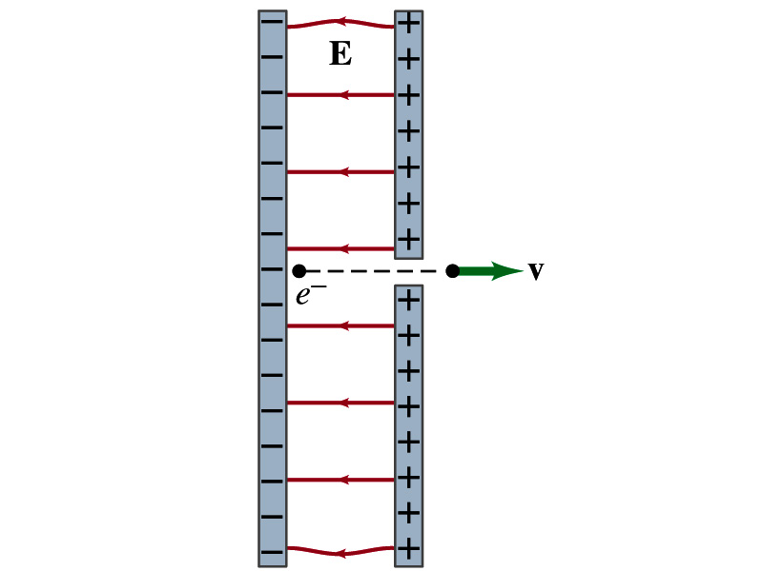
Reminder: Special Project #4
Particle Accelerator. A charged particle of mass M with charge -Q is accelerated in the uniform field E between two parallel charged plates whose separation is D as shown in the figure on the right. The charged particle is accelerated from an initial speed v₀ near the negative plate and passes through a tiny hole in the positive plate.
Derive the formula for the electric field E to accelerate the charged particle to a fraction f of the speed of light c. Express E in terms of M, Q, D, f, c and v₀.
(a) Using the Coulomb force and the kinematic equations. (8 points)
(b) Using the work-kinetic energy theorem. ( 8 points)
(c) Using the formula above, evaluate the strength of the electric field E to accelerate an electron from the initial speed of 0.1% to 90% of the speed of light. You need to look up and write down the relevant constants, such as mass of the electron, charge of the electron and the speed of light. (5 points)
Must be handwritten and not copied from anyone else!
Follow the SP naming convention: SP4-first-last-fall20.pdf which includes all pages in one file ➔ Be sure to write your name onto all pages of the project report!
Due beginning of the class Monday, Oct. 12, submitted on CANVAS!

Slide 6
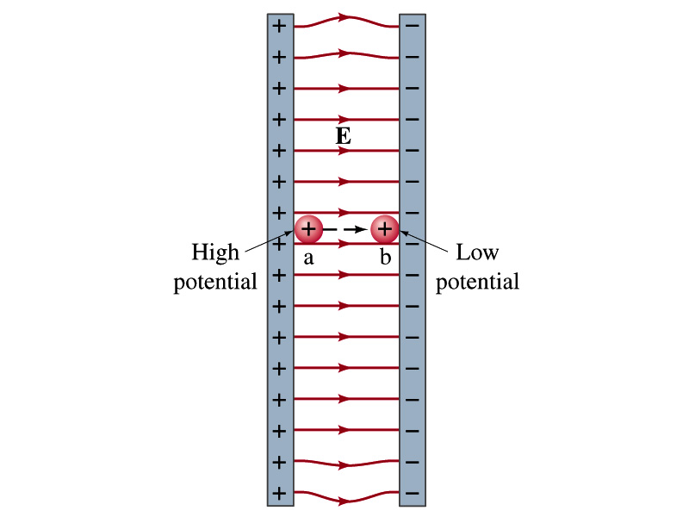
Electric Potential and Potential Energy
What is the definition of the electric potential?
The potential energy difference per unit charge
OK, then, how would you express the potential energy that a charge q would obtain when it is moved between point a and b with the potential difference V_{ba}?
In other words, if an object with charge q moves through a potential difference V_{ba}, its potential energy changes by qV_{ba}.
So based on this, how differently would you describe the electric potential in words?
A measure of how much kinetic energy an electric charge can acquire under the given field
A measure of how much work a given charge can do.
(Poll11 – V & PE)

Slide 7
Some Typical Potential Differences
Sources | Approximate Voltage
Thundercloud to ground (~5km) | 10⁸ V
High-Voltage Power Lines | 10⁶ V
Power supply for TV tube | 10⁴ V
Automobile ignition | 10⁴ V
Household outlet | 10² V
Automobile battery | 12 V
Flashlight battery | 1.5 V
Resting potential across nerve membrane | 10⁻¹ V
Potential changes on skin (EKG and EEG) | 10⁻⁴ V
In a typical lightning strike, 15C of electrons are released in 500μs. What is the total kinetic energy of these electrons when they strike the ground? What is the power released during this strike? What do you think will happen to a tree hit by this lightning?
About 5kW is needed to split a 24” diameter log!

Slide 8
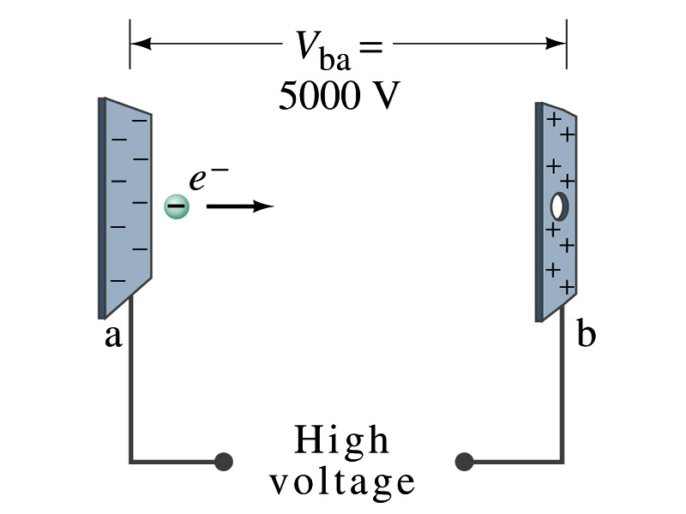
Example 23 – 2
Electrons in TV tube: Suppose an electron in the picture tube of a television set is accelerated from rest through a potential difference V_{ba}=+5000V. (a) What is the change in potential energy of the electron? (b) What is the speed of the electron (m=9.1x10⁻³¹kg) as a result of this acceleration? (c) Repeat for a proton (m=1.67x10⁻²⁷kg) that accelerates through a potential difference of V_{ba}=-5000V.
(a) What is the charge of an electron?
So what is the change of its potential energy?

Slide 9
Example 23 – 2
(b) Speed of the electron?
The entire potential energy of the electron turns to its kinetic energy. Thus the equation is
(C) Speed of the proton?

Slide 10
Electric Potential and Electric Field
The effect of a charge distribution can be described in terms of electric field or electric potential.
What kind of quantities are the electric field and the electric potential?
Electric Field (poll 2):
Electric Potential (poll 2):
Since electric potential is a scalar quantity, it is often easier to handle.
Well other than the above, how are these two quantities related?
Vector
Scalar

Slide 11
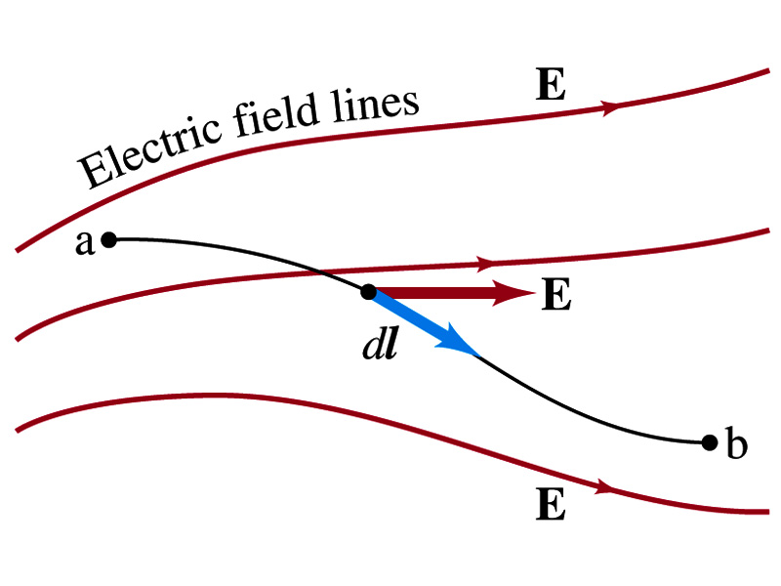
Electric Potential and Electric Field
Potential energy change is expressed in terms of a conservative force (point a at a higher potential)
For the electrical case, we are more interested in the potential difference:
This formula can be used to determine V_{ba} when the electric field is given.
When the field is uniform
so
What does “-”sign mean?
The direction of E is along that of decreasing potential.
Unit of the electric field in terms of potential? (poll 3)
V/m
Can you derive this from N/C?

Slide 12
Example
Uniform electric field obtained from voltage: Two parallel plates are charged to a voltage of 50V. If the separation between the plates is 5.0cm, calculate the magnitude of the electric field between them, ignoring any fringe effect.
5cm
What are the max PE and speed of a proton and an electron can obtain?
50V
What is the relationship between electric field and the potential for a uniform field?
Solving for E
Which direction is the field?
Direction of decreasing potential!

Slide 13
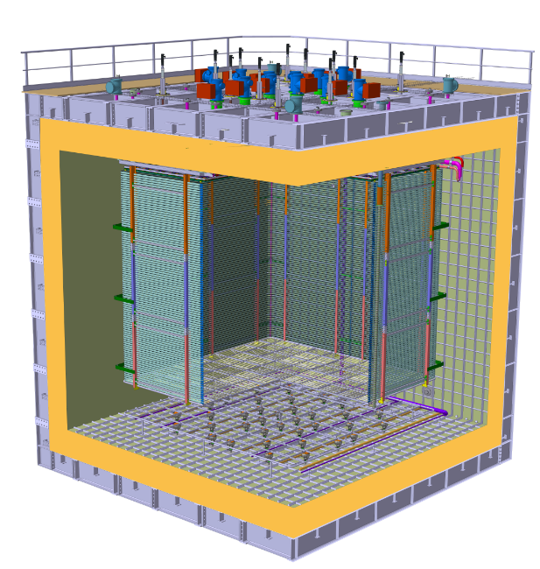
E Field in ProtoDUNE DP
What is the electric field between the cathode and the ground grid?
What do you need to know?
V_{cathode}= - 300kV
d= 70cm
Charge Readout Planes
6 m
Field Cage (common structural elements with SP)
Cathode
6 m
Ground Grid

Slide 14
DUNE Prototype Detector @ CERN
6m
6m

Slide 15
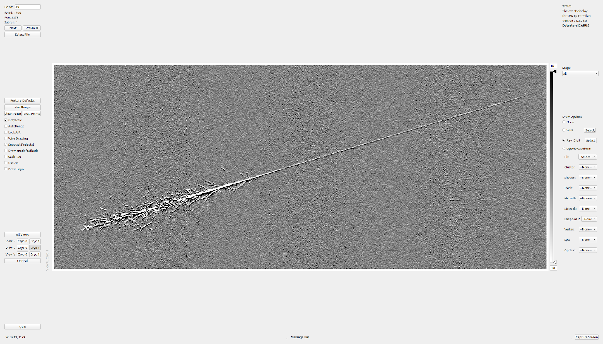

Slide 16
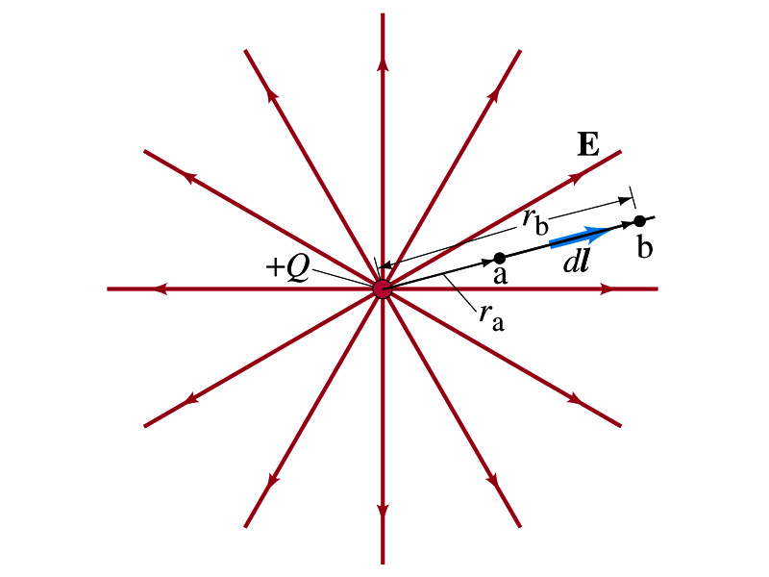
Electric Potential due to Point Charges
What is the electric field by a single point charge Q at a distance r?
Electric potential due to the field E for moving from point r_{a} to r_{b} in the radial direction away from the charge Q is

Slide 17
Electric Potential due to Point Charges
Since only the differences in potential have physical meaning, we can choose at .
The electrical potential V at a distance r from a single point charge Q is
So the absolute potential by a single point charge can be thought of the potential difference by a single point charge between r and infinity

Slide 18
Properties of the Electric Potential
What are the differences between the electric potential and the electric field?
Electric potential (poll 2)
Electric potential energy per unit charge
Inversely proportional to the distance
Simply add the potential by each of the source charges to obtain the total potential from multiple charges, since potential is a scalar quantity
Electric field (poll 2)
Electric force per unit charge
Inversely proportional to the square of the distance
Need vector sums to obtain the total field from multiple source charges
Potential due to a positive charge is a large positive near the charge and decreases towards 0 at the large distance.
Potential due to a negative charge is a large negative near the charge and increases towards 0 at a large distance.
(Poll12)

Slide 19
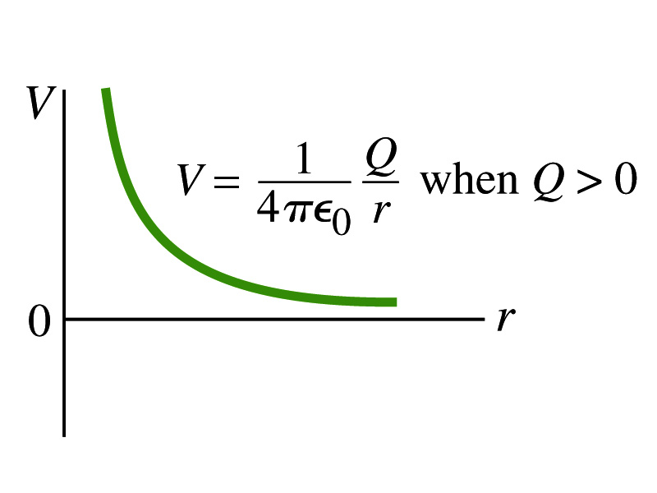
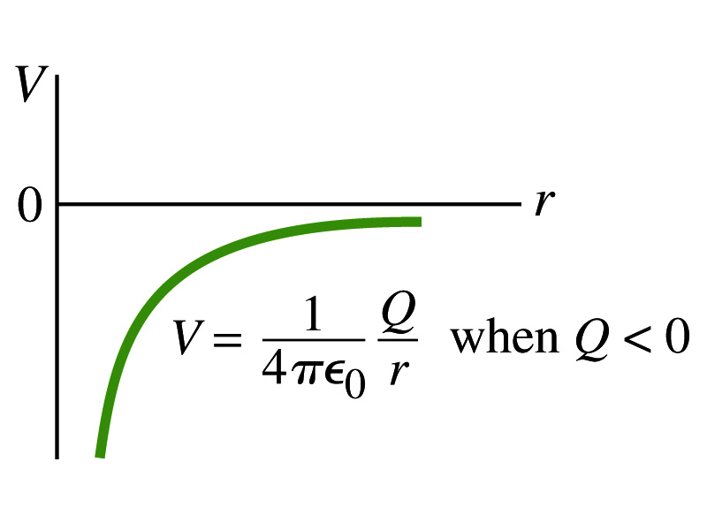
Shape of the Electric Potential
So, how does the electric potential look like as a function of distance?
What is the formula for the potential by a single charge?
If Q is Positive
If Q is Negative
(Poll12)
Uniformly charged sphere would have the potential the same as a single point charge.
What does this mean?
Uniformly charged sphere behaves like all the charge is on the single point in the center.

Slide 20
Example 23 – 6
Work to bring two positive charges close together: What is minimum work required by an external force to bring the charge q=+3.00μC from a great distance away (r=∞) to a point 0.500m from a charge Q=+20.0 μC?
What is the work done by the electric field in terms of potential energy and potential?
Since we obtain
Electric force does negative work. In other words, the external force must work +1.08J to bring the charge 3.00μC from infinity to 0.500m to the charge 20.0μC.

