Slide 1
PHYS 1441 – Section 002 Lecture #11
Wednesday, Oct. 7, 2020
Dr. Jaehoon Yu
CH24
Capacitors
Capacitors in Series and Parallel
Electric Energy Storage
Effect of Dielectric
Molecular description of Dielectric Material

Slide 2
Announcements
Online Mid-term comprehensive exam on Quest
In class Monday, Oct. 19
Covers: CH21.1 through what we finish Wednesday, Oct. 12 + math refresher
BYOF: You may bring a one 8.5x11.5 sheet (front and back) of handwritten formulae and values of constants for the exam
No derivations, word definitions, setups or solutions of any problems, figures, pictures, diagrams or arrows, etc!
No additional formulae or values of constants will be provided!
Must send me the photos of front and back of the formula sheet, including the blank, no later than 11am the day of the exam
Once submitted, you cannot change, unless I ask you to delete some part of the sheet!
Special seminar on COVID – 19: 3:30pm Sunday, Oct. 25
Dr. Linda Lee
Extra credit for participating in the seminar and
Asking a relevant question

Slide 3
Reminder: SP#3 – Civic Duty I: Voter Registration
Voter registration in Texas ends on Monday, Oct. 5, 2020
Registration can be done: https://www.votetexas.gov/register/index.html
Check your registration: https://teamrv-mvp.sos.texas.gov/MVP/mvp.do
For those who are legal to take part in the election
Your own registration to vote: 10 points
Include the screen shot your own voter registration check
You can have up to 3 more people who are not registered to register: 5 points each
Must include before and after the registration screen shots of the same person next to each other to show these are newly registered
For those who are not legal to take part in the election
You can have up to 5 people who are not registered to register: 5 points each
Must include before and after the registration screen shots of the same person next to each other to show these are newly registered
Deadline: 1pm Wednesday, Oct. 14, 2020⬅ Note extended deadline
Put all screen shots in one pdf file following the naming convention – SP3-LastName-FirstName-Fall20.pdf and upload to the CANVAS assignment

Slide 4
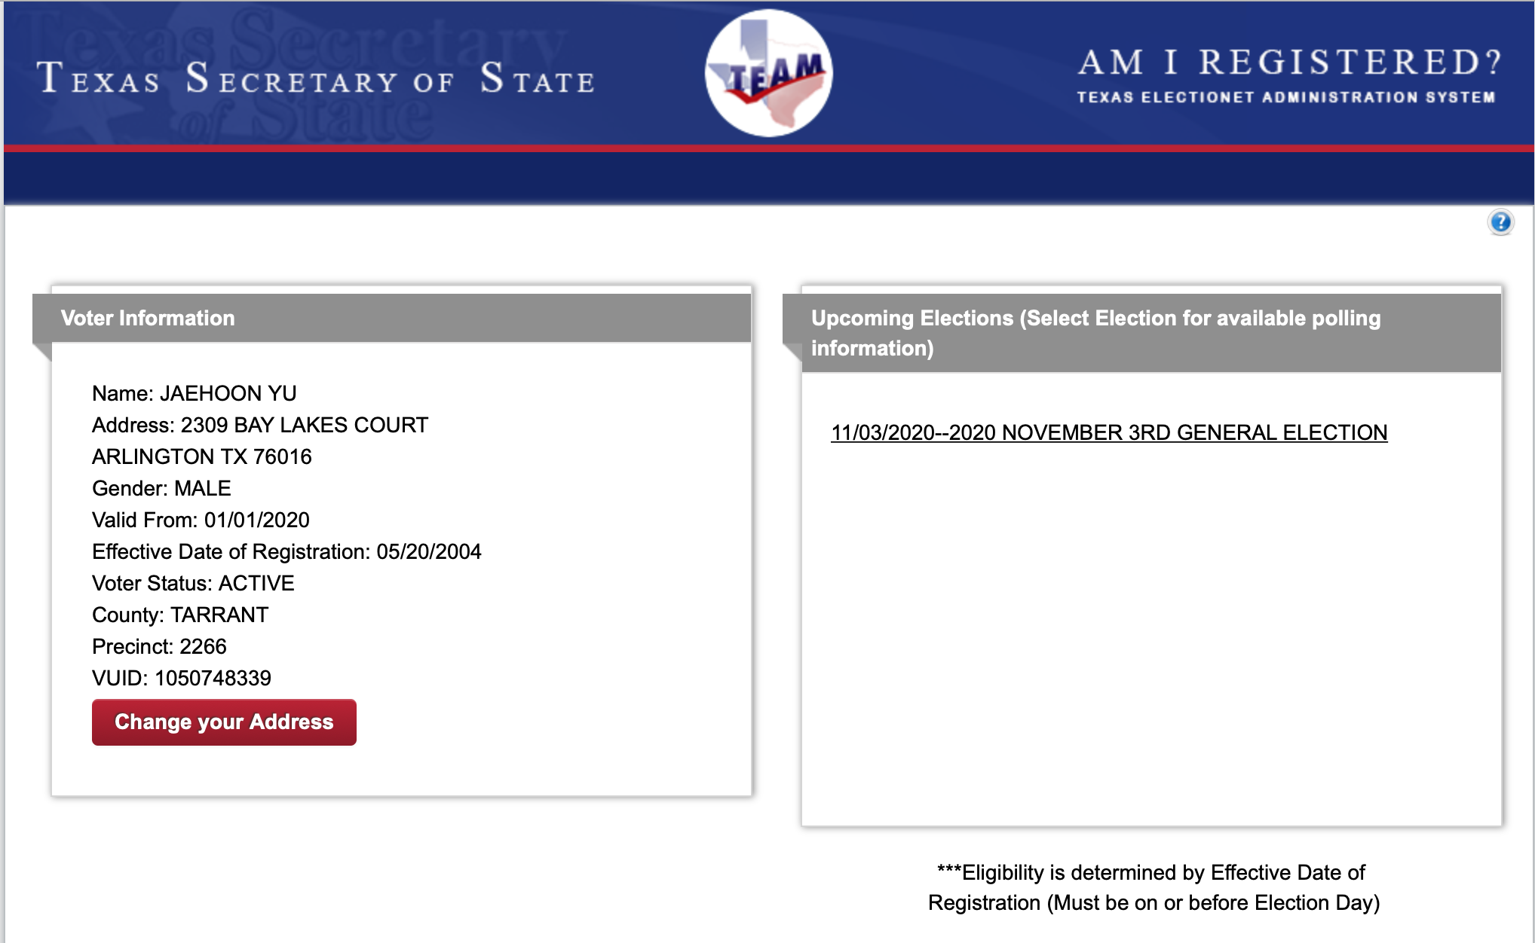
SP#3 – Civic Duty I: Voter Registration – 2

Slide 5
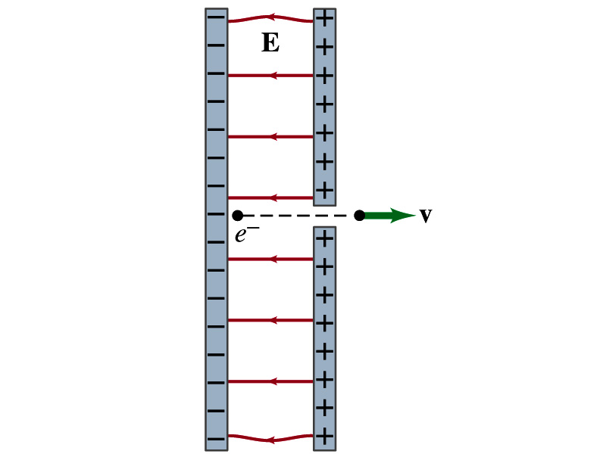
Reminder: Special Project #4
Particle Accelerator. A charged particle of mass M with charge -Q is accelerated in the uniform field E between two parallel charged plates whose separation is D as shown in the figure on the right. The charged particle is accelerated from an initial speed v₀ near the negative plate and passes through a tiny hole in the positive plate.
Derive the formula for the electric field E to accelerate the charged particle to a fraction f of the speed of light c. Express E in terms of M, Q, D, f, c and v₀.
(a) Using the Coulomb force and the kinematic equations. (8 points)
(b) Using the work-kinetic energy theorem. ( 8 points)
(c) Using the formula above, evaluate the strength of the electric field E to accelerate an electron from the initial speed of 0.1% to 90% of the speed of light. You need to look up and write down the relevant constants, such as mass of the electron, charge of the electron and the speed of light. (5 points)
Must be handwritten and not copied from anyone else!
Follow the SP naming convention: SP4-first-last-fall20.pdf which includes all pages in one file ➔ Be sure to write your name onto all pages of the project report!
Due beginning of the class Monday, Oct. 12, submitted on CANVAS!

Slide 6
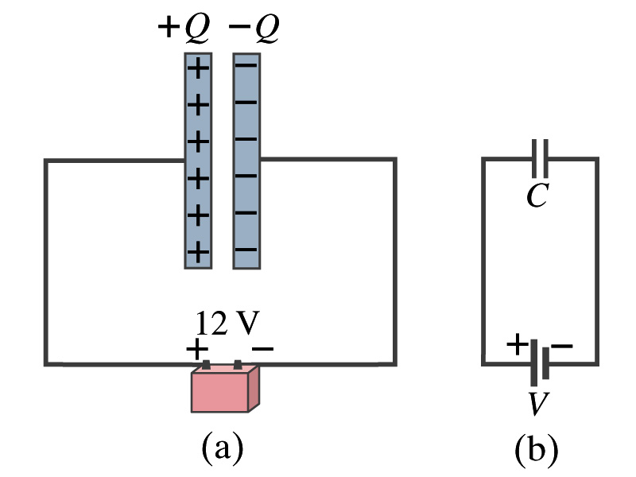
Capacitors
What do you think will happen if a battery is connected ( or the voltage is applied) to a capacitor?
The capacitor gets charged quickly, one plate positive and the other negative in equal amount of charge.
The battery terminals, the wires and the plates are conductors. What does this mean?
All conductors are at the same potential. And?
So the full battery voltage is applied across the capacitor plates.
So for a given capacitor, the amount of charge stored on each capacitor plate is proportional to the potential difference V_{ba} between the plates. How would you write this formula?
C is a proportionality constant, called the capacitance of the device.
What is the unit (poll 3)?
C is the property of a capacitor so does not depend on Q or V.
C/V
or
Farad (F)
Normally use μF or pF.

Slide 7
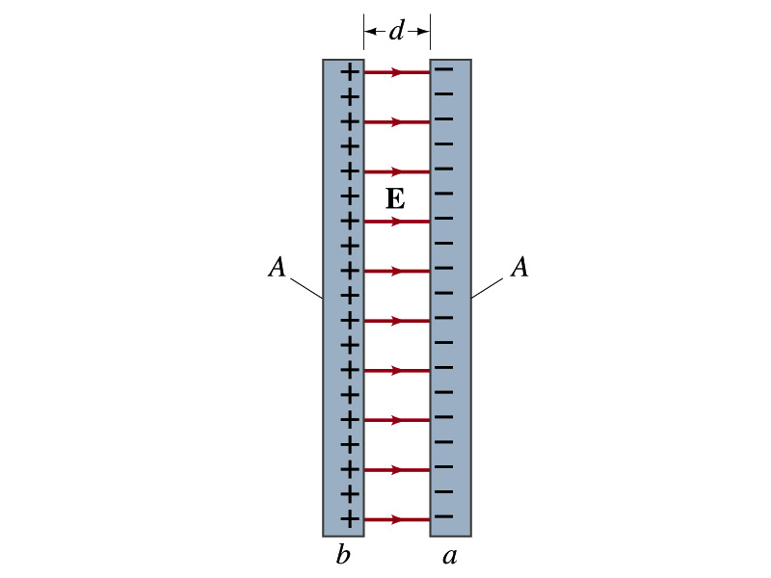
Determination of Capacitance
C, the capacitance can be determined analytically for a capacitor with a simple geometry and air in between.
Let’s consider a parallel plate capacitor.
Plates have area A each and separated by d.
d is smaller than the length, and so E is uniform.
E for parallel plates is E=σ/ε₀, σ=Q/A is the surface charge density.
E and V are related for uniform charge distribution
Since we take the integral from the lower potential (a) to the higher potential (b) along the field line, we obtain
So from the formula:
What do you notice?
C only depends on the area and the distance of the plates and the permittivity of the medium between them.

Slide 8
Example 24 – 1
Capacitor calculations: (a) Calculate the capacitance of a capacitor whose plates are 20cmx3.0cm and are separated by a 1.0mm air gap. (b) What is the charge on each plate if the capacitor is connected to a 12-V battery? (c) What is the electric field between the plates? (d) Estimate the area of the plates needed to achieve a capacitance of 1F, given the same air gap.
(a) Using the formula for a parallel plate capacitor, we obtain
(b) From Q=CV, the charge on each plate is

Slide 9
Example 24 – 1
(C) Using the formula for the electric field in two parallel plates
Or, since
we can obtain
(d) Solving the capacitance formula for A, we obtain
Solve for A
About 40% the area of Arlington (256km²).

Slide 10
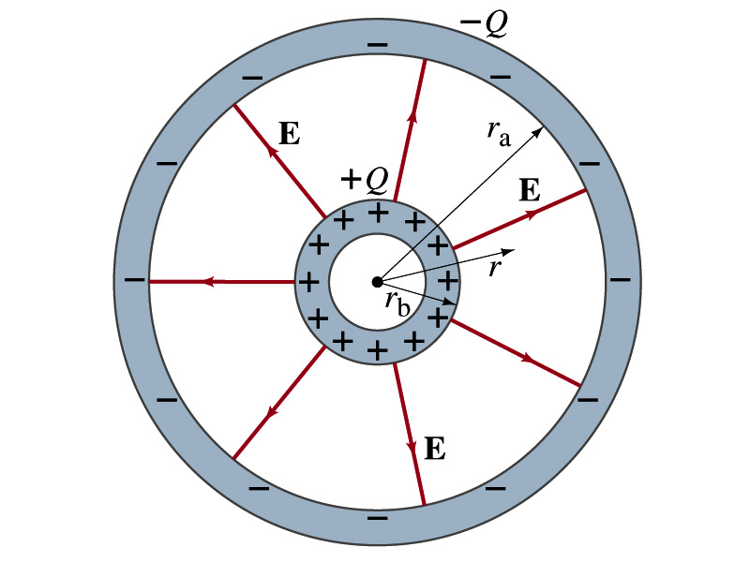
Example 24 – 3
Spherical capacitor: A spherical capacitor consists of two thin concentric spherical conducting shells, of radius r_{a} and r_{b}, as in the figure. The inner shell carries a uniformly distributed charge Q on its surface and the outer shell an equal but opposite charge –Q. Determine the capacitance of the two shells.
Using Gauss’ law, the electric field outside a uniformly charged conducting sphere is
So the potential difference between a and b is
Thus capacitance is

Slide 11
Capacitor Cont’d
A single isolated conductor can be said to have a capacitance, C.
C can still be defined as the ratio of the charge to the absolute potential V on the conductor.
So Q=CV.
The potential of a single conducting sphere of radius r_{b} can be obtained as
where
So its capacitance is

Slide 12
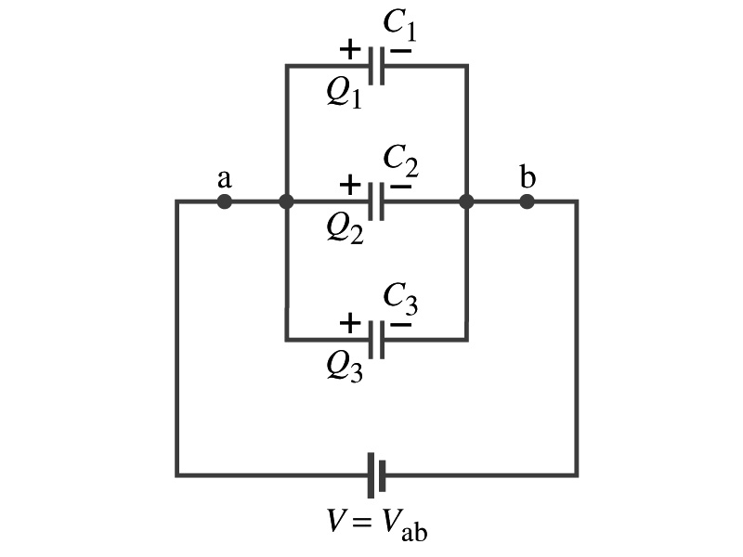
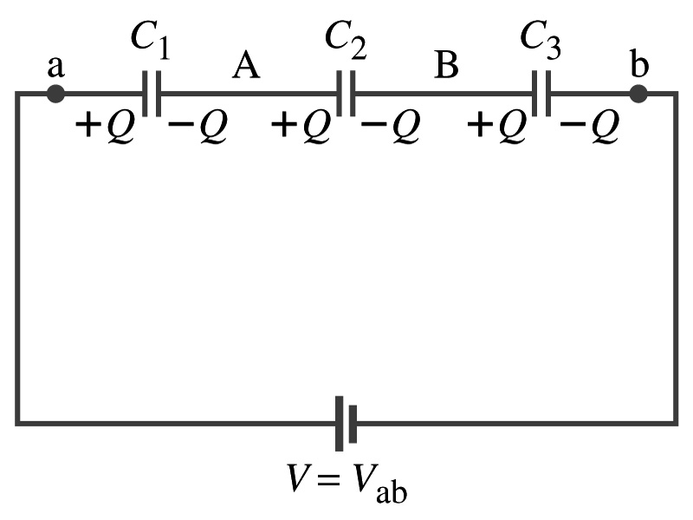
Capacitors in Series or Parallel
Capacitors may be used in electric circuits
What is an electric circuit?
A closed path of conductors, usually wires connecting capacitors and other electrical devices, in which
Charges can flow
And includes a voltage source such as a battery
Capacitors can be connected in various ways.
In parallel, in series or in combination

Slide 13
Capacitors in Parallel
Parallel arrangement provides the same voltage across all the capacitors.
Left hand plates are at V_{a} and right hand plates are at V_{b}
So each capacitor plate acquires the charge given by the formula
Q₁=C₁V, Q₂=C₂V, and Q₃=C₃V
The total charge Q that must leave the battery is then
Q=Q₁+Q₂+Q₃=V(C₁+C₂+C₃)
Consider that the three capacitors behave like an equivalent one
Q=C_{eq}V= V(C₁+C₂+C₃)
Thus the equivalent capacitance in parallel is
What is the net effect?
The capacitance increases!!!

Slide 14
Capacitors in Series
Series arrangement is more interesting
When the battery is connected, +Q flows to the left plate of C₁ and –Q flows to the right plate of C₃.
Since capacitors in between were originally neutral, charges get induced to neutralize the ones in the middle.
So the charge on each capacitor plate is the same value, Q. (Same charge)
Consider that the three capacitors behave like an equivalent one
Q=C_{eq}V
The total voltage V across the three capacitors in series must be equal to the sum of the voltages across each capacitor.
V=V₁+V₂+V₃=Q/C₁+Q/C₂+Q/C₃
Putting all these together, we obtain:
V=Q/C_{eq}=Q(1/C₁+1/C₂+1/C₃)
Thus the equivalent capacitance is
What is the net effect?
The capacitance smaller than the smallest C!!!

Slide 15
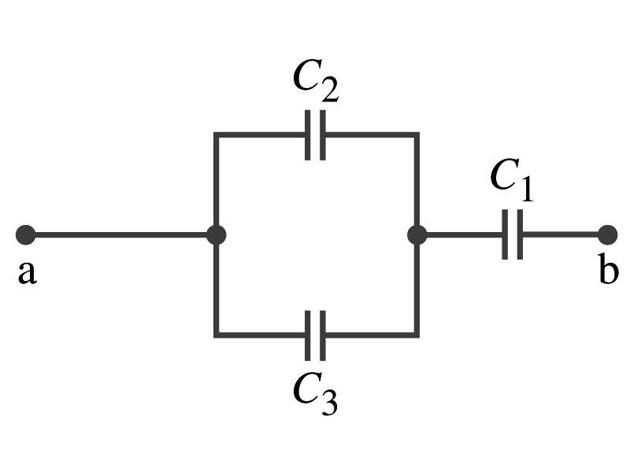
Example 24 – 5
Equivalent Capacitor: Determine the capacitance of a single capacitor that will have the same effect as the combination shown in the figure. Take C₁=C₂=C₃=C.
We should do these first!!
How?
These are in parallel so the equivalent capacitance is:
Now the equivalent capacitor is in series with C1.
Solve for C_{eq}

