Slide 1
PHYS 1441 – Section 002 Lecture #12
Monday, Oct. 12, 2020
Dr. Jaehoon Yu
CH24
Electric Energy Storage
Effect of Dielectric
Molecular description of Dielectric Material
CH25
Electric Current and Resistance
The Battery

Slide 2
Announcements
Online Mid-term comprehensive exam on Quest
In class Monday, Oct. 19
Covers: CH21.1 through what we finish Wednesday, Oct. 14 + math refresher
BYOF: You may bring a one 8.5x11.5 sheet (front and back) of handwritten formulae and values of constants for the exam
No derivations, word definitions, setups or solutions of any problems, figures, pictures, diagrams or arrows, etc!
No additional formulae or values of constants will be provided!
Must send me the photos of front and back of the formula sheet, including the blank, no later than 11am the day of the exam
Once submitted, you cannot change, unless I ask you to delete some part of the sheet!
Quiz 2 results
Class average: 35.5/60 ➔ equivalent to 58.8/100 (Q1: 80.3/100)
Top score: 60/60
Special seminar on COVID – 19: 3:30pm Sunday, Oct. 25
Dr. Linda Lee
Extra credit for participating in the seminar and asking a relevant question

Slide 3
Reminder: SP#3 – Civic Duty I: Voter Registration
Voter registration in Texas ends on Monday, Oct. 5, 2020
Registration can be done: https://www.votetexas.gov/register/index.html
Check your registration: https://teamrv-mvp.sos.texas.gov/MVP/mvp.do
For those who are legal to take part in the election
Your own registration to vote: 10 points
Include the screen shot your own voter registration check
You can have up to 3 more people who are not registered to register: 5 points each
Must include before and after the registration screen shots of the same person next to each other to show these are newly registered
For those who are not legal to take part in the election
You can have up to 5 people who are not registered to register: 5 points each
Must include before and after the registration screen shots of the same person next to each other to show these are newly registered
Deadline: 1pm Wednesday, Oct. 14, 2020⬅ Note extended deadline
Put all screen shots in one pdf file following the naming convention – SP3-LastName-FirstName-Fall20.pdf and upload to the CANVAS assignment

Slide 4
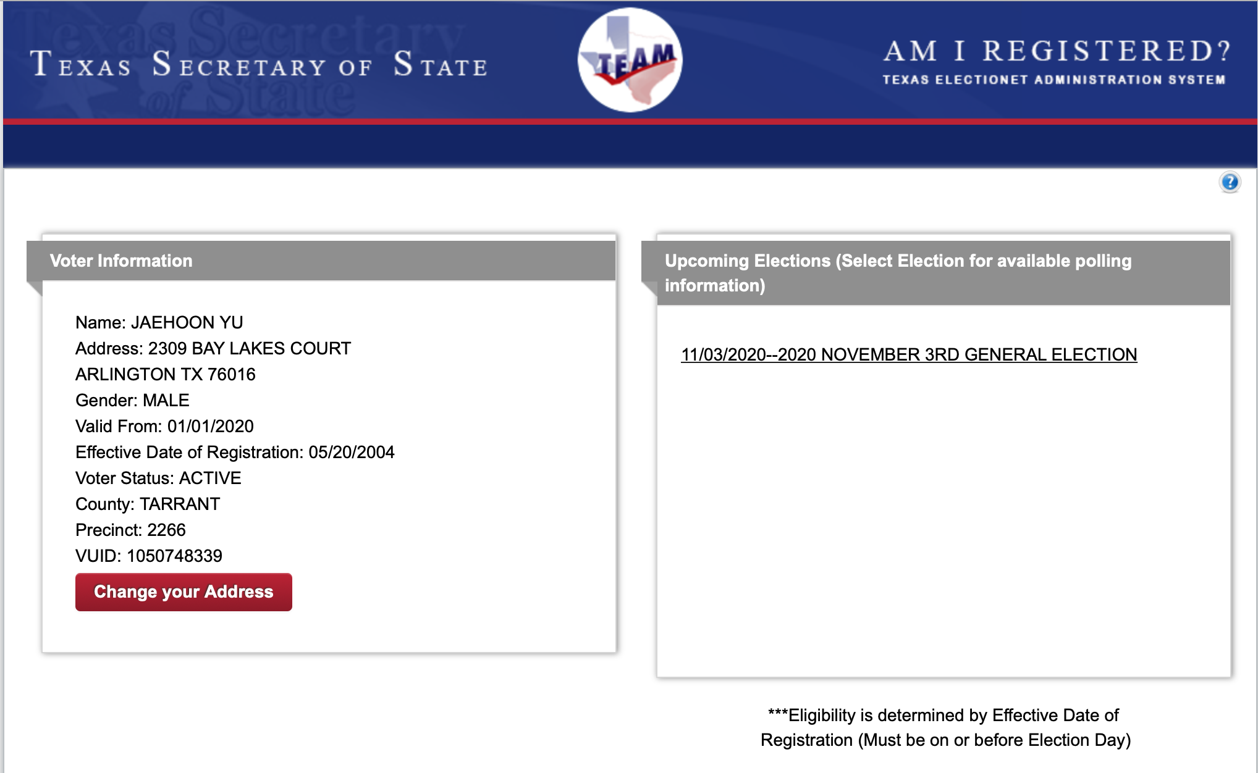
SP#3 – Civic Duty I: Voter Registration – 2

Slide 5
SP#5 – Civic Duty II: Election Participation
Election on Nov. 3 with early voting Tue. Oct. 13 – Fri. Oct. 30
For those with legal voting rights: You can submit three access code green sheet for 20 points total – one your own and two others who voted, 5 points each. Any additional ones will earn 2 points each
For those without legal voting rights: You can submit for the first four access code green sheets for 20 points total, 5 points each and any additional combinations 2 points each.
Be sure to tape one side of the stickers on a sheet of paper with your name on it.
Write the full name of the person next to the corresponding access code sheet
None of the stickers can be from the same person on someone else’s extra credit or on your own. All of those with any of the identical persons on your extra credit sheet will get 0 credit.
Deadline: Beginning of the class Monday, Nov. 9

Slide 6
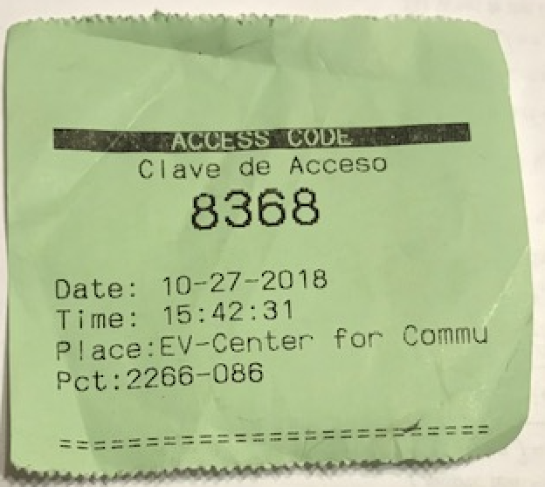
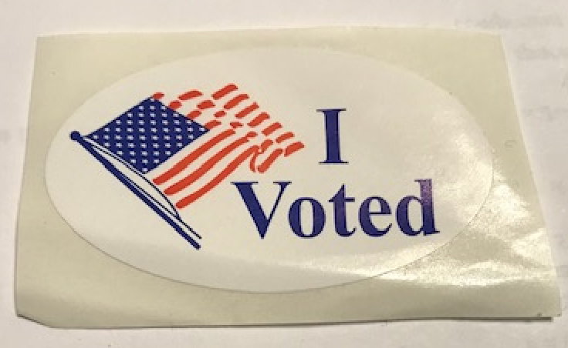
Access code sheet

Slide 7
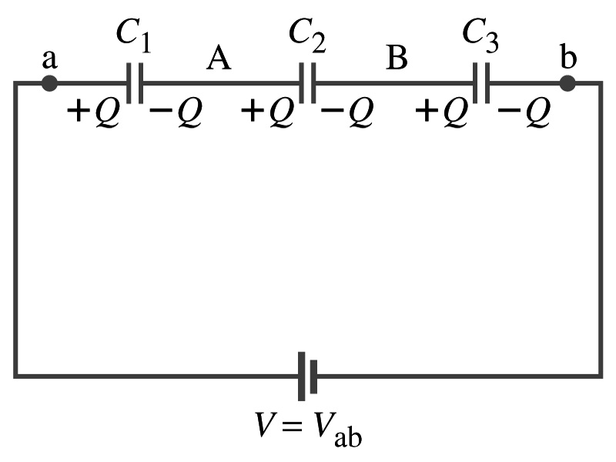
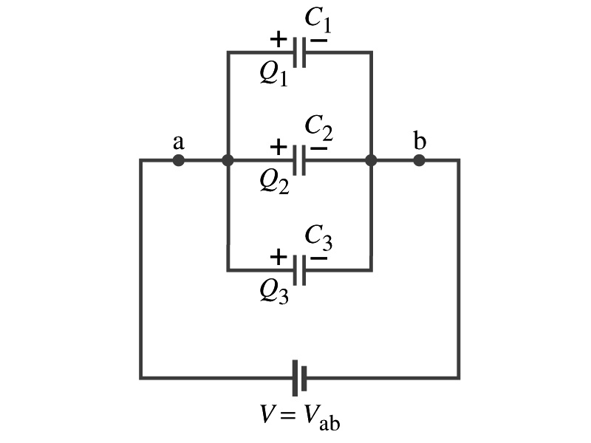
Recap: Capacitor Combinations
Capacitance
Series Combinations
Parallel Combinations

Slide 8
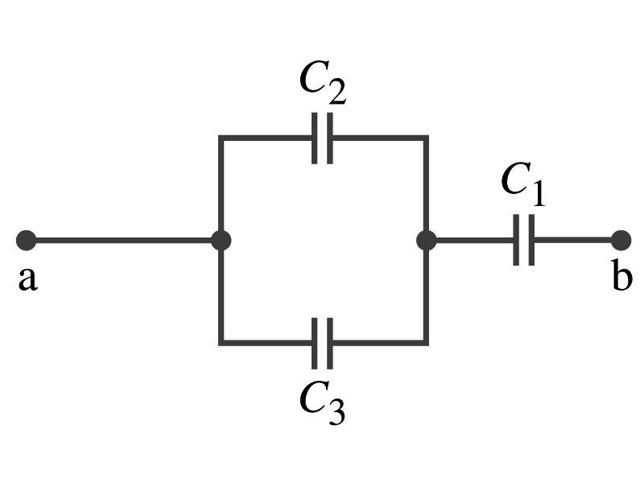
Example 24 – 5
Equivalent Capacitor: Determine the capacitance of a single capacitor that will have the same effect as the combination shown in the figure. Take C₁=C₂=C₃=C.
We should do these first!!
How?
These are in parallel so the equivalent capacitance is:
Now the equivalent capacitor is in series with C1.
Solve for C_{eq}

Slide 9
Electric Energy Storage
A charged capacitor stores energy.
The stored energy is the amount of the work done to charge it.
The net effect of charging a capacitor is removing one type of charge from one plate and putting them on to the other.
Battery does this when it is connected to a capacitor.
Capacitors do not get charged immediately.
Initially when the capacitor is uncharged, no work is necessary to move the first bit of charge. Why?
Since there is no charge, there is no field that the external work needs to overcome.
When some charge is on each plate, it requires work to add more charge due to the electric repulsion.

Slide 10
Electric Energy Storage
The work needed to add a small amount of charge, dq, when a potential difference across the plates is V: dW=Vdq.
Since V=q/C, the work needed to store total charge Q is
Thus, the energy stored in a capacitor when the capacitor carries the charges +Q and –Q is
Since Q=CV, we can rewrite

Slide 11
Example 24 – 8
Energy store in a capacitor: A camera flash unit stores energy in a 150μF capacitor at 200V. How much electric energy can be stored?
Using the formula for stored energy.
Umm.. Which one?
What do we know from the problem?
C and V
So we use the one with C and V:
How do we get J from FV²?

Slide 12
Electric Energy Density
The energy stored in a capacitor can be considered as being stored in the electric field between the two plates
For a uniform field E between two plates, V=Ed and C=ε₀A/d
Thus the stored energy is
Since Ad is the gap volume V, we can obtain the energy density, stored energy per unit volume, as
Valid for any space that is vacuum
Electric energy stored per unit volume in any region of space is proportional to the square of E in that region.

Slide 13
Dielectrics
Capacitors have an insulating sheet of material, called the dielectric, between the plates to
Increase breakdown voltage greater than that in air (3MV/m)
Apply higher voltage to the gap without the charge passing across
Allow the plates get closer together without touching
Increases capacitance ( recall C=ε₀A/d)
Increase the capacitance by the dielectric constant
Where C₀ is the intrinsic capacitance when the gap is vacuum

Slide 14
Dielectrics
The value of dielectric constant K varies depending on the material (Table 24 – 1)
K for vacuum is 1.0000
K for air is 1.0006 (this is why the permittivity of air and vacuum are used interchangeably.)
K for paper is 3.7
Maximum electric field before breakdown occurs is called the dielectric strength. What is its unit? (poll3)
V/m
The capacitance of a parallel plate capacitor with a dielectric (K) filling the gap is

Slide 15
Dielectrics
A new quantity of the permittivity of a dielectric material is defined as ε=Kε₀
The capacitance of a parallel plate capacitor with a dielectric medium filling the gap is
The energy density stored in an electric field E in a dielectric is
Valid for any space w/ dielectric w/ permittivity ε.
What is the stored energy in between ProtoDUNE cathode (-300kV) plate (6mx6m) and the cryostat wall (0V), d=1.5m, LAr K=1.5?

Slide 16
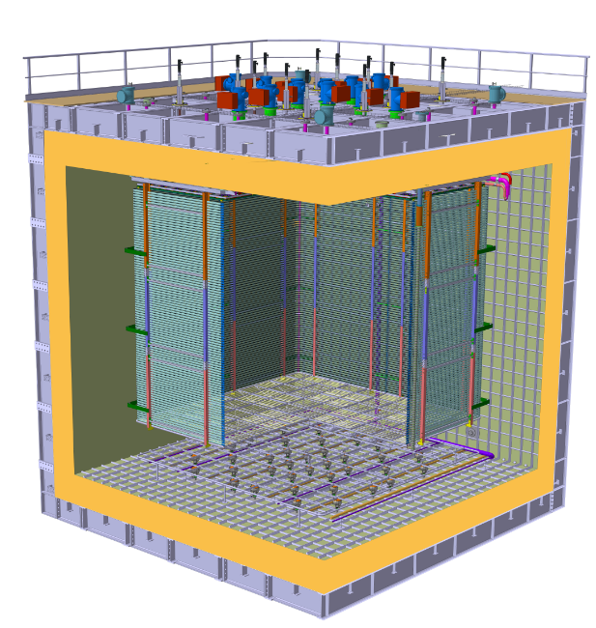
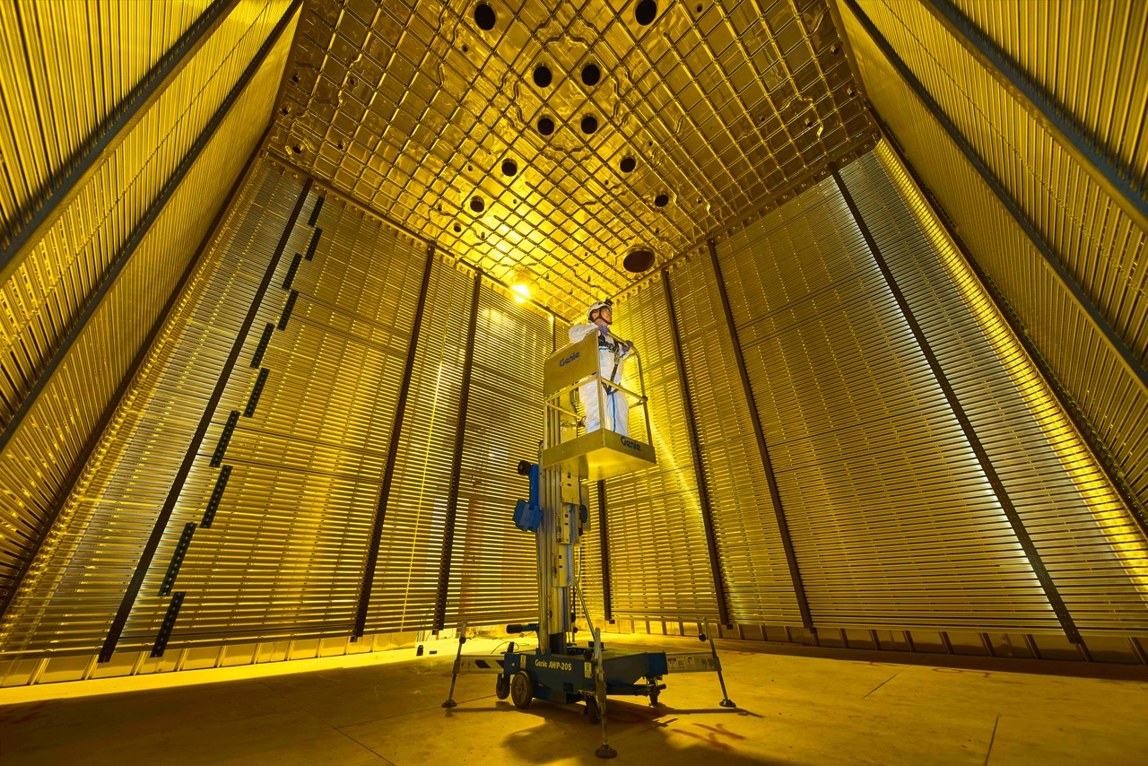
ProtoDUNE Dual Phase
Calculate the capacitance between each of the side wall to the FC & the cathode to the ground grid
Calculate the total energy stored in the capacitors
ε_{LAr} =1.4 ε₀
Charge Readout Planes
6 m
Field Cage (common structural elements with SP)
1 m
0.75 m
Cathode
6 m

Slide 17
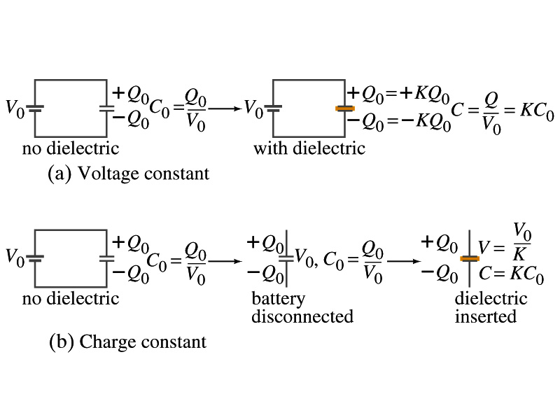
Effect of a Dielectric Material on Capacitance
Let’s consider the two cases below:
Case #1 : constant V
Case #2 : constant Q
Constant voltage: Experimentally observed that the total charge on each plate of the capacitor increases by K as a dielectric material is inserted between the gap ➔ Q=KQ₀
The capacitance increased to C=Q/V₀=KQ₀/V₀=KC₀
Constant charge: Voltage found to drop by a factor K ➔ V=V₀/K
The capacitance increased to C=Q₀/V=KQ₀/V₀=KC₀

Slide 18
Effect of a Dielectric Material on Field
What happens to the electric field within a dielectric?
Without a dielectric, the field is
What are V₀ and d?
V₀: Potential difference between the two plates
d: separation between the two plates
For the constant voltage, the electric field remains the same
For the constant charge: the voltage drops to V=V₀/K, thus the field in the dielectric is
The field in the dielectric is reduced.

Slide 19
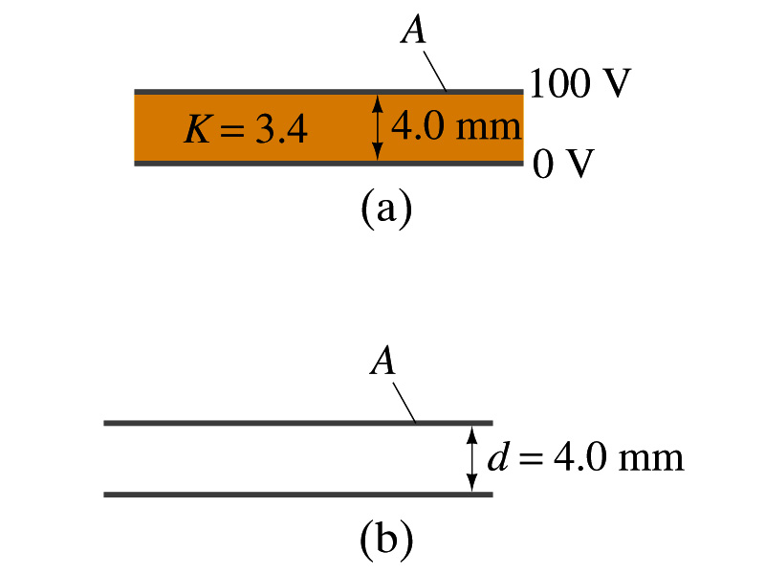
Example 24 – 11
Dielectric Removal: A parallel-plate capacitor, filled with the dielectric of K=3.4, is connected to a 100-V battery. After the capacitor is fully charged, the battery is disconnected. The plates have area A=4.0m², and are separated by d=4.0mm. (a) Find the capacitance, the charge on the capacitor, the electric field strength, and the energy stored in the capacitor. (b) The dielectric is carefully removed, without changing the plate separation nor does any charge leaving the capacitor. Find the new value of capacitance, electric field strength, voltage between the plates and the energy stored in the capacitor.
(a)

Slide 20
Example 24 – 11 cont’d
(b)
Since the dielectric has been removed, the effect of dielectric constant must be removed as well.
Since charge is the same ( ) before and after the removal of the dielectric, we obtain
Wrong!
Where did the extra energy come from?
The energy conservation law is violated in electricity???
Wrong!
Wrong!
An external force has done the work of 3.6x10⁻⁴J on the system to remove dielectric!!

Slide 21
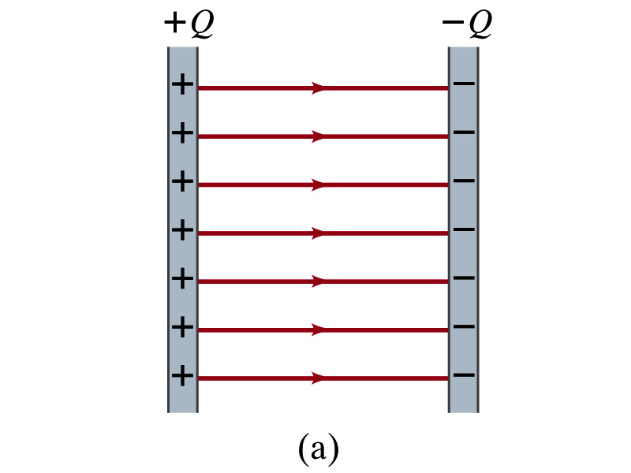
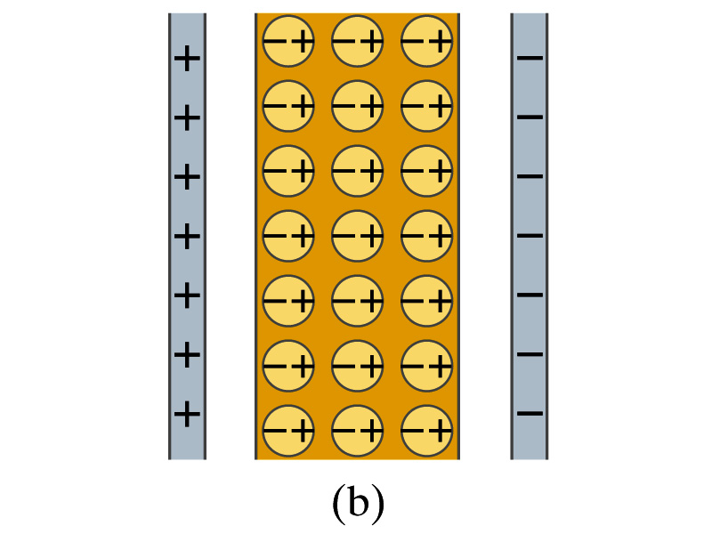
Molecular Description of Dielectric
So what in the world makes dielectrics behave the way they do?
We need to examine this in a microscopic scale.
Let’s consider a parallel plate capacitor that is charged up +Q(=C₀V₀) and –Q with air in between.
Assume there is no way any charge can flow in or out
Now insert a dielectric
Dielectric can be polar ➔ could have permanent dipole moment. What will happen?
Due to the electric field molecules will be aligned.

Slide 22
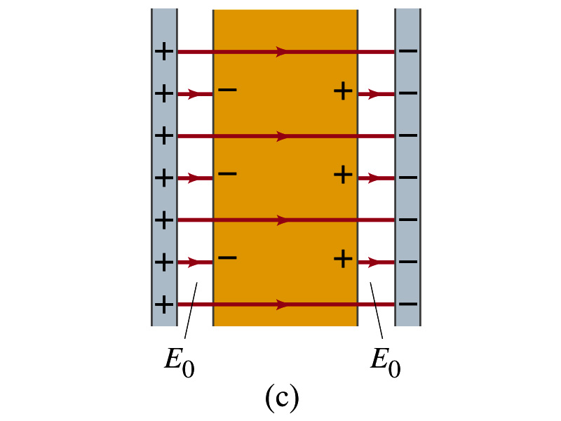
Molecular Description of Dielectric
OK. Then what happens?
Then effectively, there will be some negative charges close to the surface of the positive plate and positive charge on the negative plate
Some electric field do not pass through the whole dielectric but stops at the negative charge
So the field inside dielectric is smaller than in air
Since electric field is smaller, the force is smaller
The work need to move a test charge inside the dielectric is smaller
Thus the potential difference across the dielectric is smaller than across the air

