Slide 1
PHYS 1441 – Section 002
Lecture #13
Wednesday, Oct. 14, 2020
Dr. Jaehoon Yu
CH24
  Molecular description of Dielectric Material
CH25
  Electric Current and Resistance
  The Battery
  Ohm’s Law
  Resistors and Resistivity
Today’s homework is homework #7, due 11pm, Tuesday, Oct. 27!!

Slide 2
Announcements
Reading assignments: CH25.8 – 10
Online Mid-term comprehensive exam on Quest; roll call at 12:50
  In class Monday, Oct. 19; You will get an F if you miss the exam!
  Covers: CH21.1 through what we finish today, Oct. 14 (CH25.4?) + math refresher
  BYOF: You may bring a one 8.5x11.5 sheet (front and back) of handwritten formulae and values of constants for the exam
  No derivations, word definitions, setups or solutions of any problems, figures, pictures, diagrams or arrows, etc!
  No additional formulae or values of constants will be provided!
  Must send me the photos of front and back of the formula sheet, including the blank, no later than 11am the day of the exam
    Once submitted, you cannot change, unless I ask you to delete some part of the sheet!
Special seminar on COVID – 19: 3:30pm Sunday, Oct. 25
  Dr. Linda Lee
  Extra credit for participating in the seminar and asking a relevant question

Slide 3
SP#5 – Civic Duty II: Election Participation
Election on Nov. 3 with early voting Tue. Oct. 13 – Fri. Oct. 30
For those with legal voting rights: You can submit three access code green sheet for 20 points total – one your own and two others who voted, 5 points each. Any additional ones will earn 2 points each
For those without legal voting rights: You can submit for the first four access code green sheets for 20 points total, 5 points each and any additional combinations 2 points each.
Be sure to tape one side of the stickers on a sheet of paper with your name on it.
  Write the full name of the person next to the corresponding access code sheet
None of the stickers can be from the same person on someone else’s extra credit or on your own. All of those with any of the identical persons on your extra credit sheet will get 0 credit.
Deadline: Beginning of the class Monday, Nov. 9

Slide 4
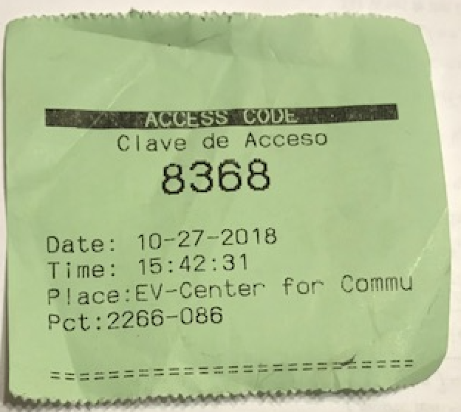

Access code sheet

Slide 5
SP #6 – Statistical Analysis : COVID19
Make comparisons of COVID-19 statistics between the U.S., South Korea, Italy and Texas from https://coronaboard.com on spreadsheet
  Total 44 points: 1 point for each of the top 20 cells and 2 points for each of the 12 cells for testing
Fill the US Historic event analysis table at the bottom half of the sheet (2 points per cell, 24 points total) and make a >3 sentence statement on COVID19 with respect to other events (6 points)
What are the 3 fundamental quantitative requirements for opening up (2 points each, 6 points total)?
  Must be quantitative! (e.g. number of tests per capita per day, positivity rate, etc)
Assess the readiness of the three fundamental requirements U.S. (Do NOT just take politician’s words!). Must provide the independent scientific entity’s reference you took the information from. (2 point each, total 6 points)
Evaluate quantitatively the success/failure of the US responses to COVID-19 in 5 sentences. Must provide quantitative reasons behind your conclusion! (2 points each sentence, 10 points total)
Assess quantitatively the effectiveness of wearing masks (4 points) and at least 4 reasons for it being effective (1 point each, 0.5 point extra after the first 4).
Due: 11pm, Friday, Oct. 23
  Submit one pdf file SP6-YourLastName-YourFirstName.pdf, including the spreadsheet
  Spreadsheet has been posted on canvas. Download ASAP.

Slide 6
SP6 spreadsheet

Slide 7
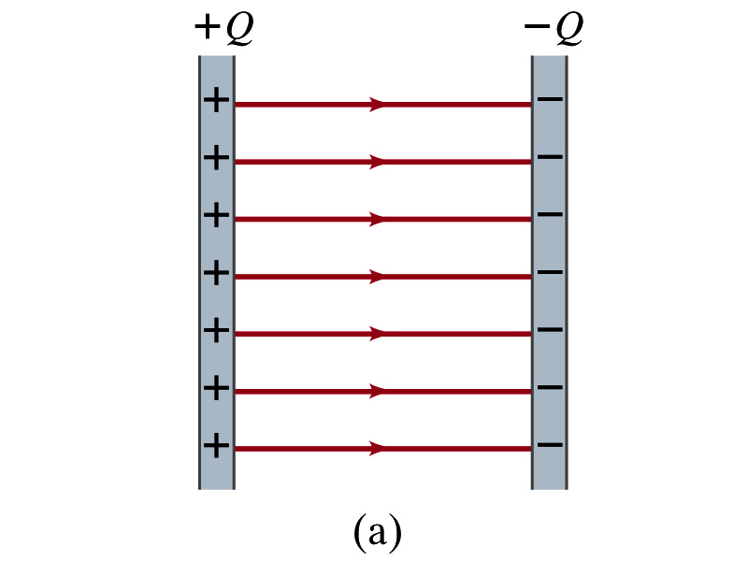
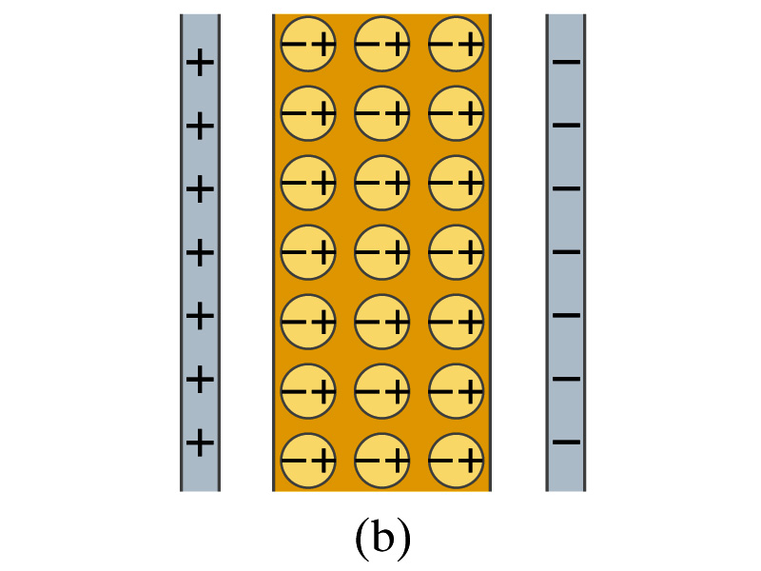
Molecular Description of Dielectric
So what in the world makes dielectrics behave the way they do?
We need to examine this in a microscopic scale.
Let’s consider a parallel plate capacitor that is charged up +Q(=C₀V₀) and –Q with air in between.
  Let’s assume there is no way any charge can flow in or out
Now insert a dielectric
  Dielectric can be polar ➔ could have permanent dipole moment. What will happen?
Due to the electric field molecules will be aligned.

Slide 8
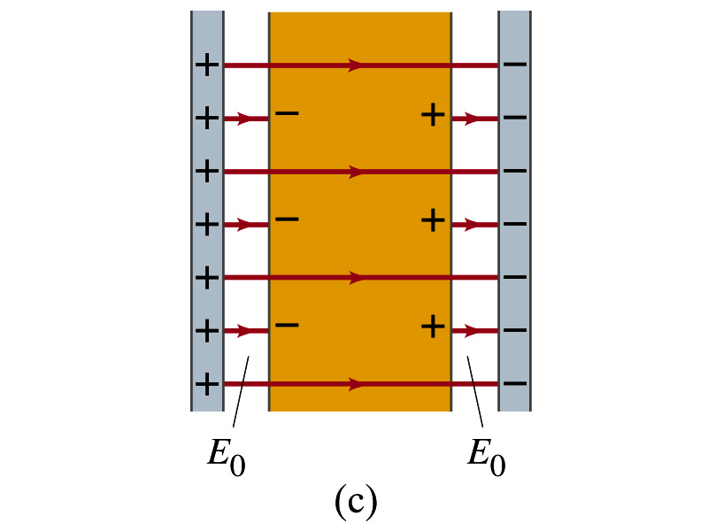
Molecular Description of Dielectric
OK. Then what happens?
Then effectively, there will be some negative charges close to the surface of the positive plate and positive charge on the negative plate
  Some electric field do not pass through the whole dielectric but stops at the negative charge
  So the field inside dielectric is smaller than in air
Since the electric field is smaller, the force is smaller
  The work need to move a test charge inside the dielectric is smaller
  Thus the potential difference across the dielectric is smaller than across the air

Slide 9
Electric Current and Resistance
So far, we have been studying static electricity
  What is the static electricity?
    The charges so far has not been moving but staying put at the location they are placed.
Now we will learn dynamics of electricity
What is the electric current?
  A flow of electric charge
  What are a few examples of the things that use electric current in everyday lives?
In an electrostatic situation, there is no electric field inside a conductor but when there is current, there is field inside a conductor. Why?
  Electric field is needed to keep charges moving

Slide 10
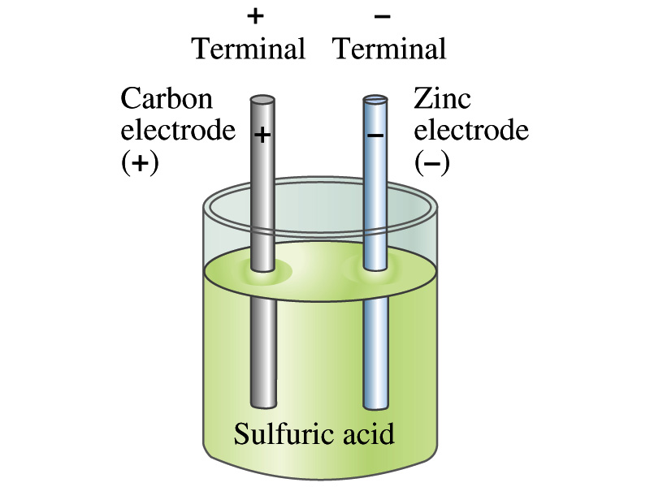
The Electric Battery
What is a battery?
  A device that produces electrical energy from the stored chemical energy and produces electricity ➔ Maintains potential difference!
Electric battery was invented by Volta in late 1790s in Italy
  It was made of disks of zinc and silver w/ salt-water soaked clothes based on his research that certain combinations of materials produce a greater electromotive force (emf), or potential, than others
  Pile (or a battery) of these connected to make up the first battery!
Simplest batteries contain two plates made of dissimilar metals called electrodes
  Electrodes are immersed in a solution, the electrolyte
  This unit is called a cell and many of these form a battery
Zinc and carbon in the figure are called terminals

Slide 11
How does a battery work – I?
One of the electrodes in the figure is zinc and the other carbon
The acid electrolyte reacts with the zinc electrode and dissolves it.
Each zinc atom leaves two electrons in the electrode and enters into the solution as a positive ion ➔ zinc electrode acquires negative charge and the electrolyte (the solution) becomes positively charged
The carbon electrode picks up the positive charge
Since the two terminals are oppositely charged, there is a potential difference between them

Slide 12
How does a battery work – II?
When the terminals are not connected, only the necessary amount of zinc is dissolved into the solution.
How is the particular potential difference maintained?
  If the terminals are not connected, as too many zinc ions get produced,
    zinc electrode gets increasingly charged up negative
    zinc ions get recombined with the electrons in zinc electrode
Why does battery go dead?
  When the terminals are connected to a circuit, the negative charges will flow away from the zinc electrode
  More zinc atoms dissolve into the electrolyte to produce more charge
  One or more electrode get used up not producing any more charge.

Slide 13
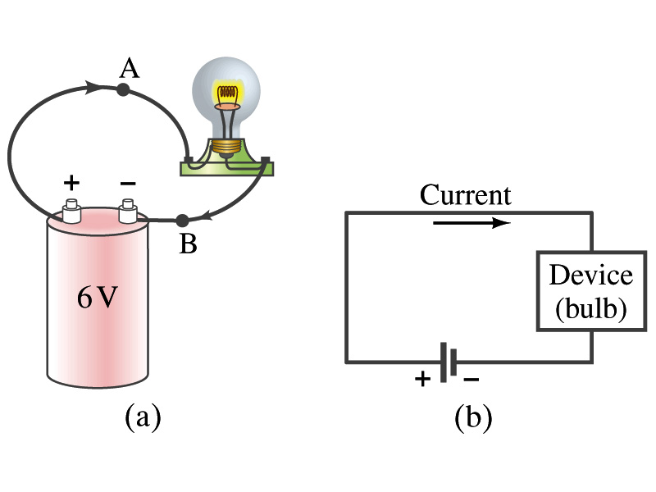
Electric Current
When a circuit is powered by a battery (or a source of emf) the charge can flow through the circuit.
Electric Current: Any flow of charge
  Current can flow whenever there is a potential difference between the ends of a conductor (or when the two ends have opposite charges)
    The current can flow even through the empty space under certain conditions
  Electric current in a wire can be defined as the net amount of charge that passes through the wire’s full cross section at any point per unit time (just like the flow of water through a conduit.)
  Average current is defined as:
  The instantaneous current is:
  What kind of a quantity is the current? (poll 2)
Unit (Poll3)?
C/s
1A=1C/s
Scalar
In a single circuit, conservation of electric charge guarantees that the current at one point of the circuit is the same as any other points on the circuit.

Slide 14
Example 25 – 1
Current is a flow of charge: A steady current of 2.5A flows in a wire for 4.0min. (a) How much charge passed by any point in the circuit? (b) How many electrons would this be?
Current is total amount charge flown through a circuit in a given time. So from we obtain
The total number of electrons passed through the circuit is

Slide 15
Direction of the Electric Current
What do conductors have in abundance?
  Free electrons
What happens if a continuous loop of conducting wire is connected to the terminals of a battery?
  Electrons start flowing through the wire continuously as soon as both the terminals are connected to the wire. Why?
    The potential difference between the battery terminals sets up an electric field inside the wire and in the direction parallel to it (poll11)
    Free electrons in the conducting wire get attracted to the positive terminal
    The electrons leaving negative terminal flow through the wire and arrive at the positive terminal
      Electrons flow from negative to positive terminal
  Due to historical convention, the direction of the current is opposite to the direction of flow of electrons ➔ Conventional Current

Slide 16
Ohm’s Law: Resistance and Resistors
What do we need to produce electric current?
  Potential difference
George S. Ohm experimentally established that the current is proportional to the potential difference ( )
  If we connect a wire to a 12V battery, the current flowing through the wire is twice that of 6V, three times that of 4V and four times that of a 3V battery
  What happens if we reverse the sign of the voltage?
    It changes the direction of the current flow
    Does not change the magnitude of the current
  Just as in water flow case, if the height difference is large the flow rate is large ➔ If the potential difference is large, the current is large.

Slide 17
Ohm’s Law: Resistance
The exact amount of current flow (I) in a wire depends on
  The voltage (V)
  The resistance of the wire (R) to the flow of electrons
    Just as the gunk in water pipe slows down water flow
    Electrons are slowed down due to interactions with the atoms in the wire
The higher the resistance (R) the less the current (I) for the given potential difference V
  So how would you define resistance?
    Such that current is inversely proportional to the resistance
  Often it is rewritten as
  What does this mean?
    The metal conductor’s resistance R is a constant independent of V.
  This linear relationship is not valid for some materials like diodes, vacuum tubes, transistors etc. ➔ These are called non-ohmic
Unit (poll 3)?
Ohm’s Law
ohms

Slide 18
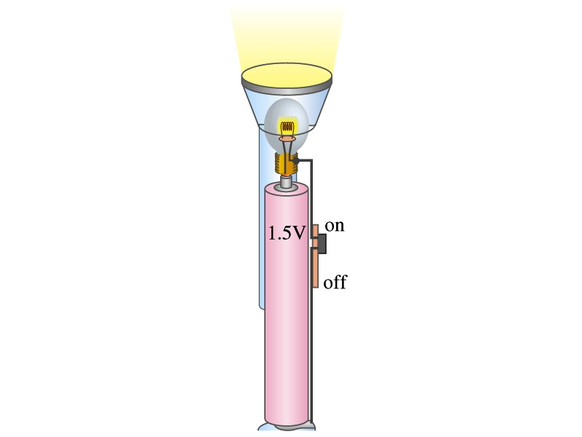
Example 25 – 4
Flashlight bulb resistance: A small flashlight bulb draws 300mA from its 1.5V battery. (a) What is the resistance of the bulb? (b) If the voltage drops to 1.2V, how would the current change?
From Ohm’s law, we obtain
Would the current increase or decrease, if the voltage reduces to 1.2V?
If the resistance did not change, the current is

Slide 19
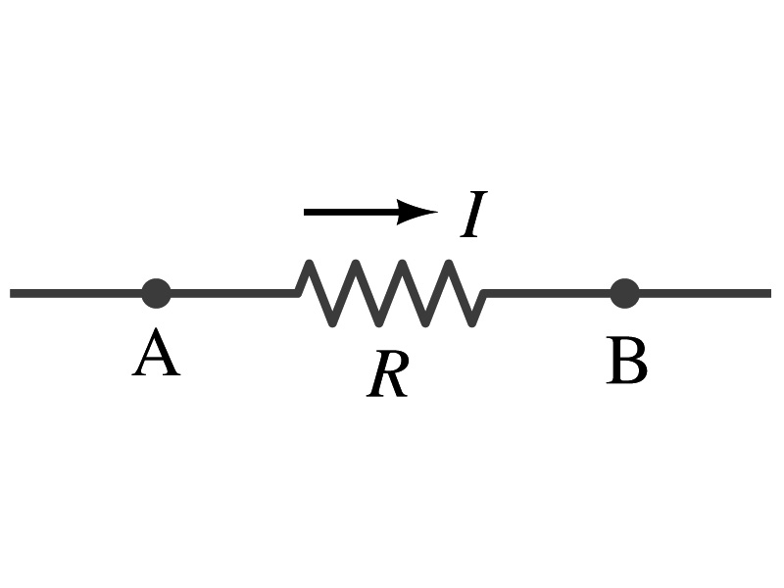
Ohm’s Law: Resistors
All electric devices offer a resistance to the flow of current.
  Filaments of light bulbs or heaters are wires with high resistance to cause electrons to lose their energy in the wire
  In general connecting wires have low resistance compared to other devices on the circuit
In circuits, resistors are used to control the amount of current
  Resistors offer resistance of less than one ohm to millions of ohms
  Main types are
    “wire-wound” resistors which consists of a coil of fine wire
    “composition” resistors which are usually made of semiconductor carbon
    thin metal films
When drawn in the circuit, the symbol for a resistor is:
Wires are drawn simply as straight lines

Slide 20
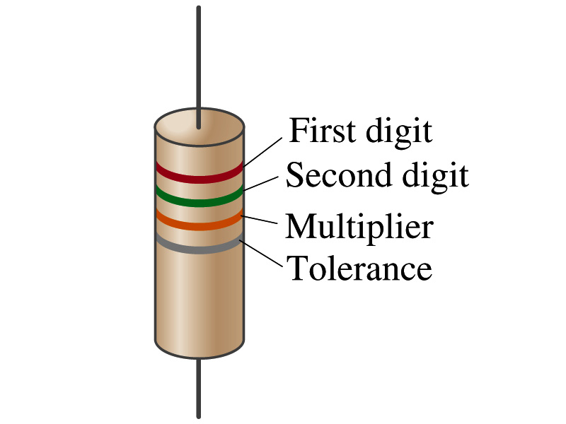
Ohm’s Law: Resistor Values
Resistors have its resistance color-coded on its body
The color-coding follows the convention below:
Color | Number | Multiplier | Tolerance
Black | 0 | 1=10⁰
Brown | 1 | 10¹
Red | 2 | 10²
Orange | 3 | 10³
Yellow | 4 | 10⁴
Green | 5 | 10⁵
Blue | 6 | 10⁶
Violet | 7 | 10⁷
Gray | 8 | 10⁸
White | 9 | 10⁹
Gold |  | 10-¹ | 5%
Silver |  | 10⁻² | 10%
None |  |  | 20%
What is the resistance of the resistor in this figure?

Slide 21
Resistivity
It is experimentally found that the resistance R of a metal wire is directly proportional to its length l and inversely proportional to its cross-sectional area A
  How would you formularize this?
  The proportionality constant ρ is called the resistivity and depends on the material used. What is the unit of this constant?
    ohm-m or Ω−m
    The values depends on purity, heat treatment, temperature, etc
  How would you interpret the resistivity?
    The higher the resistivity the higher the resistance
    The lower the resistivity the lower the resistance and the higher the conductivity ➔ Silver has the lowest resistivity.
      So the silver is the best conductor
  The reciprocal of the resistivity is called the conductivity, σ,
A
l

Slide 22
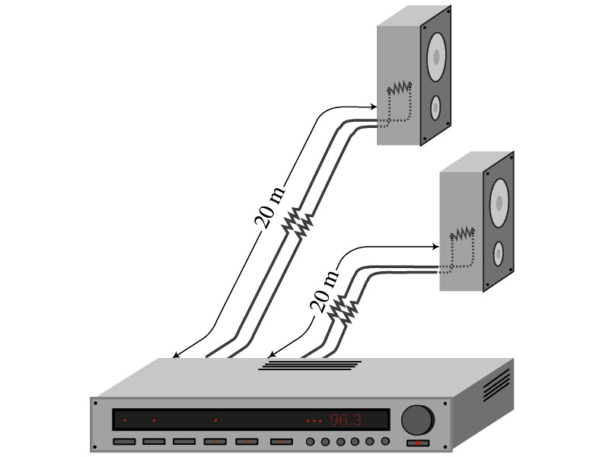
Example 25 – 5
Speaker wires: Suppose you want to connect your stereo to remote speakers. (a) If each wire must be 20m long, what diameter copper wire should you use to keep the resistance less than 0.1-Ω per wire? (b) If the current on each speaker is 4.0A, what is the voltage drop across each wire?
The resistivity of a copper is
Table 25.1
From the formula for resistance, we can obtain the formula for area
Solve for A
Solve for d
From Ohm’s law, V=IR, we obtain

Slide 23
Example 25 – 6
Stretching changes resistance: A wire of resistance R is stretched uniformly until it is twice its original length. What happens to its resistance?
What is the constant quantity in this problem?
The volume!
What is the volume of a cylinder of length L and radius r?
What happens to A if L increases factor two, L’=2L?
The cross-sectional area, A, halves. A’=A/2
The original resistance is
The new resistance is
The resistance of the wire increases by a factor of four if the length increases twice.

Slide 24
Temperature Dependence of Resistivity
Do you think the resistivity depends on temperature?
  Yes
Would it increase or decrease with the temperature?
  Increase
  Why?
  Because the atoms are vibrating more rapidly as temperature increases and are arranged in a less orderly fashion. So?
    They interfere more with the flow of electrons.
If the temperature change is not too large, the resistivity of metals usually increase nearly linearly w/ temperature
  α is the temperature coefficient of resistivity
  α of some semiconductors can be negative due to increased number of freed electrons.

