Slide 1
PHYS 1441 – Section 002
Lecture #14
Wednesday, Oct. 21, 2020
Dr. Jaehoon Yu
CH25
  Electric Power
  Alternating Current
  Microscopic View of Electric Current
  Ohm’s Law in Microscopic View

Slide 2
Announcements
Reading assignments: CH25 – 9, 25 – 10 and CH26 – 7
Special seminar on COVID – 19: 3:30pm this Sunday, Oct. 25
  Dr. Linda Lee; Roll call will begin at 3:15pm.
  Extra credit for participating in the seminar and asking relevant questions
We will have mid-term a grade discussion next Wednesday, Oct. 28, starting 11:30am ending at 4:30pm on a separate zoom link
  Mark your preference in the doodle poll which is limited to 15 students in each 30min slot – Poll: https://doodle.com/poll/zpad5me89scp2whd
  Grade discussion zoom link: https://uta.zoom.us/j/98724294579?pwd=MlBJQXF3RnNZamtUbzQ3b3FXd2VIdz09
Mid-term exam results
  Class average: 59.7/102
    Equivalent to 58.5/100 (Term 1: 65.7/100)
  Top score: 102/102
Warning: I will mark those of you still connected at the end of the class but not answering to my call missing the class

Slide 3
Evaluation Policy
Homework: 25%!!!
Exams
  Final Comprehensive Exam (11am, Wed., 12/16/20): 23%
  Mid-term Comprehensive Exam (1pm, Mon., 10/19/20): 20%
  One better of the two term Exams (9/23/20 and 11/11/20): 12%
  Missing an exam is not permissible unless pre-approved
    No makeup test
    You will get an F if you miss any of the exams without a prior approval no matter how well you’ve been doing in class!
Lab score: 10%
Pop-quizzes: 10%
Extra credits: 10% of the total
Grading will be done on a sliding scale on the final scores
100%

Slide 4
SP#5 – Civic Duty II: Election Participation
Election on Nov. 3 with early voting Tue. Oct. 13 – Fri. Oct. 30
For those with legal voting rights: You can submit three access code green sheet for 20 points total – one your own and two others who voted, 5 points each. Any additional ones will earn 2 points each
For those without legal voting rights: You can submit for the first four access code green sheets for 20 points total, 5 points each and any additional combinations 2 points each.
Be sure to tape one side of the access code (or “I Voted” sticker if the voting was not using an electronic machine) on a sheet of paper with the date, the precinct number, the name of the person voted
None of the stickers can be from the same person on someone else’s extra credit or on your own. All of those with any of the identical persons on your extra credit sheet will get 0 credit.
Deadline: Beginning of the class Monday, Nov. 9 (poll 13)

Slide 5

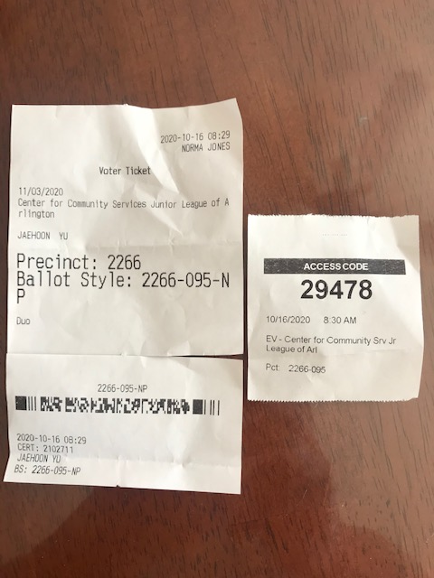
Access code sheet/Sticker
This must be accompanied with date of the vote, the county name, the precinct number, the full name of the person voted and the signature of the person

Slide 6
SP #6 – Statistical Analysis : COVID19
Make comparisons of COVID-19 statistics between the U.S., South Korea, Italy and Texas from https://coronaboard.com on spreadsheet
  Total 44 points: 1 point for each of the top 20 cells and 2 points for each of the 12 cells for testing
Fill the US Historic event analysis table at the bottom half of the sheet (2 points per cell, 24 points total) and make a >3 sentence statement on COVID19 with respect to other events (6 points)
What are the 3 fundamental quantitative requirements for opening up (2 points each, 6 points total)?
  Must be quantitative! (e.g. number of tests per capita per day, positivity rate, etc)
Assess the readiness of the three fundamental requirements U.S. (Do NOT just take politician’s words!). Must provide the independent scientific entity’s reference you took the information from. (2 point each, total 6 points)
Evaluate quantitatively the success/failure of the US responses to COVID-19 in 5 sentences. Must provide quantitative reasons behind your conclusion! (2 points each sentence, 10 points total)
Assess quantitatively the effectiveness of wearing masks (4 points) and at least 4 reasons for it being effective (1 point each, 0.5 point extra after the first 4).
Due: 11pm, this Friday, Oct. 23
  Submit one pdf file SP6-YourLastName-YourFirstName.pdf, including the spreadsheet
  Spreadsheet has been posted on canvas. Download ASAP.

Slide 7
SP6 spreadsheet

Slide 8
Special Project #7: Electric Power Usage
Make a list of the power consumption and the resistance of all electric and electronic devices at your home and compile them in a table. (10 points total for the first 10 items and 0.5 points each additional item.)
Estimate the cost of electricity for each of the items on the table using your own electric cost per kWh (if you don’t find your own, use $0.12/kWh) and put them in the relevant column. (5 points total for the first 10 items and 0.2 points each additional items)
Estimate the the total amount of energy in Joules and the total electricity cost per day, per month and per year for your home. (8 points)
Due: Beginning of the class Monday, Nov. 2
  Scan all pages of your special project into the pdf format
  Save all pages into one file with the filename SP7-YourLastName-YourFirstName.pdf
  Submit on CANVAS

Slide 10
Temperature Dependence of Resistivity
Do you think the resistivity depends on temperature? (poll 14)
  Yes
Would it increase or decrease with the temperature? (poll 15)
  Increase
  Why?
  Because the atoms are vibrating more rapidly as temperature increases and are arranged in a less orderly fashion. So?
    They interfere more with the flow of electrons.
If the temperature change is not too large, the resistivity of metals usually increase nearly linearly w/ temperature
  α is the temperature coefficient of resistivity
  α of some semiconductors can be negative due to increased number of freed electrons.

Slide 11
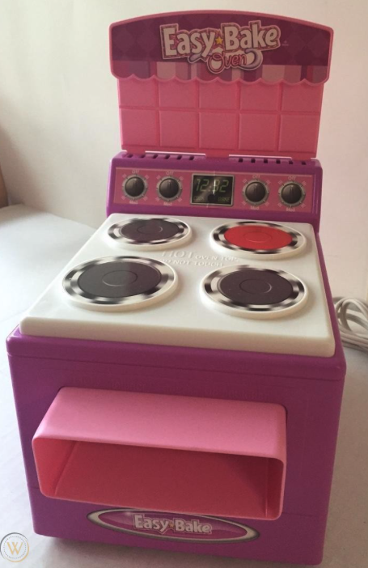
Electric Power
Why is the electric energy useful?
  It can transform into different forms of energy easily.
    Motors, pumps, etc, transform electric energy to mechanical energy
    Heaters, dryers, cook-tops, etc, transforms electricity to thermal energy
    Incandescent light bulb filament transforms electric energy to light
      Only about 10% of the energy turns to light and the 90% lost via heat
      Typical household light bulb and heating elements have resistance of order a few ohms to a few hundred ohms
How does electric energy transforms to thermal energy?
  Flowing electrons collide with the vibrating atoms of the wire.
  In each collision, part of electron’s kinetic energy is transferred to the atom it collides with.
  The kinetic energy of wire’s atoms increases, and thus the temperature of the wire increases.
  The increased thermal energy can be transferred as heat through conduction and convection to the air in a heater or to food on a pan, through radiation to bread in a toaster or radiated as light.

Slide 12
Electric Power
How do we find out the power transformed by an electric device?
  What is definition of the power?
    The rate at which work is done or the energy is transformed
What is the energy transformed when an infinitesimal charge dq moves through a potential difference V?
  dU=Vdq
  If dt is the time required for an amount of charge dq to move through the potential difference V, the power P is
  Thus, we obtain .
  What is the unit? (Poll 3)
  What kind of quantity is the electrical power? (Poll 2)
    Scalar
  P=IV can apply to any devices while the formula with resistance can only apply to devices that have resistance.
What is this?
In terms of resistance
Watts = J/s

Slide 13
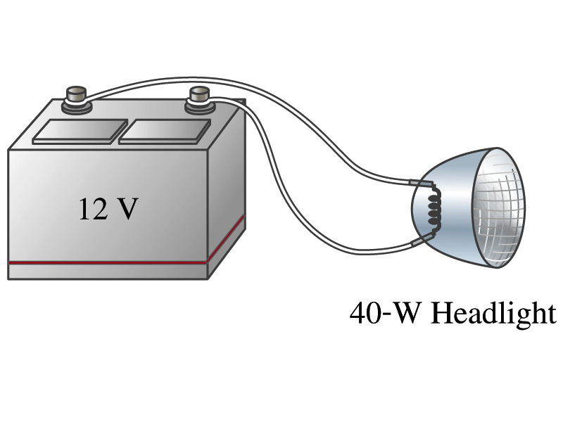
Example 25 – 8
Headlights: Calculate the resistance of a 40-W automobile headlight designed for 12V.
Since the power is 40W and the voltage is 12V, we use the formula with V and R.
Solve for R

Slide 14
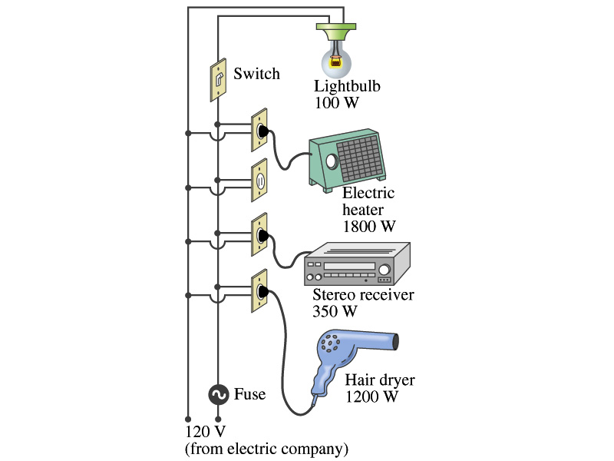
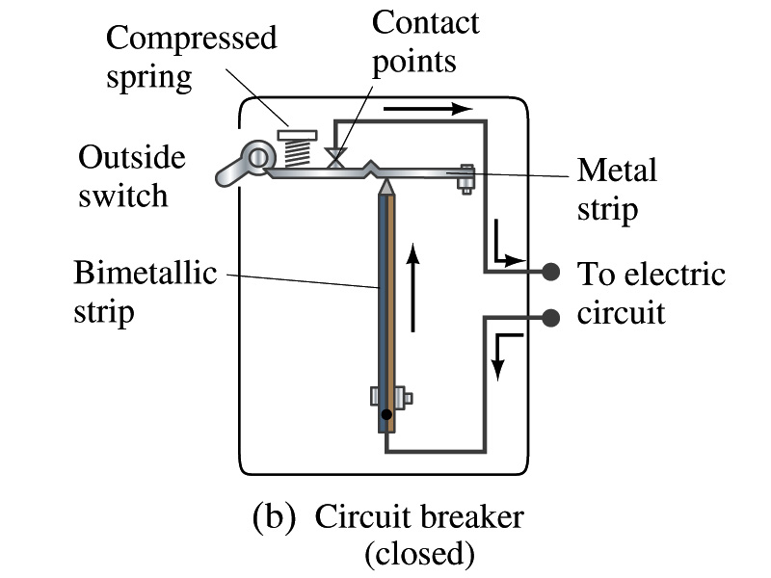
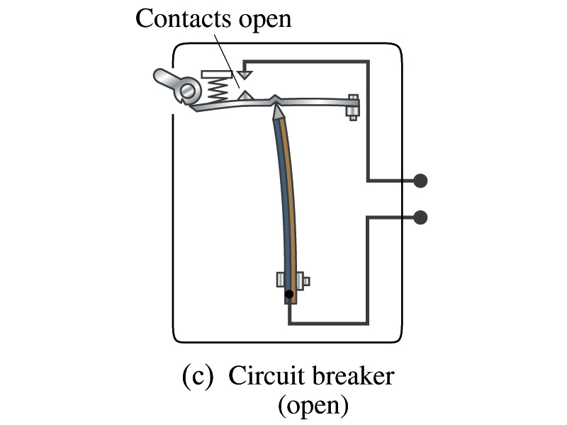
Power in Household Circuits
Household devices usually have small resistance
  But since they draw current, if the current becomes large enough, wires can heat up (overloaded)
    Why is using thicker wires safer?
      Thicker wire has less resistance, lower heat
  Overloaded wire can set off a fire at home
How do we prevent this?
  Put in a switch that would disconnect the circuit when overloaded
    Fuse or circuit breakers
    They open up the circuit when the current is over certain value
Overload

Slide 15
Example 25 – 11
Will the fuse blow?: Determine the total current drawn by all the devices in the circuit in the figure. Will a 20A fuse blow?
The total current is the sum of current drawn by individual device.
Solve for I
Bulb
Heater
Stereo
Dryer
Total current
What is the total power?

Slide 16
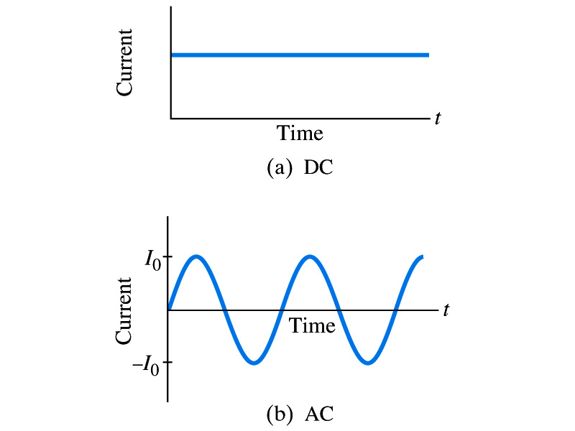
Alternating Current
Does the direction of the flow of current change while a battery is connected to a circuit? (poll 14)
  No. Why?
    Because its source of potential difference stays put, once connected
  This kind of current is called the Direct Current (DC), and it does not change its direction of flow while the battery is connected.
    How would DC look as a function of time? (poll 16)
      A straight line at the same value
Electric generators at electric power plant produce alternating current (AC)
  AC reverses direction many times a second (poll 16)
  AC is sinusoidal as a function of time
Most the currents supplied to homes and business are AC.

Slide 17
The Alternating Current
The voltage produced by an AC electric generator is sinusoidal
  This is why the AC current is sinusoidal (Poll 17)
Voltage produced can be written as
What are the maximum and minimum voltages?
  V₀ (–V₀) and 0
  The potential oscillates between +V₀ and –V₀, the peak voltages or amplitude
  What is f?
    The frequency, the number of complete oscillations made per second. What is the unit of f? What is the normal size of f in the US?
      f=60Hz in the US and Canada.
      Many European countries have f=50Hz.
  ω=2πf

Slide 18
Alternating Current
Since V=IR, if a voltage V exists across a resistance R, the current I is (poll 17)
What are the maximum and minimum currents?
  I₀ (–I₀) and 0.
  The current oscillates between +I₀ and –I₀, the peak currents or amplitude. The current is positive when electron flows to one direction and negative when they flow opposite.
  AC is as many times positive as negative. What’s the average current?
    Zero. So there is no power and no heat is produced in a heater?
      Yes there is! The electrons actually flow back and forth, so power is delivered.
What is this?

Slide 19
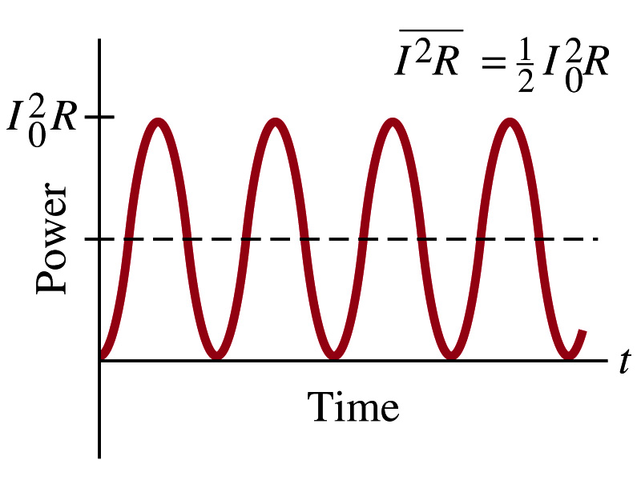
Power Delivered by Alternating Current
AC power delivered to a resistance is:
  Since the current is squared, the power is always positive
The average power delivered is
Since the power is also P=V²/R, we can obtain
The average of the square of current and voltage are important in calculating power:
Average power

Slide 20
Power Delivered by Alternating Current
The square root of each of these are called root-mean-square, or rms:
rms values are sometimes called the effective values
  These are useful quantities since they can substitute current and voltage directly in power, as if they are in DC
  In other words, an AC of peak voltage V₀ or peak current I₀ produces as much power as DC voltage of V_{rms} or DC current I_{rms}.
  So normally, rms values in AC are specified or measured.
    US uses 115V rms voltage. What is the peak voltage?
    Europe uses 240V

Slide 21
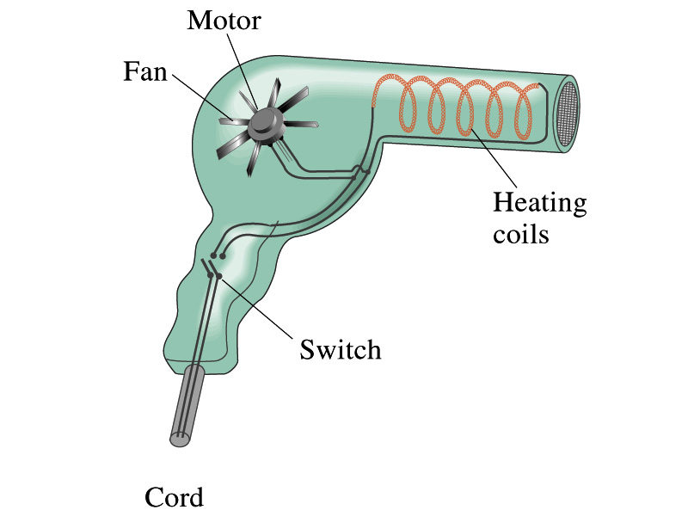
Example 25 – 13
Hair Dryer. (a) Calculate the resistance and the peak current in a 1000-W hair dryer connected to a 120-V AC line. (b) What happens if it is connected to a 240-V line in Britain?
The rms current is:
The peak current is:
Thus the resistance is:
(b) If connected to 240V in Britain …
The average power provide by the AC in UK is
So?
The heating coils in the dryer will melt!

